Slide 1
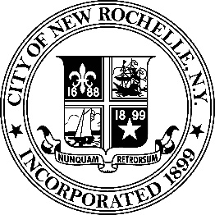
CASE STUDY: Real Estate – Community Engagement, Public Affairs, and Place-Based Economic Development
Background
The City of New Rochelle sought a Master Developer through an RFQ/P process to revitalize and redevelop its struggling downtown. Brandon Palanker, as a Principal of Renaissance Downtowns, led the response efforts, positioning Renaissance and its JV Partner, RXR Realty, to be designated as Master Developer by the City. Subsequent to being designated, Brandon led community outreach and public affairs, and market research, acting as the interface between the developer, the City’s elected officials and staff, and the community at large.
Challenges
Coming on the heels of multiple false starts and failed redevelopment efforts, the City was eager to find a development partner that could build strong public support and undertake a comprehensive redevelopment effort, rather than a piecemeal approach
Prior to Renaissance’s involvement, a similar project, albeit one of smaller size and scope, was voted down in bi-partisan fashion, 6-1
Significant public opposition to largescale development existed, further fractured by various factions within the community that had competing interests
The market for downtown redevelopment was unproven at the time, providing challenges in terms of garnering interest from vertical developers, retailers, and receiving project financing
Result
Brandon successful led new business development efforts, including the RFP/Q response, subsequent interviews, and negotiations with the City to garner Master Developer status
In less than one-year’s time, Brandon’s team was able to garner unanimous, bi-partisan approval for 12+ million sf of mixed-use, transit-oriented development
Approach
Utilizing the Crowdsourced Placemaking public engagement platform, in which Brandon was a co-creator, the team was able to build strong public support from the community
By taking an outcome-oriented approach, local constituencies that had once been at odds with development, and often with each other, banded together in support of the effort which would provide them with “wins” that included funding of programs and amenities, job creation, tax relief, and economic development
By undertaking a comprehensive redevelopment that considered the potential of over 12 million square feet of new entitlements, Brandon was able to work with market analysts and his internal urban design team, to create a compelling development vision rooted in economic realities that promoted social, environmental, and economic benefits
The vision created by Brandon and his team was recognized for creativity and ingenuity in planning, being awarded the William H. Whyte Award from the American Planning Association
Construction on multiple stages has commenced, with early phases now under leaseup under the direction of RXR Realty
www.toprightpartners.com
© Copyright 2018 TopRight®, LLC. All Rights Reserved
CORNER THE MARKET

Slide 2
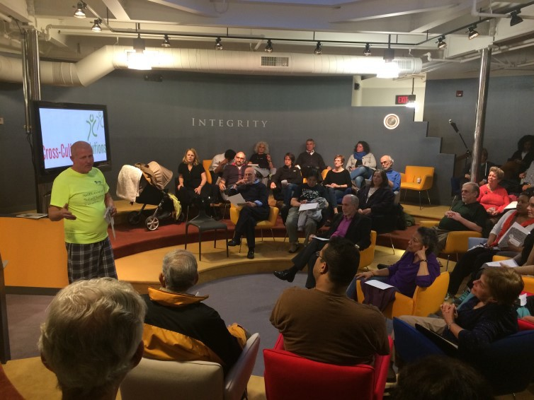
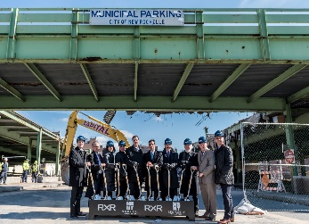
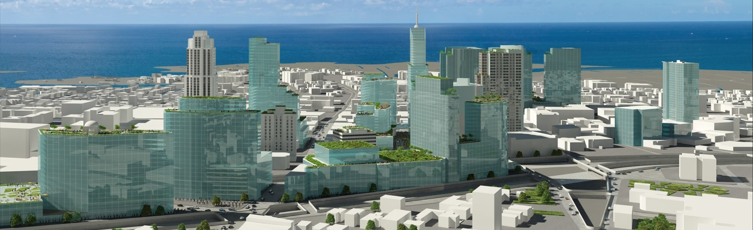
CASE STUDY: Real Estate – Community Engagement, Public Affairs, and Place-Based Economic Development
Program:
6,500+ Residential Units
2+ Million SF Commercial
1+ Million SF Retail
300k SF Hospitality
2+ Million SF Institutional, Student & Adult Housing
Key Roles:
Business Development
Municipal Affairs
PR / Spokesperson
Public Engagement CSPM
Planning/Urban Design (Support Role)
www.toprightpartners.com
© Copyright 2018 TopRight®, LLC. All Rights Reserved
CORNER THE MARKET

