Slide 1
CLIMATE AND WHAT NGO CAN CONTRIBUTE TO CLIMATE CHANGE Presented by AFRICAN REFUGEES AND MIGRANTS AID
NAME: XX

Slide 2
INTRODUCTION
The Sustainable Development Goals enacted by United Nations in 2015 ushered a new wave of responsibilities for Non-Governmental Organisations across the globe.
Precisely, the 13th goal of SDGs; Climate action reveals that there is an urgent need to protect existence of Earth.
In previous epochs, less attention was given to global matters and climate change.
Consequently, there has been more focus and keen attention towards policies and programme relating to climate change.
In simple terms, climate change can be captured as series of sporadic changes in the totality of nature.
The atmosphere is divided into various stratas; troposphere, stratosphere, mesosphere and thermosphere.
Sadly, each layer is getting more weakened with time.
Therefore, intellectuals in Geoinformatics realm strongly believe that Earth is depreciating various ways.
In fact, one of the frontier factor of Earth depreciation can be traced to industrial waste and biochemical substances

Slide 3
WHY CLIMATE CHANGE VITAL?
Empathetically, it is very possible to establish that Globalization and Industralization are major contributory agents of climate change.
Climate change is reportedly responsible for crisis, chaos and physicological defects in many societies and regions.
For instance, in Australia last year, massive forest fire by natural factors rendered many animals dead and many people homeless as a result of climate change thereby making them refugees in their country.
Many NGOs had to intervene and volunteer to helped those affected by this predicament
Thus, the SDG Goal 13 is geared towards controlling the negative impacts of these two agents. NGOs come into play in, by serving as agent of change.
As climate changes, NGOs believed that our approach to climate must change as well.
This translates to the notion that everyone has a role to play in the protection Earth.
In achieving this, the United Nations partners with NGOs across continents to establish a front channel in relaying information on how to improve Earth’s rejuvenation.

Slide 4
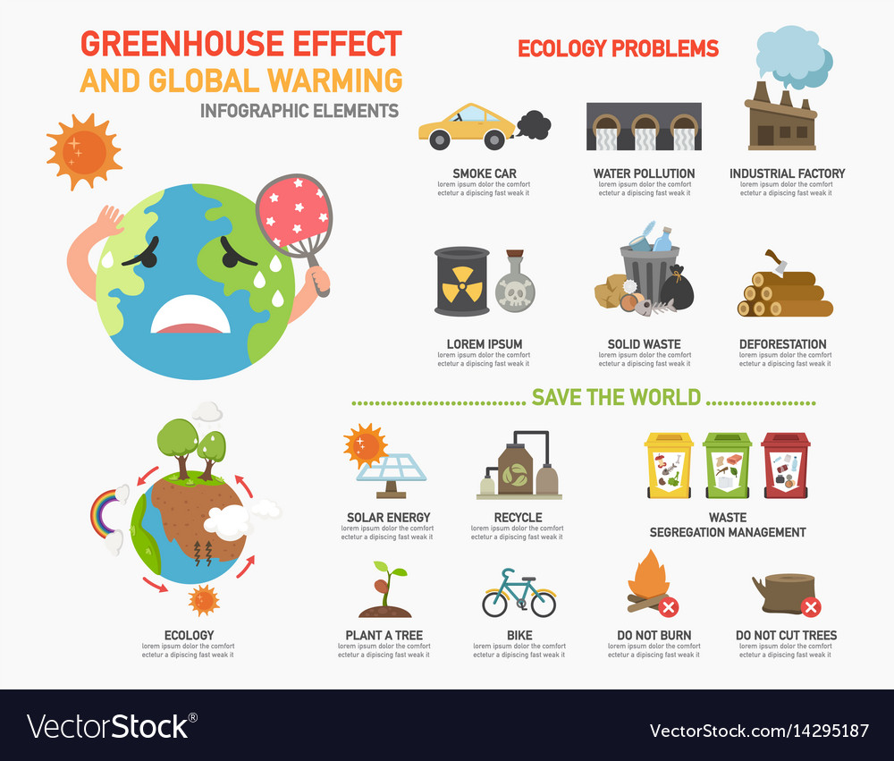
.
PICTORIAL VIEW OF CLIMATE CHANGE
Researchers in Geoinformatics strongly believe that Earth is depreciating various ways.
On of the frontier factor of Earth depreciation can be traced to industrial waste and biochemical substances.
Industrialization, urban congestion and globalization all have their costs.
Thus, climate change is considered as one of the costs of scientific advancements.
Interestingly, during the last two years, it has been discovered that the ozone layer is gradually heaking.
This is a reflection of the awareness and educational support provided across the globe through NGOs and other notable governmental organisations.

Slide 5
THINKING OUTSIDE THE BOX ROLES OF NGOs IN CLIMATE ACTION
Advocacy
Activism
Crisis Intervention
Resource mobilization
Education
Sensitization
Dialogue
arbitration
NGOs also help in policy formulation and Implementation process

Slide 6
THANK YOU!

