Slide 1
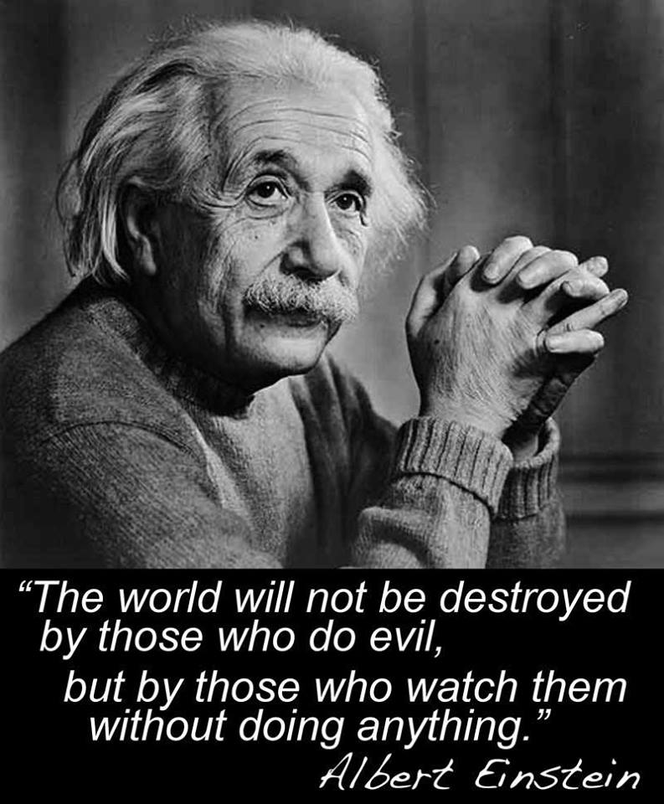
Part 1 - The People Finally have the Power -
The Historical Timeline of the Great fraud and How to Deal with it.

Slide 2
An Affidavit of Truth
Historical Proof of The corruption of crimes for commerce against you including
Personage, Peonage, Barratry, Fraud, Slavery, Involuntary Servitude, Unlawful Conversion, and even False Charges and False Imprisonment,
Profits beyond your wildest dreams.

Slide 3
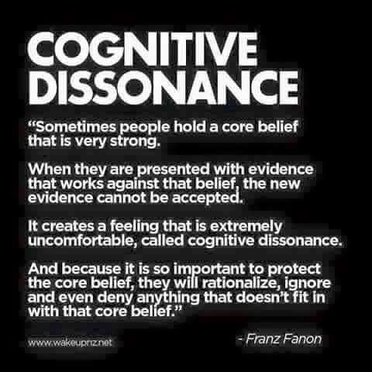

Slide 4

The People Finally have the Power
Britain is owned by the Vatican. (Treaty of 1213)
1215 The Magna Charta,
Promise of the King
Giving Power and Rights to the People

Slide 5
The Global ESTATE Trusts
1302 The Unam Sanctum, Pope Boniface VIII creates the worlds first and largest Trust.
1455 The Romanus Pontifex, Pope Nicholas V publishes the first Testamentary Trust.
1481 The Aeterni Regis, Pope Sixtus IV publishes the second Testamentary Trust.
1537 The Convocation, Pope Paul III publishes the third Testamentary Trust.
What did these trusts do? Everything! That effects us today.

Slide 6
The Global Estate Trusts each set a different Jurisdiction
The Jurisdiction of the LAND: All resources of the land people, animals, plants, minerals, are National in Nature, control was given to the Spanish King and later it was given to the people of the world.
The Jurisdiction of the AIR: living and dead souls, spirits, angels, demons, idea’s global in nature including dead entities known as (Corporations) these are controlled by the pope and his appointee’s.
The Jurisdiction of the WATER: Sea, Vessels, Mariners, Merchants, Ports, Shipping, International and Commerce in Nature Controlled by British Monarchs.

Slide 7
The Global Estate Trusts each set a different Jurisdiction
Each Jurisdiction has its own law form and Language. Juris = Law - Diction = words
Law Words= the words you choose determines the type of law and jurisdiction your under.
LAW = Land, Air, Water.
Legalese = language game or type of law "words" which determine jurisdiction or type of law that "you’re" ruled by.
Land = Self Governed, Common, Equity Air = Ecclesiastical, Trust. Water = Admiralty, Contract.

Slide 8
The Global EstateTrust
operates by providing services
The Empire of the Global EstateTrusts has four administrative Heads or independent City Nation States.
1) Rome (Vatican Inc.) is the Corporate Headquarters and the “Owner of Souls”. Roman Curia.
2) Westminster Inc.(London) is the Legal and Banking or comptroller of … the Law and Finance Headquarters.
3) UNITED STATES Inc. (District of Columbia) is the Headquarters of Police and Military Defense Services Corp.
4) UNITED NATIONS Inc. (New York & Hague) is Trade, Treaty, Negotiation, and human resources including labor/welfare Services.
Their Goal: they say “Private Investment for Public Advancement”.
Government pays the military that protects commercial interests that in-turn funds the government

Slide 9
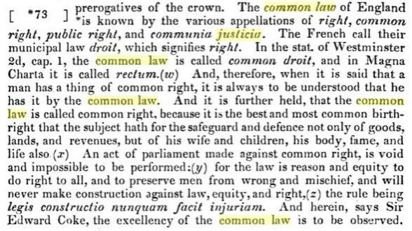
New York City is defined in the Federal Regulations as the United Nations.
Rudolph Gulliani stated on C-Span that "New York City was the capital of the World"
and he was correct. (20 CFR chapter 111, subpart B 422.103 (b) (2) (2)

Slide 10
America, Upon These Shores, I Shall Live.
or here shall I, Die ashore Free;
-Stephen Hopkins-
Stephen Hopkins; A Bermuda Castaway in 1606, A Jamestown survivor in 1607, and A Mayflower Pilgrim in 1620.
1607 Jamestown, Virginia; The Common Law is set upon these shores… The law of the Land.
1620 Mayflower Compact, Plymouth Rock; The First Government is instituted upon these shores.

Slide 11
The Historical Timeline - Pieces of the Puzzle
1666; The Cestui Que Vie Act of 1666. The Great Fire of London creates the occasion for the creation of individual public trusts as a Government means of seizing private property.
1702; The British Crown and Dutch East India Company collude under the Maritime Wagering Act. Living men are deemed to be “Vessels” and Insured. Their death/loss becomes a means of enrichment for the commercial corporations and the British Government.
1765; The pollution of English Common Law with Admiralty Law to create “Equity Law” granting absolute power to the judiciary to seize upon and distribute private property comes to fruition in England under Lord Mansfield.

Slide 12
The Historical Timeline - Pieces of the Puzzle
July 4, 1776: the declaration of Independence. Standing up to Authority and against tyranny, and declaring our liberty.
Every single American at this moment in time, has more Authority on the land than the entire government. Life’s good!
1783: The Treaty of Peace, Promising friendship and “amity in perpetuity.” One of the most important documents.
1789: The Organic, Original Constitution for the united “States of America”… Bill of Rights… No Titles of Nobility shall hold office. We are Americans, We are Free, We are civil, and We are at peace. A Compact Between Sovereign Nation States Forming A Union for the provision of 19 essential Governmental Services, and NO MORE.

Slide 13
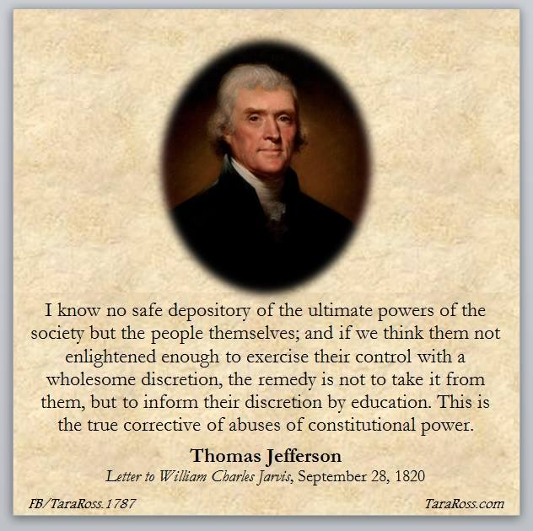

Slide 14
The Historical Timeline - Pieces of the Puzzle
War of 1812: America Standing up to Authority again… against both England and France.
1815: to protect our trading ships from Muslim Pirates and other Privateers we sign, the Treaty of Ghent, with England giving up control of our seas and inland navigable waterways.
1819: The American states pass the Titles of Nobility Amendment to the original Constitution, putting teeth and penalties into earlier provisions effectively prohibiting members of the Bar Associations from holding any public offices.
November 22, 1822: The Secret Treaty of Verona is the basis of the Monroe doctrine. It throws a powerful white light upon the conflict between monarchial government and a government by the people.

Slide 15
The Historical Timeline - Pieces of the Puzzle
1837: The British Settlement Act sets aside public wastelands as “common wealth” and paupers are said to be settled upon this land, thus becoming wards of the state. This effectively prevents the lower classes from ever being landlords and provides a basis for claiming them as chattel property.
1848: Karl Marx: The “Communist Manifesto” Changing the minds of the Elite Bankers and those who want to rule others rather than live free.
1858: Benjamin Disraeli begins the push to enfranchise British laborers as properties belonging to the British Crown. They and their assets are seized upon in the process as collateral backing government debt. Their “voluntary” enslavement is used to fund the British Raj in India---though they are never told any of this.

Slide 16
Abraham Lincoln; the beginning of the end of the republic
1860: After Failing six times, Abe Lincoln, a BAR attorney with the backing of the Wealthy Big Businesses and Bankers of Chicago, Boston, New York, and Philadelphia, finally is elected President. He can serve only in the private office of President of the United States (Trading Company), not as President of the United States of America, as a result of the Titles of Nobility Amendment. He contrives to start the Civil War, which is never declared by Congress.
May of 1860: The U. S. Congress passed the Morrill Tariff Bill (named for Republican Congressman and steel manufacturer, Justin S. Morrill of Vermont) raising the average tariff from about 15% to 37% with increases to 47% within three years. This was to be the true cause of the Civil War.
March 27, 1861: Seven Southern States Pull from the Union fighting over the huge tax increases of the Morrill Tariff Act. 11 Delegates, from the ⁷ southern States walk out, this leaves Congress Sin Die, without a quorum, and No Functioning Government existed. With no Government to run, Abe started using for the first time in History executive powers.
1862: Abe’s Congress a De Facto (Board of Directors) Changes the meaning of the word “PERSON” to mean “corporation”.

Slide 17
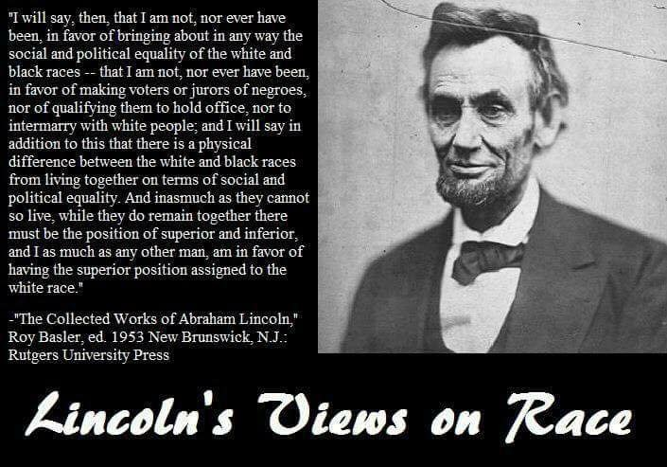
Abraham Lincoln; Civil War was not about Slavery

Slide 18
Abraham Lincoln; the beginning of the end of the republic
1863: With his first few executive orders he bankrupted the Original and organic, The united “States of America”, and its trading companies. And then he, incorporated the “United States of America,” as a Delaware Corporation. A look a like, sound a like fraud.
April 24, 1863: With Executive Order #100 (The Leiber Code) places the Grand Army of the Republic in charge of the government. He contrives to start the Civil War, which is never declared by Congress. He put the Nation under Marshall Rule (which was never rescinded). Making himself the Commander in Chief and placing the government of “we the people” under military occupation, officially ending the “REPUBLIC” thus through the communistic acts of a new President, Civil War was Declared. And, the Republic DIED!
1863: UNITED POSTAL NETWORK (U.P.N.) Berne, Switzerland This is the Architects and Surveyors hired to set up the addressing system of the NWO. Now owns and controls the UNITED STATES POSTAL SERVICE (U.S.P.S.)

Slide 19
The destruction of the republic continues
1865; Lee surrenders his army to Grant at Appomattox, but no official peace treaty is ever signed. The Southern States are carved up into ten military districts and all the original states are improperly subsumed into the bankruptcy of the United States (Trading Company) by a process of assumpsit.
1865; Lincoln is murdered by John Wilkes Booth; Andrew Jackson Becomes President of the new Democracy.
The Southern States are in Ruins and under military occupation. The Northern States are Bankrupt.
Andrew Jackson declares Peace upon the Land (May 10th 1865) again April 2, 1866, and again August 20, 1866, urging congress to do so.
But Congress refuses and has never Declared Peace on the Land or Sea.

Slide 20
The destruction of the republic continues
Together both the 39th and 40th Congress violated the constitution of America in six different but very dramatically important ways!
1)Article V, Section 5 was violated as shown by The House Journal, March 3, 1866, page 353.
2)Article III, Section 3, was Violated by The Reconstruction Acts of 1867
3)Article 1, Section 9, Clause 3 was violated by the reconstruction Acts of 1867
4)Article IV, Section 4, was violated by The Reconstruction Acts denial of a republican form of Government to the Southern States AFTER the Armistice.
5)Article 1, Section 8, Clause 17, was violated by the 39th Congress unlawfully exercising exclusive legislation outside their district and allowed federal enclaves.
6)Article IV, Section 3, was violated when the 39th Congress formed unlawful de-facto “FEDERAL STATES” within the organic States of the union to operate as Franchises of “The United States of America, Inc.” So, “Oregon” State became the “State of Oregon” Etc…

Slide 21
The destruction of the republic continues
The Corporate Congress acting as officers of a De Facto, Private for profit governmental services corporation and not the De Jure government of the people.
With the reconstruction Acts of 1867, Congress created Military Districts and “Special Admiralty” Courts, (Gold Fringed Captured War Flag) to deal with the remaining “Rebels” Still at-large. This is not addressed or allowed under any “constitution.”
1868: The corporate Congress Published its new look a like sound a like, The Constitution for “the United States of America” replacing the original organic The Constitution for the united “States of America”. This new and entirely different document is used as Articles and By-laws of a De Facto commercial corporation. There was no need for any “ratification” of Amendments by any “STATES” created as franchises of the parent company so Secretary of State William Seward simply declared the new 13th and 14th Amendments “ratified.” Mere lip service was given to the process by the States. Except for Oregon, who wrote a letter.
1868-1875: This new “government” entity then forces the original unincorporated state governments to write new state constitutions and to assume new Doing-Business-As names in the form of: Wisconsin State, Connecticut State, and so on, while seizing upon the name of the original states and operating “Territorial franchises” for itself under their names: State of Wisconsin, State of Connecticut, and so on. All these semantic deceits are pulled off on the trusting public via look a like, sound a like, fraud.

Slide 22
The destruction of the republic continues
“The District”
1871: The District of Columbia Organic Act of 1871 created a “municipal corporation” to govern the District of Columbia. Considering the fact that the first municipal government itself was incorporated in 1808 in London, an “Organic Act” which means a (first Act) using the term “municipal corporation” in 1871 can only mean a private corporation owned by the municipality or the “District of Columbia”. Hereinafter we will call that private corporation, “Corp. U.S.” By consistent usage, Corp. U.S. trademarked the name, “United States Government” referring to themselves.
The District of Columbia Organic Act of 1871 places Congress in control (like a corporate board) and gives the purpose of the act to form a governing body over the municipality. This allowed Congress to direct the business needs of the government under the existent martial rule and provided them with corporate abilities they would not otherwise have. This was done under the constitutional authority for Congress to pass any law within the ten mile square of the District of Columbia. Known as the District of Columbia Corporation.

Slide 23
The destruction of the republic continues
1871: The Corporation is Ratified 28 USC 3002 (15) (A): United States = Federal Corporation = Commercial Corporation doing business as “UNITED STATES.”
The Corporate 13th Amendment Free’s the Black Slaves and then 14th Amendment creates All “Persons” (see 1862) as US Citizens and specifically disenfranchises American State Citizens and extends federal “Territorial Jurisdiction” or admiralty to the “States.”
2nd of February, 1871: 41st Congress, Third session, Chapters 62, 63, 64, 65- The Congress declares itself to be the “Successor” of ALL “United States Corporations” and the property of all said “Corporations.” They Claim to own every corporation in America that was formed under the “U.S.” Auspices.
And that is why they incorporate “YOU.”

Slide 24
DUNS Numbers of the U.S. Corporate Government and
Most of Its Major Agencies
United States Government-052714196
US Department of Defense (DOD)-030421397
US Department of the Treasury-026661067
US Department of Justice (DOJ)-011669674
US Department of State-026276622
US Department of Health & Human Services (HHS)-Office of the Secretary-112463521
US Department of Education-944419592 US Department of Energy-932010320 US Department of Homeland Security-932394187
US Department of the Interior-020949010
US Department of Labor-029536183
US Department of Housing & Urban Development (HUD)-Office of the Secretary-030945779 US Department of Veterans Affairs (VA)-931691211
US Transportation Security Administration (TSA)-050297655
US Federal Aviation Administration (FAA)-056622429
Bureau of Customs & Border Protection (CBP)-796730922
Federal Bureau of Immigration & Customs Enforcement (ICE)-130221646 US Environmental Protection Agency (EPA)-057944910

Slide 25
DUNS Numbers of the U.S. Corporate Government and
Most of Its Major Agencies
National Aeronautics & Space Administration (NASA)-003259074 National Oceanic & Atmospheric Administration (NOAA)-079933920
US Nuclear Regulatory Commission (NRC)-364281923
Federal Emergency Management Agency (FEMA)-037751583
Federal Communications Commission (FCC)-020309969
US Securities & Exchange Commission (SEC)-003475175
US Public Health Service (USPHS)-039294216
National Institutes of Health (NIH)-061232000
US Centers for Disease Control & Prevention (CDC)-927645465
US Food & Drug Administration (FDA)-138182175
US Internal Revenue Service (IRS)-040539587
Federal Reserve Board of Governors (Fed)-001959410
Federal Bureau of Investigation (FBI)-878865674
National Security Agency (NSA)-617395215
US Drug Enforcement Administration (DEA)-167247027
Federal Bureau of Alcohol, Firearms & Tobacco (BAFT)-132282310 Federal Bureau of Land Management (BLM)-926038563 Federal Bureau of Indian Affairs (BIA)-926038407

Slide 26
DUNS Numbers of Each US Corporate State and Its Largest City
State of Alabama-004027553 City of Birmingham-074239450 State of Alaska-078198983 City of Fairbanks-079261830
State of Arizona-068300170 City of Phoenix-030002236
State of Arkansas-619312569 City of Little Rock-065303794 State of California-071549000 City of Los Angeles-159166271 State of Colorado-076438621 City of Denver-066985480
State of Connecticut-016167285 City of Bridgeport-156280596 State of Delaware-037802962 City of Wilmington-067393900 District of Columbia-949056860 City of Washington-073010550 State of Florida-004078374 City of Miami-965299576
State of Georgia-069230183 City of Atlanta-065372500
State of Hawaii-077676997 City of Honolulu-828979612
State of Idaho-071875734 City of Boise-070017017
State of Illinois-065232498 City of Chicago-556057206
State of Indiana-071789435 City of Indianapolis-964647155 State of Iowa-828089701 City of Davenport-963855494
State of Kansas-827975009 City of Wichita-069862755
State of Kentucky-828008883 City of Louisville-943445093

Slide 27
DUNS Numbers of Each US Corporate State and Its Largest City
State of Louisiana-0612389911 City of New Orleans-033692404 State of Maine-061207536 City of Portland, Maine-071747802 State of Maryland-847612442 City of Baltimore-052340973 State of Massachusetts-138090548 City of Boston-007277284 State of Michigan-054698428 City of Detroit-021733631
State of Minnesota-050375465 City of Minneapolis-009901959 State of Mississippi-008210692 City of Jackson-020864955
State of Missouri-616963596 City of Kansas (City)-832496868
State of Montana-945782027 City of Billings-068925759
State of Nebraska-041472307 City of Omaha-926604690
State of Nevada-123259447 City of Las Vegas-019342317
State of New Hampshire-066760232 City of Manchester-045009073
State of New Jersey-067373258 City of Newark-019092531
State of New Mexico-007111818 City of Albuquerque-129962346
State of New York-041002973 City of New York-021741036
State of North Carolina-830979667 City of Charlotte-809275006
State of North Dakota-098564300 City of Bismarck-080245640

Slide 28
DUNS Numbers of Each US Corporate State and Its Largest City
State of Ohio-034309166 City of Columbus-010611869
State of Oklahoma-050411726 City of Oklahoma (City)-073131542
State of Oregon-932534998 City of Portland (Oregon)-054971197
State of Pennsylvania-933882784 City of Philadelphia-929068737
State of Rhode Island-008421763 City of Providence-069853752
State of South Carolina-067006072 City of Columbia-878281562
State of Tennessee-04143882 City of Memphis-051386258
State of Texas-002537595 City of Houston-967421590
State of Utah-009094301 City of Salt Lake City-017096780 State of Vermont-066760240 City of Burlington-037442977
State of Virginia-047850373 City of Virginia Beach-074736299
State of Washington-079248936 City of Seattle-009483561
State of West Virginia-828092515 City of Charleston (West Virginia)-197931681 State of Wisconsin-001778349 City of Milwaukee-004779133
State of Wyoming-832826015 City of Cheyenne-021917273

Slide 29
DUNS Numbers of the United Nations Corporation and Some of Its Major Corporate Agencies
United Nations (UN)-824777304
UN Development Program (UNDP)-793511262UN Educational, Scientific, & Cultural Organization (UNESCO)-053317819 UN World Food Program (UNWFP)-054023952
UN International Children's Education Fund (UNICEF)-017698452
UN World Health Organization (WHO)-618736326
dun & bradstreet - D-U-N-S Number Lookup https://www.dandb.com/dunsnumberlookup/

Slide 30
The United Nations Corporation and
Some of Its Major Corporate Agencies
Manta.com is a website for obtaining data on corporations. If the names of any of these government entities are entered then you will find that virtually all of them are listed as private, for–profit corporations. You will also see in the aggregate valuations of their assets that Manta.com provides is vastly greater than what is listed in these private government corporations’ fraudulent but well-publicized budget documents that seek to justify fraudulent budget cuts and their related tax-based extortion rackets.
This confirms that many hundred Billions/trillions of dollars of the people’s money listed in the semi-secret government Comprehensive Annual Financial Reports - CAFRs as government institutional investments are being siphoned off by the global banking cartel and those sinister forces behind it. This is real fact. Here’s an example, in real time, how a STATE OF WISCONSIN Corporation subsidiary UNIVERSITY OF WISCONSIN hid a $1,000,000,000.00 in the FEDERAL RESERVE:
http://cafr1.com/Wisconsin.html
CAFR1 Note: Wisconsin State University is but a pebble on the beach. All of the State Universities do the same and have been doing so for decades. In many a case those other much larger State Universities if the stashes were identified, they are much larger rocks or boulders on the beach. Wisconsin CAFR looked at $1,000,000,000.00 (BILLION) pebble on the beach identified. Now in other states start identifying those rocks and boulders!

Slide 31
The destruction of the republic continues
Constitutional lawful Bloodline American Republic Vs British Democratic Citizen
The federal Constitution makes a careful distinction between Natural born Citizens and Citizens of the United States*
Compare in the constitution: 2:1:5 with the so-called 14th Amendment section 1-2.
One is an unconditional Sovereign by natural birth, who is endowed by the Creator with certain unalienable rights; the other has been granted the revocable privileges of U.S. citizenship, endowed by the Congress of the United States*.
*One is a Citizen, the other is a subject. One is a Sovereign, the other is a subordinate. One is a Citizen of our constitutional Republic; the other is a citizen of a legislative democracy (the federal zone).
Notice the superior/subordinate relationship between these two statuses. I don't know how many can hear or comprehend this....
But we lawful bloodline Americans STAND strong, we STAND our ground, we STAND for our rights. Standing is strength, standing is a sign of a Breathing living man and woman, a living souls.

Slide 32
A legal person = a legal fiction = US Citizen: Acts of Congress
One of the terms used predominantly by the present civil governments and courts in America is “legal person.” Just what is a legal person? Some definitions are:
[A] legal person: a body of persons or an entity (as a corporation) considered as having many of the rights and responsibilities of a natural person and especially the capacity to sue and be sued. Merriam-Webster's Dictionary of Law (1996).
Person. I. A human being (a "natural" person). 2. A corporation (an "artificial" person). Corporations are treated as persons in many legal situations. Also, the word "person" includes corporations in most definitions in this dictionary. 3. Any other "being" entitled to sue as a legal entity (a government, an association, a group of Trustees, etc.). 4. The plural of person is persons, not people (see that word). — Oran's "Dictionary of the Law," West Group (1999).
Person. An entity with legal rights and existence including the ability to sue and be sued, to sign contracts, to receive gifts, to appear in court either by themselves or by lawyer and, generally, other powers incidental to the full expression of the entity in law. Individuals are "persons" in law unless they are minors or under some kind of other incapacity such as a court finding of mental incapacity. Many laws give certain powers to "persons" which, in almost all instances, includes business organizations that have been formally registered such as partnerships, corporations or associations. -- Duhaime's Law Dictionary.
PERSON, noun. per'sn. [Latin persona; said to be compounded of per, through or by, and sonus, sound; a Latin word signifying primarily a mask used by actors on the stage.] -- Webster's 1828 Dictionary.

Slide 33
The destruction of the republic continues
1900 - 1904: The Insular Tariff Cases; A series of supreme court cases giving Congress permission to create a separate nation using the federal territories and Possessions as “States,” Guam, Puerto Rico, American Samoa and others became a union of states known as ‘the United States of America’ (minor) from then on Congress began referring to this entity as if it were referring to the continental United States.
Jan 4,5,6, 1906: Hale vs Henkel, 201 US 43, supra 74, 75, (1905) Tells All, An Individual State Citizen Has Unalienable Constitutional Rights, while A US Citizen, a creature of the “State” has privileges and civil rights and is held subject to all policies, rules, codes, and statutes, the same as any other public servant. Up held over 1600 Times by both the District and the Supreme courts.
1907: The 1868 version of The United States of America, Inc. is bankrupted. The land of the actual states and people is unlawfully seized upon by the creditors of The United States of America, Inc., as collateral backing its debts in bankruptcy. “Title” is taken to the land and the actual patents seized upon, with the Creditors receiving the equitable title and benefit.
1912: A group of mostly European Banking Interests, the League of Nations (precursor to the United Nations), and a few American Traitors Like J.P Morgan, and Woodrow Wilson’s -Edward Mandell House meets on Jekyll Island and forms the Federal Reserve, called that so people would believe it was part of their government. When in reality its about as “Federal” as Fed Ex. Yet, Just another look a like sound a like Fraud.

Slide 34
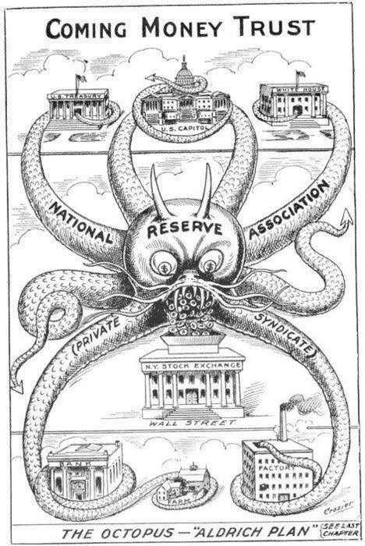

Slide 35
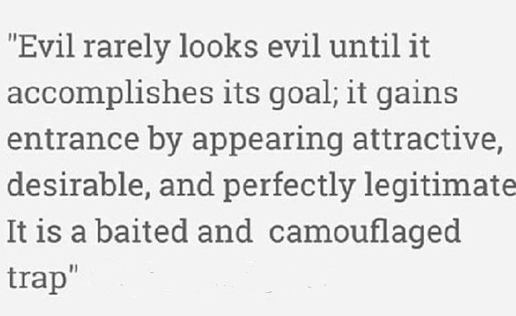

Slide 36
The destruction of the republic continues
The great fraud
1913: All Hospitals are declared “Foundling” Hospitals! A, Pregnant mother goes in to have a child, She is “declared” indigent, the child is “declared” Abandoned and Birthed as a vessel and Adopted by the “STATE,” The Child is Registered as “Human Resources” a “Certificate of Bond” is issued and EVERYONE gets a number.
Definition: foundling 1)An abandoned child, left by its parent(s), often a baby left at a church, convent, hospital, or similar safe place.
"The primary control and custody of infant is with the government.” Tillman Vs Roberts. 108 So. 62
Prior to 1913: most Americans owned clear, allodial title to their property, free and clear of any liens of mortgages until the Federal Reserve Act (1913) “Hypothecated” all property within the Federal United States to the Board of Governors of the Federal Reserve, in which the Trustees (stockholders) held legal title. The U.S. Citizen (tenant, franchisee) was registered as a “beneficiary” of the trust via his/her birth certificate. And, then later his SS#.
Prior to 1913: There was no income tax. So, How did we run government? The income tax is installed, The IRS is created out of Puerto Rico and a division or as a subsidiary of the Department of Alcohol, Tobacco, and Firearms. It is set up as the Private “Collection Agency” for the newly created Privately owned, mostly foreign owned, Federal Reserve corporation. The income tax was designed to pay the interest on funds borrowed from the Federal Reserve Corporation.

Slide 37
The destruction of the republic continues
The Federal Reserve
On December 23, 1913: Taking advantage of the absence of congressmen opposed to the creation of a fiat monetary system during the Christmas break, the Federal Reserve Act was passed. President Woodrow Wilson, and Congress Pass the Federal Reserve Act and establish their fiat currency. To be used by the U.S. and its franchised corporations as legal tender and designed to trap Americans into eternal indebtedness. In a practice politely called "deficit spending". Other terms which would aptly describe the practice include "counterfeiting" and "check kiting", but it all comes down to the same thing; spending money one does not actually have.
Legal Tender = Federal Reserve Note = Not Money = does not pay off debt but instead Tenders it to a later date. Each FRN costs .04 to print and distribute and is traded 1:1 for all real money (Gold-Silver) in circulation. Profit to Bank Face Value of Bill - .04 plus interest. And the bankers profited… again
(side note) In 2009 The Federal Reserve transferred the bulk of its Assets to a new entity under the U.N. doing business as The FEDERAL RESERVE INC. doing business as The UNITED STATES INC. Bankrupting the old entity and leaving hapless US Citizens to pay their… “NATIONAL DEBT.”

Slide 38
The destruction of the republic continues
The Federal Reserve cont…
In describing the FED, Congressman Louis T. McFadden (who served twelve years as Chairman of the Committee on Banking and Currency) remarked in the Congressional Record, House pages 1295 and 1296 on June 10, 1932: Said…
"Mr. Chairman, we have in this country one of the most corrupt institutions the world has ever known. I refer to the Federal Reserve Board and the Federal reserve banks. The Federal Reserve Board, a Government Board, has cheated the Government of the United States and the people of the United States out of enough money to pay the national debt. The depredations and the iniquities of the Federal Reserve Board and the Federal reserve banks acting together have cost this country enough money to pay the national debt several times over. This evil institution has impoverished and ruined the people of the United States; has bankrupted itself, and has practically bankrupted our Government. It has done this through the misadministration of that law by which the Federal Reserve Board, and through the corrupt practices of the moneyed vultures who control it”.

Slide 39
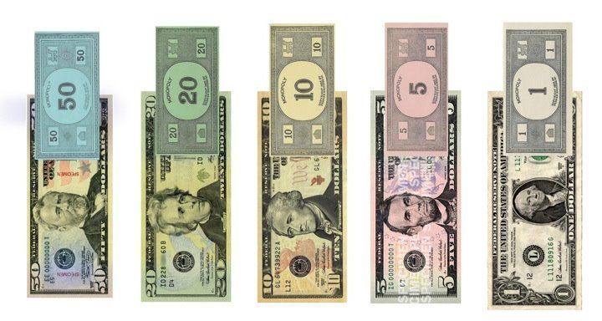
The destruction of the republic continues
FIAT Currency = Monopoly Money ?
At least they have a sense of humor

Slide 40
The destruction of the republic continues
The War Powers of Lincoln continue
1917: The War Powers Act, and The Emergency Act. Congress grants themselves power they never had and they gratuitously “conscripted” all the private property in America for the war effort. Meaning they borrowed everyone (MEN AND WOMAN) and everything (All Goods and Services) in America they needed for military use.
1917: The Trading with the Enemy Act. This makes U.S. Citizens enemies of the Federal Government. However, in Section 21 it specifically excluded American State Citizens from being classified as enemies.
1921: The “roaring Twenties” The Federal Reserve prints up a whole bunch of FRN’s and unleashes them into the public allowing Hypothecation of Debt and people spent, spent, spent, and enjoyed a life style they never before in history had.
October of 1929: The deliberate Crash, The Bankers abruptly stopped the money supply, shut down the banks, people could not pay their debts. As a result the Federal Reserve member banks put their competitors out of business, bought up massive amounts of Real Estate for pennies and hired laborers to do their bidding for nearly nothing, And the bankers profited…yet again Hence, The “GREAT DEPRESSION” And, many thousands committed suicide.

Slide 41
The destruction of the republic continues
Quotes of Woodrow Wilson
Prior to 1912: “Since I entered politics, I have chiefly had men's views confided to me privately. Some of the biggest men in the U. S., in the field of commerce and manufacturing, are afraid of somebody, are afraid of something. They know that there is a power somewhere so organized, so subtle, so watchful, so interlocked, so complete, so pervasive, that they had better not speak above their breath when they speak in condemnation of it. Or fear for their lives.”
1921: In his final speech as President. - “I, am a most unhappy man. I, have unwittingly ruined my country. A great industrial nation is now controlled by its system of credit. We are no longer a government by free opinion, no longer a government by conviction and the vote of the majority, but a government by the opinion and duress of a small group of dominant men.” ~ Woodrow Wilson, 28th President of the United States President (1913–1921)

Slide 42
The destruction of the republic continues Edward Mandell House Woodrow Wilson’s Chief Advisor who set up Federal Reserve said
“[Very] soon, every American will be required to register their biological property in a national system designed to keep track of the people and that will operate under the ancient system of pledging. By such methodology, we can compel people to submit to our agenda, which will effect our security as a chargeback for our fiat paper currency. Every American will be forced to register or suffer being unable to work and earn a living. They will be our chattel, and we will hold the security interest over them forever, by operation of the law merchant under the scheme of secured transactions. Americans, by unknowingly or unwittingly delivering the bills of lading to us will be rendered bankrupt and insolvent, forever to remain economic slaves through taxation, secured by their pledges. They will be stripped of their rights and given a commercial value designed to make us a profit and they will be none the wiser, for not one man in a million could ever figure our plans and, if by accident one or two should figure it out, we have in our arsenal plausible deniability. After all, this is the only logical way to fund government, by floating liens and debt to the registrants in the form of benefits and privileges. This will inevitably reap to us huge profits beyond our wildest expectations and leave every American a contributor to this fraud which we will call “Social Insurance.” Without realizing it, every American will insure us for any loss we may incur and in this manner, every American will unknowingly be our servant, however begrudgingly. The people will become helpless and without any hope for their redemption and, we will employ the high office of the President of our dummy corporation to foment this plot against America.”

Slide 43
The destruction of the republic continues
Some History of The Pledge of Allegiance
1887: George Belch wrote the first Pledge; his version read… “We give our heads and hearts to God and then our country; one country, one language, one flag! God was First and foremost!
1892: Francis Bellamy, a registered communist, and School Teacher was hired to re-write the Official “pledge of Allegiance” using the word “my” to make it personally ingrained so as to give “A Personal Legal Consent”… “I pledge allegiance to my Flag and the Republic for which it stands, one nation, indivisible, with liberty and justice for all.
F. Bellamy updated it in 1906 to read; I, pledge allegiance to my flag, and the republic for which it stands. I, pledge my head and my heart to God and my country. One country, one language and one flag.
It’s Current Form was adopted June 14, 1954:

Slide 44
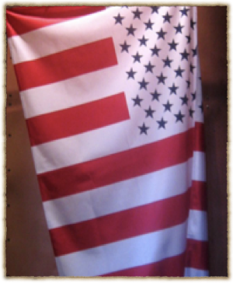
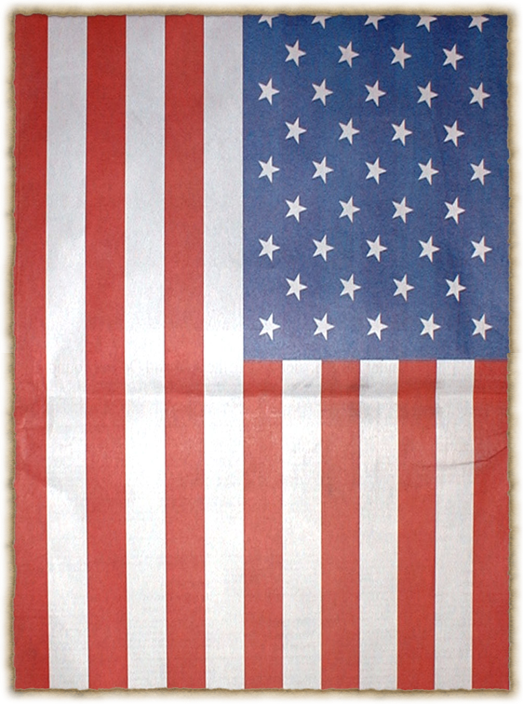
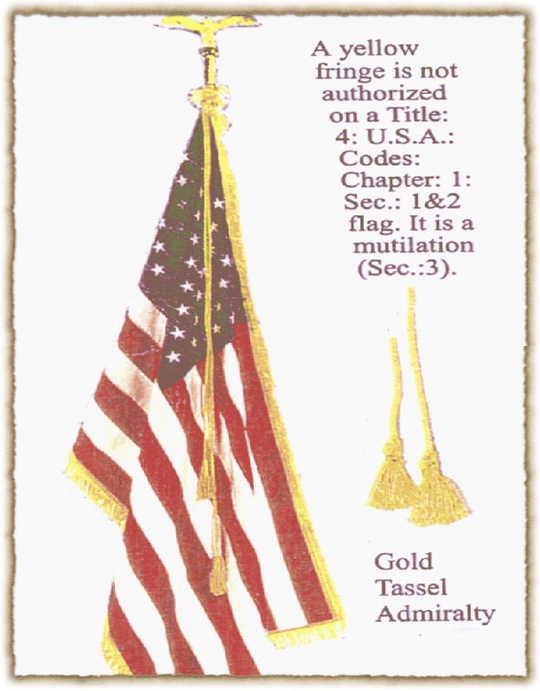
The destruction of the republic continues
The Nations Flags - Know your Flag
U.S. Civil Flag of Peace;
Flown only in peace time on both the land and sea.
Used as our US Coast Guard Flag, a Civil defense Organization
U.S. War Flag;
Flown only in time of war on both the land and sea.
designating Military property, a ship, base, outpost, fort, or M. force.
U.S. Flag of Admiralty;
Flown only when Captured by foreign Pirates, Nations, States, or Organizations.
Yet it is in Every Courtroom in UNITED STATES

Slide 45
The destruction of the republic continues
The Great Fraud goes into full swing
1916: The Supreme Court in Brushaber vs Union Pacific R.R. Co., 240 U.S. 1 (1916) ruled the 16th amendment (The Income Tax) did nothing that was not already done other than to make plain and clear the right of the United States (Corp. U.S.) to tax corporations and government employees only.
1921: the Sheppard-Towner Maternity Act created the birth "registration" or what we now know as the "Birth Certificate". It was known as the "Maternity Act" and was sold to the American people as a law that would reduce maternal and infant mortality, protect the health of mothers and infants, and for "other purposes". One of those other purposes provided for state agencies in overseeing of it's operations and expenditures. What it really did was create a federal "birth registry' which exists today, creating "FEDERAL CHILDREN" . This government of "Parents Patriae, now legislates for American children as if they are owned by the federal government.

Slide 46
The destruction of the republic continues
Franklin Delano Roosevelt - The New Deal
1930-1934: A second corporation calling itself “the United States of America” is bankrupted. This time, FDR unlawfully converts the entire population of this country, re-interpreting our Trade Names on the land to be Foreign Situs Trusts operating in the international jurisdiction of the sea. This allows the Creditors of the bankrupt private, mostly foreign-owned “United States of America, Inc.” to seize upon the labor and other private property of Americans in gross Breach of Trust owed to us by the Popes and by the British Monarch. By this deliberate fraud, we are “presumed” to be commercial vessels belonging to the bankrupt United States of America, Inc., and by process of extortion and assumpsit, are forced to pay its debts.
1933: Social Security Act, along with The Sheppard-Towner Act, through your Birth Certificates you are now “issued” as a “Certificate of Bond” and every ONE gets a number. “Bonded and Insured.”
We are also considered “missing, presumed lost at sea” and Cestui Que Vie Trusts are established by the Municipal United States in our names. These things are operated under deceptive account designations that appear to be our names: JOHN QUINCY PUBLIC, JANE ANN PUBLIC, and so on.

Slide 47
The destruction of the republic continues
Franklin Delano Roosevelt - The New Deal
Your SS# is issued, Your “LABOR” is monetized as property of the Federal Government.
Social Security Numbers are issued by the UN through the IMF. The Application for a Social Security Number is the SS5 form. The Department of the Treasury (IMF) issues the SS5 not the Social Security Administration. The new SS5 forms do not state who or what publishes them, the earlier SS5 forms state that they are Department of the Treasury forms. You can get a copy of the SS5 you filled out by sending form SSA-L996 to the SS Administration. (20 CFR chapter 111, subpart B 422.103 (b) (2) (2) Read the cites above)
You are “Domiciled” as a “US citizen” and as a permanent resident of "the District of Columbia" and as the property of THE UNITED STATES OF AMERICA Inc. A corporation. and its subsidiary STATE OF ______, Franchises. Under “Districts” extensions of District of Columbia, such as “97702” = the 9th District of Columbia.
We were made slaves with all our future labor and earnings as its assets and as its security collateral bonded to the international bankers. They registered your birth as a corporation put your name in all capital letters, a corporate fiction, a US Citizen, an entity for them to levy tax, license, fine, sue, and charge, and getting you to pay for it by making you believe it's YOU. (U.S. 243) U.S citizens are Human capital. (Executive Order 13037)

Slide 48
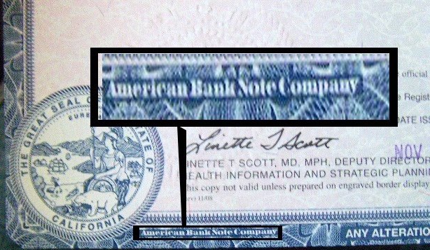

Slide 49
The destruction of the republic continues
The New War Powers Act of 1933 cont…
It suited Roosevelt’s plans to seize control of the nation for his socialist agenda, by and maintain it by Executive Order, so he accepted the Federal Reserve Board’s request, which amended the 1917 Wars Powers Act, thus giving the President license over all the citizens of this country… rather than just an enemy. We became the enemy of our country, and remain so to this day. See Black’s Law Dictionary 6th Edition under Bank Holiday P. 146.
Congress returned from its annual recess and rubber-stamped Roosevelt’s Executive Orders and the Federal power grab began. From that day to the present, the United States of America has been under emergency powers. Presidents, and the Congress, to maintain and justify the enormous growth in the power of the Federal government, have systematically exploited its people. The States cooperated with the Federal government because they benefited, right down to the County level from a massive increase in their revenues and powers.
The area over which Emergency powers may be declared can cover part of a state (city or county), an entire State, several states, or an entire nation… as is the case, today.

Slide 50
The destruction of the republic continues
The New War Powers Act of 1933
More Additional Power: Characteristics of Emergency Powers- Means any form of military style government, martial law, or martial rule. Martial law and martial rule are not the same. NOTE: The term emergency powers’ is generic, as used herein. Nations declare emergency powers under the Doctrine of Necessity, when a crisis (war, riots, rebellion, national collapse, etc.) occurs that cannot be dealt with in a normal peaceful manner. This has been the normal manner of dealing with these emergency situations from time in memorial.
Emergency powers are supposed to be only a temporary measure to deal with a specific crisis. When the crisis ends, the emergency powers are supposed to end. In the United States, Franklin Delano Roosevelt declared emergency powers in 1933 that was supposedly to deal with a bank crisis that was in progress when he assumed the Presidency. (created by the banks intentionally) In fact, the crisis as sold to the President is a figment of the Federal Reserve bankers’ imagination.

Slide 51
The destruction of the republic continues
The New War Powers Act of 1933 Cont…
The single most dominant feature of all emergency powers of Government(s) is unlawful civil authority. Civil courts cease to exist, being replaced by courts with an appearance of ‘legitimacy’, but without the substance. Court Process and procedures are a mix of rules from previous lawful courts and military courts. Traffic courts, for example are courts of summary court martial using military rules as applied to civilians. An example of this is seen when defining so-called “traffic infractions”. Infraction is not defined in most state codes, but is defined in “The Manual of Courts Martial (1994), (4)” along with the terms “contempt,” “appeal”, etc., and in other military sources.
Emergency powers: Government(s) varies in the degree of the emergency declared. The most extreme form is called Martial Law. The benign, less restrictive form is Martial Rule. Currently the U.S. is under the less restrictive form called Martial Rule. Martial law puts all major resources in an emergency powers’ area; transportation, food, minerals, metals, communications, etc., under the direct control of the nations’ armed forces and its Commander-in-Chief, the President.
A snow storm of Executive Orders, have been issued already so that in the event the President declares a National Emergency, all resources and citizen’s come under direct control of (FEMA) Federal Emergency Management Agency and the severe Martial Law form of governance.

Slide 52
The destruction of the republic continues
Franklin Delano Roosevelt - The New Deal
U.S. citizens are slaves and own absolutely nothing, not even what we think are our children. (Tillman v. Roberts108 So. 62, Van Koten v. Van Koten 154 N.E. 146, Senate Document 43 & 73rd Congress 1st Session, Wynehammer v. People 13 N.Y. REP 378, 481)
1933: All Peoples GOLD and SILVER confiscated under threat of fines and imprisonment. $ = FRN or Fiat $ = Real Money
They embezzled all of the Gold on deposit in their banks and were running scared when they thought that by claiming that the American people were hoarding gold, precipitating a banking crisis they would be off the hook…
“The Pan American treaty of December 26, 1933 (49 STAT 3097) Treaty Series 881 – (Convention on Rights and Duties of States) stated Congress replaced Statutes with international law, placing all states under international law.

Slide 53
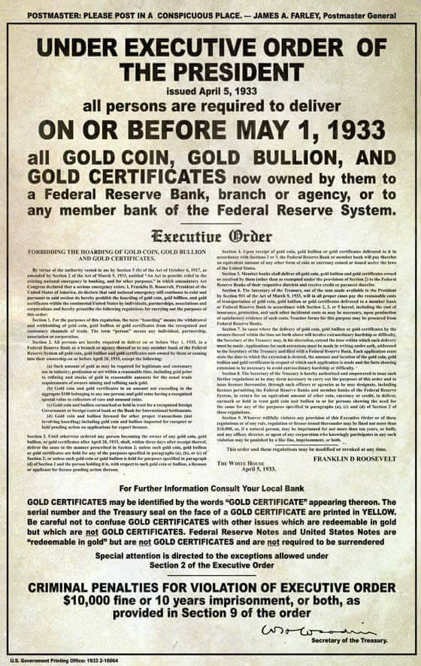

Slide 54
The destruction of the republic continues
The Name Game - Who am I?
“:john-quincy: Public” is your private property and the living soul, living in the de jere “oregon state".
“John Quincy Public” is a defunct foreign situs trust “residing” in the defunct “state of Oregon”.
“JOHN QUINCY PUBLIC” is a Testamentary Trust (Cestui Que Vie) formed by the “District of Columbia” Municiple Government “Born” in the “STATE OF OREGON” but removed to “Puerto Rico”, where it falls under the laws of “the United States of America,” Minor.
“JOHN Q. PUBLIC” is a new transmitting utility owned and operated by the new “FEDERAL RESERVE,” organized under the auspices of the “UNITED NATIONS INC.”
“John Q. Public” is a state level transmitting utility operated by the “FEDERAL RESERVE” doing business as “THE UNITED STATES OF AMERICA, INC.”

Slide 55
In Senate Document No. 43, Under Contracts Payable in Gold, 1933, we read: (Chattel)
"The ULTIMATE OWNERSHIP OF ALL PROPERTY IS IN THE STATE, individual so called ownership is only by virtue of Government. i.e. Law, amounting to mere user. And use must be in accordance with law and subordinate to the necessities of the State.
“The State”, in this case, refers to the District of Columbia. The District of Columbia is not a State of the Union, but it is a STATE just as Israel is a STATE. The District of Columbia is a sovereign jurisdiction unto itself. And so, by the above language we see that Government decrees that everything you own is by virtue of government, amounting to mere user. Sounds criminal to me, does it sound criminal to you?
What this means to we Americans is simply this. There are two forms of Title. There is legal title and their is equitable title. The government holds legal title to all property and People hold equitable title, allowing us the use of the item and making us liable for all fees and taxes associated with the use of said item.
To make the point. New vehicles come with a manufacturers Statement of Origin. You never see it. Dealers register this document with the government, providing the government with legal title to the vehicle. With government holding the legal title to the vehicle, then when you purchase the vehicle you are given only Equitable title which allows you use of the vehicle and makes you responsible to pay all taxes and other fees due, but you are not the legal owner. Ever wonder why your title or registration says “for official use only?” Now you know. Remember, you do not own anything in which someone else can make a claim and then confiscate it through court proceedings.
The question here is, “Are American juries going to continue to allow this criminal behavior?” If they do, then they condemn their children and grand children. I suspect that once they know and understand the criminality of this action, the property seizures and loss of property rights will evaporate like morning dew.

Slide 56
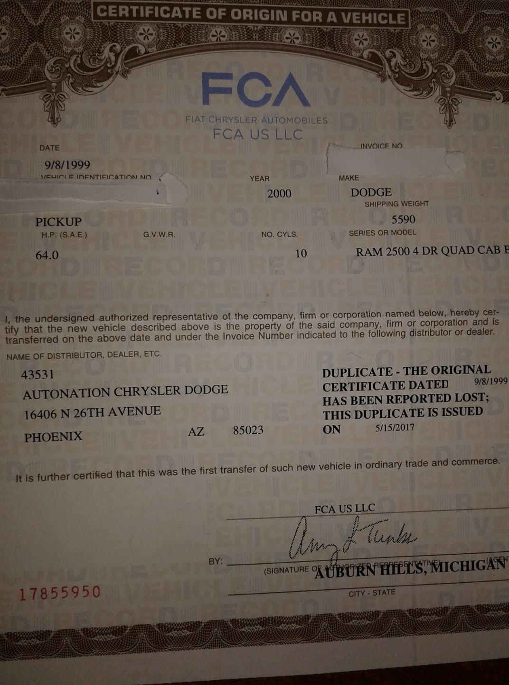

Slide 57
The destruction of the republic continues
Franklin Delano Roosevelt - The New Deal
1935: FDR created, The Federal Register Act. It was codified as Title 3, Section 301, et seq. by Executive Order. He gave himself the power to create federal agencies, to appoint the heads of those agencies, and to give those agencies the power to tax and regulate all federal citizens. i.e. US Citizens
"Because of what appear to be Lawful commands on the surface, many citizens, because of their respect for what appears to be law, are cunningly coerced into waiving their rights, due to ignorance." (U.S. v. Minker, 350 U.S. 179, 187)
“Tell the powers that be" that you are alive and Not lost at sea and claim the Cestui Que Vie BIRTH CERTIFICATE TRUST account, (Title 31 U.S. Code 1321/1322), is what we are supposed to do too. - Nationality Act, 1940.

Slide 58
The destruction of the republic continues
the usurpation of the law of the land
1938: Thompkins vs Erie Railroad, The case that changed justice. The U.S. Supreme Court admitted that the Federal Government acting (as a Corporation) has no such thing as General Common Law and is therefore incompetent to fulfill Article VII. Not a Government of the People, NOT De Jure.
The Four Acts of 1939: All are Tell Tales of how an “American” born and living on the Land of the “States” have been systematically reduced to living as a “US Citizen,” redefined as corporations and subjects (CHATTEL), made to follow the policies, rules, codes, and statutes, designed for employee’s of government. Defrauded of their property, and Press Ganged (Kidnapped) into the foreign jurisdiction of the SEA.
1)The Old Age Pension Act
2)The Buck Act
3)The Alien Registration Act
4)The BAR Act

Slide 59
The destruction of the republic continues
The United Nations - One World Government
1944: The French create the International Monetary Fund (IMF) and purchased “the League of Nations.”
1945: The U.N Treaty. A replacement for the League of Nations, the organization was established on 24 October 1945 after World War II in order to prevent another such conflict… Or So was Their excuse. At it’s founding, the United Nations had 51 member states; there are now 193. The headquarters of the UN is in Manhattan, New York City, and experiences extraterritoriality. “Member States” are “Owned by their treaty, giving them a testamentary title” of ownership.
December 9, 1945: the International Organization Immunities Act relinquished every public office of United States to the United Nations as Congress relinquished every public office over to the U.N. Local governments, up to the president, fall under U.N. jurisdiction. Congress gave the U.N. the right to dictate what laws will be international & gave them the right to tax the States.
1946: THE ADMINISTRATIVE PROCEDURES ACT. The ACT changed forever the structure and the method for dealing with "We The People". All Towns, Cities, Counties, States, School Districts, Policemen, Sheriffs, etc became CORPORATIONS and fell under THE ADMINISTRATIVE PROCEDURES ACT. The FEDERAL GOVERNMENT would now (through the towns, cities, counties, states) rule "We The People" through Rules, Regulations, Codes, Procedures, and Statutes (Color of Law)-if the "Sovereign" cedes their rights. THE TOWN OF _, THE CITY OF _, THE COUNTY OF_, THE STATE OF _, are the vehicles used for accomplishing their deeds.

Slide 60
The destruction of the republic Ends
The Bar Association, Crown Inc.,
What is a treaty? A treaty is an agreement under international law entered into by actors in international law, namely sovereign states and international organizations these forms of agreements are, all under international law.
1947 BAR Association Treaty: So, Why does The United States Corporation need a treaty with the BAR Association?
Answer: Because The BAR Association or British Accreditation Registry is a foreign owned and controlled entity, a subsidiary of the Crown Inc., a subsidiary of Westminster Inc. Ownership of which is held jointly by the Queens of England and Holland, and the Vatican. They are installed by treaty here on our shores to enforce Admiralty Law and to Protect the interests of The Crown Inc. (see; Treaty of Ghent, Treaty of Veronia, and nearly any “STATE” attorney Generals web site under History of The Attorney General) On the State of Illinois web site it is an easy one to find. “They are there to protect the interests of the crown!”

Slide 61
The destruction of the republic Ends
The Bar Association, Crown Inc.,
Under the Federal Rules of Civil Procedure 12b 6: the prosecution has failed to provide adequate proof that the parties (individuals) involved in this situation are actually corporate entities. There is however, ample proof that the prosecution and other agents are actually corporations.
The International Reorganization Rescind Act: Congress put this into form but they never took action to rescind the act. Fairly recently an Ohio judge filed suit claiming that Congress did not have the right to relinquish government authority over to the U.N. (a corporation or foreign country) and that the Congressional act was a constitutional violation because they didn’t put it to the States or the people to agree on it. In 2005 the US Supreme court declined to hear the case therefore all public offices are under U.N. jurisdiction and they are not American’s or US Citizens, but Foreign Agents.
The Oath of Office: Title 5 USC 331, 332, 333 backed up by Title 22 CFR Foreign Relations 92.12 – 92.31 and Title 8 USC, section 1481 – the public official relinquishes his national citizenship and are thus foreign agents as stipulated under Title 22 USC, chapter 11, section 611, loss of national citizenship – Public officials are no longer US Citizens, but rather are foreign agents and must register as such.
1950: The 81st Congress investigated the Lawyers Guild and determined that the B.A.R. Association is founded and run by communists under definition. Thus any elected official that is a member of the B.A.R. will only be loyal to the B.A.R. and not the people. Attorneys/Attornors/Brokers are considered Foreign Agents under the Foreign Agents Registration Act (FARA) and are SUBJECTS of the Crown Temple B.A.R.

Slide 62
The Battle Against the People - Television
1953: We finally pay off the 1907 bankruptcy of The United States of America, Inc., but instead of returning the land patents owed to the actual states and people, those responsible pretended not to know who the land belonged to, and rolled it all up in giant land trusts, which they continued to tax, lease, rent, and otherwise benefit from in our purported “absence”.
A race for fast knowledge, 1940’s-50’s: Television grew popular, and the Government was afraid that if private industry had control, then the pieces of the puzzle would be discovered, The FCC was formed by the Communications Act of 1934, which now sought to regulate and subvert it. While the CIA, performed many studies of subversion, distraction, subliminal messaging, and mind control, using the good ole T.V. They heavily investing in Hollywood.
Some fun reads researching this stuff, lol.

Slide 63
The Battle Against the People -
The Department of Education
April 11th 1953: Government takes control, taking the reins of the educational system away from the States. by promising federal $$$, Under the Auspice to improve and standardize (Propagandize) The education(minds) of our youth. Under the threat of force. (Truancy)
April 11th 1953: After selling the “States” for nearly two years on the idea of a standardized educational system, using Jane Morrow Spaulding, a former teacher as the face of the Idea. She lasted less than 2 months, just 49 Days, Appointed by then President Dwight D. Eisenhower, came Nelson Aldrich Rockefeller Taking Office of Secretary of education in June 1, 1953.
Funny how a family member of one of the worlds prominent leading Banking Families finds it “a most important position in Government.”
Nelson Aldrich Rockefeller Commented: “Give me just ONE Generation and I’ll change the minds and therefore the direction of the world.”

Slide 64
Some Great, Some Bad
John FitzGerald Kennedy
January 20, 1961: JFK becomes the 35th President of The United States of America Inc., a private for profit Governmental Services Corporation.
Averted Thermo-Nuclear war with Russia and the Cuban Missile Crises.
He subsequently rejected plans by the Joint Chiefs of Staff to orchestrate false-flag attacks on American soil in order to gain public approval for a war.
Approved Across-the-board, top-to-bottom cuts in personal and corporate income taxes to be enacted and become effective in 1963.
Executive order #11110- issued on June 4, 1963: “In 1961, at my direction, sales of silver were suspended by the Secretary of the Treasury. As further steps, I repeal those Acts that oblige the Treasury to support the price of silver; and repeal of the special 50-percent tax on transfers of interest in silver and give authorization for the Federal Reserve System to issue notes in denominations of $1, so as to make possible the gradual withdrawal of silver certificates from circulation and the use of the silver thus released for coinage purposes.”
Then he gave his Exposing “Secret Societies” Speech and was Assassinated on 22, November 1963.

Slide 65
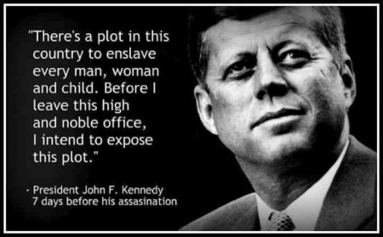

Slide 66
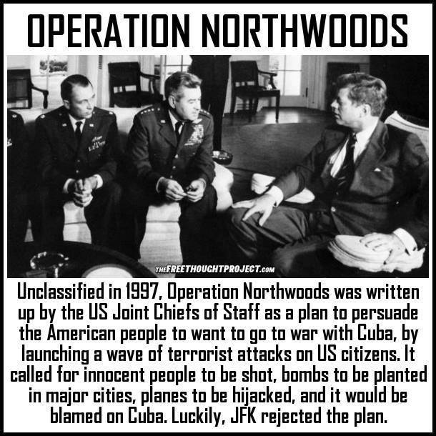
But did George Bush?

Slide 67
U.N. Wars and The U.N. STATE of Being
27 June, 1950: The United Nations Security Council authorized the formation and dispatch of UN forces to Korea to repel what was recognized as a North Korean invasion. Twenty-one countries of the United Nations eventually contributed to the UN force, with the United States providing 88% of the UN's military personnel.
1 November, 1955 The United Nations Security Council authorized the formation and dispatch of UN forces to Vietnam which didn’t end until 30 April, 1975.
Korea, Vietnam,Thailand, Zaire, Lebanon, Granada, Libya, Persian Gulf, Panama, Iraq, Somalia, Haiti, Bosnia, Serbia, Afghanistan, Pakistan, and..Libya..again, How about the War with ISIL(Operation inherent resolve)
All wars listed above since 1950 have been… “United Nations Security Council” authorized wars and only against, Non-UNITED NATIONS Countries !
So, you tell me…Who runs this Nation? Is it “we the People”?
Tell me..is the US Military, Ours? or is it the United Nation’s?

Slide 68
The U.N. STATE of Being
What about our police forces?
In all Incorporated Cities, Counties, States, and all federal agencies. All Police forces are under the policies and direction of the United Nations.
All Officers have two lockers, One with their official uniform and one with the uniform of the UNITED NATIONS and when under “State of Emergency” can be tasked to represent the U.N. Global interests.
Only in the few remaining Unincorporated Counties is a duly elected county Sheriff a De Jurely elected Officer, But is he? When he is Voted in by US Citizens and not elected American State Nationals. One can not serve two masters!

Slide 69
FREEDOM FROM WAR
THE UNITED STATES PROGRAM FOR
GENERAL AND COMPLETE DISARMAMENT IN A PEACEFUL WORLD
DEPARTMENT OF STATE PUBLICATION 7277
Disarmament Series 5
Released September 1961
Office of Public Services
BUREAU OF PUBLIC AFFAIRS
Summary
DISARMAMENT GOAL AND OBJECTIVES
The over-all goal of the United States is a free, secure, and peaceful world of independent states adhering to common standards of justice and international conduct and subjecting the use of force to the rule of law; a world which has achieved general and complete disarmament under effective international control; and a world in which adjustment to change takes place in accordance with the principles of the United Nations.
In order to make possible the achievement of that goal, the program sets forth the following specific objectives toward which nations should direct their efforts:
• The disbanding of all national armed forces and the prohibition of their reestablishment in any form whatsoever other than those required to preserve internal order and for contributions to a United Nations Peace Force;
•
• The elimination from national arsenals of all armaments, including all weapons of mass destruction and
•
• 3
• the means for their delivery, other than those required for a United Nations Peace Force and for maintaining internal order;
•
• The institution of effective means for the enforcement of international agreements, for the settlement of disputes, and for the maintenance of peace in accordance with the principles of the United Nations;
•
• The establishment and effective operation of an International Disarmament Organization within the framework of the United Nations to insure compliance at all times with all disarmament obligations.
TASK OF NEGOTIATING STATES
The negotiating states are called upon to develop the program into a detailed plan for general and complete disarmament and to continue their efforts without interruption until the whole program has been achieved. To this end, they are to seek the widest possible area of agreement at the earliest possible date. At the same time, and without prejudice to progress on the disarmament program, they are to seek agreement on those immediate measures that would contribute to the common security of nations and that could facilitate and form part of the total program.

Slide 70
“Our government has kept us in a perpetual state of fear -- kept us in a continuous stampede of patriotic fervor -- with the cry of grave national emergency’s... Always there has been some terrible evil to gobble us up if we did not blindly rally behind it by furnishing the exorbitant sums demanded. Yet, in retrospect, these disasters seem never to have happened, seem never to have been quite real.” ~ General Douglas MacArthur

Slide 71
“There has never been a just WAR, never an honorable one--on the part of the instigator of the war. I can see a million years ahead, and this rule will never change in so many as half a dozen instances. The loud little handful--as usual--will shout for the war. The pulpit will--warily and cautiously--object--at first; the great, big, dull bulk of the nation will rub its sleepy eyes and try to make out why there should be a war, and will say, earnestly and indignantly, 'It is unjust and dishonorable, and there is no necessity for it.' Then the handful will shout louder. A few fair men on the other side will argue and reason against the war with speech and pen, and at first will have a hearing and be applauded; but it will not last long; those others will outshout them, and presently the anti-war audiences will thin out and lose popularity. Before long you will see this curious thing: the speakers stoned from the platform, and free speech strangled by hordes of furious men who in their secret hearts are still at one with those stoned speakers--as earlier--but do not dare say so. And now the whole nation--pulpit and all--will take up the war-cry, and shout itself hoarse, and mob any honest man who ventures to open his mouth; and presently such mouths will cease to open. Next the statesmen will invent cheap lies, putting the blame upon the nation that is attacked, and every man will be glad of those conscience-soothing falsities, and will diligently study them, and refuse to examine any refutations of them; and thus he will by and by convince himself the war is just, and will thank God for the better sleep he enjoys after this process of grotesque self-deception.” ~ Mark Twain

Slide 72
The U.N. & U.S.Government Battle Against “The People” Population Control
Roe vs Wade, The Abortion Act, The killing of the unborn.
The Immunization Act, The Killing of our children.
The Environmental Protection Act, The Killing of the weakest.
The Weather Control and Manipulation Act, Seriously folks! Seriously!
The child protective services Act, Kidnapping of our children for profit and sex trade.
The National childhood Vaccine Injury Act of 1986 - Protecting the companies from lawsuits derived from adverse side effects of vaccines.
The Farm Act, The FDA Act, The Monsanto Act, The Chemical Act, All to regulate Poison, Not to eliminate poisons, but to regulate and to demand there USE.

Slide 73
The U.N. & U.S.Government Battle Against The People Population Control
The Prescription Drug Act, Chemical Poisons to reduce the elderly and in-firmed. Have you seen the side effect warnings, last year more than 250,000 people, dead from Prescription Drugs.
The Affordable Care Act, to regulate and to protect the profits of the health care system. To make sure we keep getting sick.
The Prison Act, Getting the dangerous, the mentally ill, the annoying ones, and the ones who think for themselves and take a stand out of the way, For big Profits! The Largest prison population in the world per capita …by far..!
The Patriot Act, What’s left? The theft of our rights is about over! We are enemies of the “State”
The NDAAct, US Citizens are now not just enemies, but ARE Domestic Terrorists!
The Miller Act, The great extraction of capital, Theft of our Cesti Que Vie Trust Estates. This is truly how Governments are funded.

Slide 74
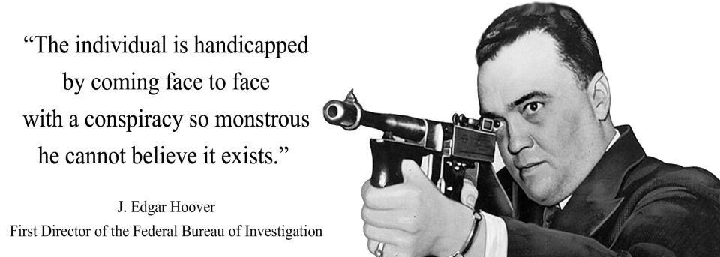
Remain mindful and ever vigilant, and guard with jealous attention,
your rights, and the rights of your loved ones, and all people.
We must protect ourselves from people whose sole purpose
is to take over the world and to enslave the population.

Slide 75
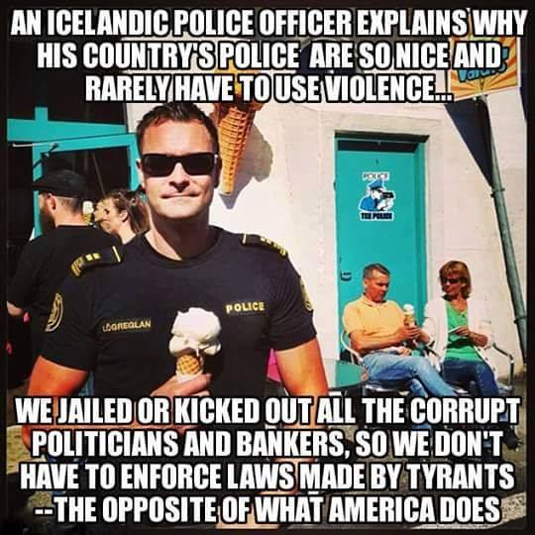

Slide 76
The final Pieces
1999: We finally pay off the 1933 bankruptcy of the United States of America, Inc., but instead of returning all the Cestui Que Vie ESTATE trust assets owed to the living people, Bill Clinton signs Executive Order #13037. This steps up the conscription process, and pretending that nobody knows who these accounts belong to, hoped to seize upon all our property including our names via a “ claim on abandonment.”
2015: President Obama puts the UNITED STATES, INC. and all its “Municipal Franchises” including the Cestui Que Vie ESTATES belonging to Americans into Chapter 7 Bankruptcy Liquidation. Almost as an afterthought, he puts the USA, Inc. into Chapter 11 Reorganization. --- all the Municipal Government franchises dba OREGON, FLORIDA, and JOHN QUINCY PUBLIC, all the Territorial Government franchises dba John Quincy Public.
2015: Americans who have become aware of the fraud return to the land jurisdiction of their birth. The new government issues new “Sovereign Letters Patent” for the states (November 4) and for the “Indian Nations” (November 6) and also issues an Express Trust --- “The Declaration of Joint Sovereignty.”

Slide 77
The final Pieces
2017: After extensive Due Process given to all the Principal Parties responsible, the liens against all the Municipal and Territorial government corporations and their franchises are completed and cured, including Agricultural Liens.
January 6, 2017: a Private Registered Indemnity Bond covering all the actual states and people is lodged with the United States Treasury, and a Payment Bond is lodged with the Vatican Chancery Court.
June 29, 2017: The American states and people represented by the unincorporated United States of America visit The United States District Court for the District of Columbia and claim back their property and assets as the Paramount Security Interest Holders and Priority Creditors of the bankrupt Territorial and Municipal Government corporations and their franchises worldwide.
That all brings us forward to the present moment. Problem, We Americans: “The One People’s Public Trust” foreclosed on the Territorial and Municipal corporations, intending to create a gigantic global version of the Public Charitable Trust that they would then control. However, they were not the Creditors. We are, the few Americans

Slide 78
The final Pieces…cont.
We are the lawful owners of all that several generations of dishonest employees and middlemen have amassed- and which they have hoped to claim as abandoned property. The success of this scheme would have ended private property rights worldwide.
The Secondary Creditors had already set up a plan to discharge the debts of the Municipal franchises in bankruptcy via Treasury Direct Accounts. This process avoids the fact that these debts are all odious hypothecated debts that the living people never owed in the first place. It also avoids the fact that the living people are the actual Paramount Security Interest Holders who have been defrauded in Breach of Trust, and instead mischaracterizes them as bankrupt “US citizens”
As our included Public and Judicial Notice- Number 4 discloses, “citizenship” is a form of indentured servitude to the government of a country, and in the modern world, it must be voluntary, proven, and equitable, or it becomes a form of peonage and enslavement outlawed worldwide since 1926.
We maintain that the incorporated foreign governmental service corporations operating under color of law and purposeful deceit on our shores since 1868 have effectively enslaved our population and brought insupportable claims against our land and our assets.

Slide 79
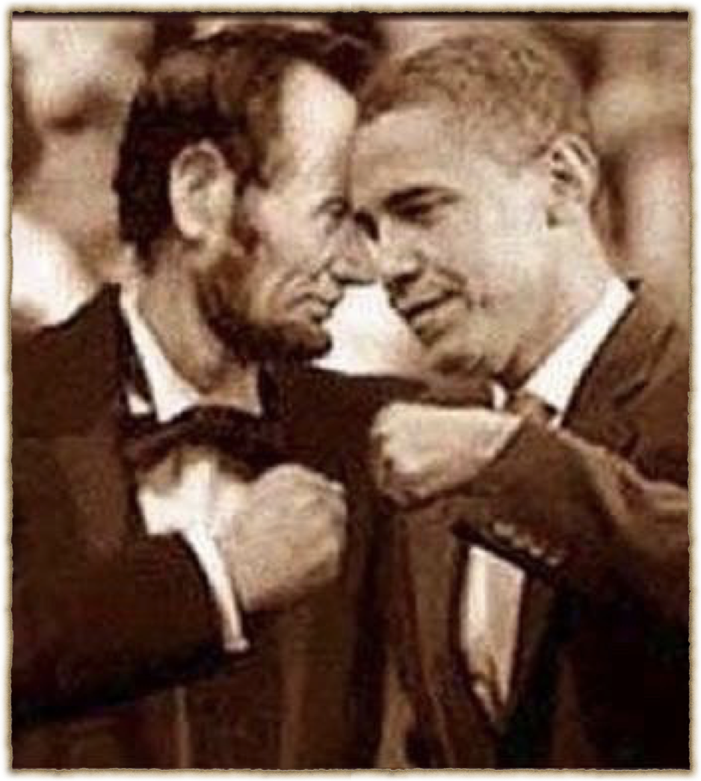
The Proof - The Puzzle Completion The beginning and to the End of the “Republic

Slide 80
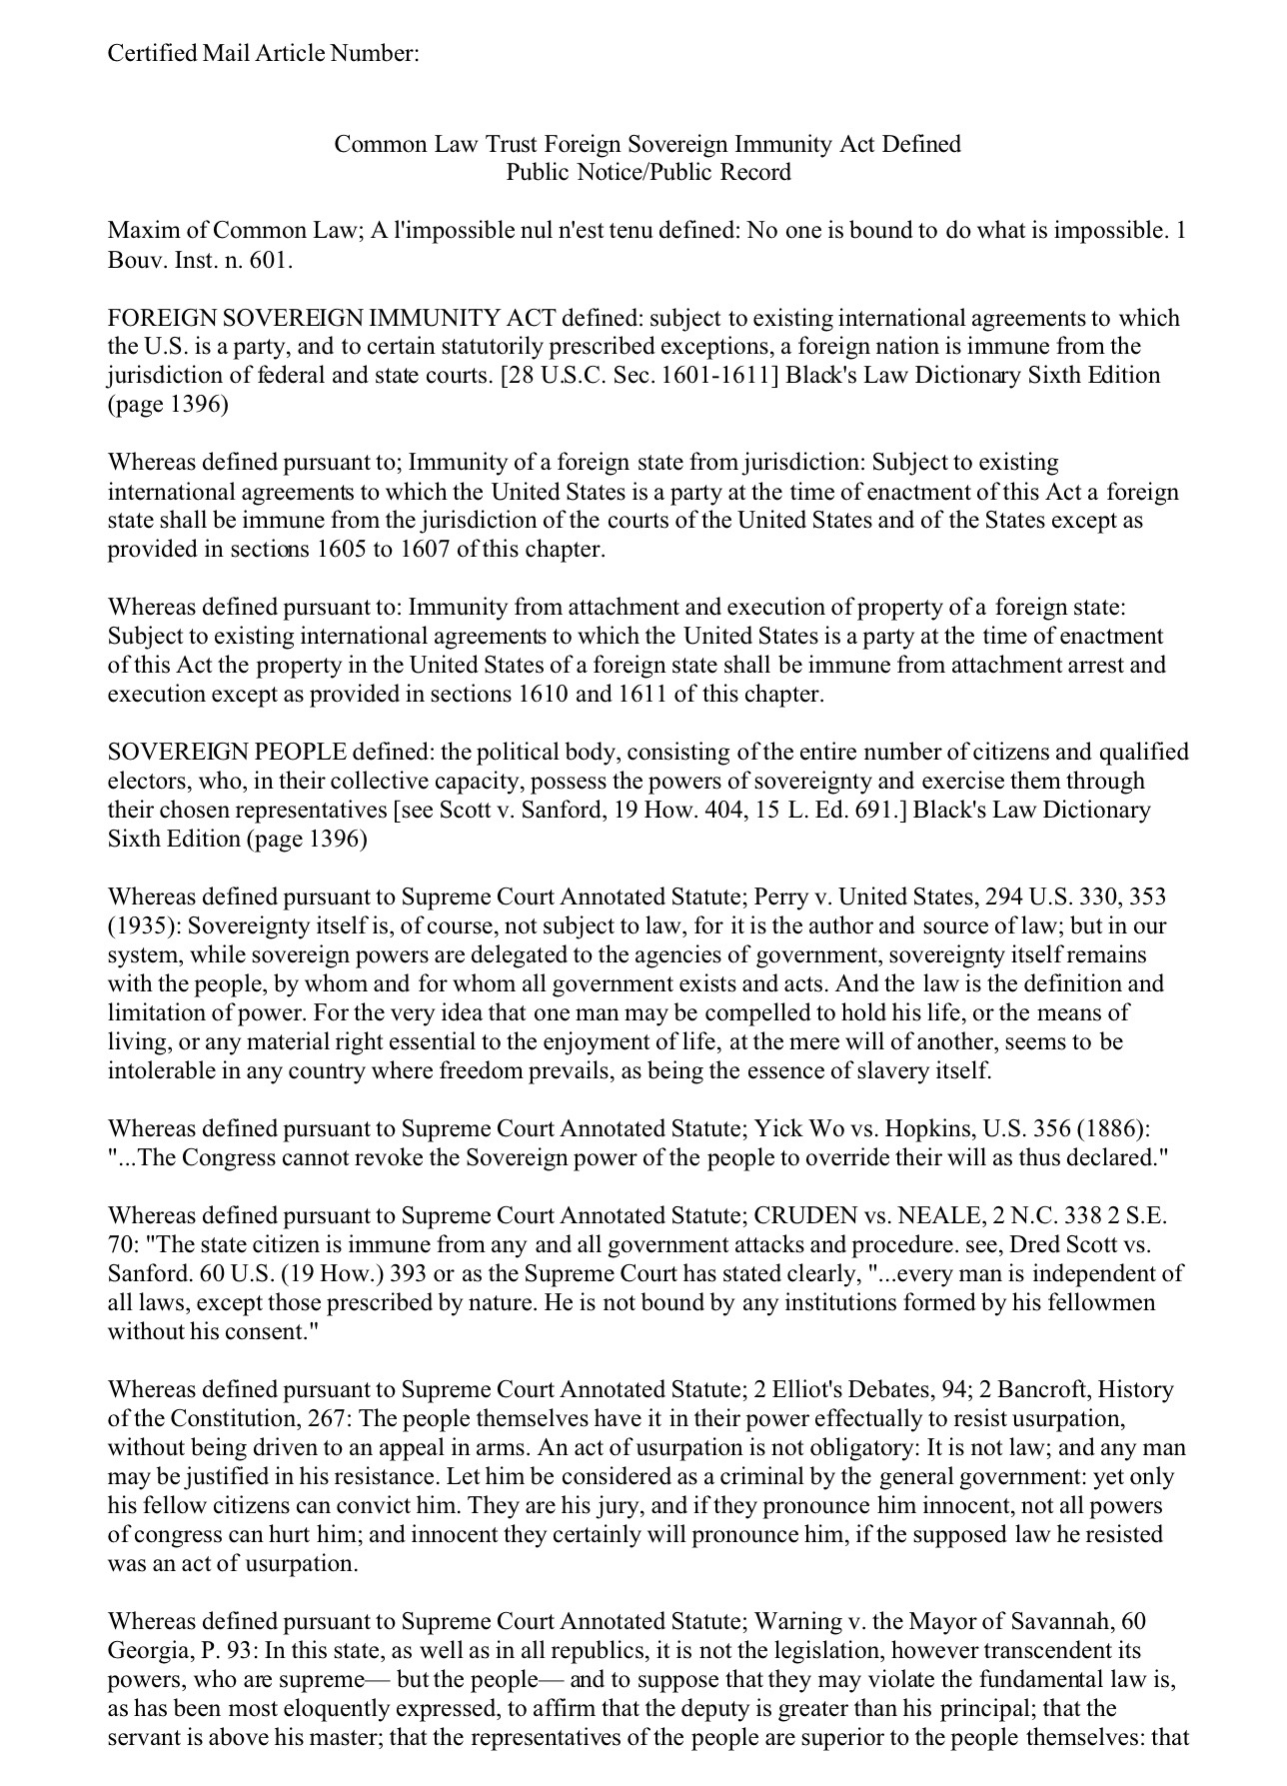

Slide 81
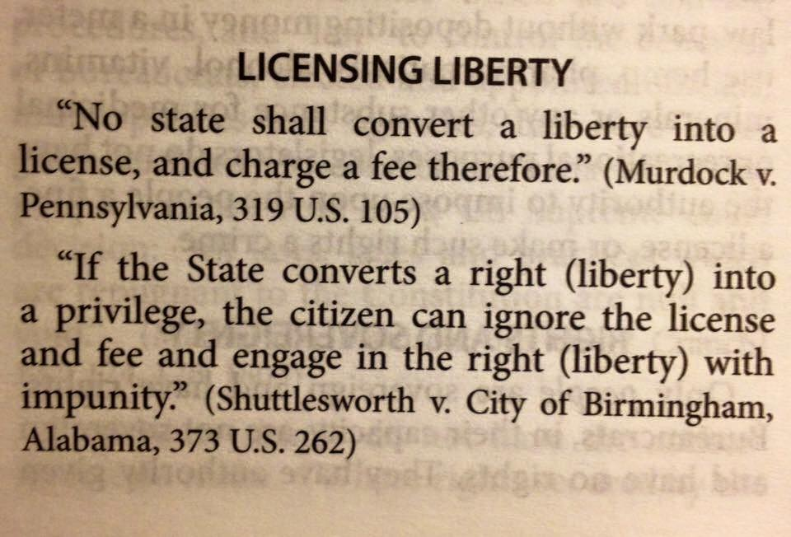

Slide 82
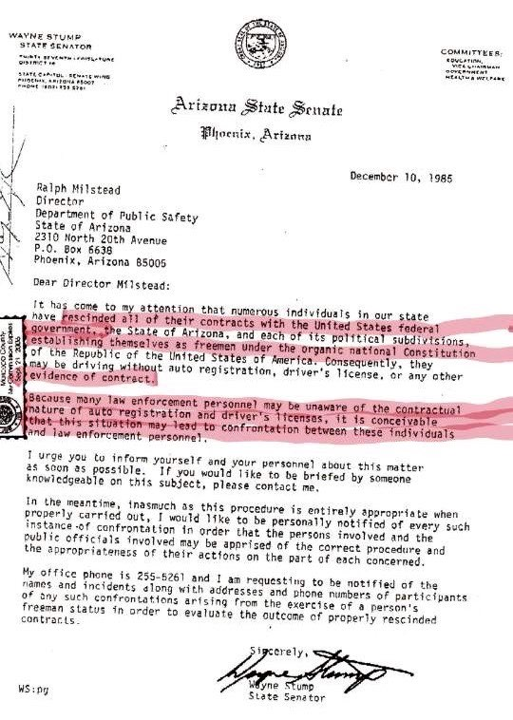

Slide 83
…See Just who owns “YOU”! and insures your life.
You can now view the entities worldwide that trade on your Birth Certificate Bonds at…www.fidelity.com or https://www.GMEIUtility.org/search
In the later; Simply type in your SS# w/dashes or # off your birth Certificate in the search bar, (magnifying glass) when the list appears go to bottom of page and in the box that says # 15 items per page use the arrow and change it to 100 per page.
They have monetized you, you are a numbered slave. A, 14th Amendment US Citizen with your own subservient slave identity number or better known as an SSI#.

Slide 84
The Puzzle Pieces
- Could we even in our wildest dreams make all this stuff up?

Slide 85
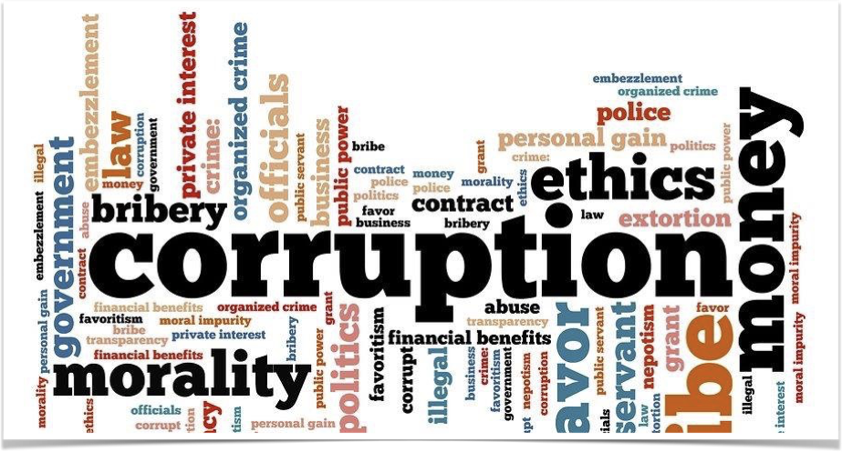
Government

Slide 86
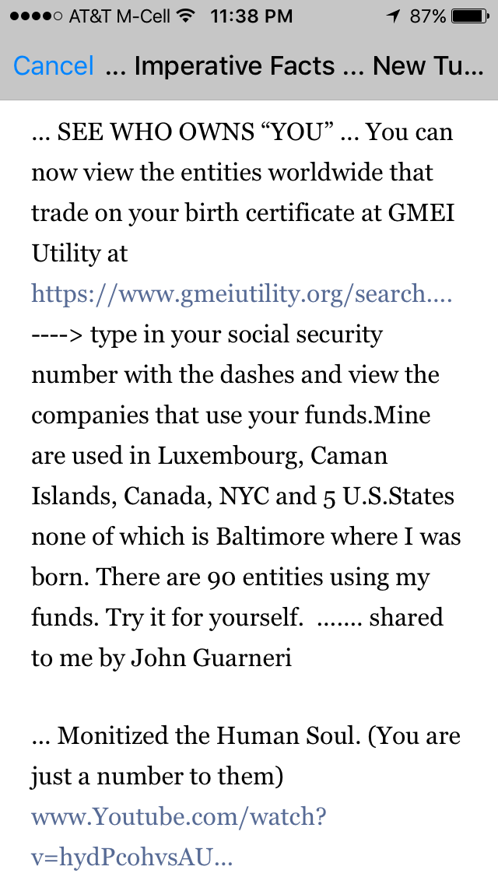
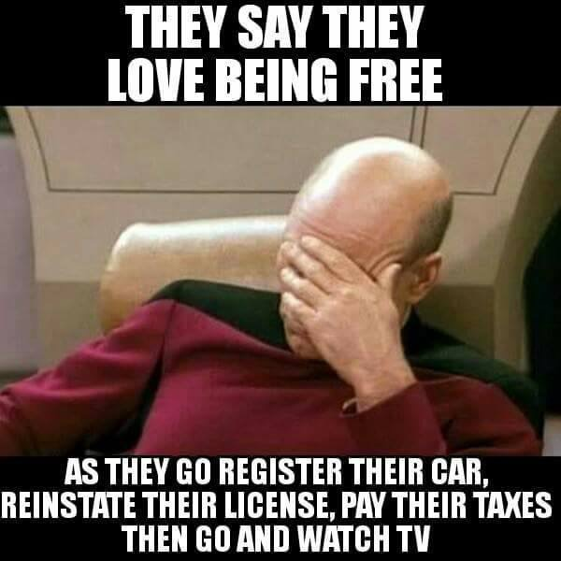

Slide 87
- Part 2 -
The corruption of the Courts

