Slide 1
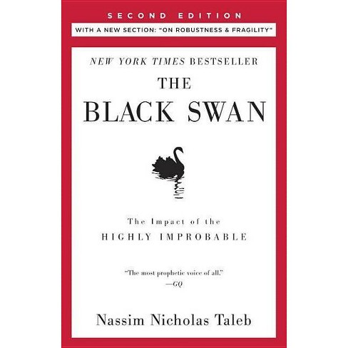
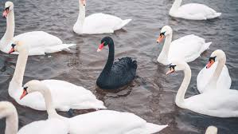

Slide 2
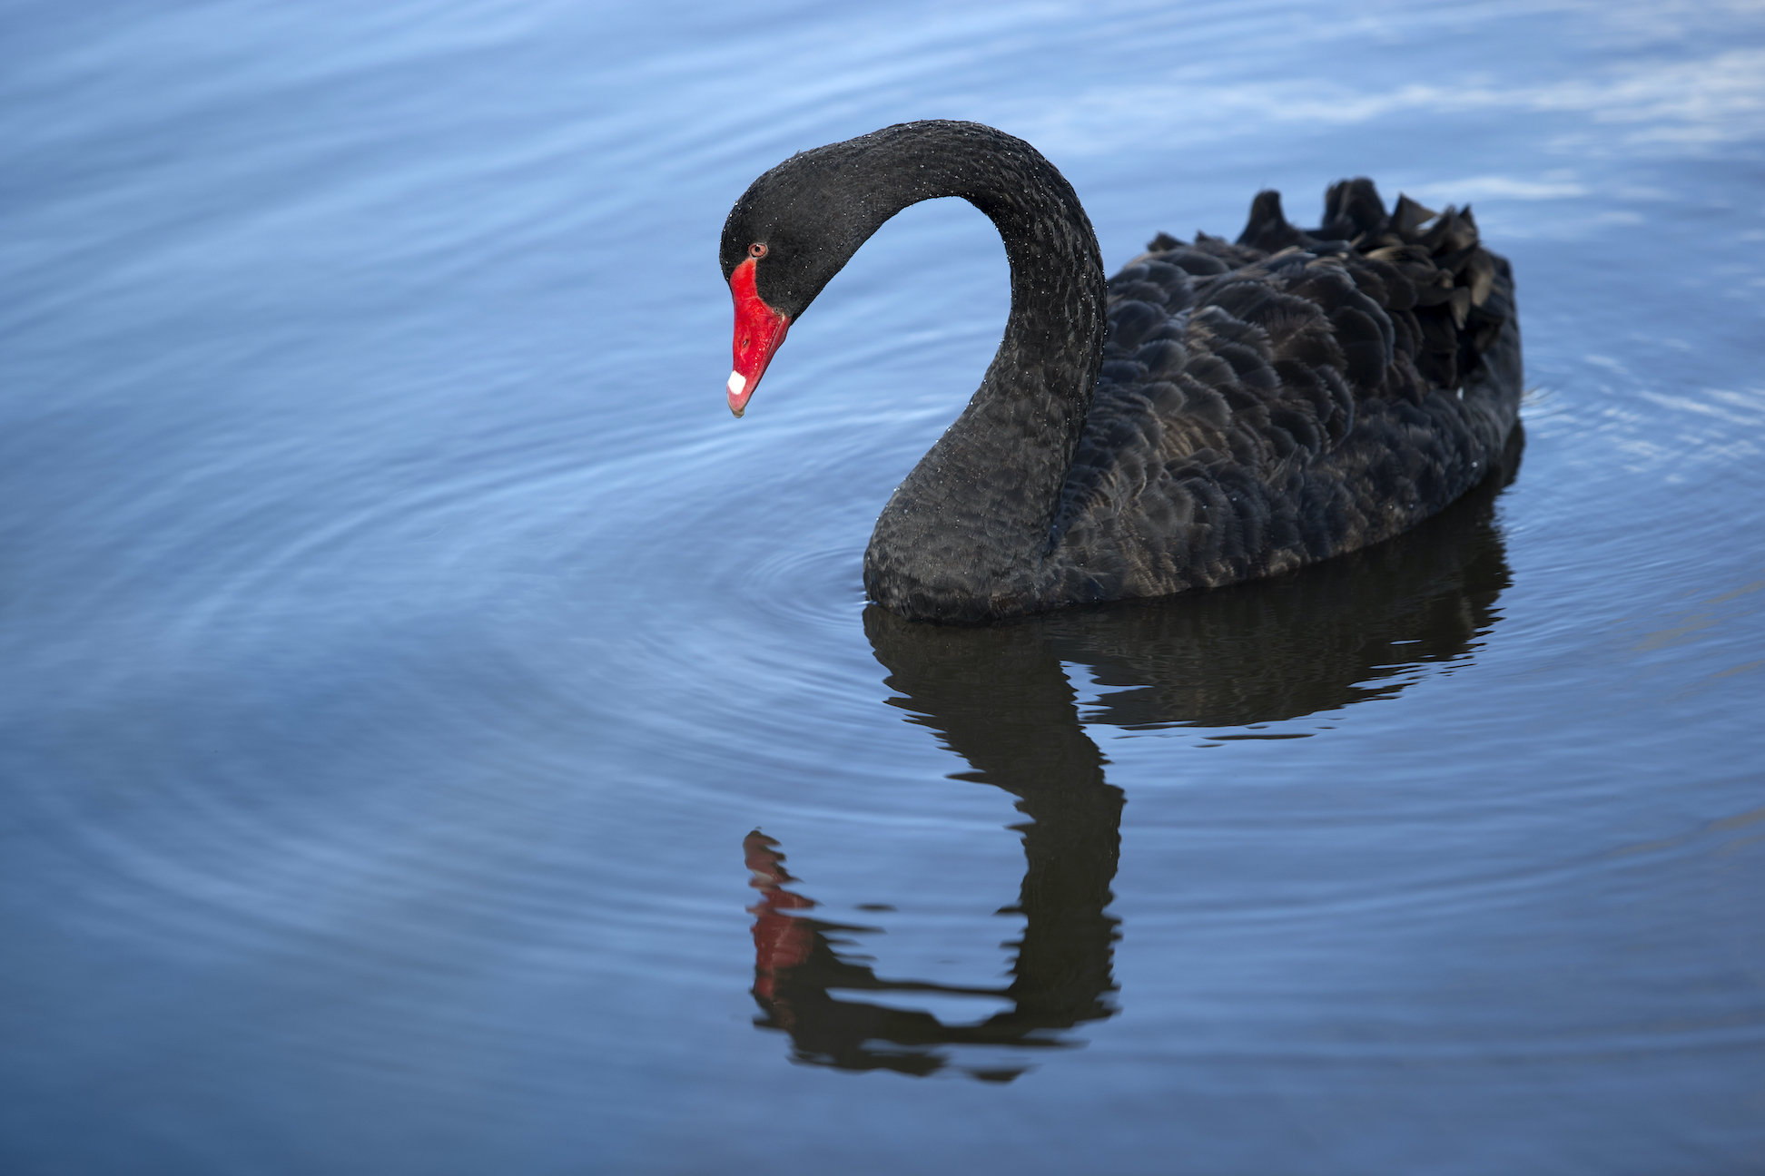
THE SUMMARY
of BLACK SWAN
The Impact of the
HIGHLY IMPROBABLE
Nassim Nicholas Taleb
2007, 2010

Slide 3
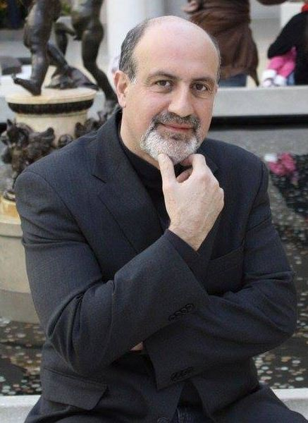
Nassim Nicholas Taleb
is a Lebanese-American essayist, mathematical statistician, former option trader, risk analyst, and aphorist whose work concerns problems of randomness, probability, and uncertainty.
Born: September 12, 1960 (age 61), Amioun, Lebanon
Parents: Najib Taleb, Minerva Ghosn
Education: Ph.D. Paris Dauphine University, University of Paris, MBA Wharton School of the University of Pennsylvania
Written:
The Black Swan: The Impact of the Highly Improbable.
Skin in the Game.
Antifragile: Things That Gain from Disorder.
Fooled by Randomness: The Hidden Role of Chance in Life and in the Markets.
The Bed of Procrustes.

Slide 4
Taleb not only has the explanation for the current financial crisis, he saw it coming, The new York Times
The Hottest thinker in the world, Bryan Appleyard, The Sunday Times (London)
The Black Swan is one of the 12 most influential book since WWII. Sunday Times.
Taleb is the real thing. He rightly understands that what’s brought the global banking system to its knee it’s simply greed or wickedness but intellectual hubris. John Straw, author of straw dogs
Taleb is a genuinely significant philosopher, …. Some one who is able to change the way we view the structure of the world through the strength, originality, veracity of his idea alone. GQ magazine
Long-standing critics of risk modeling , such as Taleb are now hailed as seers. The Economist
An eye-opening book, one that teases our intelligence. Taleb is after big gamesman he bags it,
Roger Lowenstein, Portfolio
The Black Swan changed my view of how the world works. Daniel Kahneman, Nobel laureate

Slide 5
Before the discovery of Australia, people in the old world were convinced that all swans were white, an unassailable belief as it seemed completely confirmed by empirical evidence. The sighting of the first black swan might have been an interesting surprise for a few ornithologists (and others extremely concerned with the coloring of birds), but that is not where the significance of the story lies. It illustrates a severe limitation to our learning from observations or experience and the fragility of our knowledge. One single observation can invalidate a general statement derived from millennia of confirmatory sightings of millions of white swans. All you need is one single (and, I am told, quite ugly) black bird.
I push one step beyond this philosophical-logical question into an empirical reality, and one that has obsessed me since childhood. What we call here a Black Swan (and capitalize it) is an event with the following three attributes.
It is an outlier
It carries an extreme impact
In spite of its outlier status, human nature makes us concoct explanation for its occurrence.
The Triplet: Rarity, Extreme impact, and Retrospective predictability

Slide 7
Look into your own personal life, to your choice of profession, say, or meeting your mate, your exile from your country of origin, the betrayals you faced, your sudden enrichment or impoverishment.
How often did these things occur according to plan?

Slide 9
The central idea of this book concerns our blindness with respect to randomness, particularly the large deviations
The Highly expected not happening is also black swan

Slide 10
We produce thirty years of social security deficit and oil prices without realizing that we can’t predict these for next summer.
Our cumulative prediction errors for political and economic events are so monstrous.
What is surprising is not the magnitude of our forecasting errors, but our absence of awareness of it.
Our inability to predict in environments. Experts, better in narrating, smoking you with mathematical models, more likely wear a tie.
Almost, no discovery, no technologies came from design and planning, they were just black swans.
Rare events equals uncertainty. We need to study the rare and extreme events in order to figure out the common-ones. There are two types of studying phenomenon, first concentrate on the norm and ignore the outlier while the second to consider the extreme to understand the norm.
Can you test a friend temperament in a Rosey conditions? Can you asses a criminal just by looking what he was doing in the regular days? Can we understand health without considering wild diseases and epidemics?
Black Swan logic makes What you don’t know far more relevant than what you do know.

Slide 11
The Lebanese paradise suddenly evaporated after few bullets and mortar shells, the ethnic coexistence shattered after a black swan coming out of nowhere.
The human mind suffers from THREE ailment as it comes into contact with HISTORY.
1- The illusion of understanding. Complicated or RANDOM. Cuba, Iran, Russia, and I add Iraq
2- Retrospective distortion.
3- The overevaluation of factual information. “The Triple of Opacity”
The Diary, book and editing. Led him practice of uncertainty and scientific mathematical instead.
Knowledge of his grandfather is no difference from his driver. Good knows.
Some Scientific results are not only useless in real life, because they underestimate the impact of highly improbable, but many of them be a Black Swan
October 19, 1987, I saw the largest market drop in modern history. We thought we had become sufficiently sophisticated with all these intelligent-talking intelligent economist. The event lay outside anything one could have imagined on the previous day.
It was a sensation of joy, pride, and terror, and I felt vindicated.
I became industrial scientist who applies mathematical models of UNCERTAINITY to financial data. I studied the flaws and the limit of these models. Anti Speculative market price.

Slide 12
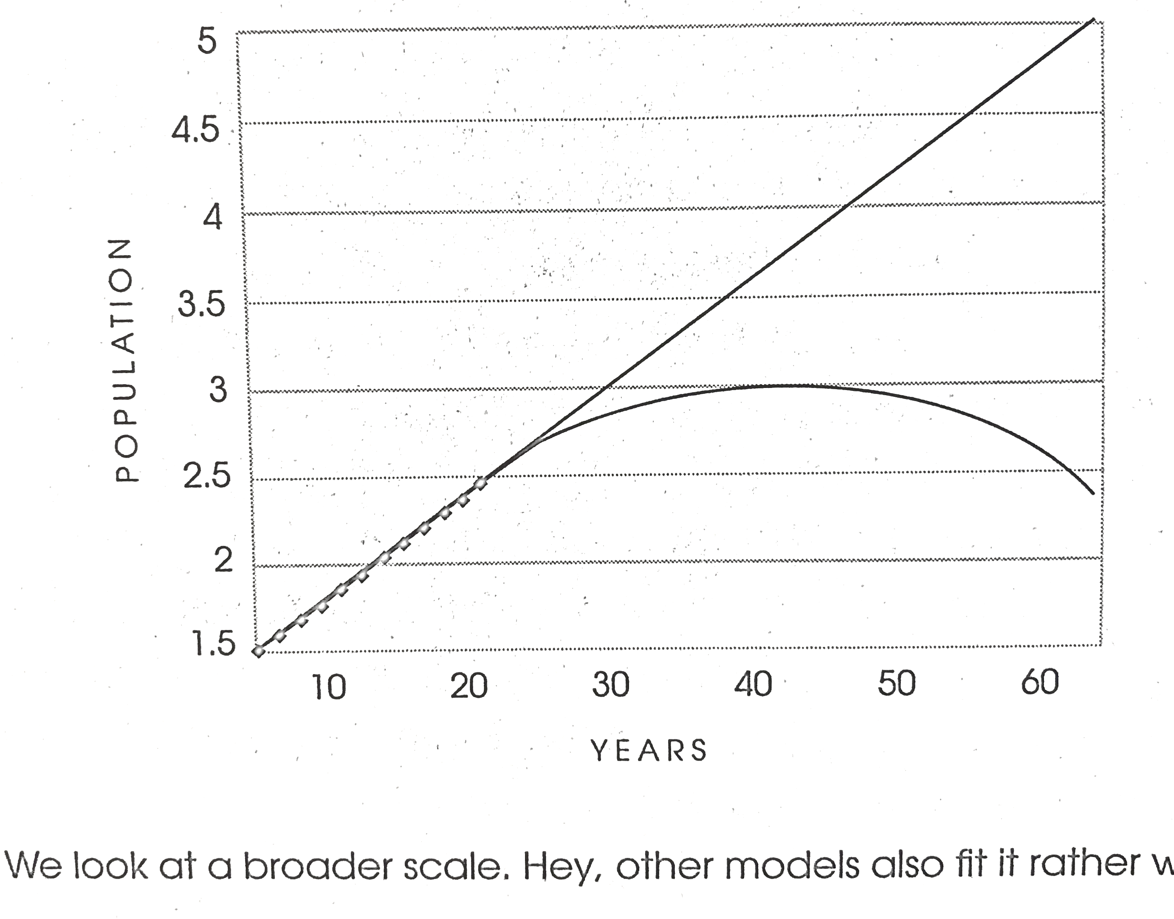
Scalability |
Mediocristan. Where normal things happen, expected and easy to compute probability.
Extremistan. The randomness and deviation from the mean.
Massage therapist,” for example, is a “nonscalable” profession. There is an upper limit on how many clients you can see—there’s only so much time in a day, and therapists’ bodies fatigue—and thus there’s only so much income you can expect from that profession.
“Quantitative trader,” however, is a “scalable” profession. It takes no additional energy or time to purchase 5,000 shares of a stock than 50, and your income isn’t limited by physical constraints.
Artist Singers

Slide 13
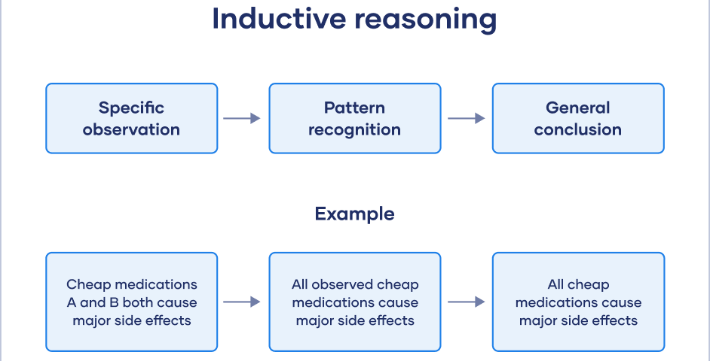
Don’t Be a Turkey | It Pays to Be a Skeptic
Made famous by British philosopher Bertrand Russell (though, in his telling, the unlucky bird was a chicken), this story illustrates the problem with inductive reasoning (the derivation of general rules from specific instances).
With certain phenomena—marketing strategy, stock prices, record sales—a pattern in the past is no guarantee of a pattern in the future.
In Taleb’s words, the turkey was a sucker—it had full faith that the events of the past accurately indicated the future. Instead, it was hit with a Black Swan, an event that completely upends the pattern of the past. (It’s worth noting that the problem of inductive reasoning is the problem of Black Swans: Black Swans are possible because we lend too much weight to past experience.

Slide 14
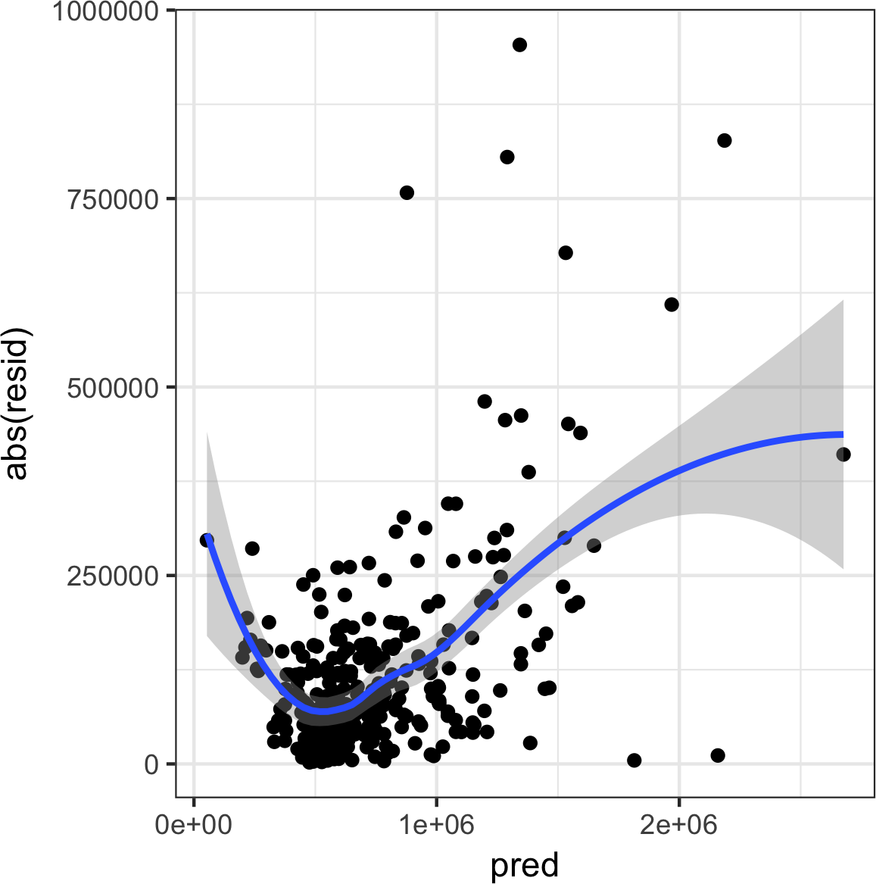
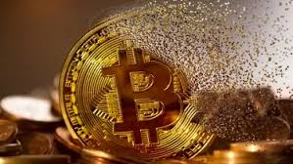
The Scandal of Prediction
Computer chips, cellular networks, the Internet—it stands to reason that our predictive capabilities too are advancing. But consider how few of these groundbreaking advances in technology were themselves predicted. For example, no one predicted the Internet, and it was more or less ignored when it was created.
It is an inconvenient truth that humans’ predictive capabilities are extremely limited; we are continuously faced with catastrophic or revolutionary events that arrive completely unexpectedly and for which we have no plan. Yet, nevertheless, we maintain that the future is knowable and that we can adequately prepare for it. Taleb calls this tendency the scandal of prediction.
Epistemic Arrogance
The reason we overestimate our ability to predict is that we’re overconfident in our knowledge.
In the absence of a feedback mechanism [not making decisions on the basis of data] you look at models and think they confirm reality.

Slide 15
Why We Can’t Know What We’ll Know
Epistemic arrogance, the pretensions of “experts,” our ever-increasing access to information—all belie an incontrovertible, perhaps even most, areas of our lives, prediction is simply impossible.
Take discoveries, for example. At any given moment, there are scores of scientists, scholars, researchers, and inventors around the world working diligently to better our lives and increase our knowledge. But what often goes unremarked is that the discoveries with the profoundest impact on our lives are inadvertent—random—rather than the reward for careful and painstaking work.
Biologist Alexander Fleming left a stack of cultures sitting out in his laboratory while he went on vacation, and when he returned, a bacteria-killing mold had formed on one of the cultures. Voila!—the world’s first antibiotic.
The same goes for the discovery of the cosmic microwave background, the omnipresent radiation in space that provides a key piece of evidence for the Big Bang. No researcher had any idea it existed until two radio astronomers noticed a hiss in their listening devices.
Microwave, Teflon, Volcanized Rubber, Radioactivity, Coca Cola, and Viagra

Slide 16
Predicting the Past
Through the limitations of inductive reasoning as illustrated by the turkey tale, as well as the distortions of the narrative fallacy and silent evidence, we’ve seen how problematic the past is vis-à-vis prediction. But because of these phenomena and others, the past itself is as unknowable as the future.
One of the major obstacles that prevents us from knowing the past with certainty is the impossibility of reverse engineering causes for events. That is, there’s no way to determine the precise cause of an event when we work backward in time from the event itself.
Think of an ice cube sitting on a table. Imagine the shape of the puddle that ice cube will make as it melts. Now think of a puddle on the table and try to imagine how that puddle got there.
The second thought experiment is much harder than the first. With the right physics know-how and ample time, one could model exactly what kind of puddle will result from the melting ice cube (based on the cube’s shape, the environmental conditions, etc.). In contrast, it’s nearly impossible to reverse engineer the past.
Predicting the Past
Predicting the Past

Slide 17
Get another Job
The two typical replies I face when I question forecasters’ business are:
What should he do? Do you have better way for us to predict? And
If you are so smart show me your own prediction?
In fact, the second question aims to show the superiority of the practitioner and doer over the philosopher, and mostly comes from people who don’t know that I was a trader.
If there is one advantage of having been in the daily practice of UNCERTAINITY, it is that one does not have to take any crap from BUREUCRATES.
When asked why they forecast? They answer “ Well, that what we’re paid to do here.
Talib suggestion : Get another job.
[{ Any one who causes harm by forecasting should be treated as either fool or a liar}]
Some forecasters cause more damage to society than criminals

Slide 18
What to Do When You Can’t Predict
If we are surrounded by randomness and unpredictability, if our well-being is radically uncertain, what—besides despair—are our options?
1) Don’t Sweat the Small Predictions
It bears repeating that humans’ ability to predict in the short-term is unique among animal species and quite possibly the reason we’ve survived and thrived as long as we have. To predict is human.
So, when it comes to low-stakes, everyday predictions—about the weather, say, or the outcome of a baseball game—there’s no harm in indulging our natural penchant for prediction: If we’re wrong, the repercussions are minimal. It’s when we make large-scale predictions and incur real risk on their basis that we get into trouble.
2) Maximize Possibilities for Positive Black Swans
Although the most memorable Black Swans are typically the negatively disruptive ones, Black Swans can also be serendipitous. (Shortform note: Love at first sight is undoubtedly a Black Swan.)
Taleb advocates (1) sociability and (2) proactiveness when presented with an opportunity as strategies for opening ourselves up to positive Black Swans.

Slide 19
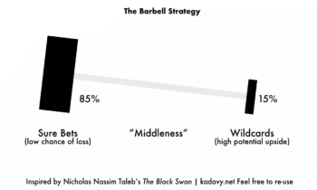
The Barbell Strategy
A barbell strategy devotes the majority of resources to safe options, and a minority to highly risky options that can pay off big. How can you integrate this into your life?
Write down a goal you’ve recently set for yourself, whether in your personal or professional life.
Think about how you can use randomness to your advantage.
The Contours of Extremistan
Unfairness in Extremistan
As exemplified by figures like Beyoncé and Jeff Bezos, social and economic advantages accrue highly unequally in Extremistan.
One reason for this disparity is the “superstar effect.” Coined by economist Sherwin Rosen to describe the unequal distributions of income and prestige in Extremistan sectors like stand-up comedy, classical music, and research scholarship, the “superstar effect” operates when marginal differences in talent yield massive rewards.
The superstar effect, it’s vital to note, is meritocratic—that is, those with the most talent, even if they’re only slightly more talented than their competitors,

Slide 20
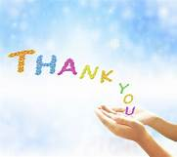
Sorry it is not a brain storming information and I couldn’t digest well the book and the mathematical principles behind
Randomness,
Uncertainty,
Probability
Fragility,
Black swan in realty could happen to use in our daily personal life, careers, and investments.
BUT

