Slide 1
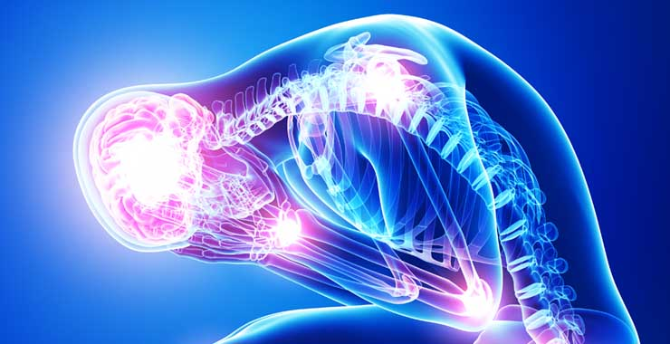
Managing Stress and Anxiety
February 11, 2025

Slide 2
Our objective today is to listen to learn about the “Stress and Anxiety” and take effective notes based on the presented material.
We will ask you to evaluate this information and to respond to these questions:
How can we improve upon the presentation to be more helpful to college students?
How can we improve upon the presentation to make it more informative to college students?
Have we responded to other questions you may have regarding identifying stress and anxiety, and healthy ways of treating and managing stress and anxiety ?
What more would you recommend that we include?
In previous classes, students responded by sharing some of their observations and experiences regarding stress and anxiety.

Slide 3
QUESTIONS TO CONSIDER…
What are stress and anxiety? How are they different and how are they similar?
Who experiences stress and anxiety?
Who experiences it more than others?
Why do people experience stress and anxiety?
What external factors cause stress and anxiety?
What internal factors cause stress and anxiety?
What more can be done on the MC campus to help students’ reduce stress anxiety?
Where do people most often experience stress and anxiety?
When do people most often experience stress and anxiety?
How can people safely manage stress and anxiety?
How does one know when they need professional assistance?

Slide 4
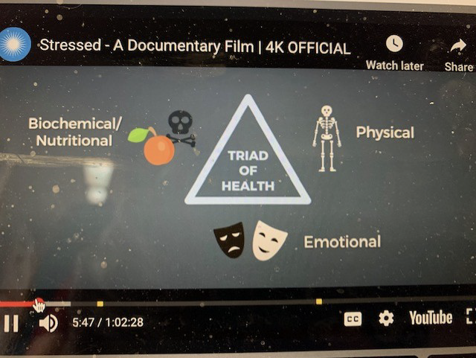
“Stressed-A Documentary Film (youtube)

Slide 5
Stress and Anxiety: What They Are and How to Cope with Them
Stress is any demand placed upon your brain or other parts of your physical body that makes you feel frustrated or nervous.
https://medlineplus.gov/stress.html
Anxiety is a feeling of fear, worry, or unease. It can occur as a reaction to stress, but can also happen without any obvious trigger.
https://medlineplus.gov/anxiety.html

Slide 6
Stress and Anxiety Are Not Always a Bad Thing
Most people experience stress and anxiety some of the time.
They can be a helpful motivator to accomplish tasks.
But unmanaged stress and anxiety can take a toll on your physical and mental health

Slide 7
What Are Some Symptoms of Stress?
dizziness feeling overwhelmed
muscle tension restlessness
digestive issues changes in appetite
trouble sleeping increased heart rate
anger or irritability difficulty focusing on a task
headaches
increased sweating
https://www.healthline.com/health/stress-and-anxiety#stress-vs-anxiety

Slide 8
What Are Some Symptoms of Anxiety?
The stress symptoms of feeling overwhelmed, increased heart rate, headaches, muscle tension, increased sweating, restlessness, changes in appetite, digestive issues, irritability, trouble sleeping, dizziness, difficulty focusing on a task, and anger, as well as:
a feeling of impending doom
tingling or numbness
brain fog
https://www.healthline.com/health/stress-and-anxiety#stress-vs-anxiety

Slide 9
Differences Between Stress and Anxiety
Stress is usually tied to a specific situation. Much of the time, once that situation is resolved, so is the stress.
However, stress can be chronic or long lasting, as in ongoing pressure from school, a demanding job, or family conflict.
While anxiety does not always have a specific stressor, it can be triggered by stress.
https://www.healthline.com/health/stress-and-anxiety#stress-vs-anxiety

Slide 10
Some Causes of Stress and Anxiety?
Starting a new school or job
Final examinations or job evaluation
Moving
Ending or beginning a relationship
Having an illness or injury
Having a family member who is ill or injured
Getting married
Having a baby
Long “to-do” list with deadlines

Slide 11
Types of Stress and Anxiety Relate Disorders
Generalized anxiety disorder
Panic disorder
Post traumatic stress disorder (PTSD)
Social anxiety disorder
Obsessive-compulsive disorder (OCD)
https://www.healthline.com/health/stress-and-anxiety#stress-vs-anxiety

Slide 12
Practice Self Care:
Ways to Cope with Stress and Anxiety
Eat a balanced diet Minimize processed foods
Limit phone use Limit screen time
Regular Exercise Limit caffeine and alcohol
Yoga Journaling—keep a diary
Meditation Self Affirmations
Breathing exercises Read a good book for enjoyment
Walk outside Getting enough sleep
Make time for joyful activities Spend time with family, friends, pets
Counseling Open up to loved ones about how you feel
https://www.healthline.com/health/stress-and-anxiety#stress-vs-anxiety

Slide 13
When To Seek Help and Where To Go
When to Seek Help:
Whenever you feel hopeless
When you stop going to classes or doing your homework
When you think about hurting yourself
Where to Go: The Maryville College Counseling Center, your doctor, trusted staff members, faculty members, resident assistants, family, friends.

Slide 14
Maryville College Counseling Center
Self Care Assessment Worksheet
Physical Self-Care
___ Eat regularly (e.g. breakfast, lunch and dinner)
___ Eat healthy
___ Exercise
___ Get regular medical care for prevention
___ Get medical care when needed
___ Take time off when needed
___ Get massages
___ Dance, swim, walk, run, play sports, or do some other physical activity that is fun
___ Take time to be sexual—with yourself, with a partner
___ Get enough sleep
___ Wear clothes you like
___ Take day trips or mini-vacations
___ Other:

Slide 15
Maryville College Counseling Center
Self Care Assessment Worksheet
Psychological Self-Care
___ Make time for self-reflection
___ Have your own personal psychotherapy
___ Write in a journal
___ Read literature that is unrelated to school
___ Let others know different aspects of you
___ Notice your inner experience—listen to your thoughts, judgments, beliefs, attitudes, and feelings
___ Engage your intelligence in a new area, e.g. go to an art museum, history exhibit, sports event, theater performance
___ Practice receiving from others
___ Be curious
___ Say “no” to extra responsibilities sometimes
___ Other:

Slide 16
Maryville College Counseling Center
Self Care Assessment Worksheet
Emotional Self-Care
Spend time with others whose company you enjoy
Stay in contact with important people in your life
Give yourself affirmations, praise yourself
Love yourself
Re-read favorite books, re-view favorite movies
Identify comforting activities, objects, people, relationships, places and seek them out
Allow yourself to cry
Find things that make you laugh
Express your outrage in social action, letters and donations, marches, protests
Play with children
Other:

Slide 17













Maryville College Counseling Center
Self Care Assessment Worksheet
i
Spiritual Self-Care
Make time for reflection
Spend time with nature
Find a spiritual connection or community
Be open to inspiration
Cherish your optimism and hope
Be aware of nonmaterial aspects of life
Try at times not to be in charge or the expert
Be open to not knowing
Identify what is meaningful to you and notice its place in your life
Have experiences of awe
Read inspirational literature (talks, music, etc.)
Other:

