Slide 1
Opioid Coalition
January 2025
Lori Miller, LCSW, Division Manager
Substance Use Prevention and Treatment
Department of Health Services

Slide 2
SNAPSHOT
Sacramento
County
Fentanyl Related Deaths

Slide 3
Sacramento County Coroner Data
Fentanyl Related Deaths By Year
404
215
226
52%
Source: Sac County Coroner’s Office
2024: 211 Deaths

Slide 4
Sacramento County Partnerships/Collaborations
Community Based Substance Use Prevention and Treatment Providers
Advisory Boards
Homeless Advocacy Groups
Harm Reduction Providers
Coroner’s Office
Public Health
Behavioral Health
Correctional Health
Jails
Justice partners (Courts, DA, PD, Probation)
Law Enforcement (SSO, Police, US Attorney’s Office, DEA)
Child, Family and Adult Services
Opioid, Meth, Youth Coalitions
Sierra Sacramento Valley Medical Society
School Districts
Sacramento State University
Hospitals
Substance Use Navigators
Grieving Families
DHCS-Naloxone Distribution Program
Sac Metro Fire
Sacramento Fire Department

Slide 5
Educational multimedia resources to guide individuals to make healthy choices and to avoid or reduce the potential harm from the use or misuse of alcohol, tobacco, marijuana, and other substances.
https://www.safersacramento.com/

Slide 8
Youth Social Media Project
Mental Health
Substance Use
Wellness

Slide 9
Promotes a healthy and safe environment for Sacramento County’s families and children through outreach and education for professionals and community members, addressing perinatal substance use prevention and intervention.
https://sachealthybeginnings.com/

Slide 10
Improved Access to Behavioral Health Services New Call Center

Slide 11
Notes:
Opiates – Fentanyl, Morphine, Codeine, Hydrocodone, Oxycodone, Heroin, MAT services (Buprenorphine, Methadone, Naltrexone).

Slide 12
BHS-SAC
Phone:
916-875-1055; CA Relay 711
Toll Free:
888-881-4881
Fax:
916-875-1190
Hours:
24 Hour a Day, 365 Days a Year
Behavioral Health Services
Screening and Coordination (BHS-SAC)
Screening and referral to a
network service provider

Slide 13
How to Seek Behavioral Health Services
BHS
Jan 1, 2025
One Point of Entry

Slide 14
BHS-SAC – Services Offered
Screening for Mental Health and Substance Use Services
Mental Health and Substance Use Outpatient Treatment
Residential Treatment
Recovery Residences/Sober Living Environments
Care Coordination
Crisis Intervention
Medication Support
Medication Assisted
Treatment
Therapy Rehabilitation
Services and Groups
Driving Under the Influence
Programs
Linkage to Community
Resources
Notes:
Change icons on right side

Slide 15
Treatment & Recovery Service Expansion What’s New?

Slide 16
Service Expansion
Detox/Withdrawal Management (WM)
Residential Treatment
Medication-Assisted Treatment (MAT)
Recovery Residences/Sober Living Environments

Slide 17
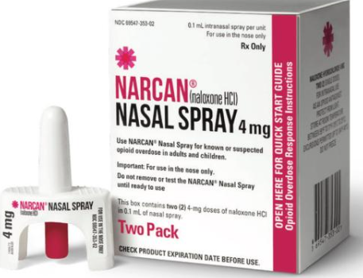
Correctional Health
Jail Services
Assessments - Group Counseling
Jail Inmate Tablet Project
MAT
Narcan
Vending
Machine
MEDICATION-ASSISTED TREATMENT

Slide 18
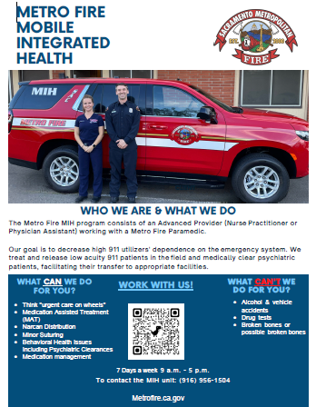
Mobile Medicine Teams

Slide 19
Narcan Distribution
Countywide Narcan Distribution Program
Opioid Coalition
Website: www.Sacopioidcoalition.org
Narcan Vending Machine
Main Jail
DHCS Naloxone Distribution project

Slide 20
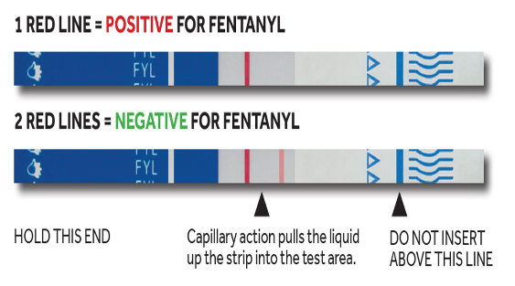
Fentanyl Test Strips
What are fentanyl test strips?
Fentanyl test strips are small strips of paper that can detect the presence of fentanyl in different drugs (such as cocaine, methamphetamine, and heroin) and drug forms (pills, powder, and injectables).
Sacramento County and DHCS Provide Free Fentanyl Test Strips
The newest initiative from the Substance Use Prevention and Treatment (SUPT) team is Safer Sacramento. The website speaks to issues with all the trending substances, free Narcan and Fentanyl test strips, processing grief, a grief support group, a page for youth, and a page for reaching out to diverse communities. For more information, visit: www.SaferSacramento.com
To request free fentanyl test strips, complete the online application located on the DHCS website. The application includes instructions, as well as terms and conditions of receiving fentanyl test strips from DHCS.
Notes:
They are a harm reduction strategy designed to reduce the negative consequences of drug use, including the risk of fatal and nonfatal overdose. This Fentanyl Test Strips to Prevent Overdose fact sheet (Fact Sheet: Fentanyl Testing to Prevent Overdose - Information for People Who Use Drugs and Healthcare Providers) contains additional information about Fentanyl Test Strips.

Slide 21
Sacramento County
Alcohol & Drug Advisory Board
}
Sacramento County
Board of Supervisors
Ryan Quist, Ph.D.,
Behavioral Health Director
Alcohol & Drug Administrator
HAVE YOUR VOICE HEARD
JOIN
MONTHLY MEETINGS
Lori Miller, LCSW
Division Manager
Substance Use Prevention and Treatment
Committees
Budget Planning and Evaluation
Criminal Justice
Executive
Membership
Prevention and Education
Treatment
https://dhs.saccounty.gov/BHS/Pages/Advisory-Boards-Committees/Alcohol-and-Drug-Advisory-Board/BC-Alcohol-and-Drug-Advisory-Board.aspx
GET INVOLVED

Slide 22
CALL TO ACTION
MAKE A DIFFERENCE
SAVE A LIFE
START THE CONVERSATION
TALK TO YOUR FAMILY, FRIENDS, AND NEIGHBORS ABOUT THE DANGER
HAVE NARCAN® AVAILABLE
KNOW THE FACTS
REACH OUT FOR HELP
KNOW RESOURCES AND WHERE TO GET HELP
ONLY TAKE MEDICATION AS PRESCRIBED
DO NOT SHARE MEDICATION OR TAKE MEDS NOT PRESCRIBED TO YOU

Slide 23
Questions?
Substance Use Prevention and Treatment (SUPT)
Main Line: (916) 875-2050
Pamela Hawkins, LCSW, Health Program Manager
Office Phone (916) 875-9850
Cell Phone (916) 639-0588
hawkinsp@saccounty.gov
Lori Miller, LCSW, Division Manager
Office Phone (916) 875-2046
MillerLori@saccounty.gov
System of Care for SUPT: (916) 874-9754 or (888) 881-4881

Slide 24
Thank You!

