Slide 1
AI Intelligence: Unleashing the Power of Smart Machines

Slide 2
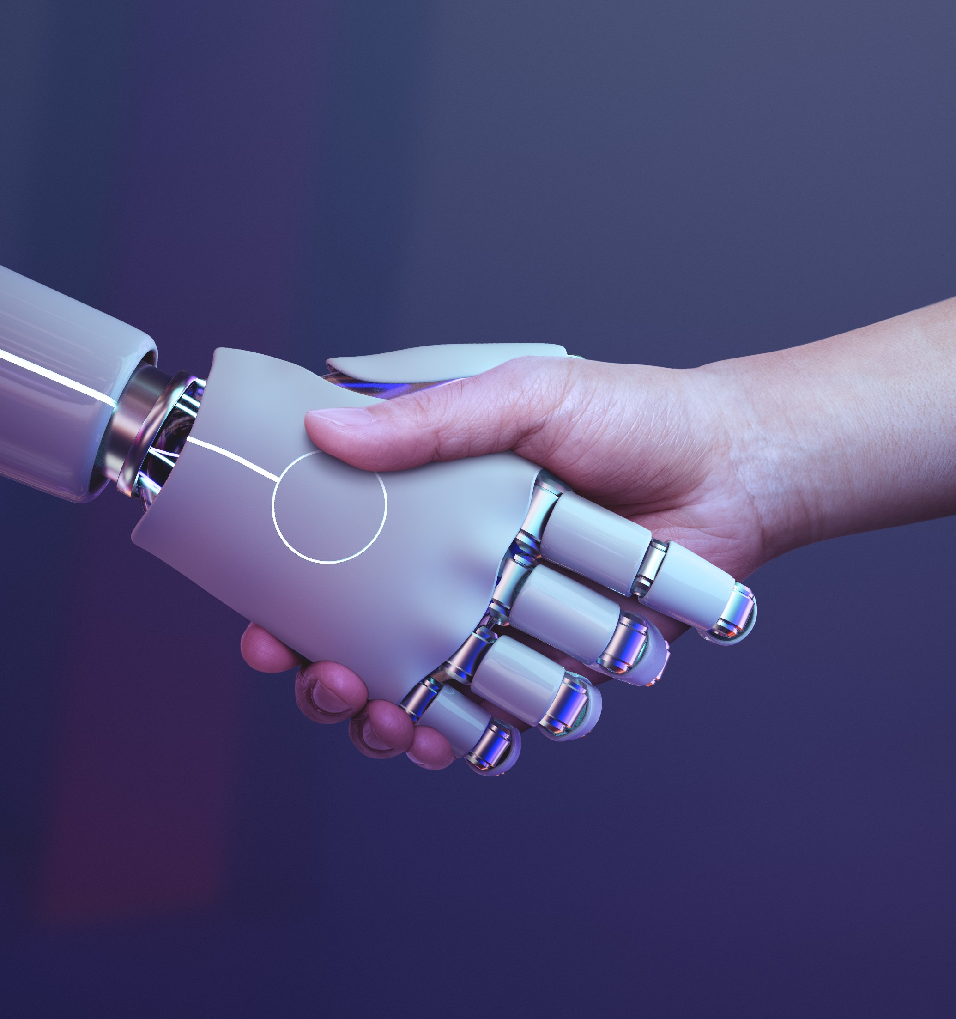
Welcome to AI Intelligence
Get ready to dive into the world of smart machines and their incredible capabilities. Let's explore how is reshaping our world.

Slide 3
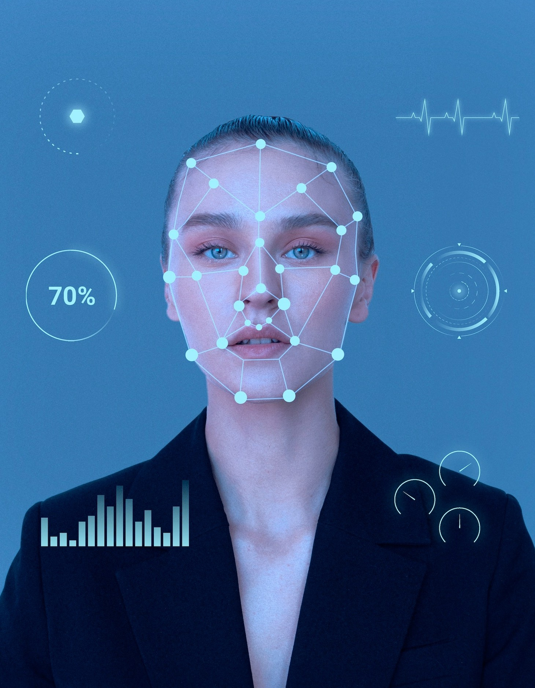
Understanding AI
AI, or Artificial Intelligence, refers to the simulation of human intelligence in machines. It involves , natural language processing, and more.

Slide 4
AI in Everyday Life
From virtual assistants like and
to personalized recommendations on streaming platforms, AI is already deeply integrated into our daily routines.

Slide 5
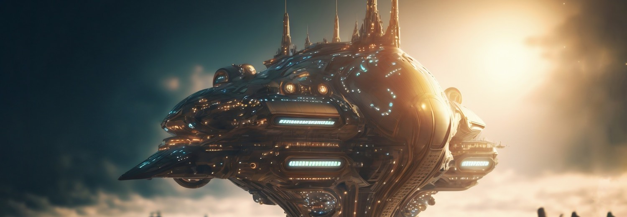
As AI continues to advance, it holds the potential to revolutionize industries such as healthcare, transportation, and . The possibilities are endless.

Slide 6
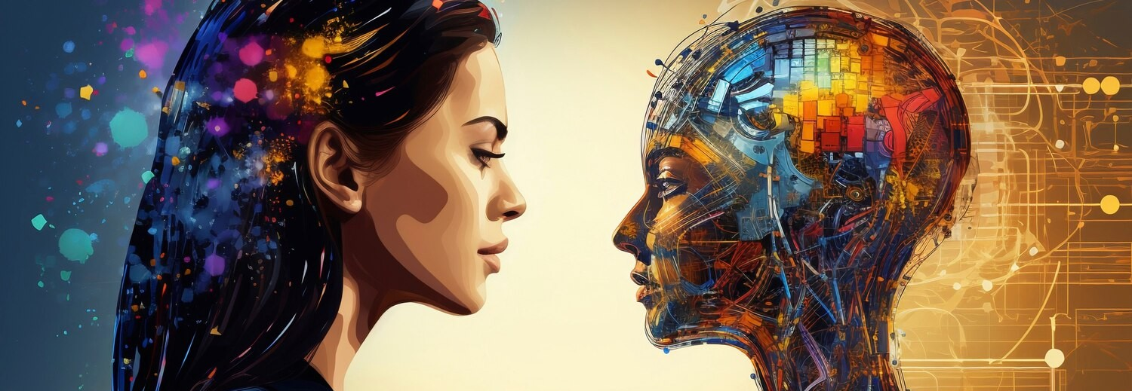
With great power comes great responsibility. We must carefully consider the of AI, including privacy, bias, and job displacement.

Slide 7
AI and Human Collaboration
Rather than replacing humans, AI can enhance our capabilities and free us from mundane tasks, allowing for more
pursuits.

Slide 8
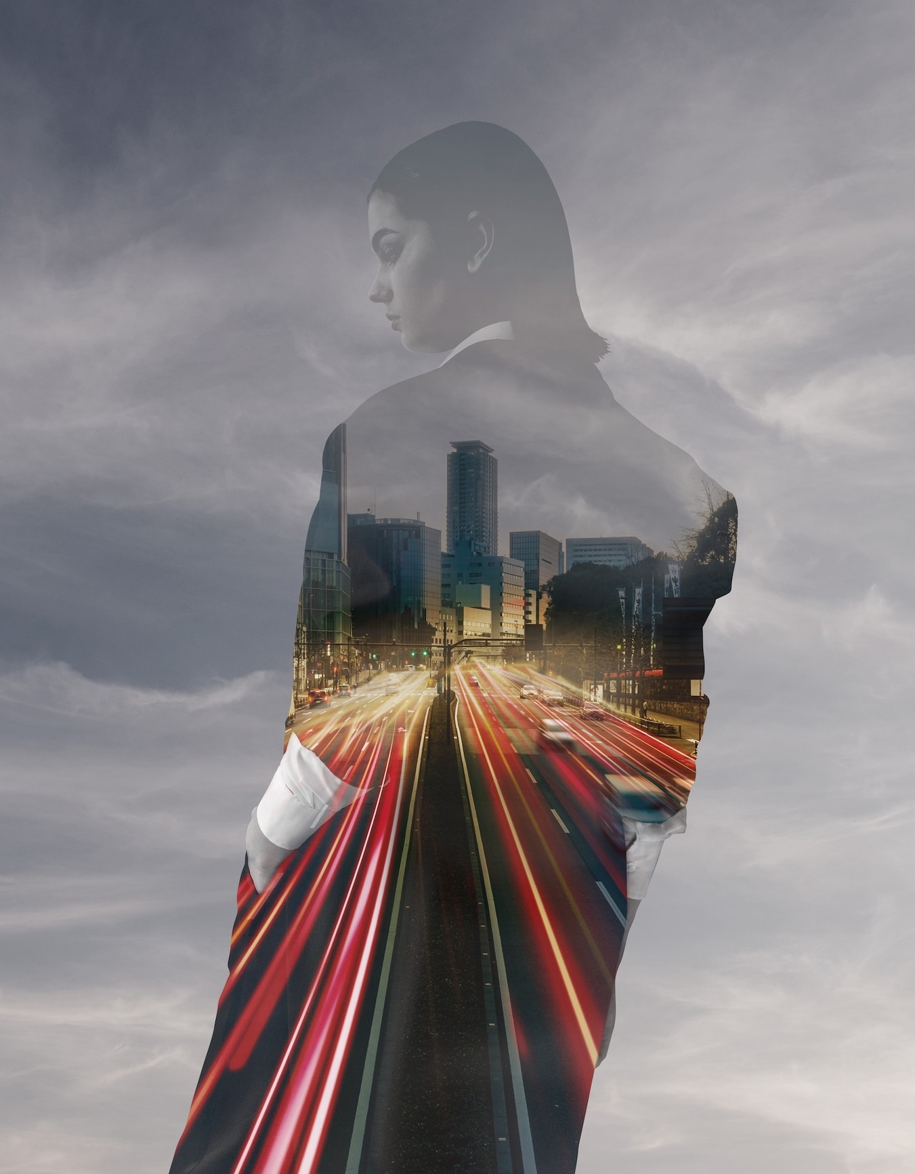
Embracing the AI Revolution
The AI revolution is already underway, and it's essential to embrace it with an open mind. Let's harness the power of AI to create a brighter future for all.

Slide 9



