Slide 1
Introduction to Slidework
Slidework is the backbone of any effective presentation, providing structure and clarity to the content. It involves crafting engaging slides that complement the speaker's message and visuals that resonate with the audience.
by Dhyan Raiyani
Da

Slide 2
Importance of Effective Slides in Presentations
Effective slides are crucial for capturing and maintaining audience attention during presentations.
Well-crafted slides enhance message comprehension and retention, contributing to the overall impact of the presentation.

Slide 3
Elements of a well-designed slide
Clear and concise content: Utilize short, impactful phrases to communicate key points effectively.
Visual hierarchy: Use size, color, and position to guide the viewer's attention.
Appropriate font choices: Select fonts that are easy to read and complement the overall design.

Slide 4
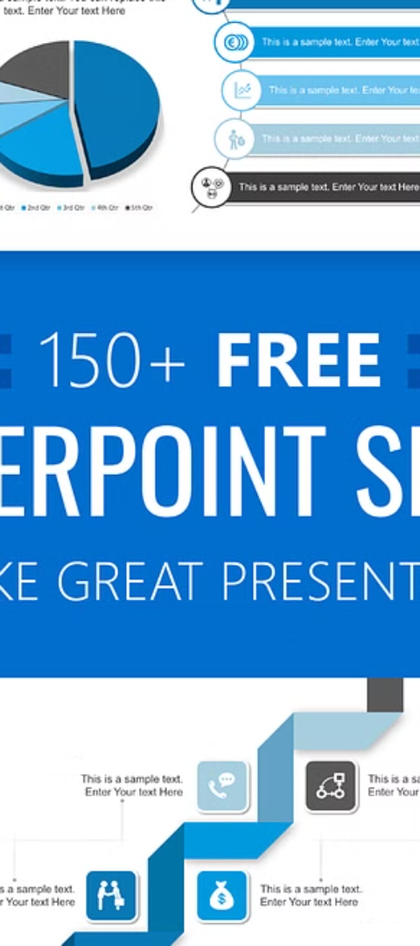
Tips for creating visually appealing slides
1
Use High-Quality Images
Include clear, high-resolution images that enhance the visual appeal of the slide.
2
Consistent Color Scheme
Choose a cohesive color palette to maintain visual harmony throughout the presentation.
3
Balance Visual Elements
Ensure a balanced distribution of text, images, and other visual components on each slide.

Slide 5
Best practices for organizing content on slides
Clear Structure
Visual Hierarchy
Consistent Formatting
Organize content logically to guide the audience through the information.
Utilize font size, color, and placement to prioritize important details.
Maintain uniformity in font, color, and spacing for a cohesive look.
Use headings and bullet points to emphasize key points.
Ensure that the audience's attention is directed where it's needed.
Consistency promotes professionalism and aids comprehension.

Slide 6
Using charts and graphs to convey data
Charts and graphs are valuable tools for visually representing complex data sets. They help in presenting trends, comparisons, and relationships in a clear and concise manner. Utilizing visuals like bar graphs, pie charts, and line graphs can aid in conveying key insights to the audience.
Integrating visual data representations can enhance the audience's understanding and retention of information, making the presentation more impactful and engaging.

Slide 7
Incorporating images and multimedia in slides
Nature's Beauty
Cultural Expression
Data Visualization
Stunning images of natural landscapes captivate and inspire the audience.
Multimedia showcasing traditional dances adds a dynamic touch to presentations.
Using infographics and charts helps convey complex information in an engaging way.

Slide 8
Dos and don'ts of slide transitions and animations
Smooth Transitions
Simple Animations
Consistent Transitions
Use subtle transitions to enhance flow without distracting.
Avoid overuse of animations, keep them simple and purposeful.
Keep transition styles consistent across all slides for coherence.

Slide 9
Common Mistakes in Slidework
Overloading with Text
Ignoring Visual Hierarchy
Avoid overwhelming slides with excessive text. Use bullet points and concise phrases.
Ensure important information stands out. Use size, color, and placement to guide focus.
Complex Charts and Graphs
Overusing Transitions
Avoid excessively intricate data visuals. Simplify for quick comprehension.
Avoid distracting transitions. Use them sparingly and purposefully.

Slide 10
Conclusion and key takeaways
Clear messages
Visual appeal
Effective slides convey clear and concise messages to the audience.
Images and multimedia enhance engagement and visual appeal.
Organized content
Avoiding distractions
Well-organized content improves understanding and retention.
Minimize distractions with simple and clean slide designs.

