Slide 1

Introduction to Engineering
Engineering is the application of scientific knowledge and mathematical methods to practical purposes of the design, construction, and operation of efficient and economical structures, machines, processes, and systems. It involves innovation, problem-solving, and critical thinking to create solutions that address real-world challenges.
By Dhyan Raiyani

Slide 2
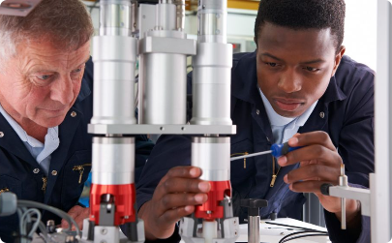
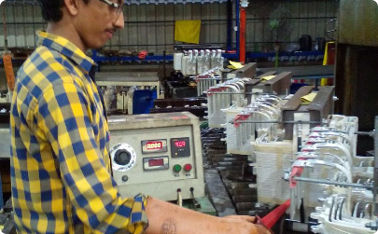
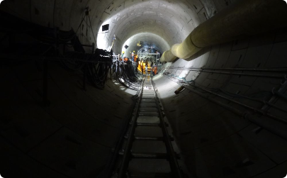
Different Branches of Engineering
Mechanical Engineering
Electrical Engineering
Civil Engineering
Electrical engineers design, develop, and test electrical devices, such as electric motors, radar and navigation systems, communications systems, or power generation equipment.
Civil engineers design, build, supervise, operate, and maintain construction projects and systems in the public and private sector, including roads, buildings, airports, tunnels, dams, bridges, and systems for water supply and sewage treatment.
Mechanical engineers design, develop, build, and test mechanical and thermal sensors and devices, including tools, engines, and machines.

Slide 3

Importance of Engineering in Society
1
Improving Quality of Life
Engineering innovations enhance people's lives by providing solutions to societal challenges, such as clean water, sustainable energy, and advanced healthcare technologies.
2
Economic Development
Engineering drives economic growth by creating jobs, fostering innovation, and developing infrastructure essential for commerce, trade, and industry.
3
Addressing Global Challenges
Engineers play a vital role in tackling global issues, including climate change, environmental sustainability, and urbanization, by developing sustainable solutions and technologies.

Slide 4
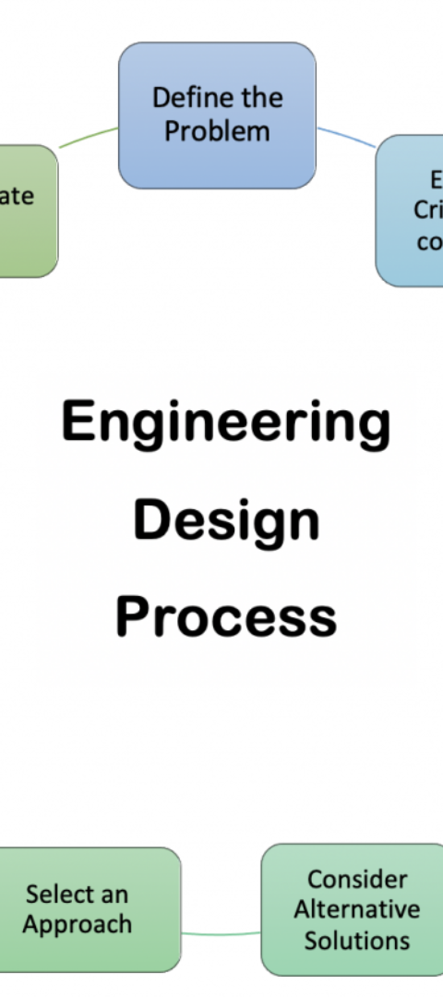
The Engineering Design Process
Define the Problem
Develop Solutions
Identify and understand the issue to be solved or the improvement to be made.
Brainstorm and analyze potential ideas to address the problem effectively.
Implement and Test
Create the solution and rigorously test it to ensure functionality and safety.

Slide 5
Tools and Technologies Used in Engineering
Computer-Aided Design (CAD)
3D Printing
Artificial Intelligence (AI)
3D printing technology is used to create prototypes, models, and production parts.
CAD software is used to create, modify, analyze, and optimize designs.
AI and machine learning algorithms are applied to automate various engineering tasks and optimize processes.

Slide 6

Case Studies of Successful Engineering Projects
1
Space Exploration
2
Green Energy Solutions
Engineering has enabled human space exploration, including the design and construction of spacecraft and space stations.
Engineers have developed innovative renewable energy technologies to address environmental concerns and reduce reliance on fossil fuels.
3
Urban Infrastructure Development
Successful engineering projects have transformed urban landscapes with efficient transportation systems and sustainable infrastructure.

Slide 7




Challenges Faced by Engineers
Complex Problem Solving
Addressing intricate and multifaceted challenges demands sophisticated problem-solving skills and innovative thinking.
Ethical Considerations
Engineers encounter ethical dilemmas related to safety, environmental impact, and social responsibility.
Rapid Technological Advancements
Keeping pace with rapidly evolving technologies requires continuous learning and adaptation.

Slide 8


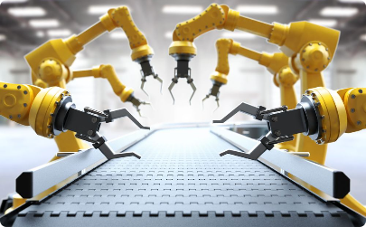
Future of Engineering
Technological Advancements
Smart Urbanization
Automation and Robotics
Engineers will play a key role in developing smart cities with efficient infrastructure and sustainable living solutions.
Engineering is poised to embrace AI, advanced materials, and sustainable technologies to shape the future.
Automation and robotics will revolutionize industries, requiring engineering expertise for implementation and management.

Slide 9
Career Opportunities in Engineering
Research & Development
Consulting and Advisory
Entrepreneurship
Many engineers leverage their skills to start innovative ventures and bring new technologies to market.
Engineers are involved in groundbreaking research and development projects across various fields.
Engineers provide expert consulting services, offering insights and solutions to diverse industry challenges.

Slide 10
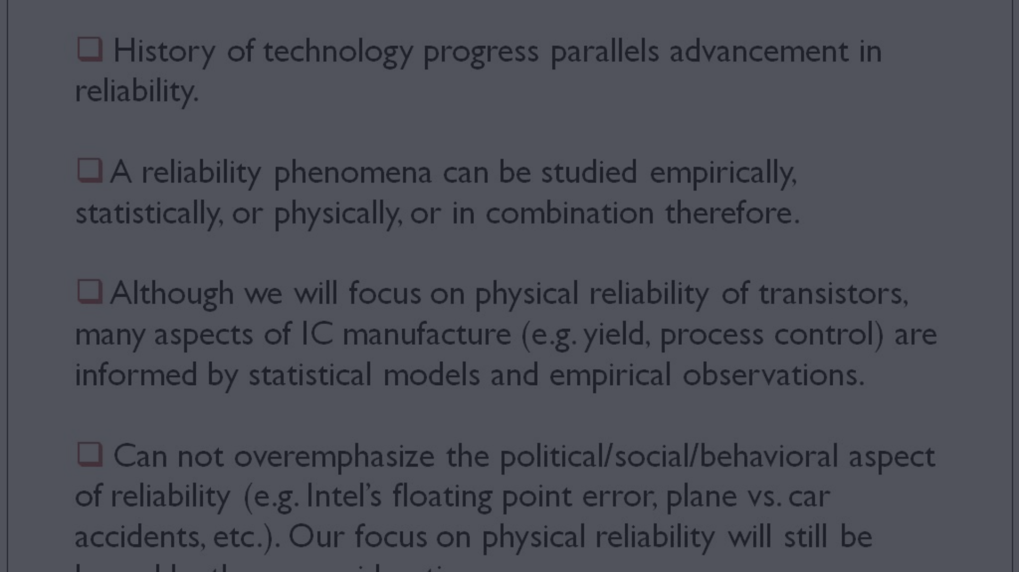
Conclusion and Key Takeaways
Continuous Innovation
Global Impact
Lifelong Learning
Engineers have a significant impact on global sustainability, economic progress, and social well-being.
Success in engineering demands a commitment to lifelong learning and professional development.
Engineering is a continuous cycle of innovation, and it drives advancements in every facet of modern life.

