Slide 1
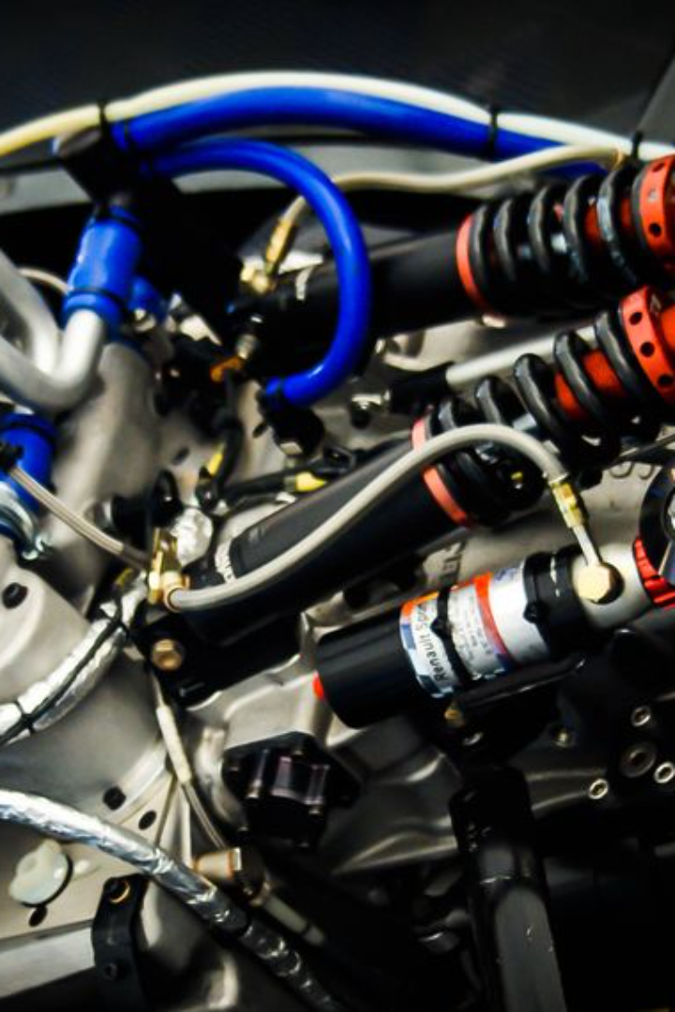
Introduction to Engines
Engines play a pivotal role in powering various types of machinery, providing the necessary energy for them to operate. From automobiles to power generators, engines come in various types and have different components and working principles, making them essential to modern society. This presentation will provide an in-depth exploration of the different types of engines, their components, and their unique characteristics.

Slide 2
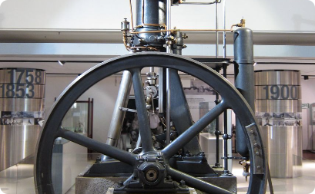
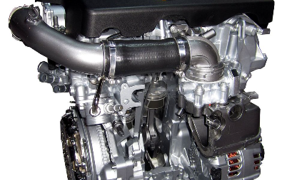
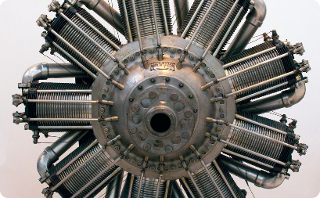
Types of Engines
Diesel Engines
Gasoline Engines
Rotary Engines
Diesel engines are known for their superior fuel efficiency and are widely used in heavy-duty applications such as trucks, buses, and industrial machinery. They operate on the principle of compression ignition, making them ideal for long-haul transportation and heavy-duty tasks.
Gasoline engines, also known as petrol engines, are commonly used in passenger cars and small vehicles. They work on the principle of spark ignition and offer a good balance between power output and fuel efficiency, making them suitable for everyday transportation.
Rotary engines, also known as Wankel engines, have a unique rotary design that provides a smoother operation and higher power-to-weight ratio. While not as common as other types, they are known for their high-revving capabilities and compact size.

Slide 3
Internal Combustion Engines
1
Efficient Power Generation
2
Wide Application Range
3
Evolving Technology
Modern advancements in internal combustion engine technology focus on enhancing efficiency, reducing emissions, and exploring alternative fuel sources, ensuring their relevance in the future.
Internal combustion engines convert the energy released from burning fuel into mechanical energy, providing a reliable and efficient power source for various applications.
These engines are widely used in automobiles, aircraft, boats, and various industrial machinery, showcasing their versatility and adaptability to different tasks.

Slide 4
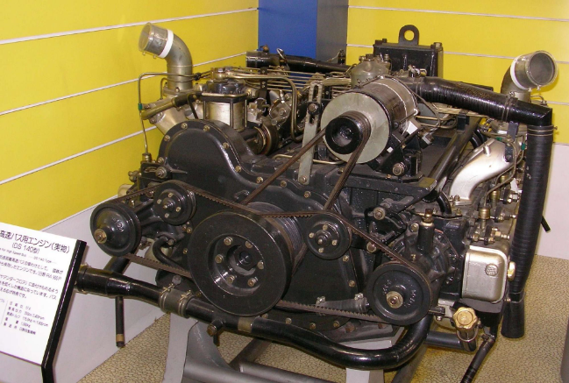
Diesel Engines
Advantages
Challenges
Diesel engines offer higher torque, better fuel economy, and longer lifespan compared to gasoline engines, making them ideal for heavy-duty applications.
They tend to produce more nitrogen oxide emissions and require more complex emissions control systems to meet environmental regulations.

Slide 5
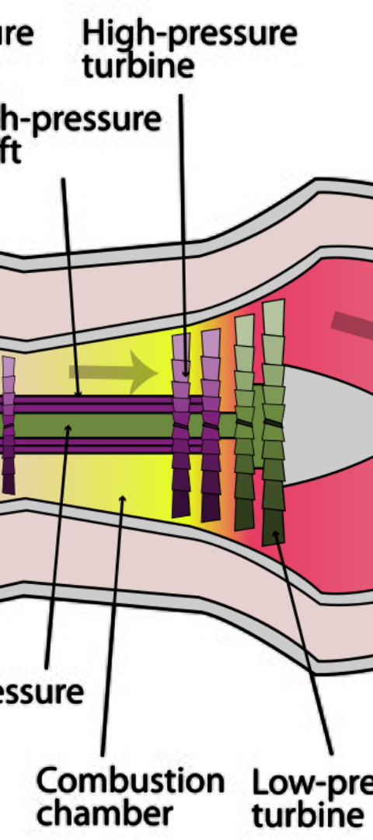
Gasoline Engines
1
Spark Ignition
Gasoline engines utilize spark plugs to ignite the fuel-air mixture, leading to smooth and controlled combustion within the cylinders.
2
Environmental Concerns
One primary challenge facing gasoline engines is the management of emissions and the transition towards greener fuel alternatives.
3
Performance Evolution
Continuous developments in engineering and technology aim to improve the power output and efficiency of gasoline engines while minimizing their environmental impact.

Slide 6
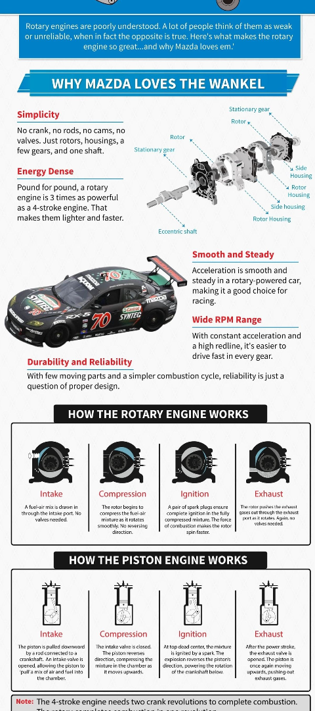



Rotary Engines
Compact Design
Rotary engines have a unique and compact design, with fewer moving parts compared to traditional piston engines, leading to smoother operation and reduced vibration.
High Revving Abilities
The rotary design allows for high-revving capabilities, providing an exhilarating driving experience in sports cars and performance-oriented vehicles.
Challenges and Innovations
Addressing the challenges of oil consumption and emissions is a key focus for further innovation in rotary engine technology.

Slide 7
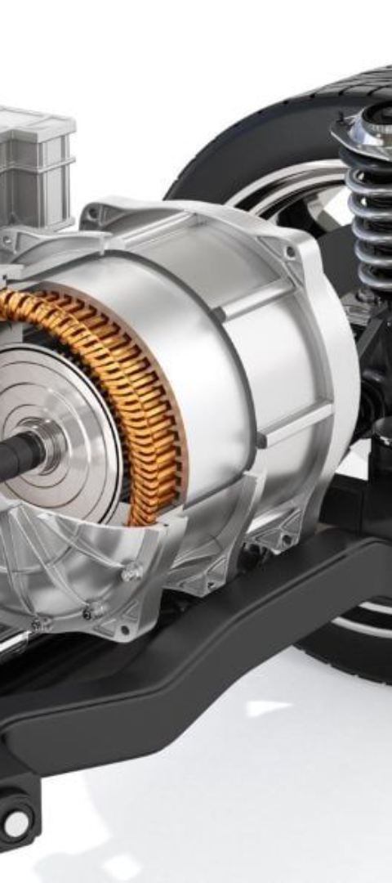
Electric Engines
Environmental Sustainability
Quiet Operation
Electric engines are powered by electricity, which can be sourced from renewable energy, promoting eco-friendly transportation and machinery.
They offer extremely quiet operation, minimizing noise pollution in urban environments and providing a more serene user experience.
Range and Charging Infrastructure
Advancements in battery technology and charging infrastructure are continuously improving the range and convenience of electric engines, making them more practical for everyday use.

Slide 8
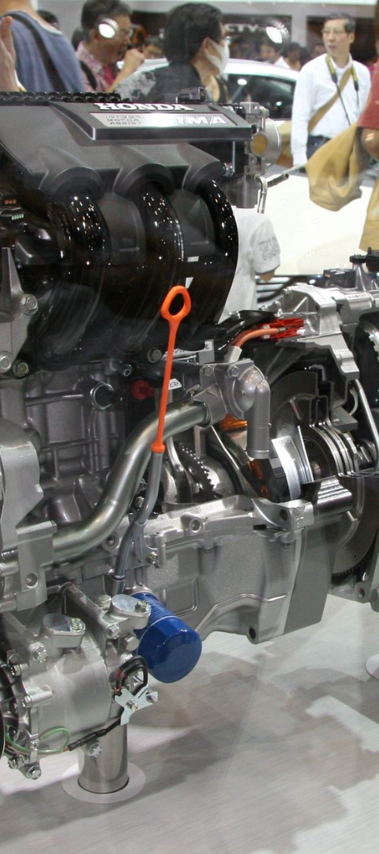
Hybrid Engines
1
Combining Power Sources
2
Fuel Efficiency and Emissions
Hybrid engines integrate the benefits of internal combustion and electric propulsion, offering an efficient and versatile powertrain solution.
They provide improved fuel economy and reduced emissions compared to traditional internal combustion engines, contributing to environmental conservation.
3
Technological Advancements
Ongoing developments focus on optimizing the integration of internal combustion and electric systems, aiming for a seamless and balanced power delivery.

Slide 9
Engine Components
Key Elements
Auxiliary Components
Fuel Injection Systems
Cooling and Lubrication Systems
Cylinder Block and Pistons
Engine Control Units
Valvetrain Mechanism
Exhaust Systems

Slide 10
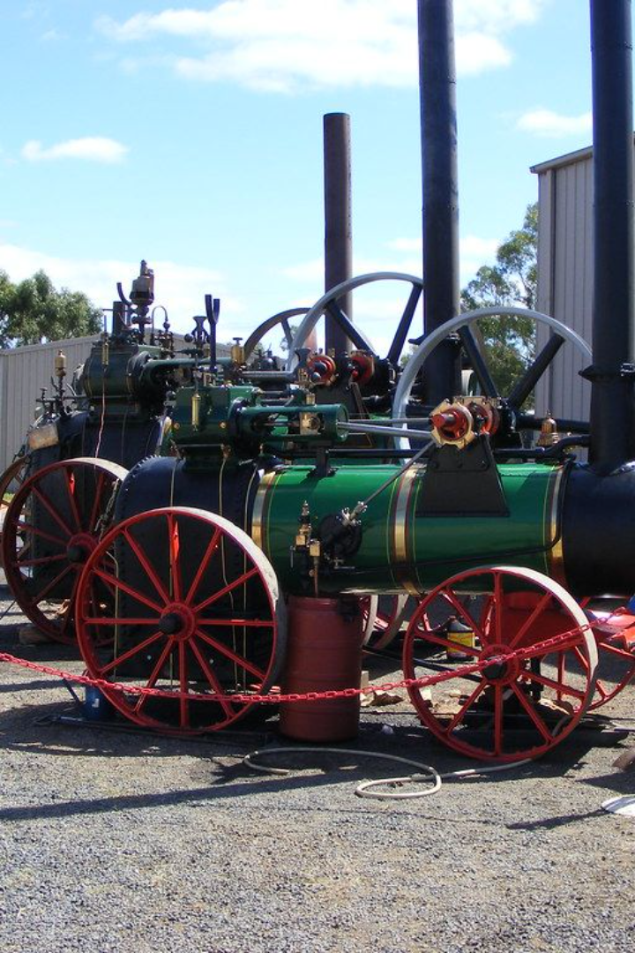
Conclusion
The diverse world of engines offers a fascinating blend of technological innovation, environmental sustainability, and efficient power generation. Understanding the distinctions between different types of engines and their components is essential for making informed decisions in various industries, from transportation to energy production. As advancements continue to shape the future of engine technology, the potential for cleaner, more powerful, and more efficient engines is an exciting prospect.

