Slide 1

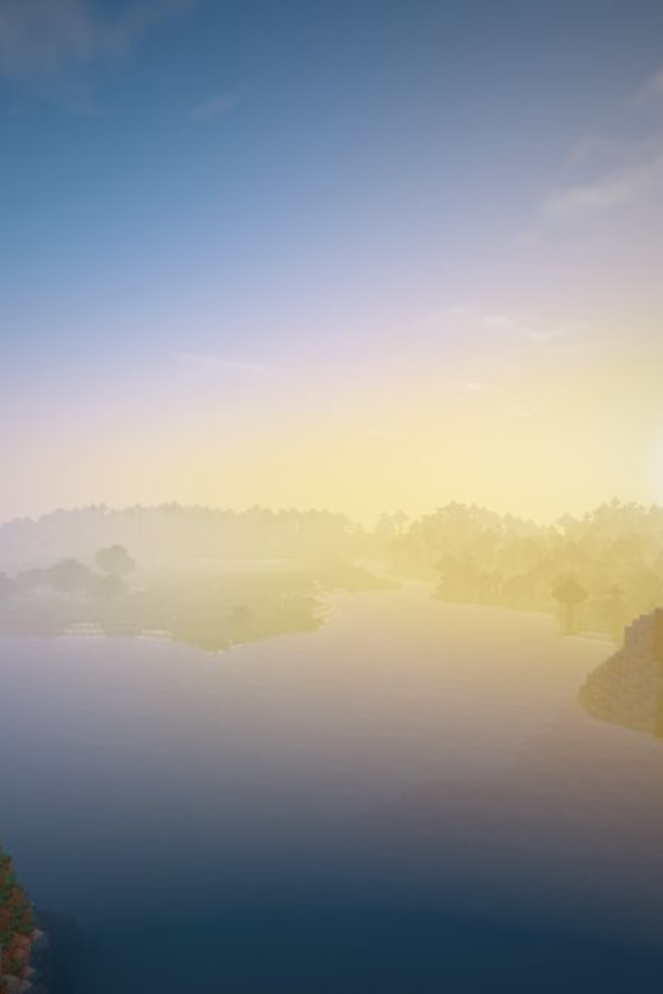
Introduction to Minecraft
Minecraft is a sandbox video game that allows players to build and explore virtual worlds made up of blocks. It offers endless creative possibilities and has gained immense popularity worldwide.
By Denil garach & Het bandhiya

Slide 2
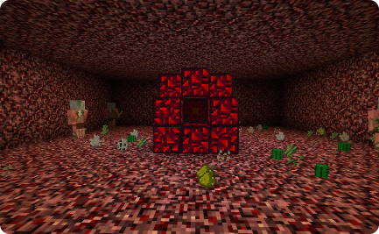
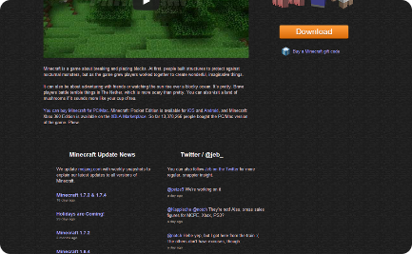
History of Minecraft
Early Development
Official Release
Dedicated Community
Minecraft was created by Markus Persson and released to the public in 2009. It initially had a small but dedicated fanbase and steadily grew in popularity.
In 2011, Minecraft had its official full release. It has since become one of the best-selling video games of all time, with millions of active players.
Minecraft has a dedicated community that has contributed to its success through mods, server hosting, and community events.

Slide 3
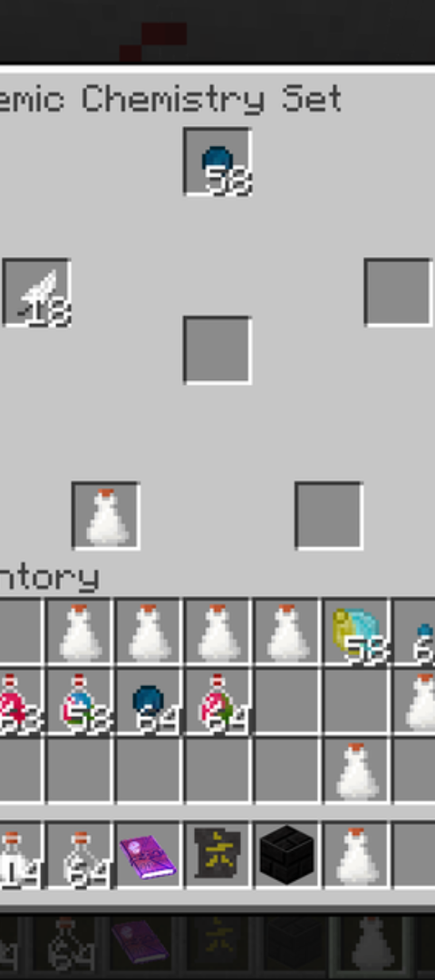
Gameplay mechanics
Survival and Creative Modes
Crafting and Smelting
Minecraft offers both survival mode, where players must acquire resources and maintain their health, and creative mode, where players have unlimited resources to build with.
Players can craft a variety of items using the game's crafting system, and smelt raw materials to create useful tools and items.
Combat and Monsters
Players can engage in combat with various hostile creatures such as zombies, skeletons, and creepers, adding an element of challenge to the game.

Slide 4
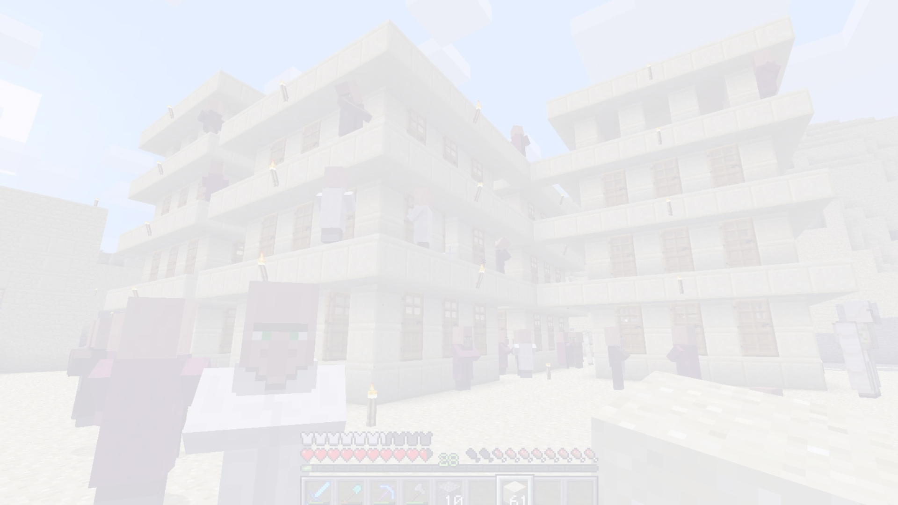
Building and crafting
1
Gathering Resources
Players gather resources by mining blocks and can then use these resources to craft tools, build structures, and create elaborate designs.
2
Architectural Creations
Minecraft allows players to construct intricate buildings, monuments, and entire cities using their creativity and imagination.
3
Redstone Engineering
Redstone, a material in the game, can be used to create complex automated structures, machinery, and circuitry, emphasizing the game's engineering aspects.

Slide 5
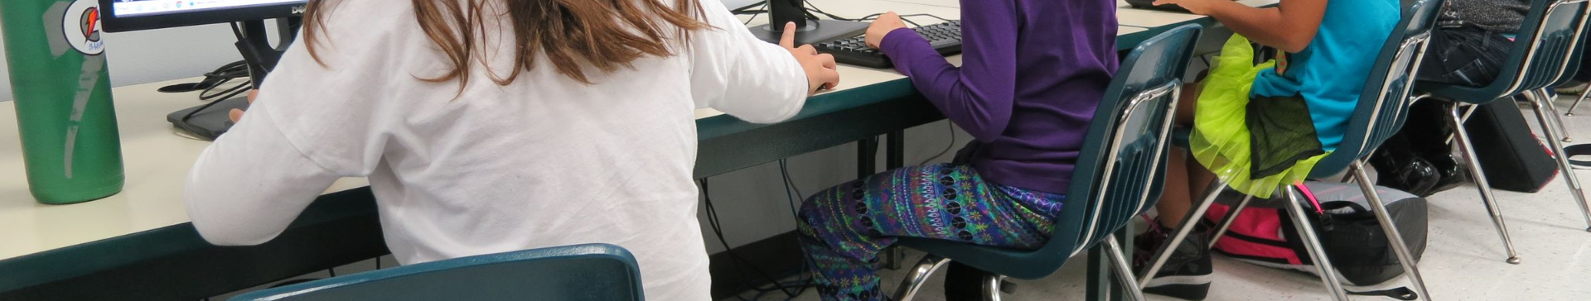
Exploration and survival
1
World Exploration
2
Day-Night Cycle
3
Food and Farming
Players can explore vast, procedurally generated worlds filled with diverse biomes, caves, and hidden structures to discover.
The game features a day-night cycle, with survival challenges escalating during the night due to the emergence of hostile mobs.
Survival is maintained through food acquisition and farming, adding a crucial element of sustainability and self-sufficiency to the game.

Slide 6
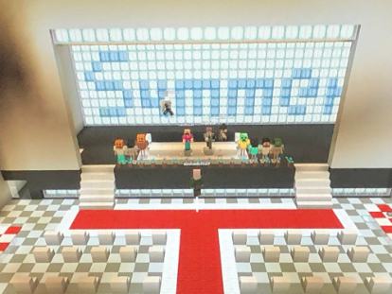
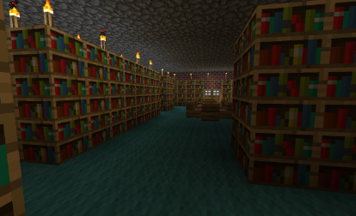
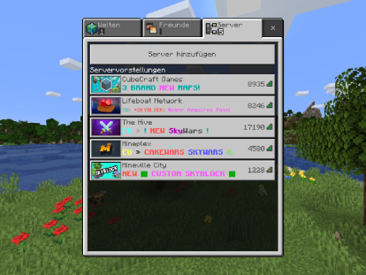
Multiplayer and community
Online Multiplayer
Community Servers
Creative Collaboration
Minecraft provides extensive multiplayer options, allowing players to collaborate, compete, and interact with others in shared virtual worlds.
A diverse community of server hosts and modders offer a multitude of player-run servers, custom game modes, and social experiences.
Communities come together to work on ambitious construction projects, mini-games, and creative endeavors within the game.

Slide 7
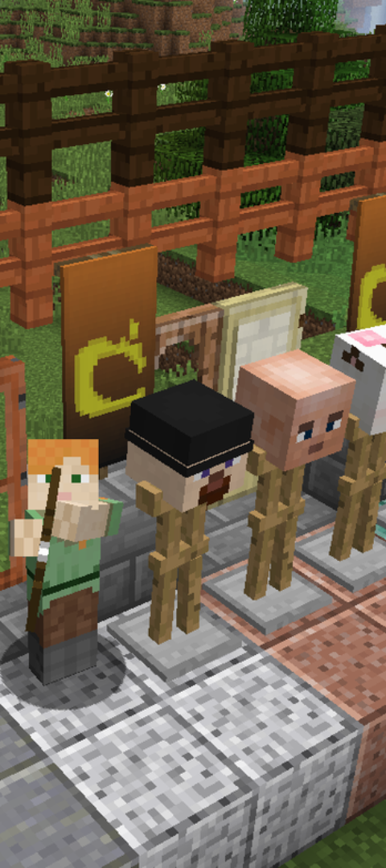



Updates and expansions
Regular Updates
Minecraft receives frequent updates, introducing new features, blocks, creatures, and mechanics, keeping the gameplay fresh and exciting.
Expansion Packs
Expansion packs add significant content updates, enhancing gameplay with new adventures, challenges, and storytelling elements.
Community Feedback
The development team actively listens to the community's feedback, often incorporating player suggestions and ideas into the game's updates.

Slide 8
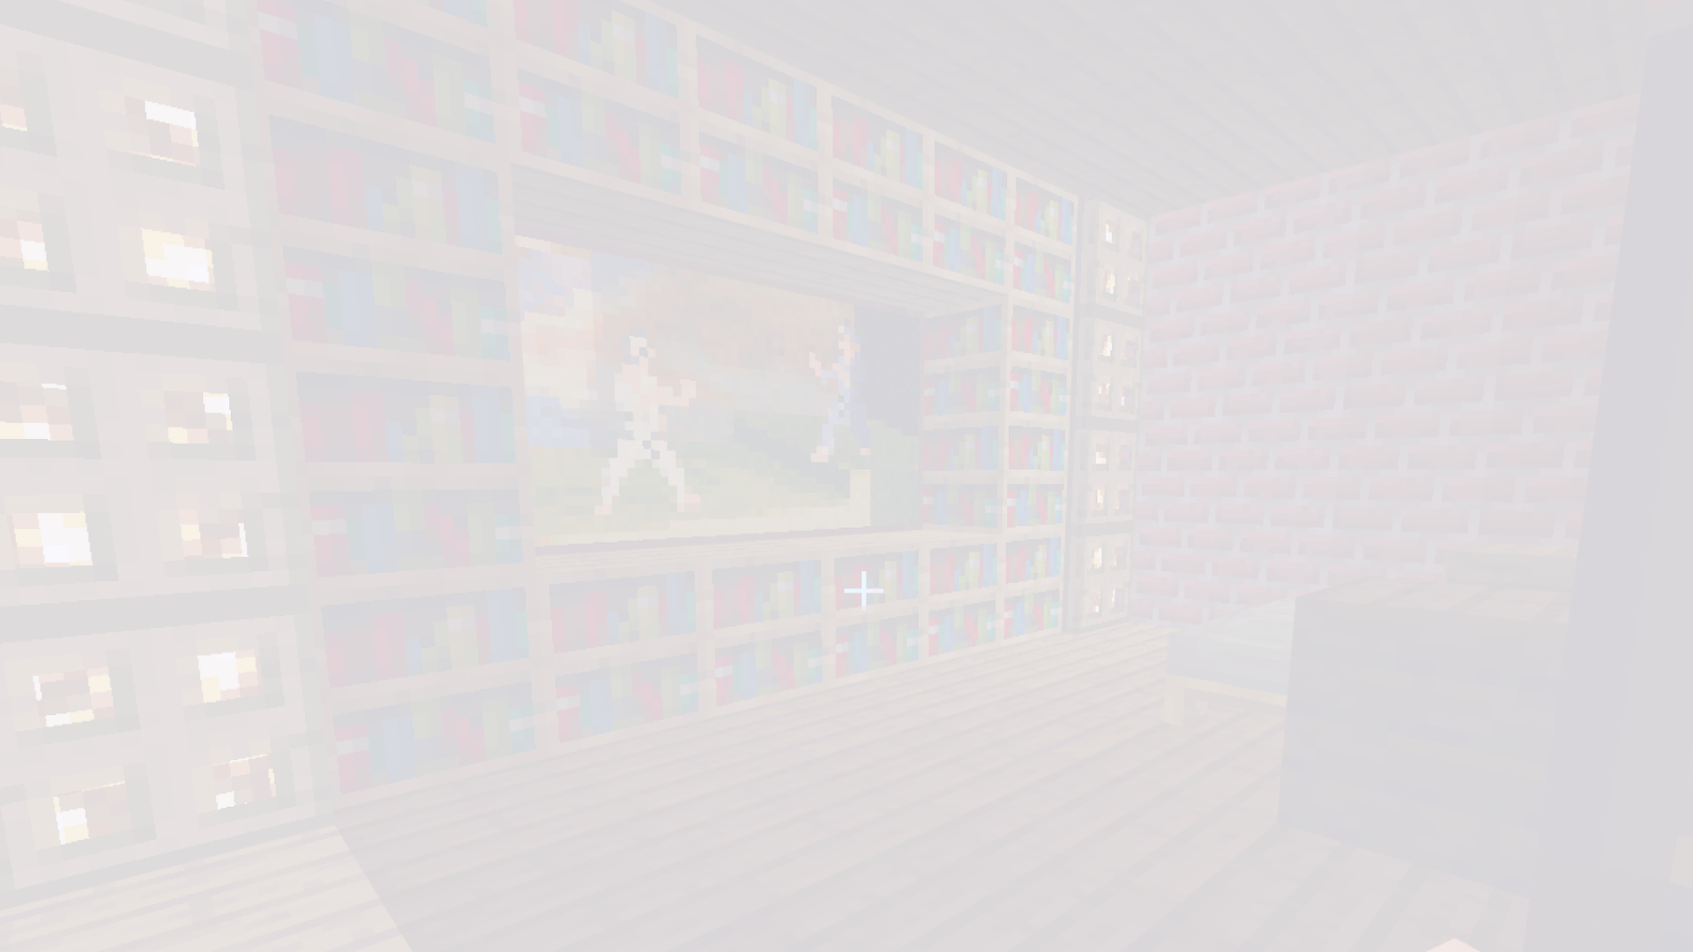
Educational benefits of Minecraft
Creative Expression
STEM Learning
Team Collaboration
Minecraft fosters creativity, problem-solving, and spatial awareness, making it a valuable tool for educational settings and child development.
The game encourages learning in science, technology, engineering, and mathematics through its architectural, redstone, and world-building mechanics.
It promotes teamwork, collaboration, and communication skills as students work together on complex projects and challenges.

Slide 9
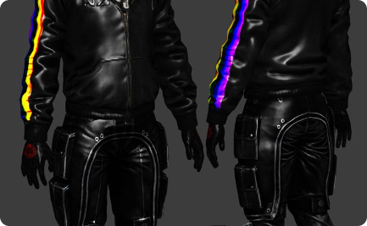
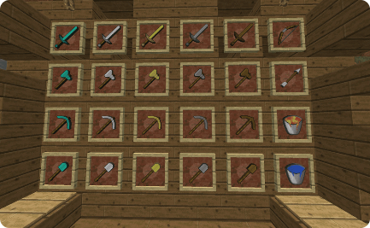
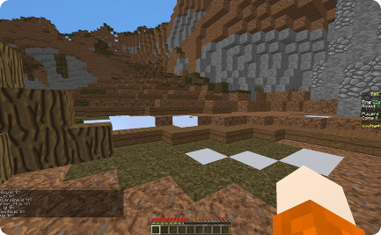
Popular mods and resource packs
Modding Community
Customization Options
Enhanced Graphics
Minecraft has a prolific modding community that has created countless modifications, expanding the game with new content and features.
Players can enrich their gameplay experience by using resource packs, which modify the game's textures, sounds, and visual elements.
Shader packs enhance the game's visuals, creating stunning visual effects and immersive atmospheres for players.

Slide 10
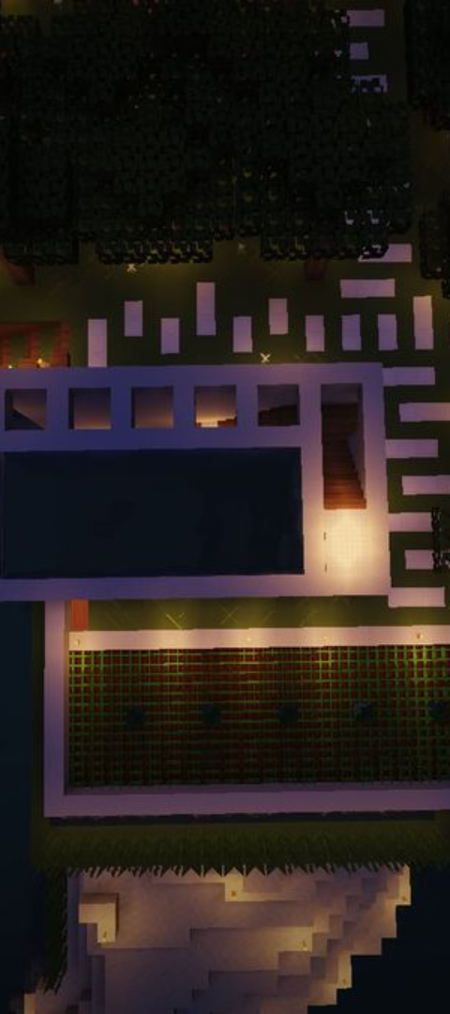
Conclusion and future of Minecraft
1
Endless Possibilities
2
Continual Innovation
Minecraft continues to expand with limitless possibilities, and its active community ensures a vibrant future.
The game's legacy of innovation and creativity sets a solid foundation for its evolution and continued success in the gaming industry.
3
Global Impact
Minecraft's influence extends beyond the gaming world, reaching into education, architecture, and various creative industries.

