Slide 1


Slide 2




Inorganic Recycling- what is it ?
Inorganic wastes (also known as non-biodegradable waste) are chemical substances of mineral origin. They include waste material such as sand, salt, Iron, Calcium, and other mineral materials that are only slightly affected by the action of organisms

Slide 3
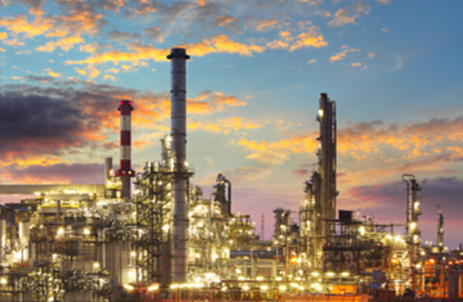

Focuses on ……..
INORGANIC MATERIAL RECYCLING

Slide 4
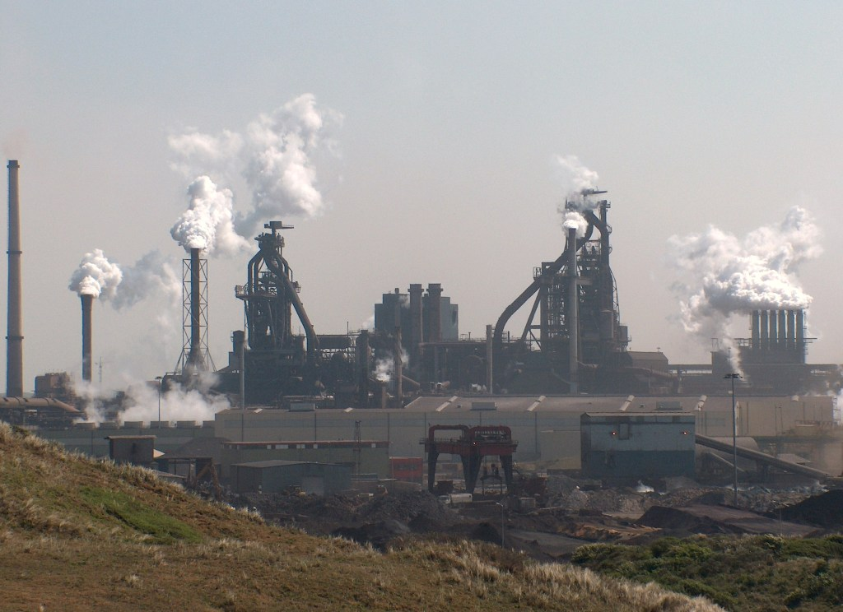
Focuses on ……..
INORGANIC MATERIAL RECYCLING

Slide 5
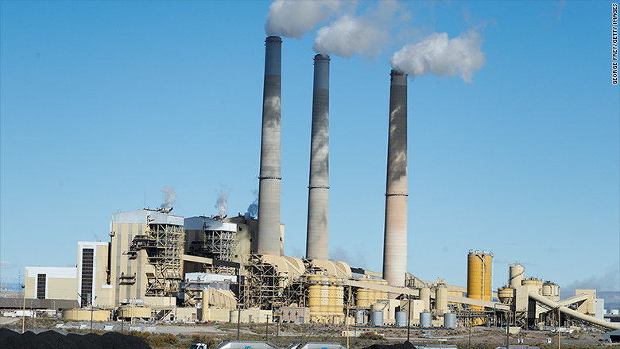
Focuses on ……..
INORGANIC MATERIAL RECYCLING

Slide 6
Globally ….
We will be left with stockpiles of factory slag piles
It is estimated that global iron slag output in 2018 was on the order of 300 million to 360 million tons, and steel slag about 190 million to 290 million tons.

Slide 7
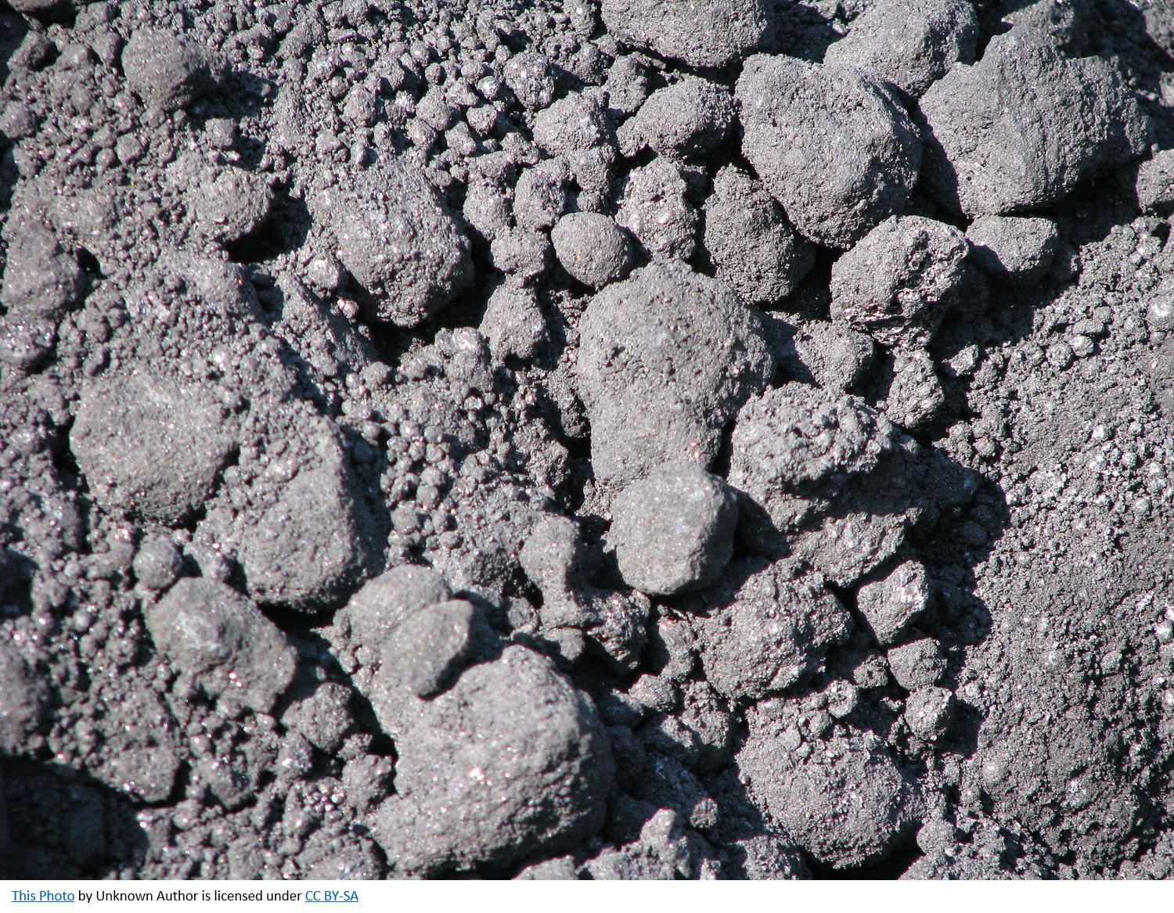
Focuses on ……..
INORGANIC MATERIAL RECYCLING

Slide 8
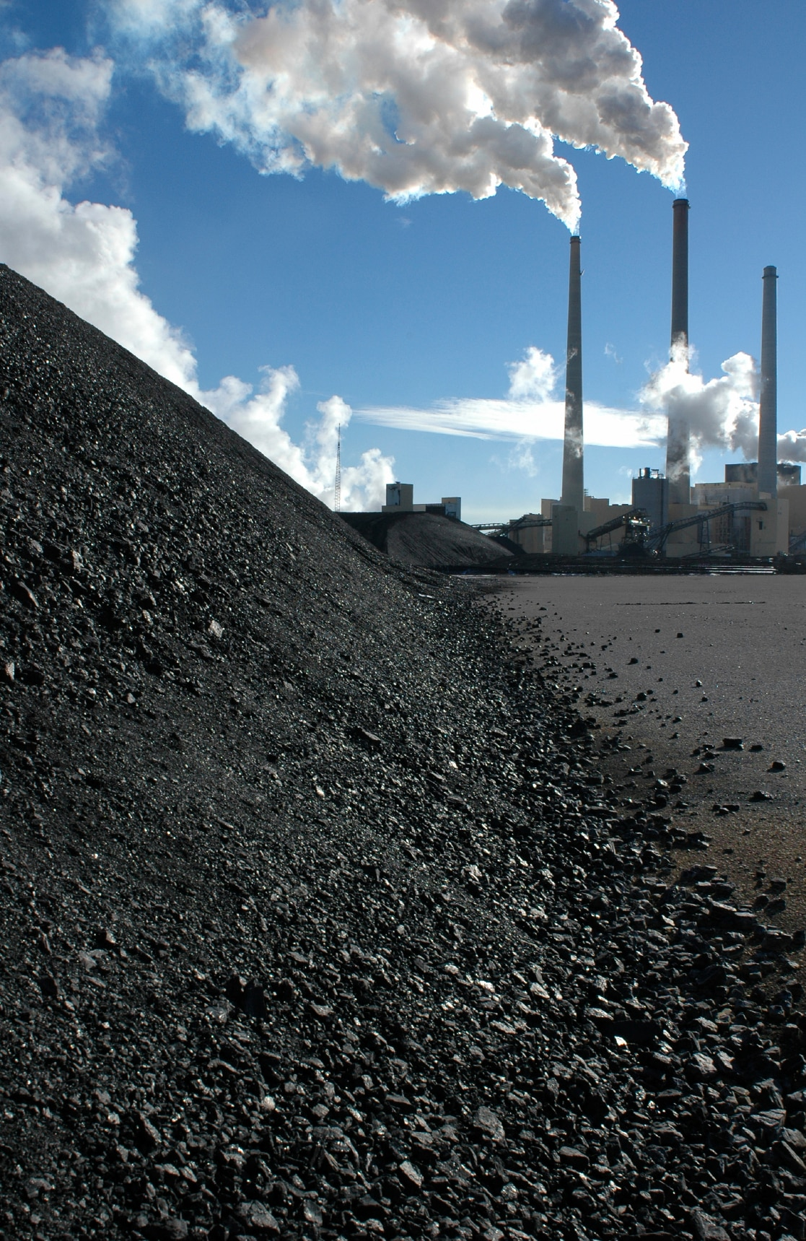
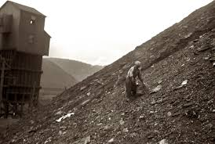
Focuses on ……..
INORGANIC MATERIAL RECYCLING

Slide 9
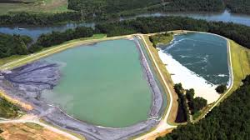
Focuses on ……..
INORGANIC MATERIAL RECYCLING

Slide 10

GEOLOGICAL
DISPOSAL
However,
the Synopsis
is NOT VALID !

Slide 11
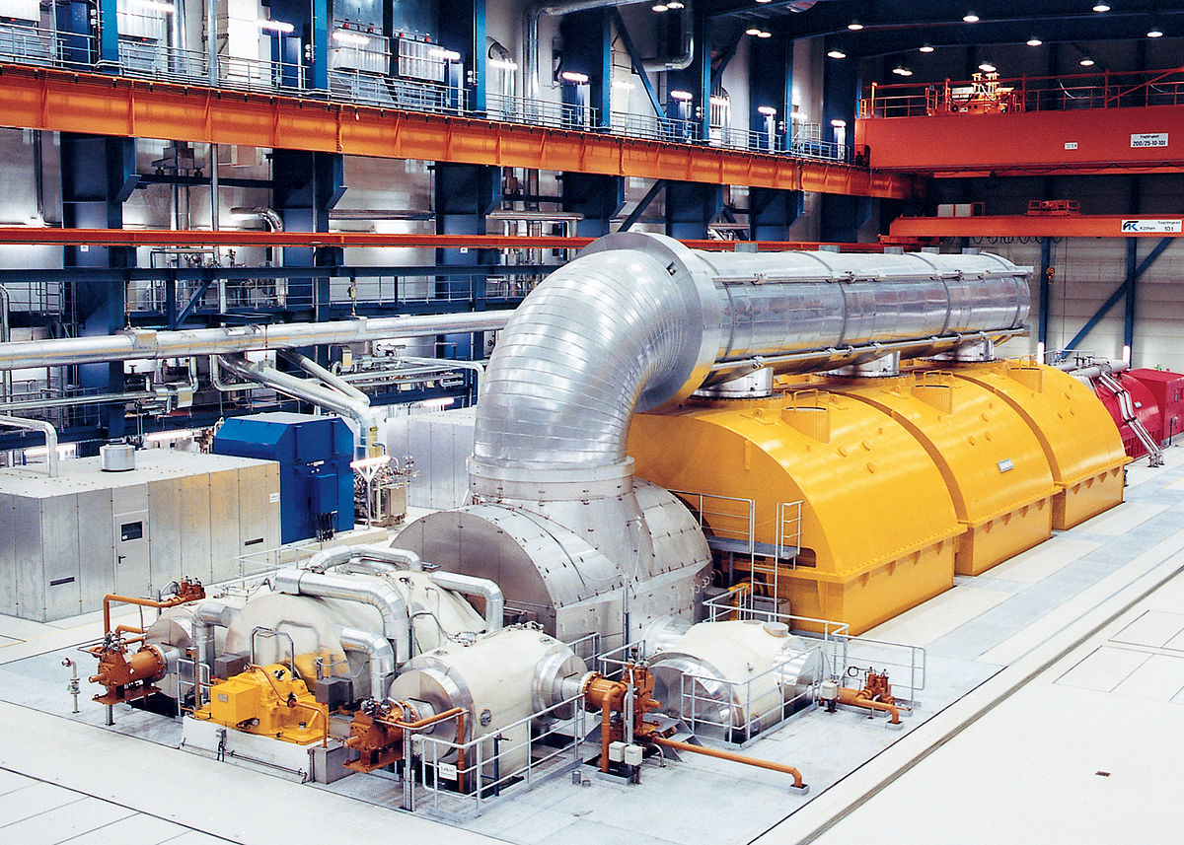

Focuses on ……..
Build the MACHINE !
This Photo by Unknown Author is licensed under CC BY-SA

Slide 12
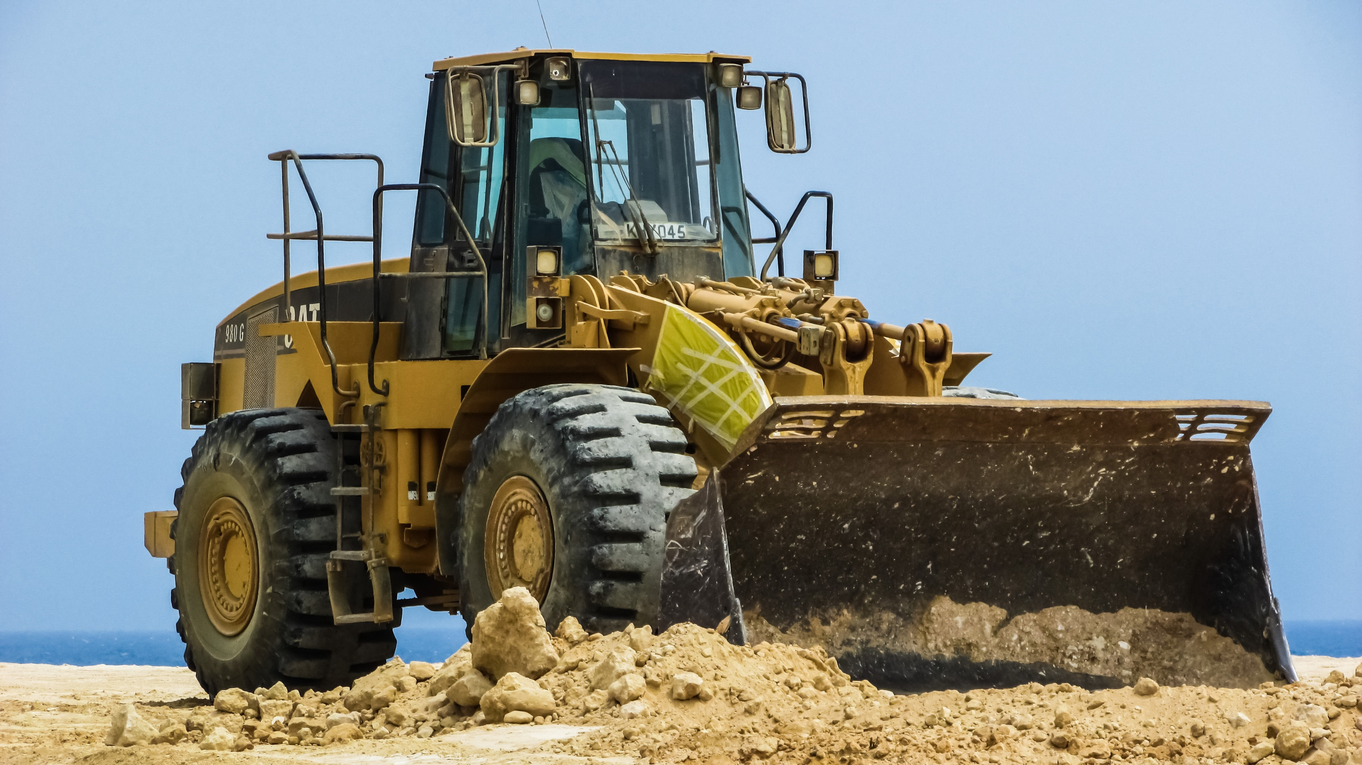
Focuses on ……..
INORGANIC MATERIAL RECYCLING

Slide 13
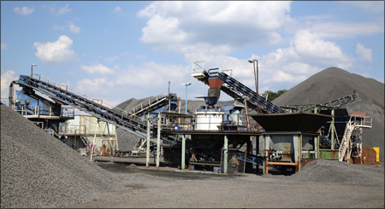
Focuses on ……..
INORGANIC MATERIAL RECYCLING

Slide 14

Focuses on ……..
INORGANIC MATERIAL RECYCLING

Slide 15
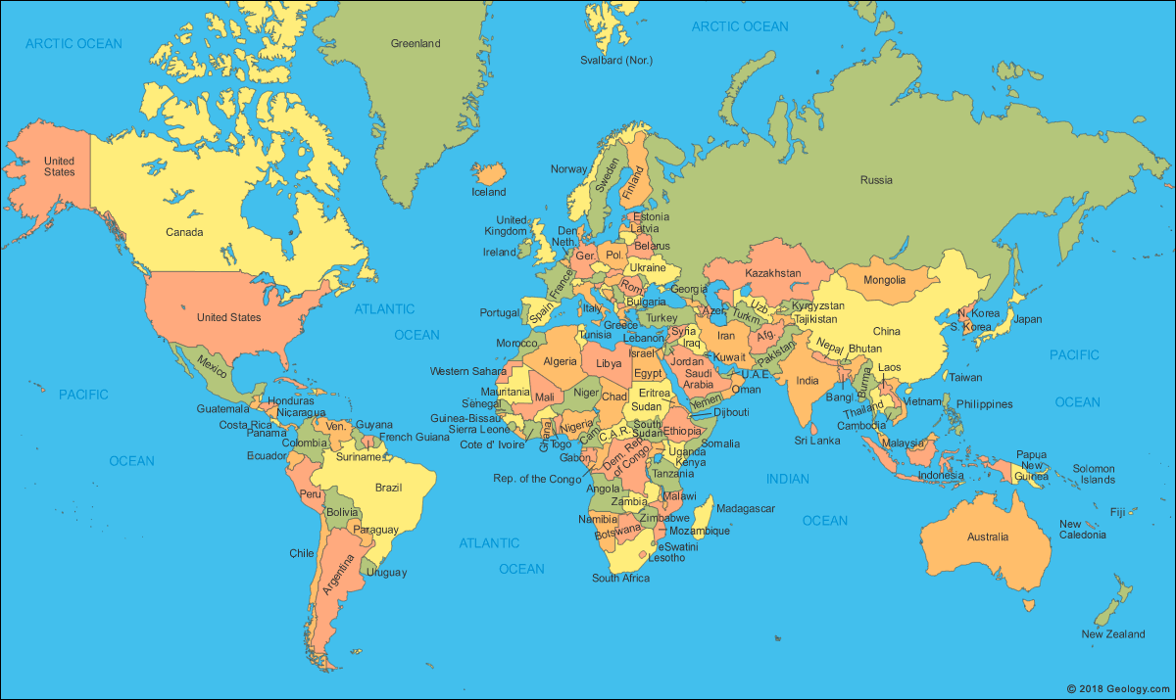
Focuses on ……..
Global Ideas

