Slide 1


Slide 2
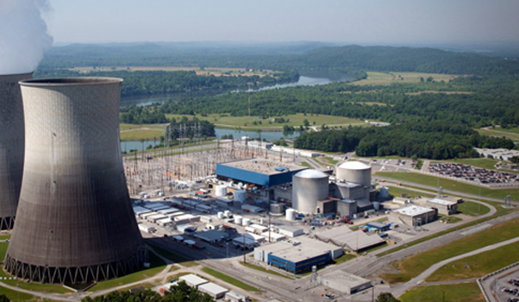

Focuses on ……..
GLOBAL NUCLEAR RECYCLING

Slide 3
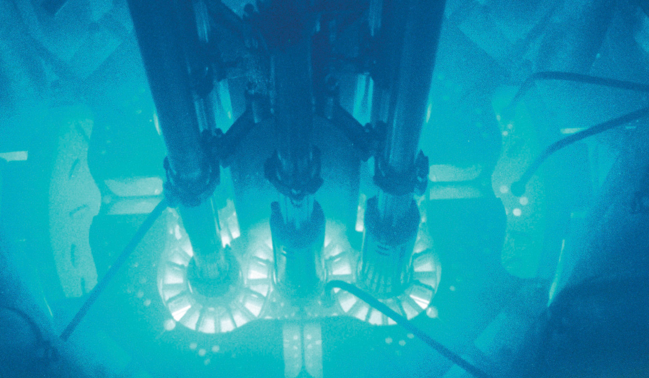
Nuclear Fission - what is it ?
Fission is a form of nuclear transmutation
This Photo by Unknown Author is licensed under CC BY-SA-NC

Slide 4
Economic Viability
Introduction into Recycling :
High Level Waste
Intermediate Level Waste
Low Level Waste

Slide 5
High Level Waste
The IEA estimates that 370,000 Metric Tons of Heavy Metal has been produced since the advent of civil nuclear power production
120,000 Metric Tons of Heavy Metal have been reprocessed

Slide 6
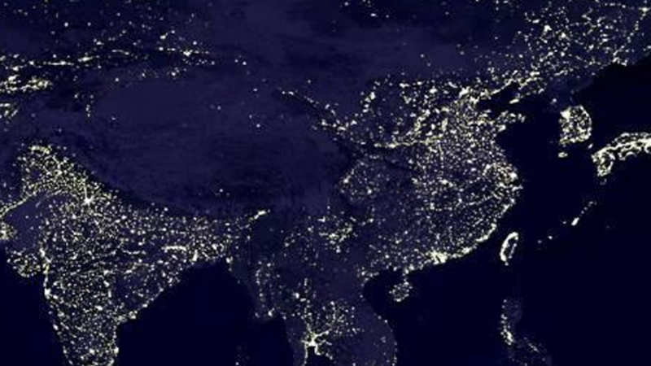
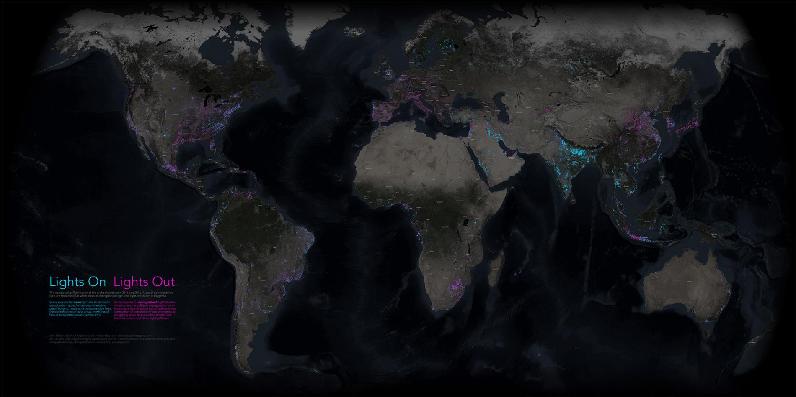
Fission will be over by 2065

Slide 7
Globally …. We will be left with stockpiles of high-level waste and the decay chains
Between 2010 and 2030
some 400,000
metric tons of used
fuel is expected to be
generated world -wide

Slide 8
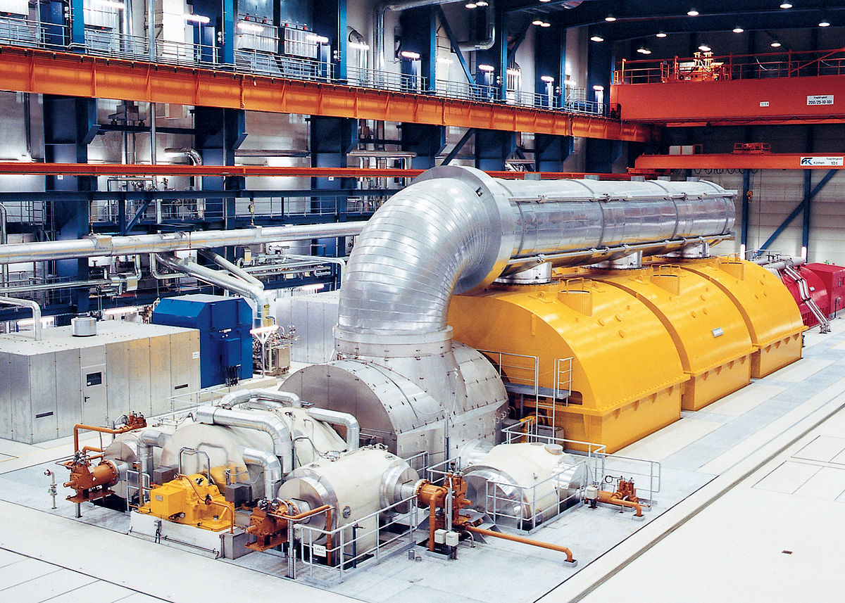

Focuses on ……..
Build the MACHINE !
This Photo by Unknown Author is licensed under CC BY-SA

Slide 9
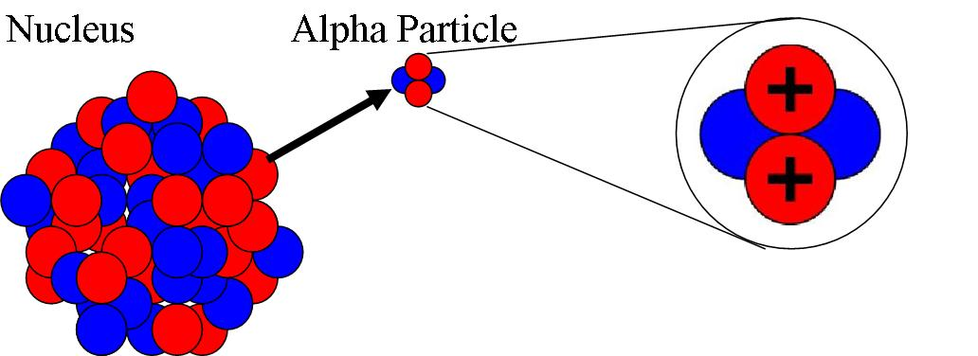

ALPHA DECAY

Slide 10
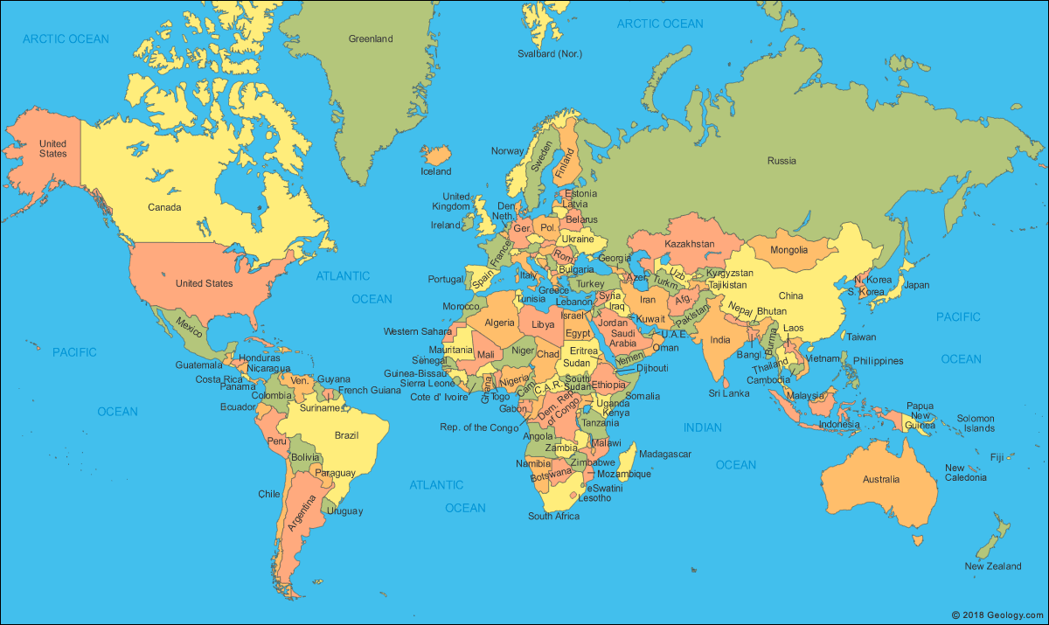
Focuses on ……..
Global Ideas

