Slide 1


Slide 2
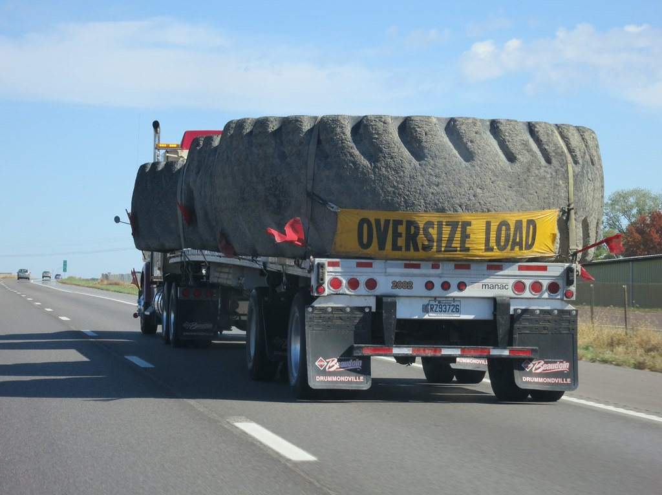

Focuses on ……..
GLOBAL ORGANIC RECYCLING
This Photo by Unknown Author is licensed under CC BY

Slide 3
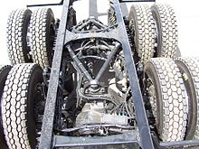
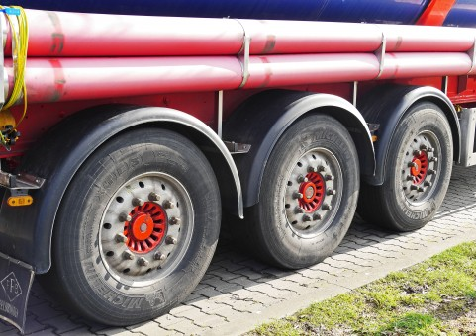
Focuses on ……..
GLOBAL ORGANIC RECYCLING

Slide 4
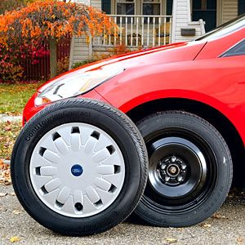
Focuses on ……..
GLOBAL ORGANIC RECYCLING
This Photo by Unknown Author is licensed under CC BY-NC-ND

Slide 5
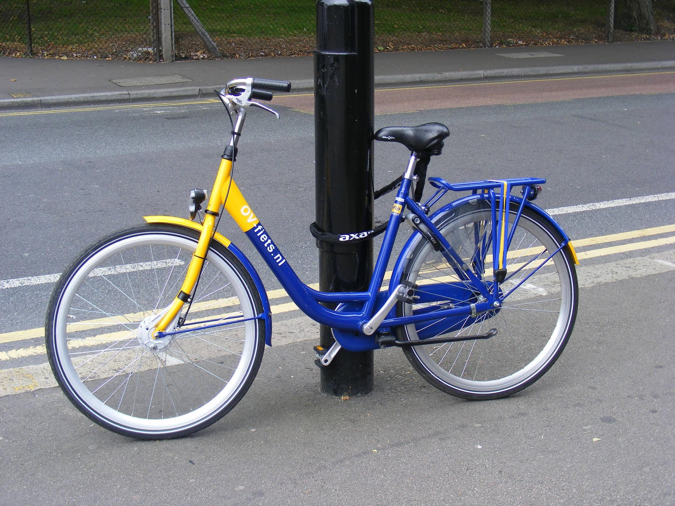
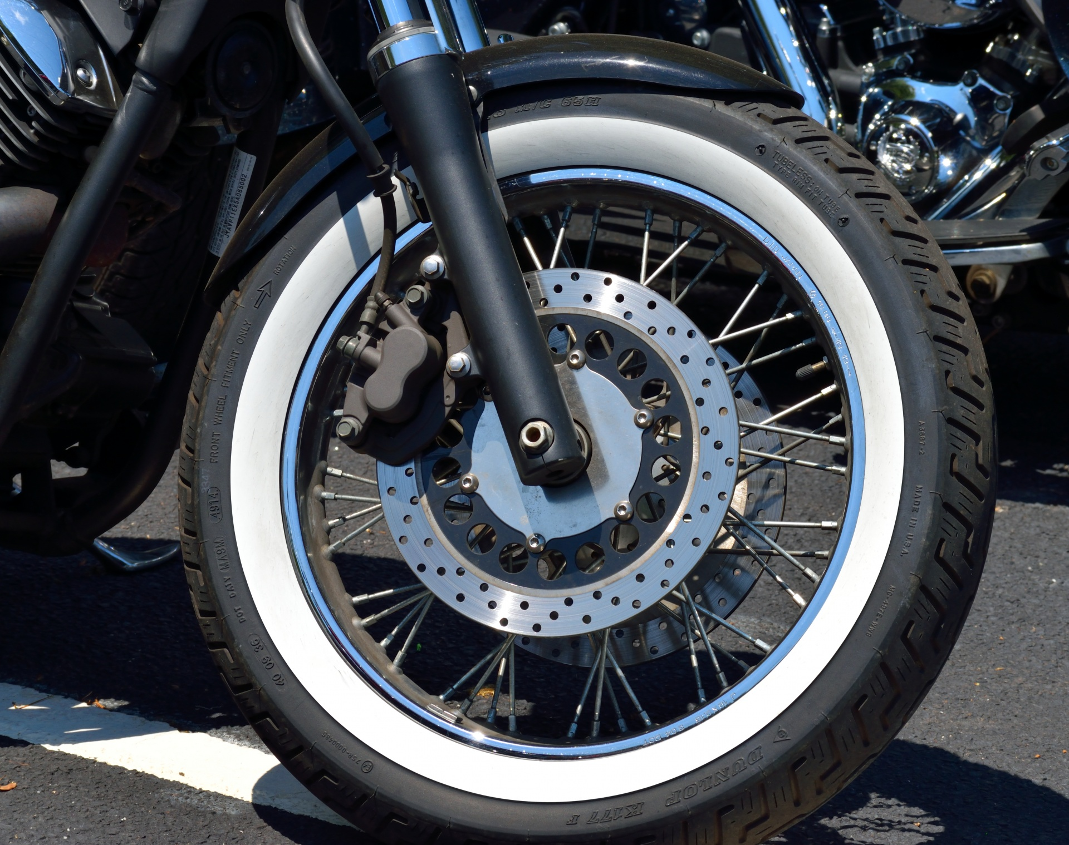
Focuses on ……..
GLOBAL ORGANIC RECYCLING
This Photo by Unknown Author is licensed under CC BY-SA

Slide 6
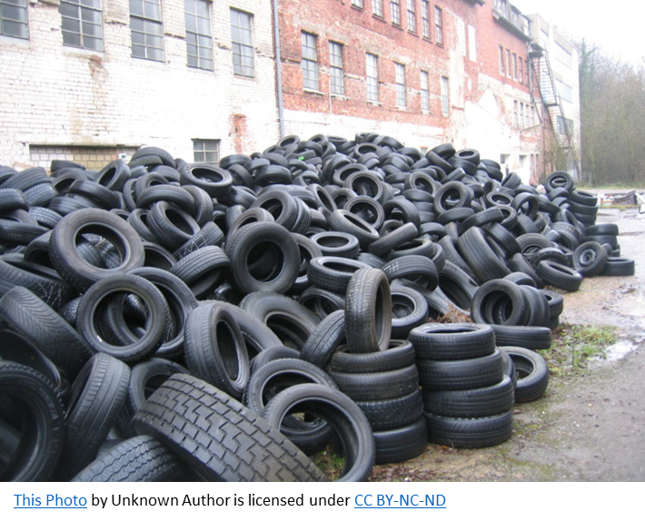
Focuses on ……..
GLOBAL ORGANIC RECYCLING

Slide 7

Focuses on ……..
GLOBAL ORGANIC RECYCLING

Slide 8
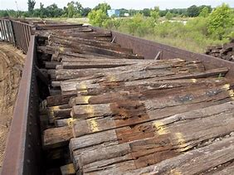
Focuses on ……..
GLOBAL ORGANIC RECYCLING

Slide 9
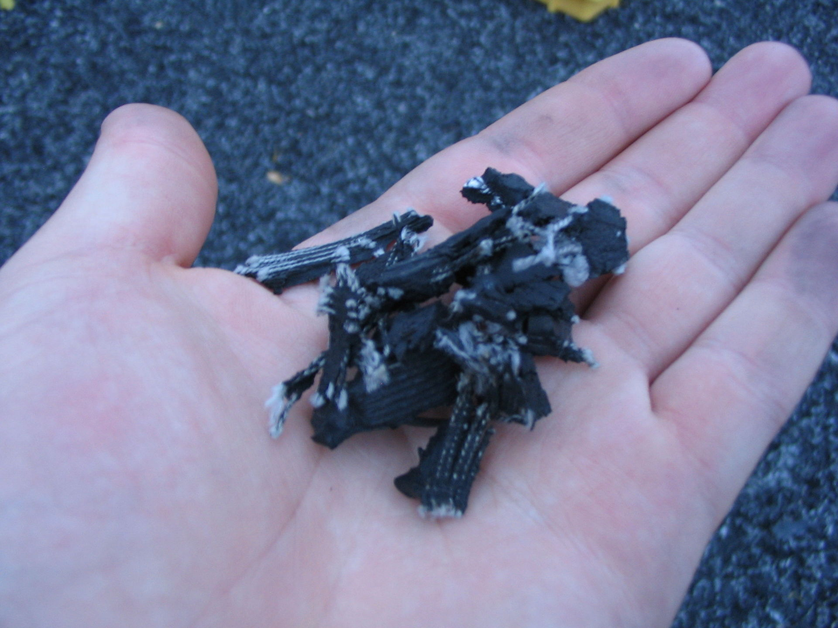
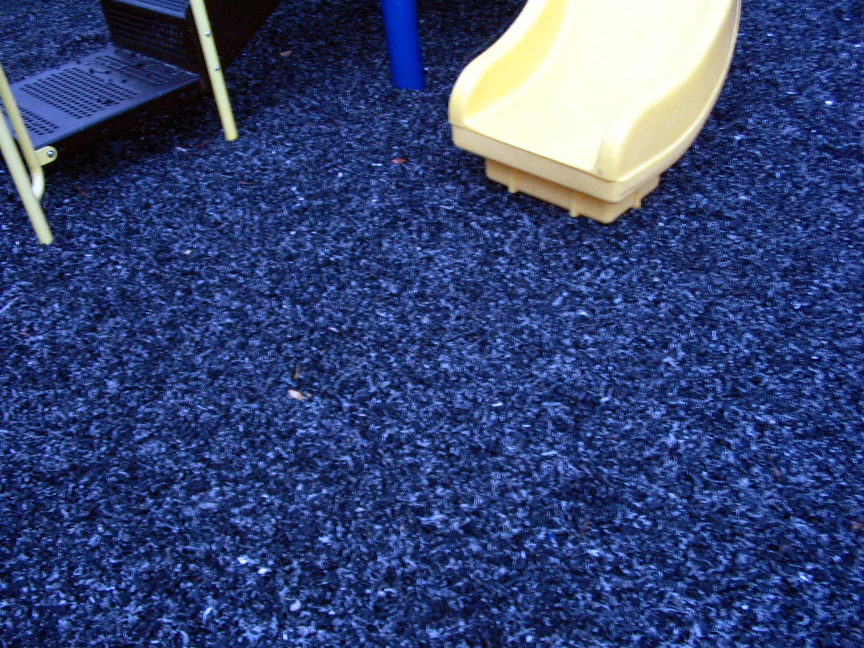
Current Organic Recycling- what is it ?
Current Organic Recycling is the process of recycling waste tires and railroad ties that are no longer suitable for use on vehicles due to wear or irreparable damage . This product is a challenging source of waste, due to the large volume produced, the durability of the tires and ties, and the components that are ecologically problematic.
This Photo by Unknown Author is licensed under CC BY-SA
This Photo by Unknown Author is licensed under CC BY-SA

Slide 10
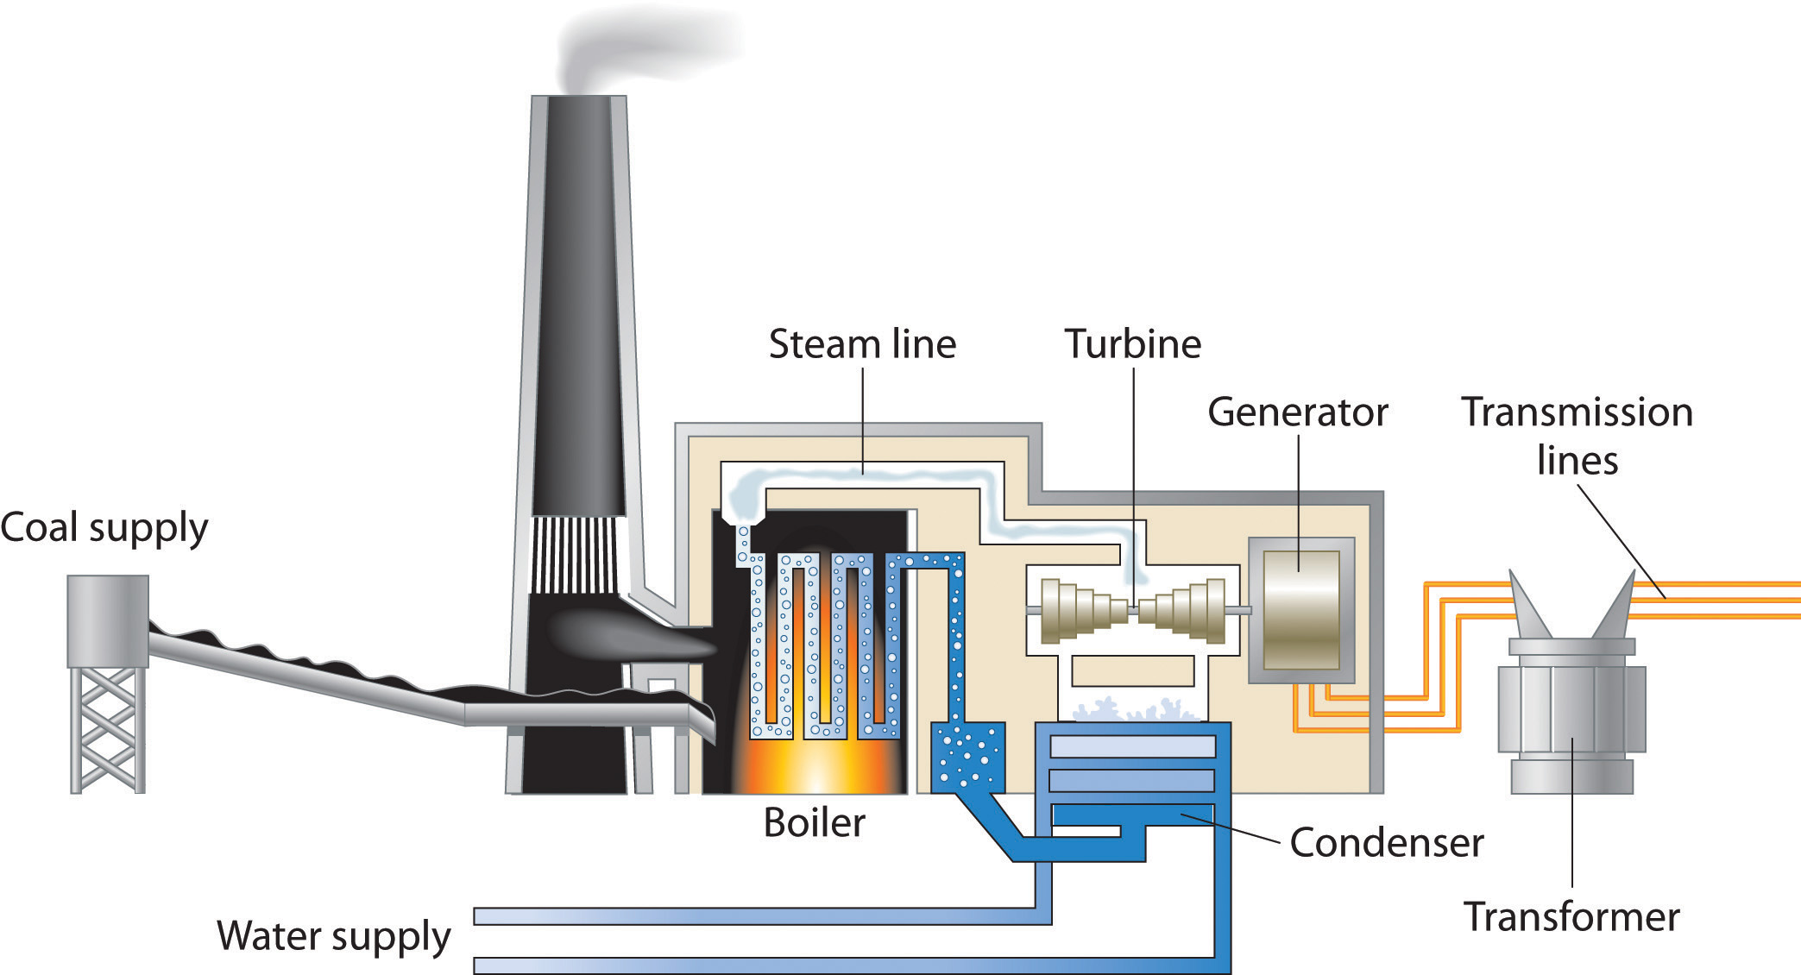
Current Organic Recycling- what is it ?
Current Organic Recycling is the process of recycling waste tires and railroad ties that are no longer suitable for use on vehicles due to wear or irreparable damage . This product is a challenging source of waste, due to the large volume produced, the durability of the tires and ties, and the components that are ecologically problematic.
This Photo by Unknown Author is licensed under CC BY-SA-NC

Slide 11
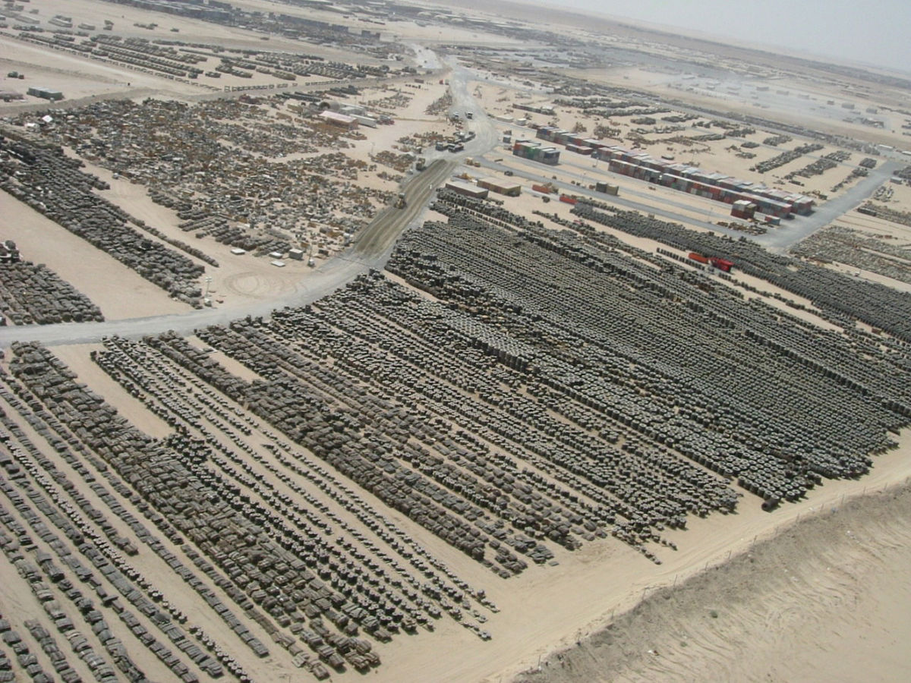
Current Organic Recycling- what is it ?
Current Organic Recycling is the process of recycling waste tires and railroad ties that are no longer suitable for use on vehicles due to wear or irreparable damage . This product is a challenging source of waste, due to the large volume produced, the durability of the tires and ties, and the components that are ecologically problematic.

Slide 12
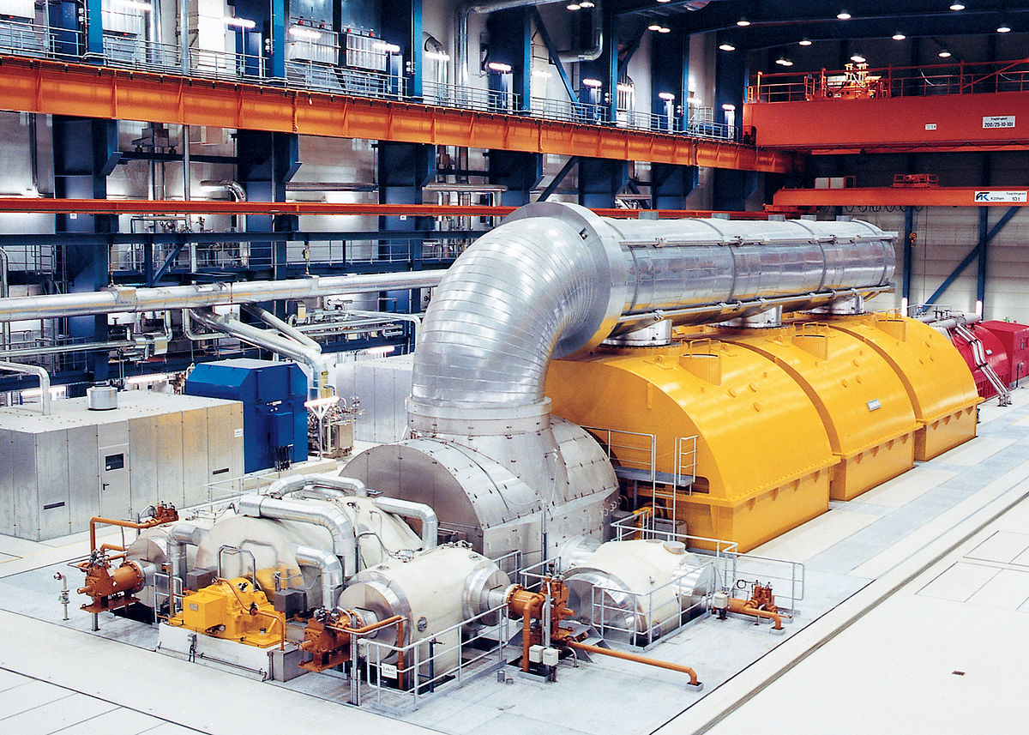

Focuses on ……..
Build the MACHINE !
This Photo by Unknown Author is licensed under CC BY-SA

Slide 13
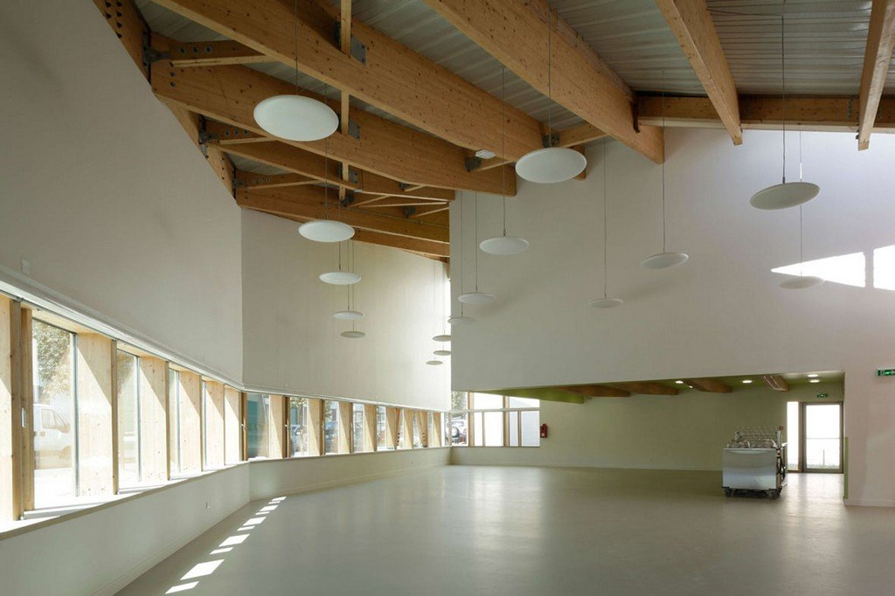
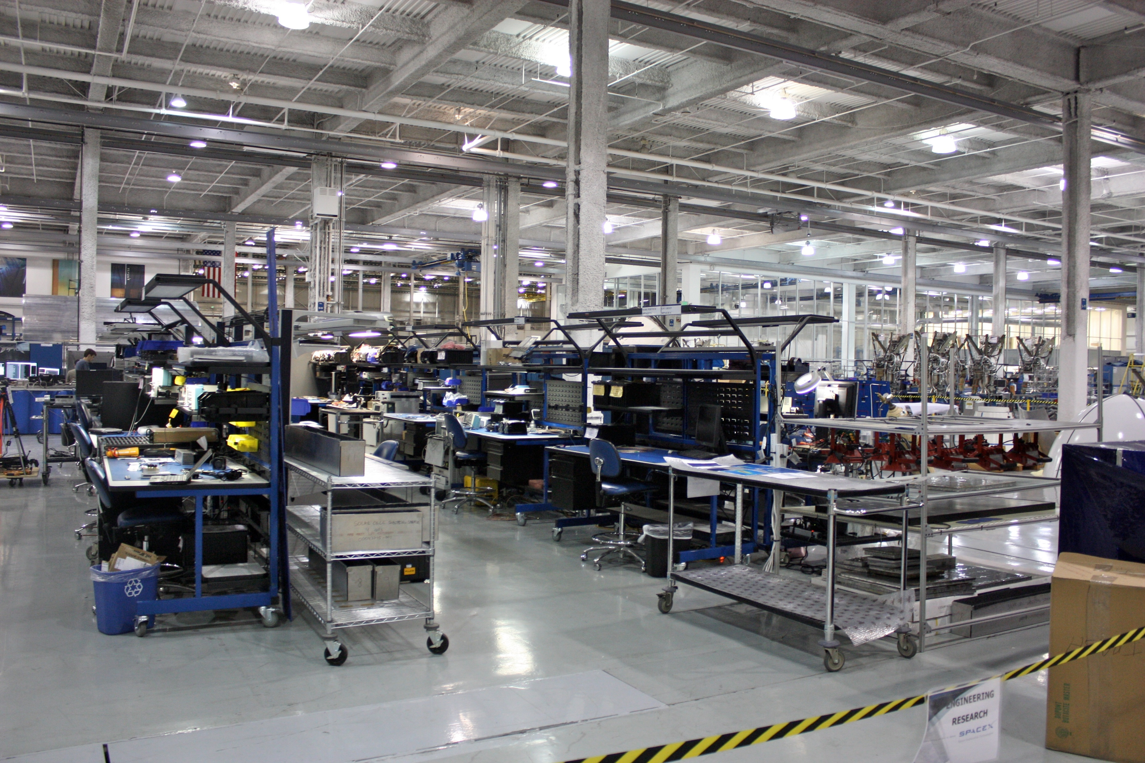
Focuses on ……..
Build the FACTORY !

