Slide 1
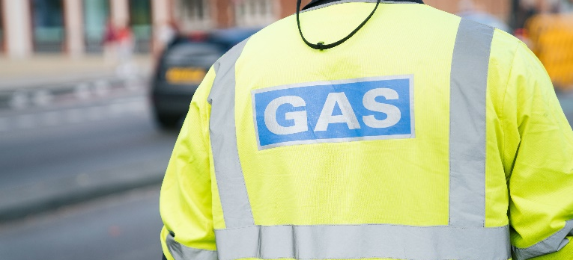
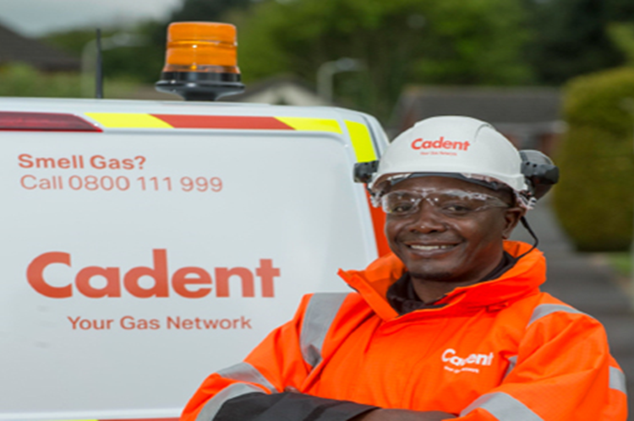

East of England
EAGA235109 Wroxham
Area Manager Chris Wade
Project Manager Liam Farrelly
Team Leader Paul Dyson
Stakeholder Coordinator Rob Hamer
Customer Care 0800 151 2404

Slide 2
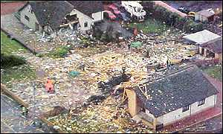
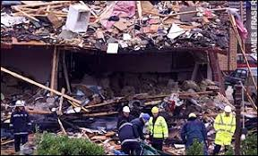
Why we’re here
Our work is part of the government’s 30-year-long gas mains replacement programme
Initiated following a gas explosion at Larkhall, Lanarkshire, in December 1999
Health and Safety Executive investigated and introduced the ‘30/30 Programme’
  Replace all iron gas mains within 30m of a building within 30 years
  Started 2002; finishing 2032

Slide 3
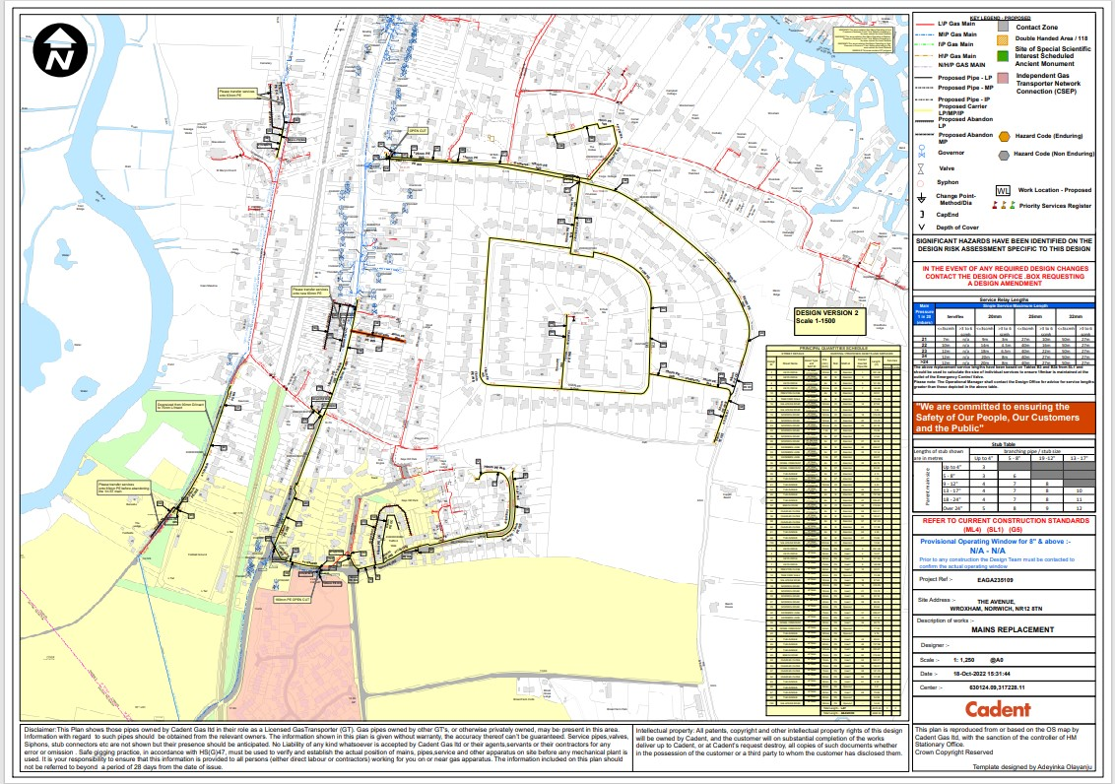
4571m
4681m

Slide 4
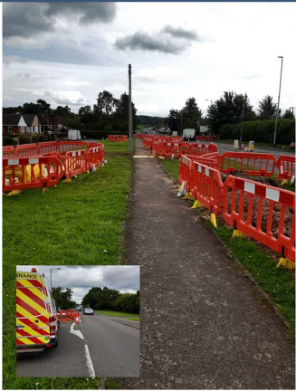
Customer Impact Dates
Keys Drive 17/10/2022 to 15/12/2022 Trafford Walk numbers 1 to 29 will have Meter Boxes
Skinners Lane 17/10/2022 to 18/11/2022
Trafford Way 14/11/2022 to 09/12/2022
Preston Close 21/11/2022 to 09/12/2022
Salhouse Way 12/12/2022 to 20/01/2023 Will have Traffic management
Norwich Road 03/01/2023 to 24/02/2023 Will have Traffic management, will be moving meters
Castle Street 23/01/2023 to 03/02/2023
Park Road 23/01/2023 to 03/02/2023
Charles Close 23/01/2023 to 28/04/2023
The Avenue TBC Will have Traffic management
Beech Road TBC Private Road

Slide 5

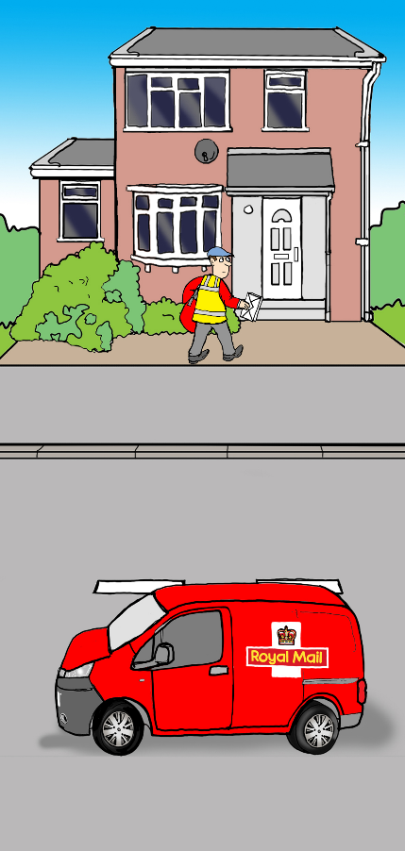
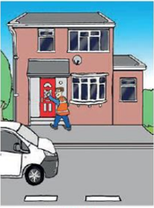
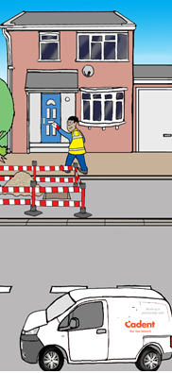
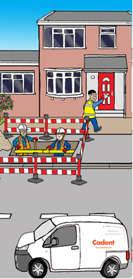
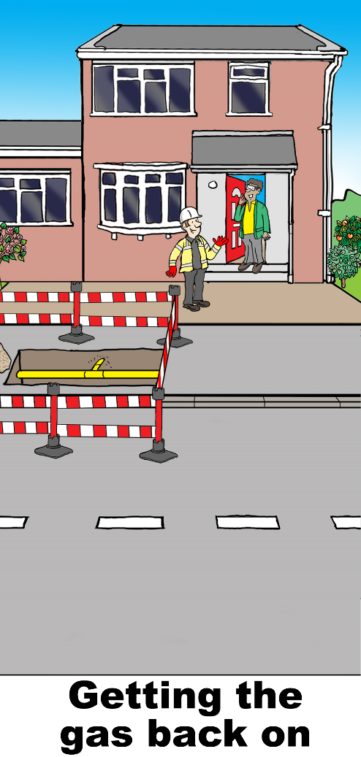
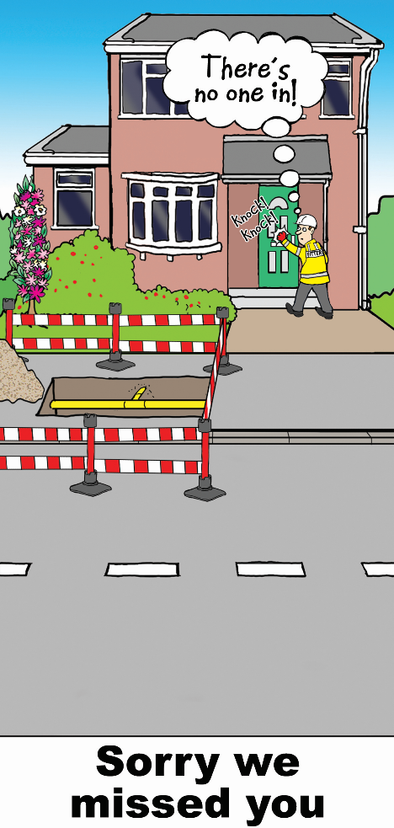
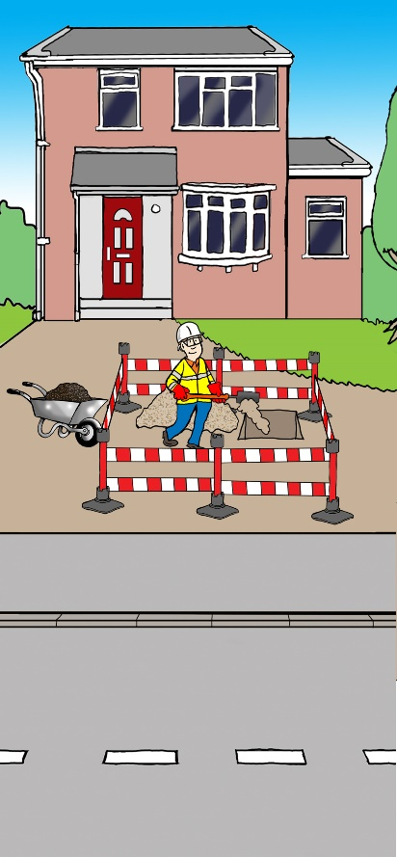
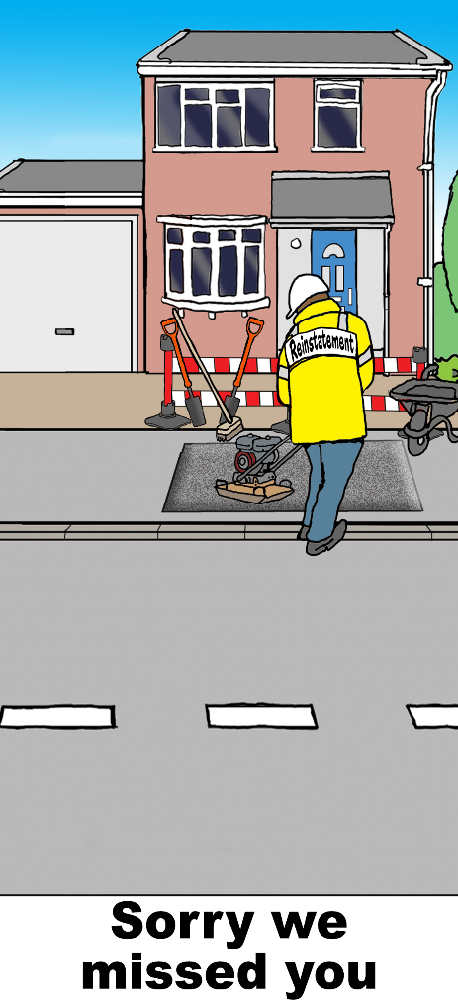
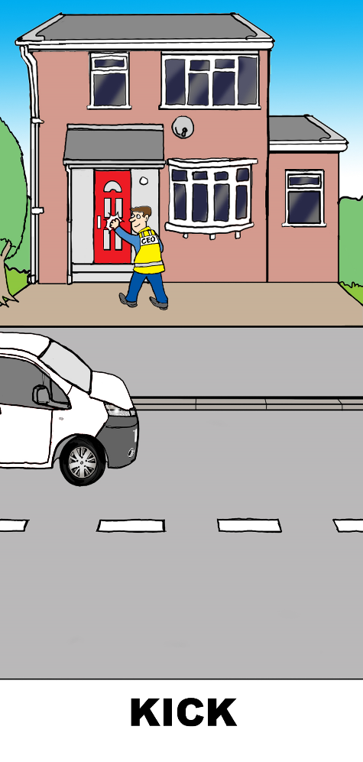
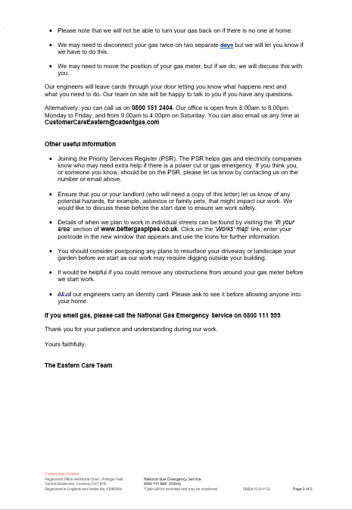


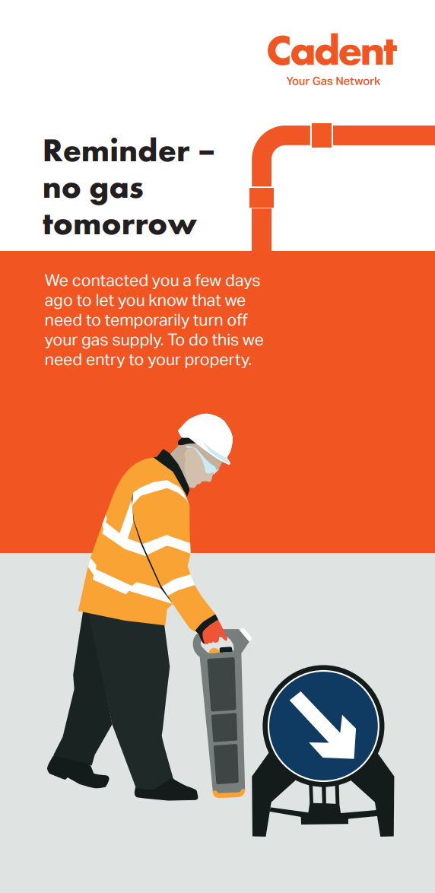

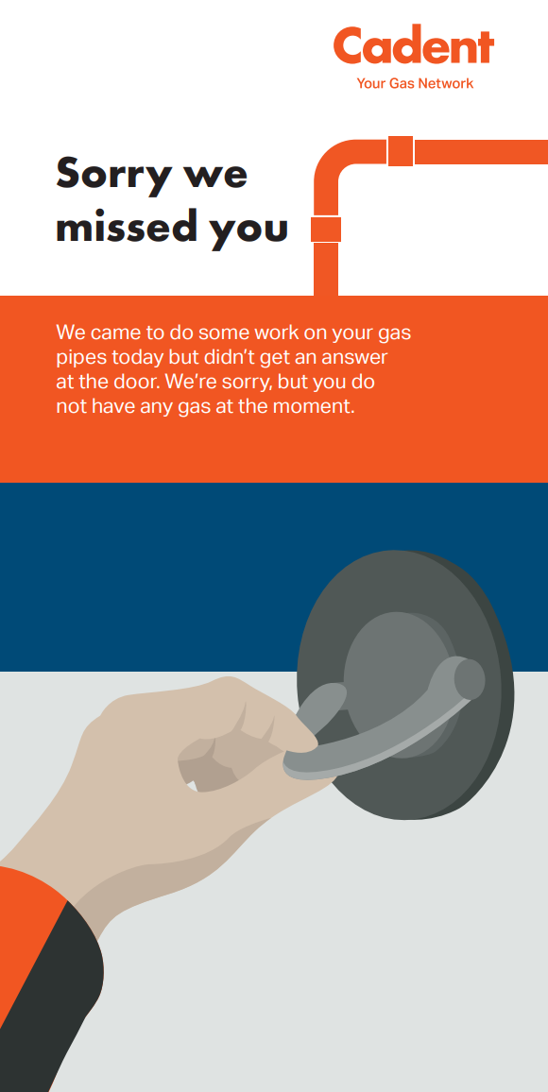

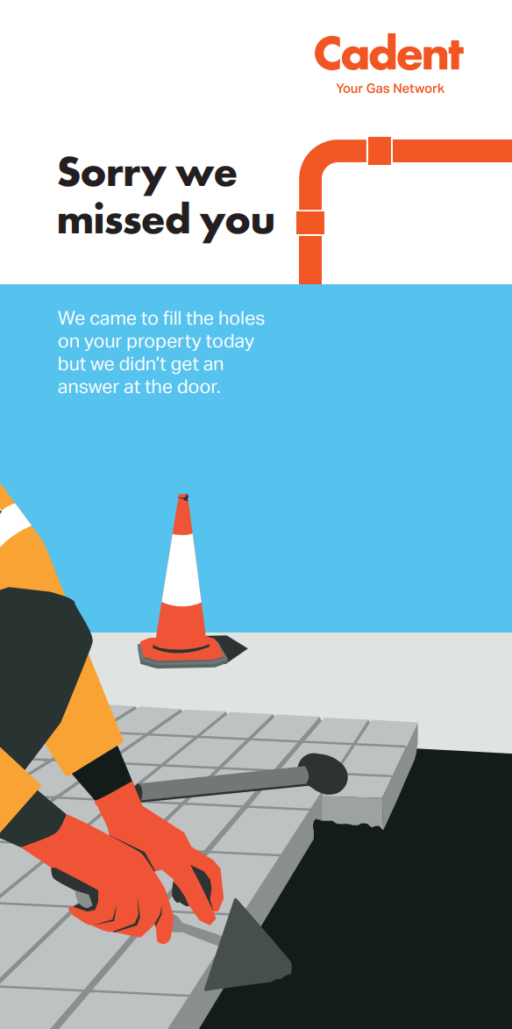
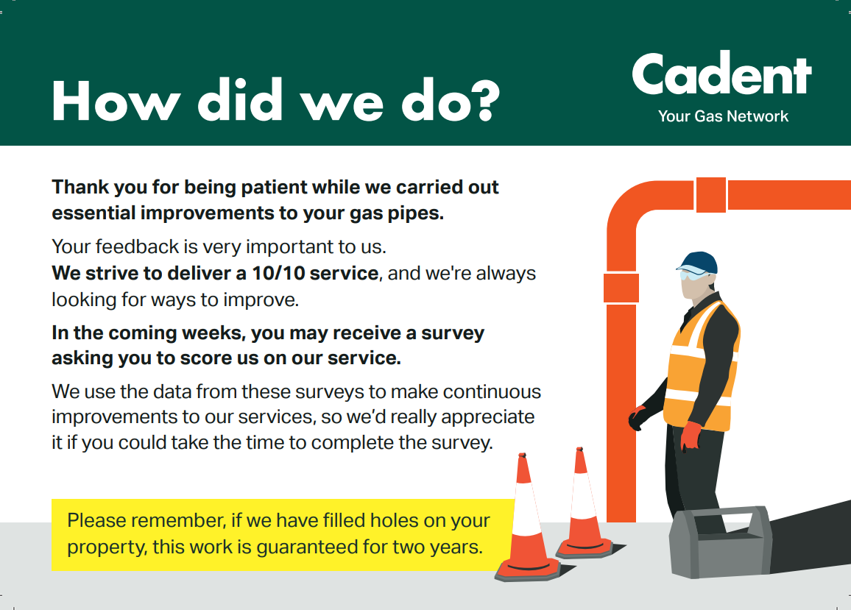
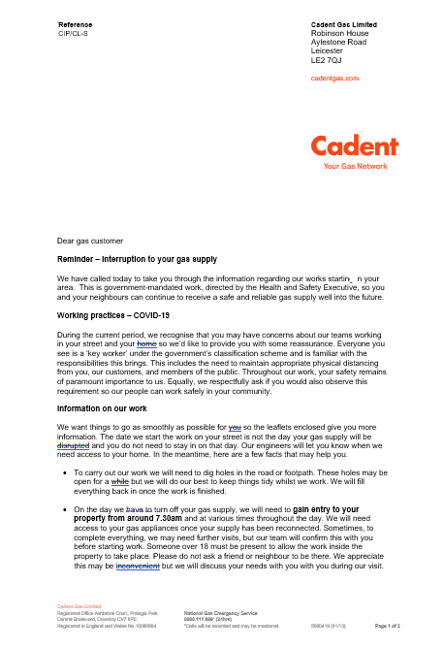


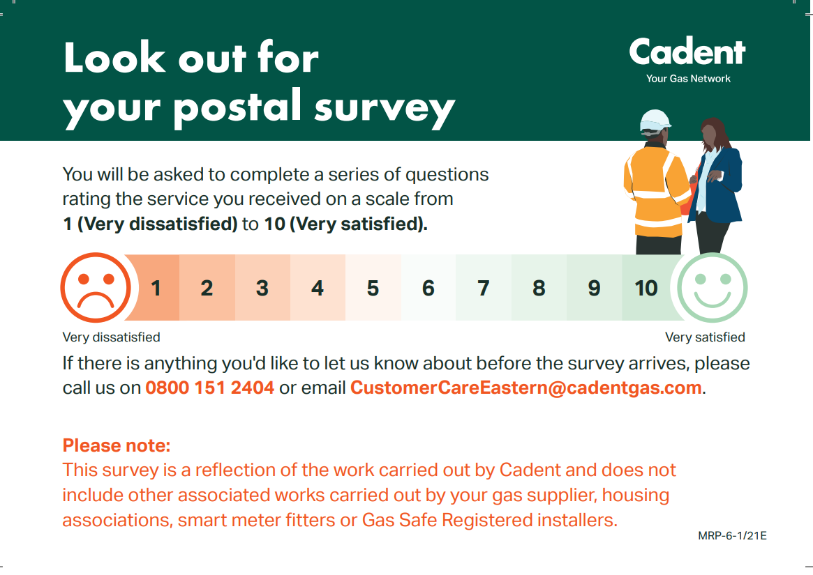
1
2
3
4
5
6
7
8
9
10 DAYS BEFORE
STARTING ON SITE…
10 – 0 DAYS BEOFRE ON SITE
COULD BE EARLIER
5 – 2 DAYS BEFORE
GAS OFF…
1 DAY BEFORE
GAS OFF
ENGINEERING
ACTIVITIES
ENGINEERING
ACTIVITIES
2 – 6 DAYS AFTER
EXCAVATION
2 – 6 DAYS AFTER
EXCAVATION
POST SITE CLEAR
10 DAY LETTER
CARE
5 DAY DROP CARDS
NO GAS REMINDER
GETTING THE GAS BACK ON
SORRY WE MISSED YOU
FILLING IN THE HOLES
SORRY WE MISSED YOU
HOW DID WE DO?
We write to customers before we start; 1 month and 7 days before.
Our CLOs knock on every door and will leave information if the customers are out.
It is imperative we give customers enough notice to be at home on the day (2 clear days).
The reminder is important so customers can make arrangements to be in.
We work up until 8pm, and we need our customers to be aware of this.
Our aim is to never leave our customers without gas, so let them know what to do.
Always knock before and after if we’re working on customers premises.
Let customers know they’re not forgotten and we will come back.
Everything needs to look at it was before we started, leave a good impressions.

Slide 6
Christmas
The gasworks will take a temporary break over the Christmas holiday
All excavations will be backfilled and reinstated before Christmas (weather permitting)
We may leave a compound on the project to store our barriers, this will be behind Heras Fencing and will be regularly checked over the Christmas period

