Slide 1
January Bible Study
Introduction: The Sermon on the mount

Slide 2
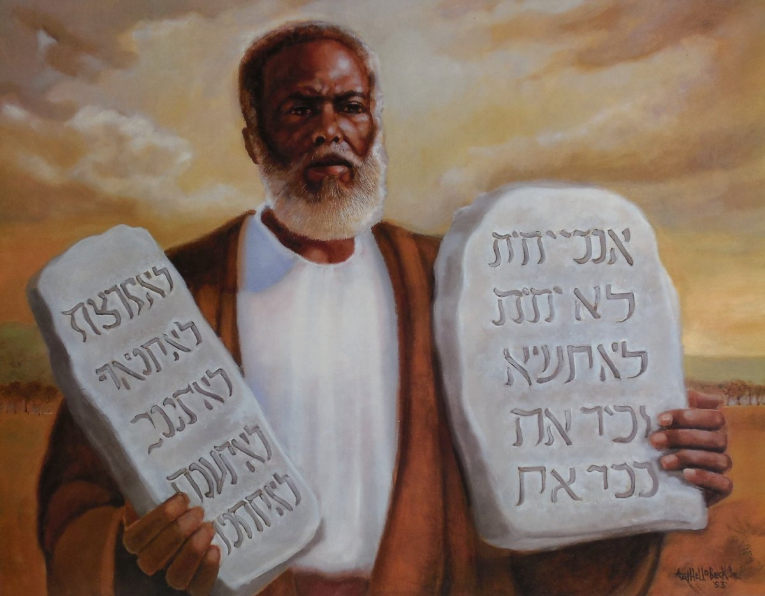
Covenant, What is it?
A Promise, A Gift, or an Agreement?
The Old Covenant
The New Covenant
Why a New Covenant?
  What was wrong with the Old One that a New Covenant is Required?

Slide 3
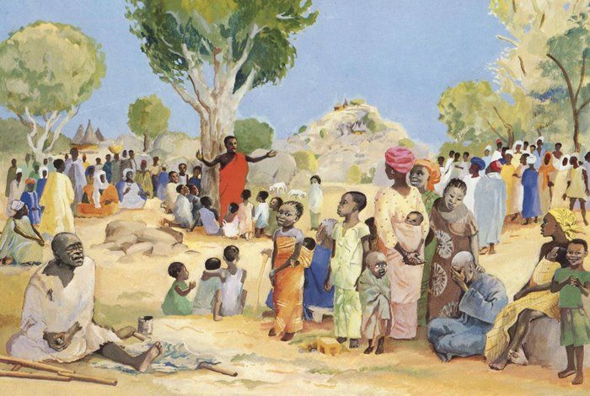
Presentation?
How was the Old Covenant Presented?
  Was that the end all be all?
How was the New Covenant Presented?

Slide 4
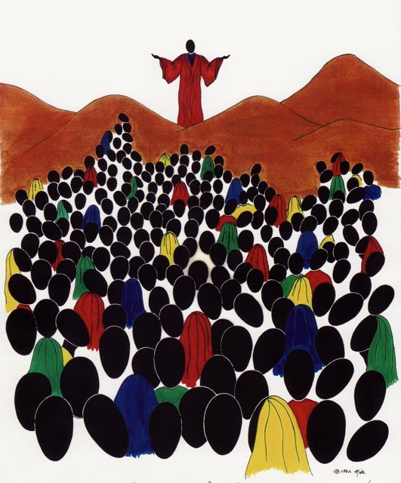
For the next three weeks, We Will Study The Sermon on the Mount
Week One: Matthew Chapter Five
  Sermon includes the Beautides
  Also includes the relationship of Jesus Christ to the Law
Week Two: Matthew Chapter Six
  Sermon includes our (followers of Christ) relationship with God
Week Three: Matthew Chapter Seven
  Sermon includes our relationship with humanity

Slide 5
At the end of this month…
The goal is to enhance our Covenant with God, and to understand the fine print

