Slide 1
January Bible Study
Week One: Chapter Five

Slide 2
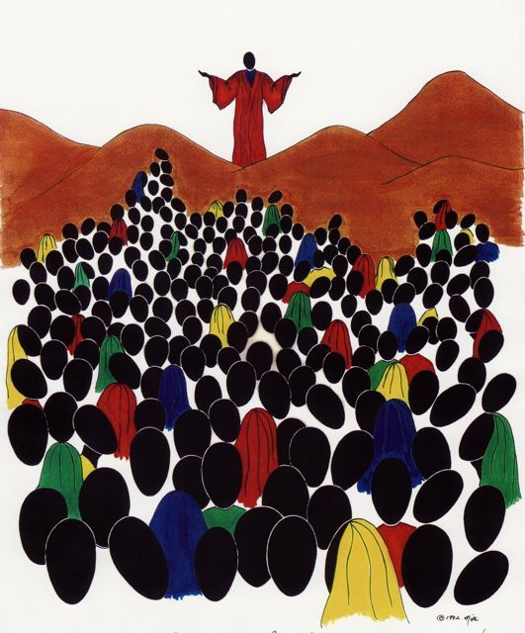
The Sermon on the Mount
Spatial Setting – Anything unique about this image?
Historical Event
What were the masses hearing?
What makes this A unique Sermon
So here is my first question, Why do you think Jesus preached a unique and private sermon to the Disciples
  Why did he preach a simpler message full of miracles and joy with the general public, and in private teach the stringent social concerns of the Covenant with the disciples

Slide 3
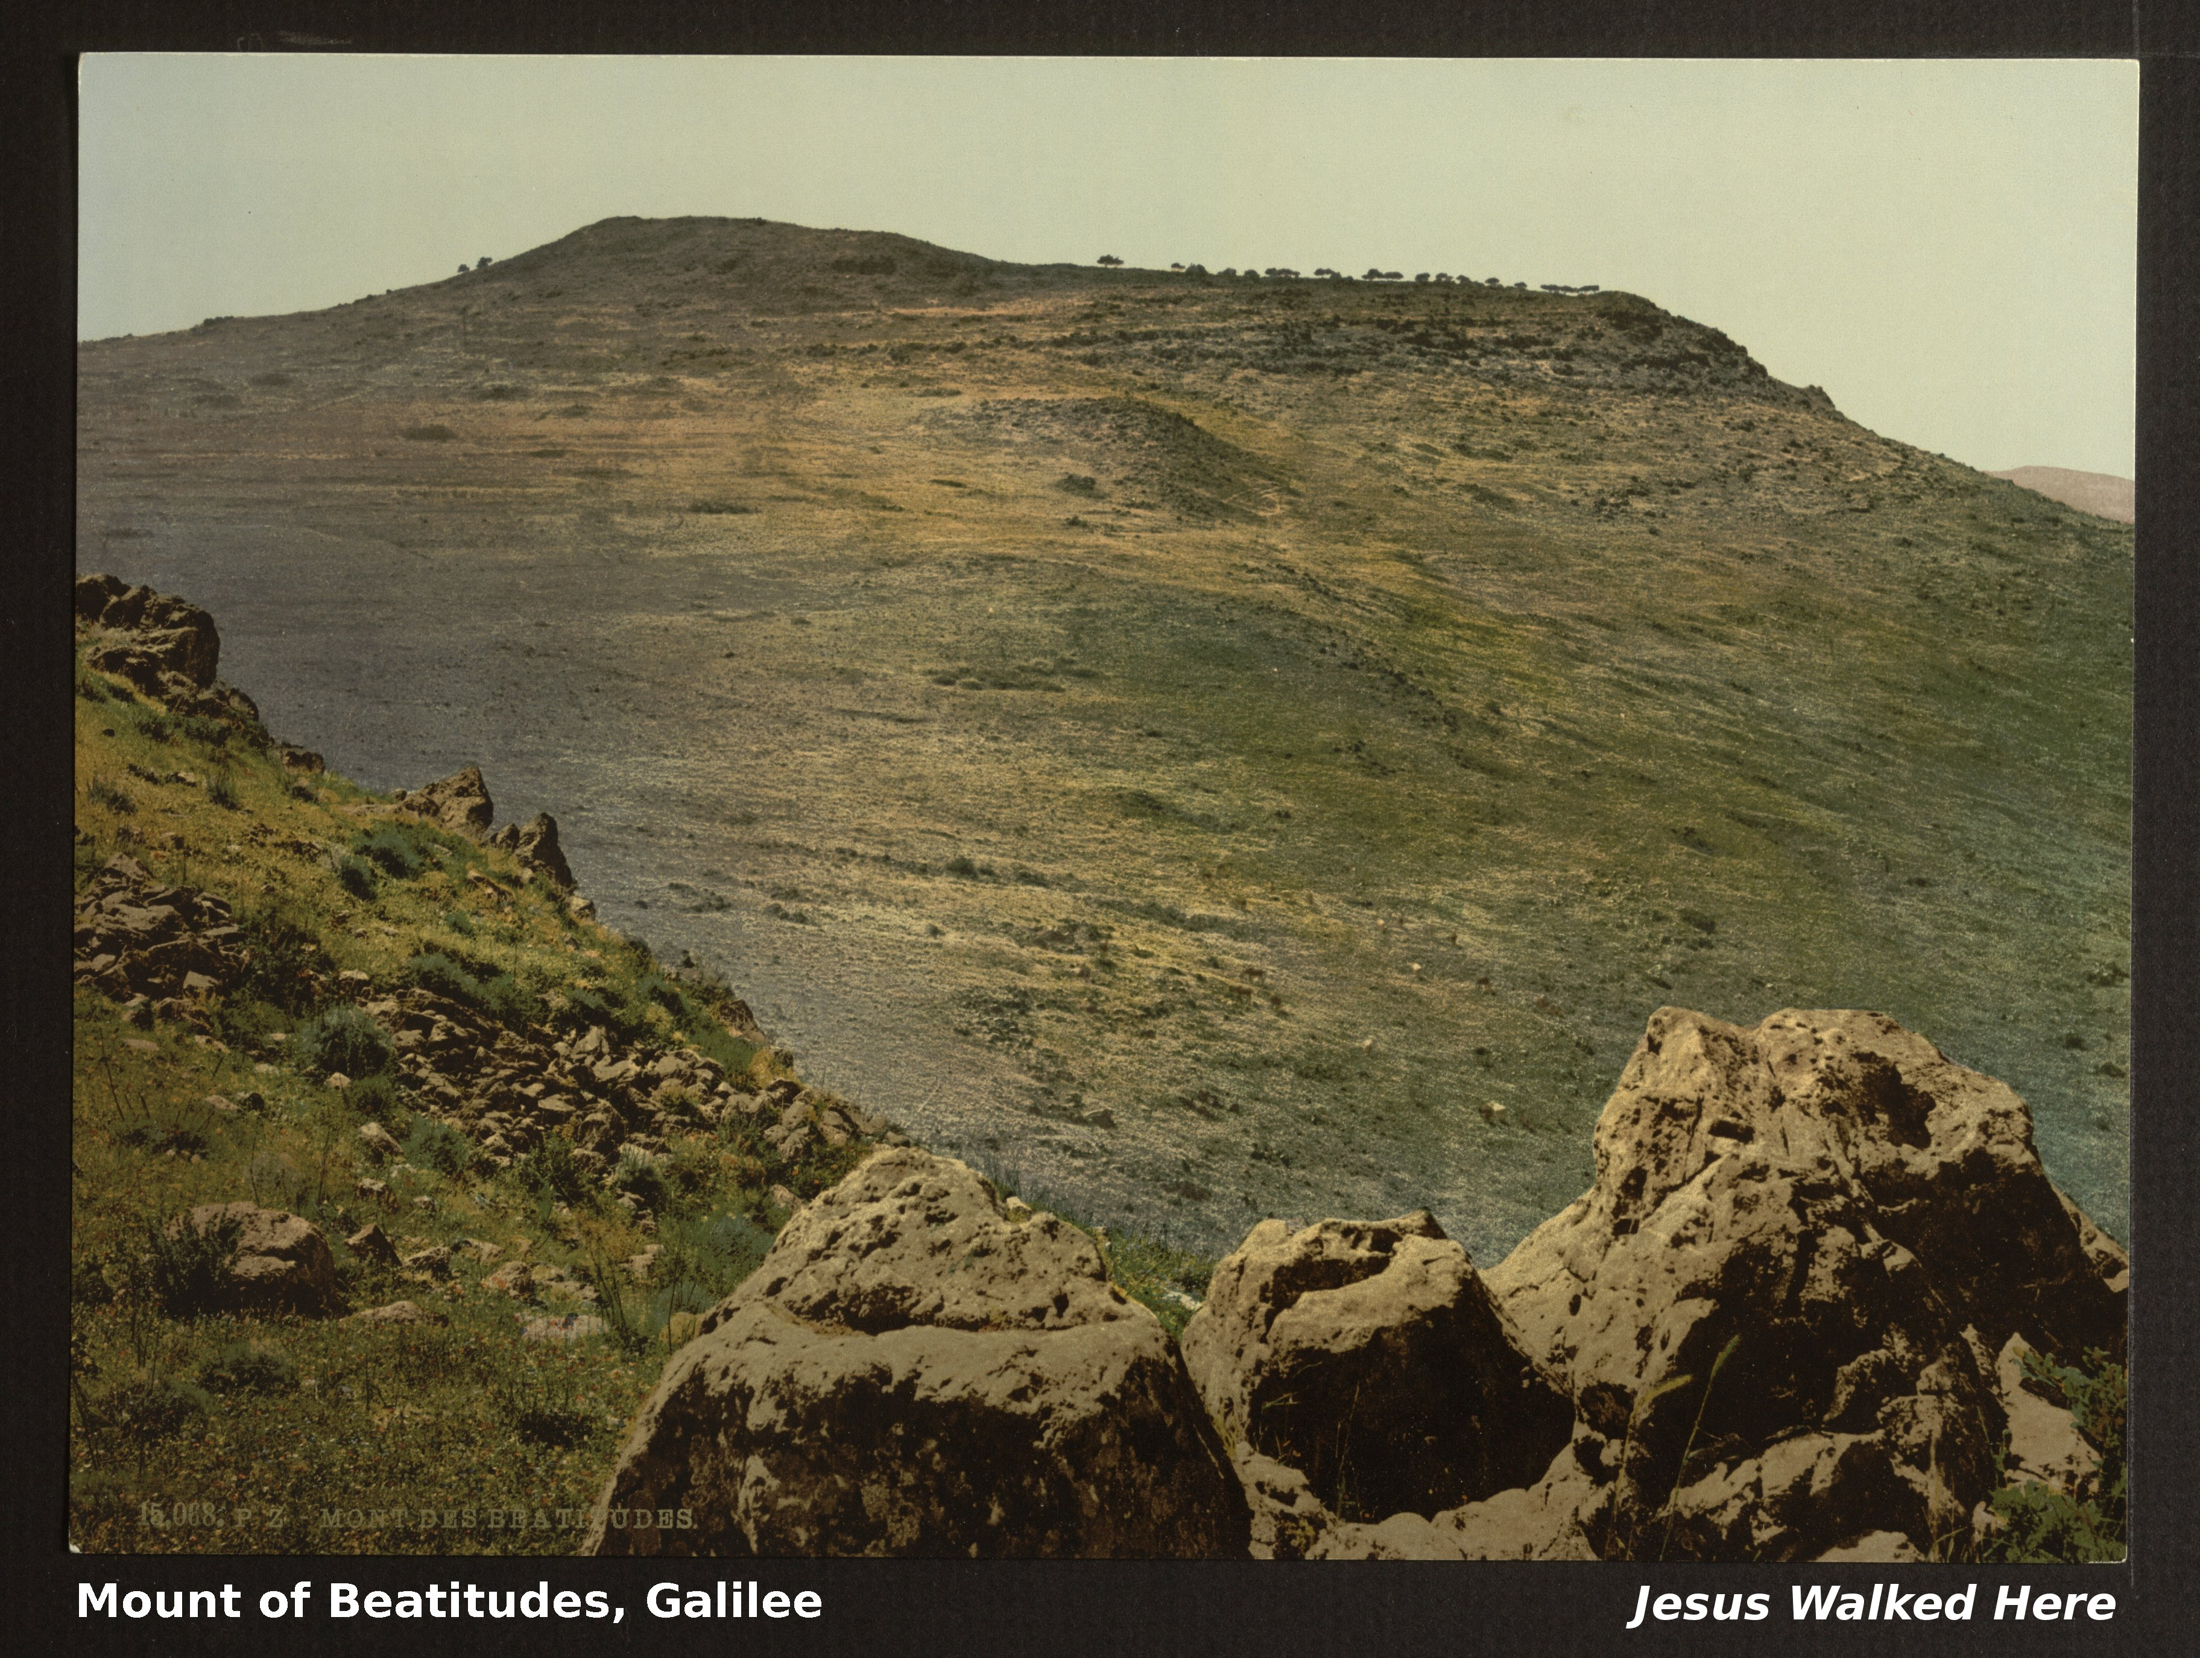
Is the Sermon on the mount outside Matthew?
As for this sermon, Matthew is not the Only Gospel that includes this narrative?
  Question, What is the Synoptic Gospel Theory?
  Sermon on the Plain Luke 6:17-49
What is the Overall purpose in knowing the synoptic process?

Slide 4
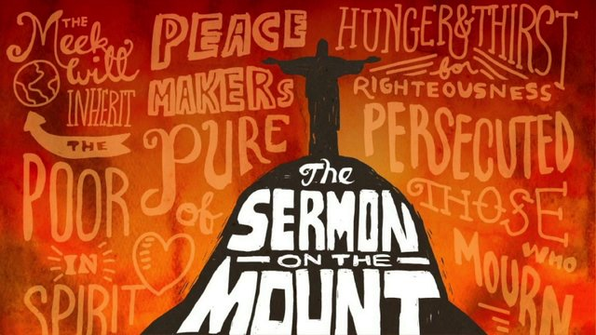
Jesus style of biblical Exegesis
Ex-e-ge-sis – to critically explain or interpret a text
So what foundation does Jesus use for his Sermon
  Torah, including Genesis 1, Exodus 20, Deuteronomy 5
  He also appreciates historical tradition and protocol
  Look at the symbolic gestures of the event
In that mirror sermonic style, Jesus also provides a simplistic window into Christian Ethics based on the Decalogue
What do these commandments warrant? Humanity has the ability to attain a high moral capacity

Slide 5
Chapter Fist: The Beatitudes
So What is a Beatitude?
  In translation – blessings
  These are proverb like blessings – Promises from God
Jesus starts off his sermon to the Disciples with this list of 8 blessings, why?
“Blessed are the poor in spirit, for theirs is the kingdom of heaven.
Blessed are those who mourn, for they will be comforted.
Blessed are the meek, for they will inherit the earth.
Blessed are those who hunger and thirst for righteousness, for they will be filled.
Blessed are the merciful, for they will be shown mercy.
Blessed are the pure in heart, for they will see God.
Blessed are the peacemakers, for they will be called children of God.
Blessed are those who are persecuted because of righteousness, for theirs is the kingdom of heaven.

Slide 6

Salt & Light
Jesus moves from blessings (proverbs) to parables on Salt
Salt is… A preservative to kill bacteria – Christians should have a preserving type of influence
Salt is… used to add flavor. Christians are to add life and flavor to people’s lives.
Salt creates thirst. Christians should create a thirst within others to know Jesus
Salt prevents infections from setting in. The word is an antiseptic of the world’s sores
Light is…. Dispelling darkness. Lives should dispel darkness
Light reveals. The light reveals the darkness in others
Light shows the way. Lead men out of darkness.

Slide 7
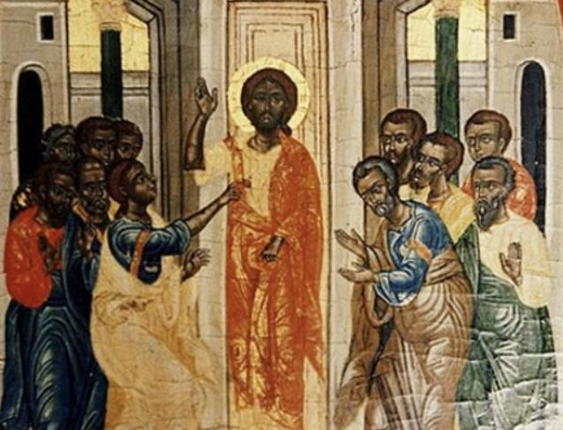
THE RELATIONSHIP OF JESUS CHRIST TO THE LAW
This reminds me of the conversations I had in private with our family
  The Law of Moses needed Clarity to be fulfilled (Matthew 15:1-3)
(1) There is no more need for sacrifice. Jesus became the sin sacrifice for the world as the Lamb of God (John 1 :29).
(2) Jesus became our sacrifice of burnt offering, the offering of consecration.
(3) Jesus became our peace offering, making peace between man and God (Ephesians 2:14).
(4) Jesus fulfilled the Sabbath law, which was the rest that God had given to His people (Hebrews 4:9-10).

Slide 8
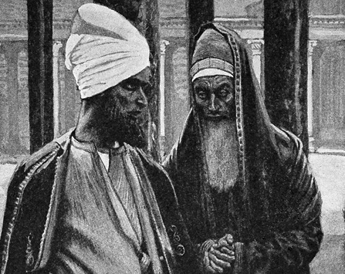
TO EXCEED THE RIGHTEOUSNESS OF THE SCRIBES AND PHARISEES
The true intention of the law was that we exceed the righteousness of the scribes and Pharisees.
  The law was to govern men's attitudes as well as their actions.
  After the Babylonian captivity, the common people could no longer read the Hebrew language, and they depended on the scribes for the interpretation of the law.
  They put the emphasis on the outward observances of the law and ignored the inward law of God
  The rest of Matthew 5 affirms the fact that God is more concerned with the propria persona (for oneself) attitudes that lead to the right actions.

Slide 9

Additional Laws in Place
Murder
Adultery
Divorce
Oaths
Eye for Eye
Love Enemies

