Slide 1
Unit 2 The Good News
John Calls for Repentance

Slide 2

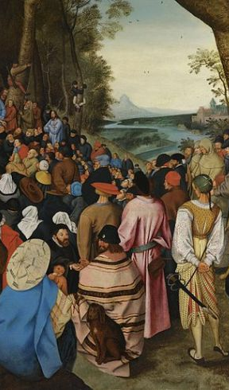
John Calls for repentance
Focal passage: Luke 3: 1-18
Background Text: Luke 3: 1-18; Isaiah 40:1-11
Purpose Statement: To insist that repentance should evidence itself in behavior.
Key Verse: “John went throughout the region of the Jordan river, calling for people to be baptized to show that they were changing their hearts and lives and wanted God to forgive their sins” (Luke 3:3)

Slide 3
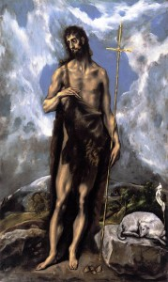
John the Baptist…
The most important man in the new testament. “Among them that are born of women there hath not risen a greater than john the Baptist” (Matthew 11:11)
His assignment from the messiah.
No jealousy here “He must increase” said John of the messiah, “but must decrease” (John 3:30)
He modeled what we as disciples of Christ should be today.

Slide 4

Happy new year (Page 47)
ARE YOU Looking back AT the last 12 month OR ARE ANTICIPATING A NEW YEAR?
New opportunities and new beginnings.
Your mind is your control center so…

Slide 5

John and his ministry
A prophet
Son of Zachariah (God Remembers) and Elisabeth
Why the wilderness?
Preached in the wilderness of judea
Spiritual messages (page 48) Bold, judgmental, demands were challenging But he offered people new life, hope, and the promise of the coming messiah.

Slide 6

John’s message
Multitude (diverse group)
Uncompromising and strong language. He described the crowd as a generation of vipers.
Failure to listen.
When you look at and back over your life….
The people’s cry (What should we do?)
A prescription for life (Page 49)

Slide 7
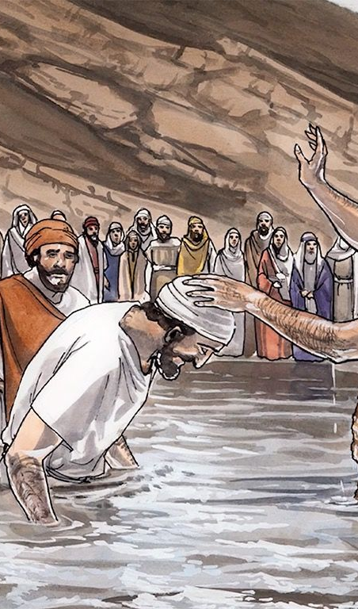
John and the messiah
The people wondered
John’s humility
John’s description of judgement.

Slide 8
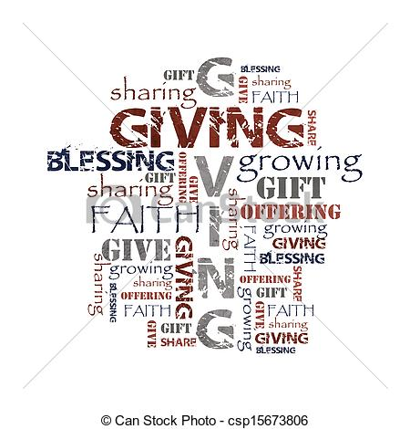
Expectations well defined
(A new way of living)
Page 51-52

Slide 9

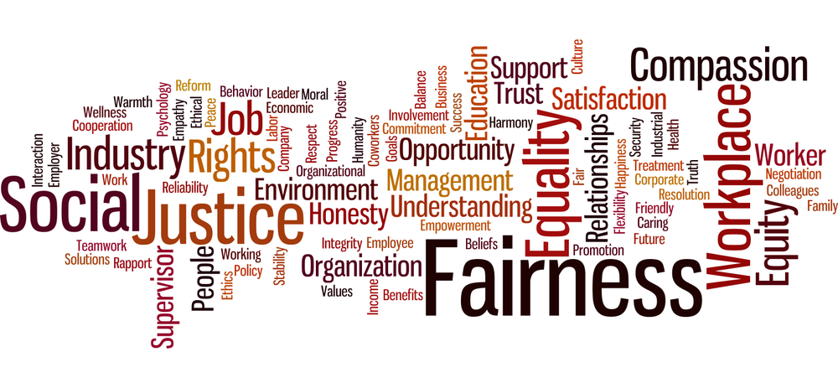

Slide 10
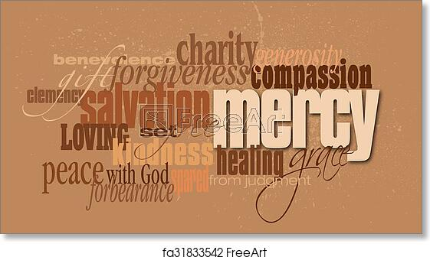

Slide 11
The spiritual practice of mercy
(page 55)
Situations of hopelessness
The works of mercy
This coming week where will you extend hope to someone through an act of mercy.

Slide 12


Slide 13


Slide 14

Song for the week

Slide 15
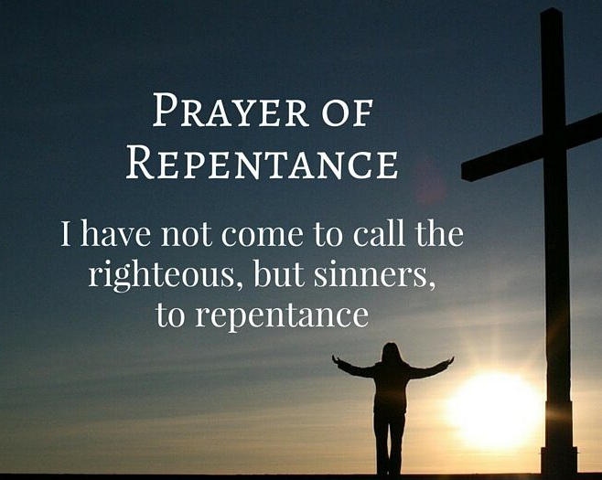
Thought for the week
Repentance and reformation bring restoration.

