Slide 1
The Cross and the Lynching Tree
Chapter Five: Oh Mary, Don’t You Weep

Slide 2
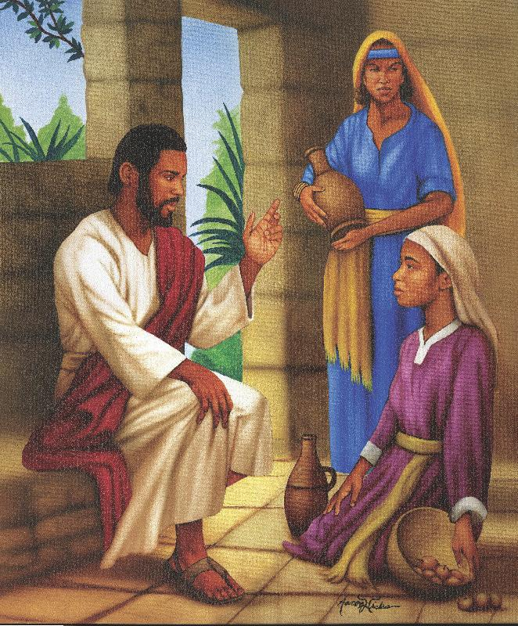
Questions
Next Week:
  What is womanism? (You Might have to look this one up)
  Why is the re-telling of the Jesus story without the inclusion of women – INADEQUATE
  Describe some of the contradictions the black church has had to overcome, concerning the treatment of women

Slide 3
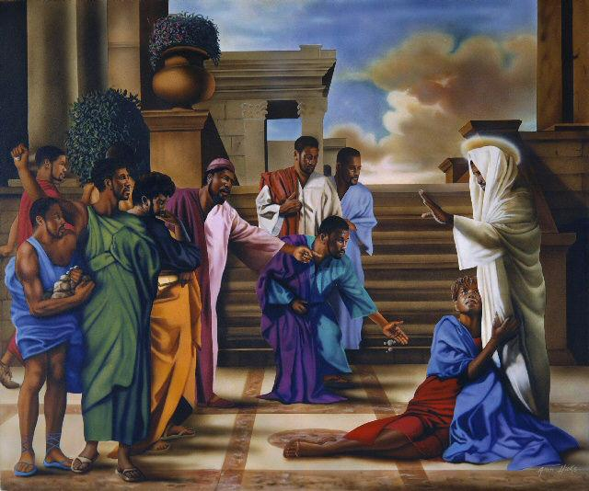
Womanism
“Black women have objected to being invisible in lynching discourse, as if they were exempt from mob violence”(122)
Anguish that lynching created on women connected to the prophets and Job’s experience (123)
What can Christians learn when seeing the faith through the eyes and lives of black women?

Slide 4
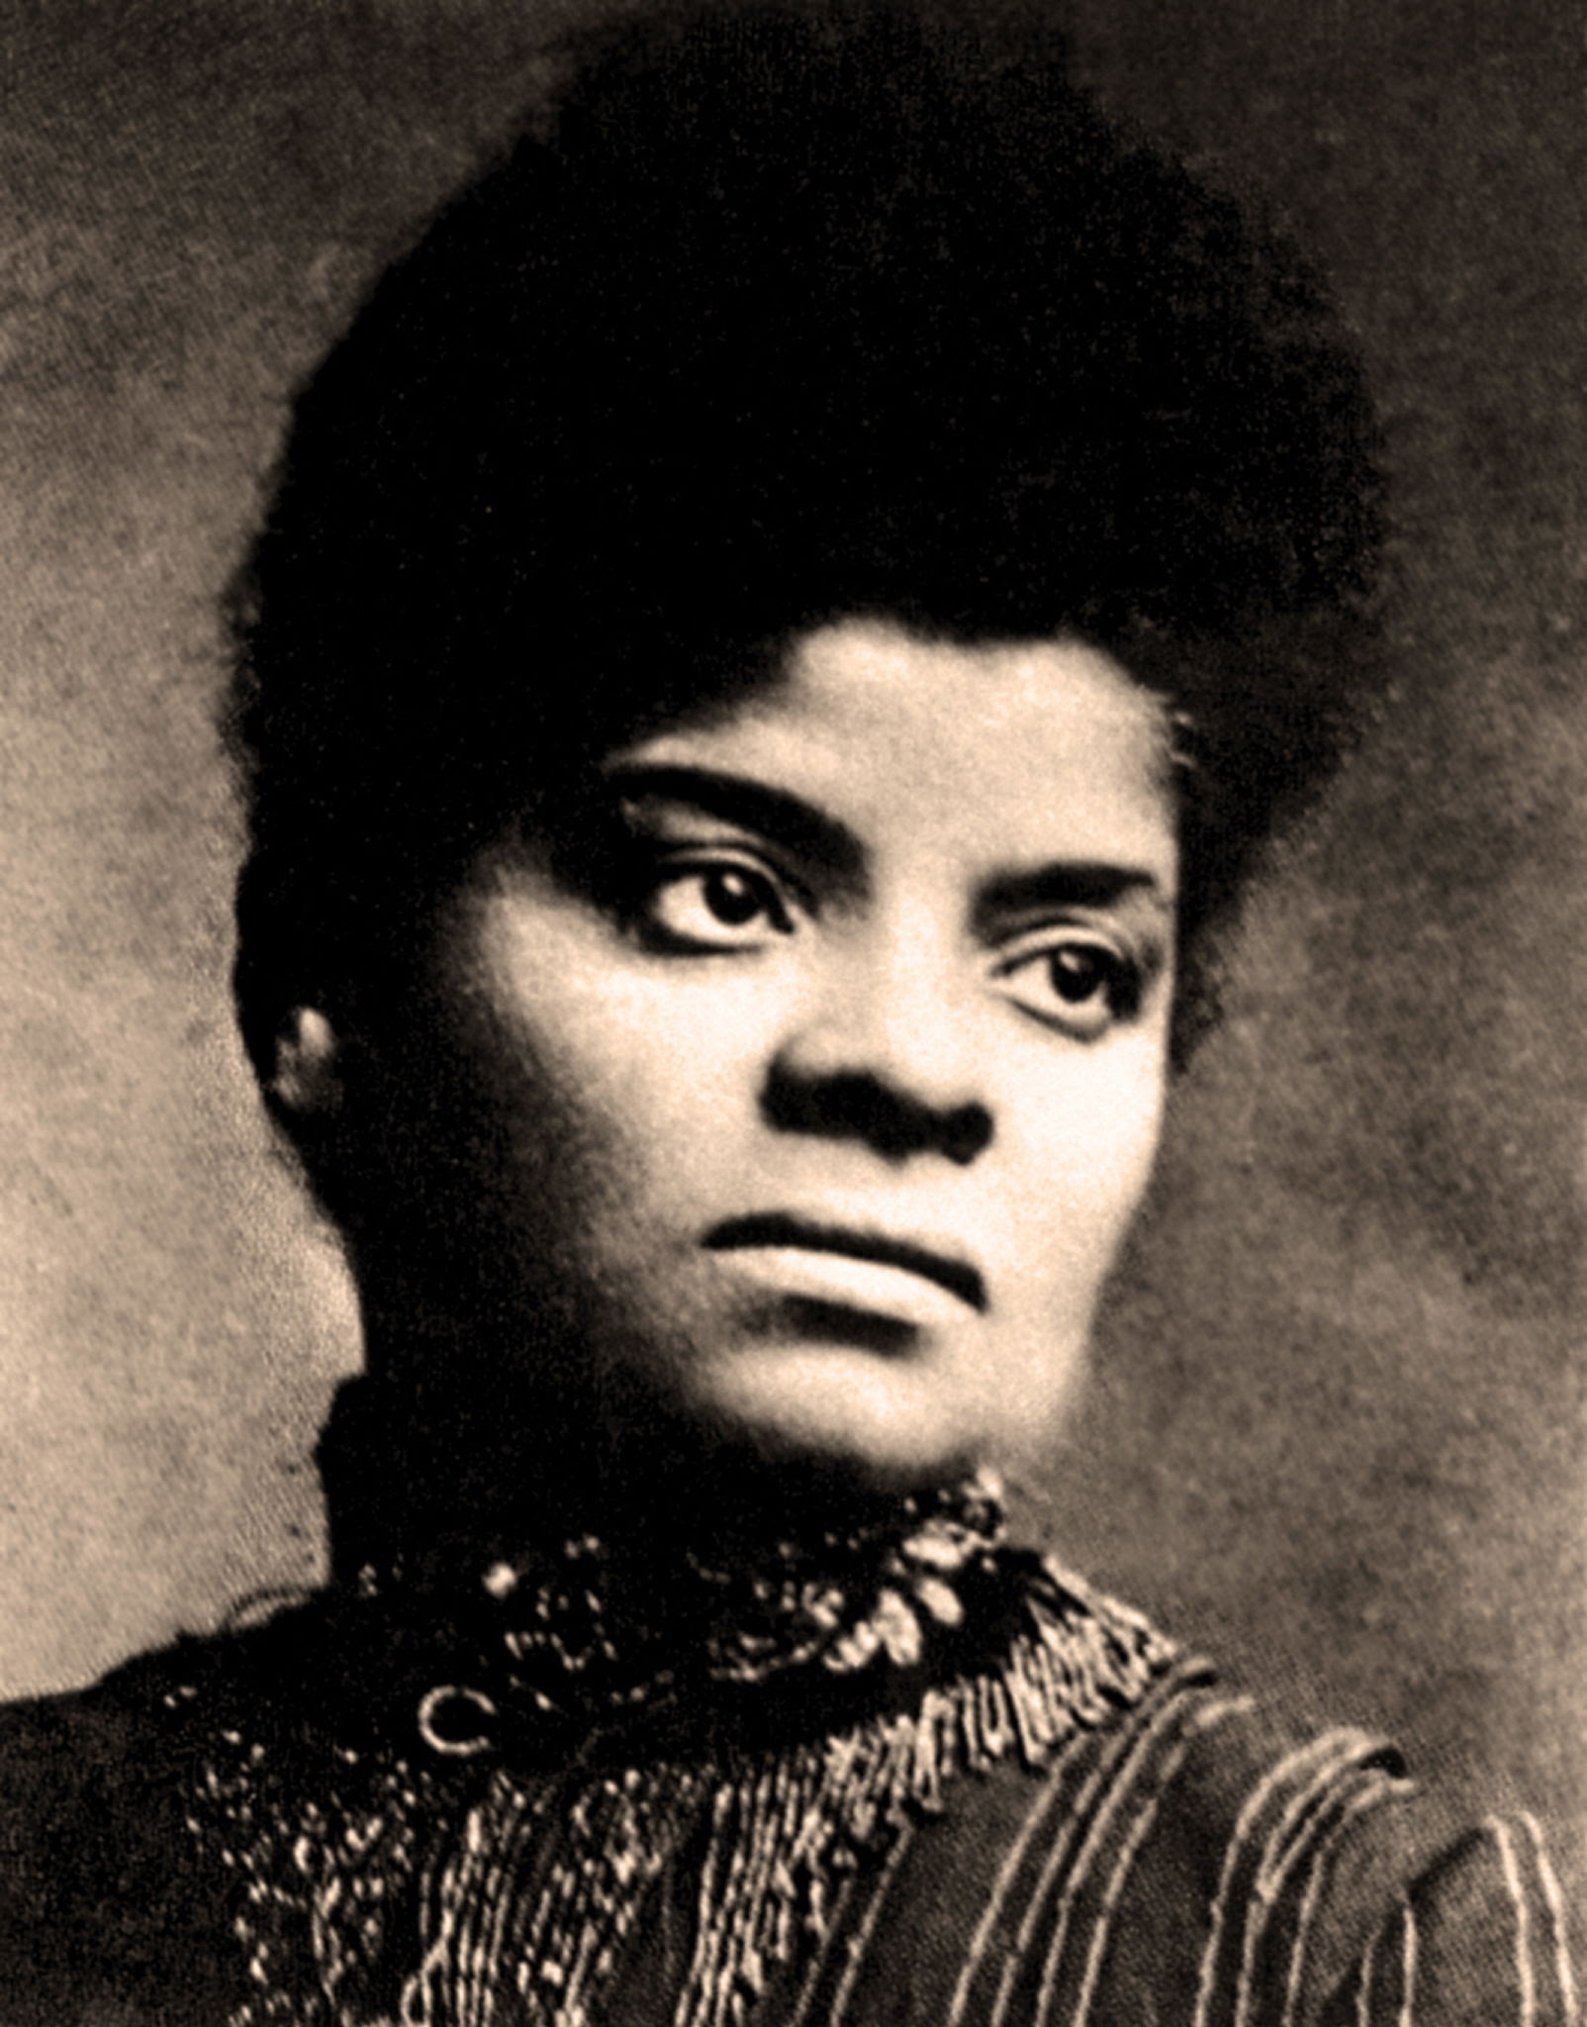
Ida B. Wells
Bio
  Born a slave in Mississippi, 1862
  Raised her siblings in Memphis, TN as an educator
  Gained notoriety when she sued a railroad company after being evicted from a train seat (126)
  Became a journalist for The Free Speech, 1892
  True calling began when three black men, one close, was lynched
Leader of the Anti-Lynching Crusade
Where did she get the courage? The Cross
  Faith defined by the cross (130)
  She rebuked those who patiently waited on God to save them from injustice
  “Why don’t you pray to live and ask to be freed? The God you serve is the God of Paul and Silas who opened the prison gates”
  She dismissed white Christianity as hypocrisy, and said It was not genuine. “Nation cannot profess Christianity.” – Speak Out

Slide 5
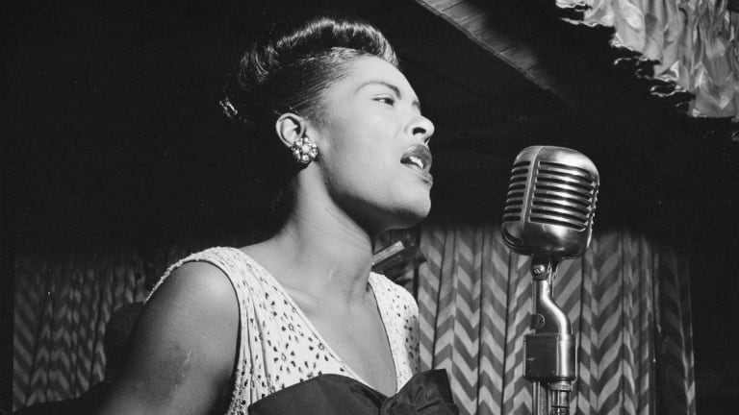
Strange Fruit
Southern trees bear a strange fruit
Blood on the leaves and blood at the root
Black bodies swingin' in the Southern breeze
Strange fruit hangin' from the poplar trees
Pastoral scene of the gallant South
The bulgin' eyes and the twisted mouth
Scent of magnolias sweet and fresh
Then the sudden smell of burnin' flesh
Here is a fruit for the crows to pluck
For the rain to gather
For the wind to suck
For the sun to rot
For the tree to drop
Here is a strange and bitter crop

Slide 6
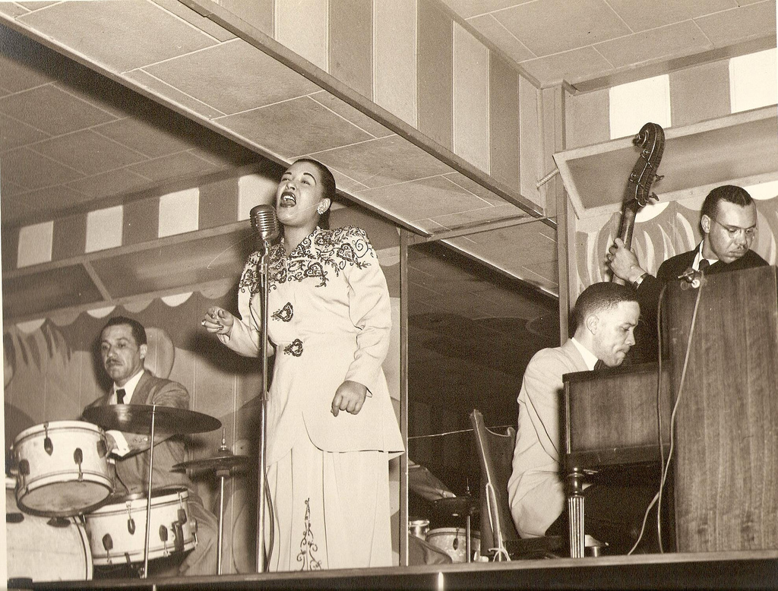
Billie Holiday
Bio:
  Elanora Fagan, was born Philly, 1915
  Known as the First Lady of Blue (Lady Day) she was influential in jazz music
Sang the song as a personal protest
  Similar to Nina Simone’s “Mississippi Goddam,” the song forced a consciousness to its listeners
  Similar to the past chapter, Simone’s art forced listeners to confront the veil of white supremacy

Slide 7
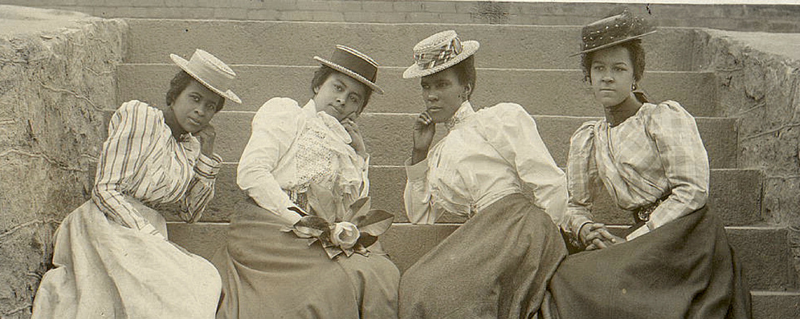
National Association of Colored Women (NACW)
Main Issue: Lynching was the main issue
They weren’t militant, and instead taught politics of respectability and racial uplift (140)
  Yet, when it failed, protest began
Appeal to the white public, especially women, to join with the black community in opposition against mob violence (141)
Nellie Burroughs, “Urged blacks to resist the temptation of spiritual passivity, as if God would liberate them without their own participation.
  “Don’t wait for deliverers.. There are none…Work as if all depends upon you. Pray as if all depends on God.

Slide 8
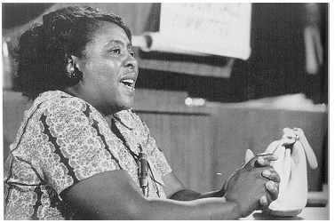
Fannie Lou Hammer
Bio:
  Born and worked as a sharecropper in Mississippi, 1917
  Notably received a hysterectomy without consent alongside experiencing frequent acts of racism as a child
FLH placed Jesus where his experience could be used in the Freedom Struggle
  The cross gave her courage (144)
She was beat for trying to register and vote in Mississippi
  Her response, spiritual power gave her the power to resist. Blessed Assurance

