Slide 1
The Cross and the Lynching Tree
Chapter Four: The Recrucified Christ in Black Literary Imagination

Slide 2
“Artist force us to see things we do not want to look at because they make us uncomfortable with ourselves and the world we have created.”

Slide 3
Walter Everette Hawkins, A Festival in Christendom”
And so this Christian mob did turn
From prayer to rob, to lynch and burn
A victim helplessly he fell
To tortures truly kin to hell
They bound him fast and strung him high
They cut him down lest he should die
Before their energy was spent
In torturing to their heart’s content
They tore his flesh and broke his bones
And laughed in triumph at his groans
They chopped his fingers, clipped his ears
And passed them round as souvenirs

Slide 4
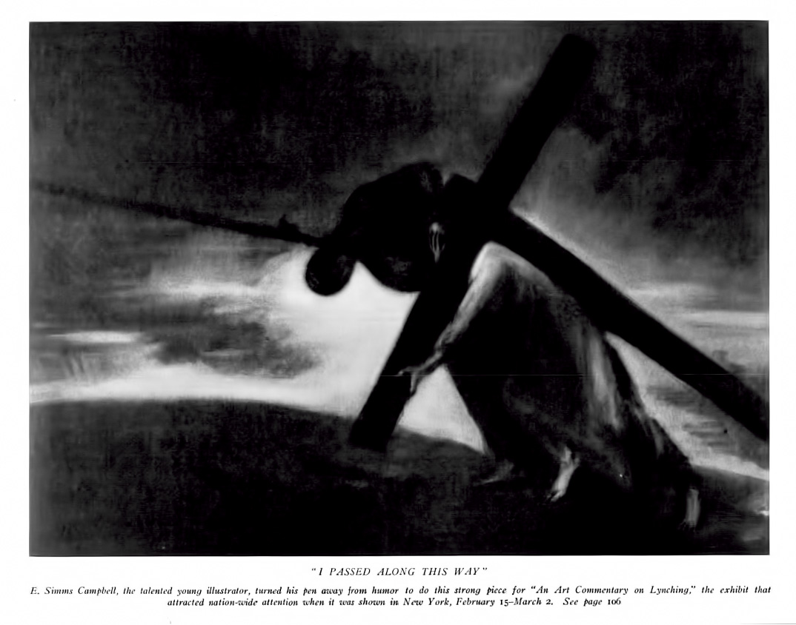
"I passed along this way"
Photo shows a man, possibly meant to be Jesus Christ, with his right hand covering his face, laboring uphill under the burden of a cross; also shows over his right shoulder, the upper torso of a lynched African American man with a rope extending from the left around his neck.

Slide 5
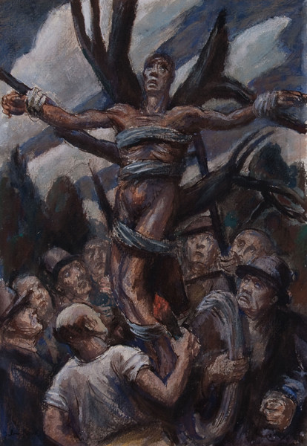
Julius Bloch, Lynching
Like many socially engaged artists of the 1930s, Bloch took the lynching of black men as one of his subjects. Outraged by newspaper stories and photographs of mob violence perpetrated against African Americans, he crafted this composition based on the crucifixion of Christ.
Here a man is bound to a dying tree, his arms outstretched and face lifted up in abject suffering. In its T-shaped form, his body unmistakably recalls Christ’s suffering posture on the cross. The black man is elevated above his white foes, who encircle him, holding a burning torch and a length of rope ready. The ominous clouds dramatize the man’s impending suffering and death.

Slide 6
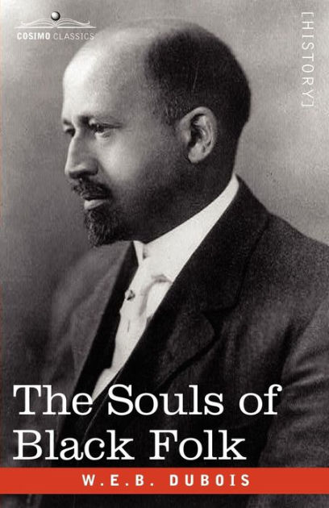
Du Bois, The Riddle of the Sphinx”
Till some dim, darker David, a hoeing of his corn
And married maiden, mother of God,
Bid the black Christ be born
Then shall our burden be manhood
Be it yellow or black or white;
And poverty and justice and sorrow
The humble and simple and strong
Shall sing with the sons of morning
And daughters of even-song

Slide 7
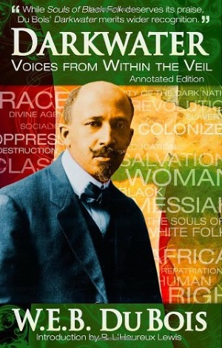
Du Bois and The True Christ
An exert story, “Jesus Christ in Texas”
  Has a stranger appearing as a messianic figure
  A mulatto with hair hung in close curls
“Second Coming”
  A black baby is born as the Black Christ in Valdosta, GA
Religion of white supremacy a miserable failure
  True Christianity was defined by the "life and teaching of Jesus of Nazareth and the Golden Rule.”
  White Christ is not the biblical Christ (103)

Slide 8
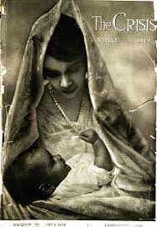
Du Bois and the crisis
“Gospel of Mary Brown”
  Luke’s retelling of Jesus’ birth
  Mary is black, living in a cabin by the creek
  Joshua works on the plantation, plowing, picking and hoeing cotton.
  Joshua is killed for his message
Other stories include:
  Pontius Pilate; My God, my God!; The Son of God; Easter
  What do these stories provide?

Slide 9
Poems
Robert Hayden’s, Night Death, Mississippi
In the sweetgum dark
Unbucked that one then
And him squealing bloody Jesus
As we cut off
Then we beat them, he said,
Beat them till our arms was tired
And the big old chains
Messy and red
O jesus burning on the lily cross
James Andrews, Burnt Offering
A fatted calf, a priestly fire;
The sacrificial knife, a dire
Foreboding of a bloody thing
It plunges deep, death takes its prize;
And smoke ascends toward the skies
Burnt offering
A lonely tree, a surging crowd
With clubs and stones and voices loud
A black man as a calf they bring
Upon a newer Cross he dies
And smoke ascends towards the skies
Burnt offering

Slide 10

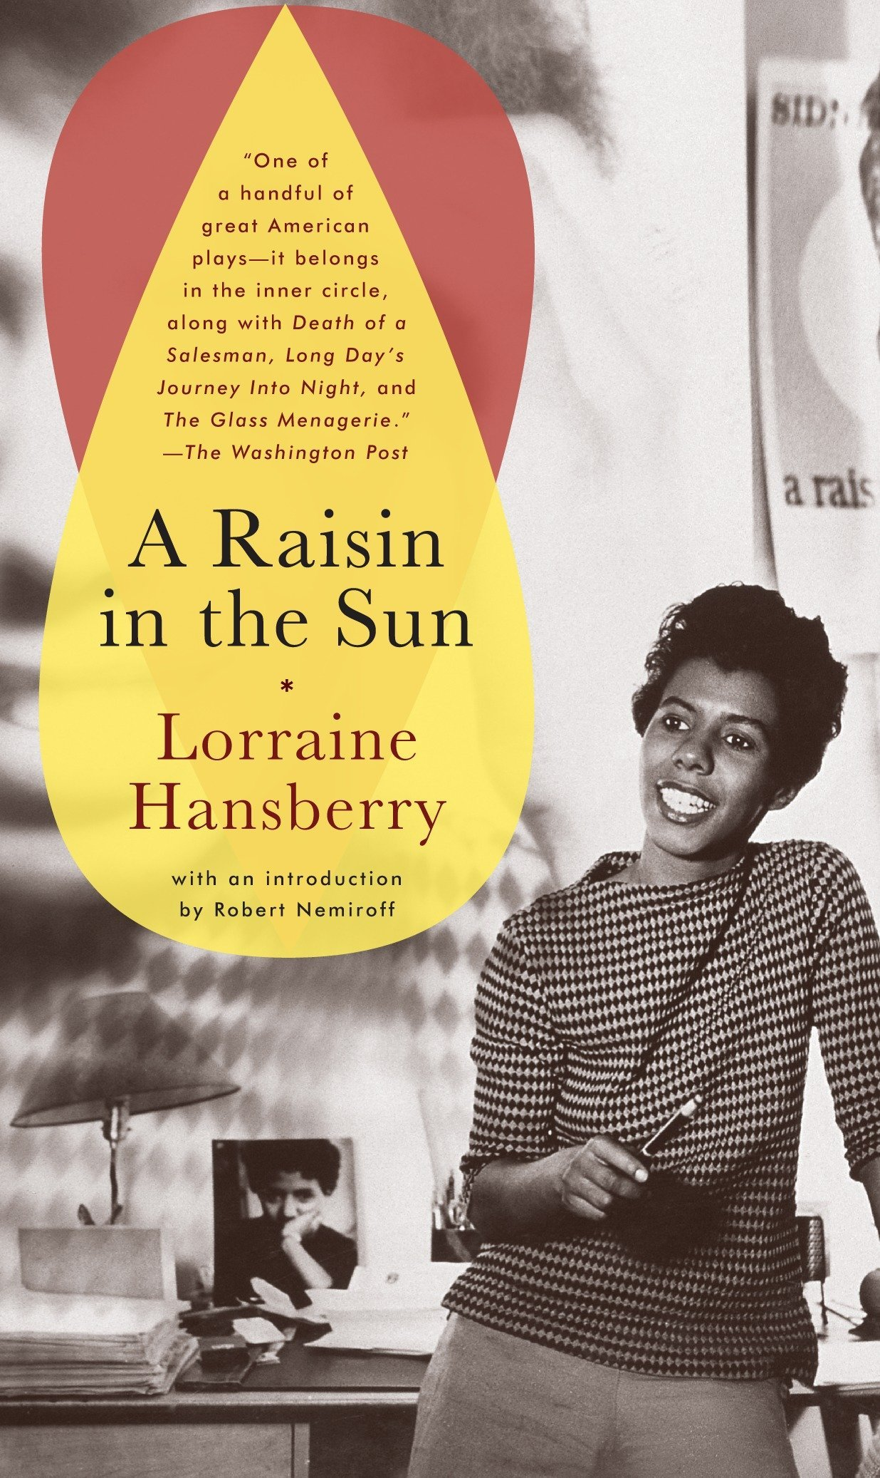
Lorraine Hansberry, Lynchsong
Laurel:
Name sweet like the breath of peace
Blood and blood
Hatred there
White robes and
Black robes
And a burning
Burning Cross
Cross in Laurel
Cross in Jackson
Cross in Chicago
And a
Cross in front of the
City Hall
In:
New York City

Slide 11
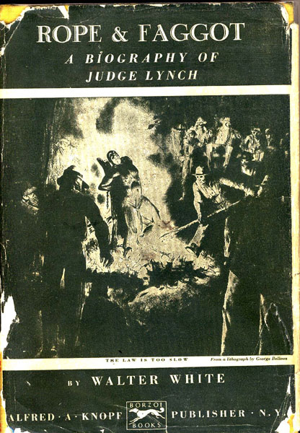
Walter White, Rope and The Faggot
Walter White was the national secretary of the NAACP and author of several novels
He would indict Christianity for creating the fanaticism that encouraged lycnihng
“It is exceedingly doubtful if lynching could possibly exist under any other religion than Christianity. Not only through tacit approval and acquiescence has the Christian Church indirectly given its approval to lynching law…, but the evangelical, .Christian denominations have done much towards creation of the particular fanaticism which finds its outlet in lynching.”

Slide 12
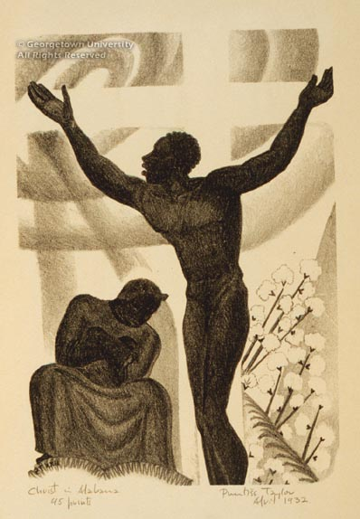
Langston Hughes, Christ in Alabama
Christ is a Nigger,
Beaten and black--
O, bare your back.
Mary is His Mother
Mammy of the South,
Silence your Mouth.
God's His Father--
White Master above
Grant us your love.
Most holy bastard
Of the bleeding mouth:
Nigger Christ
On the cross of the South.

Slide 13
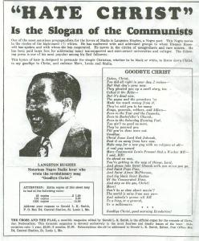
Reactions
These poems and forms of art offended the white Christian community and even African Americans were not happy about it.
Artist were often denounced in both black and white churches when challenging white supremacy in Christianity – blacks because fear, whites because racism
Artist force us to see things we do not want to look at because they make us uncomfortable with ourselves and the world we have created.
For the black artist/leader, many rejected the celebration of the cross as a means of salvation.

Slide 14
Questions
This Week:
  Artist often used their Creativity to develop nuance – new ways to understand Christianity
  How are we contextualizing or relating our experiences to that of Christ?
  Artist taught of God outside the Church, in what secular ways can we still teach the Gospel?
Next Week:
  What is womanism? (You Might have to look this one up)
  Why is the re-telling of the Jesus story without the inclusion of women – INADEQUATE
  Describe some of the contradictions the black church has had to overcome, concerning the treatment of women

