Slide 1
The Cross and the Lynching Tree
Chapter Three: Bearing the Cross and Staring Down the Lynching Tree

Slide 2
Questions from Last week
The Lynching tree was supposed to instill silence and passivity in the black community. It had the opposite effect, inspiring blacks to rise in defiance and fight back. Why, and how does this relate to your Christian Journey?
What does it take to see the REAL CROSS OF JESUS?
Cone argues that Faith will not erase the pain and suffering of a Lynching Tree experience. What does this mean to you?

Slide 3
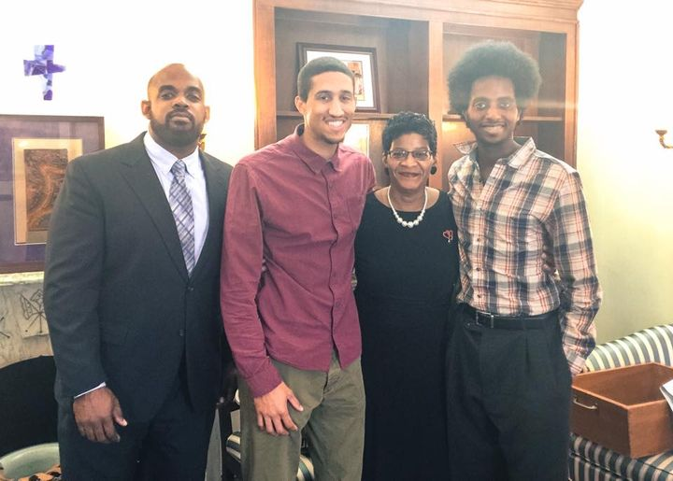
Emmett Till
Emmett Till was lynched in 1955, at 14.
  According to Cone, his death did what for Civil Rights?
  What did it mean that his death “rocked the nation”
  What are your thoughts on Mamie Till Bradley’s decision?
    How can emulate this energy?
How should the church align with these tragedies?

Slide 4
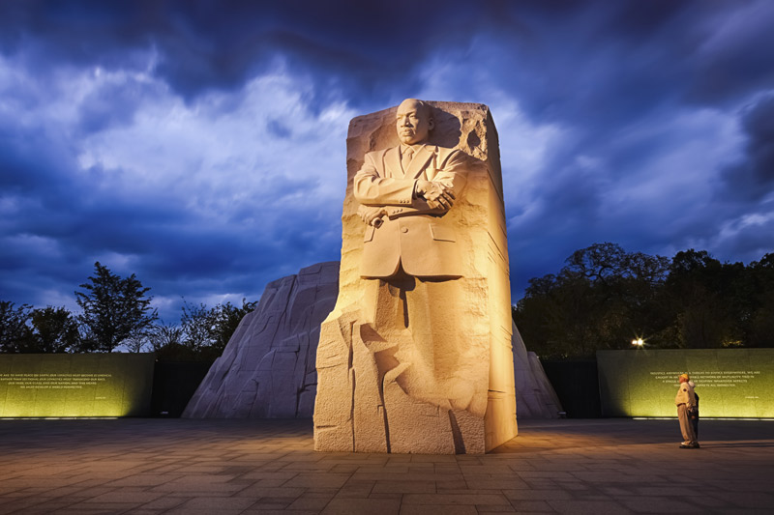
Christian Spirit of Resistance
Unlike Niebuhr, King couldn’t separate theology from religion
  “When Christ calls a man, he bids him come and die”
  What does this say as Christians having a responsibility to serve
    If we don’t serve, what does that make us?
For King, “God’s love created blacks and whites and other human beings for each other in community
  White supremacy was the sin that separated them in America (antithesis)
  God reconciled humanity through Jesus’ cross
  Therefore, white supremacy could never have the final and ultimate word on human relationship – God’s word was IT

Slide 5
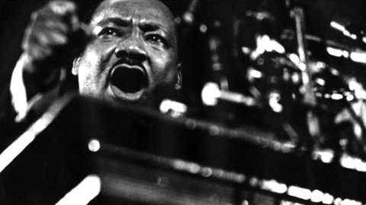

Slide 6
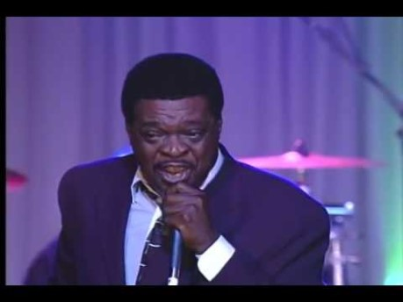
A Jericho Road
“You have to be prepared to die before you can begin to live.” Fred Shuttlesworth
  The religion has always been a “dying/sacrificing” faith
The hymn writers
  I knot it was the blood – martyrdom
  What does this blood commemorate?
A spiritual midnight, what was it?
  Have we had a spiritual midnight?
Did King want to be a martyr?
  How did he maintain the course God set him on?
A Jericho Road
  Holy Week was a dangerous act – Jesus knew the possibilities
  King stayed on his cross and he stayed on his Jericho Rd. Why?

