Slide 1

Is Your Resume Impressing Resume Robots and
Other Realities of Job Search
Helen LaVan, PhD
Professor of Management and Entrepreneurship
DePaul University
hlavan@depul.edu
312-362-8539
Experienced Helping Develop 4,000+ Resumes

Slide 2
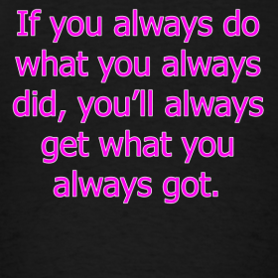
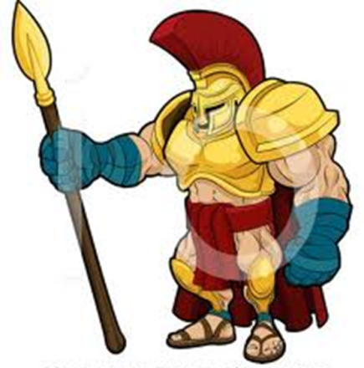

Slide 3
What You Will Learn
Best Practices For Resume Format and Content.
ATS.
Resume Robots.
Word Basics—Clear Formatting and PDF Issues.
Jobscan.
Cover Letters.
What Else To Do?

Slide 4
Resume Format

Slide 5
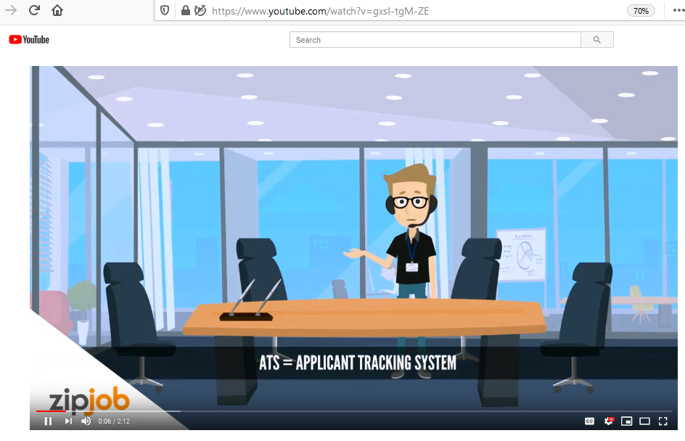
https://www.youtube.com/watch?v=gxsI-tgM-ZE

Slide 6
Who Will Read My Resume—Mostly No One
According to a study by Preptel, a job search firm, 75 percent of all resumes are never seen by a real human being. Instead, they are filtered out by ATS without a second glance. Apr 9, 2019
https://blog.careerminds.com/75-percent-of-resumes-are-never-read

Slide 7
What is an ATS
An applicant tracking system (ATS) is software that manages the recruiting and hiring process, including job postings and job applications. It organizes and makes searchable information about job seekers. As its name implies, an ATS tracks candidates through the hiring process. It helps scheduling, issues notification alerts and sends automated emails to candidates. But these systems are far more than organizers.

Slide 8
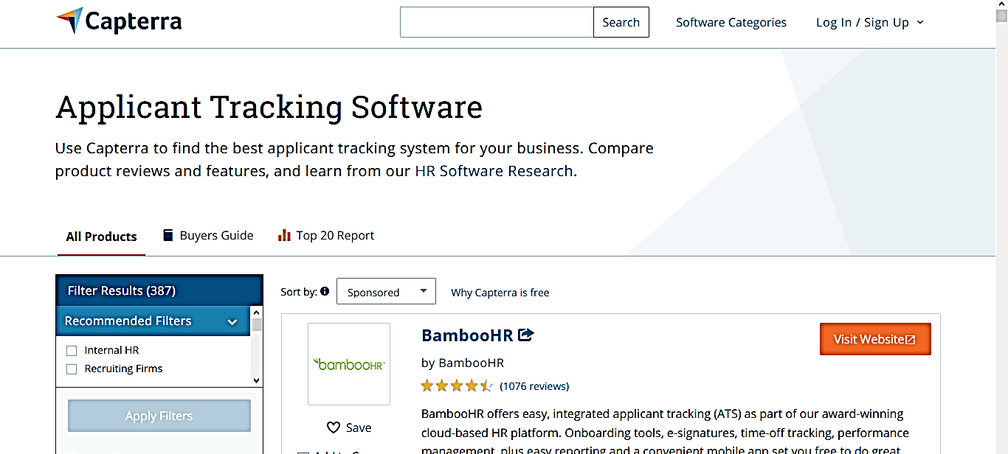
How Many ATS Are There?
Maybe 387
https://www.capterra.com/applicant-tracking-software/

Slide 9

What is a Resume Robot
https://www.themuse.com/advice/meet-the-robots-reading-your-resume

Slide 10
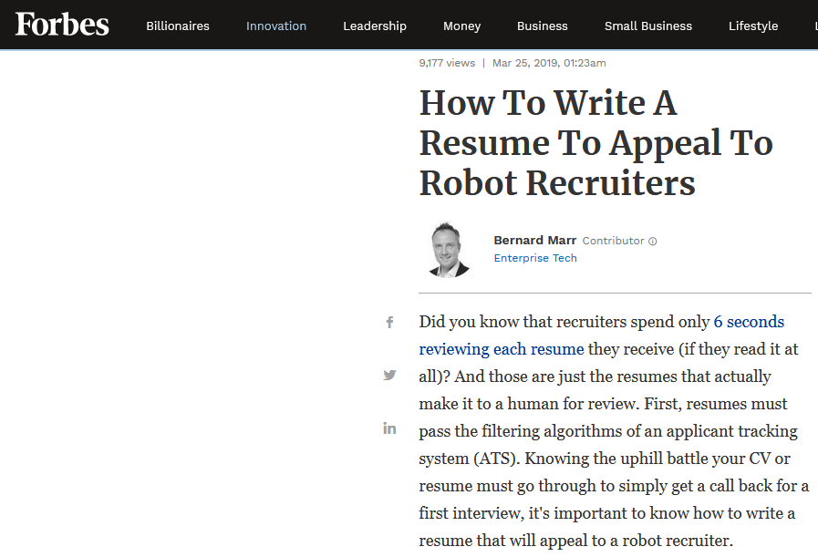
How To Write A Resume To Appeal
To Robot Recruiters
https://www.forbes.com/sites/bernardmarr/2019/03/25/how-to-write-a-resume-to-appeal-to-robot-recruiters/#6097f2d89dfa

Slide 11
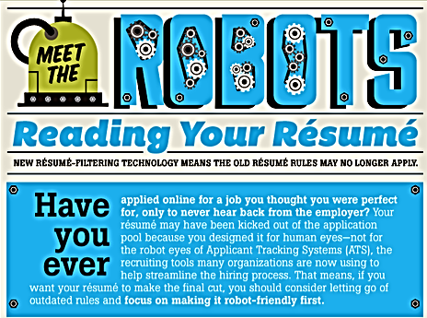

Slide 12
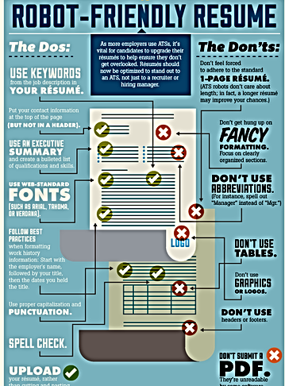

Slide 13
Word Processing Basics

Slide 14
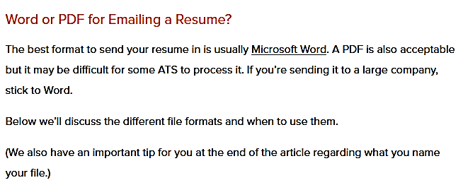
Word Vs. PDF
https://www.zipjob.com/blog/pdf-vs-word-for-sending-your-resume/

Slide 15

Word Processing—Limiting or None of the Following
One inch margin all around.
Clear formatting—this is an option on Word also.
No fonts with serifs.
Set tab for 5.5 to get date on the right side.
Limit bullets.
No one page.
No pdf unless requested.
No extraneous spaces or tabs
No Headers.
No Fonts with Serifs.
No Graphics.
No symbols such as & \ |* -

Slide 16
Word Basics
After you are sure there are no spelling or grammar errors: Word>Options>Proofing>Hide Spelling Errors and Hide Grammar Errors. Otherwise, if a word is not in the dictionary of the recipient, it might appear as misspelled, even if it is correct.

Slide 17
Resume Content

Slide 18
What is Resume Optimization Software
Resumes can be optimized for format or content. Prior slides were related to optimization format.
Next slides are related to resume content. You’ve made it through the ATS—now what should happen? Here is where you need to have content matching key words in the job listing.

Slide 19
How Many Resume Optimization Software Are There? Hard to Know
See: https://www.toptenreviews.com/best-resume-writing-software
However, be sure the format is ATS friendly.

Slide 20
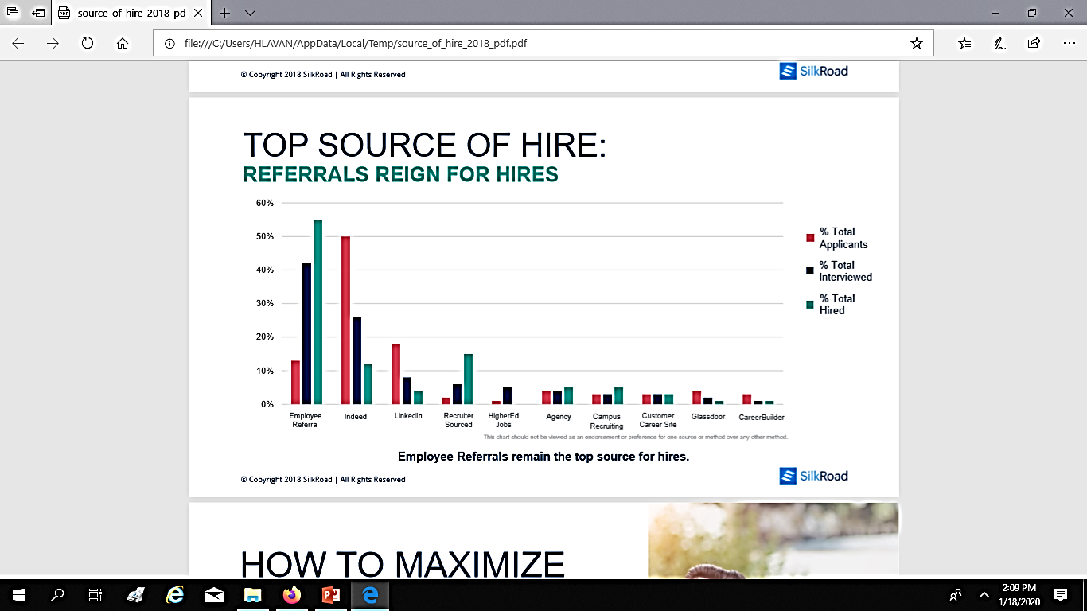
Why LinkedIn May or May Not Be Your Friend
Not as much of a source of hires as is generally touted.
In my experience, it is slow and recruiters do not always remove filled positions.
Also, you are not networking with people who know your qualifications.
Silk Road Sources of Hire Report, based on 650,000 Interviews.

Slide 21
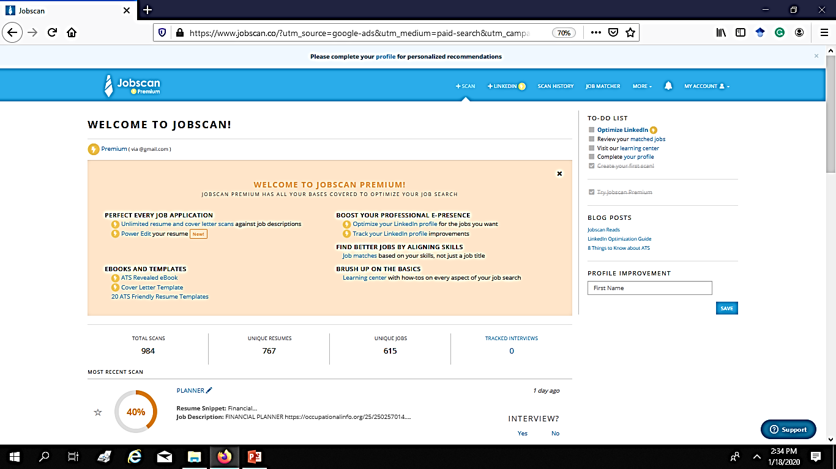
What is Jobscan? http://www.jobscan.co
I do not have a financial interest in Jobscan, but I am provided with free scans.

Slide 22
Jobscan
https://www.jobscan.co/faq?sscid=11k4_e39g5
Five free scans monthly.
I do not have a financial interest in Jobscan, but I am provided with free scans.

Slide 23
Jobscan Offers
See: https://www.jobscan.co/faq?sscid=11k4_e39g5
Five free scans monthly.
Most importantly—provides a matching score and lists terms that are omitted from you resume. You can edit your resume (summary) to have at least a 70% matching score.
May provide ATS friendly info.
LinkedIn Optimization.
Suggest Jobs.
Power Edits
I do not have a financial interest in Jobscan, but I am provided with free scans.

Slide 24
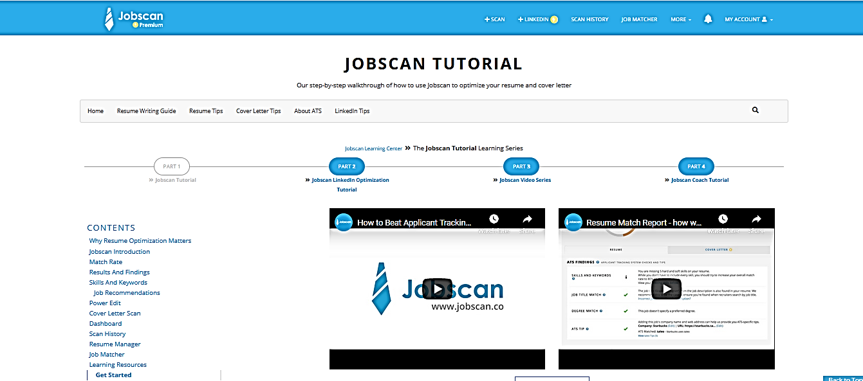
Jobscan Tutorials- https://www.jobscan.co/jobscan-tutorial

Slide 25
Do I Really Need To Modify My Resume—I Am Providing A Cover Letter?
Many recruiters don't read cover letters. But it's always important to include a cover letter with your application and use it to explain things your resume might miss. Even if you choose to write a short, simple one, a well-written cover letter can be the thing that lands you the job. Jan 9, 2020.

Slide 26
How Many Resumes Should I Send?
The answer to this depends on the extent to which you are tailoring your resume.
You will need fewer tailored resumes to get interviews.
150

Slide 27
How Do I Know If My Resume Is Working—What Else Should I Do?
Develop a secondary approach—apply to known openings related to your secondary skillset.
Get additional training and certifications—low cost through MOOCs.
Network—at professional meetings, on-line, and/or job fairs.
Don’t network more than ten hours per week and don’t focus on strangers.
Script and practice interview questions.
Volunteer.

