Slide 1
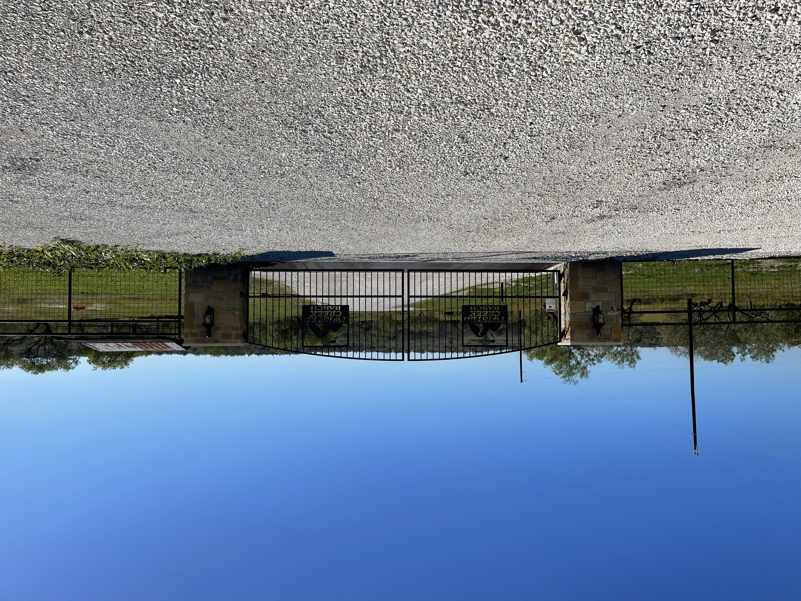
Twisted Creek Ranch
Board Meeting
08 April 2025

Slide 2
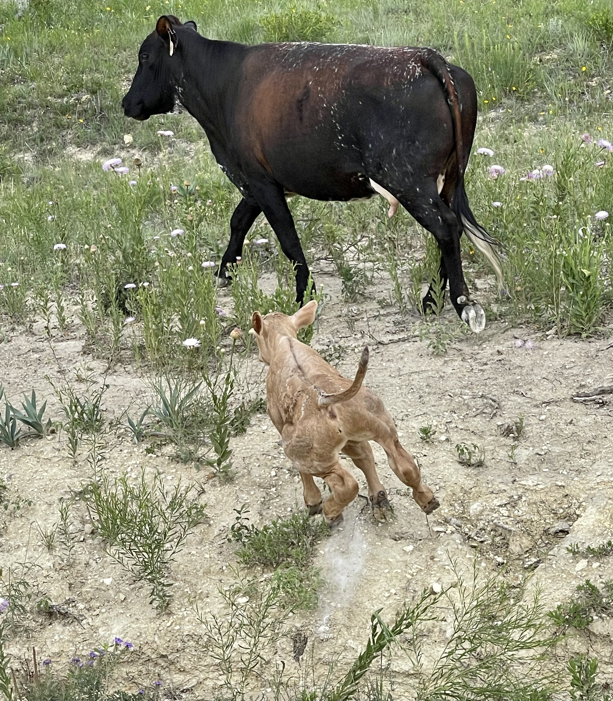
Agenda
Open Meeting – 3 min.
Treasurer Update (Cindy O’Brien) – 15 min.
Member at Large Update (Erica Hinerman) – 5 min.
VP (Michael Bentley) – 10 min.
Secretary (Mike Kitchens) – 5 min.
President (David De La Rosa) – 10 min.
  Renewed
    Website & E-mail
Open Forum – 10 min.
Meeting End 1 Minute

Slide 3
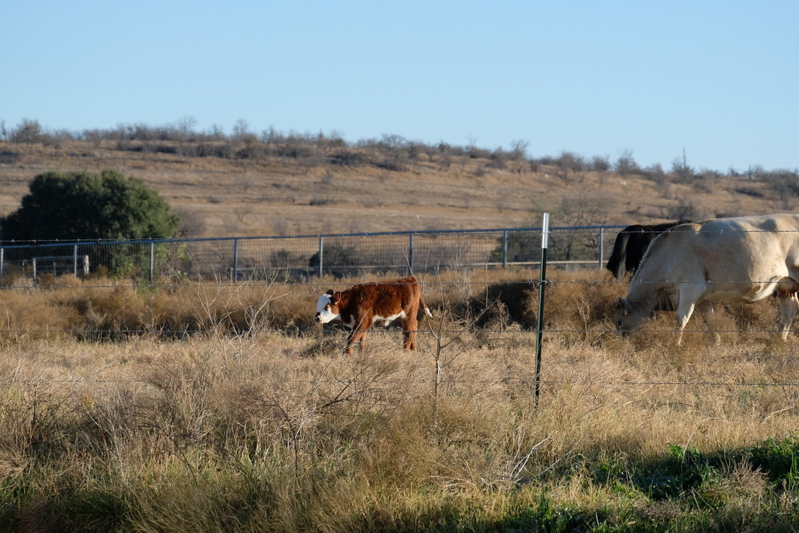
Board Member Positions
President David De La Rosa
Vice Pres. Michael Bentley
Secretary Michael Kitchens
Treasurer Cindy O’Brien
Member at Large Erica Hinerman
Website Admin David De La Rosa
Architectural Control Committee
Oscar Fumero
Open Position
Open Position

