Slide 1
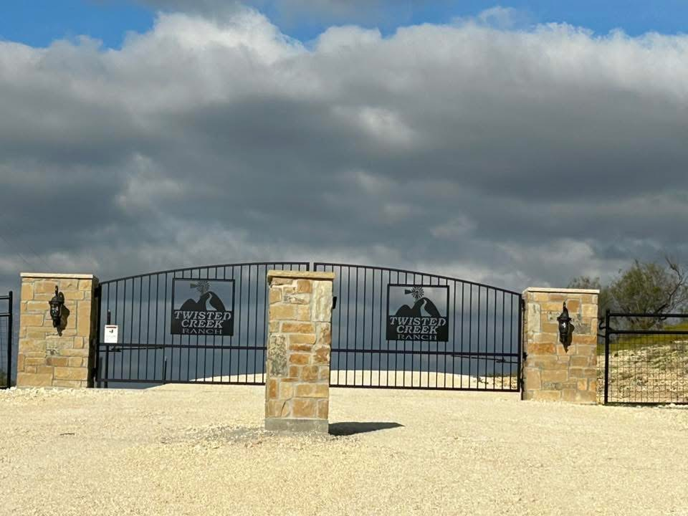
Twisted Creek Ranch
March 2026 Board meeting

Slide 2
Board Members
President- Jill Ricci
Vice President Barry Huckabee
Treasurer- Open
Secretary- Michael Kitchens
Member at Large- Kate Wood

Slide 3
Agenda
Opening of Meeting
Secretary Mtg Minutes
Financial Update
Old Business
New Business
Board Member Updates
  Member at Large
  Secretary
  Vice President
  President
Open Forum
Close of Meeting

Slide 4
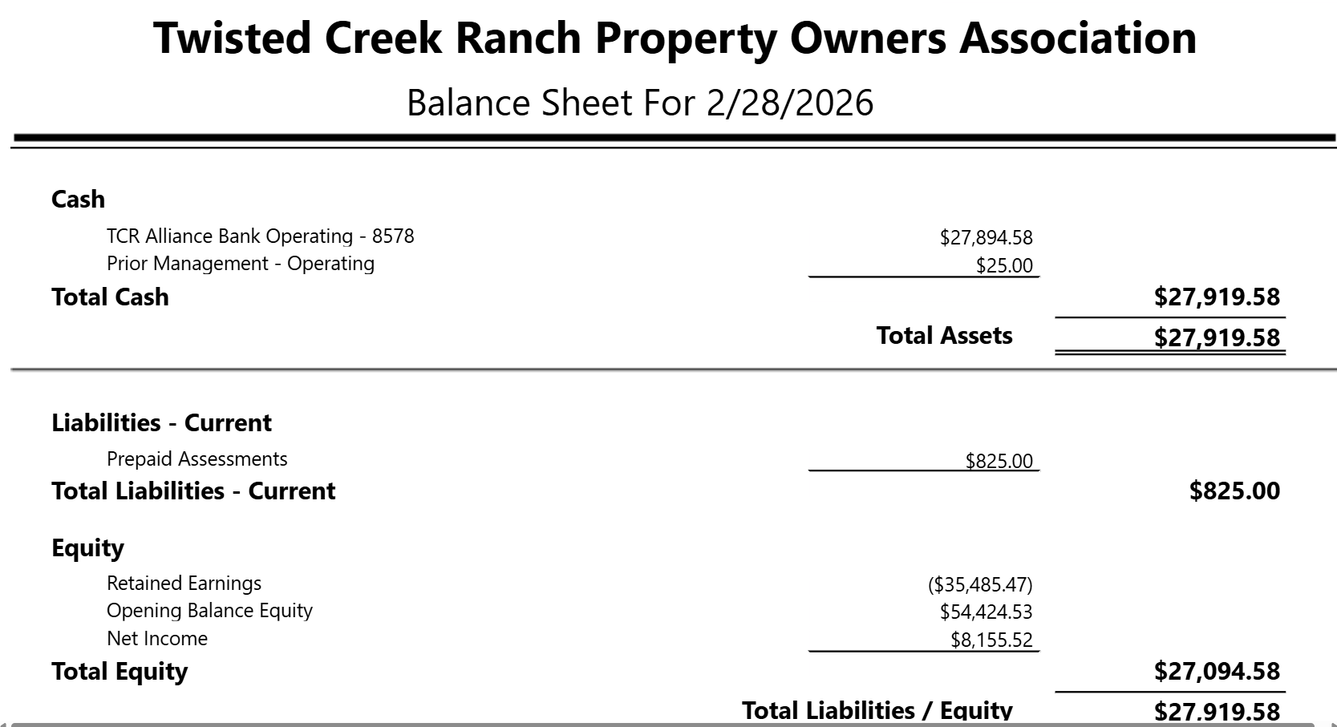
Financial Update (Jan 31st, 2026)

Slide 5
Old Business
LSLP and road update

Slide 6
New Business
Financial Audit
Delinquent Property Assessment Fees greater than current year
Group email
April In-person Meeting

Slide 7
Board Member Updates
Member at Large-
Secretary-
Vice President-
President-

Slide 8
Property Owners Open Forum

Slide 9
Meeting Adjournment

