Slide 1
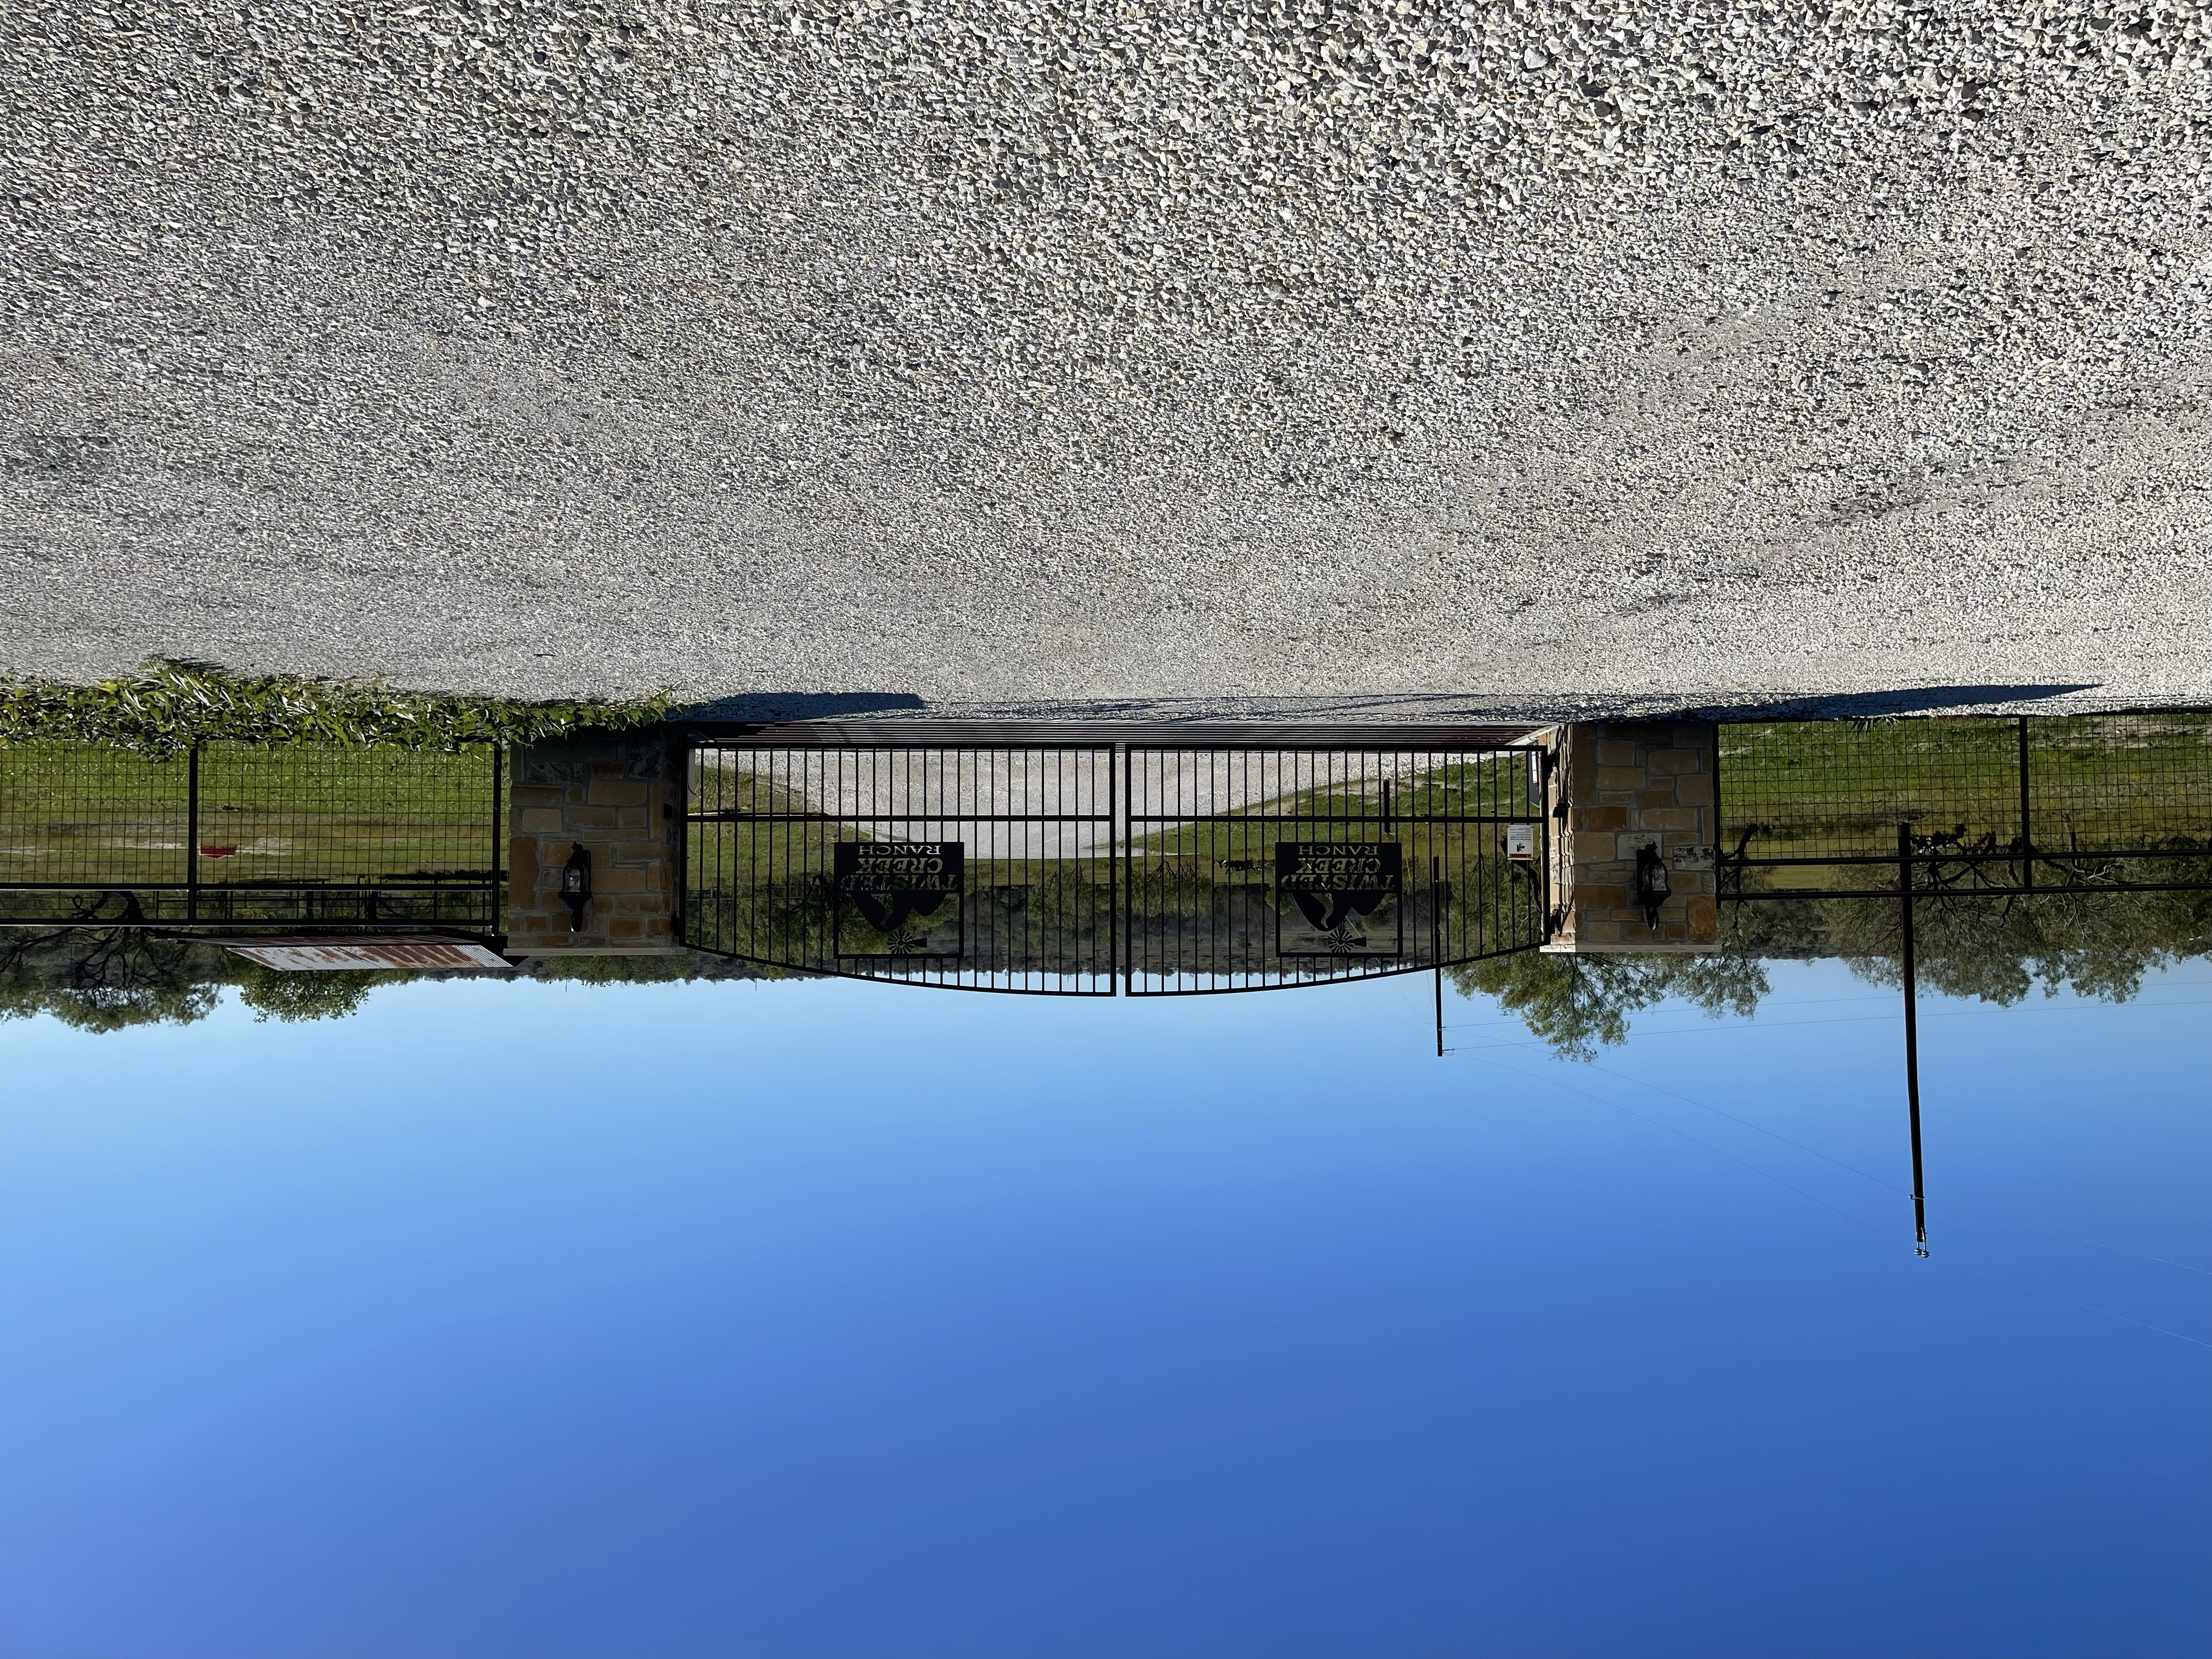
Twisted Creek Ranch
Board Meeting
08 July 2025

Slide 2
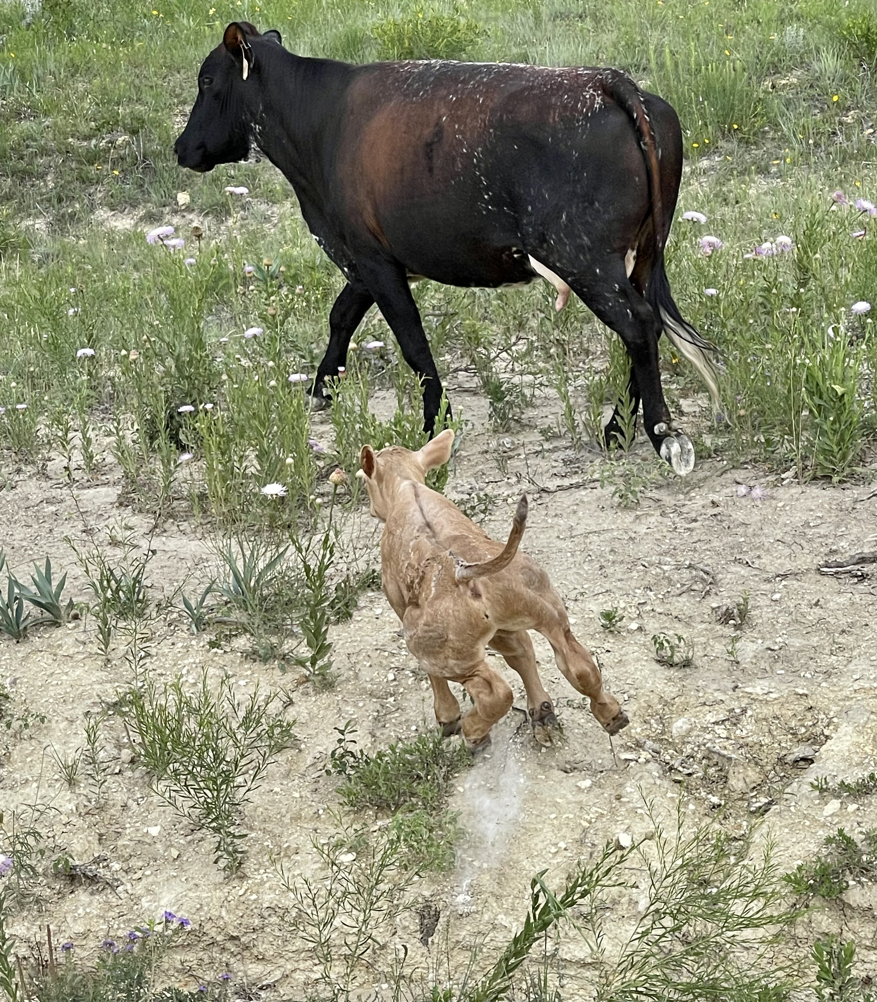
Agenda
Open Meeting – 2 min.
Treasurer Update (Cindy O’Brien) – 10 min.
  Financial update
Member at Large Update (Erica Hinerman) – 5 min.
VP (Michael Bentley) – 10 min.
Secretary (Mike Kitchens) – 5 min.
  Lone Star points from e-mail *
President (David De La Rosa) – 10 min.
  Road *
  CC&R amendment voting process *
Open Forum – 15 min.
Meeting End 1 Minute
* = pending every board member is present

Slide 3
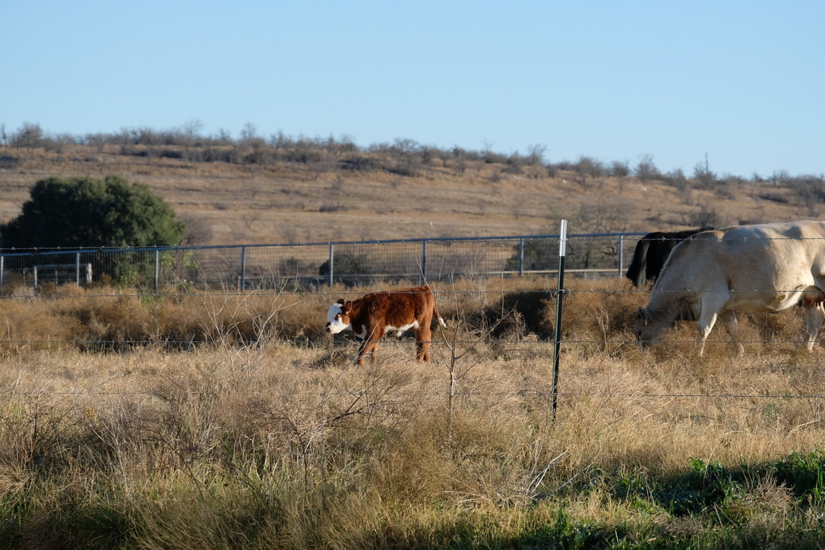
Board Member Positions
President David De La Rosa
Vice Pres. Michael Bentley
Secretary Michael Kitchens
Treasurer Cindy O’Brien
Member at Large Erica Hinerman
Website Admin David De La Rosa
Architectural Control Committee
Oscar Fumero
Stephen Ricci
Open Position

