Slide 1
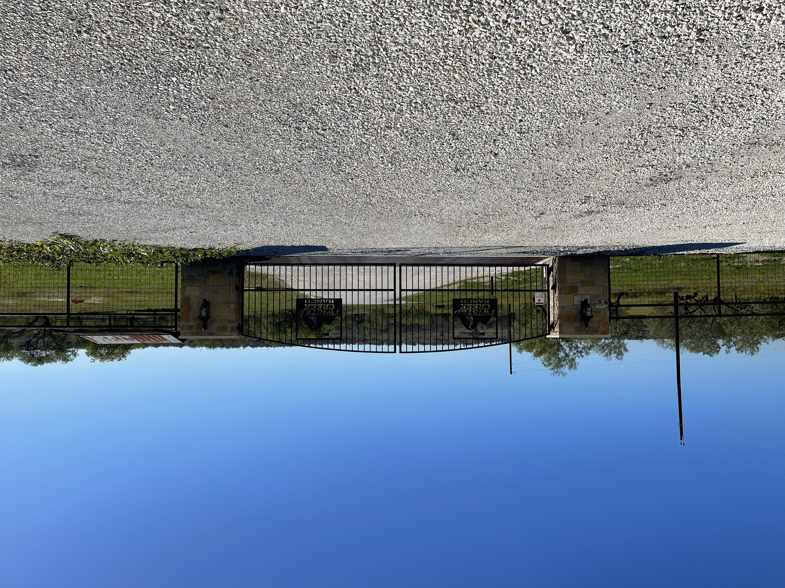
Twisted Creek Ranch
Board Meeting
09 September 2025

Slide 2
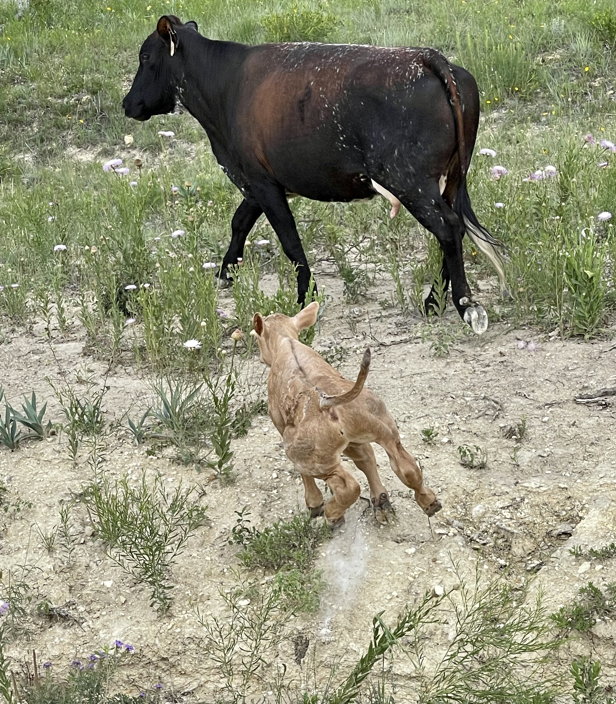
Agenda
Open Meeting – 2 min.
Treasurer Update (Cindy O’Brien) – 20 min.
  Financial update
  Westward 360, inc.
Member at Large Update (Erica Hinerman) – 5 min.
  CC&R amendment submittal and voting process
VP (Michael Bentley) – 5 min.
Secretary (Mike Kitchens) – 5 min.
  Road Improvement Quotes
President (David De La Rosa) – 5 min.
  President & V.P. candidates
Open Forum – 15 min.
Meeting End 1 Minute

Slide 3
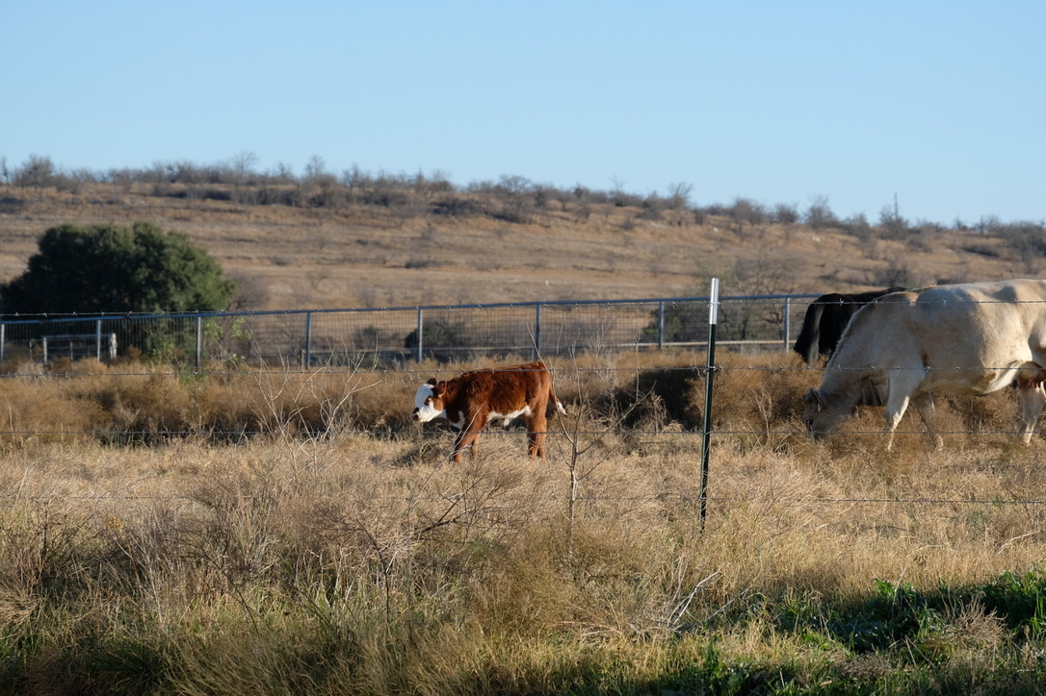
Board Member Positions
President David De La Rosa
Vice Pres. Michael Bentley
Secretary Michael Kitchens
Treasurer Cindy O’Brien
Member at Large Erica Hinerman
Website Admin David De La Rosa
Architectural Control Committee
Open Position
Open Position
Open Position

