Slide 1
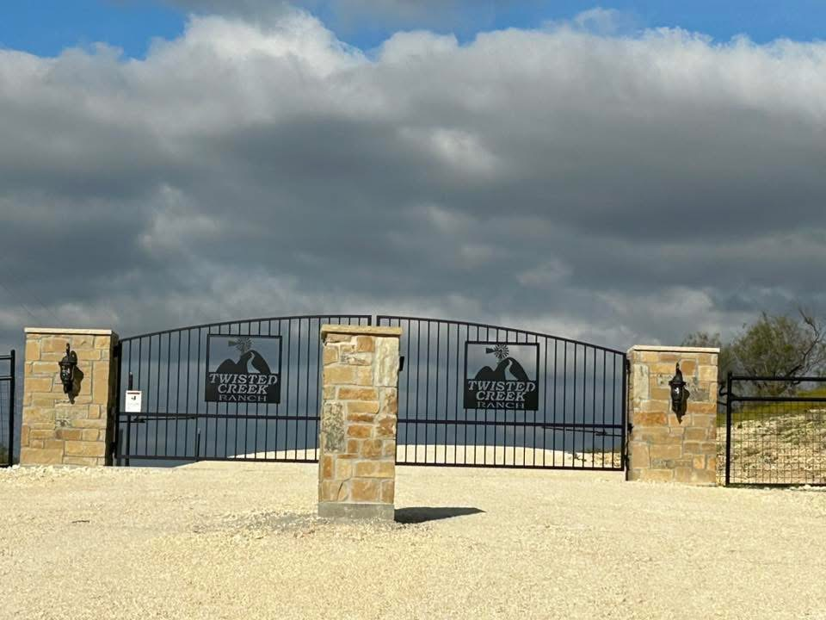
Twisted Creek Ranch
January 2026 Board meeting

Slide 2
Board Members
President- Jill Ricci
Vice President Barry Huckabee
Treasurer- Open
Secretary- Michael Kitchens
Member at Large- Kate Wood

Slide 3
Agenda
Opening of Meeting
Financial Update
Old Business
New Business
Board Member Updates
  Member at Large
  Secretary
  Vice President
  President
Open Forum
Close of Meeting

Slide 4
Financial Update (October 31st)
Opening Balance-21172.97
Expenditures-
Income-
Ending Balance- 21172.97

Slide 5
Old Business
Issues with broken lights
LSLP and road update
Property Map

Slide 6
New Business
2025 Taxes-Westward
Past Due Bill Overhead
Broken Key Pad

Slide 7
Board Member Updates
Member at Large-
Secretary
Vice President
President

Slide 8
Property Owners Open Forum

Slide 9
Meeting Adjournment

