Slide 1


AI for Educators Workshop, July 2025
Overview of
Brisk AI Assistant
https://www.briskteaching.com/
W. Renee Wilder, MBA, PMP, CSM
VDOE Graduate Professional License:
Computer Science, Business/IT, Algebra1, Math 6-8, LD, ED, EMR
AI Ready RVA Member and Founding Funder, 2025
info@TeachersDaughter.org

Slide 2
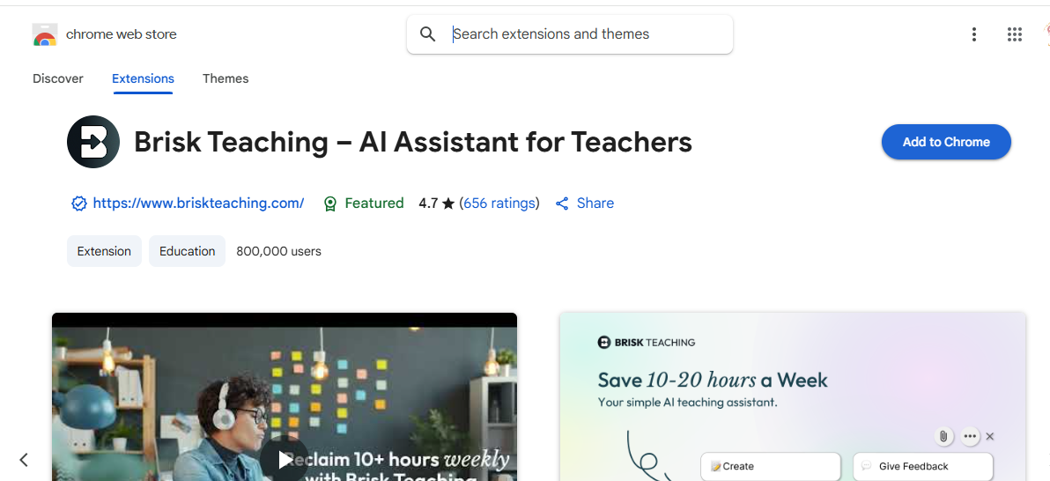
https://www.briskteaching.com/

Slide 3
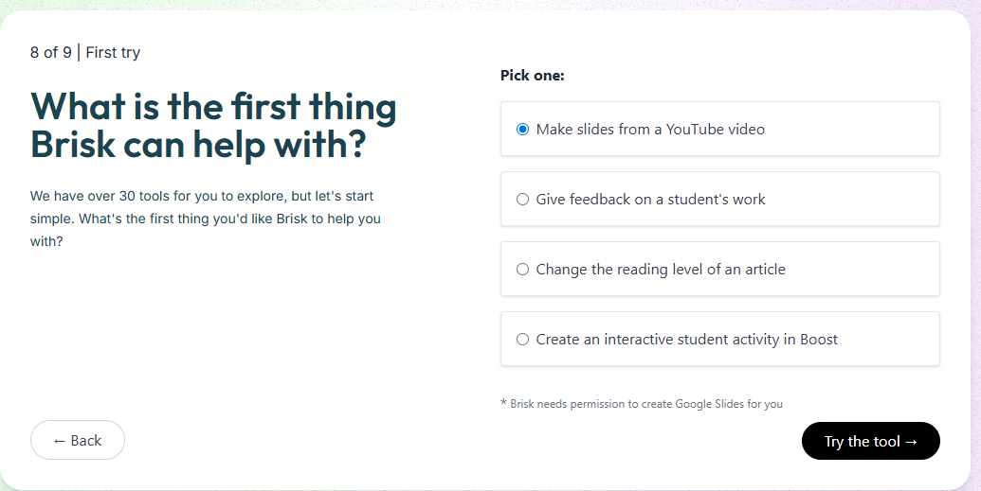
Notes:
Curriculum across various modalities

Slide 4
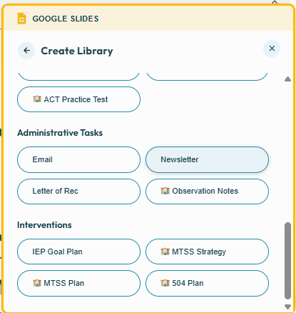
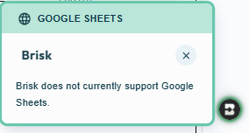
Brisk Helps With
but not:
Notes:
Interventions!

Slide 5
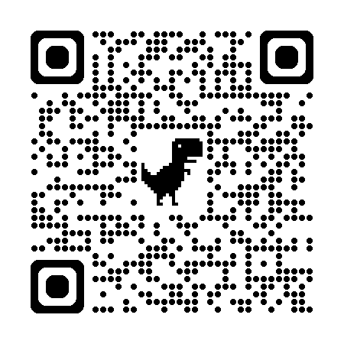
What Teachers Get for Free
https://www.briskteaching.com/plans#compare-section

Slide 6
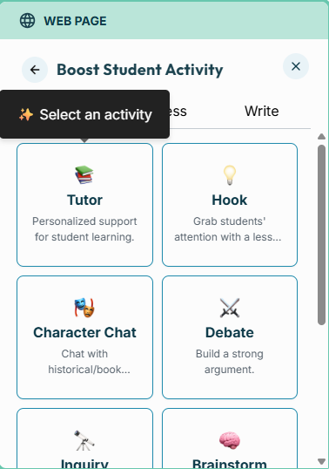
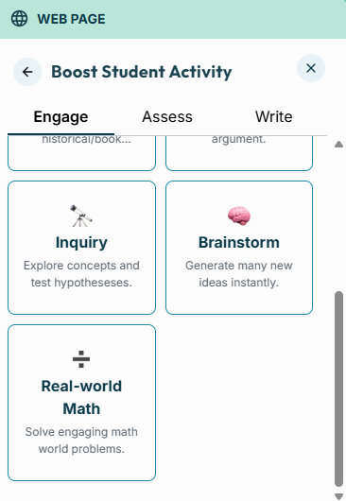
(Boost) Student Activities

Slide 7
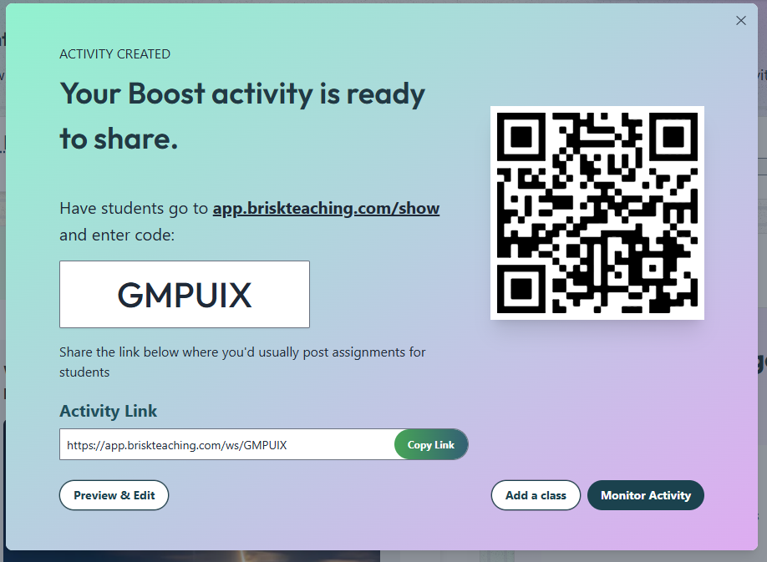

Slide 8
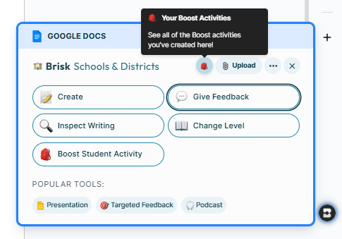
Navigation

Slide 9
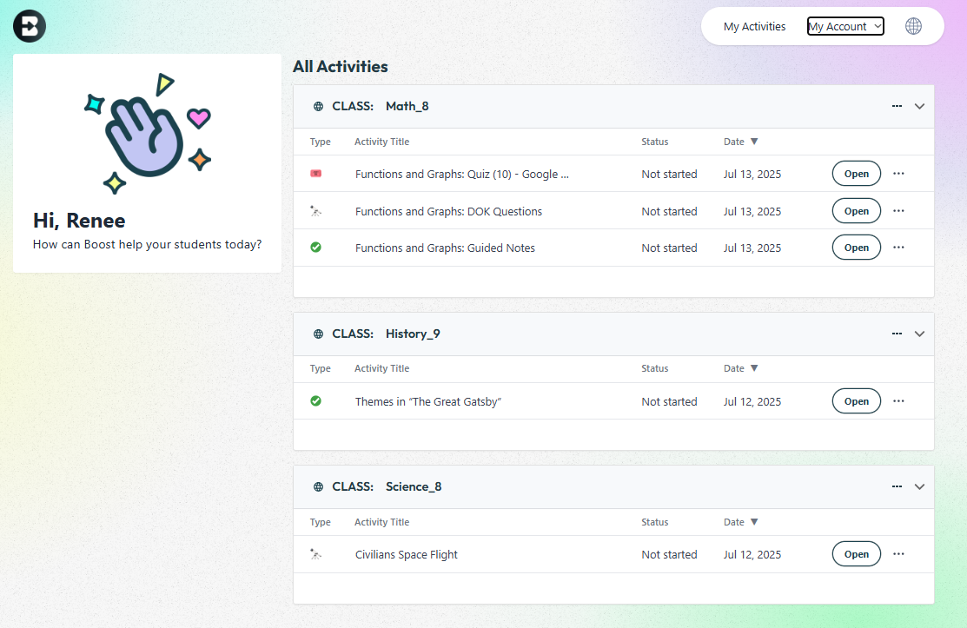
Brisk Activities Page

Slide 10
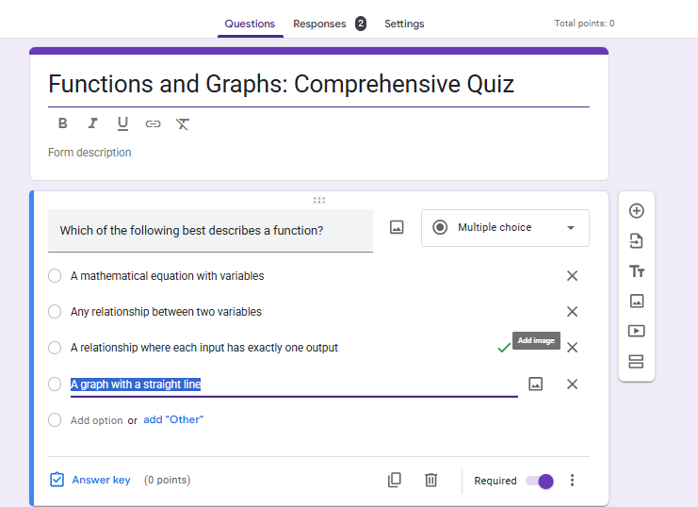
Google Forms → Answer Keys

Slide 11
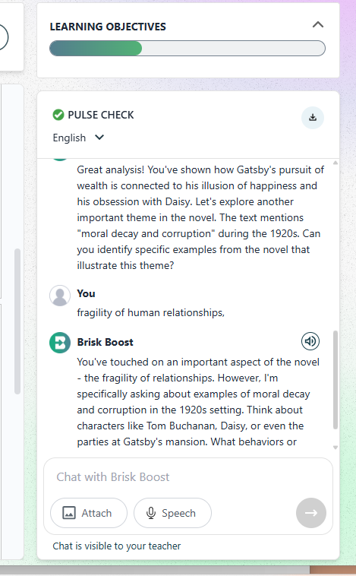
Language/Writing
The model has rigor
in evaluating student responses
to the Learning Objectives
Notes:
ASK: go into ELA detail? Or another feature? ihttps://app.briskteaching.com/teacher_activity_monitor?id=3260787#activityId=3260787

Slide 12
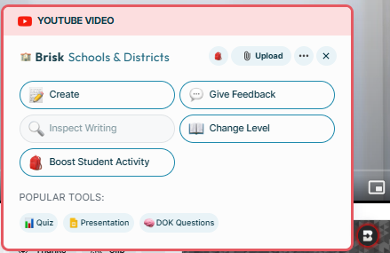
Mathematics
Guide Notes
Depth of Knowledge
Quiz
Notes:
Quiz:
https://docs.google.com/forms/d/e/1FAIpQLSczygnEBHhpOl3E-K2fUXqt0M1mevDaAuFUDJpuE-FFRX5H5Q/viewform

Slide 13
Interventions

Slide 14
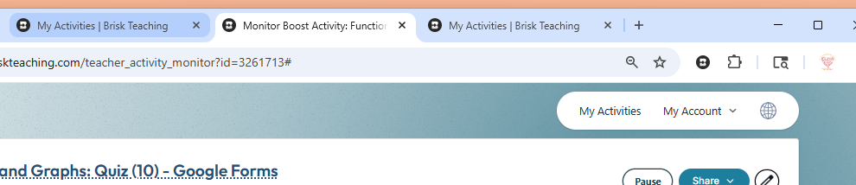
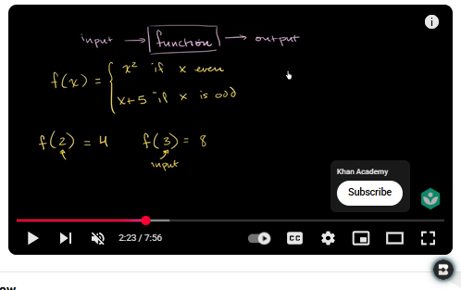

Summary
Browser will show if you’re in Brisk or Boost
Don’t see the pop-up?

