Slide 1
What is the Universe made of?
Rob Clemenson – Particle Physicist

Slide 2
Matter
Matter = Stuff which has weight
Almost everything you can touch, smell, and see is made of matter.
Can you think of anything you can feel or see that isn’t matter?

Slide 3
Energy
Energy = Something that makes matter move
Light and heat are types of energy. We can feel heat and see light.

Slide 4
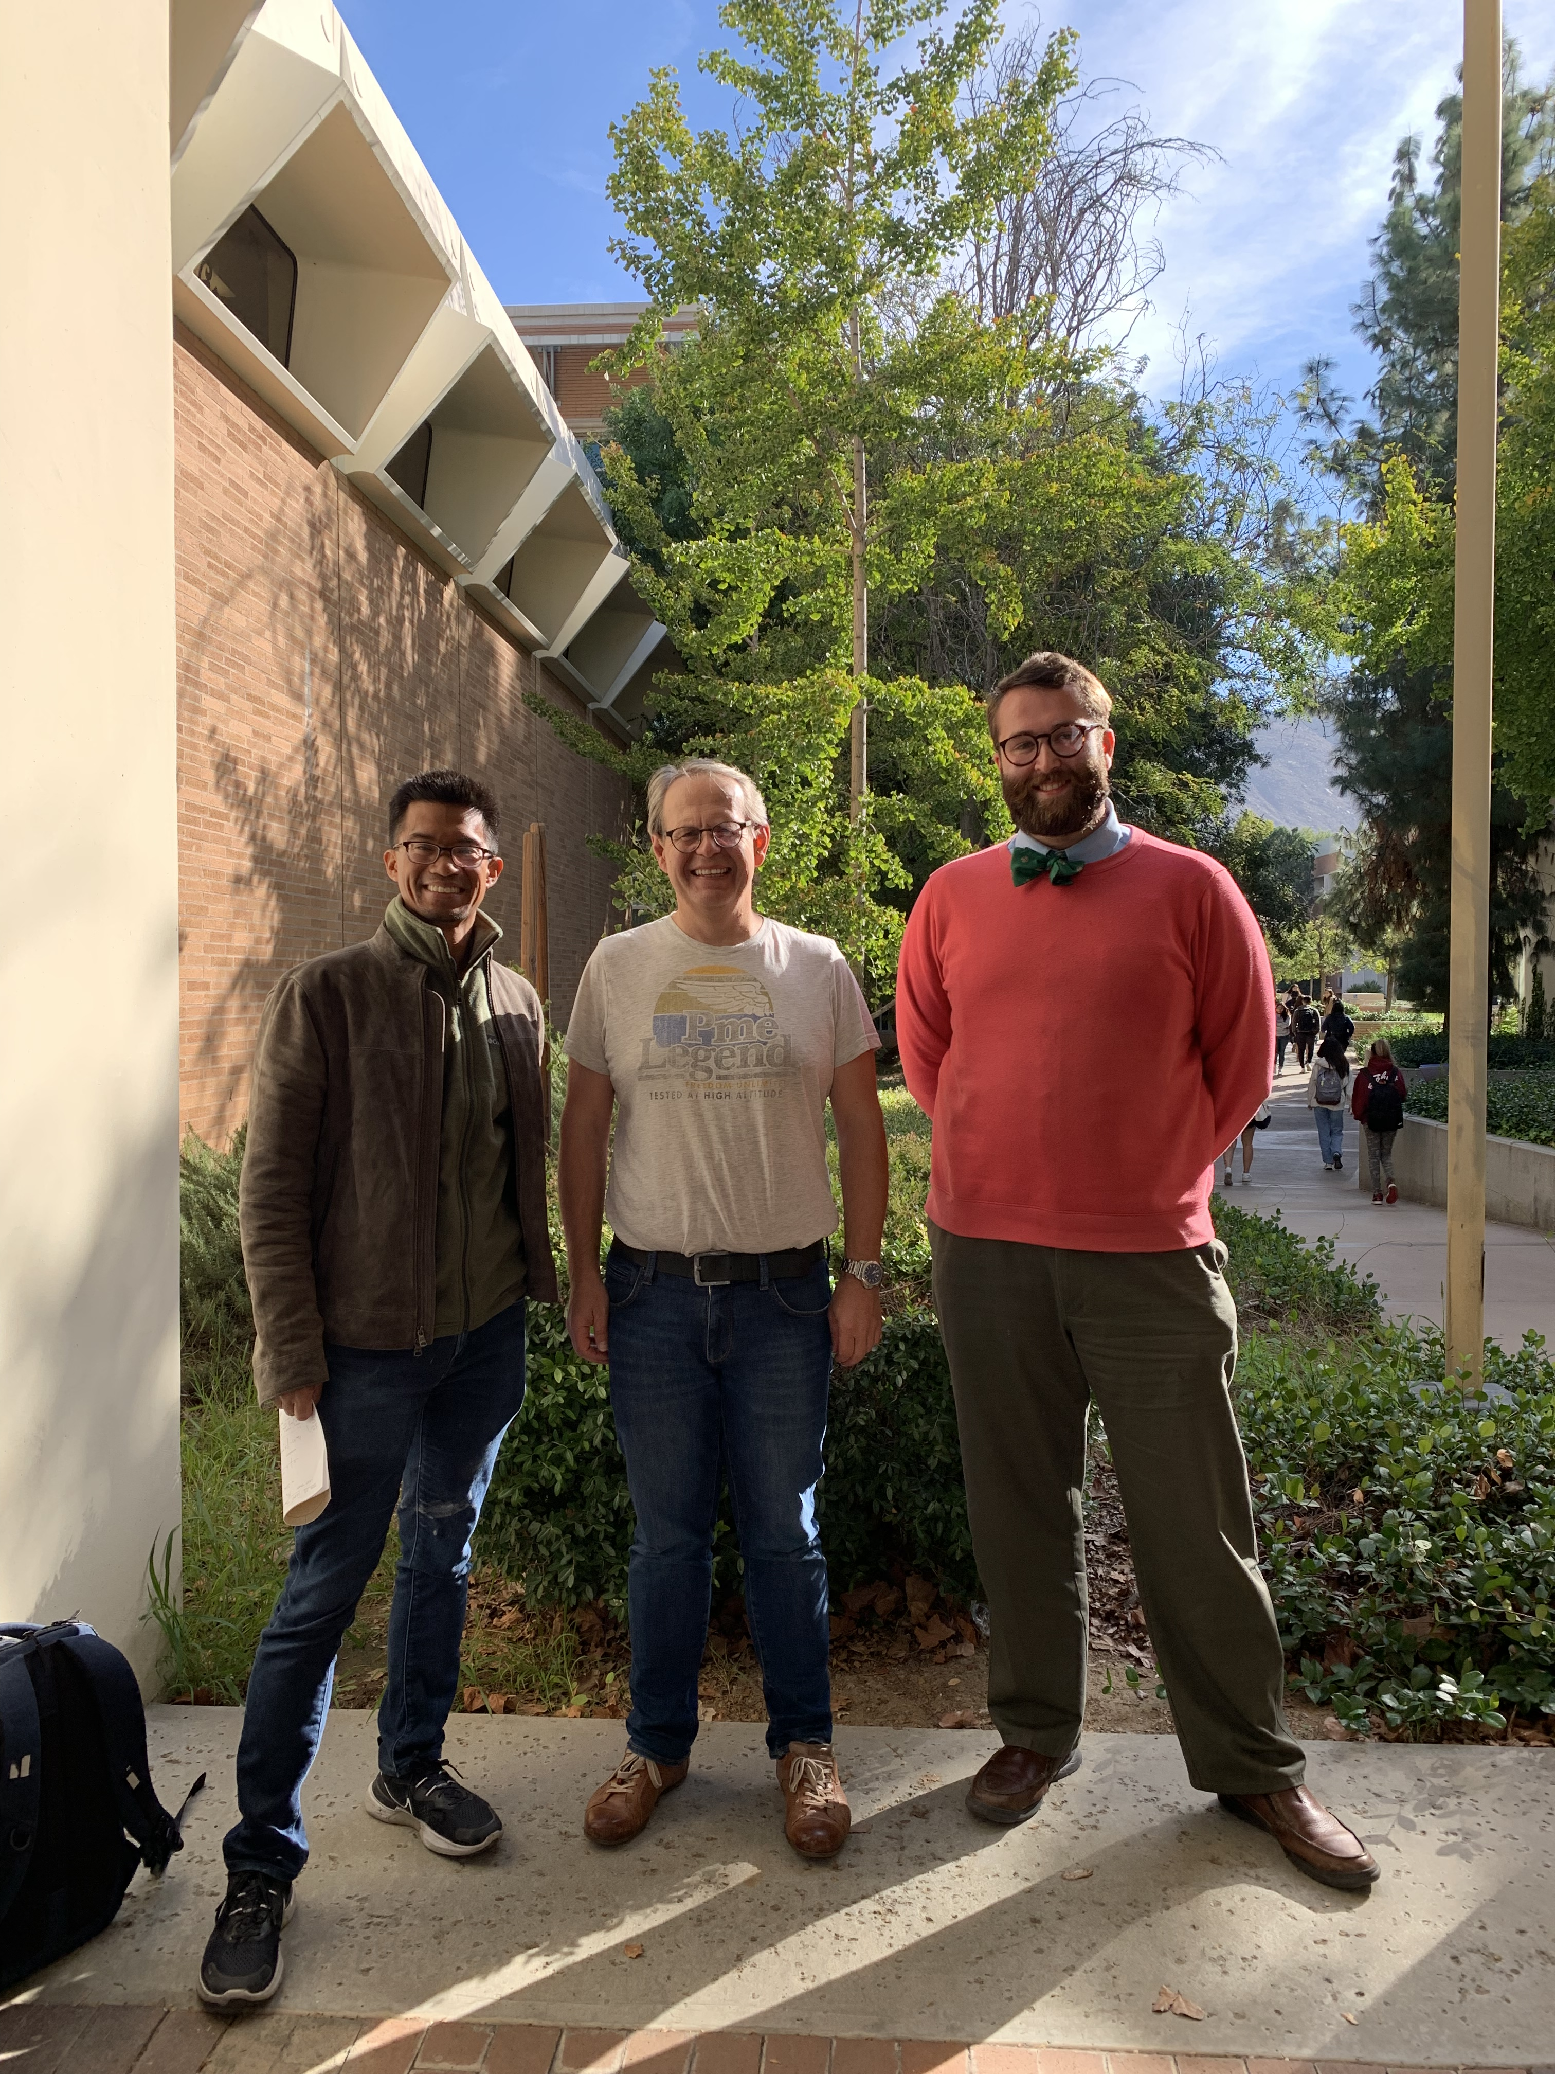
Looking Closer at Matter…
Take three Particle Physicists
Let’s zoom in a little!
People are made out of matter

Slide 5
Looking Closer at Matter…
Take three Particle Physicists
Let’s zoom in a little!
What comes next?

Slide 6
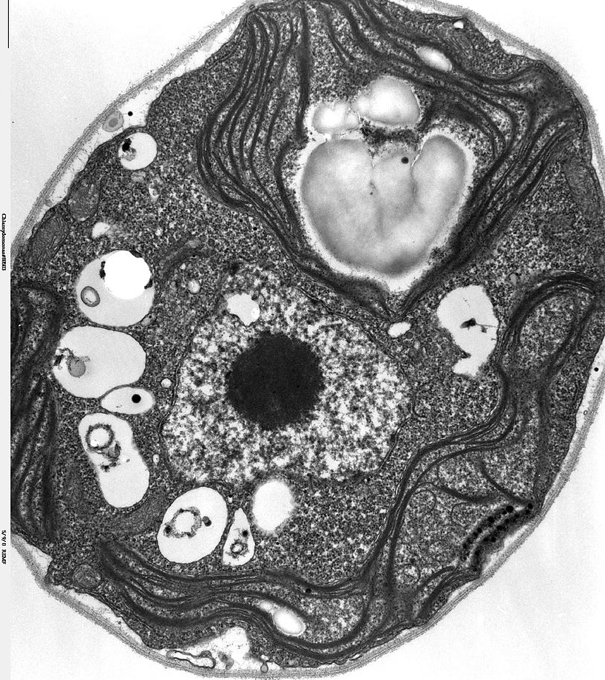
Looking Closer at Matter…
Human Cells
All life is made of up ‘cells'

Slide 7
Looking Closer at Matter…
Human Cells
All life is made of up ‘cells’
Let’s zoom in even more!

Slide 8
Looking Closer at Matter…
Atoms
All the ‘stuff’ we see on Earth is made out of atoms.

Slide 9
Looking Closer at Matter…
Atoms
All the ‘stuff’ we see on Earth is made out of atoms.
Let’s look even closer…

Slide 10
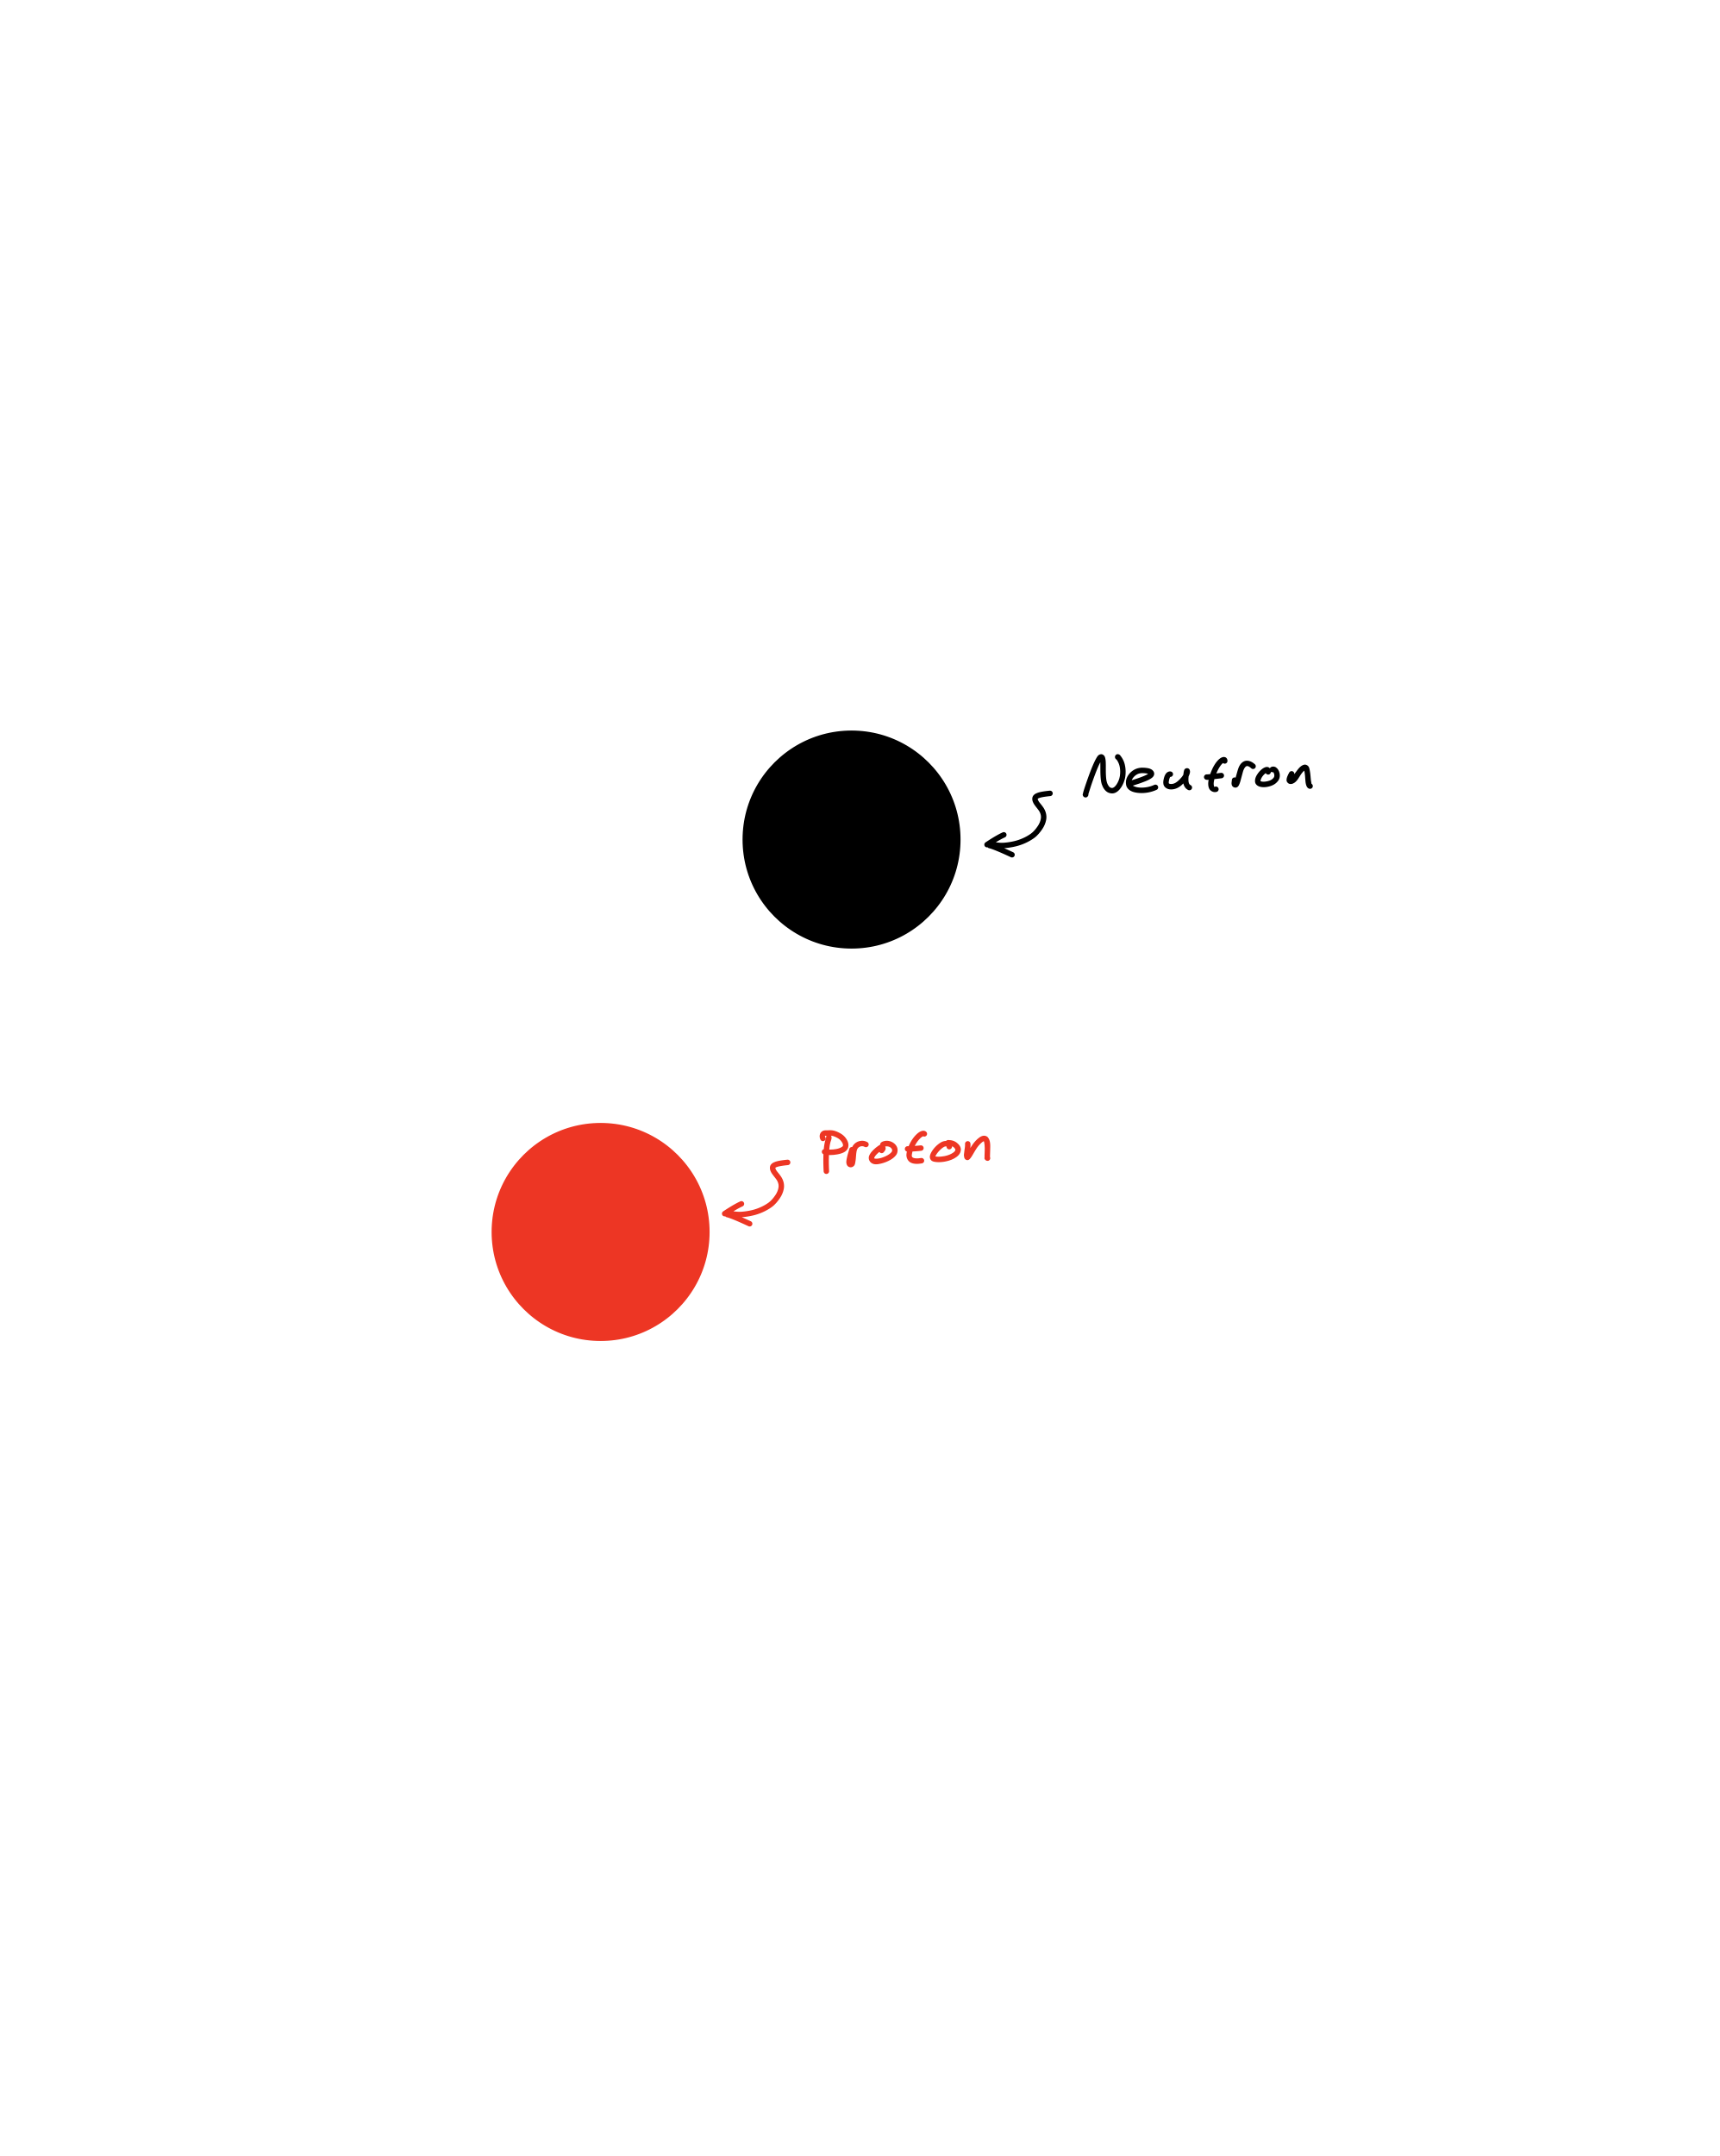
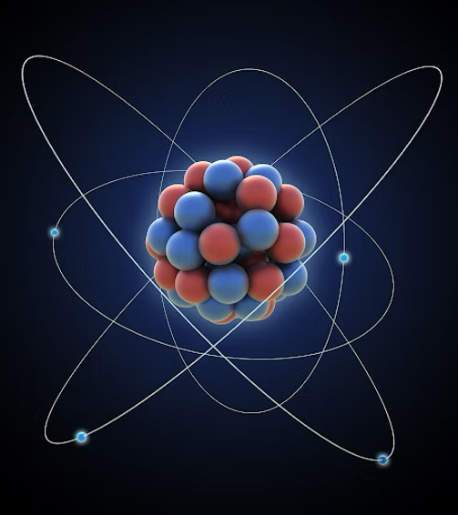
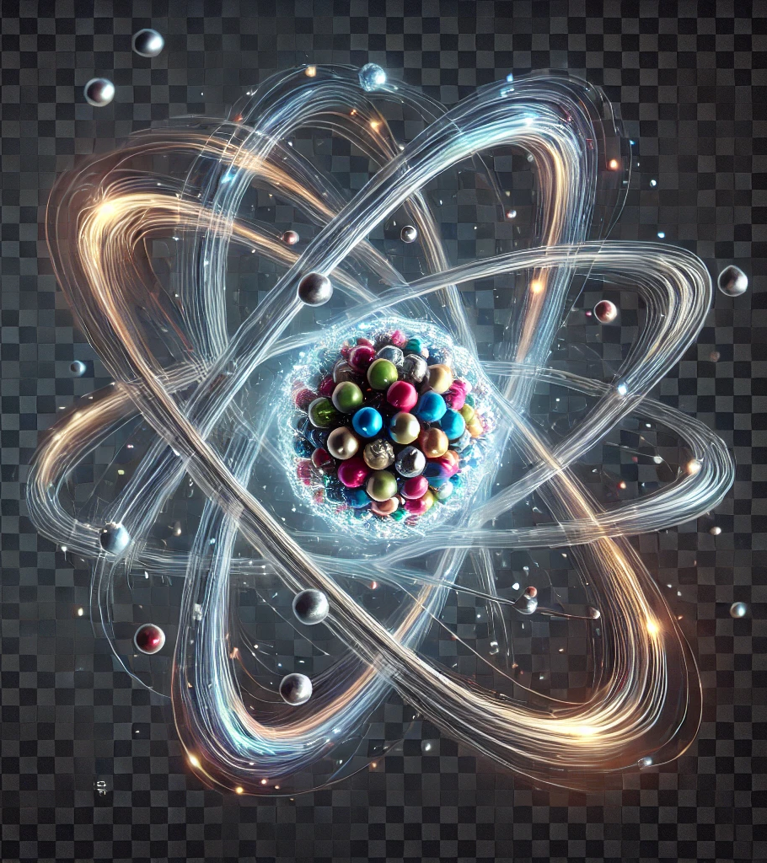
Looking Closer at Matter…
Protons & Neutrons
The center of an atom is made out of particles called ‘Protons’ and ‘Neutrons’.

Slide 11
Looking Closer at Matter…
Protons & Neutrons
The center of an atom is made out of particles called ‘Protons’ and ‘Neutrons’.

Slide 12
Looking Closer at Matter…
Quarks
Protons and Neutrons are made up of ‘quarks’.

Slide 13
Looking Closer at Matter…
Quarks
Protons and Neutrons are made up of ‘quarks’.
But what are quarks made of?!

Slide 14
Looking Closer at Matter…
Beyond Quarks?
“But what are quarks made of?!”
We don’t know!
Quarks, ‘just are’!

Slide 15
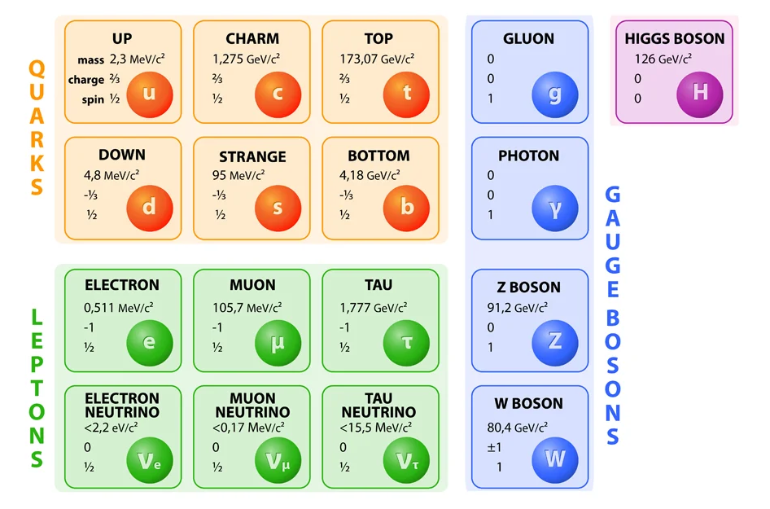
What other things ‘just are’?
‘The Standard Model of Elementary Particles’
If you were cooking up a Universe from scratch, this would be you list of ingredients.

Slide 16
What other things ‘just are’?
‘The Standard Model of Elementary Particles’
If you were cooking up a Universe from scratch, this would be you list of ingredients.
Is that everything??
Can you name a kind of matter not shown here?

Slide 17
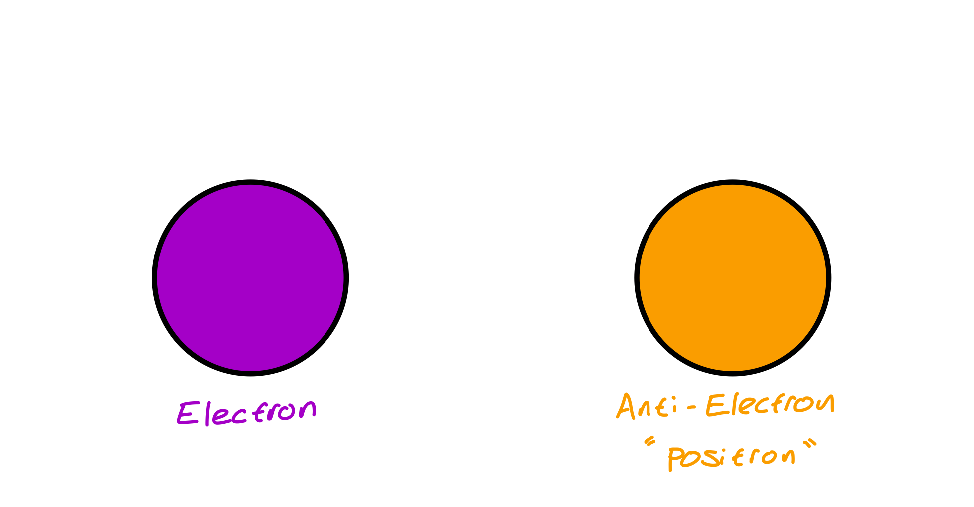
Anti-matter
Anti-matter weighs the same as normal matter, but some properties are reversed.

Slide 18
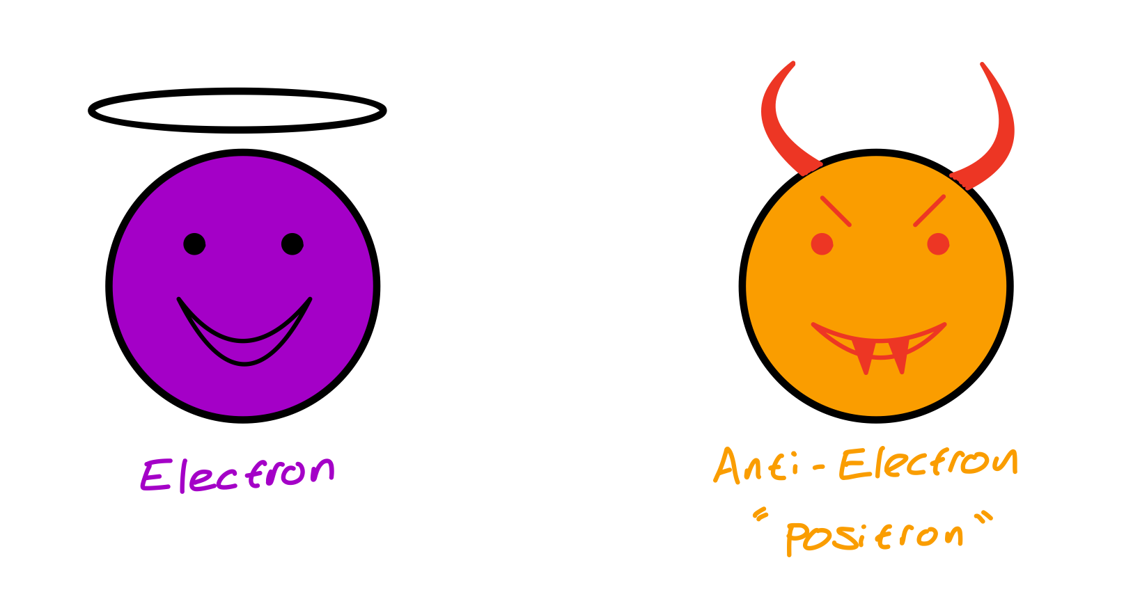
Anti-matter
Anti-matter is a bit like matters evil twin!

Slide 19
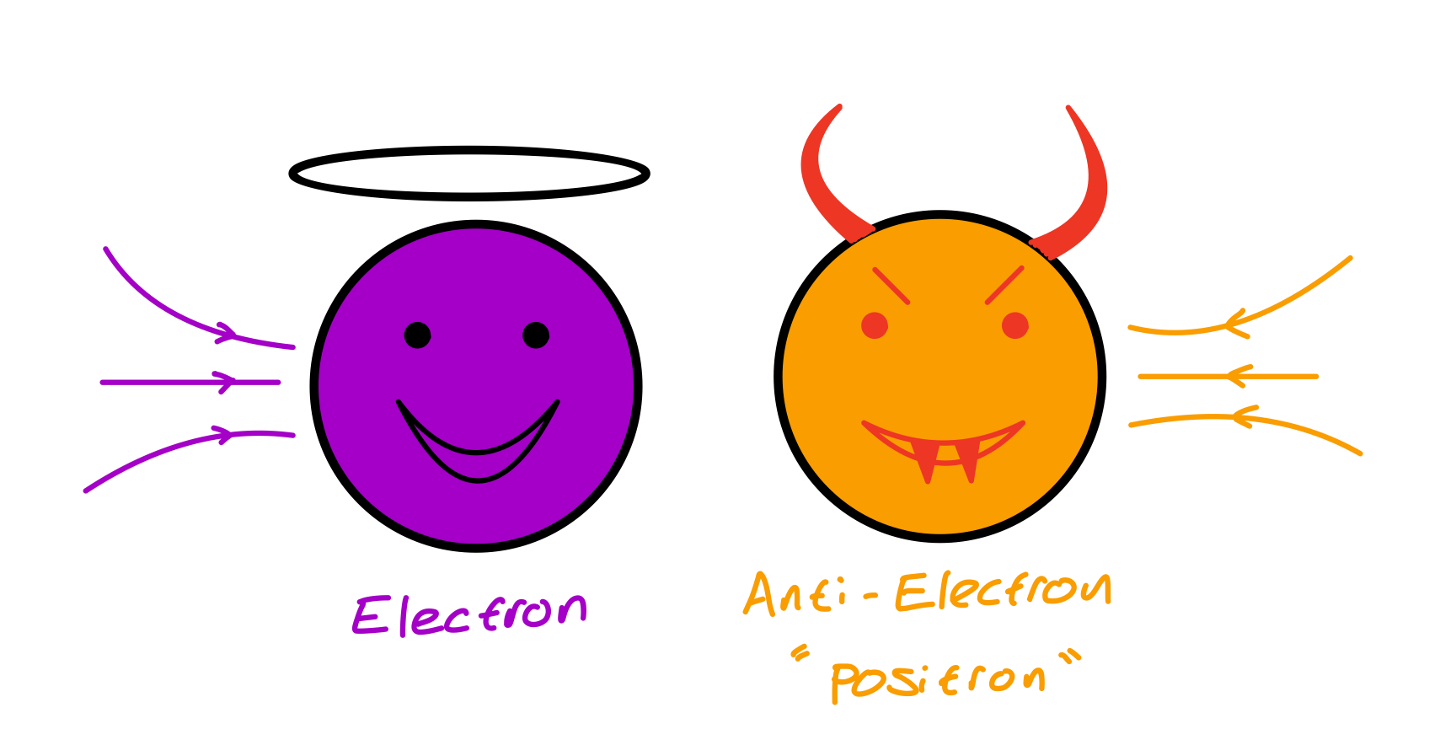
Anti-matter
What happens when matter and anti-matter meet?

Slide 20
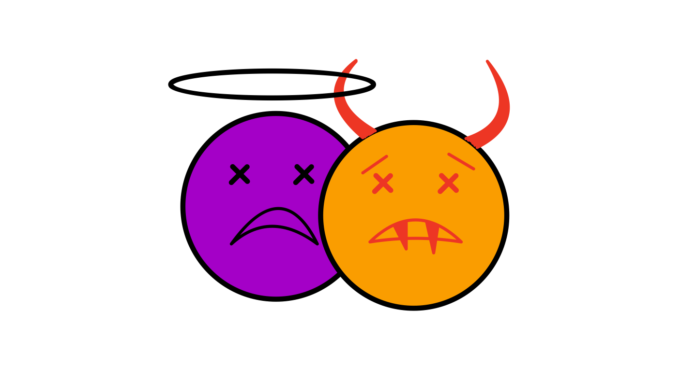
Anti-matter
When matter and anti-matter touch, they ANNIHILATE.

Slide 21
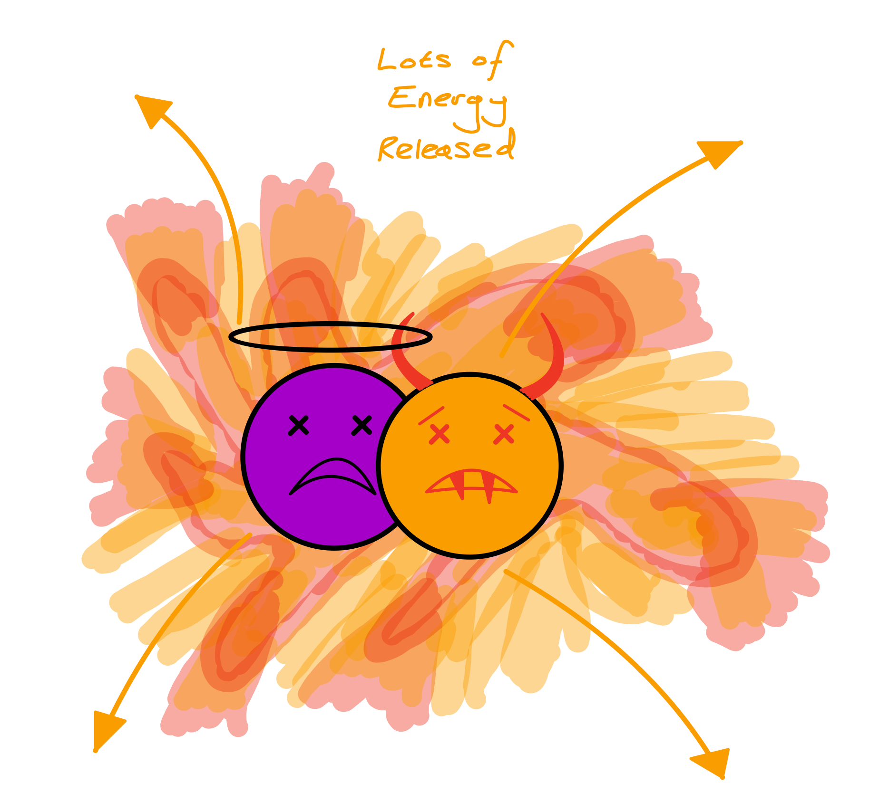
Anti-matter
Annihilation destroys the particles, and causes HUGE amounts of energy to be released.

Slide 22
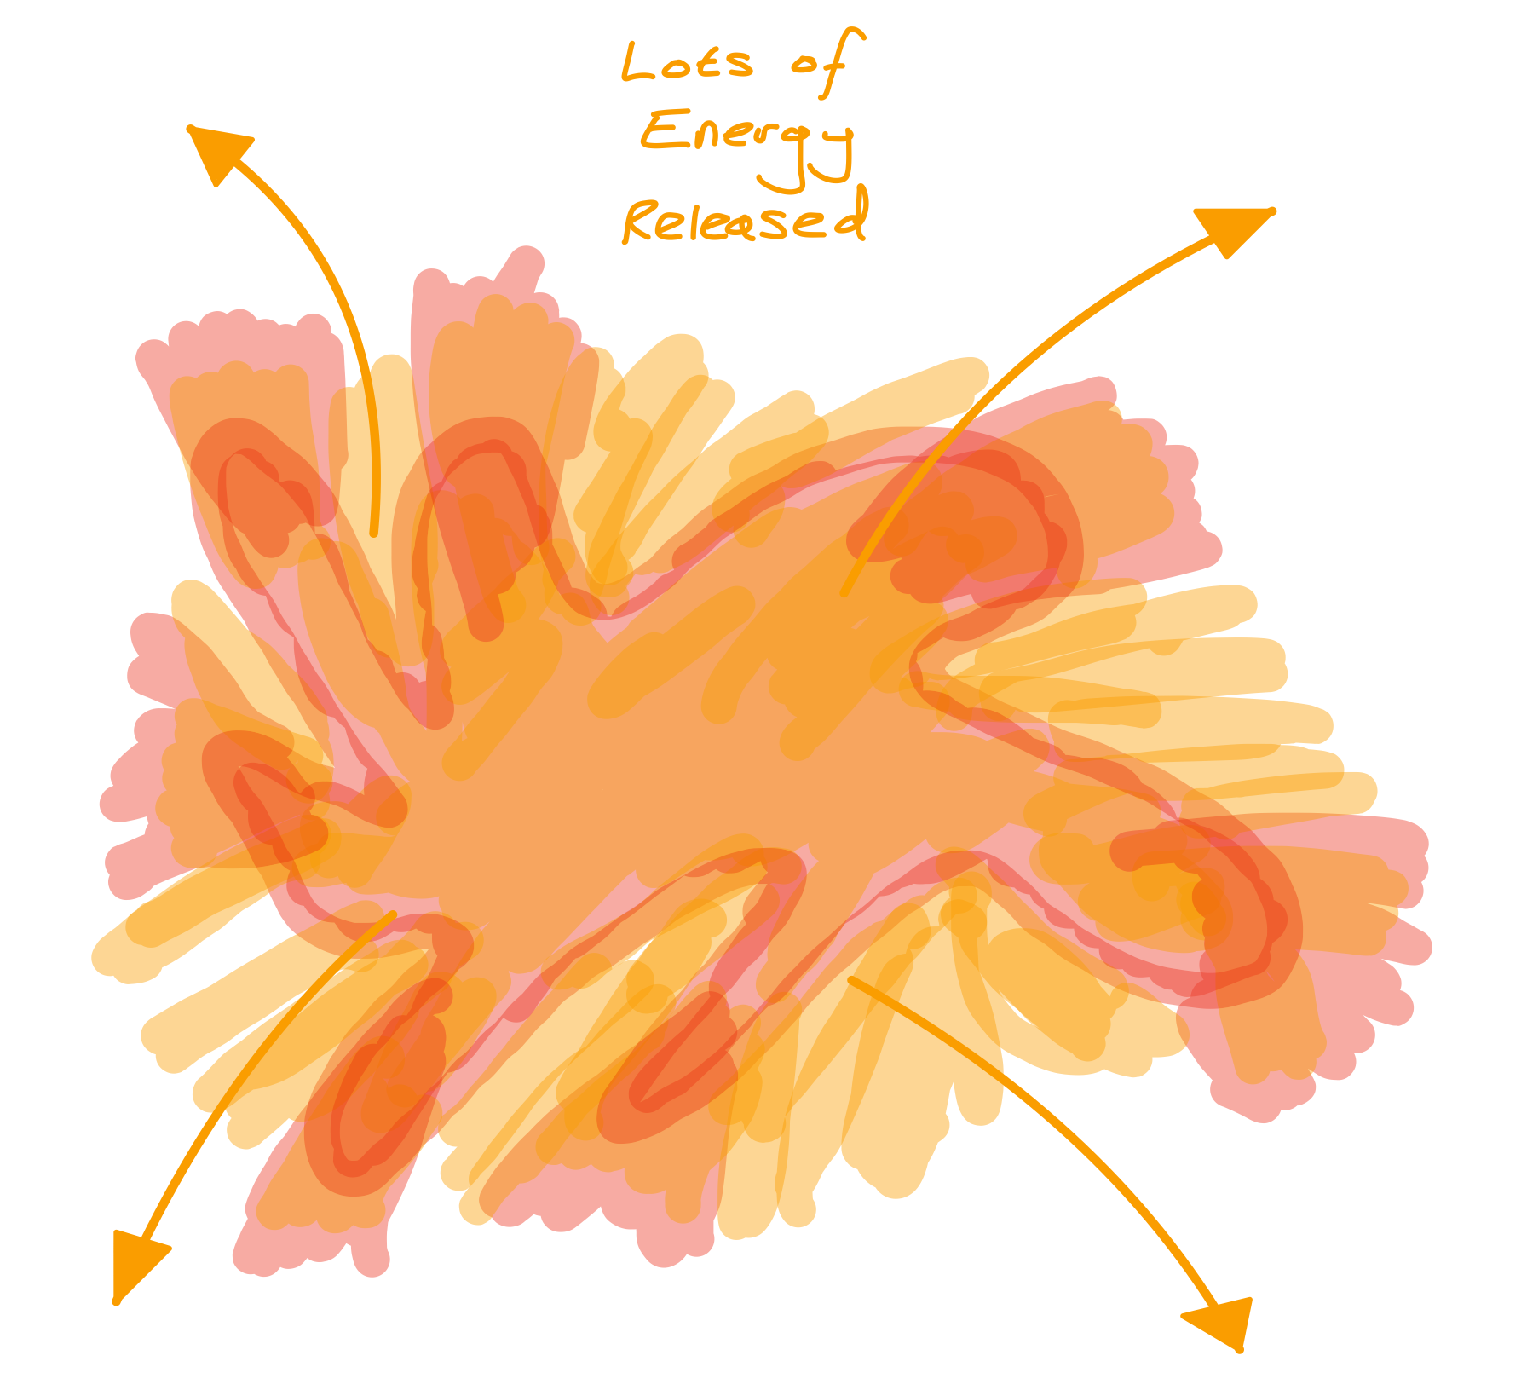
Anti-matter
Annihilation destroys the particles, and causes HUGE amounts of energy to be released.

Slide 23
Anti-matter
If humans every develop the technology to travel to other galaxies, we will probably need anti-matter to power our spacecraft.
What is a galaxy?

Slide 24
Anti-matter Generator
Who volunteers to help me take out my anti-matter generator?

Slide 25
Anti-matter
Bananas emit anti-electrons!
This is because they contain potassium atoms, which are slightly radioactive.

Slide 26
Anti-matter
The radioactive potassium atoms decay into calcium atoms.
In this process, they release a very tiny amount of anti-matter!

Slide 27
Dark Matter
About 85% of all of the matter in the Universe is totally mysterious, and completely invisible.
We call this ‘Dark Matter’.

Slide 28
Dark Matter
If it’s invisible, how do we know it’s there?

Slide 29
Dark Matter
We know from looking at all the galaxies in the night sky!
What is the name of the galaxy we live in?

Slide 30
Dark Matter
The way galaxies spin means there is a lot of extra weight in addition to the stars and planets we can see.
This extra weight comes from Dark Matter.

Slide 31
“How do I become a Particle Physicist?”
Work hard in science and maths lessons.
Be curious and ask questions.
Enjoy solving tough ‘problems’.
Believe in yourself! Anyone can be a scientist!

