Slide 1
FALL WINTER 2025
GOLF & RESORT
MERCHANDISING
SOLUTIONS
BIRKENSTOCK
FW25

Slide 2
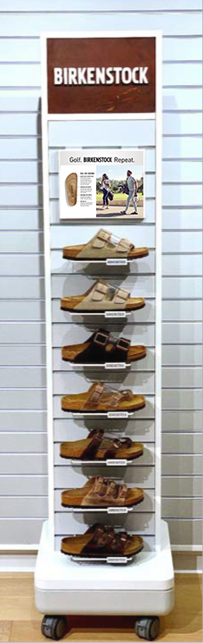
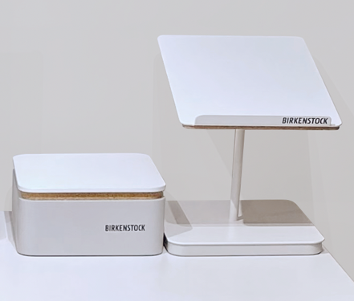
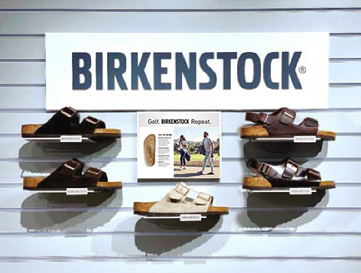
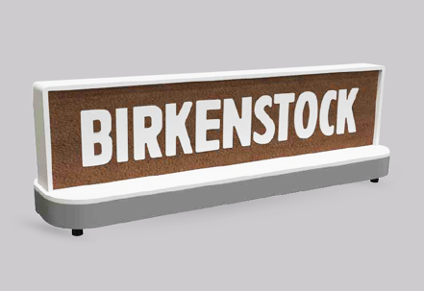
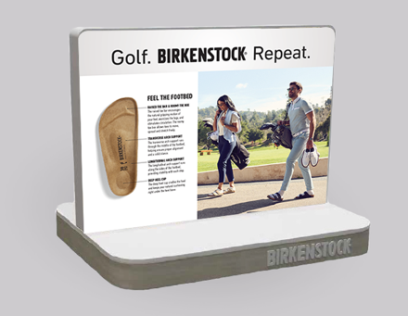
FW25 GOLF & RESORT | MERCHANDISING SOLUTIONS
TABLETOP PROGRAM
STANDARD SLATWALL PROGRAM
DOUBLE-SIDED TOWER
Plexi logo header
8”x10” image frame
Wire logo shelves
Slatwall pegs available
Plexi logo block available
Holds up to 10-14 SKUs
Mobile unit w/ lockable casters
70” high
8”x10” image frame
Wire logo shelves
Metal/cork logo shelves available
Slatwall pegs available
Shoe platform & shoe riser
Leather logo block
8”x10” image frame

Slide 3


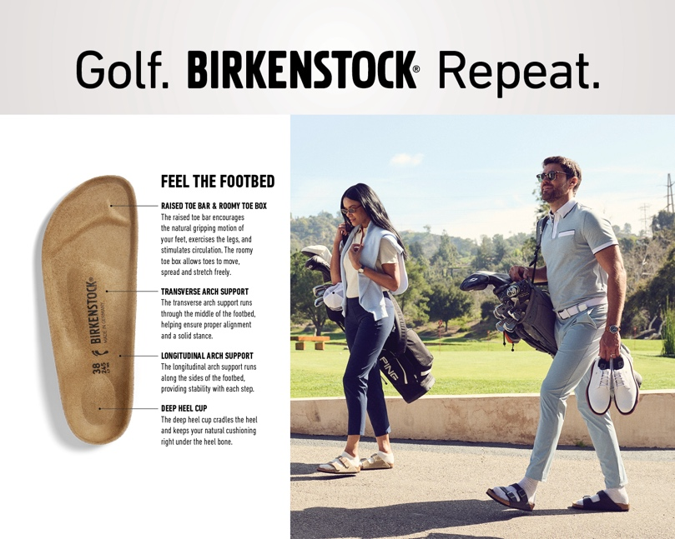
FW25 GOLF & RESORT | MERCHANDISING SOLUTIONS
8”x10” IMAGE SIGNS
WOMENS
MENS
UNISEX / FOOTBED

Slide 4
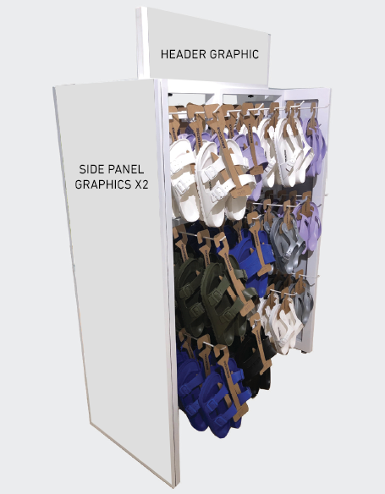
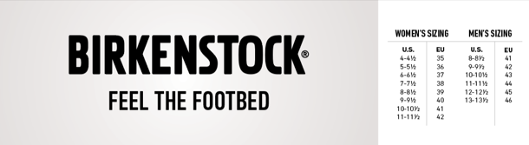
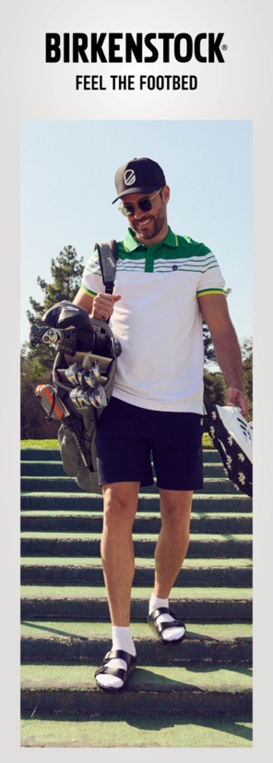
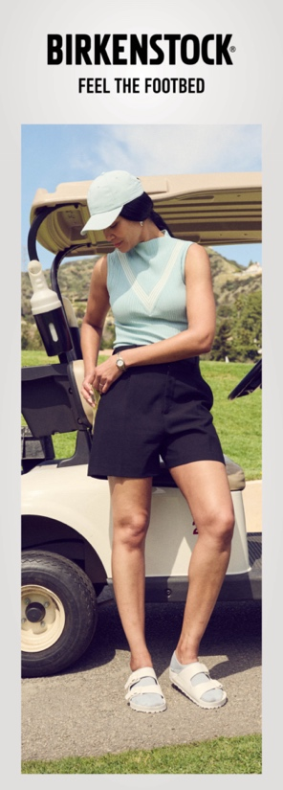
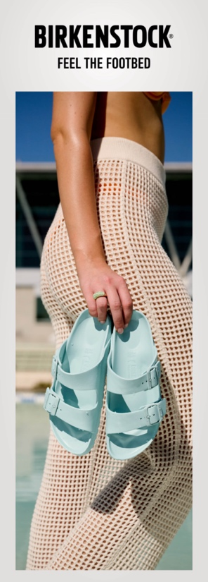
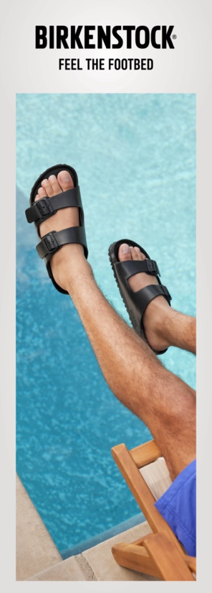
FW25 GOLF & RESORT | MERCHANDISING SOLUTIONS
EVA FIXTURE
Holds 96 pairs of EVA
Comes with 24 pegs and 1 set of graphics
GOLF SPECIALTY GRAPHIC SET
Header includes W/M size charts
RESORT SPECIALTY GRAPHIC SET
Header includes W/M size charts

