Slide 1
Mortimer Jordan Baseball
2027

Slide 2
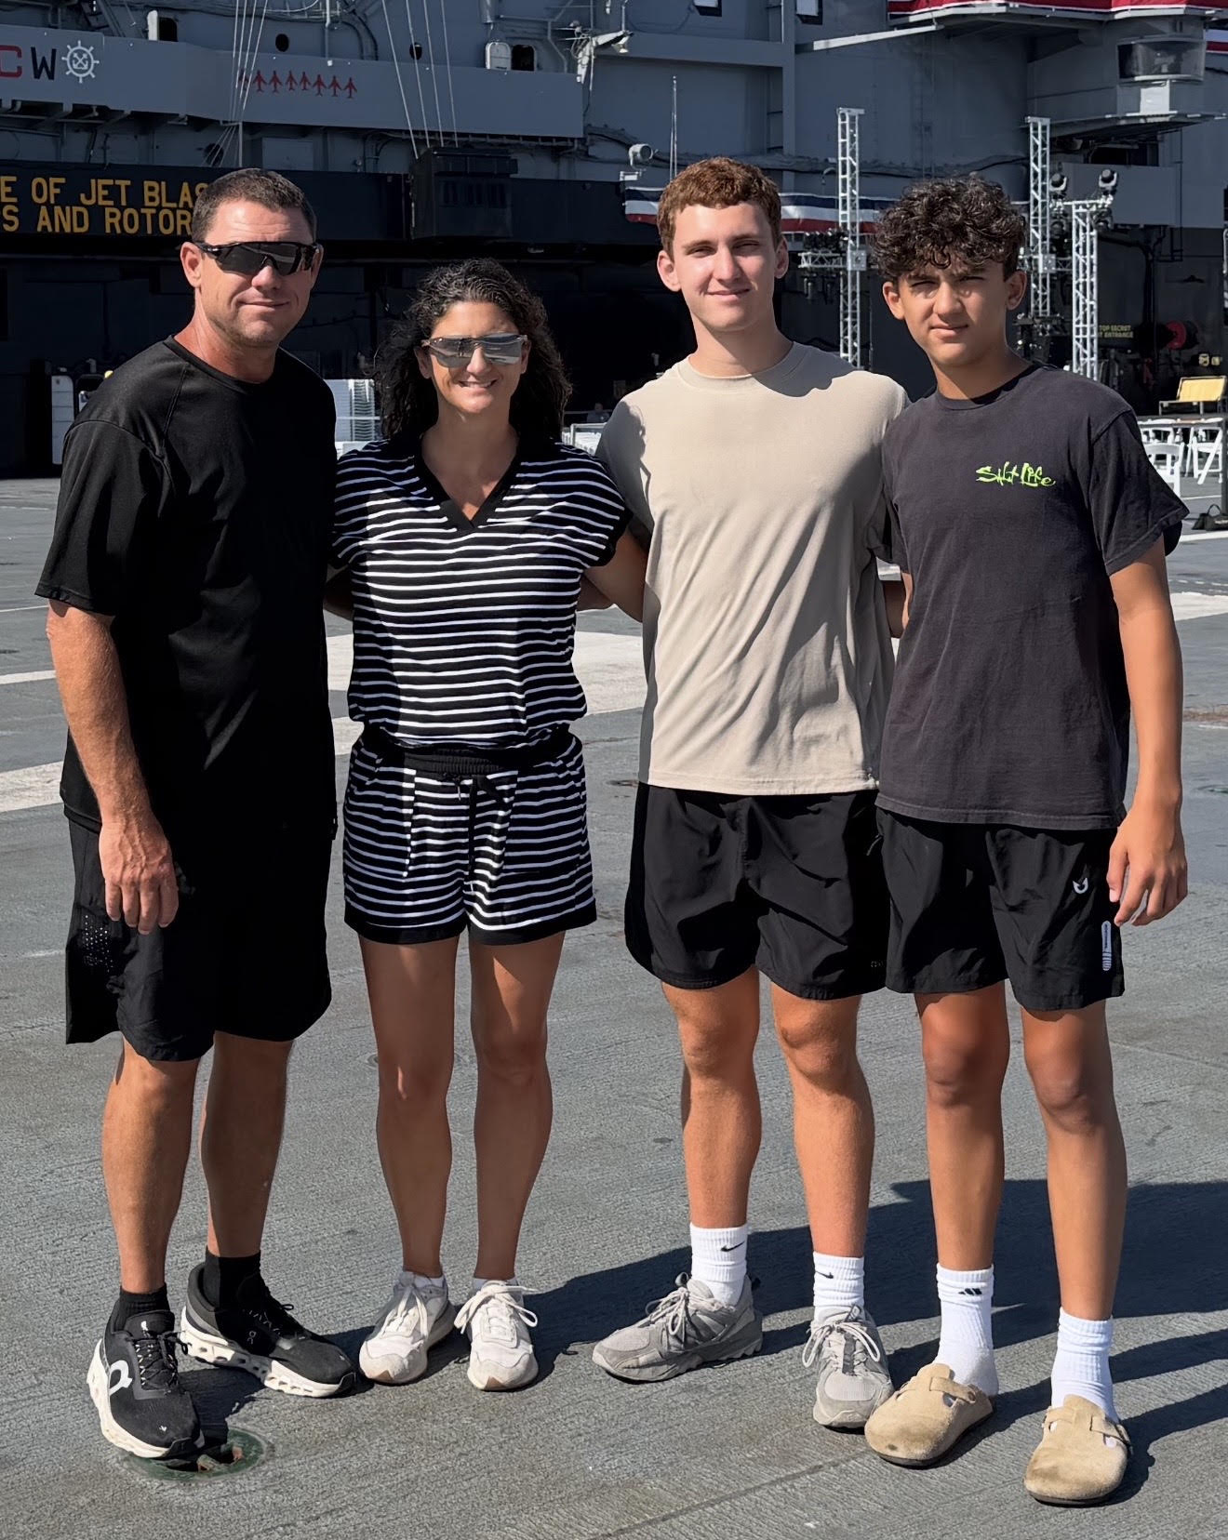
Head Baseball Coach
Shayne Carnes –
21st year as Head Baseball Coach at MJ, 25th year overall
Jamie –
wife (20 years)
Conner –
son, age 18
Caden –
son, age 14

Slide 3
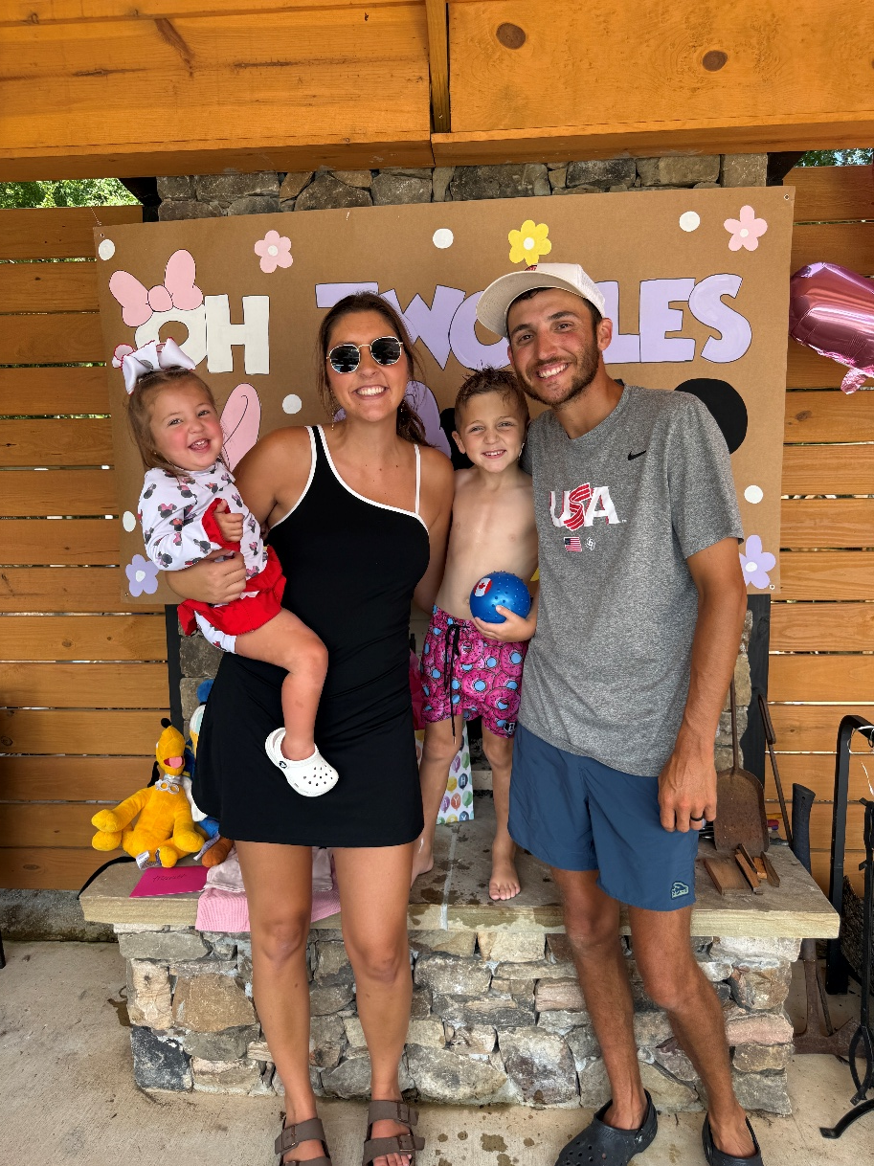
Assistant Coach
Chase Graveman –
11 Years Coaching
Haley –
wife (7 years)
Tripp –
son, age 4
Merritt –
daughter, age 2

Slide 4
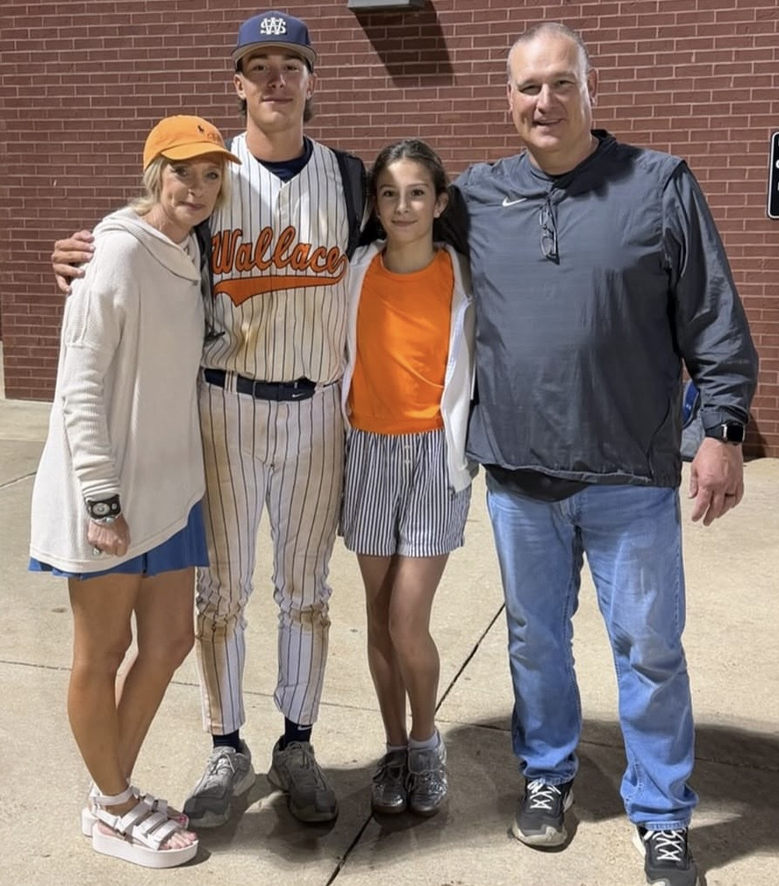
Assistant Coach
Carl Rickman –
26 Years Coaching
Laura – wife (24 years)
Tucker – son, age 20
Mallie Kate –
daughter, age 14

Slide 5
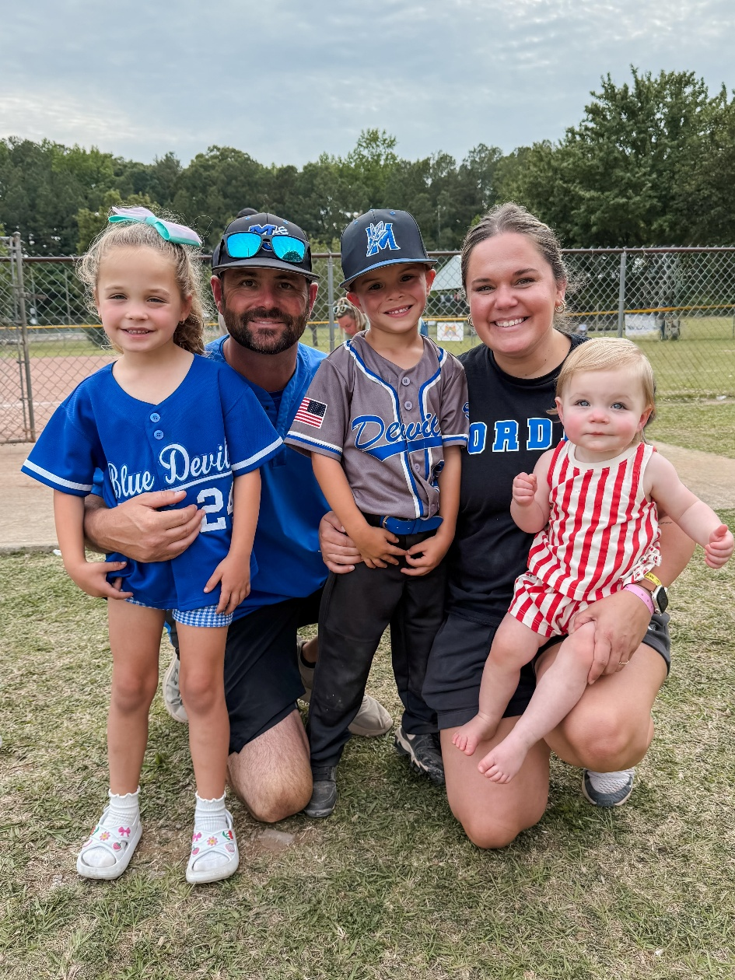
Assistant Coach
Chris Shelton –
15 Years Coaching
Stacy –
wife (12 years)
Scottie –
daughter, age 5
Tate –
son, age 5
Colbie –
daughter, age 1

Slide 6
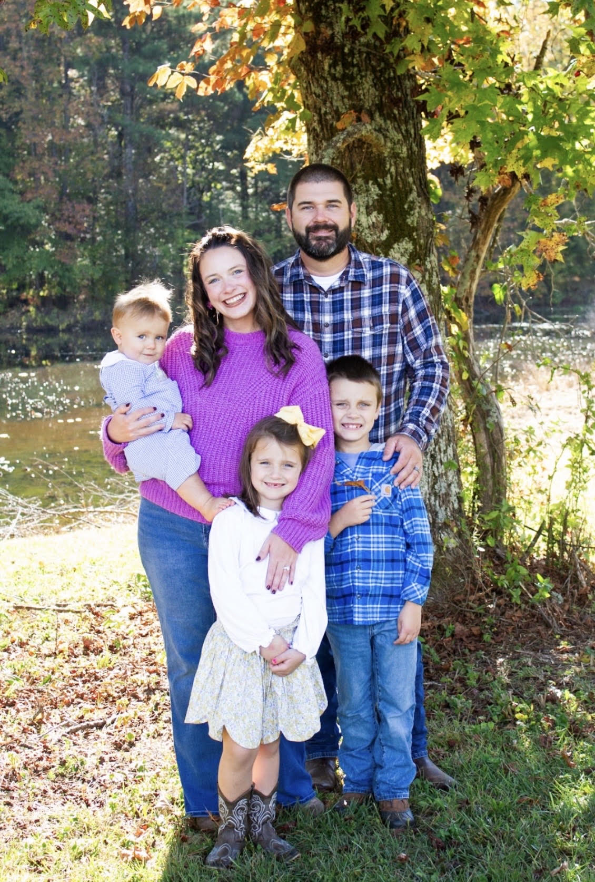
Assistant Coach
Andrew McLendon –
14 Years Coaching
Debra –
wife (13 years)
Gates –
son, age 8
Millie Kate –
daughter, age 7
Drew
son, age 2

Slide 7
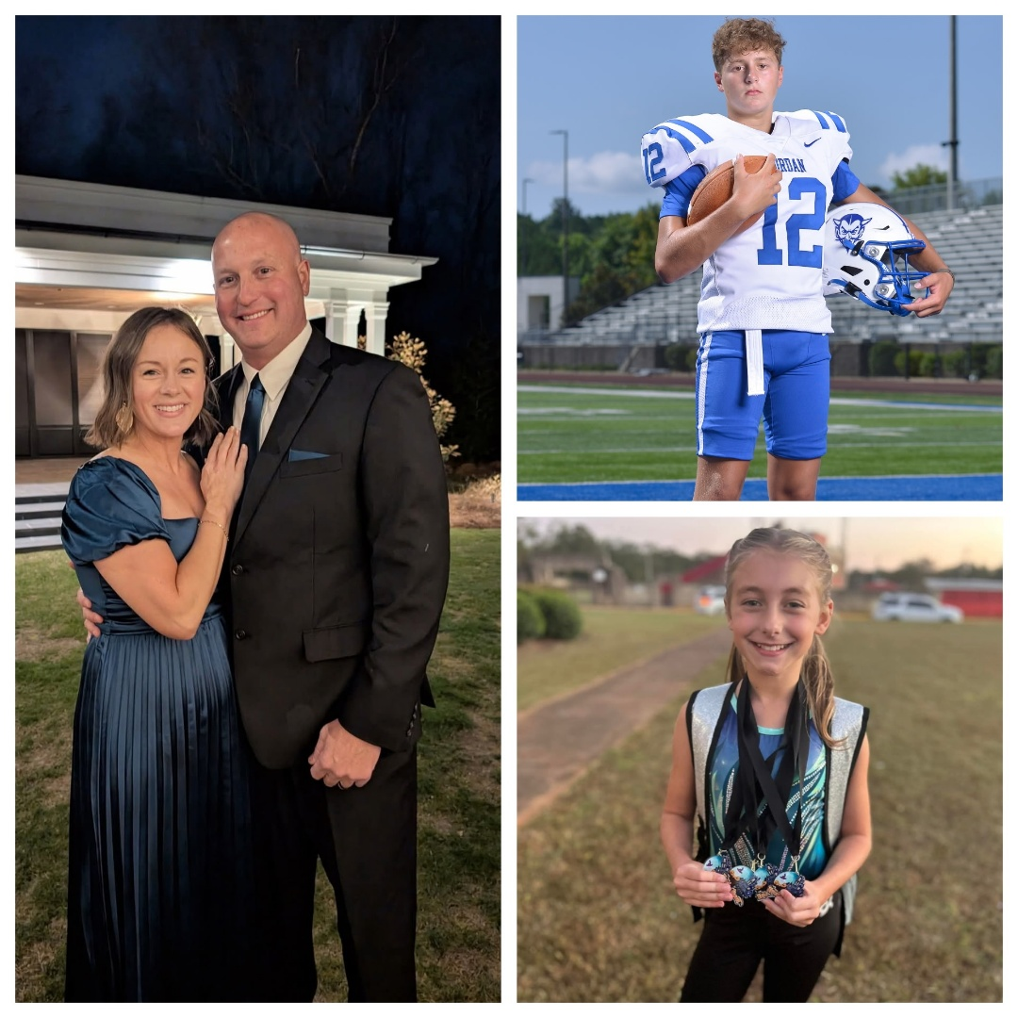
Assistant Coach
Adam Crain –
16 Years Coaching
Andie –
wife (17 years)
Eli –
son, age 15
Evie –
daughter, age 12

Slide 8
Baseball Philosophy
Provide a professional atmosphere where student athletes can reach their full potential
Develop players and improve skills daily
Control the things we have the ability to control: Effort and Attitude
Priority is to win games, but we will not play to win at all cost.
Develop skills and to learn how to play winning baseball

Slide 9
Baseball Philosophy
Goals / Improvements for players when they graduate:
  Be Better - Person, Husband, Father
  Work Ethic
  Adversity
Full Transparency – try to keep everyone informed of all things regarding MJHS Baseball

Slide 10
Roster Breakdown
Seniors: 8
Juniors: 6
Sophomores: 17
Freshmen: 15
Varsity, JV, and 9G rosters will be finalized roughly a week prior to the start of the season.
Players may play at different levels during the season based on need and performance.

Slide 11
2027 and Beyond
Senior and Junior groups have less than 10 players per grade
17 Sophomores, 15 Freshman – we cannot keep everyone next year that made the team this year
Underclassmen need to look at this season as a year long tryout
We should have enough players to have a 9th Grade team for the 2028 season based on the current NJMS numbers

Slide 12
Team Rules
Playing baseball is privilege, not a right.
Each disciplinary action with be dealt with on an individual basis.
No Alcohol, No Drugs
Academics – C’s or better
Expect appropriate behavior both on and off the field
Players are expected to be at all practices and games.

Slide 13
Playing Time
Will discuss playing time with a player
Will NOT discuss playing time with parent(s)
Playing time is merit based
We will play the players that give us the best chance to win on that day
Playing time must be earned
No player is guaranteed playing time

Slide 14
Parent Conduct
Set a good example for the student athletes
Do not harass the umpires
Please do not coach your player from the stands during practice or a game
Please do not yell at your kid from the stands. It is counter-productive and it is embarrassing for the player.
Social Media – “The Don’ts”

Slide 15
Parental Concerns
24 hour cooling period
Do not confront a coach during or after a game
Call, text, email – set up time to meet and discuss issue during the school day
Will not discuss playing time
My door is always open…please let me know if there is an issue that needs to be discussed

Slide 16
AHSAA Eligibility / DragonFly
Birth Certificate
NFHS Sportsmanship
Physical – must be current
AHSAA Concussion Form - yearly
AHSAA Student Release Form – yearly
AHSAA Student/Parent Sudden Cardiac Arrest Awareness - yearly

Slide 17
MJHS Eligibility
MJHS Athletic Contract
JEFCO Photo / Video Release
EMS Form
Permission to Travel – Bus
Permission to Travel – Parent Responsibility

Slide 18
Player Injury
Please let us know as soon as possible
We have 2 Certified Athletic Trainers on Staff – Jeremy Free and Adrienne Murphy
Please talk with Jeremy or Adrienne before taking a player to the doctor
Pediatricians – result will more than likely be 2 weeks of rest and then re-evaluate.
Jeremy’s phone number: 205-446-0865
Adrienne’s phone number: 205-767-6921

Slide 19
Practice Schedule
Will be on a day-to-day basis – plan for Monday through Friday
May change because of weather
May need to come to field on some Sundays and put the tarp on.

Slide 20
Missing Practice
Player is sick
Player is hurt
Family Emergency
Death in the family
Extenuating circumstance
Dentist Appointment – NOT a valid reason to miss practice

Slide 21
Practice Attire
Practice Hat
Practice Jersey
White Baseball Pants
Belt
Blue Socks
Cleats

Slide 22
2027 Scheduling Guidelines
AHSAA Baseball Schedule Restrictions
  28 Games for Varsity
  28 Games for JV
  28 Games for 9th Grade
Scheduling Restrictions - Problems
  Playing Time

Slide 23
2027 Game Schedule
Varsity – 34 games scheduled
JV – 28 games scheduled
9th Grade – 28 games scheduled
Spring Break
  Varsity at Gulf Shores / Orange Beach (Fri-Sat)
  Gulf Coast Classic III (Mon-Thur)
  At least 6 varsity games
  JV / 9G Off
All Varsity games take precedence over JV / 9th grade games

Slide 24
2027 Season
AHSAA Baseball Pitching Rules
Level – Pitches Allowed Per Day
  11th & 12th Graders 120
  9th & 10th Graders 100
  7th & 8th Graders 85

Slide 25
2027 Season
AHSAA Baseball Pitching Rules
If a pitcher throws:
  76 or more pitches in a day 3 days rest
  51-75 pitches in a day 2 days rest
  26-50 pitches in a day 1 day rest
  1-25 pitches in a day 0 days rest

Slide 26
MJHS Baseball Website
MJHS Baseball Website Address: www.mortimerjordanbaseball.com
Announcements
All Baseball Forms
Updated Game Schedules
Updated Stats – Varsity Only
Updated Game Results – Varsity Only

Slide 27
Communication
MJ Baseball Facebook Page / Twitter
Group Me App – Parents
Group Me Etiquette
JEFCO Email – Players Only
Please do not call the school to ask if practice or game is canceled…it will be posted to these social media sites as soon as a decision has been made.

Slide 28
MJ Baseball Dugout Club
Our Dugout Club is responsible for fundraising, facility operations, parent work-days, concessions, and most other baseball related items.
Special Thanks to the following people:
  Mary Ann Woods – DC Treasurer
  Valerie Maldonado – Concession Stand
  All DC Board Members

Slide 29
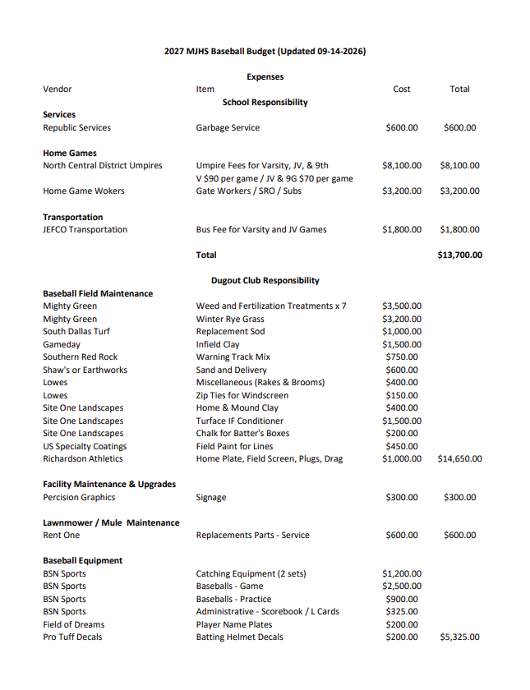
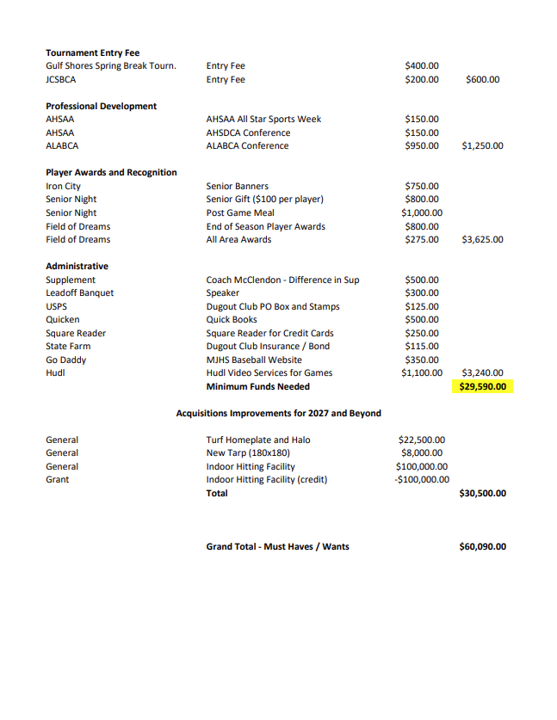
MJ Baseball DC Budget

Slide 30
Fundraisers
School
  20/20 Letters
    Letters will be mailed out again this year.
    Players are to address envelopes and stuff envelopes with the 20/20 letters.
Dugout Club
  Golf Tournament
  Digital Advertising
  Steak Dinner
  Concession Stand

Slide 31
Spirit Packs
High school baseball expenses add up fast, so we want to be as flexible as possible.
To help ease the financial burden, we’re offering a 3-installment payment plan. You can simply take your player's total spirit pack balance and divide it by 3, following the schedule below:
Payment 1: Due Thursday, 09/24/2026
Payment 2: Due Monday, 11/02/2026
Payment 3: Due Tuesday, 12/01/2026

Slide 32
Spirit Packs
Forms & First Payment:
Spirit Pack forms are due Thursday, 09/24/2026.
You can choose to pay in full or pay Installment 1 at this time—whatever works best for your family.
You are also welcome to pay the remaining balance off in full at any point before 12/01/2026.

Slide 33
Spirit Packs
Payment Methods: Cash, check, or credit card. Note: Credit card payments include a 3% processing fee charged by Square.
In-Person Card Payments:
Card payments can be made in person at MJHS from 6:00 PM – 6:30 PM on each of the due dates listed above.
Item Distribution:
Spirit pack items will be handed out to players once their balance is paid in full.

Slide 34
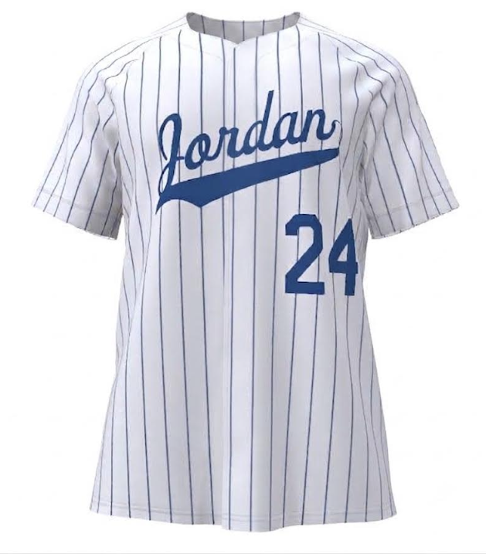
Pinstripe Uniform
Jersey - $66
Pants - $62
Thoughts?
Varsity Only vs. All Teams?
Vote

Slide 35
Important Dates
October 16th – 20/20 Letters Due
January 11th – First day of practice
January 23rd – Assigned signs due for SP credit, Steak dinner tickets are due, Parent workday at the baseball field, Dugout Club dues are due
January 30th – Steak Dinner, LOB tickets are due
February 11th – Leadoff Banquet, Unsold signs are due for SP credit
February 18th – Opening Day

Slide 36
Conclusion
We are truly blessed – players, facility, parents, support of the program
The coaching staff will create a positive learning environment for the players
Players will learn the game of baseball and all the lessons in life it has to offer
Program will be ran in a professional manner mimicking that of a college or professional program.
Thank you for all you have done and will do to make our baseball program one of the best in the state.

