Slide 1
Mortimer Jordan Baseball
2026

Slide 2
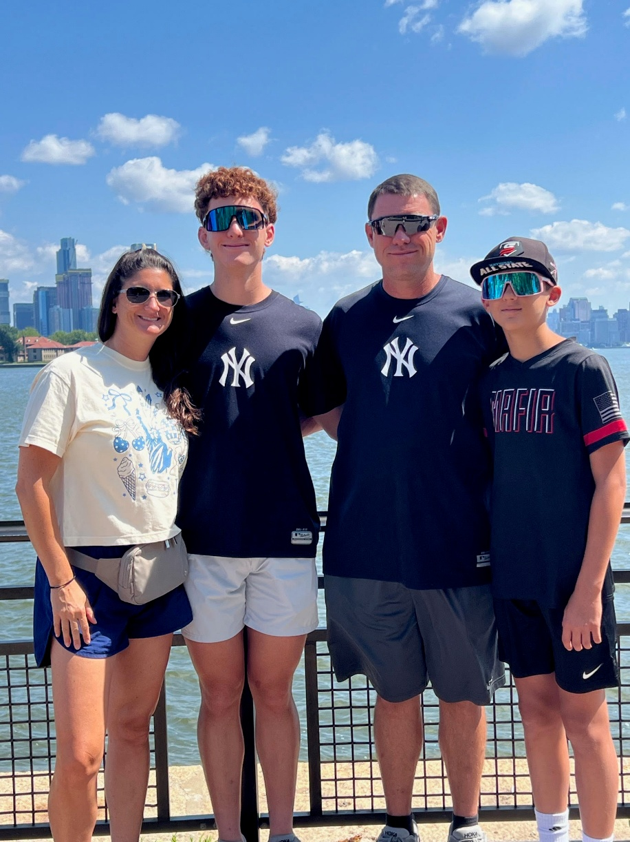
Head Baseball Coach
Shayne Carnes –
20th year as Head Baseball Coach at MJ, 24th year overall
Jamie –
wife (19 years)
Conner –
son, age 17
Caden –
son, age 13

Slide 3
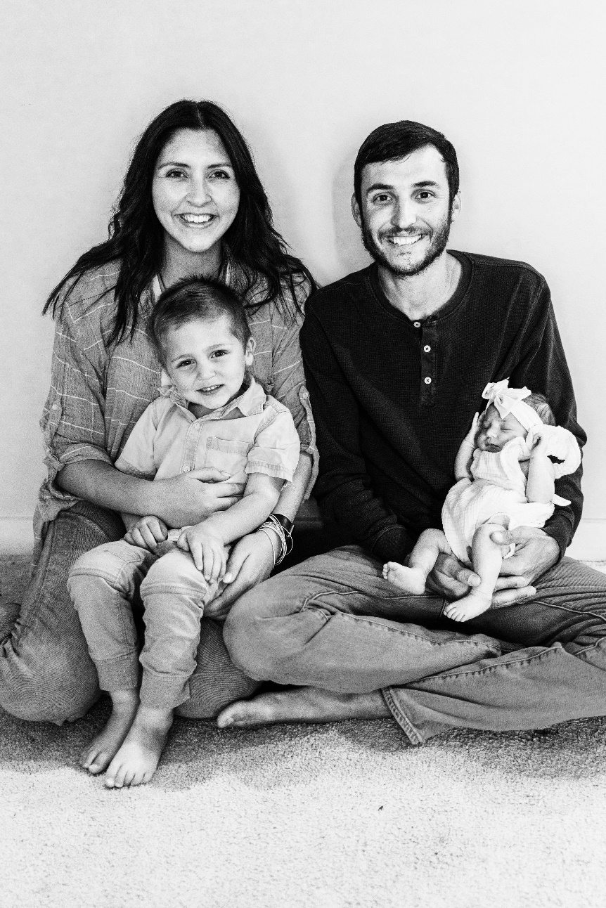
Assistant Coach
Chase Graveman –
10 Years Coaching
Haley –
wife (6 years)
Tripp –
son, age 3 Yrs.
9 Months
Merritt –
daughter, age
1 year 3 Months

Slide 4
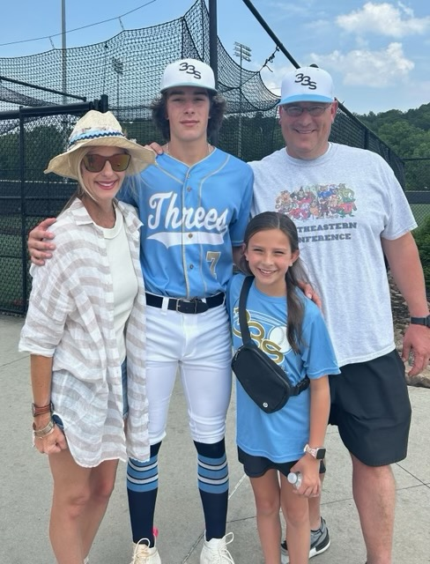
Assistant Coach
Carl Rickman –
25 Years Coaching
Laura – wife (23 years)
Tucker – son, age 19
Mallie Kate –
daughter, age 13

Slide 5
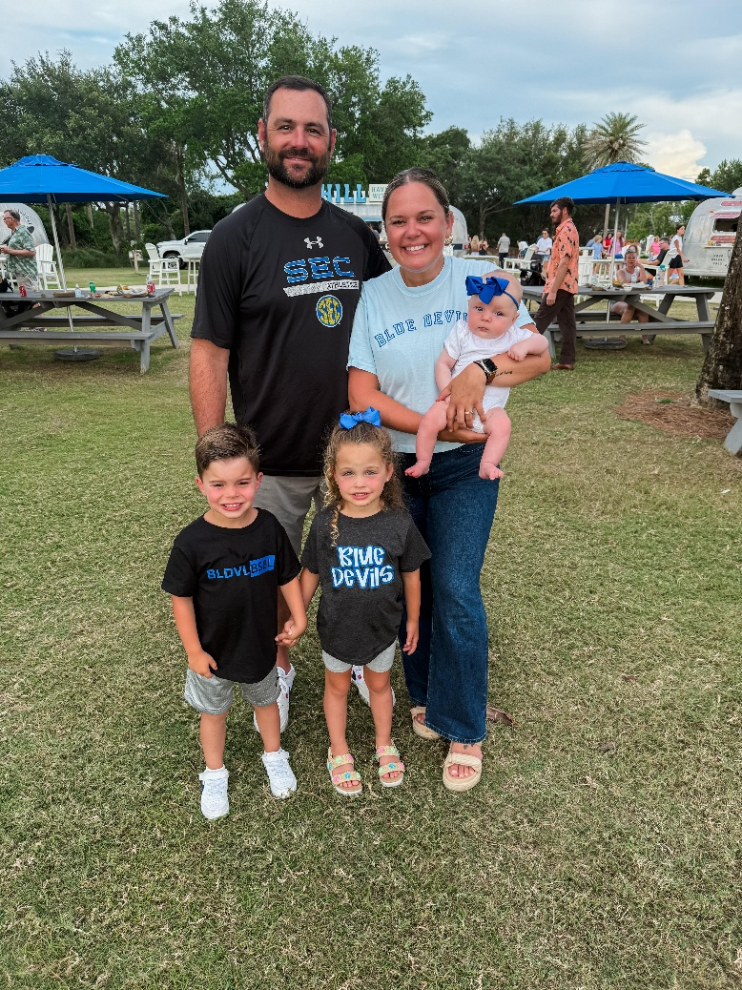
Assistant Coach
Chris Shelton –
12 Years Coaching
Stacy –
wife (11 years)
Scottie –
daughter, age 4
Tate –
son, age 4
Colbie –
daughter, age 6 months

Slide 6
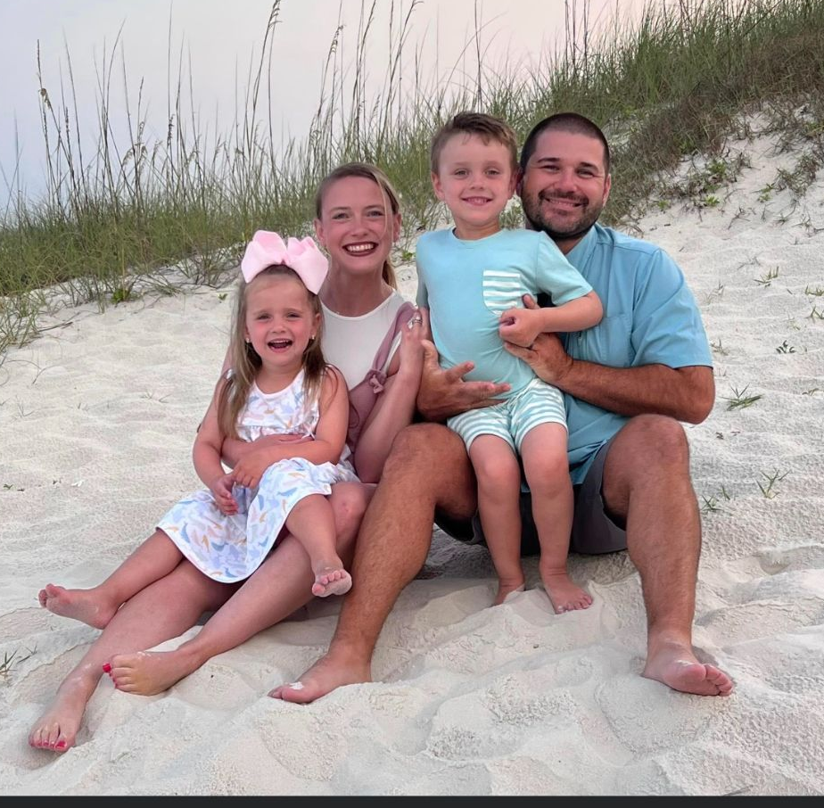
Assistant Coach
Andrew McLendon –
13 Years Coaching
Debra –
wife (12 years)
Gates –
son, age 7
Millie Kate –
daughter, age 6
Drew
son, age 9 months

Slide 7
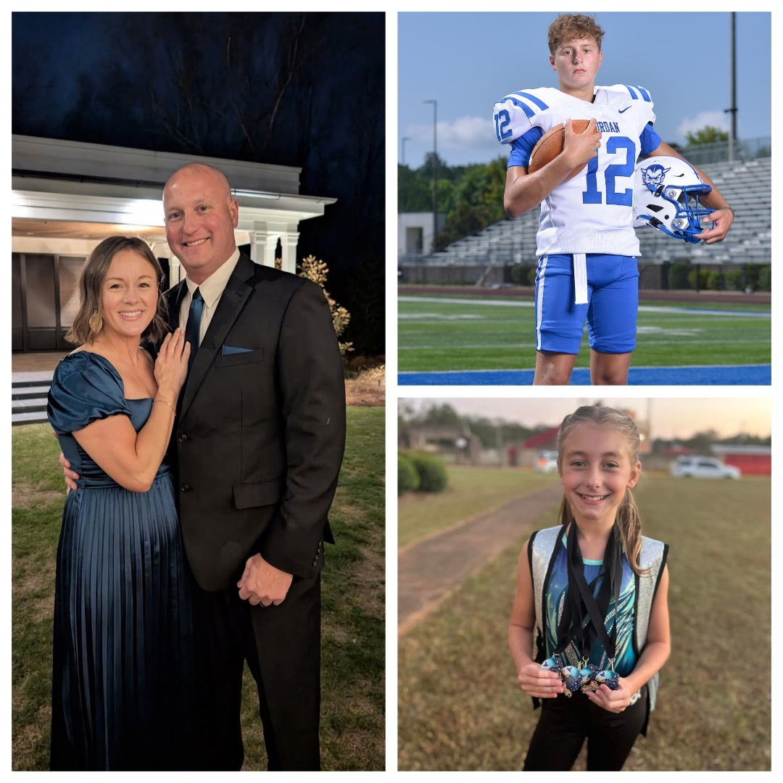
Assistant Coach
Adam Crain –
15 Years Coaching
Andie –
wife (16 years)
Eli –
son, age 14
Evie –
daughter, age 11

Slide 8
Baseball Philosophy
Provide a professional atmosphere where student athletes can reach their full potential
Develop players and improve skills daily
Control the things we have the ability to control: Effort and Attitude
Priority is to win games, but we will not play to win at all cost.
Develop skills and to learn how to play winning baseball

Slide 9
Roster Breakdown
Seniors: 8
Juniors: 6
Sophomores: 12
Freshmen: 19
Varsity, JV, and 9G rosters will be finalized roughly a week prior to the start of the season.
Players may play at different levels during the season based on need and performance.

Slide 10
2026 and Beyond
Senior and Junior groups have less than 10 players per grade
12 Sophomores, 19 Freshman – we cannot keep everyone next year that made the team this year
Underclassmen need to look at this season as a year long tryout
We may not have the numbers to have a 9th Grade team in 2027 based on the current NJMS numbers

Slide 11
Team Rules
Playing baseball is privilege, not a right.
Each disciplinary action with be dealt with on an individual basis.
No Alcohol, No Drugs
Academics – C’s or better
Expect appropriate behavior both on and off the field

Slide 12
Playing Time
Will discuss playing time with a player
Will NOT discuss playing time with parent(s)
Playing time is determined by performance in practice and in games
We will play the players that give us the best chance to win on that day
Playing time must be earned
No player is guaranteed playing time

Slide 13
Parent Conduct
Set a good example for the student athletes
Do not harass the umpires
Please do not coach your player from the stands during practice or a game
Please do not yell at your kid from the stands. It is counter-productive and it is embarrassing for the player.
Social Media – “The Don’ts”

Slide 14
Parental Concerns
24 hour cooling period
Do not confront a coach during or after a game
Call, text, email – set up time to meet and discuss issue during the school day
Will not discuss playing time
My door is always open…please let me know if there is an issue that needs to be discussed

Slide 15
AHSAA Eligibility / DragonFly
Birth Certificate
NFHS Sportsmanship
Physical – must be current
AHSAA Concussion Form - yearly
AHSAA Student Release Form – yearly
AHSAA Student/Parent Sudden Cardiac Arrest Awareness - yearly

Slide 16
MJHS Eligibility
MJHS Athletic Contract
JEFCO Photo / Video Release
EMS Form
Permission to Travel – Bus
Permission to Travel – Parent Responsibility

Slide 17
Player Injury
Please let us know as soon as possible
We have 2 Certified Athletic Trainers on Staff – Jeremy Free and Adrienne Murphy
Please talk with Jeremy or Adrienne before taking a player to the doctor
Pediatricians – result will more than likely be 2 weeks of rest and then re-evaluate.
Jeremy’s phone number: 205-446-0865
Adrienne’s phone number: 205-767-6921

Slide 18
Practice Schedule
Will be on a day-to-day basis – plan for Monday through Friday
May change because of weather
May need to come to field on some Sundays and put the tarp on.

Slide 19
Practice Attire
Practice Hat
Practice Jersey
White Baseball Pants
Belt
Blue Socks
Cleats

Slide 20
2026 Scheduling Guidelines
AHSAA Baseball Schedule Restrictions
  28 Games for Varsity
  28 Games for JV
  28 Games for 9th Grade
My Plan
  Play games during Spring Break
    6 Varsity Games
Scheduling Restrictions - Problems
  Playing Time

Slide 21
2026 Game Schedule
Varsity – 34 games scheduled
JV – 28 games scheduled
9th Grade – 28 games scheduled
Spring Break
  Varsity – Gulf Shores, Al
All Varsity games take precedence over JV / 9th grade games

Slide 22
2026 Season
AHSAA Baseball Pitching Rules
Level – Pitches Allowed Per Day
  11th & 12th Graders 120
  9th & 10th Graders 100
  7th & 8th Graders 85

Slide 23
2026 Season
AHSAA Baseball Pitching Rules
If a pitcher throws:
  76 or more pitches in a day 3 days rest
  51-75 pitches in a day 2 days rest
  26-50 pitches in a day 1 day rest
  1-25 pitches in a day 0 days rest

Slide 24
MJHS Baseball Website
MJHS Baseball Website Address: www.mortimerjordanbaseball.com
Announcements
All Baseball Forms
Updated Game Schedules
Updated Stats – Varsity Only
Updated Game Results – Varsity Only

Slide 25
Communication
MJ Baseball Facebook Page / Twitter
Group Me App – Parents
Group Me Etiquette
JEFCO Email – Players Only
Please do not call the school to ask if practice or game is canceled…it will be posted to these social media sites as soon as a decision has been made.

Slide 26
MJ Baseball Dugout Club
Our Dugout Club is responsible for fundraising, facility operations, parent work-days, concessions, and most other baseball related items.
Special Thanks to the following people:
  Mary Ann Woods – DC Treasurer
  Valerie Maldonado – Concession Stand
  All DC Board Members

Slide 27
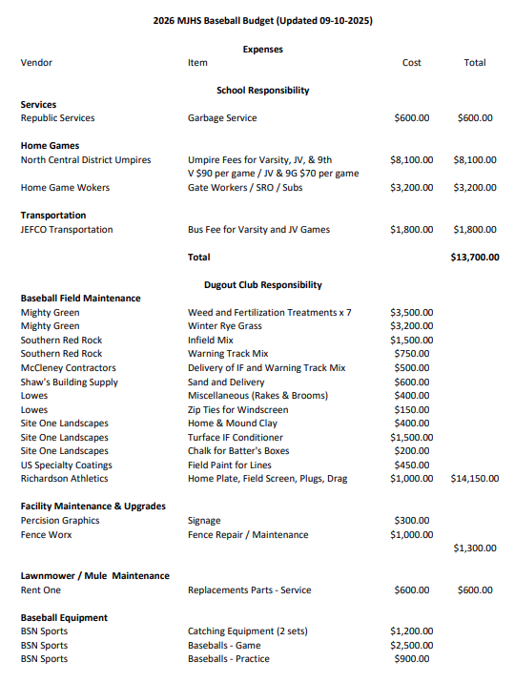
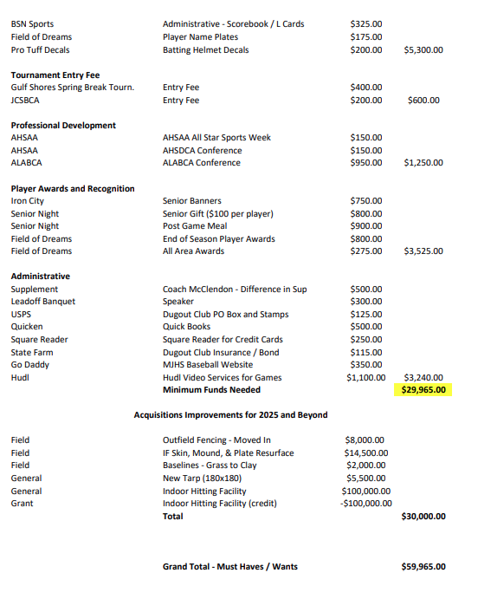
MJ Baseball DC Budget

Slide 28
Fundraisers
School
  20/20 Letters
    Letters will be mailed out again this year.
    Players are to address envelopes and stuff envelopes with the 20/20 letters.
Dugout Club
  Golf Tournament
  Digital Advertising
  Steak Dinner
  Concession Stand

Slide 29
Spirit Packs
Spirit Pack order forms are due on Thursday, September 25, 2026.
Spirit Packs must be paid for in full before spirit pack items will be given to the players.
If there is a problem with the spirit pack order, I need to know immediately so the problem can be corrected.

Slide 30
Important Dates
November 6th – 20/20 Letters Due
January 12th – First day of practice, assigned signs due for SP credit, SP money is due
January 24th – Steak dinner tickets are due, parent workday at the baseball field, Dugout Club Dues are due
January 31st – Steak Dinner, LOB tickets are due
February 12th – Leadoff Banquet, Unsold signs are due for SP credit
February 19th – Opening Day

Slide 31
Conclusion
We are truly blessed – players, facility, parents, support of the program
The coaching staff will create a positive learning environment for the players
Players will learn the game of baseball and all the lessons in life it has to offer
Program will be ran in a professional manner mimicking that of a college or professional program.
Thank you for all you have done and will do to make our baseball program one of the best in the state.

