Slide 1
Mortimer Jordan Baseball 2023

Slide 2
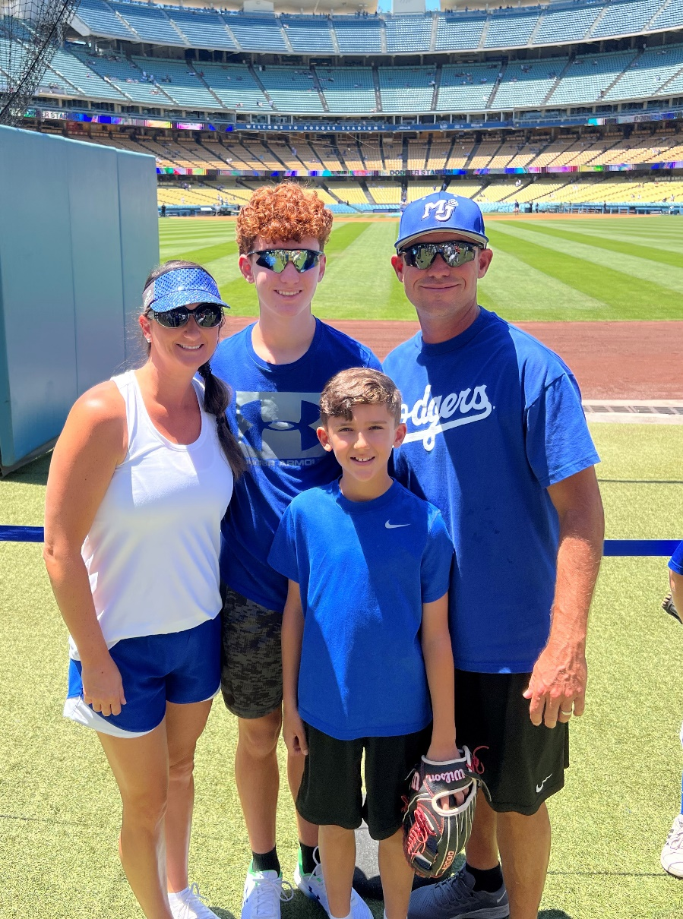
Head Baseball Coach
Shayne Carnes –
17th year as Head Baseball Coach at MJ, 21st year overall
Jamie –
wife (16 years)
Conner –
son, age 14
Caden –
son, age 10

Slide 3
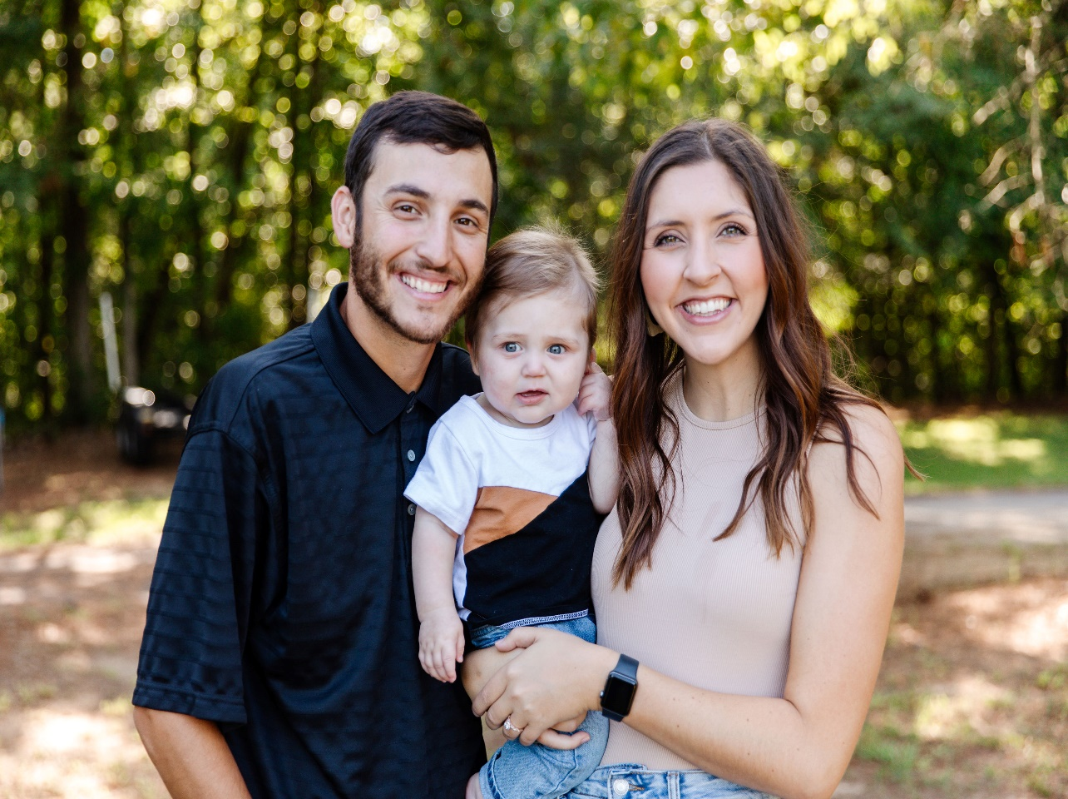
Varsity Assistant Coach
Chase Graveman –
7 Years Coaching
Haley – wife (3 years)
Tripp –
son, age 9
Months

Slide 4
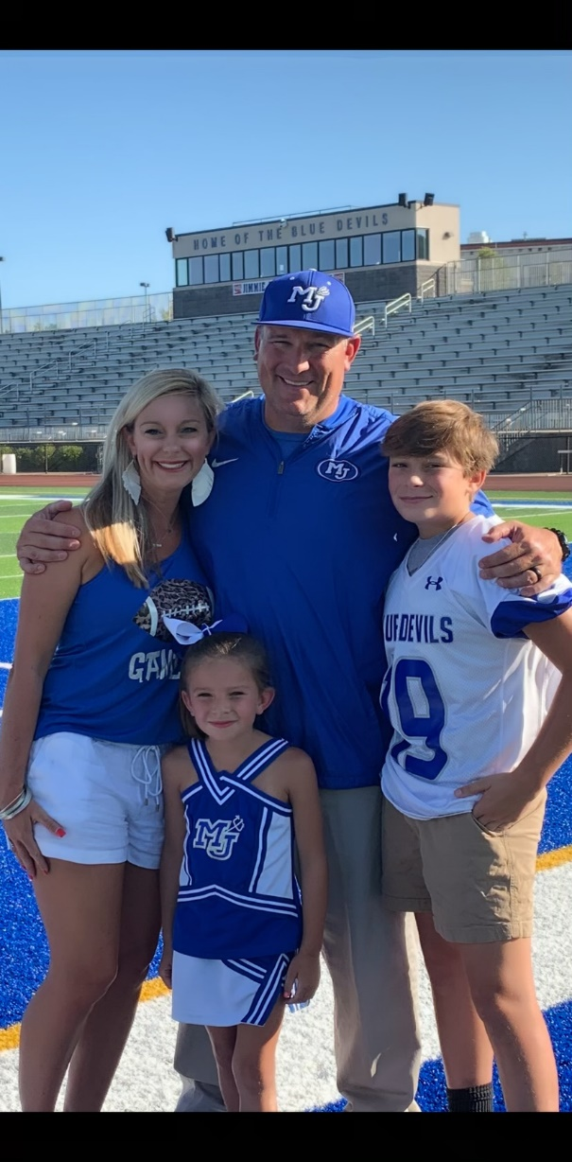
Varsity Assistant Coach
Carl Rickman –
22 Years Coaching
Laura – wife (20 years)
Tucker – son, age 16
Mallie Kate –
daughter, age 10

Slide 5
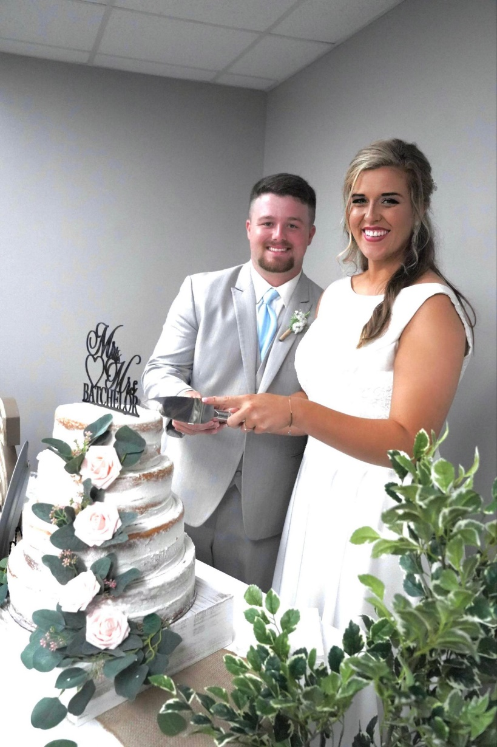
Head JV Coach
Chase Batchelor –
4 Years Coaching
Skylar –
wife (<1 year)

Slide 6
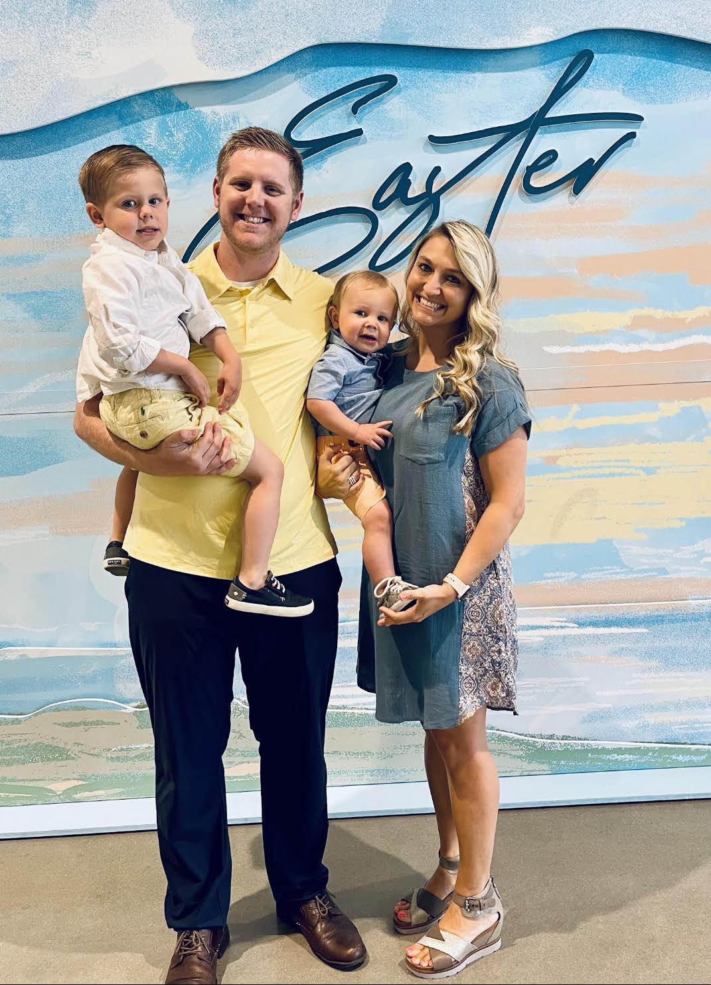
Head 9th Grade Coach
Josh Pruett –
5 Years Coaching
Brandi – wife (5 years)
Cooper – son, age 4
Jack – son, age 2

Slide 7
Baseball Philosophy
Provide a professional atmosphere where student athletes can reach their full potential
Develop players and improve skills daily
Control the things we have the ability to control: Effort and Attitude
Varsity Baseball – priority is to win games, but we will not play to win at all cost
JV / 9th Grade Baseball – priority is to develop skills and to learn how to play winning baseball

Slide 8
Team Rules
Playing baseball is privilege, not a right.
Each disciplinary action with be dealt with on a individual basis.
No Alcohol, No Drugs
Academics – C’s or better
Hair Cuts – Above the eyes, ears, and collar of shirt
Expect appropriate behavior both on and off the field

Slide 9
Practice Attire
Practice Hat
Practice Jersey
Blue T-Shirt Under Jersey
Gray Baseball Pants
Belt
Blue Socks
Cleats

Slide 10
Uniforms
Players are responsible for all school equipment loaned to them
Uniforms should be washed after every game and will be required to be hanging in the player’s locker the next day

Slide 11
Playing Time
Will discuss playing time with a player
Will NOT discuss playing time with parent(s)
Playing time is determined by performance in practice and in games
We will play the players that give us the best chance to win on that day
Playing time must be earned
No player is guaranteed playing time

Slide 12
Parent Conduct
Set a good example for the student athletes
Do not harass the umpires
Absolutely no coaching your player from the stands during practice or a game
Please do not yell at your kid from the stands. It is counter-productive and it is embarrassing for the player.
Social Media – “The Don’ts”

Slide 13
Parental Concerns
24 hour cooling period
Do not confront a coach during or after a game
Call, text, email – set up time to meet and discuss issue during the school day
Will not discuss playing time
My door is always open…please let me know if there is an issue that needs to be discussed

Slide 14
Player Injury
Please let us know as soon as possible
We have a Certified Athletic Trainer on Staff – Jeremy Free
Please talk with Jeremy before taking a player to the doctor
Pediatricians – result will more than likely be 2 weeks of rest and then re-evaluate.
Jeremy’s phone number: 256-238-3320

Slide 15
AHSAA Eligibility / DragonFly
Birth Certificate
Star Sportsmanship
Physical – must be current
AHSAA Concussion Form - yearly
AHSAA Student Release Form - yearly

Slide 16
MJHS Eligibility
MJHS Athletic Contract
JEFCO Photo / Video Release
EMS – Jeremy Free
Permission to Travel – Bus
Permission to Travel – Parent Responsibility
Information and Waiver Form

Slide 17
Spirit Packs
Will order next week and should be here by the time we start practice in January.
Spirit Packs must be paid for in full by January 28, 2023.
If there is a problem with the spirit pack order, I need to know immediately so the problem can be corrected.

Slide 18
Practice Schedule
Will be on a day-to-day basis – plan for Monday through Saturday
May change because of weather
May need to come to field on some Sundays and put the tarp on (will not be required)

Slide 19
MJHS Baseball Website
MJHS Baseball Website Address: www.mortimerjordanbaseball.com
Announcements
All Baseball Forms
Updated Game Schedules
Updated Stats – Varsity Only
Updated Game Results – Varsity Only

Slide 20
Communication
MJ Baseball Facebook Page / Twitter
Group Me App – Parents
JEFCO Email – Players Only
Please do not call the school to ask if practice or game is canceled…it will be posted to these social media sites as soon as a decision has been made.

Slide 21
MJ Baseball Dugout Club
Our Dugout Club takes care of fundraising, facility operations, and concessions.
Fundraisers, concession stand workers, gate workers, parent work-days, and all other things needed throughout the year is coordinated by the MJ Baseball Dugout Club

Slide 22
Fundraisers
School
20/20 Letters
Letters will be mailed out again this year.
Players are to address envelopes and stuff envelopes with the 20/20 letters.
Dugout Club
Field Signs
Steak Dinner
Lead Off Banquet
Concession Stand

Slide 23
Important Dates
November 4th – 20/20 Letters Due
January 9th – First Day of Practice
January 28th – Signs due for spirit pack credit, steak dinner tickets are due, parent work day at the baseball field, concession stand “not to work” fee due, Dugout Clubs are due, and Spirit Pack money is due.
February 4th – Steak Dinner, LOB tickets are due
February 9th – Leadoff Banquet
February 16th – Opening Day

Slide 24
2023 Scheduling Guidelines
AHSAA Baseball Schedule Restrictions
28 Games for Varsity
28 Games for JV
28 Games for 9th Grade
My Plan
Play games during Spring Break
6 Varsity Games / 2 JV Games
Scheduling Restrictions - Problems
Playing Time

Slide 25
2023 Game Schedule
Home Games
Free Admission for Parents and Siblings of MJ Baseball Players
Varsity – 36 games scheduled
JV – 30 games scheduled
9th Grade – 28 games scheduled
Spring Break
Varsity – Gulf Shores, Al
JV – 2 games on Friday leading up to Spring Break
All Varsity games take precedence over JV / 9th grade games

Slide 26
2023 Season AHSAA Baseball Pitching Rules
Level – Pitches Allowed Per Day
11th & 12th Graders 120
9th & 10th Graders 100
7th & 8th Graders 85

Slide 27
2023 Season AHSAA Baseball Pitching Rules
If a pitcher throws:
76 or more pitches in a day 3 days rest
51-75 pitches in a day 2 days rest
26-50 pitches in a day 1 days rest
1-25 pitches in a day 0 days rest

Slide 28
Conclusion
We are truly blessed – players, facility, parents, support of the program
The coaching staff will create a positive learning environment for the players
Players will learn the game of baseball and all the lessons in life it has to offer
Program will be ran in a professional manner mimicking that of a college or professional program.
Thank you for all you have done and will do to make our baseball program one of the best in the state.

