Slide 1

Vitamins, Herbs, & Supplements
Boosting the Immune System During Covid-19

Slide 2
Introduction:
As we know, the immune system is constantly working to defend your body from pathogens, viruses, bacteria, and toxins that causes illness.
Having a healthy immune system is key to preventing infection and disease.
Research has shown that adding certain vitamins, minerals, herbs, and other supplements s can help improve immune response to potentially protect against illness.

Slide 3
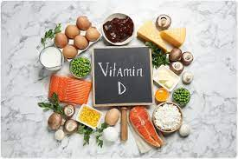
Vitamin D
Essential for a functional immune system
Enhances the effects of the immune defense
May protect against respiratory tract infections
Vitamin D can help stall inflammation in the respiratory system expedite healing

Slide 4
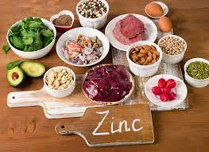
ZINC
An essential mineral that boosts the immune system
Vital for immune cell development and inflammatory response
Protects tissue barriers to prevent foreign pathogens
Zinc deficiency increases the risk of infection and disease
Can reduce the duration of infection
Demonstrates anti-viral activity

Slide 5
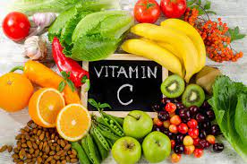
Vitamin C
Most popular supplement used to promote immune health and protect against infections
Powerful antioxidant
Clears out old cells and replaces them with newer cells
Reduces the duration and improves symptoms of respiratory infections

Slide 6
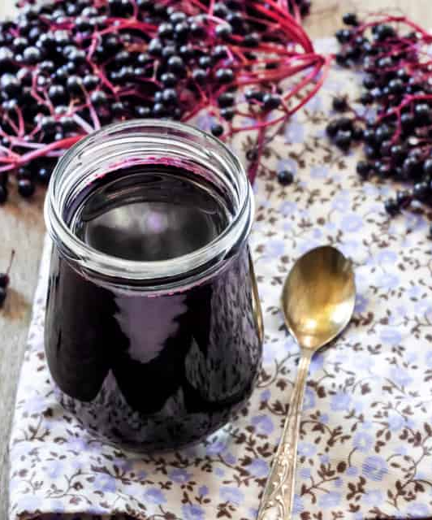
Elderberry
Has been used for many years to treat infections
Has potent antiviral and antibacterial potential to fight against pathogens that causes respiratory tract infections
Enhances the immune response
Shortens the duration and reduces the symptoms of viral infections

Slide 7
References
Harvard Health. (2021, February 15). How to boost your immune system. Harvard Health. Retrieved January 8, 2022, from https://www.health.harvard.edu/staying-healthy/how-to-boost-your-immune-system
Kubala, J. (2021, April 19). Can supplements fight coronavirus (COVID-19)? 15 immune boosters. Healthline. Retrieved January 8, 2022, from https://www.healthline.com/nutrition/immune-boosting-supplements

