Slide 1
Family Based Immigration: Top Problems and Solutions
By: Jessica Weiss, Esq.
NBLI Class

Slide 2

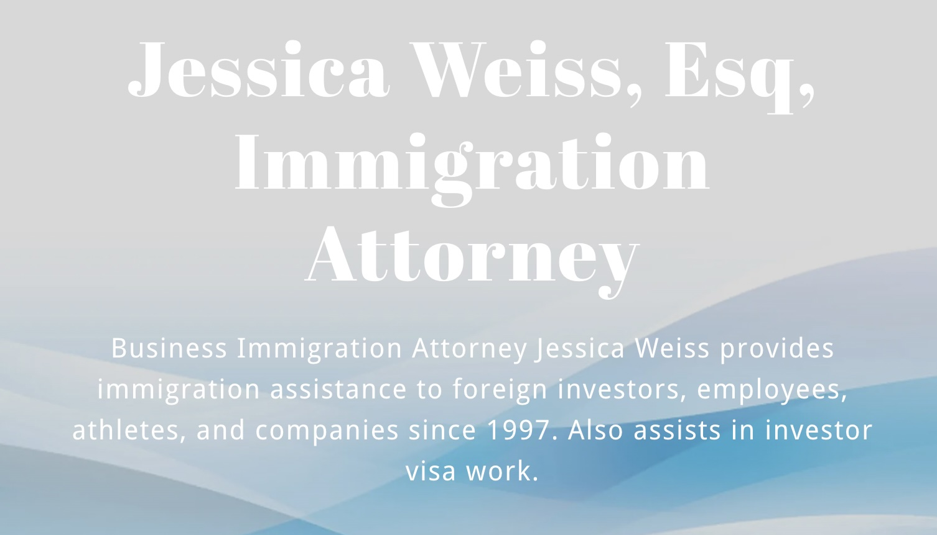

Slide 3

Point 1: Risk of Deportation (NTAs)
Feb 2025 USCIS memo restored presumption of NTAs after denials
Applies when applicant is out of status or removable
Adjustment of Status denials can trigger removal proceedings
Filing is no longer a low-risk strategy

Slide 4

Point 2: CSPA “Aging-Out”
USCIS narrowed CSPA protection (effective Aug 2025)
Only Final Action Date controls age calculation
Filing eligibility does not freeze a child’s age
Children in long backlogs face highest risk

Slide 5

Point 3: N-400 Good Moral Character (GMC)
USCIS applies a totality of circumstances standard
Arrests, dismissed cases, taxes, and fraud reviewed
Older conduct may still be considered
Issues commonly arise at interview
Ways to overcome GMC concerns

Slide 6
Point 4: Visa Backlogs & Per-Country Caps
Annual numerical limits on family-based visas
Per-country cap of approximately 7%
Severe delays in F1–F4 categories
Immediate relatives exempt from caps but still delayed
Derivative Children Issues and visa backlog

Slide 7

Point 5: NVC Bottlenecks & Interview Scheduling
NVC reviews documents but does not control interview results
Consular posts have limited interview capacity
Documentarily qualified cases often wait months
Expedites granted only in limited circumstances

Slide 8

Point 6: USCIS Processing Times
I-130 processing times continue to increase
Added verification and interview scrutiny
RFEs issued more frequently
Errors can add many months of delay
Ways to help prevent RFE's resulting in delays

Slide 9

Point 7: Affidavit of Support (I-864)
Sponsors must meet 125% of poverty guidelines
Joint sponsors often required
Public charge focus is on sponsor’s finances and public benefits usage
Incomplete forms commonly trigger RFEs

Slide 10

Point 8: The Interview & Vetting
Heightened scrutiny in marriage-based cases
Officers assess bona fide relationship
Consistency across forms and testimony is critical
Social media is reviewed
Tips to help prepare applicants for vetting at their interview.

Slide 11

Point 9: Inadmissibility & Waivers
Common grounds: unlawful presence, crimes, misrepresentation
Inadmissibility can block visa issuance
Waivers require proof of extreme hardship
Strong documentation is essential
Provisional Waivers

Slide 12

Point 10: AOS vs. Consular Processing
Strategic choice based on location and eligibility
AOS allows filing inside the U.S.
Consular Processing requires interview abroad
90-day rule raises misrepresentation concerns when entering as a visitor or in certain other nonimmigrant categories

Slide 13

Point 11: RFE / Checklist Prevention
Common RFEs: birth certificates, translations, I-864 issues
Missing or inconsistent documents cause delays
Prevention through careful review is critical

Slide 14

Point 12: Social Media & Online Footprint
USCIS reviews online presence for credibility
Inconsistencies with filings raise red flags
Posts suggesting fraud or intent issues are risky
Clients should audit profiles before filing

Slide 15

Point 13: New Fees, Benefits & Financial Pressure
New non-waivable filing fees
Reduced access to public benefits
RFEs and refiling now significantly more expensive
Financial consequences are more severe

Slide 16

Point 14: Travel & Border Risks
Travel during pending cases is riskier
ESTA or visitor entry triggers scrutiny
Advance Parole does not guarantee entry
Border questioning and delays common

Slide 17
Final Takeaways
Family-based immigration cases carry serious risk if not prepared properly
Early issue spotting is essential
Small mistakes can cause major harm to an applicant and/or their family
Never assume a case is routine, you must be up to date on all the latest regulations related to that case.

Slide 18

Questions and Discussion
Jessica Weiss, Esq.
Weiss & Moy, P.C.
Email: jessicaw@weissiplaw.com
Phone: (480) 994-8888
Firm Website: www.weissiplaw.com
Personal Website: https://attorneyjessicaweiss.com/

