Slide 1
E-2 & EB-5 VISas Basics to Advanced Details: What brokers Need to Know to Close on a Deal! The Next Level
Attorney Jessica Weiss Esq.
Weiss & Moy PC

Slide 2
Typical Situations
Broker gets a call from a foreigner and they want to buy a business, live in the U.S. and get U.S. citizenship?
What does the broker do? You need to know about the E-2 nonimmigrant investor visa and the EB-5 permanent investor visa?
Impact of COVID-Visa issuance delays and certain citizens of countries can’t enter the US without a national interest waiver. (Nov. 1st, 2021 waivers not required)

Slide 3
How do I know if the business qualifies for an E-2?
Criteria:
Buy a qualifying U.S. business or create one
Be a national of a qualifying E-2 treaty country.
Source of investment is legal
Substantial Investment
Creation of U.S. jobs
Funds invested from a legal source;
Two full time legal employees to work at the U.S. Company when filed E-2 or shortly thereafter;
Trace source of funds from E-2 investors personal assets

Slide 4
How do I know if the U.S. has aN E-2 treaty with my client’s country?
Check here: https://travel.state.gov/content/travel/en/us-visas/Visa-Reciprocity-and-Civil-Documents-by-Country.html

Slide 5
The treaty for E-2 purposes determines the length of the E-2 visa. Some treaties have a five-year E-2 visa length such as countries like Canada, Colombia, Austria, etc.
Some countries have a 12 month E-2 visa length like Ecuador, Jordan, Ukraine, Thailand, etc.

Slide 6
How do I know what businesses to show my client for E-2 purposes?
Show them businesses they like and have the skills to run. COVID related ones can help get visas issued quicker. But be careful with businesses hurt by COVID-financials often weak.

Slide 7
What types of businesses qualify for an E-2?
Active vs. Passive Business
Ideal businesses: Restaurants, hotels, franchises,
medical offices, etc. (COVID RELATED ONES)
Less ideal: Buying a home and flipping it. Exception real estate franchises or buying several homes or apartments, might be viable option for E-2.

Slide 8
Can I create my own E-2 business and not buy an existing one?
Don’t file an E-2 case right away, wait a few months.
A. Get customers and open the doors to the business (COVID RELATED ONES IDEAL-Get creative!;
B. Get a few months of payroll records; and
C. Develop a strong business plan with financial projections and future hires over the next 6 months, 1 year, 3 year and 5 year periods.

Slide 9
Substantial Investment
Look for a business to buy that costs approx. $150K.
Total investment can include: attorney fees, fixtures, cars, computers, airfare, etc.
Suggestions:
Businesses under $500k invest 75% of the money before filing the case
Business from $500,000 - $3million invest 50%
Businesses more than $3 million one should invest 30%.

Slide 10
Marginality Issue: Investment must have the present or future capacity to generate more than enough of a living for the treaty investor and his or her family.
Ex. of marginality issue. U.S. business has two part time workers total gross sales $100k, salaries of two part time workers $30K and expenses $75K so there is no salary for the E-2 investor,

Slide 11
How many workers & what type are enough to qualify for an E-2 visa?
W-2 (2) full time employees –ideal, or
1099 (2) full time employees-less ideal, and
Part time W-2/1099 employees –least ideal - as many as possible (but full time needed too).

Slide 12
Funds MUST Come from a legal source
Buyer must have paid taxes on funds invested (including crypto currency), and they must come from legal activities

Slide 13
Funds:
Funds must be actively invested.
Ways to borrow money to buy an E-2 business- Amount to borrow depends on purchase price.
- Seller carry-back note.
- Promissory notes
- Lines of Credit secured by the E-2
business
- Lines of Credit secured by other
assets

Slide 14
Employees of E-2 Companies
E-2 Investment must be owned 50% by person(s) with same nationality as employee coming to the US.
Employees can come in as managers/executives or persons with specialized knowledge or skill in a field.
Owner(s) of qualifying E-2 businesses can’t be citizens of the U.S. or Green card holders.
For Example: U.S. Company has five owners but over 50% is owned by three Canadian citizens so qualifying E-2 employee that is a Canadian citizen could come in on an E-2 employee visa.

Slide 15
Can E-2 Company make a profit now and over the next 5 years?
It’s all about documentation
What documentation is needed for an E-2 visa case?
Set up a legal entity or declare it as a sole proprietorship
Get a tax ID number (DELAYS DUE TO COVID)
Open a U.S. business account (DELAYS DUE TO COVID -NEED TAX ID #)
Funds transferred to buy business should come from investors personal account or business one.
Better to Purchase US business in Company name

Slide 16
E-2 Documentation – Team Effort to get necessary Documenation.
Brokers help gather info. Some typical documentation needed:
Copies of all closing documents, or if there is a contingency clause copy of active contract;
Last two years of tax returns of US Company;
Business plan- with five-year financial projections;
Last two years of payroll documentation including all W-2 and 1099 forms issued;
All licenses to operate the business;
Proof of active business via documentation of contracts, invoices, utility bills, photos of the business, etc.

Slide 17
Transferring Funds
How must funds be transferred for an E-2?
Show bank statement(s) and/or wire transfer(s) from foreign buyer’s funds directly to Seller’s account.
Provide a detailed letter explaining source of funds that Buyer signs.
Transfer of funds into a bank account and not actively invested isn’t an E-2.

Slide 18
E-2 Contingency Clause
Allows foreign buyer to file for E-2 visa without owning the US business yet.
How is this done?
Sample E-2 Contingency Clause used in a contract: (NOT TYPICALLY BEING USED DURING COVID FOR CONSULATE PROCESSING)
Consulate Processing
“Remaining funds owed to complete the deal will be released automatically from the neutral escrow account where they are being held upon approval of the E-2 visa by the U.S. Consulate abroad. Closing will take place within two weeks after that date.”
Filed with USCIS while in the US
If case is filed in the US, you can use this clause as well. It would state, “Once E-2 classification is approved by USCIS then funds will be automatically released and deal will close on xxx date.”

Slide 19
How soon can I get to the US if I want an E-2 visa?
Is Covid going to delay my entry?
Depends on the country you’re applying from.
COVID RELATED CHANGE-Strategy to get an E-2- enter on an ESTA with business intent, locate a US business then file an E-2 visa while abroad or enter the US in B-1 business visitor status but wait 90 days before filing for a change of status to E-2. Once E-2 change of status approved, apply for an E-2 visa while in the US, don’t leave US till you have E-2 visa appointment scheduled.

Slide 20
Why go for an E-2?
Advantages
- Ability to travel freely in and out of the U.S- exception need NIE waiver if from a banned country due to COVID 19.
- Work legally in the U.S. with the E-2
company only
- Remain in the U.S. for prolonged basis in E-2 if you qualify
- Dependents can accompany you to US while E-2 parent works here
- Spouse and children under 21- spouse can apply for a work permit
- Dependents can attend school in U.S. but once 21 will need an F-1 visa (student visa)
Disadvantages
- Limited to specific treaty countries
- Must work for E-2 business
- Approved in two years status increments once you enter the US and some countries issue the visa for 1 year.
- E-2 beneficiary must have intent to be in the U.S. temporarily during E stay

Slide 21
What is form I-508 and how does this apply to an E applicant?
This form indicates that one must give up their E treaty rights in order to get a green card in the U.S. It could mean paying back taxes. Advisable to consult a tax expert before one signs this.

Slide 22
E-1 Criteria
Substantial trade or services with US;
Open a US Entity;
Must have E-1 Treaty with US and their home country.
E-1 is easier to get than an E-2, Why?
No office needed, no employees, and no proof of substantial investment.
Can qualifying workers come in under E-1? Yes
Similar types of workers as the E-2 visa:
Managers/Executives and Specialized
knowledge personnel.
Spouse and children under 18 get E dependent status also.

Slide 23
How can i turn an E-2 Visa into an EB-5 Green card?
Covid Related Delays in Processing EB-5 Cases
Criteria:
Invest $500k or $1 million in a new commercial enterprise exception if one invests in a Targeted Employment Area.
Create 10 full time jobs for U.S. Citizens and Green card holders during conditional green card period-2 years
10 employees don’t include investor, their spouse, kids or any foreign national in any nonimmigrant status or illegal persons.
Must be a "new commercial enterprise”.

Slide 24
EB-5 Process
File form I-526;
Once I-526 is approved, file adjustment of status if in US and if outside the US file Consulate Processing.
Granted a two-year conditional status
File form I-829 to remove conditional status timely- within 90 days of the two-year anniversary of the date you got the EB-5 status.

Slide 25
Where Should Your Client invest the money for aN EB-5 Investment?
Regional Center (No new filings of these allowed since June 30th, 2021) vs. Stand Alone EB-5
Ask the client who will run the business?

Slide 26
Creation of a new commercial enterprise
What is considered a new commercial enterprise?
For profit enterprise your client creates; or
If investor has expanded an existing business resulting in an increase in the business’ net worth of at least 40% or resulting in a 40% increase in its number of employees

Slide 27
Creation of US Jobs- EB-5 Criteria
Must create 10 new full-time positions, exception:
Troubled Business Exception: Enterprise in existence for at least two years and has incurred a net loss during the 12 to 24 month period prior to the priority date on the immigrant investor’s form I-526. Loss from the period must be at least 20 percent of the troubled businesses net worth prior to the loss.

Slide 28
What documents to Review for an EB-5 Regional Center?
Ask for docs to prove from USCIS it’s a regional center-see regional center approval letter
Verify territory in letter
NAICS codes are correct
Review project documents
What are the other investors returns on investment
SEC investigations check if any
Who is managing the team
Total investors being recruited
Business plan, permits, construction plans, how many investors already
Is it a TEA?

Slide 29
Relevant issues regarding EB-5 Investor Visas
Retrogression- in numbers-speculative investments may need to refile EB-5 if not approved timely. COViD RELATED DELAYS
Failure to read fine print on Regional Centers- no return of funds if EB-5 fails (New Regional Centers not available at this time to file for)
Removal of Conditional Status after two years- were funds invested and jobs created.
Material changes in company requiring amendments of EB-5.

Slide 30
Green Card Options Other than EB-5
EB-1- Extraordinary Ability applicant or Intracompany Manager/Executive
EB-2 Individual has a business in the national interest & has a job offer requiring an advanced degree or foreigner has a master’s or higher degree and will work in ones’ field for an employer
EB-3 Skilled worker- has a job offer requiring two years of full-time work experience in field one will work in for the green card position.
(E-2 transitions to EB-3 if they don’t qualify for EB-5)
EB-4 Special Immigrant category for a religious worker/minister.
Marrying a U.S. Citizen is still the most viable option if one doesn’t fit into any of the options above. BEST OPTION DURING COVID

Slide 31
COVID RELATED CHANGE
NEW RULE
ALL GREEN CARD APPLICANTS MUST BE
VACCINATED AS OF OCTOBER 1st, 2021.

Slide 32
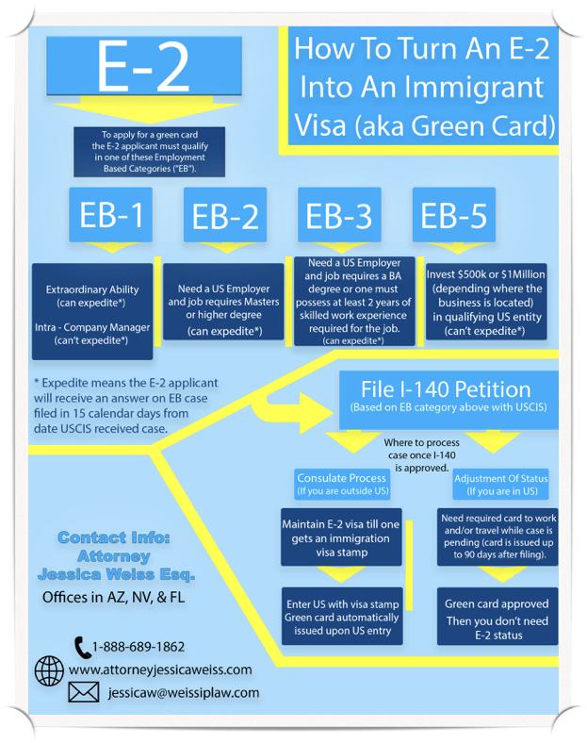
Sample chart for your review from my website at AttorneyJessicaWeiss.com

Slide 33
Contact Info for Attorney Jessica Weiss
Boca Raton, FL Office
7100 W. Camino Real
Ste 302-20
Boca Raton, FL 33433
561-948-3433
Las Vegas, NV Office
3753 Howard Huges Parkway #200
Las Vegas, NV 89169
1-702-784-7682
Phoenix, AZ Office - Headquarters
4455 E. Camelback Rd., Ste. E-140 Phoenix, AZ 85018
Phone: 480-994-8888
Fax: 480-947-2663
Toll Free: 1-888-689-1862

