Slide 1
Scheduling utilization & it’s benefits
Jamie L. Nezbeth-PMI-SP
Project Controls Manager-ZIN Technologies, Inc.

Slide 2






Notes:
For the past 3 years, I’ve been creating presentations for the Schedule portion of the Symposium that have shown you how ZIN Technologies has evolved in the Scheduling world and the steps we took to get where we are today.

Slide 3
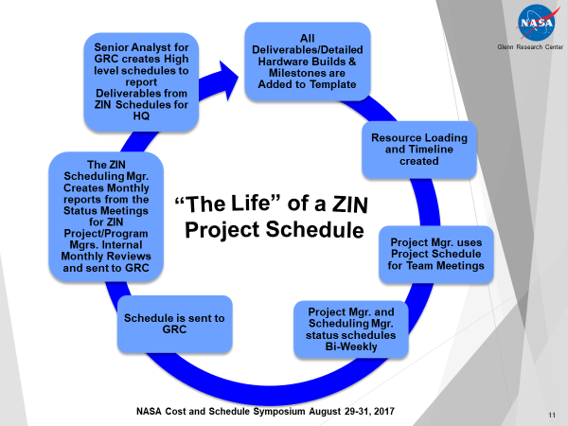
This was the original Life cycle of a ZIN Project Schedule. It’s a cycle that we used over and over with each new project schedule that was built. It all started with the detailed schedule being built once the SOW was delivered. We sat down with each PM and created the detailed schedule starting with the Deliverables and hardware builds/Milestones being added to the template. Then we would move on to the Resource loading and the time line for the project was created. The PM used the schedule for team meetings to let the team know what was coming up, to get status on the project itself and to keep track of the resources that were on each project. We sat down with the PM and status updated our schedules bi-weekly so that we had an accurate representation of the project to report to Upper Mgmt. At the end of every month, I still send the schedules over to GRC for their analysis of the projects and reporting. While The Senior Analyst at NASA is working on her analysis, I then create monthly reports to use internally at ZIN to report the project status and to GRC to show them the status of the projects.
Do you remember the
beginning?

Slide 4
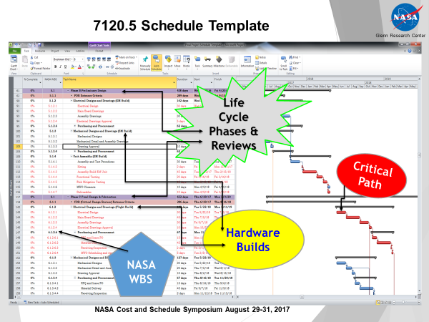
This slide shows the actual NASA Project Management Life Cycle template put into MS Project. This was the original ZIN Template that we created. It shows the life cycle phases and the gateway reviews/milestones in each phase, it shows the individual hardware builds i.e. the Breadboard build in Phase A to Phase B, the EM build from Phase B into Phase C and the Flight Build from Phase C spilling over into Phase D. It shows a valid waterfall critical path that the template creates based on historical data pulled from schedules that are archived and Lessons Learned. It also shows the NASA WBS that’s connected to the Project Cost WBS so that labor hours and project costs are applied appropriately to the tasks the resources are performing. So this way it was all tied into the Cost and Schedule of the project.
How we built our Schedules
When we started out!

Slide 5
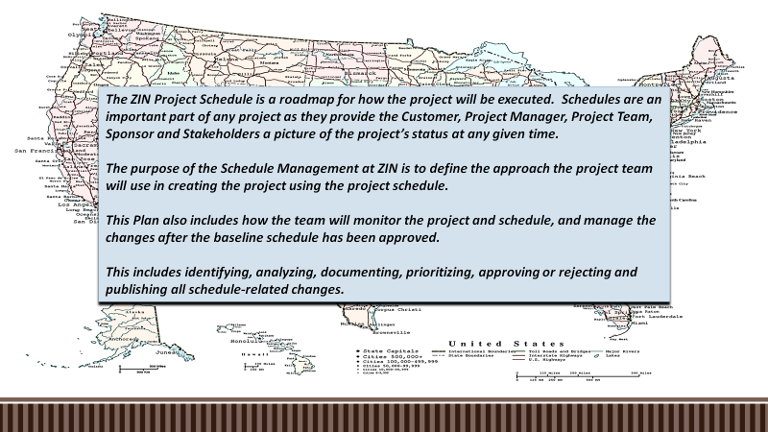
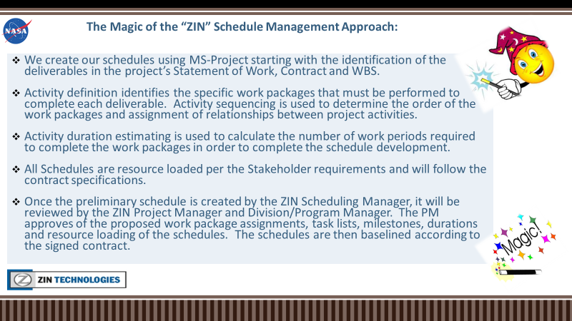
After the 2nd year, we realized that we needed a little more organization in the next phase of Creating the
Scheduling Department. We used the original template along with a few other Scheduling Management
Ideas from the PMBOK Guide and came up with a ZIN Schedule Management Plan that was reality based and we could use…so we adopted
these philosophies to further enhance the changes at ZIN and give us better direction. It also showed us how we could pull reports from the project schedules and analyze the data to get valid and credible information from the schedules now to really help the Projects.

Slide 6
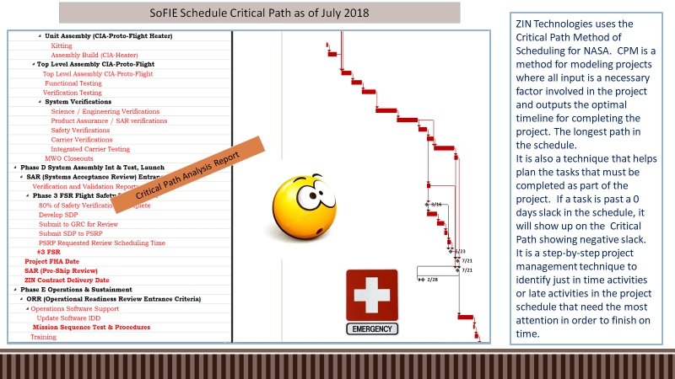
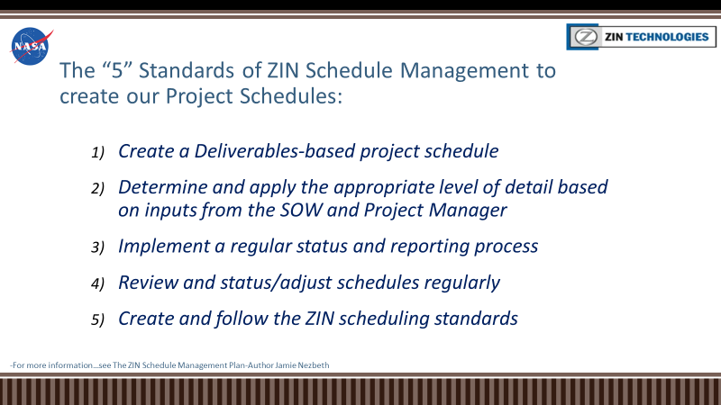

Soon we evolved into this!
Critical/Driving path identification and analysis were essential to ensure that management was focusing on the correct tasks to prevent slippage of the project end date.

Slide 7
2020: Scheduling Utilization & It’s Benefits!!!
We Created an entire Scheduling Department at ZIN!
We Implemented Deliverables based/Rolling Wave Scheduling into the Projects.
We Created an IMS (Integrated Master Schedule of all Projects at ZIN).
We Created Scheduling Processes, Procedures and Expectations of the Department.
We Created Detailed Data Driven reports for the Project Managers/Project Teams.
We are now able to feed project information to the PM’s and Teams using the Schedules.
We can pull information from the schedules to assist the Matrix Department Managers
in Staffing/Labor Hour ETC’s for each project.
We can now Prioritize Projects based on Critical path analysis and Contract Delivery Dates.
We can use the IMS to determine staffing plans for the life of the Projects and Check
We can utilize the IMS to check Conflicting Priorities between Projects for Senior Mgmt.

