Slide 1


“Creating Confidence in the World of Schedule Management at ZIN”
| Jamie L. Nezbeth PMI-SP
Project Controls Manager-ZIN Technologies

Slide 2


The Definitions of Schedule Management:
The PMBOK definition of Schedule Management is: “The process of developing, maintaining and communicating schedules for time and resource. “ Reference: Project Management Book of Knowledge Guide Version #6
The NASA definition of Schedule Management is: “To provide the framework for Time-Phasing, Resource Planning, Coordination and Communication of the necessary tasks within a work effort.” Reference: NASA/SP-2010-3403 pg. ix
As the Prime Contractor for SpaceDOC II at GRC, “ZIN Technologies” strives to Manage, Maintain and Communicate the Schedules to our Customer NASA-GRC with the transparency and credibility they have come to expect from us.

Slide 3

Plan Schedule Management is the process of establishing the policies, procedures and documentation for planning, developing, managing, executing and controlling the project schedule.
The key benefit of this process is that it provides guidance and direction on how the project schedule will be created and managed throughout the project.
We will take a look at how ZIN Technologies uses the NASA Project Management Handbook 7120.5 to create our schedules and the Inputs, tools and techniques and outputs of schedule management in the next slides…
-for more info…See A Guide to the Project Management Book of Knowledge (PMBOK Guide version…6)

Slide 4

The ZIN Project Schedule is a roadmap for how the project will be executed. Schedules are an important part of any project as they provide the Customer, Project Manager, Project Team, Sponsor and Stakeholders a picture of the project’s status at any given time.
The purpose of the Schedule Management at ZIN is to define the approach the project team will use in creating the project using the project schedule.
This Plan also includes how the team will monitor the project and schedule, and manage the changes after the baseline schedule has been approved.
This includes identifying, analyzing, documenting, prioritizing, approving or rejecting and publishing all schedule-related changes.

Slide 5



The Magic of the “ZIN” Schedule Management Approach:
We create our schedules using MS-Project starting with the identification of the deliverables in the project’s Statement of Work, Contract and WBS.
Activity definition identifies the specific work packages that must be performed to complete each deliverable. Activity sequencing is used to determine the order of the work packages and assignment of relationships between project activities.
Activity duration estimating is used to calculate the number of work periods required to complete the work packages in order to complete the schedule development.
All Schedules are resource loaded per the Stakeholder requirements and will follow the contract specifications.
Once the preliminary schedule is created by the ZIN Scheduling Manager, it will be reviewed by the ZIN Project Manager and Division/Program Manager. The PM approves of the proposed work package assignments, task lists, milestones, durations and resource loading of the schedules. The schedules are then baselined according to the signed contract.

Slide 6
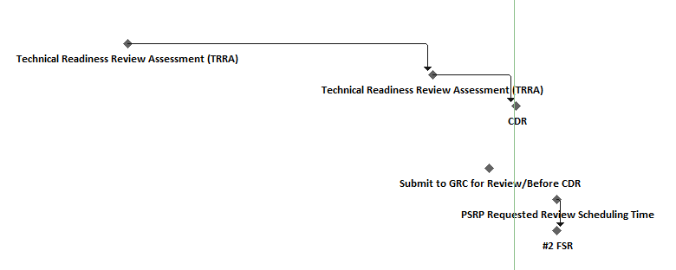
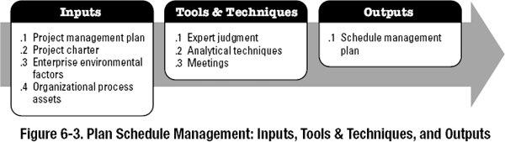


Inputs to the “ZIN” Schedule Management Plan!!!
Project Milestones
NASA WBS
3.0
3.1
4.0
5.0
6.0
6.1.1
6.1.1.15
6.1.1.16
6.1.1.18
1. Schedule Management Plan Inputs:
  Scope Baseline Includes Project Scope statement, Work Break Down Structure (WBS), and WBS Dictionary created by NASA. (From the ZIN Project Management Plan)
  Other Information including-Schedule Related Costs, Risks and communications (Decisions from the project management Plan)
  Project Charter or SOW-Defines the Summary Milestone Schedule that the Project Manager creates with the
  project approval requirements that will influence the management of the project schedule.
  Enterprise Environmental Factors
  Organizational Process Assets
***PMBOK Guide to Planning Processes and Plan Schedule Management Version #6

Slide 7
Tools and Techniques of the “ZIN” Schedule Management Plan!!!
Expert Judgement-ZIN’s expert judgement is obtained through individual consultations (one-on-one meetings, interviews, etc.) or through historical data or lessons learned of past projects.
Analytical Techniques-Involves choosing strategic options to estimating and scheduling the project-i.e. scheduling methodologies (NASA Project Management Handbook 7120.5) tools & techniques, ZIN’s estimating approaches, formats and MS Project…ZIN’s scheduling tools.
Meetings-The Project Manager, Project Team, Scheduling Manager, Project Sponsor, Stakeholders (NASA) or anyone with responsibility for inputs into the schedule planning and project execution holds a meeting to develop the Project plan and milestones.

Slide 8

Outputs!!!!!
1. The “ZIN” Schedule Management Plan.

Slide 9
The “5” Standards of ZIN Schedule Management to create our Project Schedules:
Create a Deliverables-based project schedule
Determine and apply the appropriate level of detail based on inputs from the SOW and Project Manager
Implement a regular status and reporting process
Review and status/adjust schedules regularly
Create and follow the ZIN scheduling standards
-For more information…see The ZIN Schedule Management Plan-Author Jamie Nezbeth

Slide 10

1. Creating a Deliverables Based Schedule:
Completion of Statement of Work and WBS/WBS Dictionary | Division/Program Manager-Negotiates the contract and SOW according to the Stakeholders requirements and creation of the WBS
Create a Project Schedule Template based on the Stakeholders wants and needs | Scheduling Manager-Creates the schedule using MS Project and validates the schedule according to the signed Contract and SOW provided by the Project Manager
Baselined project schedule | Scheduling Manager-Obtains final schedule approval from the Project Manager and baselines the schedule.
Approval of final project schedule and budget | Project Manager-Responsible for facilitating work package definition, sequencing and estimating durations, resources and budgets for the project.
Project kick off | Stakeholders, Project Manager and Project Team-Attends the Kick off meeting with all Stakeholders associated with the project.
Approval of roles and responsibilities in the project | Project Manager-Reviews and validates the Project team. Assigns activities to all project team members.
Requirements definition approval for the project and schedule resource loading | Project Manager, Scheduling Manager-The Project Manager approves the project requirements and the Scheduling Manager and Project Manager resource load the schedule based on the project requirements.
Completion of data mapping/inventory | Project Manager
Project implementation | Project Manager
Acceptance of final deliverables as listed in each Statement of Work and/or Contract | Stakeholders-Customer, Division/Program Manager and Project Manager

Slide 11
2. Determine and apply the appropriate level of detail based on the template and inputs from the SOW and Project Manager
NASA WBS | Task Name | Total Slack | Duration
1 | ISS Research Project Life Cycle | 0 days | 1296 days
1.1 | Project Start Date | 0 days | 0 days
4.1 | Phase A-Concept Development | 0 days | 422 days
4.1.1 | SRR System Readiness Review Entrance Criteria | 0 days | 98 days
4.1.2 | Mechanical Breadboard Designs and Drawings | 0 days | 137 days
4.1.3 | Electrical Breadboard Designs and Drawings | 15 days | 122 days
4.1.4 | Breadboard Assembly Build | 0 days | 234 days
5.1 | Phase B-Preliminary Design | 0 days | 438 days
5.1.1 | PDR Entrance Criteria | 0 days | 289 days
5.1.2 | Electrical Designs and Drawings (EM Build) | 0 days | 142 days
5.1.3 | Mechanical Designs and Drawings (EM Build) | 30 days | 112 days
5.1.4 | Unit Assembly (EM Build) | 9 days | 129 days
6.1 | Phase C Final Design & Fabrication | 35 days | 652 days
6.1.1 | CDR (Critical Design Review) Entrance Criteria | 35 days | 286 days
6.1.2 | Electrical Designs and Drawings (Flight Build) | 0 days | 182 days
6.1.3 | Mechanical Designs and Drawings (Flight Build) | 55 days | 127 days
6.1.4 | Unit Assembly (Flight Build) | 56 days | 322 days
7.1 | Phase D System Assembly Int & Test, Launch | 0 days | 246 days
7.1.1 | SAR (Systems Acceptance Review) Entrance Criteria | 0 days | 246 days
8.1 | Phase E Operations & Sustainment | 0 days | 90 days
8.1.1 | ORR (Operational Readiness Review Entrance Criteria) | 24 days | 66 days
8.1.2 | Launch | 0 days | 0 days
8.1.3 | OPS | 0 days | 25 days
8.1.4 | Data Return | 0 days | 10 days
9.1 | Phase F Final Report & Closeout | 0 days | 1296 days
9.1.1 | PFAR (Post Flight Assessment Review) Entrance Criteria | 0 days | 71 days
9.1.2 | Project Closeout | 0 days | 0 days
9.1.3 | Final Report | 0 days | 20 days

Slide 12
3. Implement a regular status and reporting Process
ZIN Technologies has put together a pro-active and project specific way of creating and status updating the schedules along with the monthly reporting process to Management and Stakeholders.
1. The ZIN Scheduling Manager is responsible for building, updating and keeping the controlled copies of each project schedule based on the individual Statement of Work or Contract for each project and the Project Manager’s inputs.
2. The Scheduling Manager can distribute “Uncontrolled” copies of the schedule to the Project Managers, Division/Program Manager, Project teams and stakeholders if needed or required, but will always keep the “Controlled” copy of the schedule for management of the project, status updates and reporting.
3. The project schedule will be reviewed and updated as necessary on a bi-monthly basis with actual start, actual finish, and completion percentages by the Scheduling Manager which inputs will be provided by the Project Manager and project team.
4. The Scheduling Manager will resource load all schedules based on inputs from the Project Manager and to follow standard Stakeholder guidelines.

Slide 13
3. Implement a regular status and reporting Process…cont’d.
5. The Scheduling Manager is responsible for holding bi-monthly schedule updates/reviews with the Project Managers; determining impacts of schedule variances; submitting schedule change requests; and reporting schedule status in accordance with the project’s communications plan.
6. The Project Manager is responsible for participating in bi-monthly schedule updates/reviews; communicating any changes to actual start/finish dates to the Scheduling Manager; and participating in schedule variance resolution activities as needed.
7. The Division/Program Manager will maintain awareness of the project schedule status and review/approve any schedule changes submitted by the Project Manager based on any Statement of Work (SOW) changes or Contract changes.
8. The Division/Program Manager will provide the SOW and/or signed Contract to the Scheduling Manager to confirm and implement the correct milestone information that’s incorporated in the SOW or Contract for each project schedule.
9. The Scheduling Manager at the end of every Calendar Month will upload all the status updated schedules to the NASA E-Room at GRC so the Senior Analyst at GRC can then dissect the schedules and pull out the information needed to create the Upper level schedules for the Project Managers at GRC and at HQ.

Slide 14
10. The ZIN Management Reporting process and Stakeholder Monthly/Quarterly Reports:
The list of Monthly Reports for the Project Manager, Program Manager and all Stakeholders:
The Overall Schedule Integrity Report-Monthly
The One Pager Status Update Report-Monthly
The Slack Erosion Report-Monthly
The Resource Requirements Report-As Needed to help keep the projects staffed appropriately/Mostly completed Quarterly at ZIN
The Monthly Review Report
The Integrated Master Schedule Milestone Report-Monthly
The Baseline VS. Actuals Report-Quarterly
The Baseline Execution Index Report-Quarterly
The Critical Path Analysis Monthly Report
This list can be increased or decreased based on information needed by the Project Managers, Division/Program Manager and Stakeholders of each project and are created and implemented by the Scheduling Manager once approved.
Here are a few examples of the reports that ZIN creates monthly for the Project Managers, Division Managers and the Customer/Stakeholders…

Slide 15
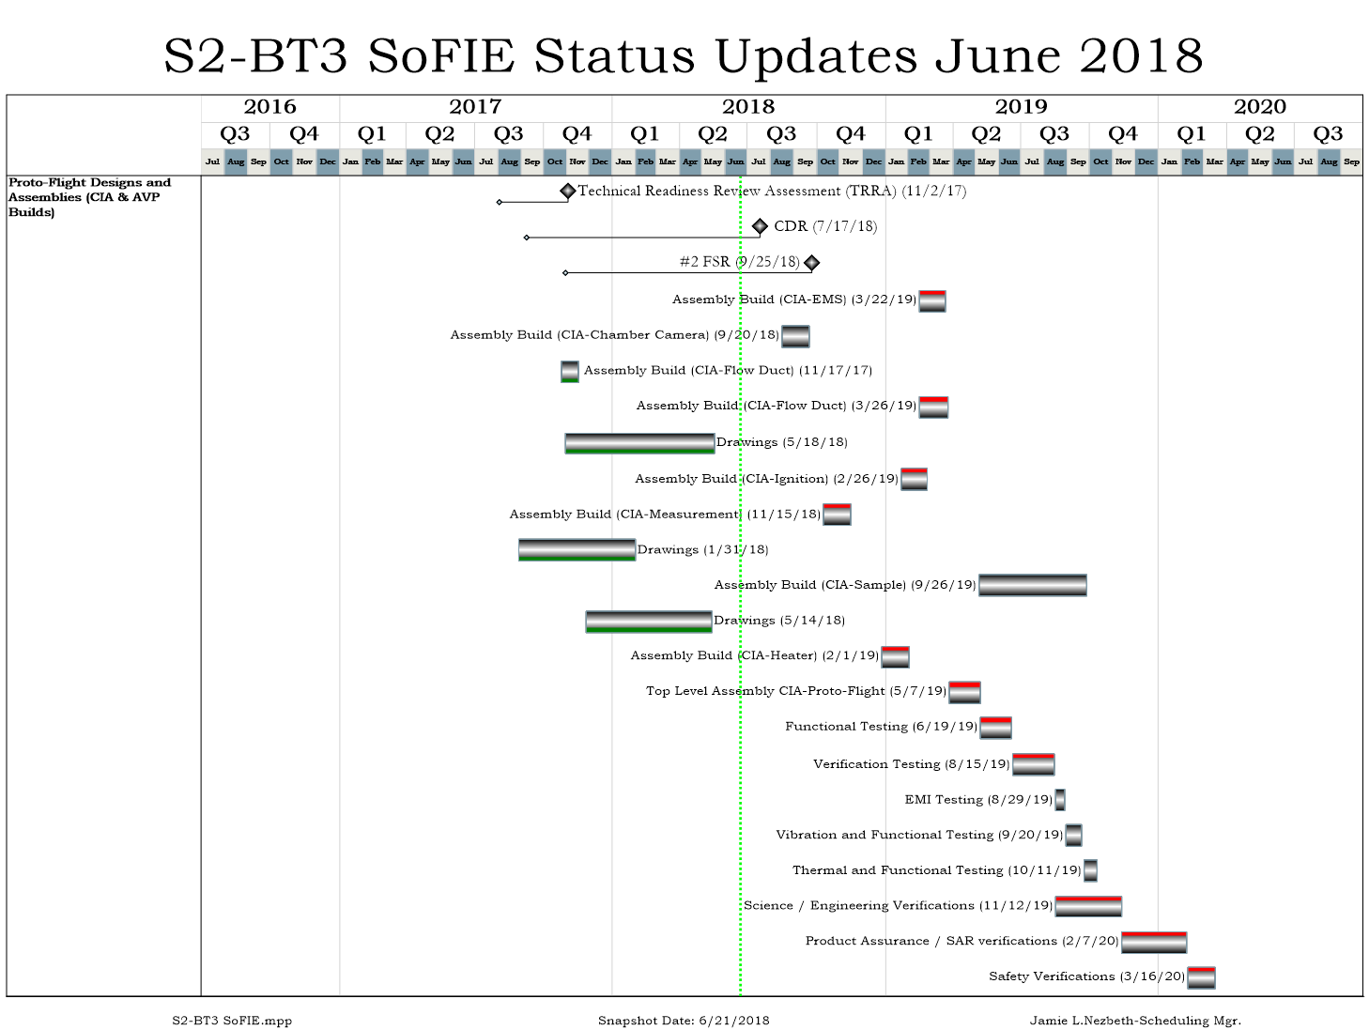
One Pager Report
Schedule Integrity Report

Slide 16
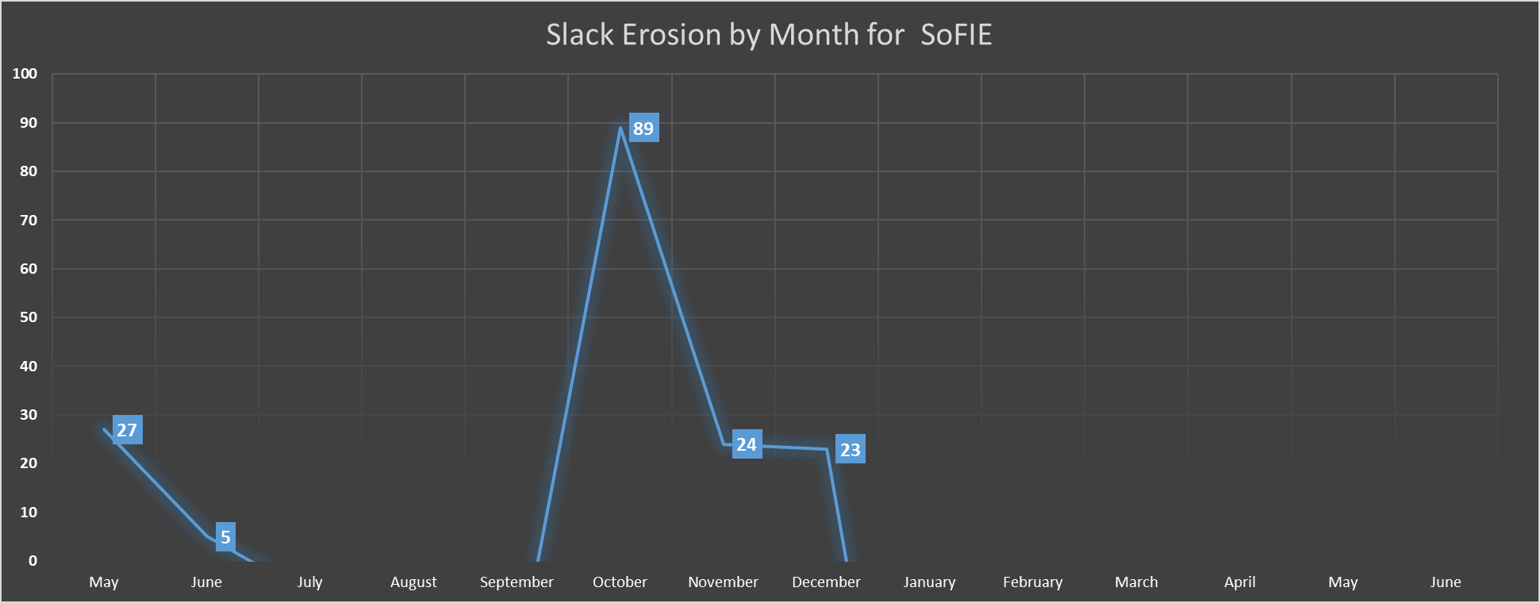
When a DO-MOD is Approved
Scope Creep

Slide 17
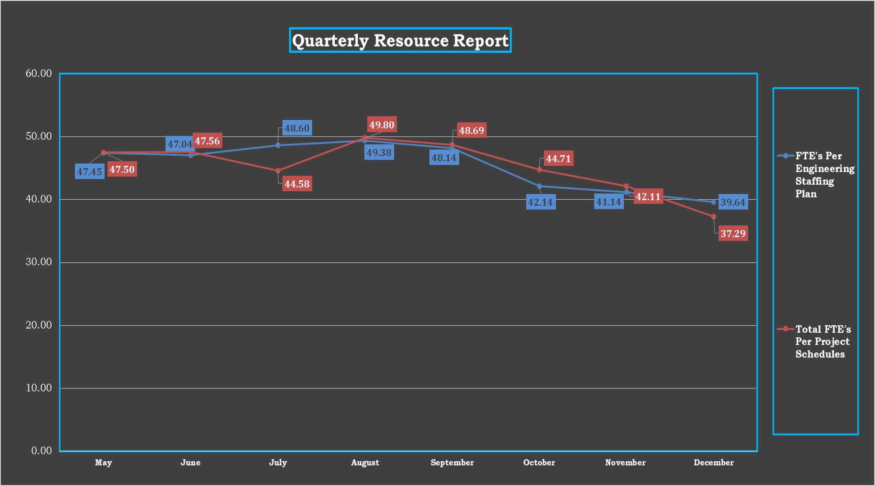
Quarterly Resource Report for the Engineering Department

Slide 18
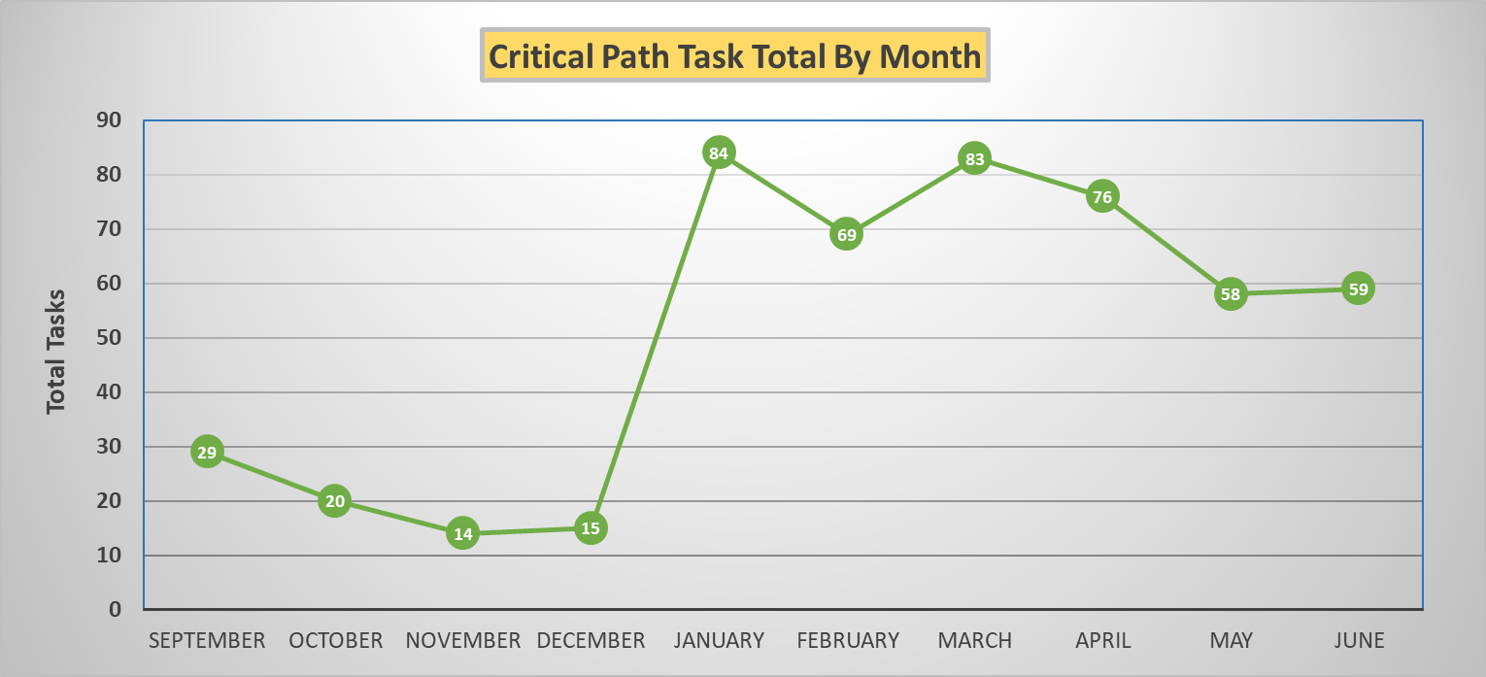
ZIN Monthly Review Report Dashboard

Slide 19
One Pager Report

Slide 20
A Schedule Baseline vs. Actuals Report divides the Baseline Status into the Actual Status and gives a good picture of Schedule Performance based on a specific point in time.
The closer to 1.00 without going over means your project is performing in schedule according to your project plan.
ZIN performs this functional report every 3 months to give the Project Managers/Division Manager a good picture of the schedule performance of the projects, And how well the project teams did with estimating their Project Baseline. And it’s shows the whether the Forecast dates for completion are right on target or if the planning of the entire project was off.
NASA Health-check Baseline vs. Actuals Quarterly Report

Slide 21
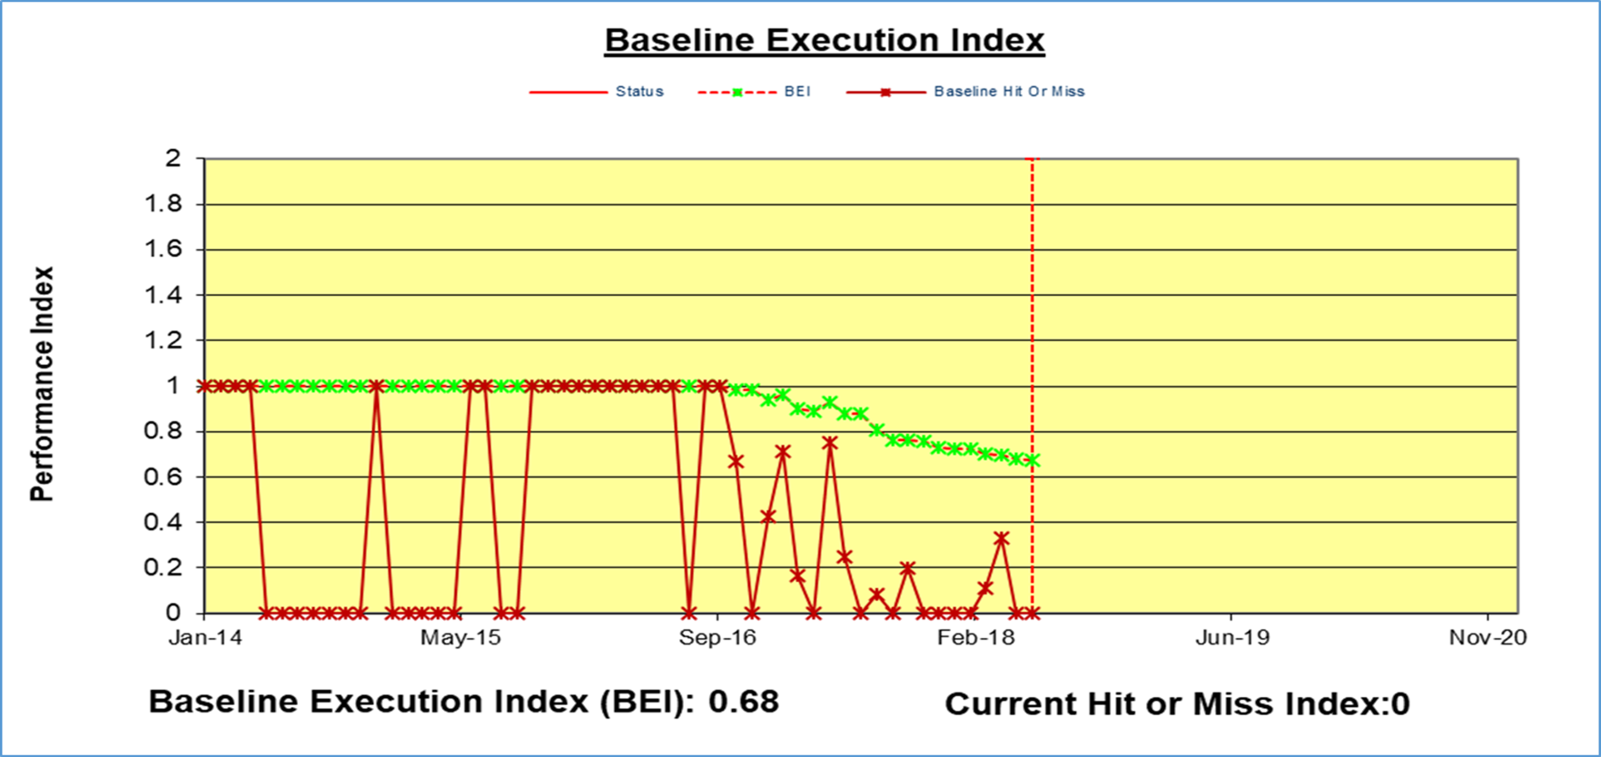
NASA Baseline Execution Index Quarterly Report

Slide 22
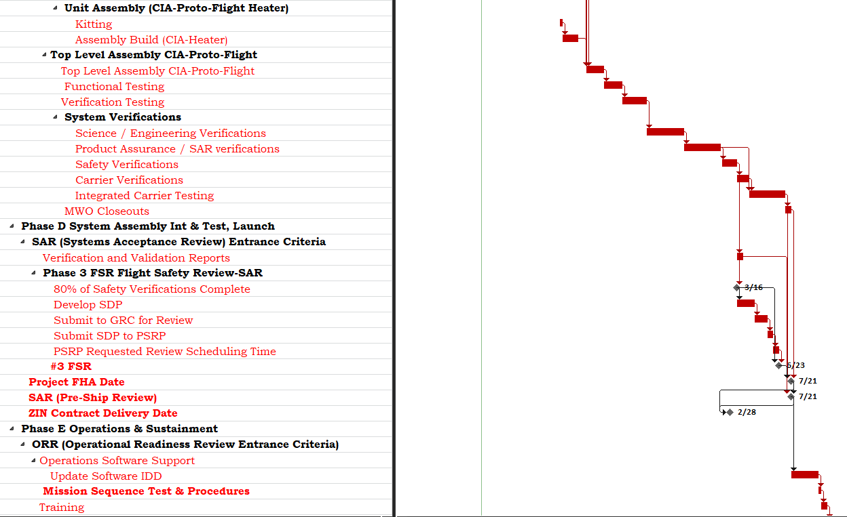


SoFIE Schedule Critical Path as of July 2018
ZIN Technologies uses the Critical Path Method of Scheduling for NASA. CPM is a method for modeling projects where all input is a necessary factor involved in the project and outputs the optimal timeline for completing the project. The longest path in the schedule.
It is also a technique that helps plan the tasks that must be completed as part of the project. If a task is past a 0 days slack in the schedule, it will show up on the Critical Path showing negative slack.
It is a step-by-step project management technique to identify just in time activities or late activities in the project schedule that need the most attention in order to finish on time.
Critical Path Analysis Report

Slide 23

In Conclusion:
Schedule Management is presented all over the world in many different ways in order to suit the circumstances of the projects the schedules are created to help manage. The choices of presentation depends on level of detail required, time and/or resources are being shown, the context of work, the dimension being scheduled (Project, Program or Portfolio) and the target audiences of the schedules. Which is ZIN Technologies case, it’s the project teams, Project Managers and the ZIN Upper Management.
Schedule Management is fundamental to the control and successful outcome of a project and care must be taken in selecting the calculation techniques (CPM, etc.) the forms of presentation and software tools.
On Conclusion of the Deliver Order/Project, the ZIN schedules show The GRC Senior Analyst what was planned and what actually happened and are the most important resource in determining Lessons Learned for ZIN and gives NASA a great picture of what really happened to the projects ZIN creates for them.
ZIN wants to continue to create credible and logical schedules that NASA and NASA Glenn can extract the information out of them that they need to provide HQ with accurate and up to date information.
Thank you.
Jamie L. Nezbeth PMI-SP-Project Controls Manager
ZIN Technologies, Inc.

