Slide 1


“Schedule Flexibility in Meeting Customer Demands and the Resulting Consequences”
Author: “Jamie L. Nezbeth-Project Controls Manager” for “ZIN Technologies”

Slide 2
Back in 2017 Paul McMasters and I created a presentation for the Cost and Schedule Symposium-”Bridging The Gap Between Contractor and NASA-GRC”. We explained how we created a schedule template at ZIN based on the 7120.5 NASA project life cycle and how, in creating this, the schedules provided NASA with credible project information needed to make informed decisions on scope, budget, and schedule. We still have this template in use today, but we’ve made some much needed changes and improvements to our scheduling process and Contractor responsibilities based on:
NASA Schedule demands and the Resulting Consequences of those Demands.
I will show you how the changes we’ve made and the consequences of those changes have improved our ability to provide better detailed schedules and more effective project information that has brought NASA-GRC and our commercial customers the confidence and peace of mind they have come to expect from us.

Slide 3
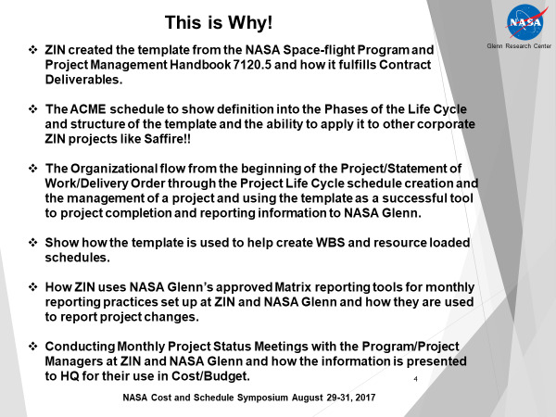
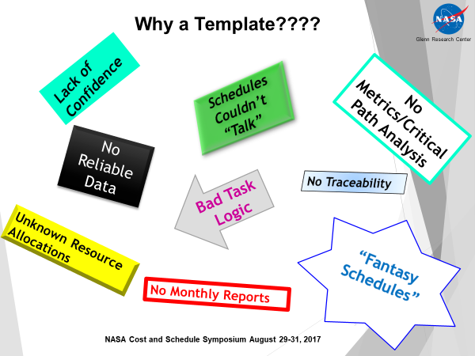
Remember When???

Slide 4
7120.5 Original Standards of Scheduling by NASA:
NASA WBS: The WBS that NASA created with the latest contract, is used to identify deliverables and the Project Life Cycle.
Task Constraints: The standard task constraints used were Finish-to Start, As soon as Possible, Must Finish On (Reviews and project milestones only).
Leads and Lags: Added to tasks when they needed to move to the right due to lower level tasks (work) being done that were not in the schedules. These were applied to allow for those tasks to get accomplished.
Valid Critical Path: Because of the way NASA has the phases of the life cycle divided individually, we were able to link our top level schedule tasks to create the critical path for the project.
Task Type: NASA insisted on using Fixed Duration for tasks actually having resources applied.
Task Name: Top Level work pkgs., Gateway reviews, Entrance Criteria-Documentation for each gateway review and project deliverables were used to create the schedules.
Schedule by Phases: The schedules are created by the phase of the project life cycle.
Resource Loading: Resource loading was done with individual employee names so we could follow employee labor allocations and we could hold responsible the person who was doing that task.
Task Calendars: NASA uses the standard task calendar of 8 hours a day, 5 days a week and all Standard Federal Holidays.

Slide 5
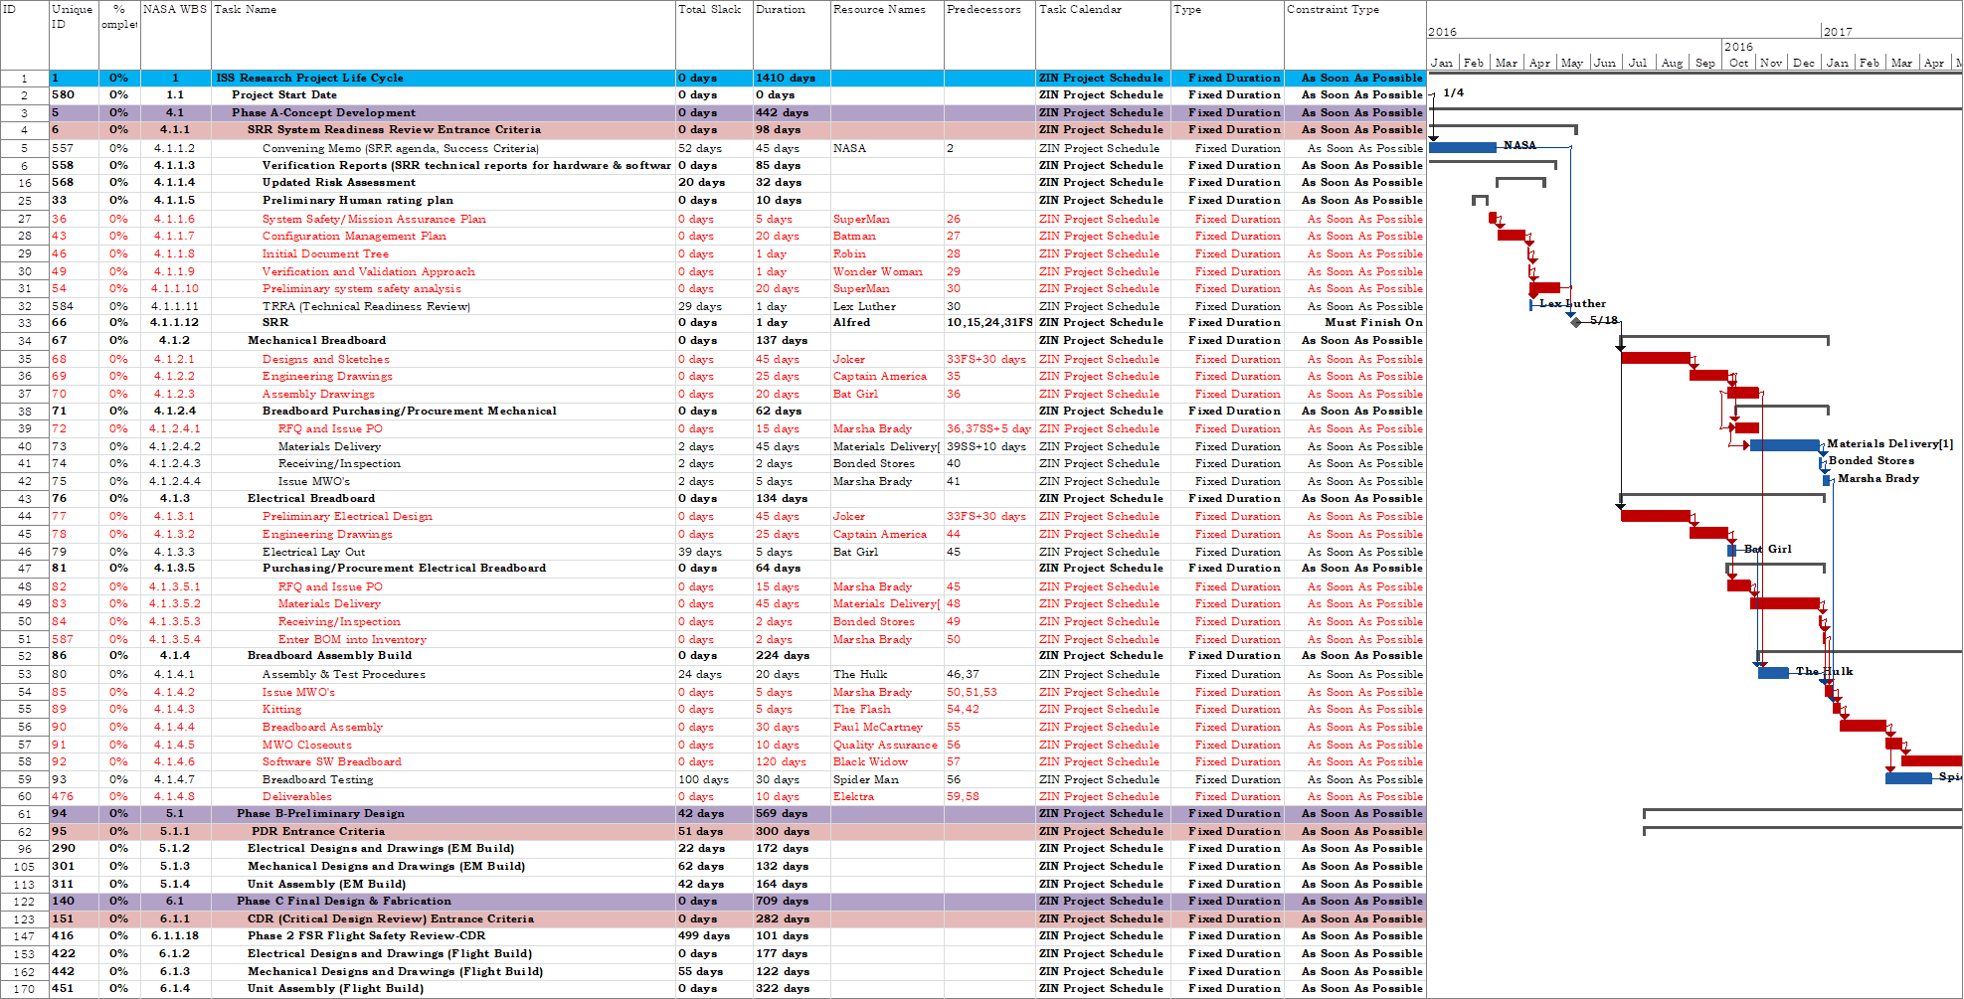
ZIN followed the Predictive way of scheduling (Traditional/Waterfall Methodology) i.e. Fixed Durations, Finish-to-Start, As-Soon-As-Possible, Must Finish On, etc. as to follow the 7120.5 NASA Standard of scheduling for the past 6 years.
We relied on the Project Managers to get the information we needed to status update the schedules when we scheduled at a higher level of detail, which was required by NASA. See below:
Task % Complete
Predictive Waterfall Scheduling practice.
Resources: Resource Loaded from the PM by Employee name once project team put into place.
Durations & % of Resources applied to Individual Tasks

Slide 6

The Standard ZIN Used for Planning, Initiating, Executing, Monitoring & Controlling &
Close-Out of Project Schedules:
Schedule Creation-MS-Project starting with the identification of the deliverables in the project’s Statement of Work, Contract, WBS and schedule template.
Activity definition identified the top level work packages that were to be performed to complete each deliverable. Activity sequencing was used to determine the order of the work packages and assignment of relationships between project activities.
All Schedules were Fixed Duration, Finish to Start, Resource loaded by Person’s Name and As soon as Possible to follow the Waterfall Methodology and 7120.5 NASA PM Handbook.
It was reviewed by the ZIN Project Manager and Division/Program Manager. The PM would approve of the work package assignments, task lists, milestones, durations and resource loading of the schedules. This baseline was snapped and this then became the controlled copy of the project schedule.
Monthly, meetings were created with the PM’s to get schedule status and update project information in the schedules.
Monthly reports were created that were sent to NASA-GRC along with the schedules for review. The Senior Analyst would critique the information and send it to HQ and the Program Manager for ISS.
The process would be repeated monthly until the project was complete and the hardware was shipped to NASA.

Slide 7
We decided to “Get back to Basics”. To study the way we were scheduling in more depth and to try to enhance “The Basics” of scheduling so we could move to a more Iterative or Incremental way of Project Scheduling. ZIN decided to do a re-organization of the company and moved towards a completely Matrixed Organization so the Schedule Template had to be re-structured to portray the changes in the schedule and contract deliverables but it had to be developed at a higher level of detail until we could move closer to each phase of the work that was to be performed.
Resource Loaded: By each Matrix Dept. Resource Loading with % of Resources applied to each task.
NASA WBS
Remaining Work: Matrix Dept. Mgrs. Provide actual Work hours for each task.
Task Type: Fixed Work, Fixed Duration
Valid Critical Path
Task Name: Phases, Top Level Work Pkgs, Gateway Reviews, Contract Deliverables

Slide 8
6.1 Plan Schedule Management
Baseline #1-Project Kick Off
6.2 Applying SOW WBS to Template
6.6
Monitoring and Controlling the Schedule
6.2 Define Detailed Activities
6.3 Sequence Activities.
Baseline #2 Typically PDR
6.4 Estimate Activity Durations
6.5 Develop Detailed Schedule
6.2 Define Detailed Activities for Next Phase
6.3 Sequence Activities.
Baseline #3 Typically CDR
6.4 Estimate Activity Durations
6.5 Develop Detailed Schedule
6.2 Define Detailed Activities for Contract MOD
6.3 Sequence Activities.
…(Typically Contract MODS)
6.4 Estimate Activity Durations
6.5 Develop Detailed Schedule
6.7 Closeout and Archive Project Schedule
Typical project schedules will have at least 3 baselines to each schedule

Slide 9
ZIN Schedule Process: 6.1 Plan Schedule Management
6.1.1 Inputs
Project Management Plan.
WBS Inputs.
Contract Inputs.
Statement of Work Inputs.
Schedule Template.
Historical Data.
Data Analysis.
Meetings
6.1.2 Initial Schedule Planning Process: (Typically happens Prior to Phase-A)
1. Attend Kick Off Meeting for Project-Obtain Project Information.
2. Obtain SOW from Project Manager.
3. Identify Functional Areas & Deliverables from SOW.
4. Start with schedule template.
5. Set up Initial meeting with Project Manager/Project Team.
6.1.3 #1 Baseline Output-Preliminary Schedule

Slide 10



Expert Judgment
Team Meetings
Data Analysis

Slide 11
ZIN Schedule Process: 6.2 Define Activities Per WBS
6.2.1 Inputs
Create Activity list.
Create Milestone List.
Create Activity Attributes List.
Create Task List from Preliminary Drawing Tree.
Statement of Work Inputs.
WBS Inputs.
Activities and Milestones inputs into Schedule template.
6.2.2 Process-Define Activities and Tasks per Project WBS:
1. Obtain Project WBS from Project Manager.
2. Start to Define Design Activities & Start Defining Schedule by adding Project Deliverables from SOW/Contract.
3. Define Milestones from the SOW and insert into schedule template.
4. Add any additional Entrance Criteria Activities for all Reviews based on SOW/Contract into schedule template.
5. Receive Preliminary Drawing tree and start adding additional work pkgs. at a more detailed level.
6.2.3 Preliminary Detailed Schedule.

Slide 12
ZIN Schedule Process 6.3 Sequence Activities
6.3.1 Inputs
Define Activities and Milestones and enter in Schedule Template.
Identify Specific Work Packages.
Activity Sequencing-Determine the order of work packages and milestones in the Schedule Template.
Create the Drawing and MWO Portion of Schedule.
Assign Activity and work package relationships.
Activity duration estimating.
6.3.2 Sequencing the Activities and Tasks added to the Schedule Template:
1. Insert Drawing and MWO information into the schedule from the Preliminary Drawing Tree.
2. Start linking tasks and activities together based on the flow of the work in this phase of the project.
3. Create the schedule logic for the Drawing & MWO portion of the schedule. (Drawing & MWO schedule template.)
4. Meet with Project Manager for Inputs into the Sequencing of the Project Tasks. (Typically starts just prior to PDR.)
6.3.3 Estimated Detailed Schedule Per Drawing Tree

Slide 13
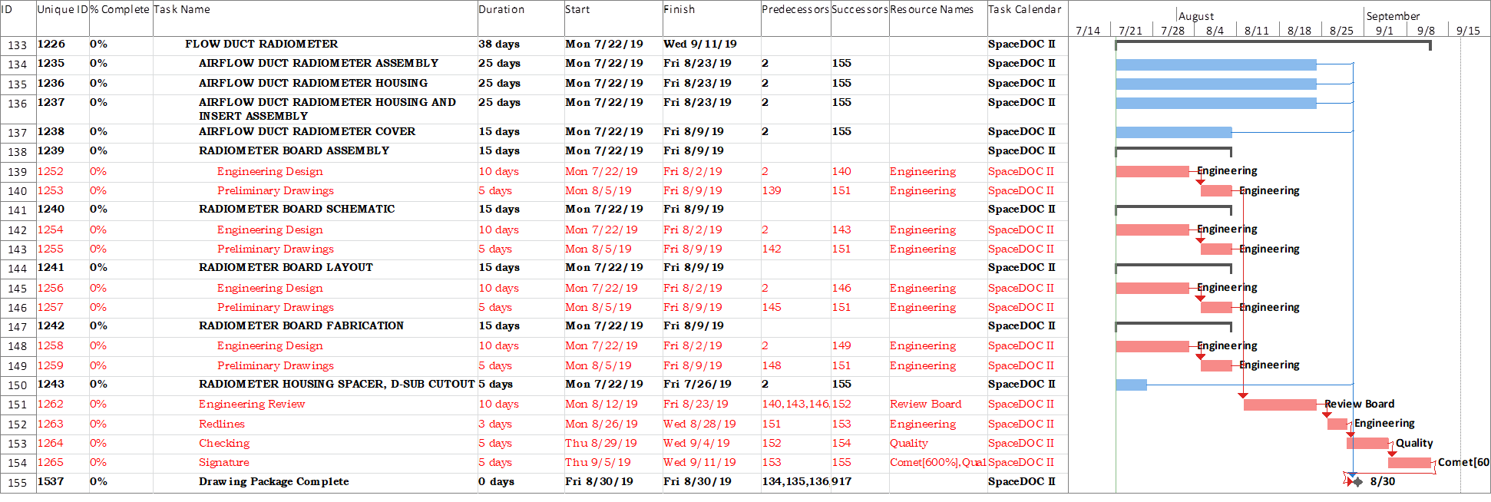
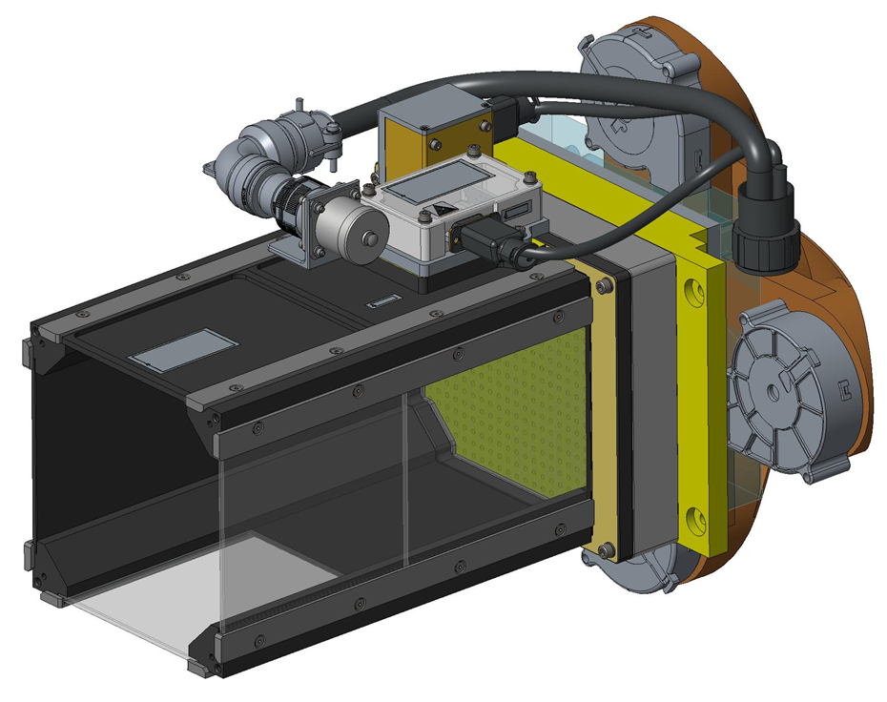
The Project Engineers provide the scheduler with a drawing tree (Preliminary (E.M.) & Final (Flight)) to add the Drawing & MWO information into the schedule so we can apply the correct level of detail to add work hours and Matrix Departmental resources to each work package and individual tasks.
These increments of the schedule are then linked together to create the proper logic of each individual work package. We can then track the progress of the design creation by inputting this level of detail. This detail below is from the initial Drawing & MWO portion of the schedule.
SoFIE Flow Duct

Slide 14
ZIN Schedule Process 6.4 Estimate Activity Durations/Hours:
6.4.1 Inputs
Project Management plan.
Statement of Work.
Request for Quote Schedule Estimate.
Activities and task lists.
Schedule Template.
Expert Judgment.
Data Analysis.
Duration Estimates.
Fixed Hours/Work Estimations.
Decision Making-Matrix Department Managers.
Meetings.
Historical Data.
6.4.2 Process to Estimate Activity/Task Durations & Hours for the Project Schedule:
1. Add Work hours/durations to the project tasks & work packages from historical data, Project Manager estimates for the project.
2. Create list of tasks for each Matrix Department to get estimates for work hours and send them to the Matrix Department Managers.
3. Obtain verification from the Matrix Department Managers on work hours & resources needed and available and enter into schedule.
4. Run a baseline #2 on the schedule to capture all work hours confirmed by the Matrix Department Managers and the resources applied to each task.
5. The timeframe for these steps is usually near the Preliminary Design Review (PDR).
6.4.2 Baselined Schedule #2 (PDR)

Slide 15
The Project Manager gives Estimates on hours it will take to do each task. These estimates are then sent to the Matrix Dept. Managers and they give actual hours to complete for each task that’s not completed.

Slide 16
ZIN Schedule Process 6.5 Develop Schedule:
6.5.1 Develop Schedule
Schedule Management Plan.
Project Management Plan.
Project Documents.
Flight Drawing Tree.
Demand Planner Spreadsheets-Procurements.
Schedule Template.
Schedule Durations/Fixed Work Estimates for PM Assigned Tasks.
Schedule Network Analysis. (Logic analysis)
Critical Path Methodology.
Resource Loading.
Matrix Department Durations/Fixed Work Inputs.
Data Analysis of the Project.
Leads and Lags in the Schedule.
Resource Leveling of Schedule.
Schedule Compression. (If Needed)
Schedule Baseline.
Weekly Schedule Data Updates and Status.
Project Schedule Calendars. (ZIN Project Calendar, Overtime Calendar)
6.5.2 Develop Detailed Schedule Information around Schedule Template with Project Deliverables from SOW & Drawing Trees:
1. Once the Project Manager has received the approval to proceed with the project from each gateway review, then the next phases of the schedule are vetted and the schedule is then developed in the next phase with more details from the Project Manager and information obtained from the gateway reviews.
2. The scheduler obtains the flight drawing tree from the Project Engineer and starts entering updated information into the #2 baselined schedule.
3. Add Flight Drawing & MWO information into the schedule and define activities.
4. Meet with Project Manager and define Verifications, Testing and Entrance Criteria for the final gateway review of the project.
Create the schedule logic for the rest of the schedule and add the Engineering Model actual hours as a starting point for the creation of the Flight build. These are the estimates for the Flight build.
5. Send report files to Matrix Department Managers for confirmation of the actual hours to enter and resource estimates based on availability of resources and hours used for estimating the Flight hours and enter into schedule.
6. Re-baseline schedule once approved by Project Manager. Baseline #3.
6.5.3 #3 Final Baselined Schedule (CDR)

Slide 17
Iterative/Incremental Scheduling Standards now used for all ZIN Projects:
Task Calendars: Project Calendar-8 hrs./5 days-Federal Holidays: Overtime Calendar-Matrix Dept. Discretion of hours/days a wk.-Federal Holidays
Scheduled by Phases including Drawing Tree/MWO from Sub-Assemblies up to Top Level Assemblies by Part # & Build Sequence.
Resource Loaded: By each Matrix Dept. Resource Loading with % of Resources applied to each task.
Contract WBS
Valid Critical Path
Task Name: Detailed Work Pkgs, Gateway Reviews, Deliverables, Detailed Requirements & Verifications.
Task Type: Fixed Work/Effort Driven and Fixed Duration.
Task Constraints: Finish-To-Start, Start-To-Start/As Soon As Possible, Start No Later than/Apply Deadline Dates for (Reviews, Contract Dates, Launches)
Leads and Lags: Very little Leads/Lags, Now scheduling to the level of detail needed to accommodate hours/durations.

Slide 18
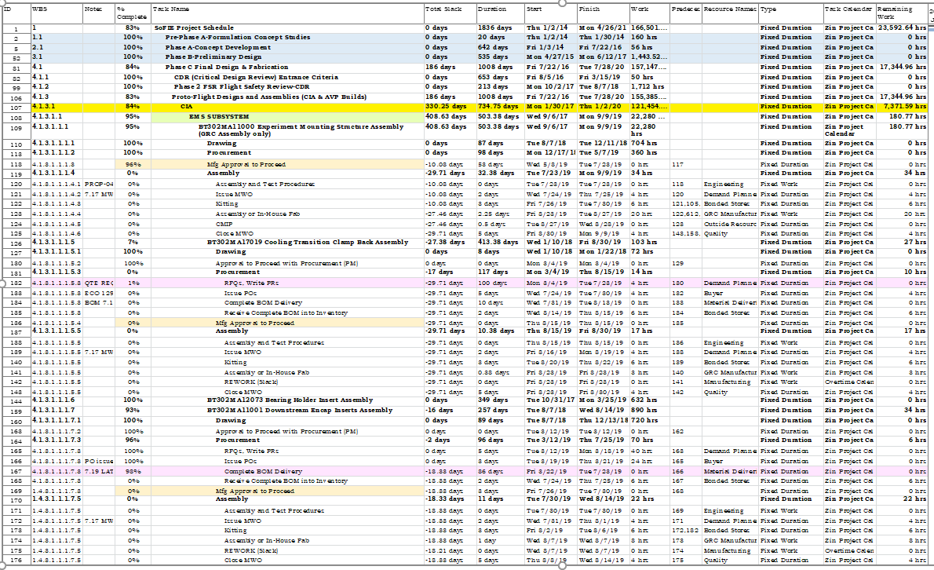
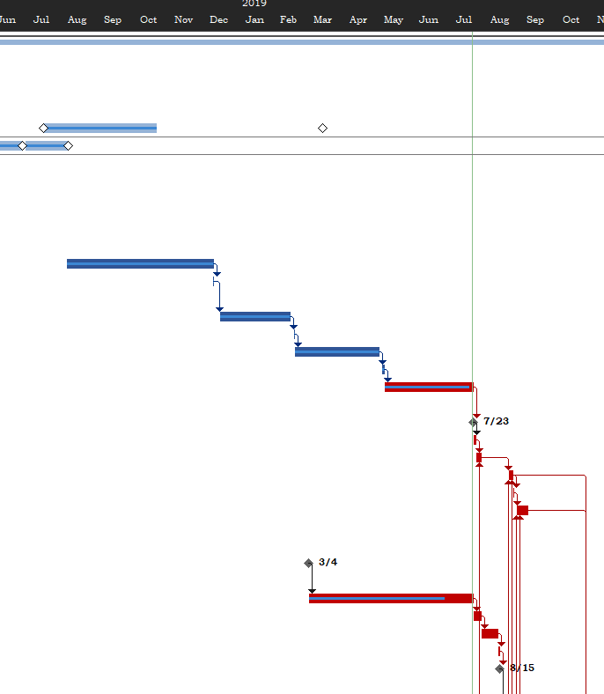
This is the SoFIE Schedule once the 3rd baseline is snapped. All Detailed parts, Drawings & MWO’s are added to the detail of each build phase. All Work hours have been verified with the Matrix Dept. Mgrs., All Sub-Assemblies are now linked to roll up into the Top Level Assemblies and then Testing & Verifications are completed. Which finishes out the Waterfall look of the Gantt Chart, but with much more detail for more accurate project information.
Valid Critical Path
This level of detail is now listed in each schedule and linked together to create the actual flow of the work through each department and gives us the ability to track the assembly completions, procurements, designs & drawings, hours worked & resources assigned. We can now track the minute details in the projects that we need to so that we can improve our work flow and FHA dates. This new process is more detail oriented, but it will help the Project Managers and the Matrix Dept. Managers manage the projects and the resources for each project.

Slide 19
ZIN Schedule Process 6.6 Monitoring and Controlling the Schedule:
Side Note: Each phase of the schedule has to go through 6.2 through 6.5 when creating that specific phase and this is done in the 6.6 Monitor & Control ZIN process. It’s repeated as needed…
6.6.1 Inputs
Status Update Schedule.
ERP Updates on Manufacturing.
Meeting with Project Manager to approve updated schedule.
Create Reports
Upload Controlled copy of Schedule on SharePoint.
6.6.2 Process for Monitoring (Status Updating the Schedule for Final Review and Delivery) and Controlling the Schedule in SharePoint:
1. Once each phase (Section) of the schedule is created, vetted and approved by the Project Manager, the schedule is status updated (depending on criticality of the project) weekly, bi-weekly or daily.
2. Prior to meeting with the Project Manager, The Scheduler will go into the ERP system and extract information pertinent to the project and status update the schedule based on that information.
3. The scheduler schedules a meeting with the Project Manager and works through incomplete/late tasks and updates the information the Project Manager gives them.
4. The Scheduler also attends Project Team/Manufacturing meetings to get updates on the build portion of the schedule.
5. Once the schedule is status updated, it is then uploaded onto ZIN SharePoint in:
http://mars/BP/pmis/teamwork/schedule/SitePages/Home.aspx. It then becomes the controlled Project Schedule.

Slide 20
Matrix Department Mgr. Actual Hours are applied to each Assembly and where/when it moves into the next phase of the Build and Test. The Manufacturing Work Order # is listed, Part Name, When it’s due to be completed, the Build Type and the Status. There is also listed Mfg. Actual hours worked. This information is verified when status updating the schedules and this is the initial data we use to status update the schedules along with Historical Data we use when creating new schedules. The Scheduler can retrieve this information from ZIN’s ERP system prior to meeting with the Project Managers so the build portion of the schedules are statused and they can see the outcome of each date change or % complete.
MWO # and Part Description
The Assembly Due Date & Build Type
The Mfg. Actual Hours worked on each Assembly and the dates it moves from Assembly/Fabrication & Testing to QA Review completion.
MWO Status
This data helps the PM’s make informed decisions on changes that may need to happen along with giving them more accurate information to meet Contract Delivery Dates and/or request a Modification to the contract due to issues with assemblies, vendors, etc.

Slide 21
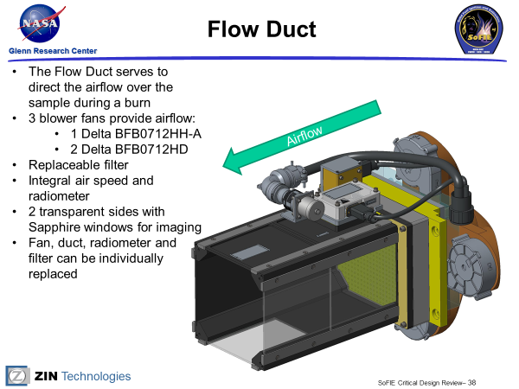
Detailed Project Schedule Inputs:
Project Document Inputs
Demand Planner tracker, Procurements
SoFIE Flight Drawing Tree for the Flow Duct Assembly

Slide 22
6.6 Monitoring and Controlling the Schedule Cont’d:
6.6.2 Outputs: Reporting Status of the Project Using the Schedule:
1. After each schedule is status updated, The Scheduler is to perform a list of reports for the Project Manager to evaluate. These reports are emailed to the Project Managers and the Project Controls Manager weekly.
A. Late Task Report
B. 2 Week Look Ahead
C. Critical Path Analysis
D. Resource Graph for Matrix Departments.
E. Slack Erosion Report-Project Controls Manager creates from list of deliverables for all the projects.
6.6.3 Status Updates, Monthly Reports and Project Analysis

Slide 23
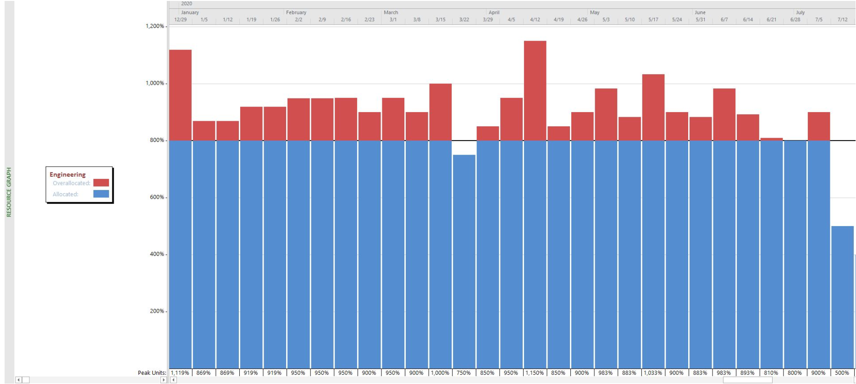
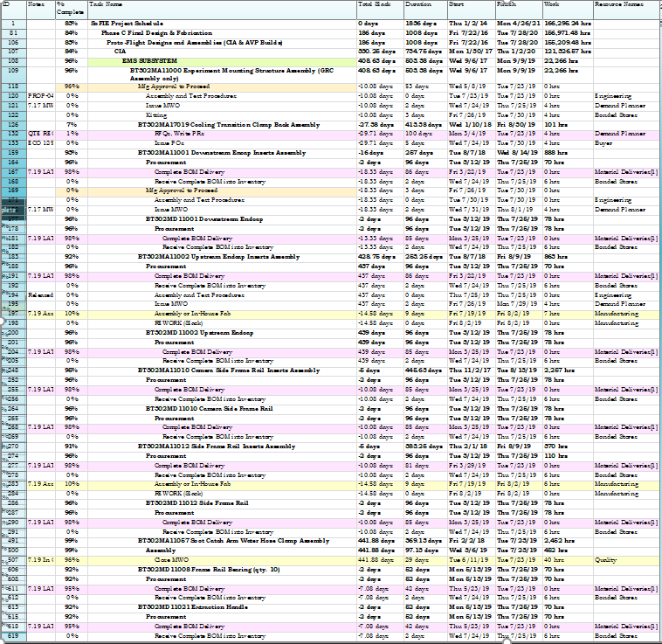
Matrix Dept. Resource Graph Report
Notifies PM that they need to hire more resources.
2 Week Look Ahead
This report lets the PM know what is coming in the near future regarding tasks.
Late Task Report:

Slide 24
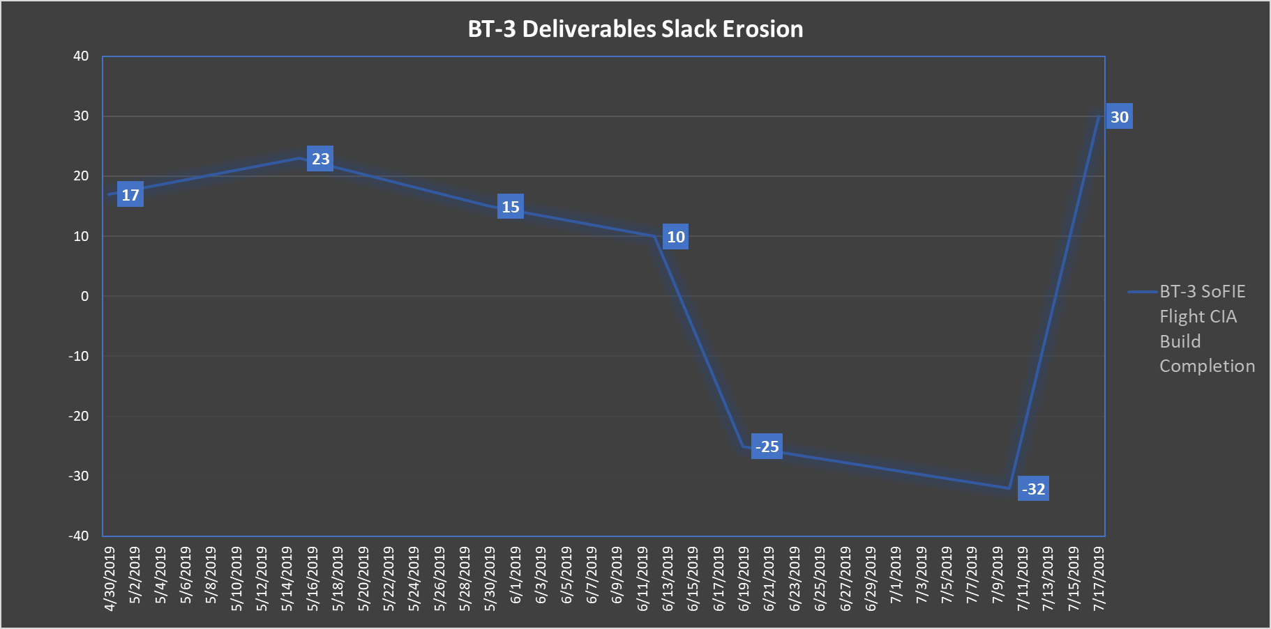
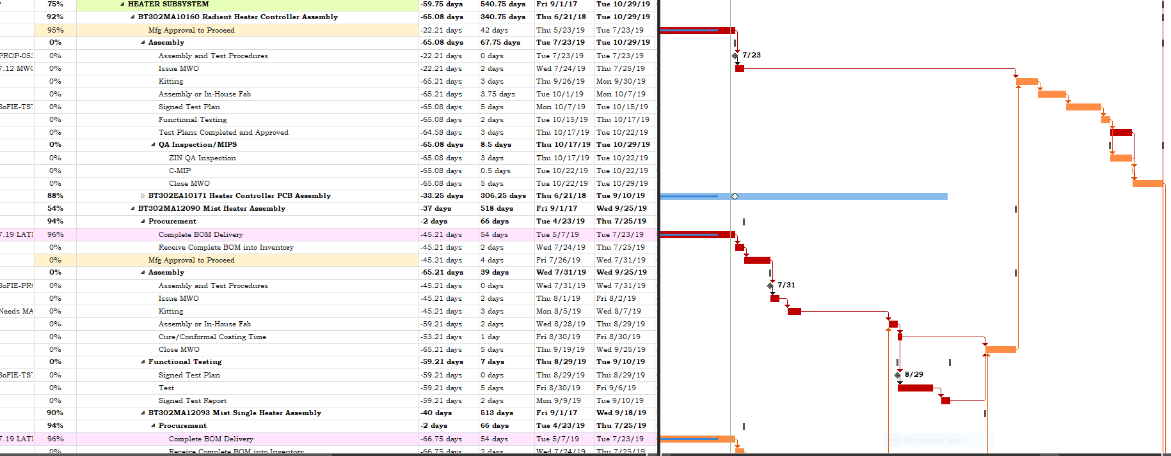
Contract Mod Received
More Reports:
Weekly Slack Erosion Report
Scope Creep
Critical Path Analysis showing Driving Predecessors affecting the Critical Path

Slide 25
I want to show you how the reports are useful to the projects themselves…what information the PM’s get from these reports help them manage their projects better and how the Schedulers are providing better information in less time.
2 week look ahead-it triggers the PM to go to the task owner and make sure they can meet the dates shown in the schedule and to help mitigate any issues that may arise from missed deadlines or incorrect effort estimates.
Late task report-the PM goes through this report to see how late tasks really are based on the status updates and to figure out how they can recover schedule.
Slack Erosion report-This report shows the PM where scope creep happens in the project and when/or if they would need to go to the customer and ask for a contract modification and gives them a good view of when they need to recover scope and schedule.
Critical Path Analysis report-this report shows the PM exactly which tasks (by using Driving predecessors) are affecting their top level assembly builds, Contract Delivery Date and what tasks are moving into the Critical Path. This report helps them make a decision to re-prioritize the work that’s in the critical path to help recover schedule.

Slide 26
ZIN Schedule Process 6.7 Closeout the Schedule:
6.7.1 Inputs:
Completed Schedule.
Project Completion Documentation.
Archive Schedule in Archive Schedule Folder on ERP system.
6.7.2 Completion and Closeout of the Project Schedule:
1. When the last task is marked 100% complete, the Scheduler then will closeout the project schedule and archive it in the Controlled Schedule Archive folder on SharePoint.
2. All Project Documentation (Monthly reports, Schedule iterations, etc.) Will be archived in the SharePoint Project Folder.
3. http://mars/BP/pmis/teamwork/schedule/Schedule%20Reports/Forms.
6.7 Closed/Archived Schedule

Slide 27
Key Takeaways:
Because NASA-GRC & the ISS Program are asking for more in depth information from our schedules and better cost estimates for the projects (Estimates to Complete, Resource labor costs & Information, etc.) we are creating more detailed schedules and status updating more frequently with credible information. We are able to create more meaningful schedules and pull more valid data reporting for the NASA PM’s and for the ZIN Project Managers to use to stay on task.
The Scheduling Department is working with the Matrix Department Managers, the Project Teams and the Project Managers to get the schedules created in more detail as we approach the new phases of the project and get status updates on a weekly basis if needed depending on criticality.
To publish the information right away because the Schedulers can do most of the updating of the schedules prior to meeting with the Project Managers/Teams using the Demand Planner information and our ERP system information.
This gives the Project Managers more visibility into the project performance and schedule performance.
We are now able to pull more detailed information from the schedules to put into reports that notify the Project Manager, Project Teams and Upper Management of possible issues with the overall project and the ability to mitigate them.
The Project Manager now has more control over the successful completion of the project using the Schedule as a powerful tool to help manage the project throughout it’s life cycle.
We can now see issues arising ahead of time and we are able to be pro-active on notifying the Project Teams, the Project Managers and the Matrix Dept. Managers of pending issues that due to any number of reasons, may be late…
With the ability to see issues arise and the ability to be pro-active in mitigating the issues, we have given our customers more confidence in the schedules and also the projects themselves with finishing on scope, time and budget.

Slide 28
The End…

