Slide 1




Glenn Research Center
How NASA Glenn and its Contractor Team Set the Standard for ISS Research Projects
August 30, 2017
Authors:
Jamie L. Nezbeth-ZIN Technologies
Scheduling Manager/Master Scheduler

Slide 2


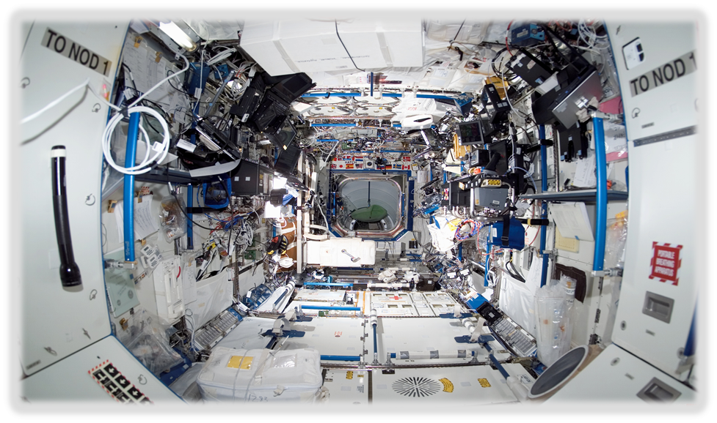

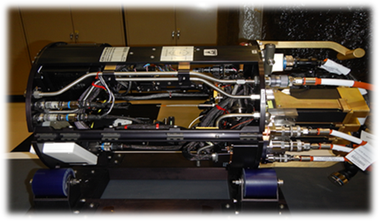
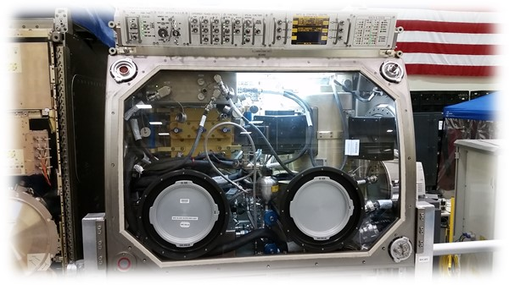
Some of the Zin Projects that use the Schedule Template 7120.5
LMM Inside FIR Rack
Destiny Laboratory
CIR Rack
ACME Flight Build
ZBOT Inside the MSG
Notes:
ACME-Payload flight build-Advanced Combustion via Microgravity Experiment that’s getting installed in Sept. 2017 into the CIR-Combustion Integrated Rack and we are scheduled to start Ops in November.
LMM-Light Microscopy Module inside the FIR-Fluids Integrated Rack and ZBOT-Zero Boil Off Tank that’s installed inside the Microgravity Science Glovebox that ZIN built also.
These are some of the experiments that ZIN built and we used the template to help create some of these pieces of flight hardware that are on station now.

Slide 3
Why a Template????
Lack of Confidence
Schedules Couldn’t “Talk”
No Metrics/Critical Path Analysis
No Reliable Data
Bad Task Logic
No Traceability
“Fantasy Schedules”
Unknown Resource Allocations
No Monthly Reports
Notes:
Well we created a template at ZIN because the PM’s couldn’t use the schedules to help manage their projects. When I first started at ZIN, the PM’s all had their own style of scheduling and everything was chaotic to say the least. Everyone scheduled the way they knew, there were issues with Fantasy Schedules, No Monthly reporting, No reliable data that could be extracted from the schedules and no traceability. The Division/Program Mgr. had no idea if he needed to hire people, or lay them off because the resources weren’t being reported from the schedules, so the schedules didn’t talk to each other either. There was no consistency or “Best Practices” used with any of the schedules. And PM’s think they could do our job…The benefit of creating the template made it possible for the PM’s to use the schedules to help manage their projects and keep their teams engaged.

Slide 4
This is Why!
ZIN created the template from the NASA Space-flight Program and Project Management Handbook 7120.5 and how it fulfills Contract Deliverables.
The ACME schedule to show definition into the Phases of the Life Cycle and structure of the template and the ability to apply it to other corporate ZIN projects like Saffire!!
The Organizational flow from the beginning of the Project/Statement of Work/Delivery Order through the Project Life Cycle schedule creation and the management of a project and using the template as a successful tool to project completion and reporting information to NASA Glenn.
Show how the template is used to help create WBS and resource loaded schedules.
How ZIN uses NASA Glenn’s approved Matrix reporting tools for monthly reporting practices set up at ZIN and NASA Glenn and how they are used to report project changes.
Conducting Monthly Project Status Meetings with the Program/Project Managers at ZIN and NASA Glenn and how the information is presented to HQ for their use in Cost/Budget.
Notes:
I worked with one of the PM’s at ZIN and came up with the template that we use today to start all the schedules. I created it from the 7120.5 handbook and it’s worked very well in the organization and standardization of the schedules and reporting practices from ZIN to GRC. It added to the smooth transition and Best Practices that NASA approves of and uses.
We will use the ACME schedule to show the definitions of the phases in the life cycle, and how it works in other corporate contracts such as Saffire.
We will show the organizational flow of the project through the SOW/DO and the creation of the schedule and management of the project.
We will show how the template is used for the WBS and resource loaded schedules.
We will show how creating and using the template has made it possible for me to use the approved NASA matrix tools for monthly reporting internally and externally at GRC. And lastly, we will show you what happens with the detailed schedules from ZIN to GRC to HQ.

Slide 5
NASA Spaceflight Single Project Life Cycle 7120.5
Notes:
Everyone is pretty familiar with this picture. This is the 7120.5 Single Project Life cycle flow that the ZIN project schedules are patterned after.

Slide 6
Phases of 7120.5 Project Life Cycle
Phase A
Project develops Concept, Mgmt. & Technical Approaches, Requirements. Conducts SRR.
NASA WBS | Task Name
1 | ISS Research Project Life Cycle 7120.5
1.1 | Project Start Date
4.1 | Phase A-Concept & Technology Development
5.1 | Phase B-Preliminary Design & Technical Completion
6.1 | Phase C Final Design & Fabrication
7.1 | Phase D System Assembly Int & Test, Launch
8.1 | Phase E Operations & Sustainment
9.1 | Phase F Final Report & Closeout
Phase B
Project develops baseline design to meet requirements with cost & schedule constraints. Completes technology development, conducts PDR & completes baseline Project Plan.
Phase D
Initiation of Flight Assembly, Integration & testing. Integrate Payload /Launch vehicle & test. Conduct flight training. Conducts SAR/PSR.
Phase E
Project Implementation of Mission Integration & Operations Plan. Conducts ORR.
Phase C
Implementation of the Project Baseline. Completion of all Flight designs, Start Procurements & develop & test Brass-boards, Breadboards, Engineering Models. Conducts CDR
Phase F
Implementation of the Final Report-Conduct PFAR and Closeout of the Project. Implementation of Systems Decommissioning Plan
Notes:
This slide shows the different phases of the Project Life cycle taken from 7120.5 This is how we used the phases to create our schedule template for our flight projects. Every phase has a gateway review. The project has to go through the review and be approved before it can move on to the next phase. Every phase does not apply to all of our projects such as our Re-flights and Ground unit builds. So we adjust the schedules according to the type of build we are working on.

Slide 7
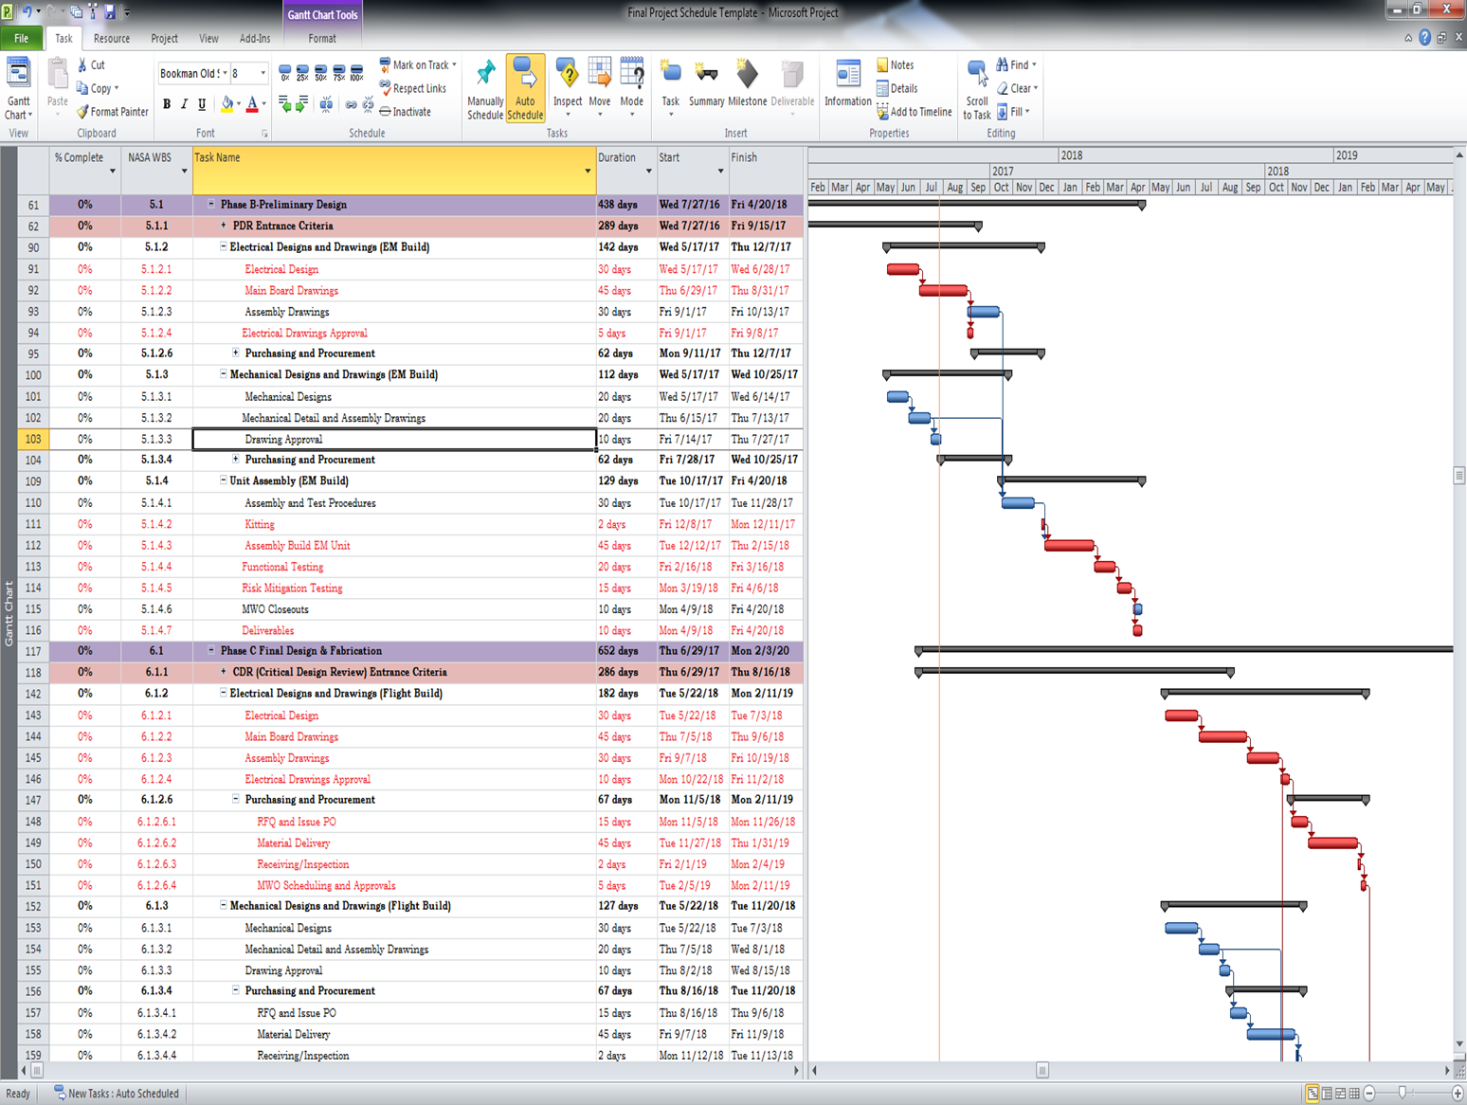
7120.5 Schedule Template
Life Cycle Phases & Reviews
Critical Path
Hardware Builds
NASA WBS
NASA Cost and Schedule Symposium August 29-31, 2017
Notes:
This slide shows the actual NASA Project Management Life Cycle template put into MS Project. It shows the life cycle phases and the gateway reviews/milestones in each phase, it shows the individual hardware builds i.e. the Breadboard build in Phase A to Phase B, the EM build from Phase B into Phase C and the Flight Build from Phase C spilling over into Phase D. It shows a valid waterfall critical path that the template creates based on historical data pulled from schedules that are archived and Lessons Learned. It also shows the NASA WBS that’s connected to the Project Cost WBS so that labor hours and project costs are applied appropriately to the tasks the resources are performing. So this way it’s all tied into the Cost and Schedule of the project.

Slide 8
ZIN – ACME Project Schedule Template Timeline
Project FHA Fri 12/30/16
Phase 3 FSR Tue 5/24/16
Table Top Review-SDP Fri 1/29/16
Start Sat 1/2/10
Finish Sat 6/3/17
1st Quarter
1st Quarter
1st Quarter
Phase A-Concept Development Sat 1/2/10 - Thu 11/3/11
Phase B-Preliminary Design Tue 5/10/11 - Wed 6/19/13
Phase E Operations & Sustainment Wed 7/13/16 - Sun 4/9/17
Phase C Final Design and Fabrication (EM) Wed 4/4/12 - Tue 12/23/14
Phase D System Assembly Int & Test, Launch Mon 7/7/14 - Fri 12/30/16
VRR Fri 1/29/16
SAR/PSR Tue 12/6/16
CDR Thu 11/21/13
ZIN Contract Delivery Date Fri 9/2/16
Launch (Sp-X 11) Sat 6/3/17
Notes:
This is a visual of the ACME Schedule in a timeline pulled directly from MS Project. This view of the schedule is good for Upper Mgmt. as they would rather see things at a high level and they can quickly look at this view and see where the project reviews/milestones are, how far along the project may be and the ability to make decisions quickly and accurately to benefit the project.

Slide 9
Organizational Flow of a Delivery Order
NO
GRC Approval?
Glenn Research Center Creates Delivery Order
Response is sent back to Glenn including Delivery Milestones, WBS, Cost & Schedule
YES
Scheduling Mgr. works with Project Mgr. to create Resource Loaded Schedule from 7120.5 Template
ZIN Project Mgr. creates Project Team based on D.O. Milestones & Deliverables
Delivery Order is sent to ZIN Technologies Contracting Officer
ZIN-Project Mgr. & GRC Project Mgr. have Kick Off Meeting with teams & Project Begins based on D.O. & ZIN Schedule created
Contracting Officer forwards D.O. to SpaceDOC II Division/Program Mgr.
ZIN-SpaceDOC II Division/Program Mgr. chooses a Project Manager for said Project
Project Begins
Notes:
The red box-This is where I do my magic…the Project Manager and I sit down and create a detailed schedule from the template that is used for the initial proposal. This is where we add the sub assemblies, the detailed tasks of the builds and the logic of the project is created. We decide what resources are working on the project and the percentages of their time is applied to the tasks, the review dates are set based on the Statement of Work and a timeline is created. The schedule is then approved by the PM and he uses the info to create his response back to GRC and the project team is set for the project to begin. *The detailed schedule is built and created from the template before the project begins based on best practices of NASA and ZIN. It makes for a much smoother project start and everyone on the project is then on the same page.

Slide 10
Provides an accurate basis in the development of the performance measurement baseline.
Provides the PM with visibility into workforce projections regarding over- or under-allocation of resources in the project.
Can alert the PM early if, due to a resource shortage, a task cannot be completed in the time allotted.
This drawing shows ZIN’s Resource loaded schedule with an individual Skill-Set.
Why We Resource Load
Notes:
Here is a view of a resource pool. The red resources listed are the over allocated resources that will alert the PM that the project is in need of more resources in these skill sets to complete the work assigned. It provides the project team with the visibility into workforce projections and whether or not there are enough people to finish the project, based on scope, schedule and budget agreed upon in the SOW. It also helps create an accurate performance measurement baseline which is the project’s plan for accomplishing or delivering a set of requirements within a specified amount of funding and time.

Slide 11
Project Mgr. uses Project Schedule for Team Meetings
All Deliverables/Detailed Hardware Builds & Milestones are Added to Template
Resource Loading and Timeline created
Project Mgr. and Scheduling Mgr. status schedules Bi-Weekly
Schedule is sent to GRC
Senior Analyst for GRC creates High level schedules to report Deliverables from ZIN Schedules for HQ
The ZIN Scheduling Mgr. Creates Monthly reports from the Status Meetings for ZIN Project/Program Mgrs. Internal Monthly Reviews and sent to GRC
“The Life” of a ZIN
Project Schedule
Notes:
This is the Life of a ZIN Project Schedule. It’s a cycle that we use over and over with each new project schedule that’s built. It all starts with the detailed schedule being built once the SOW is delivered. I sit down with each PM and create the detailed schedule starting with the Deliverables and hardware builds/Milestones being added to the template. Then we move on to the Resource loading and the time line for the project is created. The PM uses the schedule for team meetings to let the team know what’s coming up, to get status on the project itself and to keep track of the resources that are on the project. I sit down with the PM and status our schedules bi-weekly so that we have an accurate representation of the project to report to Upper Mgmt. At the end of every month, I send the schedules over to GRC for their analysis of the projects and reporting. While Paul is working on his analysis, I then create monthly reports (which you will see in the next slides) to use internally at ZIN to report the project status and to GRC to show them the status of the projects.

Slide 12
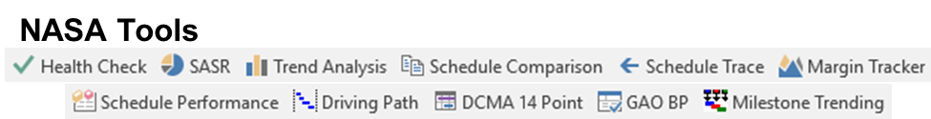


Monthly Reporting to NASA
Marshall STAT Tool Monthly Health Checks/SASR reports approved by NASA to create the ZIN Schedule Integrity Report
One Pager Report used to create a Visual picture of the Tasks/Milestones in process and completed.
ZIN Slack Erosion Report-Total Slack measured to FHA vs. Completed Tasks-Incomplete Tasks.
Utilization Schedules Created for Operations of the ZIN Experiments
ZIN Slack Erosion
Notes:
These are the NASA approved reporting tools that I use at ZIN for reporting the status of a project to the PM’s internally and externally at GRC. The Schedule Integrity report that I use is created from the NASA Marshall Stat Tool which includes the Health Check, SASR and the Schedule Performance reports that I run. The PM’s at ZIN really like the One Pager that I use to create a visual picture of the tasks that they want tracked along with the milestone completion also. The Slack Erosion report is a report that I created to give my PM’s and the Program Mgr. at GRC the ability to see the erosion of the total slack over the life of the project. I also use Fast Track to create the ZIN internal Utilization schedules. And these are schedules that show when Launches are coming up, when the Operations of the experiments that ZIN creates are going to happen and when the rockets are coming down so we can show when Docked Ops have to occur.

Slide 13
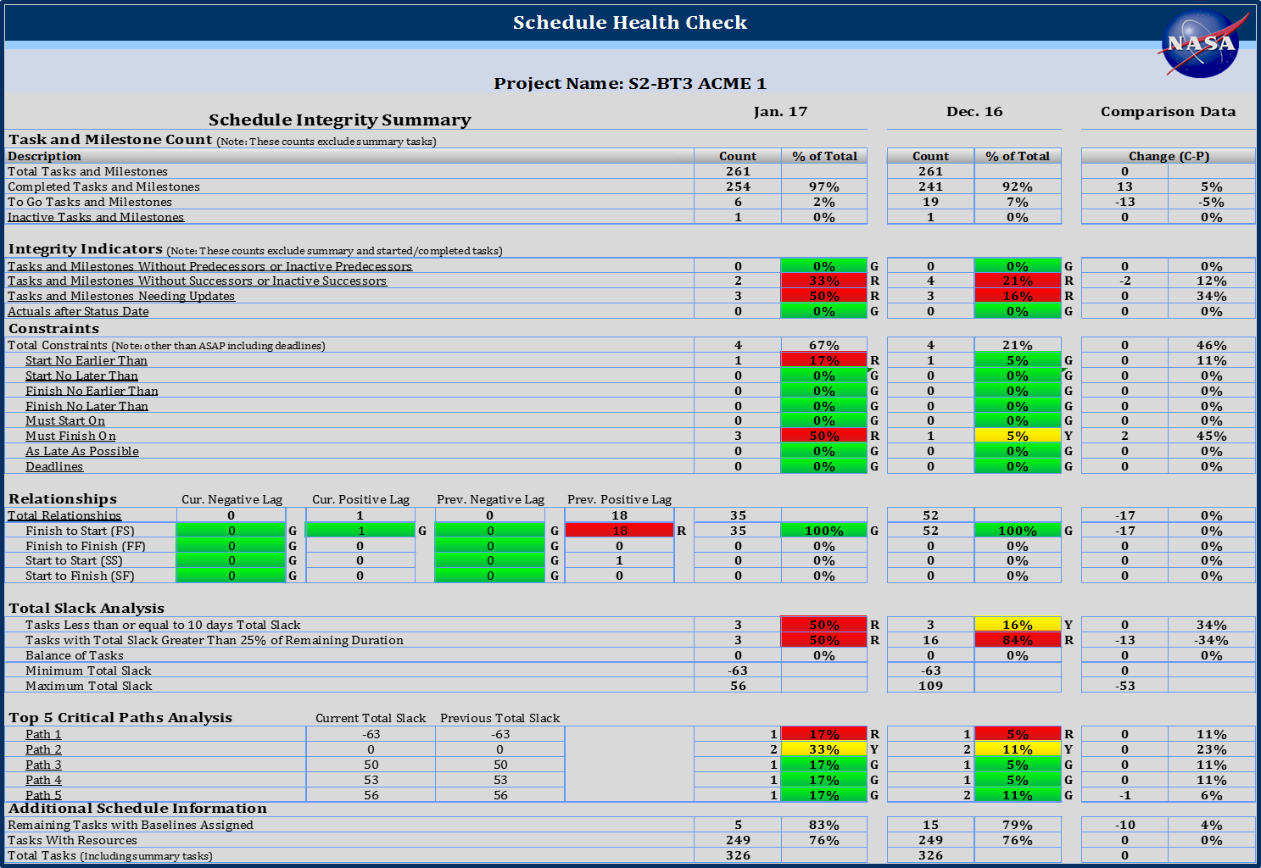

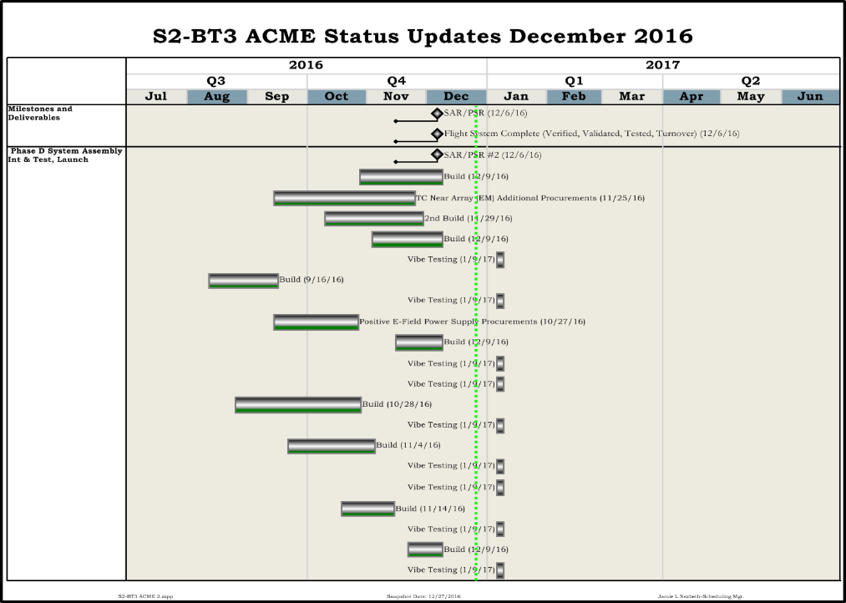
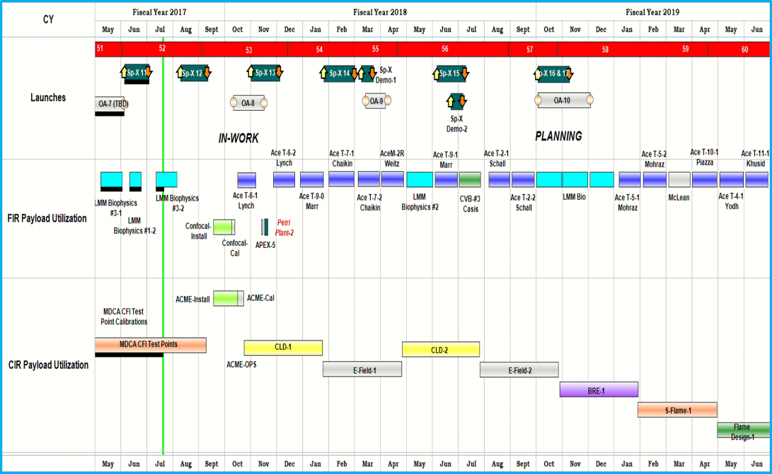


Schedule Reporting Tools Internal & External
Notes:
These are the examples of the reports that I spoke of in the last slide. Schedule Integrity Report-

Slide 14
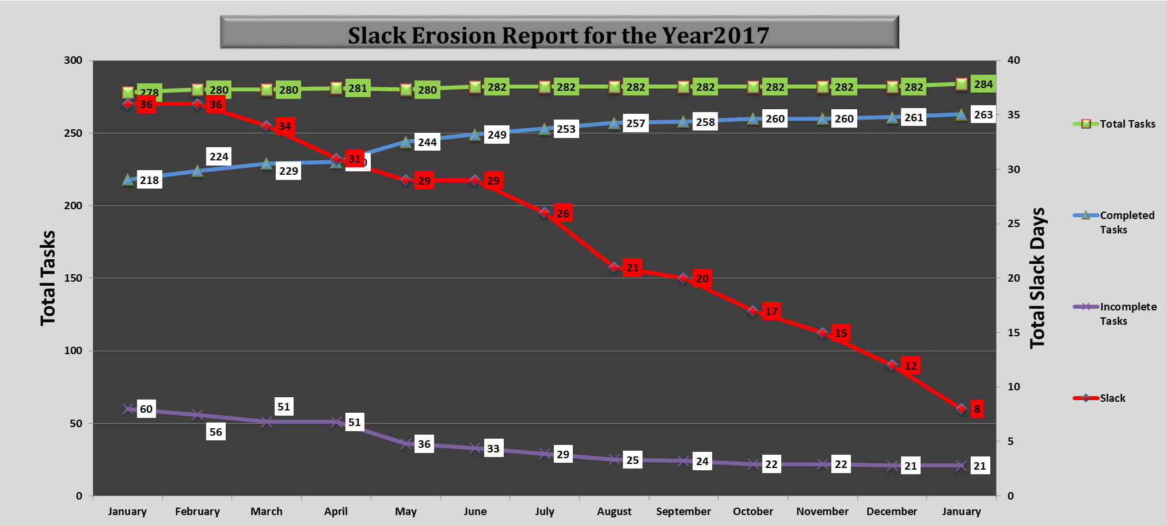
Slack Erosion
Scope Issues
Notes:
I designed the Slack Erosion report to show my Managers a way to track the erosion of slack in projects. This report shows the total tasks in a project schedule and how many are complete vs. in-complete and it shows when and where the slack is being eaten up in a project and when a Delivery Order Modification is required in the project. If you look at how this report works, it shows you the total number of tasks that are in a project schedule, and if there is a scope issue with the project, or a build problem/software issue, there are more tasks that are added to the schedule. This is where you see the majority of the slack being eaten up until they get the problem resolved. It could take months to get things back on track. Once the problem is rectified, the PM will usually submit a DO Mod to create additional slack in the schedules again so that if there are any other issues, they have the time built into the project schedule to fix the problem. We must remember always, that these projects are all Research & Development, and they have problems and issues sometimes. We try to make sure that we build an abundance of slack into the schedules but sometimes these problems that occur will eat that slack right up. But this is a great report to show on a monthly basis how much slack each project still has. And you can measure the slack to a specific milestone/gateway review, or the Flight Hardware Availability date and the template makes that possible to do so. Creating the template has also made it significantly more structured and organized to use it with other Corporate ZIN projects like the Saffire project. Once my monthly schedules are statused, and the reports are created, then Paul my NASA counterpart then takes over with the information that I present to him to do his analysis on all the info. And this is where he takes over.

Slide 15
How Schedule Template Helped NASA Glenn
Before the template; each schedule had the ZIN Project Manager’s own style
With template in place there is consistency in all schedules
Common terminology
Common durations for like tasks
Baseline tracking
Traceability – able to quickly assess schedule changes
Ease at creating summary schedules
With all of these attributes in the template it raises the confidence in the schedule
Allows metric tools to work with ease and help with margin and what-if predictions

Slide 16
Mission Integration & Operations
Quickly assess schedule & cost impacts

Slide 17
Conclusion
Template creation based on 7120.5
ZIN
Aids in communication between ZIN Project Manager and NASA Project Manager
Allows a higher level of confidence and traceability with the detail schedules
Provides useful accurate data for creating one page schedules
Provides roll up of resources across all schedules
ZIN has flown 250 Payloads to Space Station including New Projects & Re-flights
The 1st project to use the Template 7120.5 was ACME
NASA
Allows better decision making by the NASA Project Manager
Provides useful accurate data for creating one page schedules
Standardization across each project
Reporting consistency

