Slide 1

Building Social Relationships through Evidence Based Social Skills Programming for Children and Youth
Scott Bellini, Ph.D., HSPP
Indiana University
Laying the Foundation for Teaching Social Skills and Activating Social Cognitive Processing in Students

Slide 2

Scott Bellini, Ph.D., HSPP
Director
Social Skills Research Clinic
Indiana University, Bloomington
Instructor
Bellini Family…Coast of Oregon

Slide 3



Four Primary Goals
Goal 1:
To enhance your knowledge of social skills and social cognitive processing in youth on the autism spectrum
Goal 2:
To enhance your understanding of the importance of social skills on student outcomes, and increase your knowledge of the ingredients of effective social skills programming
Goal 3:
To change the way you think about social skills programming
Goal 4:
To change the way you teach social skills

Slide 4
The Importance of Early Social Skills on Later Life Outcomes…A Quick Listen to Start the Morning

Slide 5

The Importance of Early Social Skills on Major Life Outcomes
Level of Educational Attainment
Employment Status and Income
Social-Emotional Skills Entering Kindergarten Predicts…
Criminal Activity
Substance Abuse
Mental Health
(Jones et al, 2015)

Slide 6
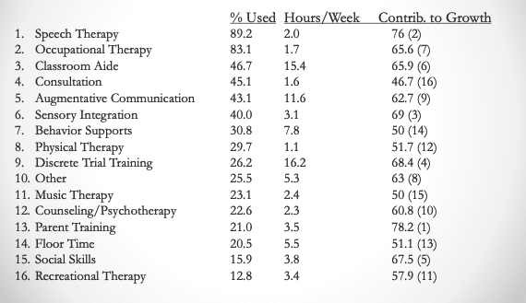
Early Intervention/Early Childhood Education Usage Practices in the State of Indiana
(Hume, Bellini, & Pratt, 2005)

Slide 7








Why Teach Social Skills:
Outcomes Associated with Social Skill Difficulties
Behavior Problems
Poor Academic Performance
Peer Failure >>> Rejection and Isolation
Bullying Relationships (Bully and Victim)
Anxiety
Depression
Employment Issues
Anti-Social/Violent Behaviors
Substance Abuse
Suicidal Ideation

Slide 8
Science Links SEL to Student Gains: Landmark study documented multiple benefits of SEL
Science Links SEL to Student Gains:
Social-emotional skills
Improved attitudes about self, others, and school
Positive classroom behavior
11 percentile-point gain on standardized achievement tests
Reduced Risks for Failure:
Conduct problems
Emotional distress
2011 meta-analysis of 213 studies involving school-based, universal SEL programs including over 270,000 students in K-12 revealed:
Source: Durlak, J.A., Weissberg, R.P., Dymnicki, A.B., Taylor, R.D., & Schellinger, K. (2011) The impact of enhancing students’ social and emotional learning: A meta-analysis of school-based universal interventions. Child Development: 82 (1), 405-432.
Notes:
This is a great slide on the most cited and compelling research on SEL, the 2011 meta-analysis. Findings from this are incorporated into the previous slide, but if you have time to spend on just this, it’s a great slide.
Specifically, you can talk about each of the bullets as their own compelling piece of evidence. Depending on your audience, you may want to emphasize certain points. For example:
Not only did we learn from this meta-analysis that SEL programming leads to improvements in SEL skills, we also see some other important outcomes:
Improved attitudes about self, others, and school (extremely important and cited by educators as one of the main reasons they value SEL, so it’s good to emphasize this if audience is school-based folks).
Positive classroom behavior (this is important, but be careful not to over emphasize this point for fear that people think SEL is primarily a behavior-management solution, which is a common misperception).
11 percentile point gain on academics: This is a significant data point that warrants emphasis. This kind of improvement on academics is frankly what has gotten the attention of so many. This data point can foster the transition from a belief that these are “soft skills,” nice-to-haves, to the idea that these are critically important and to be taken seriously.
And don’t forget about the data points in red:
Reductions in conduct problems is an important finding, but once again, it’s important to be wary of folks who think of SEL as behavior management and are looking to “fix broken kids.” See note above.
Reductions in emotional distress warrants significant emphasis. We’re living in a time when emotional distress, depression, anxiety, and suicide are at an all-time high. Understanding that SEL can have an impact here is important, but with a word of caution: SEL should not be viewed as a solution for mental illness.

Slide 9
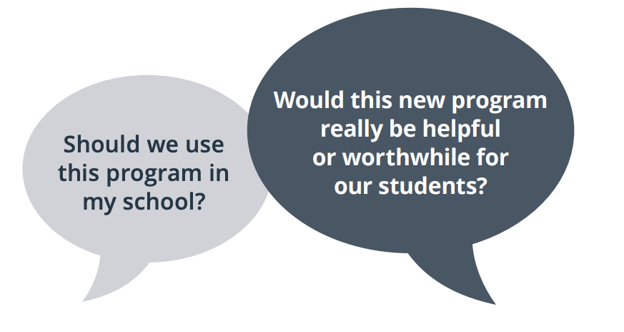
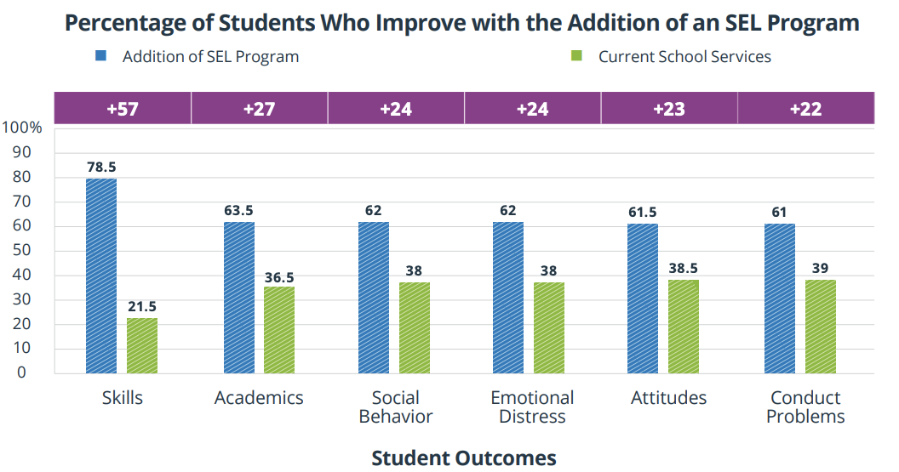

Practical Benefits of an SEL Program: Based on the 2011 meta-analysis
Adding an SEL program is likely to be a wise choice compared to students receiving current school services.
For example:
27% more students would improve their academic performance at the end of the program
57% more would gain in their skills levels
24% more would have improved social behaviors and lower levels of distress
23% more would have improved attitudes
22% more would show fewer conduct problems
Notes:
Even gains of 22% in terms of fewer conduct problems is a worthwhile benefit because it reflects what an SEL program can add to school services compared to what each school is currently doing. In sum, current data collected from many studies indicates that adding a SEL program to the school curriculum can lead to several real-life benefits for students.
Source: https://casel.org/wp-content/uploads/2019/12/Practical-Benefits-of-SEL-Program.pdf

Slide 10
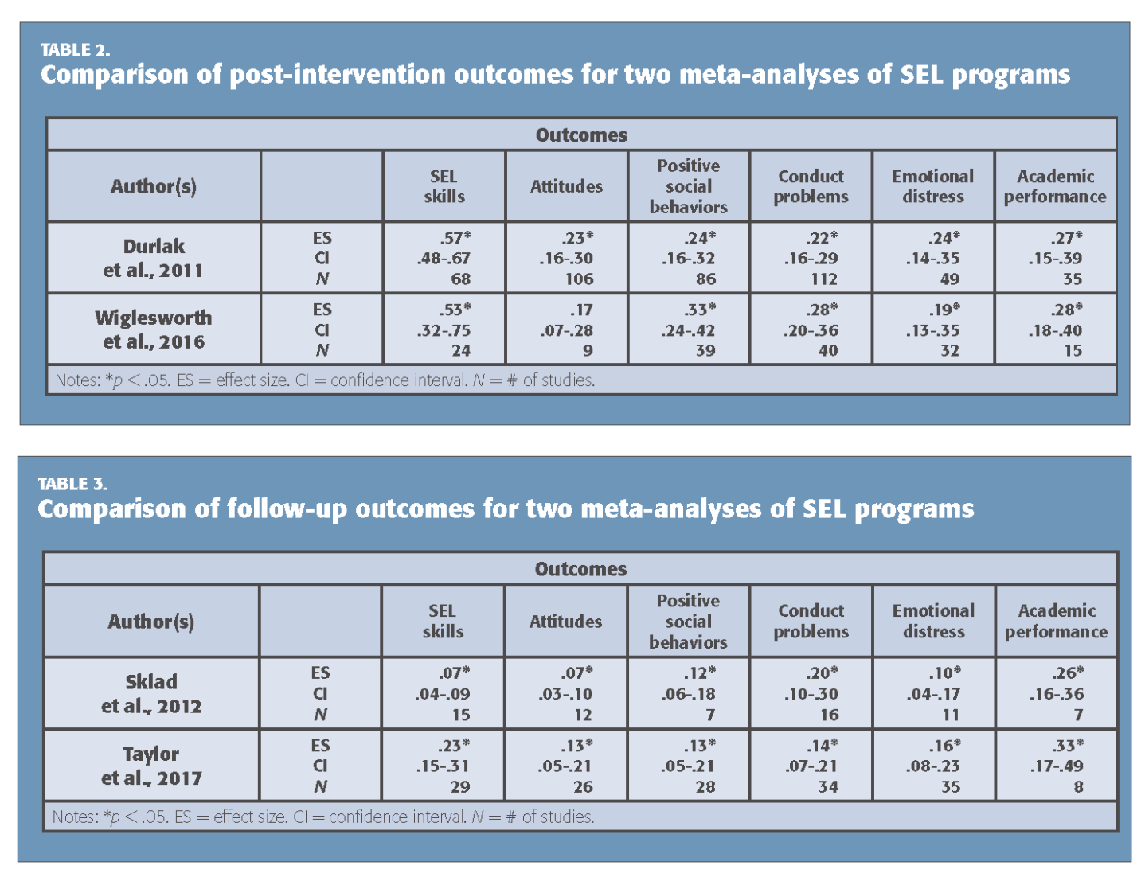
Impact of SEL:
long-lasting and global
A 2017 research study finds that SEL programs benefit children for months and even years.
82
97,000+
Students, kindergarten through middle school
6 mo – 18 yrs
after programs completed
different programs reviewed (38 outside U.S.)
Academic performance
SEL skills
Positive attitudes
Positive social behaviors
Higher social and emotional competencies among SEL students at the end of the initial intervention was the best predictor of long-term benefits.
Benefits were the same regardless of socioeconomic background, students’ race, or school location.
Conduct problems
Emotional distress
Drug use
Source: Child Development (July 2017). “Promoting Positive Youth Development Through School-Based Social and Emotional Learning Interventions: A Meta-Analysis of Follow-Up Effects”
Notes:
This slide shows the longitudinal impact of SEL programming. This 2017 meta-analysis included the 82 studies that showed longitudinal affects, and the results show that the gains are LASTING. SEL programming isn’t just a shot in the arm that benefits in the short term. There are long lasting benefits that go beyond school outcomes.
And don’t forget to point out this note at the bottom of the slide:
“Higher social and emotional competencies among SEL students at the end of the initial intervention was the best predictor of long-term benefits. Benefits were the same regardless of socioeconomic background, students’ race, or school location. “

Slide 11
Administrators, Parents, and Teachers value SEL
The overwhelming majority of administrators (96%), teachers (93%) and parents (81%) believe that social and emotional learning is just as important as academic learning.
Teaching SEL skills in the classroom is most important for improving:
Negative student behaviors such
as bullying
– according to teachers
and administrators
School safety
– according to parents
Source: 2018 Social and Emotional Learning report, 2018
Notes:
More recently, a new report from McGraw Hill was released in 2018 sharing findings from a survey conducted by Morning Consult from September 6-11, 2018.T he findings represent a national sample of 1,140 teachers, administrators and parents.
Overall, administrators, teachers and parents agree: SEL is crucial.

Slide 12
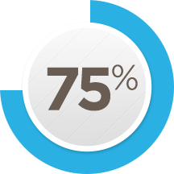
Principals value SEL
Social and emotional skills are teachable in a school setting.
I am very/fairly committed to developing students’ social and emotional skills in my school.
99%
Definitely teachable 74%
Probably teachable 25%
Very committed 69%
95%
Fairly committed 26%
believe students from all types of background would benefit from SEL
Source: Ready to Lead, 2017
Notes:
For those wanting to know what principals think

Slide 13

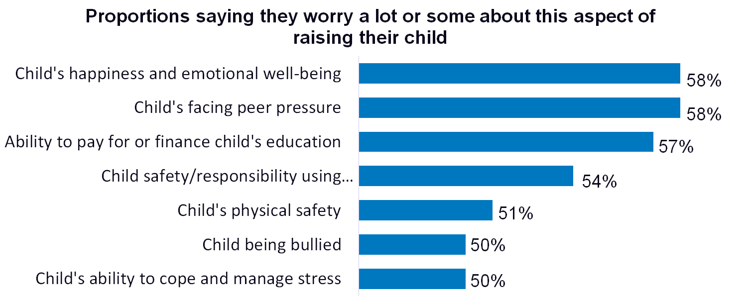
Parents value SEL
say “being happy/not overly stressed”
is more important than academics.
3 out 5 parents
*The research says this is a false choice: social and emotional well-being contributes to academic success, among other benefits.
Source: Learning Heroes, 2017
Notes:
For those wanting to know what parents think

Slide 14


Employers value SEL
Of surveyed executives say skills such as problem-solving and communicating clearly are equally or more important than technical skills.
National Bureau of Economic Research, 2015
The Top 10 skills identified by the World Economic Forum all involve social and emotional competence.
And research shows that social and emotional skills and attitudes also contribute to the other skills such as critical thinking.
Source: Future of Jobs Report, World Economic Forum
Emotional intelligence
Judgment and decision-making
Service orientation
Negotiation
Cognitive flexibility
Complex problem solving
Critical thinking
Creativity
People management
Coordinating with others
Notes:
This slide can be useful for those wanting to know what employers think.

Slide 15
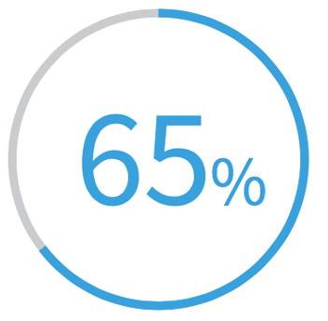



Employers value SEL
Of surveyed executives say they’d rather colleges build up students’ life skills.
High Point University survey, 2018
7 top characteristics of success at the company are all SEL-related skills, such as communicating and listening well; possessing insights into others; and having empathy.
Priorities: Conflict resolution, leadership, and civic engagement
Wanted: Employees Who Can Shake Hands, Make Small Talk
Bank of America teaches empathy in-house; Subaru pays for soft-skills training (Dec. 10, 2018)
Notes:
For those wanting to know what employers think—part 2

Slide 16



The Impact of Happiness on Educational Performance
Happiness is associated with the following academic variables:
Achievement
Engagement
Attitudes toward School
Resilience
Datu, et al. (2017)
Positive social relationships are critical to student happiness

Slide 17

Social Skills Programming for Individuals on the Autism Spectrum: A Historical Perspective
General Viewpoint as late as 1990:
Youth on the autism spectrum had a limited capacity to learn social skills and develop social relationships
The Result:
Social skills programming was relegated to secondary status in educational and therapeutic programs

Slide 18


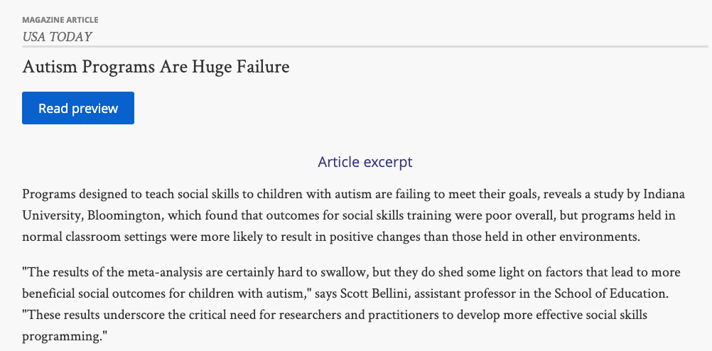
Why Social Skills Programming is often Ineffective
The Ingredients of Effective Social Skills Programming
Insufficient “Dosage”
Contrived and Decontextualized Intervention Settings
Failure to Match Skill Deficit with Type of Intervention Strategy
Failure to Assess Social Skills Prior to Intervention
Use of Ambiguous Intervention Objectives
Poorly Implemented Interventions
Lack of Systematic Programming
Bellini (2007; 2019)

Slide 19
Why Social Skills Programming is often Ineffective
Social skills programming must be intensive
Insufficient “Dosage”
Total hours of social skills training should exceed 30 hours over over a 10 week period
Bellini (2007; 2019)

Slide 20

Why Social Skills Programming is often Ineffective
Social skills programming should take place in
every environment that the child enters into
Contrived and Decontextualized Intervention Settings
Social skills training is most effective when it is implemented (at least partly) in the child’s natural environment
Bellini (2007; 2019)

Slide 21



Why Social Skills Programming is often Ineffective
We must discern between a skill acquisition deficit and a performance deficit, prior to selecting intervention strategies
Failure to Match Skill Deficit with Type of Intervention Strategy
Skill Acquisition Deficit:
Refers to the absence of a particular skill or behavior
Goal of Intervention:
Teach new skills or develop recently acquired skills
Performance Deficit:
Refers to a skill or behavior that is present, but not demonstrated or performed
Goal of Intervention: Enhance performance of existing skills
Bellini (2007; 2019)

Slide 22

Why Social Skills Programming is often Ineffective
Social skills programming must begin with comprehensive assessment of social-emotional functioning
Failure to Assess Social Skills Prior to Intervention
Purpose of Assessment:
Measure present level of performance
Identify skills to teach
Bellini (2007; 2019)

Slide 23
Factors Contributing to Social Failure
Performance
Deficits
Inadequate
Social Skills &
Cognition
Cruel/Rejecting
Peers
Social Failure
Detrimental Social
Behaviors
Bellini, 2016

Slide 24
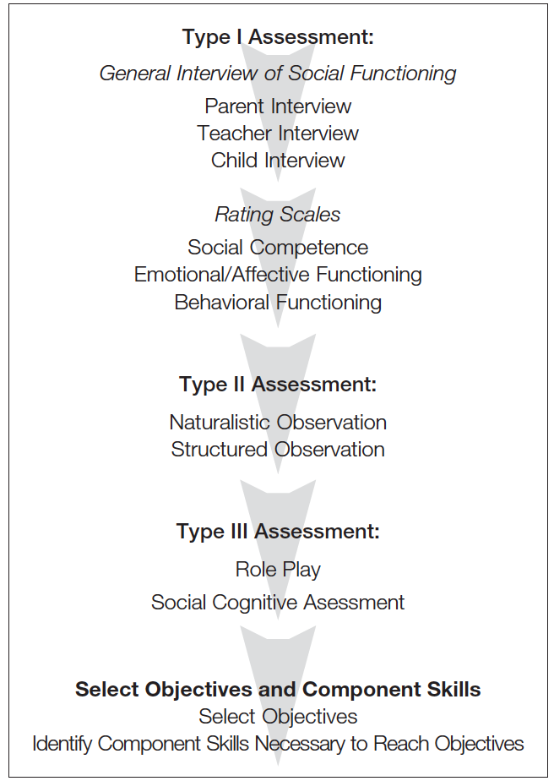
Social Skills Assessment Flowchart: Three Types of Assessment (Bellini, 2016)

Slide 25


Why Social Skills Programming is often Ineffective
Social objectives should be clear and measurable and component skills should be individualized to the child’s needs
Discerning between Goals/Objectives and Component Skills in the BSR Program:
Objectives represent what you will measure
Component Skills represent what you will teach
Use of Ambiguous Intervention Objectives
Bellini (2007; 2019)

Slide 26
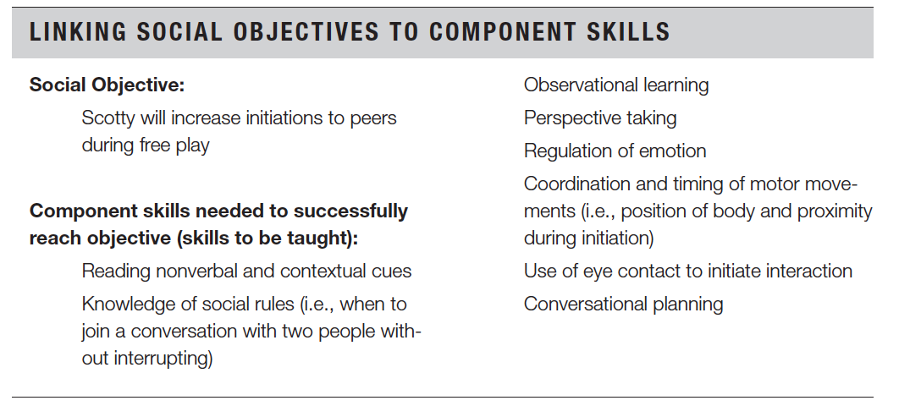
The Relationships Between Social Objectives and Component Skills (Bellini, 2016)

Slide 27

Why Social Skills Programming is often Ineffective
Poor social skill outcomes are directly related to poorly implemented interventions
Poorly Interventions
Poorly implemented interventions are often the result of two things:
Lack of training by interventionist
Most “neuro-typical” adults are are not instinctively good at teaching social skills, because we are too darn good at performing them!
Bellini (2007; 2019)

Slide 28


Why Social Skills Programming is often Ineffective
Social skills programming must be systematic
Lack of Systematic Programming
Two Things to Remember:
We can’t expect to be successful if we continue to “sort of” teach social skills
We need to stop“chasing” behaviors and start teaching essential social skills and addressing underlying deficits
Bellini (2007; 2019)

Slide 29

What is the Building Social Relationships Program?
The Building Social Relationships program is a systematic social skills program that teaches social skills and activates social cognition

Slide 30
The Building Social Relationships Program
Identify and assess areas of need
Discern between skill acquisition deficits and performance deficits
Select appropriate intervention strategies
Implement intervention strategies
Evaluate program and modify as needed
5 Step Approach

Slide 31
Five Basic Tenets of the Building Social Relationships Program
Tenet #1: Individuals on the autism spectrum want to establish meaningful social relationships
Tenet #2: If we want youth on the autism spectrum to be successful socially, then we have to teach them the skills to be successful
Tenet #3: Successful social behaviors are not always “appropriate” social behaviors
Tenet #4: Social success is dependent upon our ability to adapt to our environment
Tenet #5: Social interaction skills are not the equivalent of academic skills

Slide 32
The Essence of Social Interaction Skills and
the BSR Program
Three Integrated Components:
Thinking
Knowledge
Social Problem Solving
Perspective Taking
Observational Learning
Self-Awareness
Attention
Feeling
General Mood
Anxiety
Depression
DOING!
Execution
Body Position/Movement
Fluency
Timing
Doing
Thinking
Feeling

Slide 33
Thinking: Social Cognition
Doing
Thinking
Feeling

Slide 34

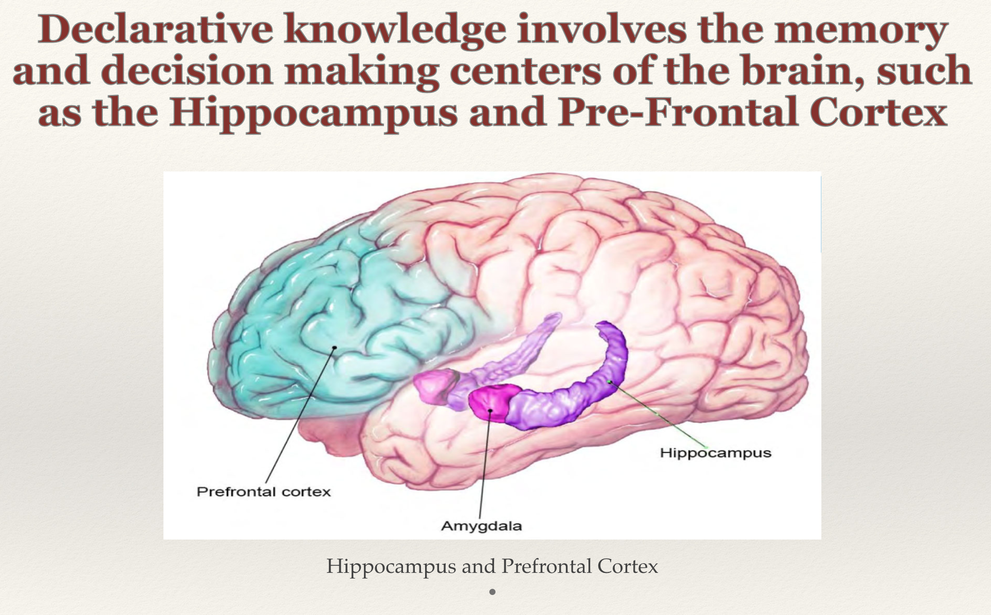
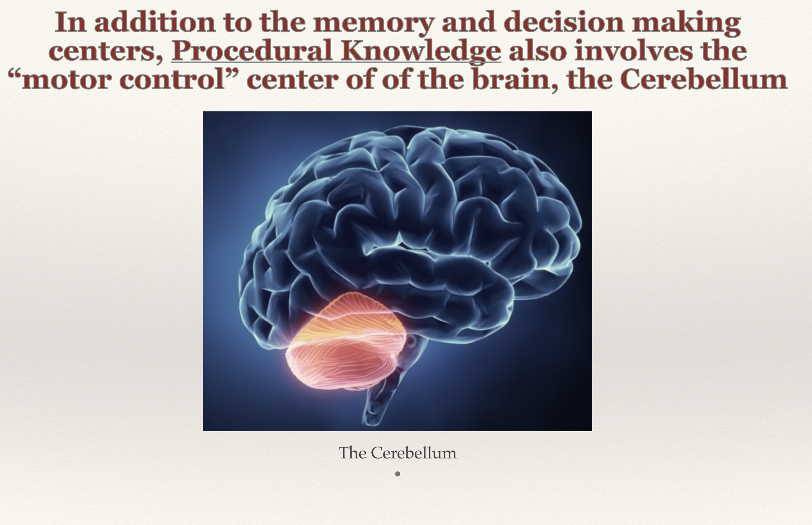


Social Knowledge
Involves knowing what to do, and how to do it, in social interactions
Two types of Knowledge relevant to social skills:
Declarative Knowledge: Knowing “what to do” in social interactions. Involves social rules, customs, or norms, and knowing which behaviors to perform in social situations.
Procedural Knowledge: Knowing “how to” perform social behaviors. Involves not just knowing what do, but also having the ability to execute the behavior.

Slide 35
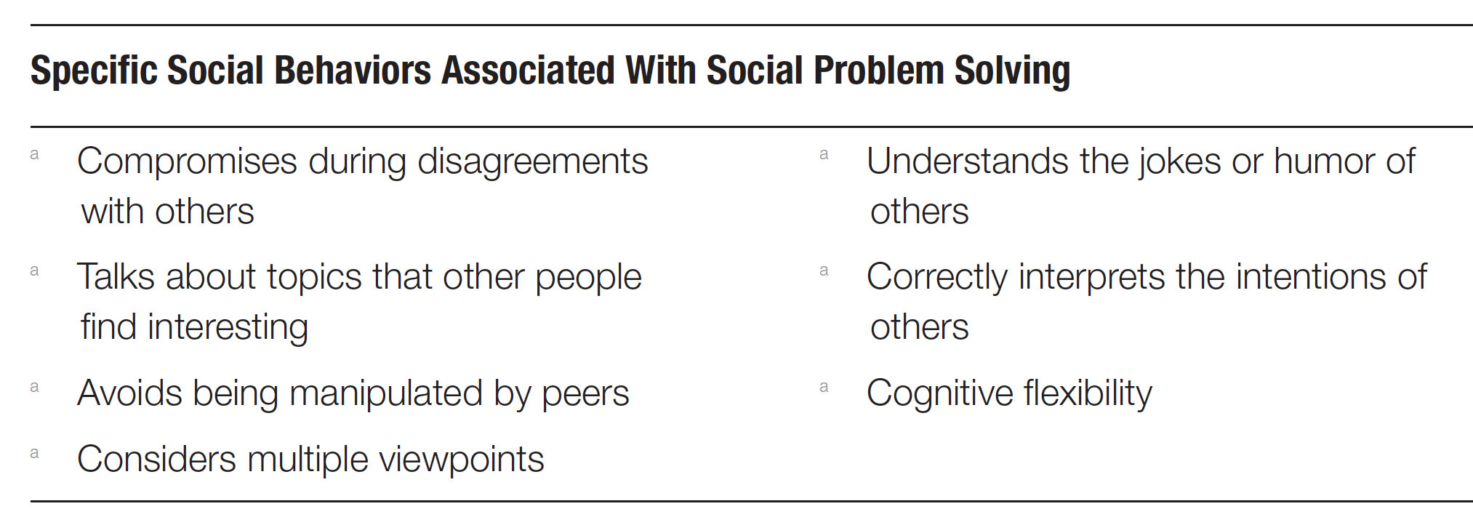
Social Problem Solving
Refers to the ability to analyze a social situation and make a behavioral decision
Bellini, 2016

Slide 36

Perspective Taking
Refers to the social-cognitive process of taking another person’s viewpoint, or seeing the world thru their “eyes.”
Important to distinguish between Perspective Taking and Theory of Mind
Theory of Mind represents static knowledge of how the mind processes information
Perspective Taking is a dynamic, “on-line” cognitive process

Slide 37
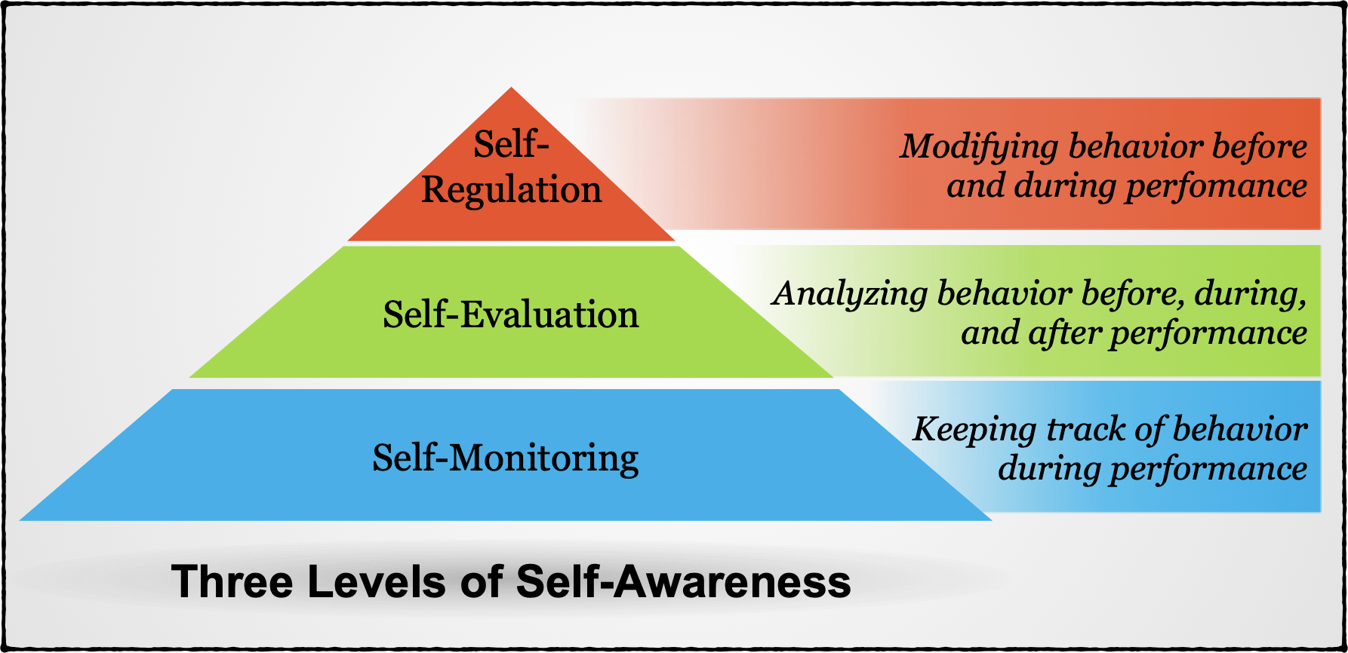
Self -Awareness
Refers to monitoring, regulating, and evaluating our own behavior

Slide 38
Observational Learning
Refers to the ability to imitate (model) and/or learn from the behavior of others.
According to Bandura, there are three prerequisites for successful modeling:
Attention:The ability to attend to behavior of others
Memory: The ability to remember what it is that you have seen
Behavioral Reproduction: The ability to perform the behavior that you have observed

Slide 39



Attention
Attending to relevant stimuli in the environment is critical to cognitive, communicative, and social-emotional development.
Individuals on the autism spectrum are thought to exhibit over-selective attention, leading them to attend to one stimulus in the environment, while forsaking all others.
Over-selective attention, interferes with Joint Attention and Divided Attention, which are critical to successful social interactions.
Joint Attention: Attending to a stimulus in unison with another person.
Divided Attention: Attending to multiple stimuli simultaneously, or rapidly shifting attention between stimuli.
Missing the Forest for the Trees

Slide 40
The Essence of Social Interaction Skills and
the BSR Program
Three Integrated Components:
Thinking
Knowledge
Social Problem Solving
Perspective Taking
Observational Learning
Self-Awareness
Attention
Feeling
General Mood
Anxiety
Depression
DOING!
Execution
Body Position/Movement
Fluency
Timing
Doing
Thinking
Feeling

Slide 41
Feeling: Emotional Regulation
Doing
Thinking
Feeling

Slide 42

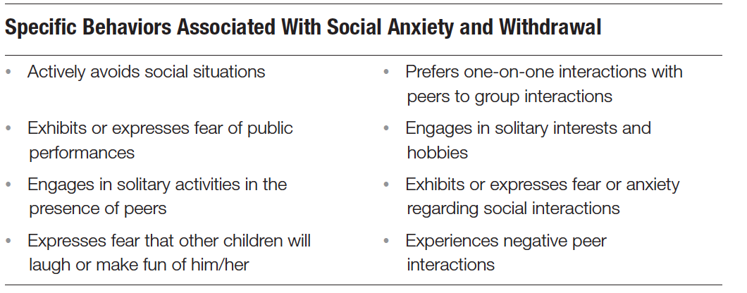
Social Anxiety and Avoidance
Individuals on the autism spectrum exhibit higher levels of social anxiety than the general population (50% v. 10%), which significantly interferes with their ability to initiate and maintain social relationships.
Bellini, 2016

Slide 43
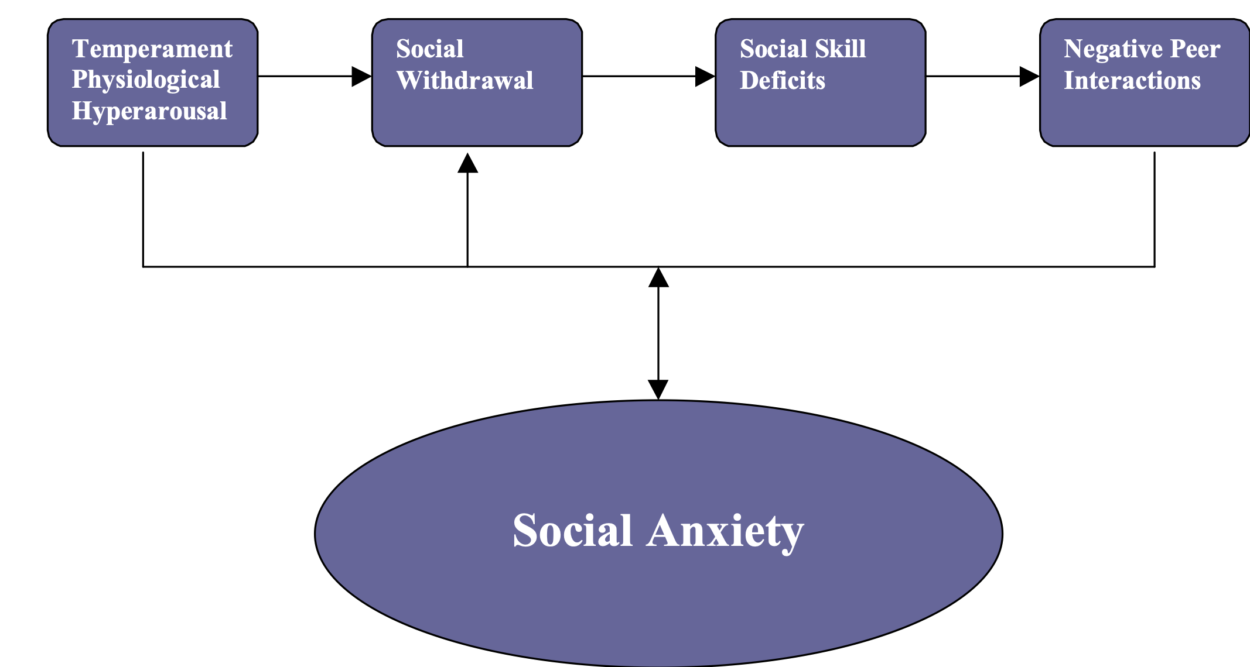

The Development of Social Skill Deficits and Social Anxiety (Bellini, 2006; 2016) Autism Spectrum Disorders (Bellini, 2006)

Slide 44
The Essence of Social Interaction Skills and
the BSR Program
Three Integrated Components:
Thinking
Knowledge
Social Problem Solving
Perspective Taking
Observational Learning
Self-Awareness
Attention
Feeling
General Mood
Anxiety
Depression
DOING!
Execution
Body Position/Movement
Fluency
Timing
Doing
Thinking
Feeling

Slide 45
Doing: Behavioral Execution
Doing
Thinking
Feeling

Slide 46

Motor Movements in Social Interactions
Successful social interactions require fluent, well-timed, and well-positioned motor movements.
Common motor skills used in social interactions:
Motor Planning
Motor Initiation
Fine and Gross Motor Coordination (Motor Execution)
Proprioception
Motor Imitation

Slide 47

Common Social Skill Difficulties in Children
on the Autism Spectrum
Difficulties with Non-verbal Communication
Difficulties with Reciprocity in Interactions
Difficulties with Social Initiation
Detrimental Social Behaviors associated with Difficulties with Perspective Taking and Self-Awareness

Slide 48
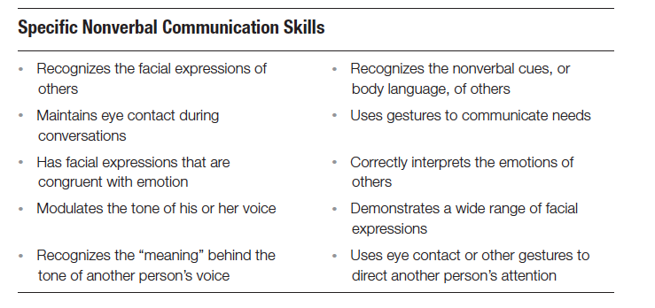


Non-verbal Communication Skills
Bellini, 2016

Slide 49
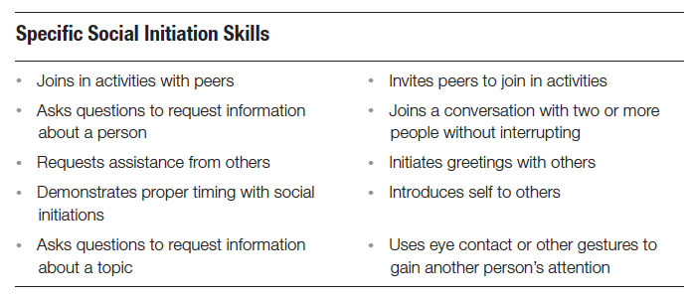
Social Initiation Skills
Bellini, 2016

Slide 50
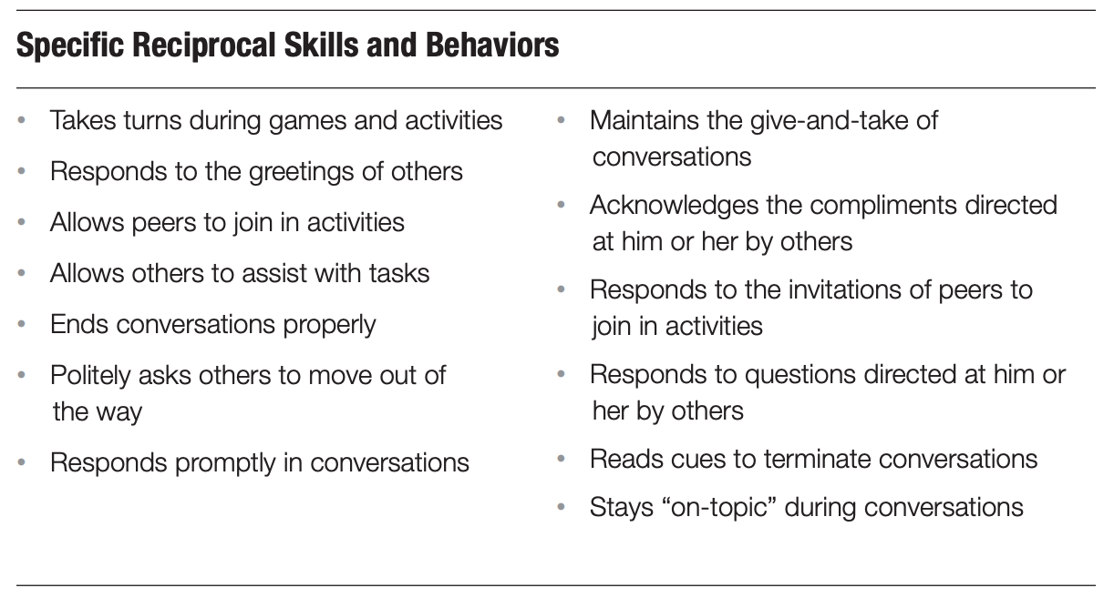




`
Caption

Slide 51
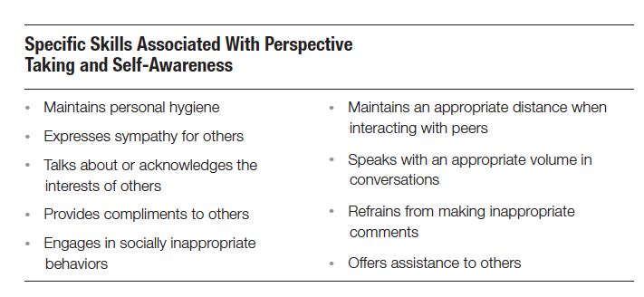


Detrimental Social Behaviors
Bellini, 2016

Slide 52
The Building Social Relationships Program
Identify and assess areas of need
Discern between skill acquisition deficits and performance deficits
Select appropriate intervention strategies
Implement intervention strategies
Evaluate program and modify as needed
5 Step Approach

Slide 53
We must discern between a skill acquisition deficit and a performance deficit, prior to selecting intervention strategies
Skill Acquisition Deficit:
Refers to the absence of a particular skill or behavior
Goal of Intervention:
Teach new skills or develop recently acquired skills
Performance Deficit:
Refers to a skill or behavior that is present, but not demonstrated or performed
Goal of Intervention: Enhance performance of existing skills

Slide 54
Skill Acquisition: From Novice to Mastery
Novice Intermediate Mastery

Slide 55
Factors Affecting Performance:
Moving Beyond “Can’t Do vs. Won’t Do”
Motivation
Sensory sensitivities
Anxiety
Attention and impulsivity
Memory
Self-efficacy
Movement differences

Slide 56
How to Discern between a SAD and PD
Does the child perform the skill across multiple settings and persons?
Does the child perform the skill when reinforcement is provided?
Does the child perform the skill without support or assistance?
Does the child perform the skill fluently and effortlessly?
Does the child perform the skill when environmental modifications are made?

Slide 57
Evidence Based Practices Used in the BSR Program
Self-Management
Social Narratives
Social Skills Training
Prompting
Peer Mediated Interventions
Modeling
Structured Play Group
Video Modeling
Reinforcement+
Cognitive Behavioral Intervention
Technology Aided Instruction
Time Delay Prompt Fading

Slide 58
Evidence Based Practices for Youth on the Autism Spectrum
National Professional Development Center on Autism:
http://autismpdc.fpg.unc.edu/node/19
National Autism Center
http://www.nationalautismcenter.org/national-standards-project/phase-2/

Slide 59
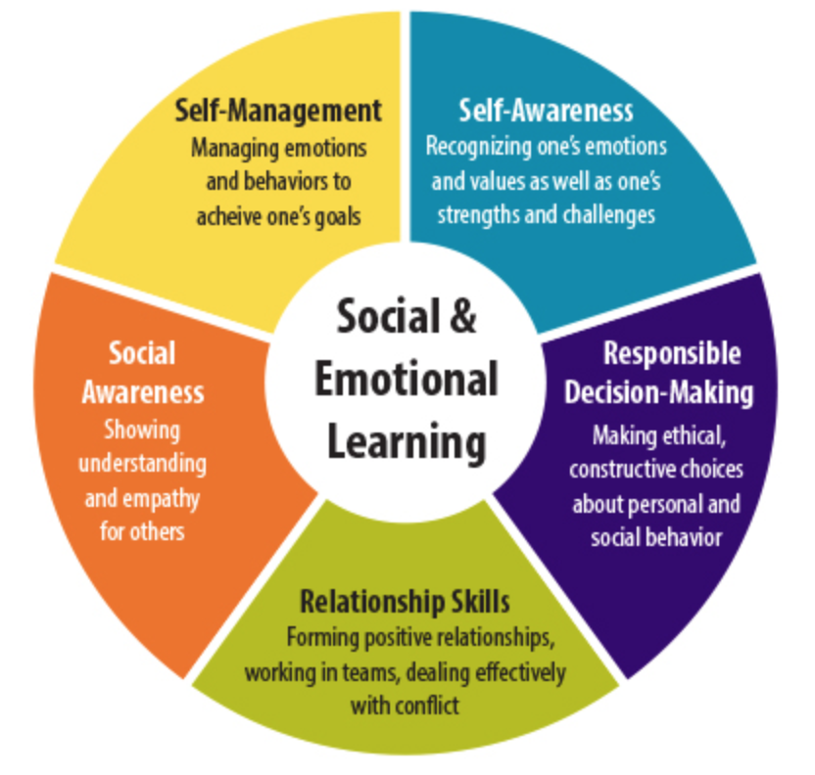
The BSR Program is Aligned with the CASEL Core SEL Competencies
Core SEL Competencies

Slide 60
BSR Intervention Strategies: Social Skill Instructional Strategies
Social Narratives
Social Skill Targeted: Social Initiation and Social Responding
Behavioral Rehearsal
Social Skill Targeted: Social Initiation and Social Responding
Conversation Game
Social Skill Targeted: Reciprocal Conversation
Structured Play (Prompting)
Social Skill Targeted: Social Initiation, Social Responding, and Social Engagement
Video Modeling
Social Skill Targeted: Social Initiation, Social Responding, and Social Engagement

Slide 61

BSR Intervention Strategies: Social Cognitive Strategies (Cont.)
Stop, Watch, and Follow Along
Social Cognitive Skill: Observational Learning
Reading Non-Verbal Cues and Inferring Feelings in Pictures
Social Cognitive Skill: Pre-Perspective Taking
Modified False-Belief Tasks
Social Cognitive Skill: Perspective Taking
“Yes/No” (Peg Board) Activity
Social Cognitive Skill: Joint Attention
Social Problem Solving (with pictures and videos)
Social Cognitive Skill: Social Problem Solving
Self-monitoring Activity During Monkey in the Middle and Telephone Game
Social Cognitive Skill: Self-Awareness
Modified I-Spy
Social Cognitive Skill: Joint Attention
Point it Out
Social Cognitive Skill: Joint Attention
Follow the Leader
Social Cognitive Skills: Perspective Taking, Joint Attention, Self-Awareness
Infer Interests
Social Cognitive Skill: Perspective Taking
Musical Chairs with Visual Cues
Social Cognitive Skill: Divided Attention
Conversation Game during Play Activity
Social Cognitive Skills: Divided Attention

Slide 62
The Social Skills Research Clinic (SSRC): Structure of Sessions
Part 1: (20 minutes)
Social cognitive instruction that targets at least two of the following areas each session:
Social Problem Solving
Perspective Taking (and pre-perspective taking skills)
Self-Awareness
Observational Learning
Joint Attention
Selective/Divided Attention
Declarative Knowledge (social rules, norms, etc.)
Part 2: (20 minutes)
Behavioral strategies that target one or more of the component skills (i.e., “Featured Skills) such as:
Joining in Others Play
Asking Others to Join in Play
Asking Questions
Responding to Initiations
Taking Turns
Part 3: (5 minutes)
Data collection/Free play

Slide 63

Examples of Evidence Based Social Skill Strategies used in the BSR Program
Social Narratives and Behavioral Rehearsal
Peer Mediated Interventions
Prompting and Structured Play Groups
Video Self-Modeling

Slide 64
Social Narratives and Behavior Rehearsal

Slide 65

Social Narratives
An evidence based approach for teaching specific social skills or social concepts by presenting the social skill or concept in the form of a story
Recommendations:
Use pictures with your Social Narratives to provide social context
Combine Social Narratives with Behavioral Rehearsal for maximum effectiveness (targets both “Thinking” and “Doing”)
Notes:
1. Transitions, initiating, responding behavior, playing a game, going on a field trip, etc.

Slide 66
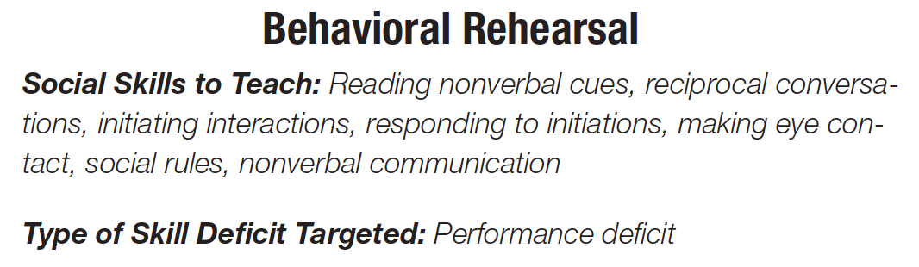
Behavioral Rehearsal/ Role-Playing
Acting out situations or activities in a structured environment to practice newly acquired skills and strategies
Notes:
-

Slide 67

Behavioral Rehearsal and “Batting” Practice
"Batting Practice” is a Behavioral Rehearsal Strategy used to teach the proper sequence for initiations
“B-A-T” or “Batting” practice:
B = Body Position
A = Attention
T = Talk

Slide 68
Peer Mediated Intervention

Slide 69
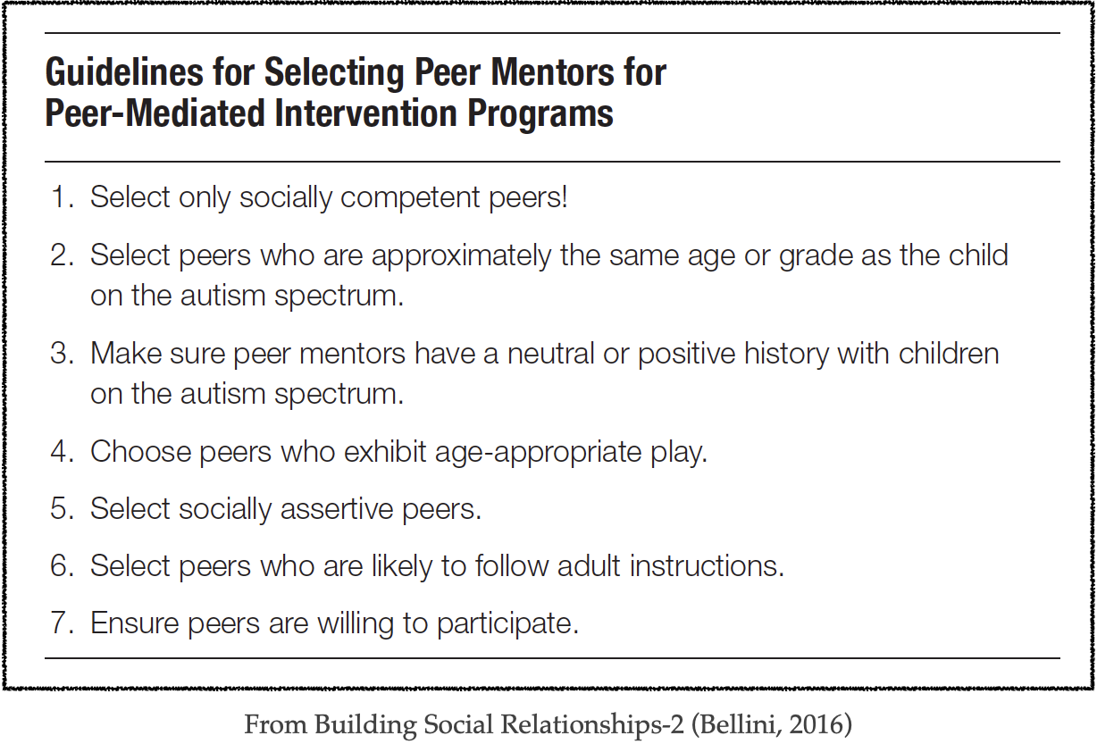

Peer Mediated Intervention
An evidence based approach for facilitating social interactions between children on the autism spectrum and their peers
Components of a PMI Program:
Non-disabled peers are systematically taught to initiate and to respond to peers with ASD
Can be used in both group social skills programs and also natural environments
Can be used to enhance performance and generalization of skills in the natural environment
KEY POINT…Use of peer mentors allows adults to serve as facilitators rather than as playmates for the child with ASD
Steps and Procedures
Identify and Select Peer Mentors
Provide “Pre-Training” to Peer Mentors
Facilitate Interactions between Peer Mentor and Child on the Autism Spectrum
Provide On-Going Training to Peer Mentors
From Building Social Relationships-2 (Bellini, 2016)
Notes:
1. Transitions, initiating, responding behavior, playing a game, going on a field trip, etc.

Slide 70
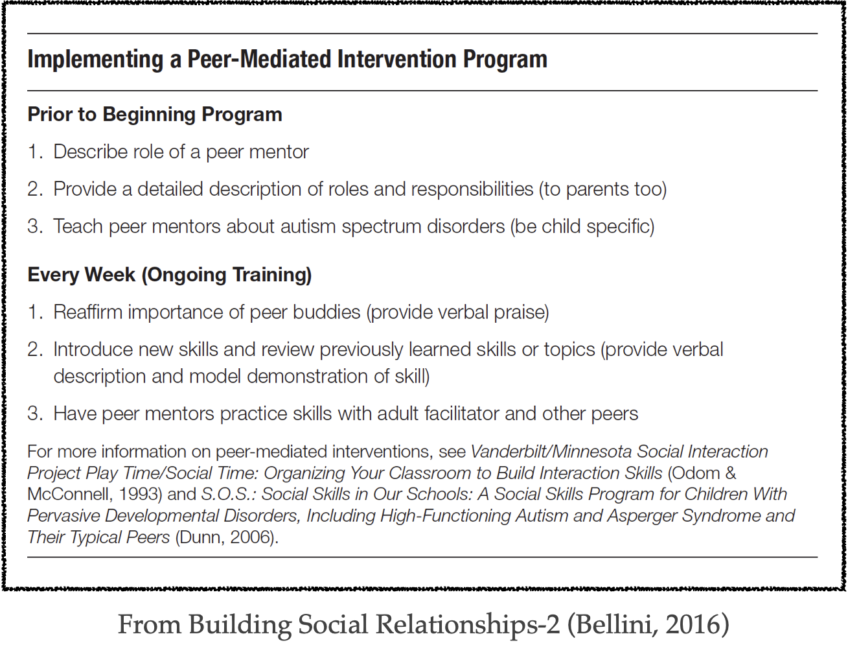
Training Peer Mentors
From Building Social Relationships-2 (Bellini, 2016)
From Building Social Relationships-2 (Bellini, 2016)

Slide 71
Prompting and Structured Play Groups (SPG)

Slide 72
Prompting
An evidence based strategy that consists of providing supports and assistance (i.e., “prompts”) to help the child acquire skills and successfully perform behaviors.
Benefits of Prompting:
Can be used as both a skill acquisition and performance enhancement strategy
Prompts and be delivered in individual, group, and naturalistic social settings
Prompts can be delivered by both adults and peers
Key point: Prompting is not your enemy…prompt dependence is your enemy!
Notes:
1. Transitions, initiating, responding behavior, playing a game, going on a field trip, etc.

Slide 73
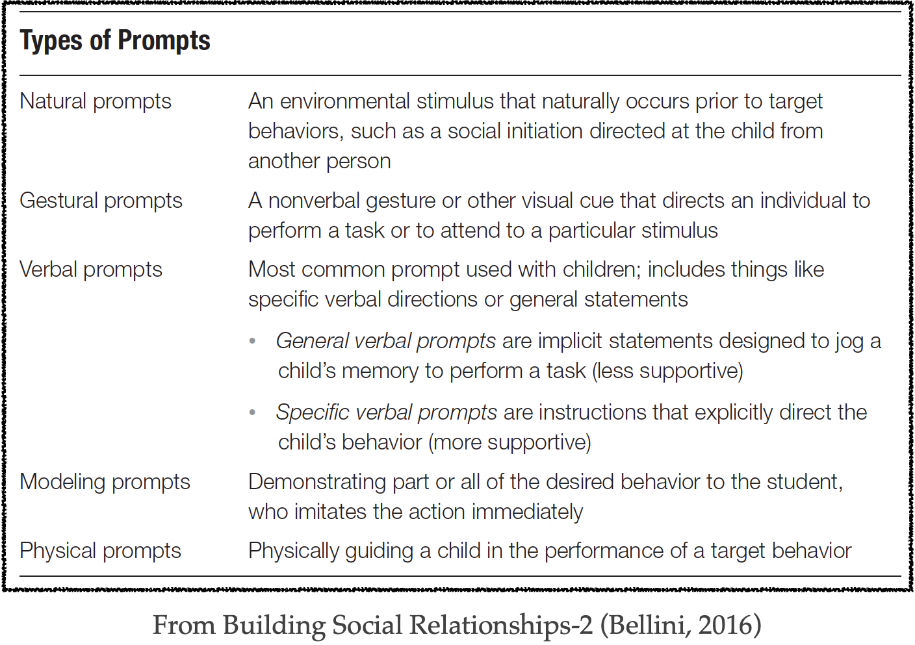
Types of Prompts
From Building Social Relationships-2 (Bellini, 2016)
Notes:
1. Transitions, initiating, responding behavior, playing a game, going on a field trip, etc.

Slide 74

Prompting Procedures
Attentional v. Behavioral Prompts in the BSR Program
Behavior Prompts: Prompt that directs the child to perform a behavior
Attentional Prompt: Prompt that directs the child to attend to the natural prompt
In the BSR Program, 75% of all prompts are attentional prompts.
Notes:
1. Transitions, initiating, responding behavior, playing a game, going on a field trip, etc.

Slide 75


Prompt Fading
Most to Least v. Time Delay Prompt Fading Procedure
Most to Least Prompt Fading: Less supportive prompts are provided just before or simultaneously to more supportive prompts until they are “faded” to the natural prompt
Progressive Time Delay Procedure: Prompt is “faded” by systematically extending the time interval between the natural prompt and the supportive prompt
Research indicates (and my clinical experience supports) that Progressive Time Delay procedures are more effective and efficient in fading prompts
In the BSR Program, 75% of all prompts are attentional prompts.
Example of Progressive Time Delay Prompt Fading
Notes:
1. Transitions, initiating, responding behavior, playing a game, going on a field trip, etc.

Slide 76

Structured Play Groups (SPG)
Organized “play” activities designed to facilitate high levels of social engagement between children on the autism spectrum and their peers.
Initial Goal of SPG: To provide as much prompting as necessary to achieve near 100% levels of engagement
Note: We almost never achieve 100% levels of engagement…but we certainly try!
Ultimate Goal of SPG: To systematically fade prompts so that social engagement remains high, but prompting reaches near zero levels
Steps and Procedures
Organize social game or activity with child on the autism spectrum and at least one other peer
Prompt as necessary (using Prompting “Cheat Sheet”) to maintain social engagement between child on the autism spectrum and peer mentor
After high levels of engagement are achieved, implement a prompt fading procedure to reduce amount of support
Note: In the BSR Program we video record the SPG activities and then show the edited clips later as part of the Video Self Modeling intervention
Notes:
1. Transitions, initiating, responding behavior, playing a game, going on a field trip, etc.

Slide 77
Video-Self Modeling

Slide 78

Modeling and Youth with ASD
Changes in behavior, thinking, or emotions that occur through observing another person, or model.
Note on the Historical Perspective on Modeling in Children with ASD:
Live Modeling v. Video Modeling

Slide 79
Three Prerequisites to Successful Modeling (Bandura)
According to Bandura, there are three prerequisites for successful modeling:
Attention: The ability to attend to behavior of others
Memory: The ability to remember what it is that you have seen
Behavioral Reproduction: The ability to perform the behavior that you have observed

Slide 80
A Meta-Analysis of Video Modeling and VSM Interventions (Bellini & Akullian, 2007)
Moderate to highly effective in 19 out of 23 studies published in peer reviewed journals
Outcomes included social-communication, functional skills, and behavioral functioning
Interventions effective across the age span (ages 3 to 20) and across the autism spectrum (varying levels of language and cognitive functioning)
Study Determined that Video Modeling met criteria for an Evidence Based Practice as defined by Horner et al. (2005)

Slide 81
Why is Video Modeling is Particularly Effective for Children with Autism?
Capitalizes on the benefits of visually cued instruction
Provides a visual representation of success
Directs attention to instructional cues and salient contextual cues
Decreased anxiety
Leverages the child’s motivation to watch videos

Slide 82
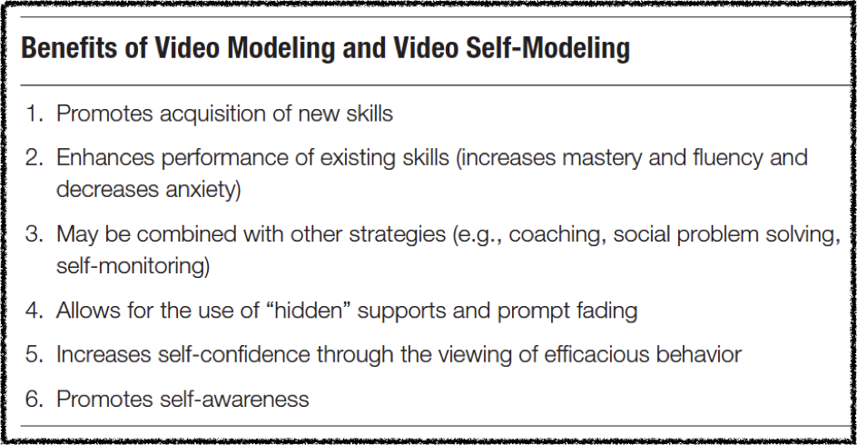
Benefits of VSM for Children and Youth

Slide 83


Video Self-Modeling (VSM)
Intervention where observers are shown videotapes of themselves successfully engaging in a skill or activity
Independent and efficacious performance is facilitated via positive self-review and use of hidden-supports
Using self as the model, ensures that the model has similar attributes and ability of target child
Example of VSM using “Hidden Supports”
Notes:
1

Slide 84
VSM has been used Successfully with the Following Populations/Disorders/Issues:
Problem Behaviors
Academic Engagement
Impulsivity
Adaptive Behavior/Daily Living Skills
Athletic Performance
Reading Fluency and Comprehension
Math Achievement
Articulation Disorders
Selective Mutism
Autism (behavior, social skills, communication)
Phobias/Anxiety (Speaking, Social, Specific, etc.)

Slide 85
Examples of VSM Editing
A “How-to” Example of Editing Videos Using iMovie

Slide 86
Frequent Questions: When can you Start using VSM?
Is there a minimum Age and Developmental Level?
Here’s an Example
“Clean-Up” age 20 months

Slide 87
Lessons Learned in Research and Practice
Keep it short…1-2 minutes will suffice
2. Keep it simple…do not talk during showing of the video and don’t try to win an academy award!
3. Keep it positive…show only efficacious behavior, not mistakes or failures

Slide 88
The Semi-Manualized Version of the BSR Model:
A Sneak Peek!
Is Data Driven
Targets both Social Behaviors and Social Cognition
Combines both Skill Acquisition Strategies and Performance Enhancement Strategies
Target Skills are Determined in Advance of the 9 Week Program
Session Structure Plans are Created in Advance of the 9 Week Program*
*Unlike the Original BSR Model, every minute of every session is pre-determined at the beginning of the 9 week program. That is, the strategies and techniques have been “manualized” or structured for the therapist or instructional team.
Preliminary Outcome Data

Slide 89
In Closing
Start with Assessment…End with Assessment
Don’t start with what you want teach, start with what the child needs to learn
Programming with a purpose…be systematic.
Use systematic model to guide programming
Stop “Chasing” Behaviors
Address underlying skill deficits
Develop a LARGE intervention tool chest
Keep learning and never stop challenging your personal and theoretical assumptions
Notes:
1. Gives intervention a purpose
-to promote skills acquisition or enhance performance
2. Throw away general characteristics
-look at individual profile of child
3. Baby steps and banging your head
4. We too often choose intervention strategies b/c we gravitate towards them, not b/c they address the individual needs of the child.
-One size fits all does not work.
5. Please contact me at the IRCA
6. Thank you

Slide 90
Building Social Relationships through Evidence Based Social Skills Programming for Children and Youth
Thank you for participating in this training!
For updates and more information on the BSR Program, including the new BSR On-Line Training Courses check out:
BelliniBSR.com

