Slide 1
WELCOME TO
MUSD and MEA
We work together to promote and protect our profession, advocate for our students, and build relationships with parents and the community. Our association provides you assurance and insurance that protects you, your career, and your family.
Brian Friefeld, MEA President
Lisa McCarter, MEA Vice President
Ryan Huisenga, Chair Membership Committee
Jake Anderson, CTA Staff
Notes:
Suggested comments:
- Welcoming comments
- Set the context for the days ahead: what is new and different and fresh about CTA’s PAR training for the second year. First, yes, we have a point of view. CTA is a teachers’ organization, so this training is put together from the perspective of CTA as a teachers’ advocacy organization. We don’t try to hide that and we offer no apologies for it either – we’re being honest with you. Having said that, though, we need to make a very important point: teachers want their students to be successful. They want public education to be successful. I don’t know of any CTA member – or an administrator or school board member for that matter, who wakes up in the morning thinking about what they can do to prevent children from learning how to read. Advocating for teachers includes this: successful students, a successful public education system. This is what teachers want; CTA, of course, works to get teachers what they want.
Second, this conference include a lot of time for talking, sharing, and collaboration, based on the premise that we all have a lot to teach each other and to learn from each other.
Lastly, we begin with the assumption that you want your PAR program to be successful. We hope to articulate a vision and a plan for a successful PAR program, and we hope that you take home with you a renewed focus, fresh ideas, and strong commitment to work for you program’s success. We’re not here to talk about how to get by. If you want your program to be strong and successful, to really be there to make a difference for education, we hope to be able to give you some tools this week to help you get there.
None

Slide 2



Moorpark Educators Association
MEA
We are your exclusive representative in MUSD
Membership in MEA automatically entitles you to membership in
  CTA (California Teachers Association)
  NEA (National Educators Association)
Notes:
General objective: to review briefly the focus of the CTA trainings last year, and to provide a context for the training this year.
First bullet: assistance model
Last year, our focus was to help districts and unions get their programs started on the right foot. A key part of this was to set up your PAR program to be based on the “assistance model;” i.e. one that provides assistance and support to teachers. [elaborate as desired]
Second bullet: focus on trust
Last year, we made the point that building trust is essential in any peer assistance process, and that a program based on assistance only is more capable of fostering the trust necessary for success.
Last bullet: the prediction
Finally, in last year’s trainings we predicted that it would take two to five years for your PAR program to evolve. That is the context for this conference: how is your program evolving as it enters the second year?
Caveat: first year participants
Although the conference is geared toward programs in their second year, programs in their first year are certainly welcome, and there is much to gain here regardless of your program year.
Bullets appear on mouse click.

Slide 3
Anticipatory Activity: True or False
1. California is a right to work state
2. California labor law does not afford public employee associations the right to collective bargaining?
3. DFR is an acronym for Duty Free Representation
4. CA educator unions must advocate and handle grievances on behalf of all unit employees—not just association members
5. The right for an employee to have union representation during an investigatory interview is called Weingarten rights.
6. An educator has the right to representation when there is a possibility of disciplinary action
7. An educator has the right to representation when they file a complaint against another educator
8. The latest research suggests a correlation between strong union activity and improved student instruction and achievement.
9. Educator associations are the main reason why inferior or underachieving teachers remain employed.
10. Your contract is also known as a collective bargaining agreement

Slide 4
Who Do We Represent?
270+ Certificated MUSD Employees
Classroom Teachers: SPED, Preschool, TK – Grade 12 (including SAI)
Speech Therapists
Counselors
Nurses
Teachers on Special Assignment (TOSA)
Notes:
General objective: introduce the concept of “Partners in Advocacy.” Offer the focus on advocacy within the PAR program as a basis for a unifying vision.
We want to share with you a foundation for a common, unifying vision for your PAR program. It is a vision based on shared responsibility and shared accountability. It is a vision that brings in the element of advocacy as a complement to professional assistance.
In other words, professional assistance, from teacher to teacher, cannot exist in a contextual vacuum. When professional assistance is provided in an advocacy context, however, it gives it new shape, purpose, and substance.
PAR offers a unique opportunity, because of its joint structure, for unions and districts to become partners in advocacy, where each party acts and sees the other as:
** Advocates for the profession of teaching
** Advocates for students, and their success in the classroom
** and advocates for quality teaching and professional development.
None.

Slide 5
What Do We Do For You?
We are your collective voice at the bargaining table as we negotiate salary, health benefits and other contract issues
We are a phone or text call away if you need assistance or representation as you perform your job duties each day
Mprkea@gmail.com
  805 422 4680
  Moorparkeducators.com
Notes:
General objective: set the context for the training more specifically.
The four elements are repeated at the end of the presentation. They form the basis for the rest of the conference. Therefore, time and emphasis is needed here.
Year 2 focus: building a cohesive program
Having started on the right foot last year [acknowledgment from participants]…
What do we need to do now to continue our program’s evolution? How do we make sure our program will continue to work well as a unit? How do we make sure the joint panel is connected to the CTs? CT’s to JPs? How do we make sure the program is well integrated into the district? In short, how do we make sure it is a cohesive program?
cohere: to be logically connected, to cause to form a united or orderly whole.
We will focus on four essential elements of a cohesive program.
First sub 2 bullet: vision
This is perhaps the most essential element. If you do not have a common vision, you will never have a cohesive program. The JP and the CTs will not be on the same page. The PAR program will never be well-integrated into the district. We will talk about vision a lot this morning.
Second sub 2 bullet: commitment and support
Commitment and support come in different shapes and sizes. It’s easy to show support by signing the checks on participating in JP meetings, but how deep does it really go? Is it intrinsic, part of the organizational culture? It is fair-weather support only, or will it be there when issues get tough?
Third sub 2 bullet: quality assistance
Do CTs have the training and support to do their jobs well?
Fourth: Clear guidelines
Are roles clearly defined? Do you have procedures worked out to get you over rough patches in the road?
Each bullet appears on mouse click.

Slide 6
What Do Your Dues Do For You?
In California, we have a Constitutional right to bargain.
  Our predecessors sacrificed, fought, and earned this legal power for us.
  We pay for our place at the negotiating table with our voice and our purse.
  "Right to Work" States or States, such as Texas, do not have a right to collective bargaining agreements (CBAs).
  Teachers in States that do not have CBA's, on average, make less money and work longer hours than teachers in State's that do have CBAs.
  Your dues give us voice here in Moorpark, in Sacramento, and in Washington D.C.
r freedom to associate, our freedom of speech, these work place First Amendment rights, are not free.

Slide 7
Your Voice; Your Power
"What would work be like without a say in our working conditions?"
  Two Choices: MEA members will continue to pay for our voice and while non-members will receive all the benefits of our efforts, or we won’t have any say.
Joining a public employee association, such as MEA/CTA, is not a partisan issue.
  MEA has a variety of political persuasions in our membership
Every year in Sacramento there are between 180 and 200 proposed bills that potentially threaten public education, including bills, invariably, that affect our classroom instruction and our pensions.
Joining MEA helps protect public education, our careers, our families, and our livelihoods.
A job in public education is not just an occupation; it’s a commitment to a career that demands planning and foresight.
MEA represents you in your classroom, locally, statewide and nationally.

Slide 8
Why Should You Join?
We want you to become part of the MEA/MUSD family
MEA is your voice in matters affecting our classes and public education
There’s strength in numbers – the more active members, the stronger our voice in advocating for our students and families
At the very least, MEA provides you will a level of protection that will benefit you and your career (insurance & assurance)
Notes:
General objective: final wrap-up of the big shift.
Traditional roles get blurred.
Focus must remain clear and on the quality of teaching and improving the professional environment.
If successful, we jointly produce the environment for optimal learning conditions.

Slide 9
The Benefits of Membership
CTA and NEA offer a variety of benefits, including:
Legal Services
Insurance Programs
$1 million Liability Policy
On-line educational programs, including master’s programs and debt forgiveness programs;
Travel and Entertainment discounts
Professional Development and Conferences
Investment and Personal Finance trainings
The opportunity to be a part of something larger than yourself – joining together for the betterment of public education!
Notes:
General objective: after the last slide’s introduction to the partners in advocacy concept, people are probably feeling lost, confused or unsure of what you mean. This slide begins the process of explaining the advocacy concept. The audience needs to buy into these premises.
Let’s talk about what this means. But first, we must begin with two very important premises that support the partnership concept. We encourage you to actively reflect on these premises. If you disagree with the premises, your partnership will be difficult.
Premise 1: [read]
Do people agree with this? [elaborate on this] Study after study shows how important the actual art, and craft, of teaching is to student success. You can have the best computers, the best physical plant, the best and/or most expensive curriculum, but it still really falls on the quality of teaching.
Point out that we say “within the school;” parent support, home environment, etc all contribute and are important, but among the factors within our control within the education professions, teaching quality is the most important.
Text box appears on mouse click.

Slide 10
Legal Coverages Through CTA and NEA
NEA provides $1 million coverage Educators Employment Liability (EEL) Insurance
CTA Legal:
Employment issues
Personal issues (1/2 hour free)
YOU MUST BE A MEMBER PRIOR TO NEEDING LEGAL SERVICES!

Slide 11


CTA/NEA Legal Services
Educators Employment Liability (EEL)
Group Legal Services Program (GLSP)
  $1 million coverage
  Civil Cases
  Civil Rights Cases
  Criminal Proceedings
  Bail Bond
  Assault-Related Personal Property Damage
  Required referral from CTA staff
  1 hour for most employment matters
  30 minutes for personal matters
Notes:
Monday 1:10-2:00 – Sean & Henry: Automatic, Discounts, Travel

Slide 12
Automatic Benefits
CTA Death and Dismemberment
CTA Disaster Relief Fund
CTA/NEA EEL (Liability Insurance for nurses)
NEA Complimentary Life Ins.
CTA Vision Discount for CTA/NEA Retired Members

Slide 13

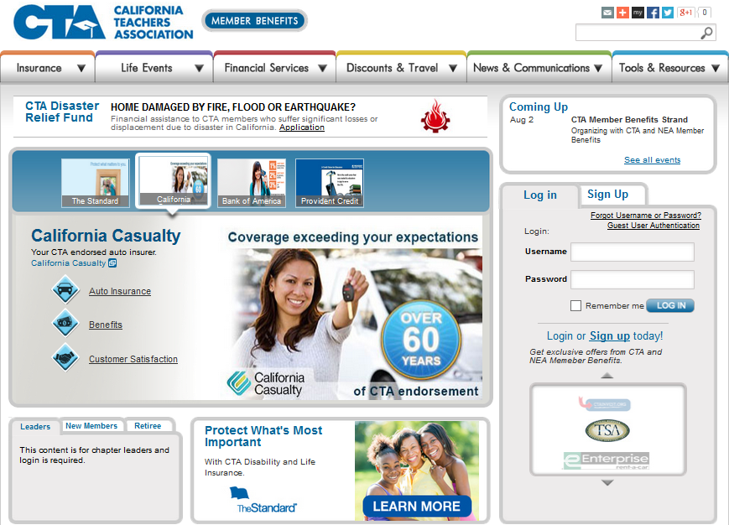
Resources
https://www.ctamemberbenefits.org/
https://ctainvest.org/
https://www.neamb.com/
Notes:
Monday 8:40-9:10 – Henry & Sean: MB Resources (toolkit to be highlighted later)

Slide 14


CTA Auto & Home Insurance Program by California Casualty
CTA endorsed since 1951
Educator specific policy benefits
Expanded skip payment options
$423 average annual savings
99% Customer Satisfaction
Free ID Defense

Slide 15
Benefits of Membership for New Members
State Level- California Teachers Association
  Life and Disability Insurance with NO health exam required during Open Enrollment
    Sign up time is 180 days from hire
    Life Insurance up to $200,000
    Disability covers up to 2 years of leave at 75% pay
    Disability coverage also includes pregnancy leave
    You are automatically accepted during Open Enrollment even if you have a pre-existing condition, like pregnancy
    https://www.standard.com/cta/member

Slide 16
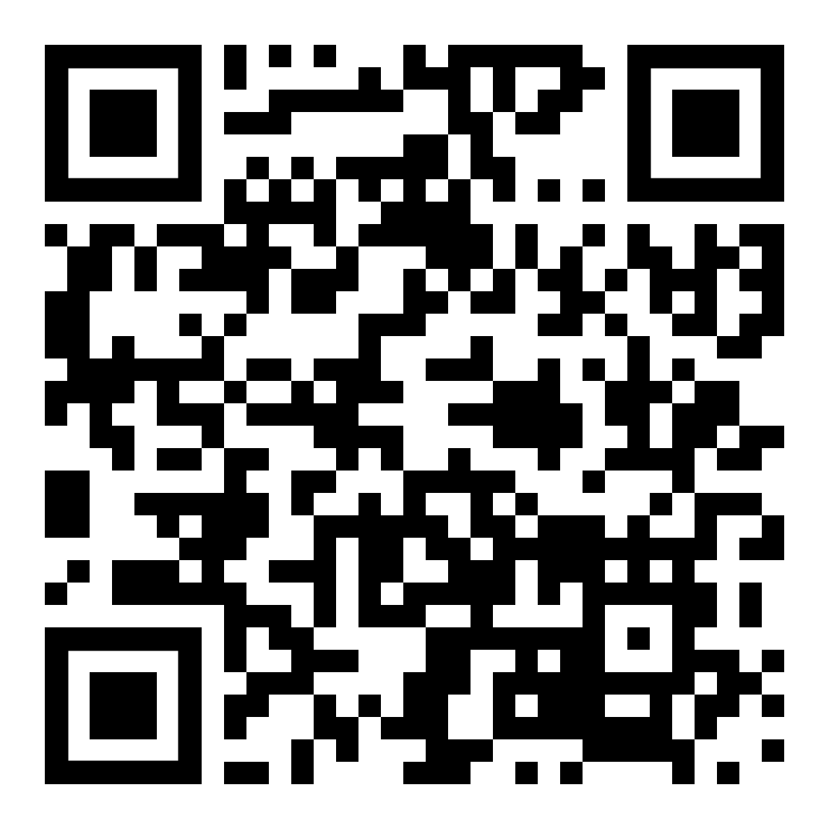

CTA-endorsed Disability Insurance Coverage
& Life Insurance
Protect Your Paycheck
Educators are not covered by state disability plan
Disability insurance pays you if you’re out of work due to an injury, illness
(including mental health disorders and substance abuse), pregnancy or childbirth
Enroll with no health questions asked
CTA-endorsed Disability insurance
Up to $200,000 of CTA-endorsed Life insurance
Life Insurance coverage options for your Spouse/Domestic Partner and/or children
How to Enroll
Schedule a virtual appointment: https://stdrd.co/team5
Online: standard.com/cta/newhire
Quick enroll: Scan this code with your smartphone →
Learn More
New Hire Flyer: https://stdrd.co/newhireflyer
Member Enrollment Brochure: https://stdrd.co/booklet
For costs and further details of the coverage and this enrollment opportunity, including the exclusions, benefit waiting periods, any reductions or limitations and the terms under which the policy may be continued in force, please contact Standard Insurance Company at 800.522.0406 (TTY). Standard Insurance Company, 1100 SW Sixth Avenue, Portland, OR 97204. GP190-LTD/S399/CTA.1 GP190-LIFE/S399/CTA.3

Slide 17
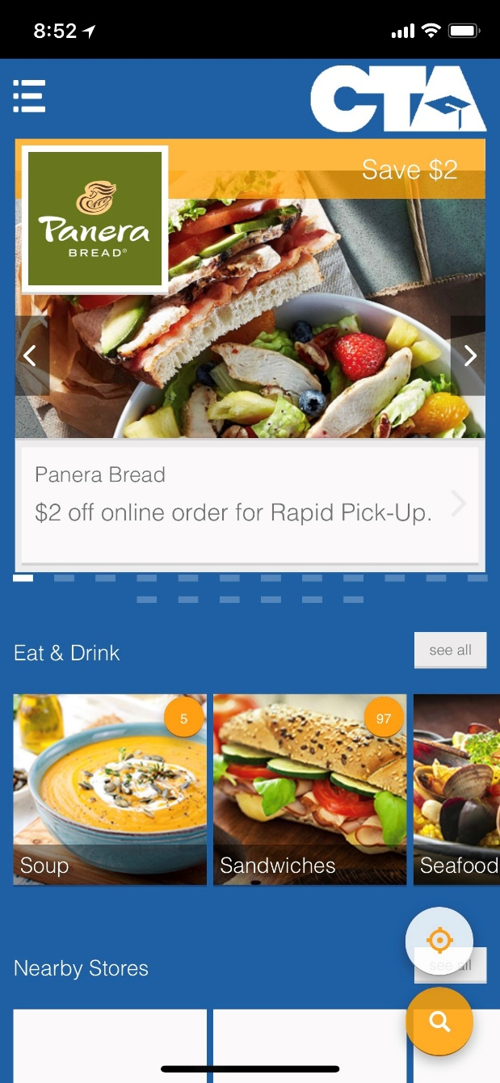
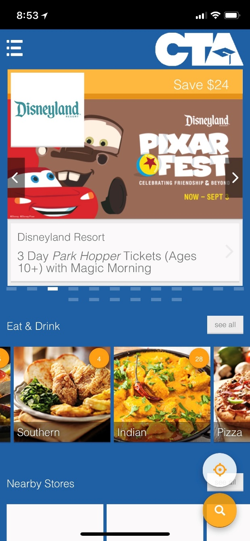
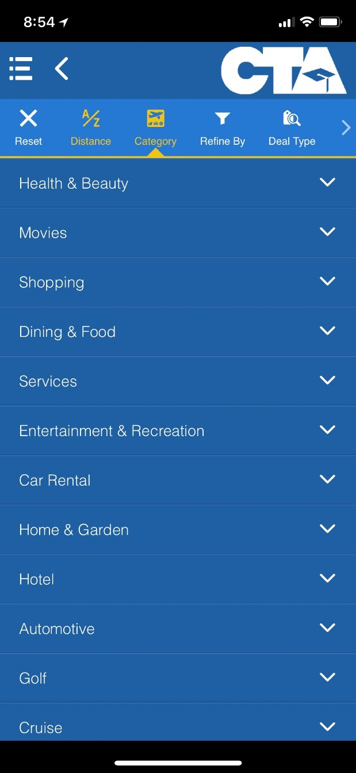
CTA MyDeals

Slide 18






NEA Magazine Service
      Over 1000 titles at up to 85% off newsstand prices with a guarantee to match the lowest prices of any magazine program available.
      Choose from selections covering news, sports, fitness, entertainment, hobbies, family and education—you are sure to find what you’re looking for—at the guaranteed lowest introductory price available!
www.neamb.com/cta
Notes:
Monday 1:10-2:00 – Sean & Henry: Automatic, Discounts, Travel

Slide 19

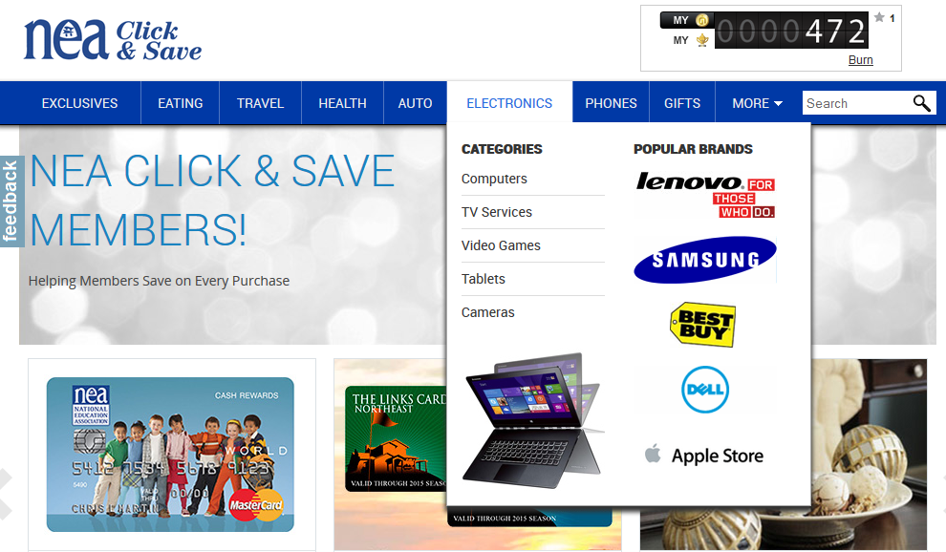

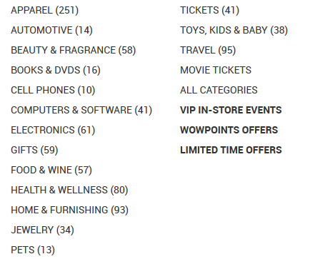
      Shop various categories
      Add reminders for offers at your favorite stores
Notes:
Monday 1:10-2:00 – Sean & Henry: Automatic, Discounts, Travel

Slide 20
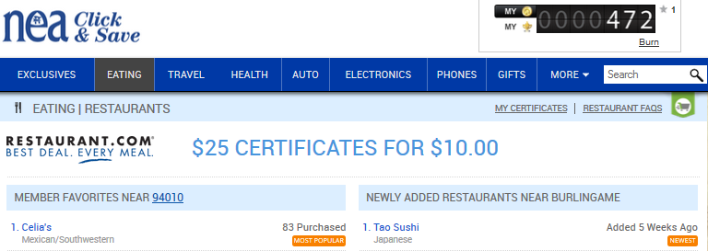
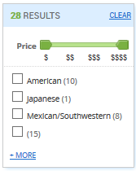
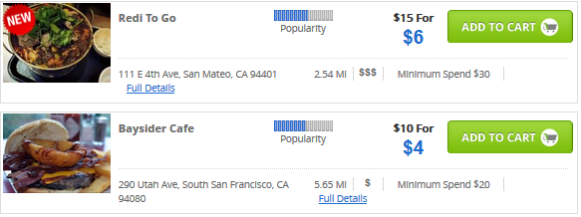

Slide 21


NEA Wireless
AT&T is proud to be the choice provider for the Union Movement and is the only national unionized wireless carrier.
15% discount on AT&T cell phone monthly service
New and current customers can sign in at https://www.neamb.com/
  to access the NEA Wireless FAN discount code. Please bring this code, along with proof of membership, to an AT&T retail location.
Notes:
Monday 1:10-2:00 – Sean & Henry: Automatic, Discounts, Travel

Slide 22
Professional Prof. Dev.
*Virtual CTA Conferences
New(er) Educator Conference (December)
https://ctago.org/future-conferences/
Good Teaching Conference (March)
https://ctago.org/future-conferences/
Virtual Pass to past Conference Sessions
https://ctago.org/virtual-pass/
CTA Instructional and Professional Development (IPD) Trainings
Previously Recorded:
  https://www.youtube.com/playlist?list=PLIPNR67CxynEjAg_Iye4WXvRWvs634BOp
*CTA plans to conduct several trainings that you can sign up for at
  https://www.cta.org/IPDTrainings
*Need membership # to sign in
Notes:
Monday 2:55-3:40 – Diane & Kimberley: Insurance and Professional Development

Slide 23


Professional Resources
NEA’s Great Public Schools (GPS) Network
Access to open source peer-reviewed resources:
Curriculum: lesson plans, units, scope & sequence, assessments, rubrics and online courses
Multimedia assets: ebooks, videos, podcasts, animations and photos
Activities: games, experiments/labs & assignments
Lesson Planet
The #1 online curriculum search for PreK-12 educators:
Search from 400,000+ teacher-reviewed and rated online lesson plans and worksheets
Discover innovative lesson ideas correlated to state and Common Core standards
Notes:
Monday 2:55-3:40 – Diane & Kimberley: Insurance and Professional Development

Slide 24




NEA Academy: Specialized Website
Bachelor’s Degree
Western Governors University
5% discount off tuition
Scholarship offers ($2,400)
Application fees waived
Degrees: Education, Math, Science, Business, Nursing, Marketing, Technology, and Health
Master’s Degree
Western Governors University (WGU)
Southeast Missouri State University
Northcentral University (NCU)
5%-15% discount
Special access to scholarships
Waiver of certain application and technology fees
Notes:
Monday 2:55-3:40 – Diane & Kimberley: Insurance and Professional Development

Slide 25
NEA Student Debt Forgiveness Program
Go Online to find out if you qualify for loan debt forgiveness!
https://www.neamb.com/student-loan-debt/student-loan-debt-repayment-calculator-helps-educators-find-relief
NEA Student Debt Navigator powered by Savi
https://www.neamb.com/products/nea-student-debt-navigator
NEA Student Debt Workshops:
these will possibly be offered online

Slide 26
MEMBERSHIP DUES STRUCTURE 2023-24
MEA Dues are $20.99 a month for 11 months
  MEA dues have not increased since 2015!
MUSD deducts dues from your pay check monthly
Total dues deducted for full-time employees is $118.82 a month or $1,307 for the year.
Most of you will be Category 1(full-time) Employees
MEA dues = $230.00 yearly
CTA dues = $858.00 yearly
NEA dues = $219.00 yearly
A few of you will be Category 2B (50-60%) 2B Employees
MEA dues = $138.00 yearly
CTA dues = $394.00 yearly
NEA dues = $204.00 yearly

Slide 27
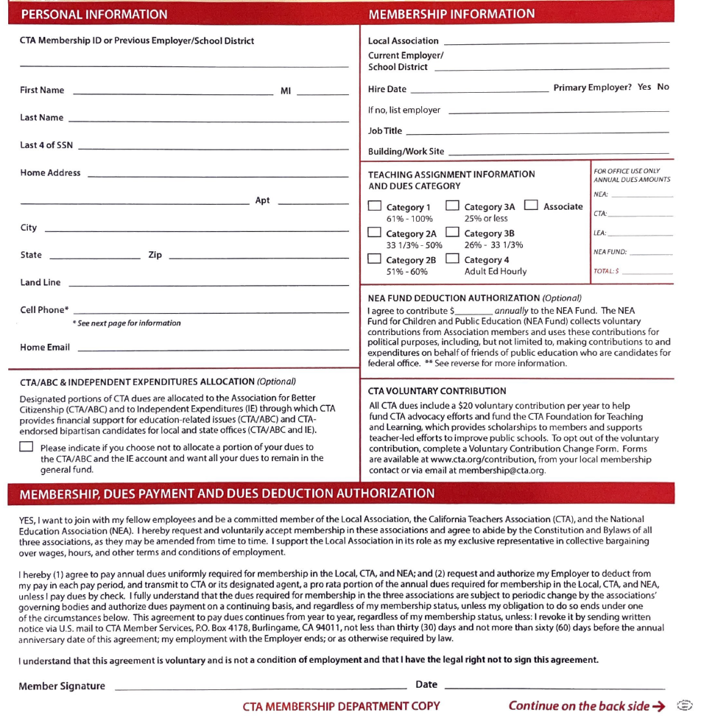
This helps redundant memberships
Moorpark Educators Association
Most of you will be Cat 1
Political Question
Contribute to NEA political fund
Remember to sign

Slide 28
Know Your Contract
Your contract explicates your working conditions, salary, stipends, et al.
  Memorandum of Understanding (MOU)
  Bargaining Additional Addendums as new mandates are issued
All available on the
MEA Website:
Moorparkeducators.com
“2 year” job interview
It is your responsibility to
  turn in Employment Verification from work performed in prior districts
  to review your paystub for accuracy
Catastrophic Leave Bank Donations- Sept.
Temporary vs. Probationary Contract (see next slide)

Slide 29
Know your Contract II
Temporary Contracts
  Short term positions that usually cover a permanent teacher’s leave of absence
Vs.
Probationary Contracts
  May lead to a permanent position
In both situations, you will be formally observed two a year for your first two years
Under both types of contracts, if you retained by MUSD, you will become a Probationary 2 teacher
In the State of CA, Permanent status occurs after the certificated employee is retained by their employer after their second year of employment

Slide 30
Your Salary is Part of a Total Compensation Package
Historically, MEA & MEA prioritize health care benefits (HCB) at the negotiating table
Your total compensation is competitive
  In MUSD, more of it goes toward HCB than in neighboring districts
Your total compensation entails
  Salary
  Statuaries (taxes, FICA, workers comp et al)
  HCB
  STRS Contribution
  Calendar (work days)
  Site Time (contracted work hours)

Slide 31
MEA Organization
MUSD Certificated Staff
  your voice, your participation, and your dues matter!
Rep Council
  (think Congress): represents members at individual site
Executive Board
  (think Senate): elected by members; represents grade level and sites
Negotiation Team
  (think Supreme Court): bargains our contract (CBA)
President
  elected, chief representative of members
CTA Representative
  MEA’s liaison to CTA (the mother ship)

Slide 32
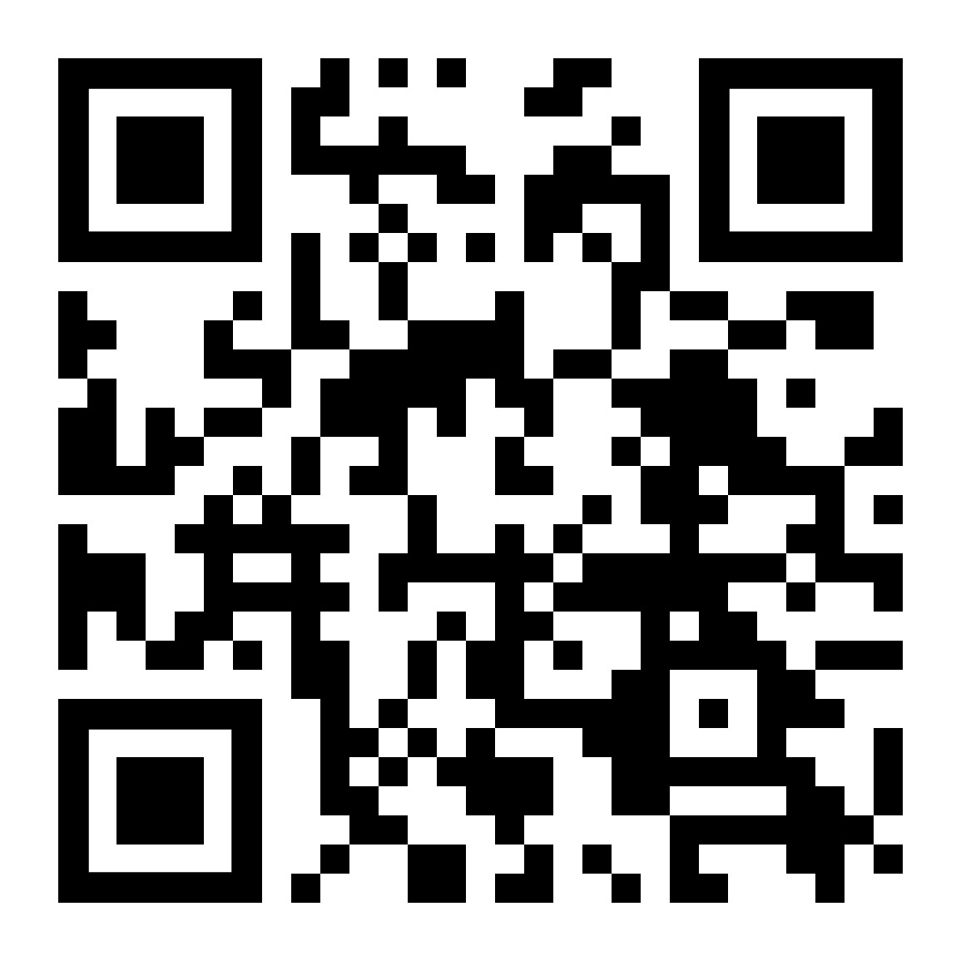
Join online

Slide 33
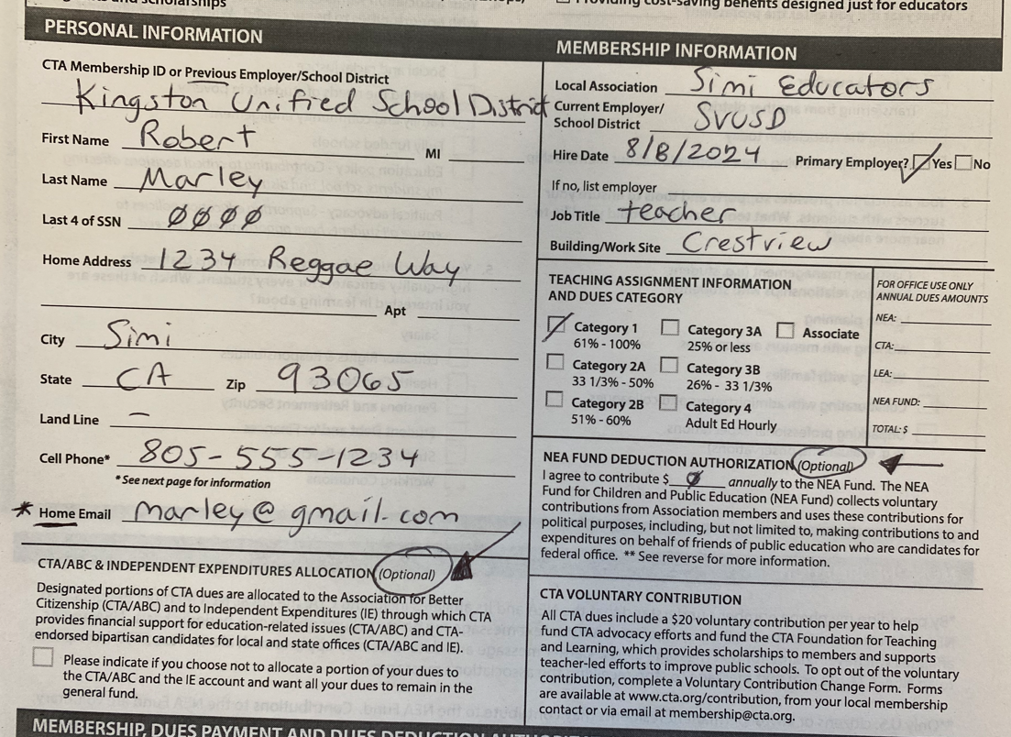
Three Ways to Join: Hard Copy, QR, or Virtual Link

Slide 34
MEA Contact Info
Office
  (805) 422-4680
Brian Friefeld, President
  mprkea@gmail.com
Jake Anderson, CTA Staff
  818-309-7206
  janderson@cta.org
MEA Website
  www.moorparkeducators.com

Slide 35

Thank You For Attending!
We’ll See You At Our
School Lunchtime
“Site Visits”
And Around the District.
Please Reach Out if You
Have Any Questions!
Notes:
General objective: talk about just cause and due process both in terms of law and obligation but also as a traditional point of advocacy for the union. Notwithstanding any partnerships or shifts, the union will still advocate for due process!!!
These laws and standards preceded the PAR law.
They affected the development of the CTA Assistance Model
They are VERY IMPORTANT, and not to be messed with!!
Someone’s JOB is a very big deal. It cannot be taken away lightly.
Many laws and procedures protect all of our property rights, including our jobs.
Auto-displays

