Slide 1
Arrowbear Park County Water District
Rate Adjustment
2025-2030

Slide 2
How We Got Here
In 2022, the District completed a professional rate study that recommended a significant adjustment to the rate structure.
The District would no longer offer the 600 cf allotment of water in the base rate due to legal requirements.
The proposed changes would have aligned revenue with actual operating and long-term capital needs and follow the law.
However, due to strong public opposition, the Board ultimately chose not to adopt the original recommendation.

Slide 3
How We Got Here
Instead, a revised and less aggressive version of the rate adjustment was adopted and implemented later.
While this compromise reduced the immediate burden on ratepayers, it also left the District unable to meet short- or long-term financial needs.
The rate adjustment that was adopted is the current rate structure the District is charging.

Slide 4
The District is relying on what were once healthy reserve funds for Daily Operations, Preventive Maintenance, and Capital Improvements.
Effects of the Current Rate Structure
The Current Rate Structure does not cover the cost of the District’s needs.
The District has had to defer many Preventive Maintenance and Capital Improvement Plans.

Slide 5
Additional Factors
Above-average inflation:
The 2022 Rate Study assumed 3% annual inflation (9% over three years 2022-2025)
Actual inflation during that period was closer to 16%(2022-2025). Just as that sharp increase stretched family budgets at home, it also put serious pressure on the District’s ability to cover rising costs for operations, maintenance, and infrastructure."
Leadership turnover:
The District incurred unexpected legal and administrative costs through two General Managers leaving.

Slide 6
Why We Started A Rate Study
-The District had been working with Rural Community Assistance Corp (RCAC) to find funding for the Highway 18 Master Plan Project. A project that represents a significant expense to the District, and possible use of an outside contractor.
-It was determined that our current rates were not adequate for optimal loan rates.
-State and federal agencies are unwilling to subsidize agencies that do not charge sufficient rates to cover basic services and reinvest in infrastructure.
-RCAC was able to provide the District with a Rate Study that was free to the District and would get our rates to an adequate level to qualify for loans and grants.

Slide 7
Reserve Fund Balance Projections
If the District were to maintain the currently approved rate adjustment schedule, our fund balances would be as follows:

Slide 8
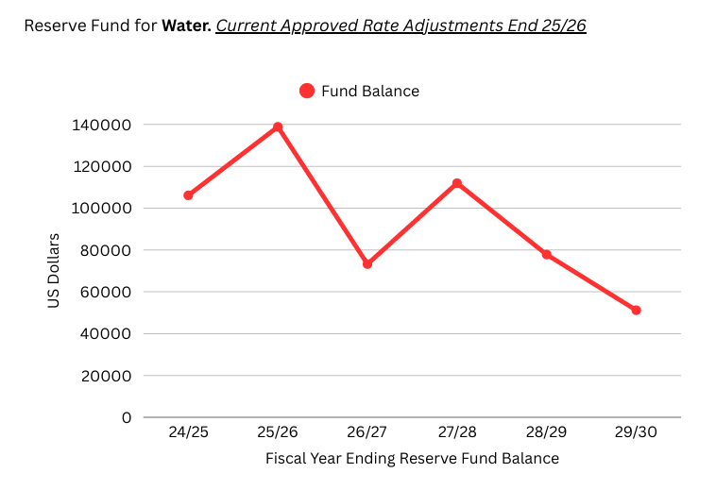

Slide 9
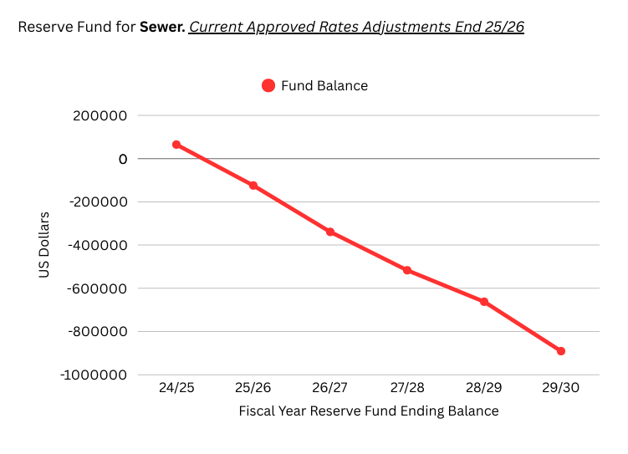

Slide 10
What We Learned During The Rate Study
While working with RCAC on this rate study, it became very clear that neither our regular Master Plan projects or the plan to have an outside contractor perform the Highway 18 Project were feasible and would result in a 50% increase to water rates the 1st year.
So, I went back to the drawing board…

Slide 11
Old
Water
Master Plan Projects
Original Plan:
Water Master Plan Projects: $879,128
Highway 18 Mainline Master Plan Project (if Outsourced): $774,500
Total: $1,653,628
These plans would have resulted in a 50% increase in water rates.
I have reassessed and deferred these plans.

Slide 12
New
Water Master Plan Projects
Revised Plan:
Strategic, smaller-scale projects totaling: $617,272 over the next 5 years
Master Plan Items Focused On:
  Equipment acquisition to build in-house and more efficient mainline installation capability
  Laying the foundation for larger capital improvement projects after reserve recovery
This represents over $1 million in deferred project costs—a responsible move that preserves service quality while moving toward our goals.

Slide 13
Sewer Master Plan
Sewer Master Plans are dependent on Running Springs Capital Improvement Plans(CIP). We currently share a 17% cost of those plans, based on our 3-year average % flow to the Wastewater Treatment Plant(WWTP).
This is something that I feel, with increased maintenance and community involvement, can be lowered to 10%. We have at times contributed 10% or less to the WWTP. If we can do it during a single month, we should be able to do it every month.

Slide 14
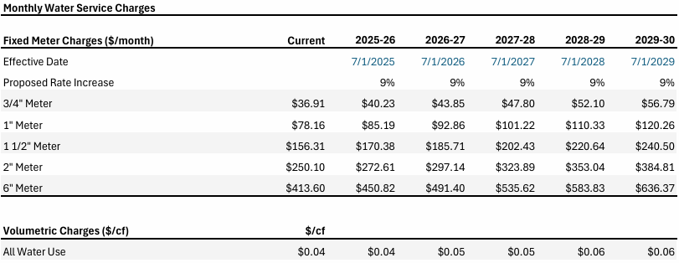
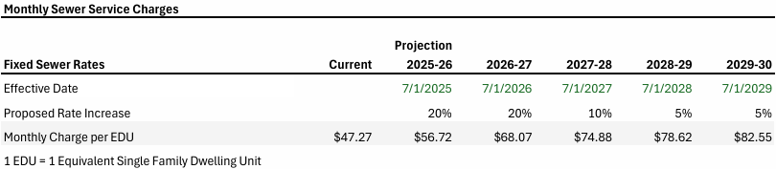
The Hard Numbers

Slide 15
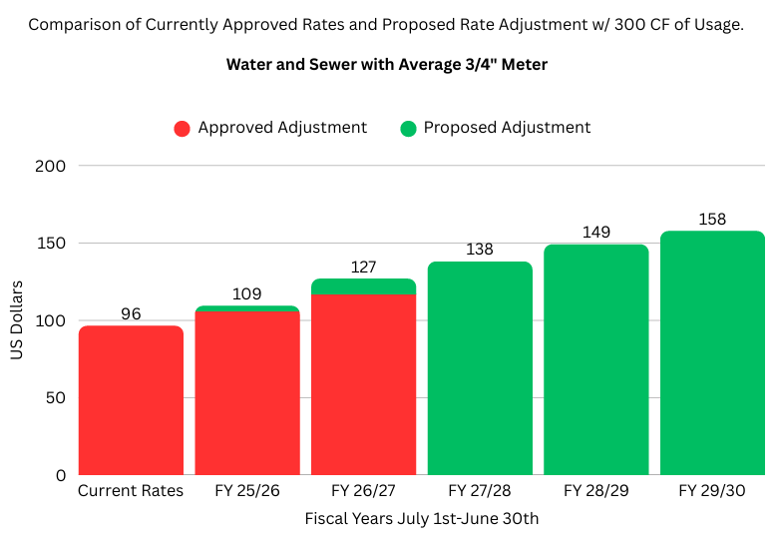
What This Rate Adjustment Looks Like Overall
FY 25/26: $3 more based on average usage.*
FY 26/27: $10 more based on average usage.*
*Based on currently scheduled rate adjustment
*Rates based on average District usage of 306 Cubit Feet with ¾” Meter.

Slide 16
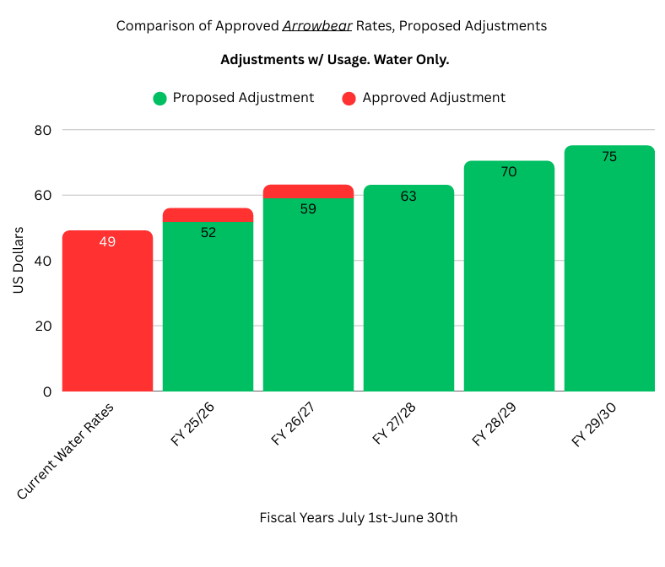
What This Water Rate Adjustment Looks Like
FY 25/26: $4 Less based on Average Usage.*
FY 26/27: $4 Less based on Average Usage.*
*Based on Currently Scheduled Rate Adjustment.
*Rates based on District average of 306 Cubic Feet with ¾” Meter.

Slide 17
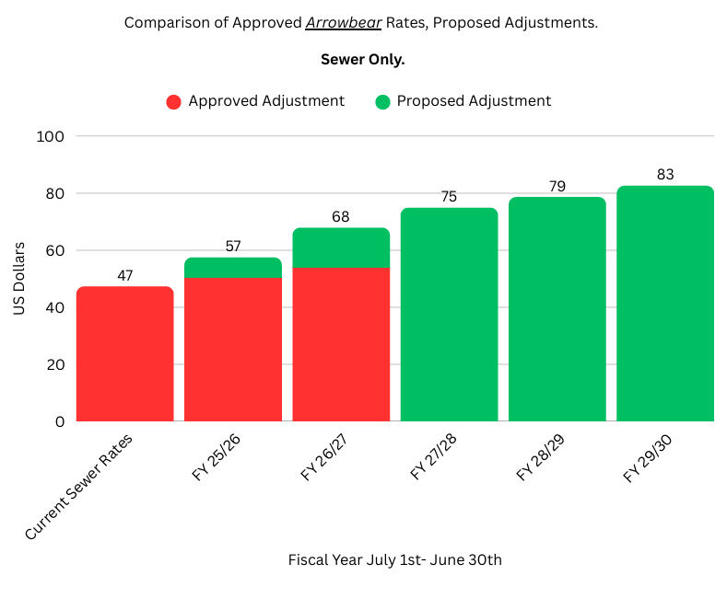
What This Sewer Rate Adjustment Looks Like
FY 25/26: $7 More.*
FY 26/27: $14 More.*
*Based on Currently Scheduled Rate Adjustment.

Slide 18
What These Adjusted Rates Will Accomplish
The proposed rate adjustment is designed to:
Rebuild reserve accounts over the next five years
Restore the District’s ability to fund Master Plan projects responsibly
Move our rates in a direction that will open the door for Grants and Loans should we choose to pursue them.
Support long-term planning, possibly adding a field employee to support our in-house infrastructure work(Mainline installation and increased sewer maintenance)
By increasing our financial capacity now, we reduce future debt needs, limit rate shock later, and maintain control over how we invest in Arrowbear’s infrastructure.

Slide 19
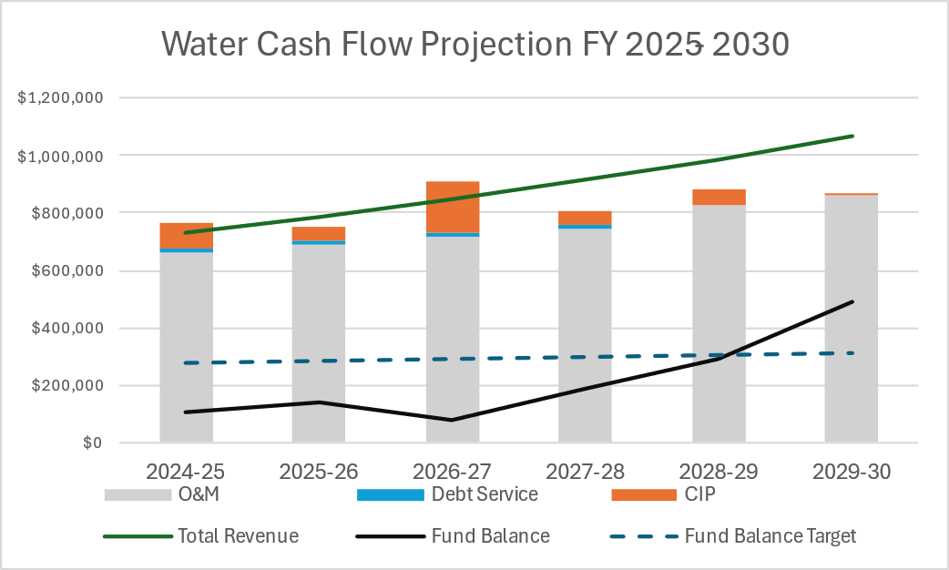
How This Adjustment Will Affect Water Funds

Slide 20
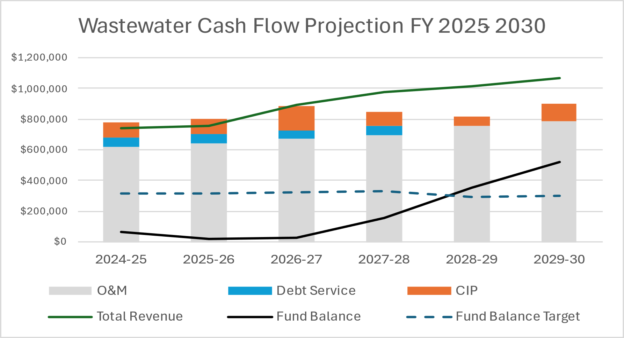
How This Adjustment Will Affect Sewer Funds

Slide 21
Conclusion
This proposal isn’t just about fixing our budget—it’s about setting the District up for:
Long-term sustainability
Increased independence from outside contractors
Smarter project execution
Safer, more reliable water and sewer service for the entire community
Lower future rate adjustments
Future Grants and affordable Loans
We’ve weathered a difficult financial period. This plan gets us back on track—not just to where we were, but to where we need to be.

