Slide 1
2025 NFHS Softball pace of play discussion

Slide 2
Discussions continue about pace of play
NFHS POE for the last several years
Focused on time between innings
Reminder for umpires to maintain good game flow as a part of game management
Focused on coaches role in game flow
Reminder of timing between innings and timing aspects for batter and pitcher between pitches
Notes:
There have been a number of discussions about the pace of play for NFHS Softball. Rule proposals have been submitted for various ways to enforce the timing between innings and various options to change the current rules providing different penalties if violated. After reviewing these proposals and comparing them with the current rules governing these items the NFHS Softball rules committee decided to reject the rule proposals and provide information by creating POE’s for these items. Starting with a reminder of the time between innings when it starts and highlighting that maintaining good game flow is an important aspect of the game. The next POE focused on umpire game management and how to enforce these items without being overly aggressive. This year the focus is on coach’s roles in management of game flow as well as highlighting the existing timing aspects within the current rules.

Slide 3
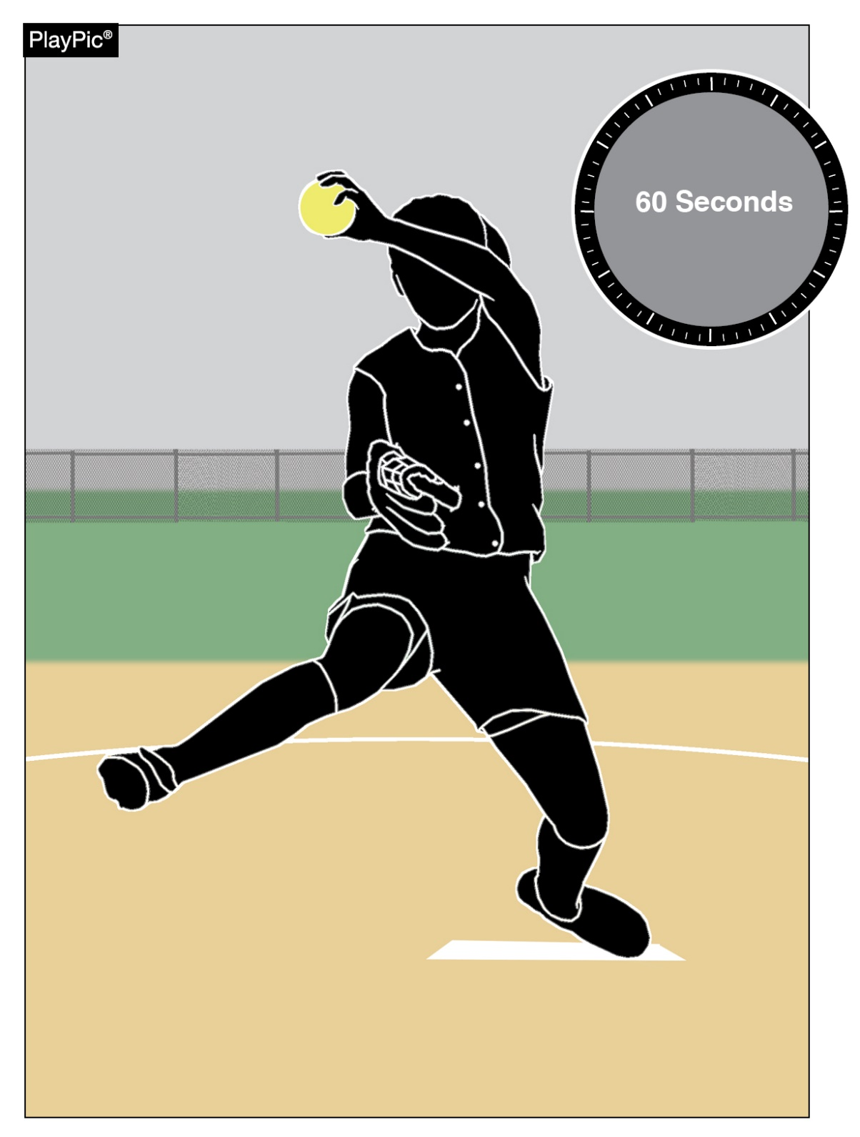
Time between innings 2022-23
Umpires and coaches should pay strict attention to the 60-second time limit between half-innings.
At the beginning of each half-inning no more than one minute may be used to deliver no more than five pitches to the catcher or other teammate.
The one-minute time limit begins from the third out of the previous half-inning.
A pitcher returning to the pitching position in the same half inning will not be granted any warm-up pitches.
Umpires may authorize more pitches during inclement weather or if a pitcher was removed due to injury or by rule.
Notes:
A reminder of the POE that was discussed in 2022-23 season. Mentioning the timing in between innings and the warm up time allowed.
Original Text with POE
TIME BETWEEN INNINGS As a point of emphasis umpires and coaches should pay strict attention to the 60 second time limit between half-innings. In accordance with Rule 6-2-5 at the beginning of each half-inning no more than one minute may be used to deliver no more than five pitches to the catcher or other teammate. The one-minute time limit begins from the third out of the previous half-inning. A pitcher returning to the pitching position in the same half inning will not be granted any warm-up pitches. Umpires may authorize more pitches during inclement weather or if a pitcher was removed due to injury or by rule.

Slide 4
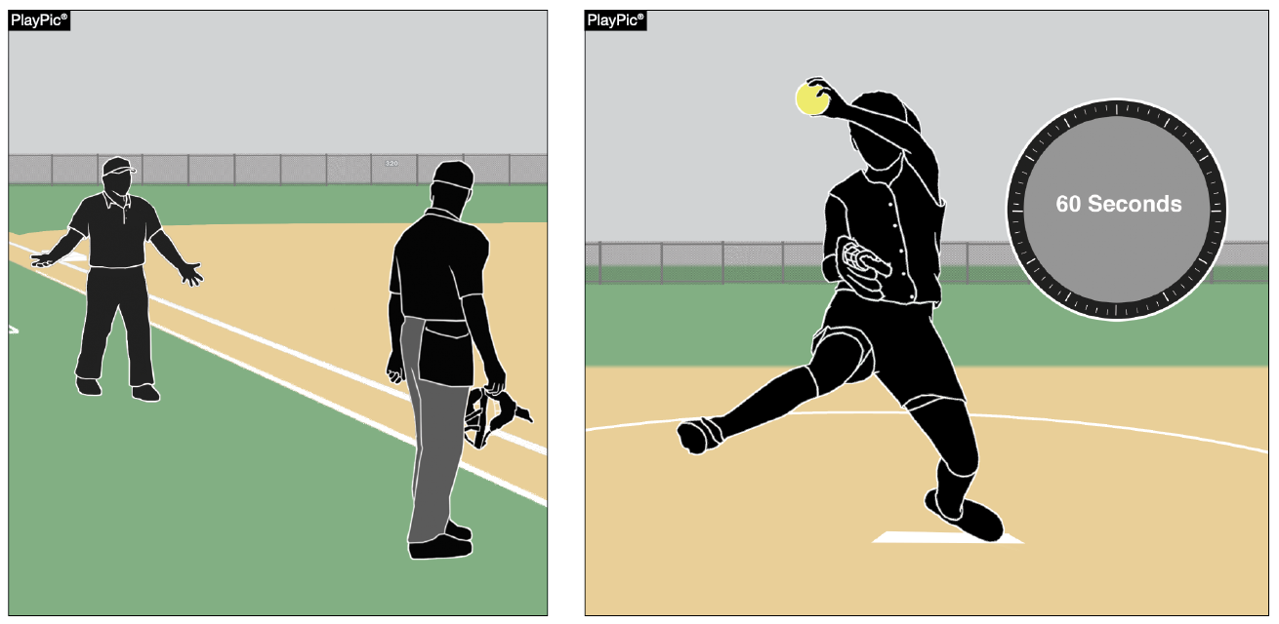
Game management 2023-24
Umpire and coach communication should be conversational, not confrontational.
Professionalism should be followed by coaches and umpires to maintain a successful working relationship.
Although umpires are not there to “rush” players, one of their responsibilities is to help maintain a good flow of the game.
Notes:
2023-24 season POE was focused more on umpire involvement to emphasis game management and positive communications and managing the time between innings to maintain the pace of play.
Original information with POE
GAME MANAGEMENT:
Coach and umpire communication should be conversational, not confrontational.
There must be a mutual respect for each other and a professionalism that is followed by both coaches and umpires to maintain the working relationship that is imperative to have a successful game.
Last year, there was a point of emphasis about the 60 seconds between innings. Although umpires are not there to “rush” players, one of the responsibilities of an umpire is to help maintain a good flow of the game. This can be done without being overly aggressive.
Game Management Coach and umpire communication should be conversational, not confrontational. Passion for their team is often the root of fiery responses from coaches about plays or rulings that they felt went against their team. As an umpire, it is important to balance an understanding of the passion coaches hold for their teams and the sporting expectations of education-based athletics. There has to be a mutual respect for each other and a professionalism that is followed by both coaches and umpires to maintain the working relationship that is imperative to have a successful game. Listening to understand a coach’s issue so you can properly respond to their concerns is a huge part of defusing the situation. Maintaining a calm demeanor when speaking to the coach also often helps to lower the temperature of the conversation and assists in having a more meaningful discussion. Another helpful tool for the umpire is utilizing rule book terminology to help keep discussions on topic and achieve resolution more quickly. Another key aspect of game management is managing the flow of the game. Last year NFHS had a point of emphasis about the 60 seconds between innings. Although umpires are not there to “rush” players, one of the responsibilities of an umpire is to help maintain a good flow of the game. This can be done without being overly aggressive, often just a simple “here we go” or “let’s get ready to play red” is all the encouragement that a team needs to know that it is time to get back to playing. Utilizing these simple reminders during each half-inning as well as during charged conferences can help make sure a good game flow is maintained.

Slide 5
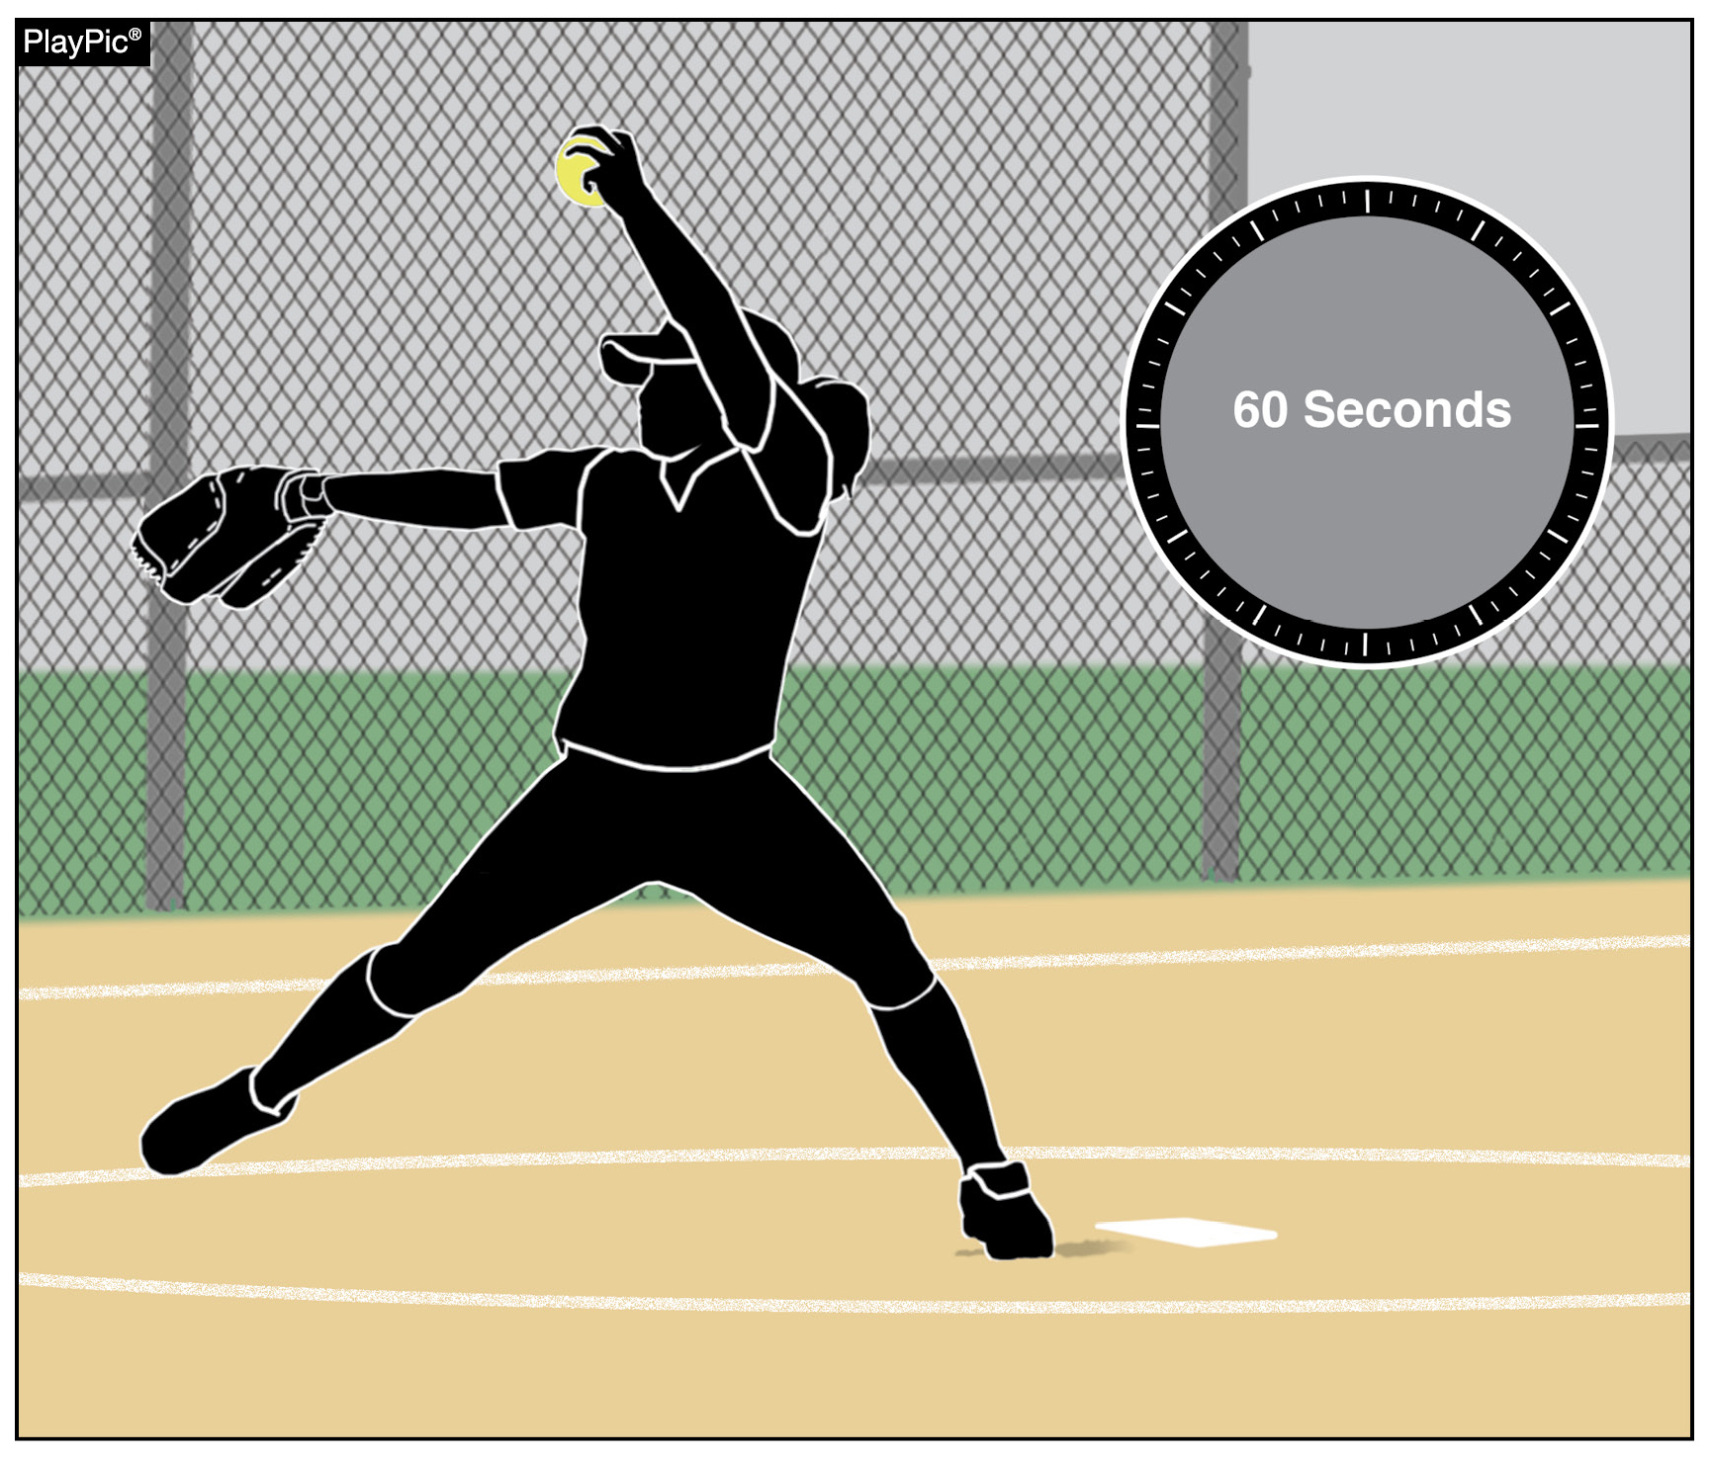
Team’s role in pace of play 2024-25
There has been a lot of emphasis on pace of play the past several seasons. This year, the focus in on coaches, who play a vital role in creating and maintaining pace-of-play standards.
Between innings, 60 seconds is provided for the defense to take the field and throw warm-up pitches. If the catcher was batting when the inning ended, coaches should have another teammate prepared to receive warm-up pitches.
Notes:
As mentioned earlier today this years POE’s also address the pace of play focused on ways coaches/teams can have a positive impact. This slide again mentions having pitchers ready to warm up with a designated person to warm them up if the catcher was batting or on base at the end of the inning.
Original Text from POE
TEAM’S ROLE IN PACE OF PLAY There has been a lot of emphasis on pace of play the past several seasons. This year, the focus in on coaches, who play a vital role in creating and maintaining pace-of-play standards. Between innings, 60 seconds is provided for the defense to take the field and throw warm-up pitches. If the catcher was batting when the inning ended, coaches should have another teammate prepared to receive warm-up pitches.
Comments: Coaches play a vital role in creating and maintaining pace-of-play standards for their individual players and teams. Every effort should be made to educate players on the rules involved and the timing protocols related to breaks between innings, as well as during gameplay. Between innings, 60 seconds is provided for (a) the defense to take the field and throw warm-up pitches, and (b) the offense to prepare to bat. There are several ways that coaches can expedite this process with simple instructions to players. For example, if the catcher was batting or on base when the third out was made, have another teammate or coach prepared to receive warm-up pitches while the catcher gets equipped.

Slide 6
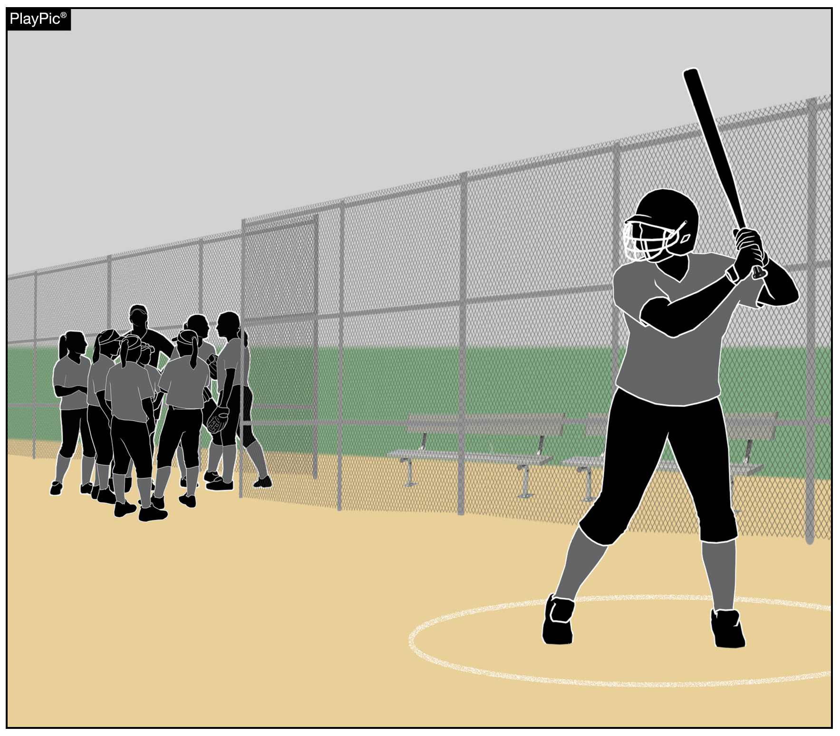
Team’s role in pace of play 2024-25
The offense also has 60 seconds to prepare to bat. While coaches may choose to huddle with their team as they come off the field, coaches should encourage their lead-off batter to gather their equipment and get ready to bat.
Notes:
This slide focuses on the offense being efficient in between innings, if a team wants to huddle make sure the lead off batter is getting their bat and helmet so they are ready when it is time for the inning to begin.
Original Text from POE
TEAM’S ROLE IN PACE OF PLAY The offense also has 60 seconds to prepare to bat. While coaches may choose to huddle with their team as they come off the field, coaches should encourage their lead-off batter to gather their equipment and get ready to bat.
Comments: For the team coming to bat, coaches should encourage their lead-off batter to gather their batting equipment allowing them to be ready to bat while the remainder of the team huddles in an appropriate area that doesn’t pose a safety risk for the defense warming up.

Slide 7
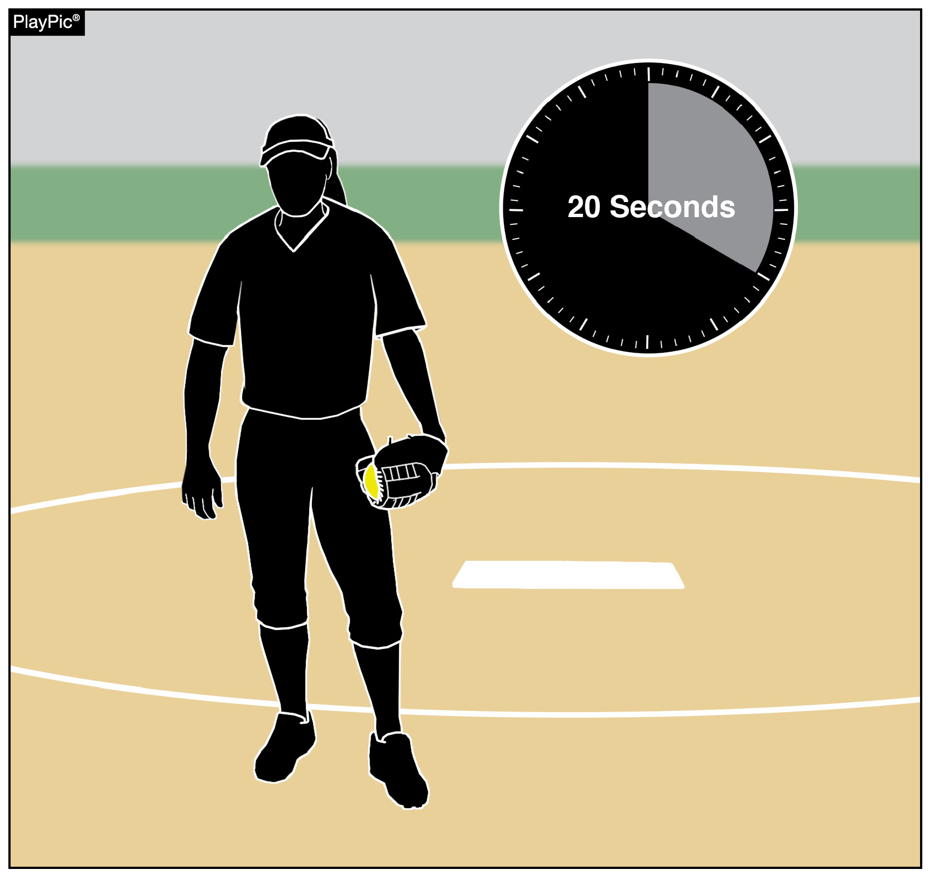
Team’s role in pace of play 2024-25
Once the 60 seconds between innings has elapsed, the batter has 10 seconds to enter the batter’s box and the pitcher has 20 seconds to legally deliver a pitch.
The pitcher also has 20 seconds to release a pitch once the ball has been returned from a previous pitch and the batter has 10 seconds to enter the batter’s box after the ball is returned.
A ball or strike is added to the count, depending on the tardy party.
Notes:
Lastly this slide highlights how the rules for warm up pitches and batter and pitcher timing between pitches should be utilized together in between innings. It also highlights that there are timing considerations between every pitch, with the batter having 10 seconds to be in the box ready to bat and the pitcher having 20 seconds to deliver the next pitch.
Original Text from POE
TEAM’S ROLE IN PACE OF PLAY Once the 60 seconds between innings has elapsed, the batter has 10 seconds to enter the batter’s box and the pitcher has 20 seconds to legally deliver a pitch. The pitcher also has 20 seconds to release a pitch once the ball has been returned from a previous pitch and the batter has 10 seconds to enter the batter’s box after the ball is returned. A ball or strike is added to the count, depending on the tardy party.
Comments: There are prescribed penalties associated with excessive time between innings. Once the allowed 60 seconds has passed, the offensive team has 10 seconds for its batter to enter the batter’s box (NFHS Rule 7-3-1). Similarly, once the allowed 60 seconds has passed, the pitcher has 20 seconds to legally deliver a pitch (NFHS Rule 6-2-3). These same time constraints exist on each pitch thrown during the game. Once the ball has been returned to the pitcher to prepare for the next pitch, the pitcher has 20 seconds to release the next pitch. Coaches who delay in calling pitches risk a penalty for exceeding the allowed 20 seconds. The same applies to the offense when a batter fails to enter the batter’s box within 10 seconds after the ball is returned to the pitcher. The respective penalties for violations of these time constraints are either a strike or a ball on the batter, depending on the tardy party.

Slide 8
Other concerns about pace of play
One item that has been mentioned is the perceived increase in time taken to call pitches
There have been delays in coaches searching the playcard then relaying the call
Resulting in increased time between pitches approaching or exceeding the 20 second allowance
Notes:
Just another point that was discussed that should be considered during the 20 seconds between each pitch of the game. Coaches have trended toward taking more time to survey the batters stance and game situation before determining the pitch call they want to give. This delay consumes a large part of the pitchers 20 seconds between pitches reducing the time they have to complete their preliminaries and release the next pitch. It should also be noted that a large number of pitchers like to get into a rhythm when pitching and this delay often takes them out of this rhythm and can negatively impact their performance.

Slide 9
State association best practices

Slide 10
Open discussion

Slide 11
Questions

Slide 12
Thank You
National Federation of State High School Associations PO Box 690 | Indianapolis, IN 46206 Phone: 317-972-6900 www.nfhs.org | www.nfhslearn.com | www.nfhsnetwork.com

