Slide 1
NEW RULES
&
MODIFICATIONS

Slide 2
USA Softball Rule Changes of Relevance to NYSPHSAA
Multiple Significant Changes/Modifications
NYSPHSAA Changes

Slide 3
CERTIFICATION MARKS
The official bat must bear either:
ASA 2000
ASA 2004
New approved “USA Softball”
NOTE 1: Bats with ASA 2013 certification marks are NOT approved for NYSPHSAA play
NOTE 2: ASA/USA Softball certification marks are not required for softballs
.47 COR & 375 Compression

Slide 4
HELMETS
Helmets shall have a non-glare (not mirror-like) surface
The difference between “shiny” and “mirror-like” is apparent

Slide 5
PITCHER’S SET-UP
The pitcher shall take a position with her pivot foot in contact with the pitcher’s plate and her non-pivot foot in contact with or behind the pitcher’s plate
Pitcher is no longer required to start with both feet on the pitcher’s plate
Pitcher must still be within 24-inch pitcher’s plate

Slide 6
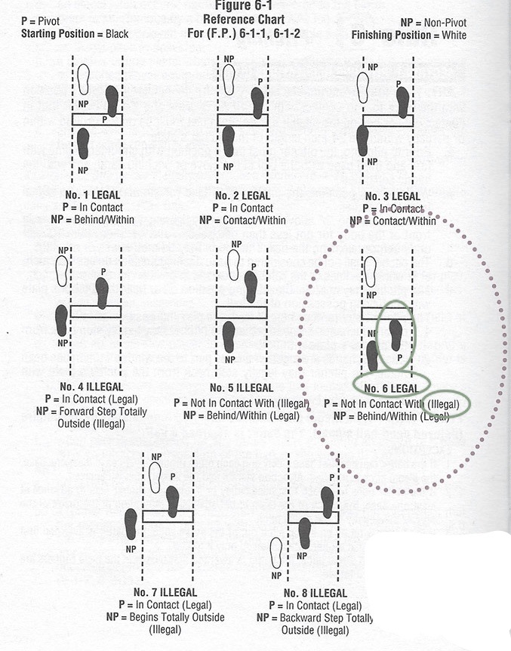
ILLEGAL
i
Not Within

Slide 7
PITCHER’S MOTION
A backwards step may be taken before, simultaneous with or after the hands are brought together
COMMENT: “Allows pitchers to take a backward step from the pitcher’s plate”

Slide 8
PITCHER’S MOTION
NOTE 1: The comment is misleading.
The pitcher may step back regardless of whether she started with both feet on the pitcher’s plate or with one foot behind the pitcher’s plate
NOTE 2: Hands & Feet
Stepping back as it relates to when the hands come together is more liberal than other rule sets
NOTE 3: Once the hands have separated (beginning of the pitch) a step back is not permitted

Slide 9
ILLEGAL PITCH
Eliminates the penalty of advancing a runner one base without liability to be put out from the effect of committing an illegal pitch
Penalty is limited to a “ball on the batter”
What happens if an illegal pitch results in a hit-by-pitch? If the pitch was not swung at, the batter is awarded first base and all runners move up if forced.
If the batter hits an illegal pitch and reaches 1st base and all other runners advance 1 base, the play stands

Slide 10
METAL CLEATS
PERMITTED
VARSITY
JV
FRESHMAN/FROSH
NOT PERMITTED
MODIFIED
NYSPHSAA FINALS
Based solely on field restrictions

Slide 11
Nassau County Softball Officials Association, Inc.
Steve Moffett, Chairperson
516-754-2904
smoffett17@gmail.com
Rick Norris, Rules Interpreter
917-865-4461
Norrisimo@aol.com

