Slide 1
2025 NFHS Softball Stepping through DP/Flex & Living Lineup

Slide 2
Understanding the DP/flex rule
DP/FLEX is often confusing to both coaches and umpires
This presentation steps through the DP/FLEX rules
We will start at the beginning and step through the most questioned parts of the rule showing some common uses
Each step builds on a previous step

Slide 3
Step 1 Know your job

Slide 4
Step 1 Positions and responsibilities
Normally starting players have two “jobs”
They play both offense and defense
DP/FLEX splits these “jobs” into two positions
DP in an offensive specialist (3-3-6a)
FLEX is a defensive specialist (3-3-6b,e&f)
Positions have to be declared and occupied at the start of the game (3-1-1)
This is why if you are going to utilize the DP/FLEX it has to be a part of the starting lineup

Slide 5
Step 2 Keep doing your job

Slide 6
Step 2 Keep doing your job
DP is an offensive specialist (3-3-6a)
They keep doing their “job” by playing offense
As long as the DP continues to play offense in their spot in the lineup they have not left the game (3-3-6d)
FLEX is a defensive specialist (3-3-6b,e&f)
They keep doing their “job” by playing defense
As long as the FLEX player continues to play defense (any of the 9 defensive positions) when their team is on defense they have not left the game (3-3-6f)

Slide 7
Step 3 FLEX can do the DP’s JOB

Slide 8
Step 3 flex does dp’s job
DP actually bats for the FLEX (3-3-6b)
They split one players “jobs” into two positions
This ties DP and FLEX together on offense
If the FLEX bats or runs they must do so in the DP’s position in the lineup (3-3-6d&g)
If this happens the DP has left the game (9 active players)
Position is still available for starting DP to reenter or legal sub to enter
If the FLEX bats in any other position in the lineup it is an illegal substitute (3-3-6g)

Slide 9
Why would FLex Do dp’s job
FLEX plays 1st base, is a great hitter but very slow runner
DP is a very fast runner but not a good hitter
FLEX bats and gets on base then DP reenters to run for them
FLEX goes back to playing defense only and has never left the game

Slide 10
flex Does dp’s job
FLEX is doing both jobs
DP has left the game
Arrow up to show who is batting in the 7th position
DP (Cooper) leaves the game (has no job) but has one reentry
1
3

Slide 11
flex Does dp’s job
DP reenters to run
Cooper uses their one reentry
FLEX (Green) returns to playing defense only
Arrow down to show FLEX is back to playing defense only
They never quit doing their job (playing defense) so they have never left the game
1
3

Slide 12
Step 4 DP can do the flex’s job

Slide 13
Step 4 dp does flex’s job
FLEX’s job is to play defense
If they no longer play defense they have left the game
If a legal substitute enters the FLEX position (3-3-6f)
Starting FLEX (player) has left the game has one reentry
FLEX position remains active (10 players)
If the DP plays defense instead of the FLEX, FLEX has left the game (9 active players) (3-3-6e)
Position is still available for starting FLEX to reenter or legal sub to enter

Slide 14
Why would DP Do Flex’s job
Coaches will start with DP/FLEX
DP is batting 7th and FLEX is listed as F1
Once lineup is official they tell umpire at the plate meeting “my DP is playing defense for the FLEX and will be my pitcher”
Why do this?
DP is their starting pitcher and a good hitter, FLEX is 2nd best pitcher but not a good hitter
If DP begins to struggle pitching later in the game coach can reenter the FLEX to pitch but keep their DP (the better hitter) batting the entire game

Slide 15
DP Does FLEX’s job
DP is doing both jobs
Identify as F1 for courtesy runner eligibility
FLEX (Green) leaves the game (has no job) but has one reentry
1

Slide 16
Step 5 Positions live forever

Slide 17
Step 5 positions live forever
Step 1 mentioned a team has to start with DP/FLEX positions if they want to use them anytime during a game
Once you start with DP/FLEX those positions are available for the entire game
These positions can be active (10 players) or inactive (9 players)
An eligible sub can enter into these positions at any time
Players lose eligibility but positions live forever
Players have one reentry, once a player leaves the game for a second time they are done for the game
But their position can be filled by any eligible sub for the entire game

Slide 18
Continue with FLEX doing DP’s job
Later in game FLEX bats again in the 7th position
DP leaves the game again
Cooper has left the game a second time and has no more eligibility for the game (done for the game)
FLEX bats again
Show arrow up to know who is batting in 7th position

Slide 19
Continue with FLEX doing DP’s job
FLEX gets on base
Cooper cannot reenter
Any of the 4 substitutes are eligible to enter in the DP position
Coach says “Blue I want 10 to run for the FLEX”
VERY important that umpire gets clarity
Is #10 entering in the DP position and the FLEX is returning to playing defense only (Green is not leaving the game) OR
Is #10 entering in the FLEX position playing offense and defense (Green leaves the game)

Slide 20
Continue with FLEX doing DP’s job
Coach wants option 1 with #10 entering the DP position and the FLEX player going back to playing defense only
Show #10 Howell entering in the 7th position in the lineup and arrow down to show FLEX going back to playing defense only
10
Howell

Slide 21
Step 6 DP does another players defensive job

Slide 22
Step 6 Defensive job
Step 1 mentioned that most players have two “jobs”- playing offense and defense
Step 4 discussed the DP doing the FLEX’s job and the FLEX leaving the game
Instead of playing defense for the FLEX the DP could play defense for one of the other 8 batters in the lineup
In this case the other player still bats in their spot in the lineup and has not left the game(3-3-6e)
That player still has a “job” as they are still playing offense so they have not left the game
This allows the FLEX and DP to both play defense at the same time

Slide 23
Why would DP Do someone else's defensive job
Two most common uses
A player is having a bad day and coach wants to talk with them to help regain their focus
A player gets a slight injury and needs treatment that is not able to be done in time to play defense but they do not want to remove them from the game
Ankle needs taped
Abrasion from slide needs bandaged
By definition this is not a substitute and does not have to be reported as no player is leaving the game
It is good preventative umpiring to ask coaches to report when DP plays defense as it helps eliminate confusion if asked by the other team

Slide 24
DP Does able’s Defensive job
DP is doing two jobs
Batting in the 7th positon in the lineup and playing F4 on defense
Mark as F4 if desired to ensure there is not a question about unreported entry
Able will continue to bat 2nd and has not left the game
They still have a job on offense so they have not left the game
4

Slide 25
Summary do you have a job?

Slide 26
Do you have a job?
If you do not have a job to do you have left the game
DP’s job is to play offense
If they continue to play offense they have not left the game
FLEX’s job is to play defense
If they continue to play defense they have not left the game
FLEX can play offense but only in the DP’s position
When this happens the DP lost their job so they have left the game
DP can also play defense
If they play defense for the FLEX the FLEX has left the game (they have no job)
If they play defense for one of the other 8 batters in the lineup that player still has an offensive job to do and has not left the game
Positions (jobs) are available for the entire game (jobs can be filled by others)
Notes:
There have been a number of discussions about the pace of play for NFHS Softball. Rule proposals have been submitted for various ways to enforce the timing between innings and various options to change the current rules providing different penalties if violated. After reviewing these proposals and comparing them with the current rules governing these items the NFHS Softball rules committee decided to reject the rule proposals and provide information by creating POE’s for these items. Starting with a reminder of the time between innings when it starts and highlighting that maintaining good game flow is an important aspect of the game. The next POE focused on umpires game management and how to enforce these items without being overly aggressive. This year the focus is on coaches roles in management of game flow as well as highlighting the existing timing aspects within the current rules.

Slide 27
Questions

Slide 28
Living Lineup

Slide 29
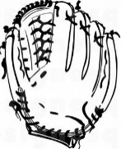
Background to living lineup
Adds action to lineup management discussion
Physical movement helps kinesthetic learners understand the concept better
Suggested “Props” for the presentation
Laminated number sheets for each person in the lineup
Laminated pieces that represent batting and fielding for the DP/FLEX with Velcro to allow them to be moved
Laminated pieces for player that had DP play defense for them with Velcro to allow them to be moved
Chairs for eligible substitutes and players that have left the game in the positions needed
Sitting down means they are not currently in the game
Laminated pieces for those that have left the game a second time no longer have eligibility
Notes:
There have been a number of discussions about the pace of play for NFHS Softball. Rule proposals have been submitted for various ways to enforce the timing between innings and various options to change the current rules providing different penalties if violated. After reviewing these proposals and comparing them with the current rules governing these items the NFHS Softball rules committee decided to reject the rule proposals and provide information by creating POE’s for these items. Starting with a reminder of the time between innings when it starts and highlighting that maintaining good game flow is an important aspect of the game. The next POE focused on umpires game management and how to enforce these items without being overly aggressive. This year the focus is on coaches roles in management of game flow as well as highlighting the existing timing aspects within the current rules.

Slide 30
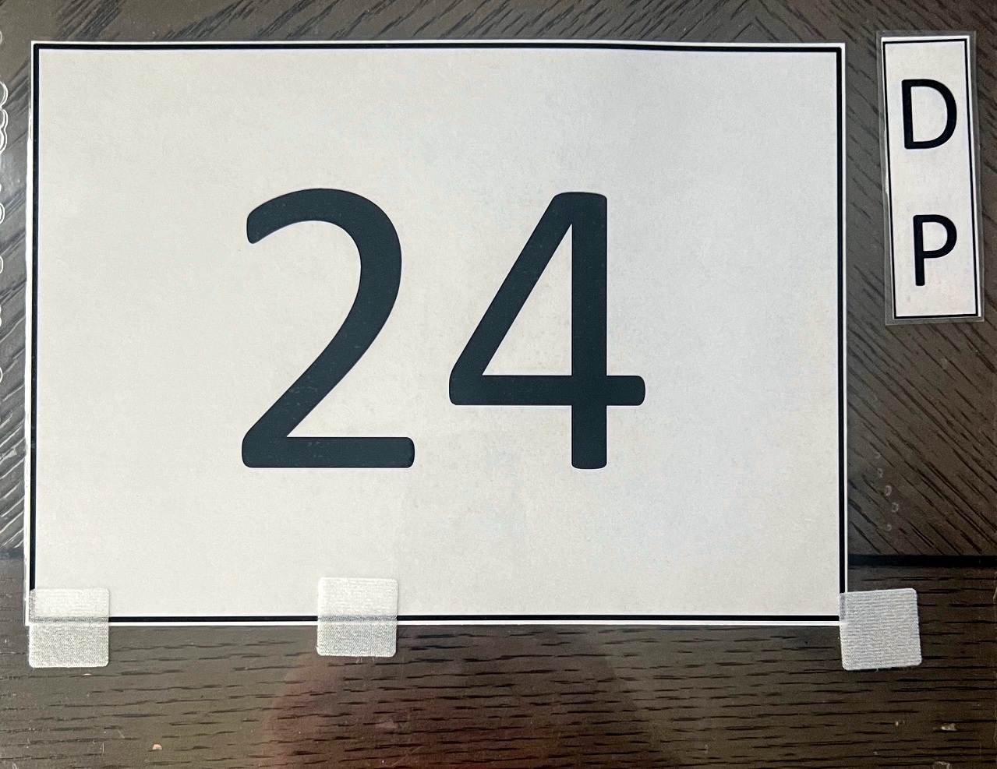
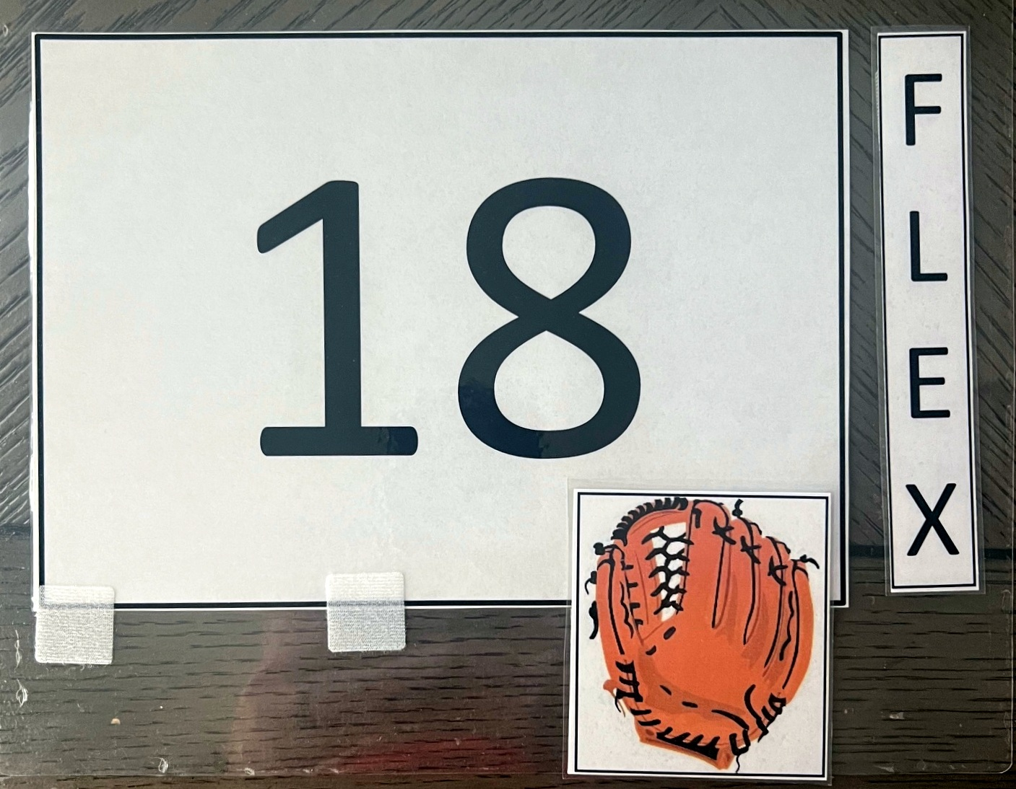
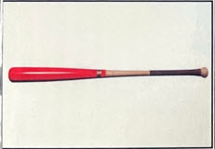
Close up of number sheets and movement

Slide 31
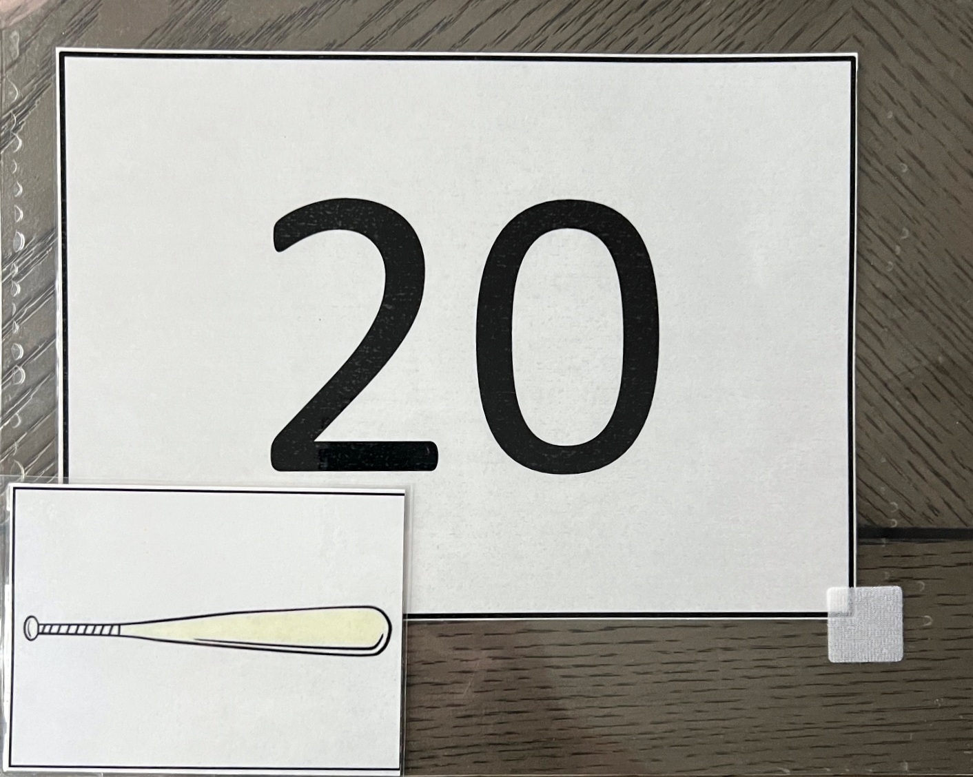
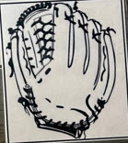
Movement for DP playing defense

Slide 32
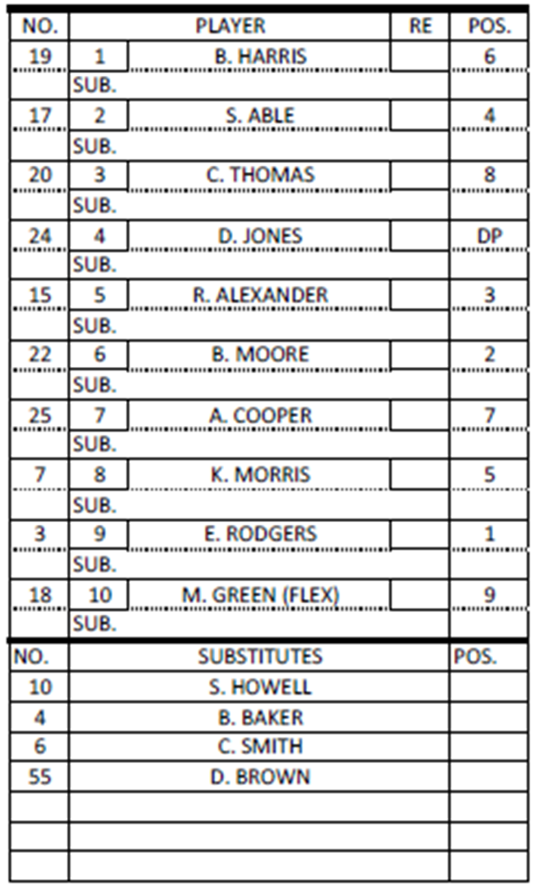
Arrangement for living lineup
*
*
Ask for 14 volunteers
Need minimum of 4
Give each volunteer a number and place them in order shown in the lineup card
* indicate the required spots
If you have limited volunteers tape the remaining numbers to empty chairs to show the positions
If you have enough volunteers have the 4 substitutes sit in chairs
Have a chair behind spot 4 and spot 10 in the lineup
*
*

Slide 33
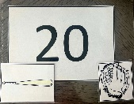
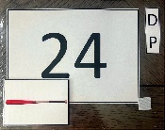
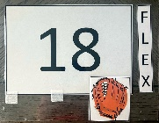
Arrangement for Living Lineup
B1
B2
B3
B4
B5
B6
B7
B8
B9
10
4
55
10
6
19
17
15
22
25
7
3

Slide 34
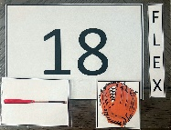
Movement for Example 1 FLEX playing offense for dp
B1
B2
B3
B4
B5
B6
B7
B8
B9
10
4
55
10
6
19
17
15
22
25
7
3
FLEX is playing offense in the 4th position (DP’s spot) in the lineup
DP has no job so they have left the game (take a seat)
FLEX playing offense for DP (taking their bat)

Slide 35
Questions

Slide 36
DP/FLEX RULE
SAMPLE EXERCISES

Slide 37
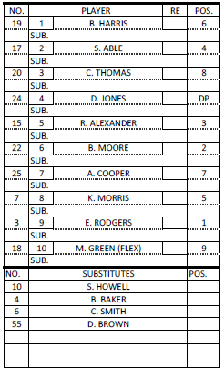
SAMPLE LINEUP CARD
All samples will use this lineup card and progress through a series of substitutions

Slide 38
Sample exercise #1
Jones (DP) bats and gets on base safely
The offensive coach asks for time to make a change
“Green will run for Jones"

Slide 39
SAMPLE EXERCISE #1
Green (FLEX) running for Jones (DP)
Notes:
This slide contains several “layers” of the lineup card that can only be seen when the slide show is being viewed.

Slide 40
Sample exercise #1
Note –
Jones has left the game (no longer playing offense), they still have one re-entry. Green is now playing offense and defense.

Slide 41
Sample exercise #2
Two innings later, Green singles to left
The offensive coach asks for time to make a change
"Smith is running for Green and Green will still be playing right field”

Slide 42
Sample exercise #2
Note –
This substitution is critical for the umpire to ensure they understand what the coach is requesting
Coach says “Smith is running for Green” at this point there are two options:
Smith is substituting for Green and is the new FLEX playing offense in the DP’s position in the lineup. Change is made and recorded in the 10th position
Smith is substituting for Jones and is the new DP, Green is going back to playing defense only. Change is made and recorded in the 4th position.
By actively listening and understanding the second part of the coach's statement “Green will still be playing right field” we know the coach wants option 2.

Slide 43
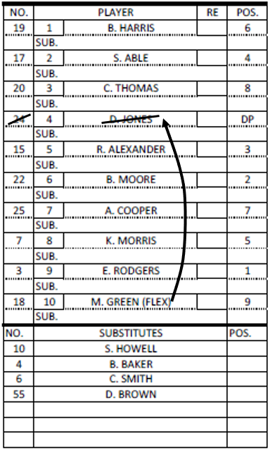
SAMPLE EXERCISE #2
Smith (sub) running for Green (FLEX) is recorded as a sub for Jones and becomes the new DP
Green remains in the game playing right field only
6
Smith
DP
Notes:
This slide contains several “layers” of the lineup card that can only be seen when the slide show is being viewed.

Slide 44
Sample exercise #2
Note –
Since Green will continue to play defense, Smith enters the game for the first time as the new DP
Since Green (FLEX) is still playing defense they have NOT left the game (never quit using their mitt)

Slide 45
Sample exercise #3
In the 4th inning, the offensive coach asks for time to make another change
“Jones to re-enter and bat for Smith”

Slide 46
SAMPLE EXERCISE #3
6
Smith
DP
Jones (starting DP) re-enters for Smith
Notes:
This slide contains several “layers” of the lineup card that can only be seen when the slide show is being viewed.

Slide 47
Sample exercise #3
Note –
Jones has used her re-entry
Smith has left the game and has a re-entry remaining
This is no different than a substitution/re-entry anywhere else in the lineup

Slide 48
Sample exercise #4
In the next half inning, the defensive coach asks for time to make another change
“Jones will play defense in center field for Thomas”

Slide 49
SAMPLE EXERCISE #4
8
6
Smith
DP
Jones (DP) to play defense in center field for Thomas
Notes:
This slide contains several “layers” of the lineup card that can only be seen when the slide show is being viewed.

Slide 50
Sample exercise #4
Note –
Jones the DP is now playing offense (using their bat) and defense (using Thomas’ mitt)
Thomas still bats in the 3rd position in the lineup is playing offense only (still using their bat) and has NOT left the game

Slide 51
Sample exercise #5
In the next inning, the defensive coach asks for time to make another change
“Thomas is going back to playing center field, Jones will play defense in right field for Green”

Slide 52
SAMPLE EXERCISE #5
8
9
8
Thomas goes back to center field
Jones (DP) to play defense in right field for Green (FLEX)
6
Smith
DP
Notes:
This slide contains several “layers” of the lineup card that can only be seen when the slide show is being viewed.

Slide 53
Sample exercise #5
Note –
Jones (DP) is still playing offense and defense (now using the FLEX’s mitt)
Green (FLEX) has left the game (still has a re-entry) since she is not playing defense (no longer using their mitt)

Slide 54
Thank You
National Federation of State High School Associations PO Box 690 | Indianapolis, IN 46206 Phone: 317-972-6900 www.nfhs.org | www.nfhslearn.com | www.nfhsnetwork.com

