Slide 1


Academic Freedom & Shared Governance
Brian L. Evans, PhD
September 19, 2025
Texas Conference of American Association of University Professors (AAUP) aaup-texas.org
Affiliated with the Texas American Federation of Teachers (AFT) texasaft.org
Brian Evans is speaking for himself as a private individual and the Texas AAUP-AFT President, and not on behalf of any other group, institution, or organization
Slides

Slide 2
ACADEMIC FREEDOM
Teachers need freedom to teach so students have freedom to learn.
Free inquiry, free expression, intellectual exploration, and open dissent are critical for student learning and the advancement of knowledge.
Academic freedom is the freedom from censorship by the institution in the instructional staff ‘s teaching, research, and expression.
AF allows instructors to develop/disseminate new knowledge from all viewpoints, including conservative, moderate, liberal, apolitical.
Safeguards include shared governance, tenure and due process.
Codified in the 1940 AAUP/AAC&U Statement of Principles on Academic Freedom and Tenure adopted by all seven Texas public university systems and more than 85% of US colleges and universities

Slide 3
SHARED GOVERNANCE
Higher ed Administration delegates tasks using a division of labor
Shared decision-making among students, staff, faculty, administrators, and board of governors based on communication, trust, mutual understanding, and transparency
Faculty (due to expertise) have primary decision-making authority
  Curriculum, subject matter, and methods of instruction
  Matters related to faculty status – appointments, reappointments, non-reappointments, promotions, granting of tenure, dismissal
Faculty have authority in financial exigency and program closures
1966 AAUP/ACE/AGB Statement of Government of Colleges and Universities adopted by 1500+ US four-year institutions

Slide 4
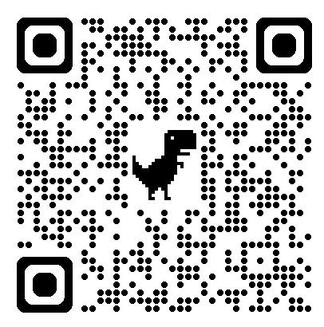
TEXAS AAUP-AFT
Champions academic freedom, advances shared governance, and organizes to promote economic security and quality education
Mobilizes 1900 members on 80 public/private
campuses and in 40 campus chapters
Affiliated with Texas American Federation of
Teachers in March 2024 (66000 members; 45 staff)
Provides employment protections: Professional
liability insurance, legal aid & Legal Defense Fund
Advocates for faculty in navigating policies,
investigations, dismissals, and grievances
Advocates at Texas Legislature, e.g. in 2023, secured change in the definition of tenure from one-year contracts to continuous employment in SB18 which also saved multi-year contracts
Reasons to Join

Slide 5
What’s not in Texas SB 37
Texas AAUP-AFT secured bipartisan support to remove provisions in earlier versions of the bill that would have
Censored certain course content related to beliefs about race, sex, ethnicity as well as religious, social, or political beliefs
Limited faculty senate members to be tenured faculty
Allowed President to remove faculty senators unilaterally
Enabled elimination of degree programs based on arbitrary return on investment thresholds
Prevented a faculty member from having final decision-making authority on any decision regarding the hiring of an individual for employment by the institution (student workers, faculty, etc.)

Slide 6
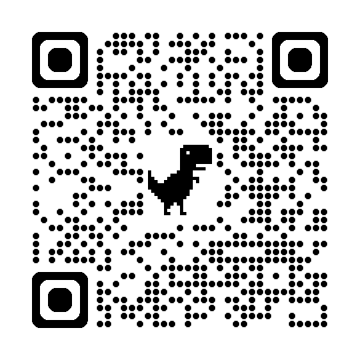
SB 37 Overview
Sweeping overhaul of faculty governance
at public colleges, universities, health inst.
SB 37 puts under political control
Core curriculum content
Undergraduate majors, minors & certificates
Faculty Senates
Deadlines for compliance
Sept. 1, 2025: Board of Regents / Trustees must
authorize a Faculty Senate or it is dissolved
Jan. 1, 2026: All other aspects of SB 37
Implementation Notes: Avoid overcompliance to reduce
harm to student learning and growth, and faculty teaching and research.
SB 37 Analysis & Implementation Notes
Instructors retain academic freedom to teach course topics with their own approach and add topics.

Slide 7
SB 37 Shared Governance Definition
Defined for the first time in statute (pages 12-13)
Top-down model
Board of Regents / Trustees ultimate decision makers
Input from faculty and staff is advisory only
Shared governance structures may not serve as a mechanism for advancing ideological / political agendas
Comment: Upends previously adopted professional standards by AAUP, ACE & AGB in which faculty, President, and Board collaborate in decision-making with President as the final decision-maker for the institution, as described on slide 3

Slide 8
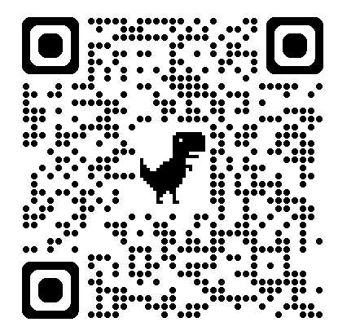
Dr. Brian Evans, President of Texas AAUP-AFT, aaup.texas@gmail.com, 512-516-5991
Dr. Evans is speaking for himself as a private citizen and Texas AAUP-AFT President, and not on behalf of any other group, institution. or organization
New Higher Ed
Laws
Presentation from Texas AAUP-AFT Blog “Higher Ed Laws from the 2025 Texas Legislature”:

Slide 9
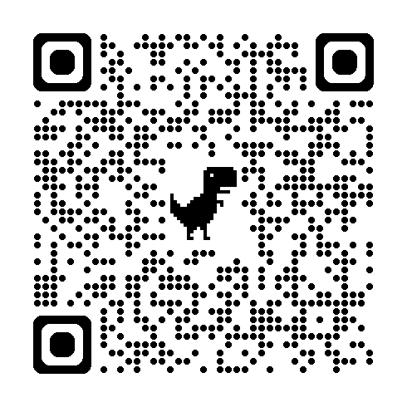
SB 530 Accreditation
Removes Southern Assoc. of Colleges and Schools (SACS) as sole agency mandated in Texas law
SACS can be chosen as institutional accreditor.
SACS requires academic freedom and shared governance at institutions.
Affects public/private inst.
Takes effect Sept. 1, 2025
Texas AAUP-AFT
SB 530 / HB 1705 Blog

Slide 10
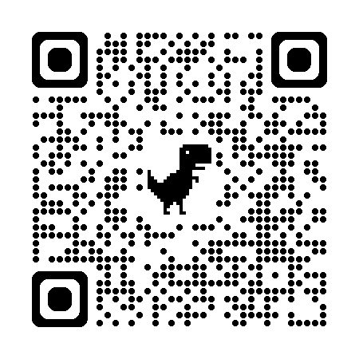
SB 2615 Telework
Pub higher ed employees: clarifies Mar. 5th Gov. email directive for state agencies
Exceptions include illness, medical cond. & disabilities
Staff retain some flexibility
Full-time faculty in-person 40 hrs/wk with narrow exceptions, e.g. online-only teaching, travel, temporary research assignment, telehealth services
Takes effect Sept. 1, 2025
Texas AAUP-AFT
SB 2615 Blog

Slide 11
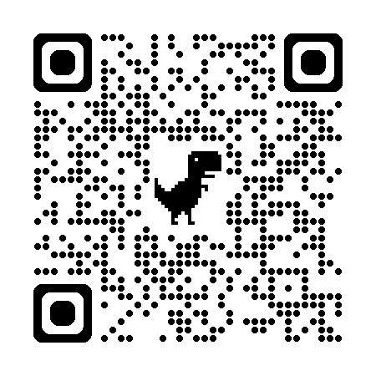
SB 412 Materials Harmful to Minors
Showing harmful (obscene) materials to minors (under 18 yrs) is a criminal offense.
Removes exceptions in state law for educational purposes.
Federal protections remain for educational purposes
500,000 high schoolers in dual-credit courses.
Affects public & private institutions, as of Sept. 1, 2025
Texas AAUP-AFT
SB 412 Blog

Slide 12
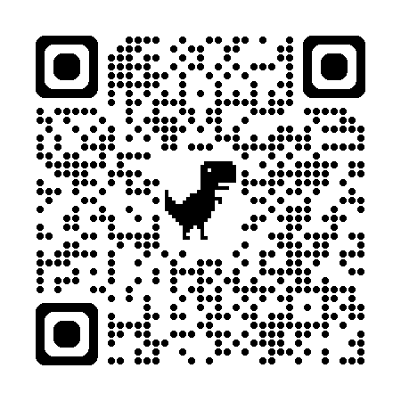
SB 2972 Expressive Activities on Campus
Restricts expressive conduct on campus and mandates disciplinary policies around disruptions.
Banned 10pm-8am and last two weeks of semester.
Takes effect Sept. 1, 2025.
Texas AAUP-AFT
SB 2972 Blog

Slide 13
Dr. Brian Evans, President of Texas AAUP-AFT, aaup.texas@gmail.com, 512-516-5991
Dr. Evans is speaking for himself as a private citizen and Texas AAUP-AFT President, and not on behalf of any other group, institution. or organization
Texas
Senate
Bill 37
Presentation from Texas AAUP-AFT Blog “SB 37 Implementation Concerns and Recommendations”

Slide 14
What’s not in Texas SB 37
Texas AAUP-AFT secured bipartisan support to remove provisions in earlier versions of the bill that would have
Censored certain course content related to beliefs about race, sex, ethnicity as well as religious, social, or political beliefs
Limited faculty senate members to be tenured faculty
Allowed President to remove faculty senate members
Enabled elimination of degree programs based on arbitrary return on investment thresholds
Prevented a faculty member from having final decision-making authority on any decision regarding the hiring of an individual for employment by the institution (student workers, faculty, etc.)

Slide 15
SB 37 Harms
Student learning and growth
Academic freedom and shared governance
Biomedical research, clinical trials, and patient care **
Faculty recruiting and retention
** The 14 Public health institutions, which include UT MD Anderson and UT Southwestern Medical Center, provide 50% of all outpatient treatment and 1 out of 7 hospital visits in Texas. Faculty Senates at these Institutions provide recommendations to the administration concerning biomedical research, clinical trials, and patient care.

Slide 16
SB 37 Overview
Sweeping bill overhauling faculty governance at public community colleges, universities & health institutions
SB 37 puts under political control
Core curriculum content
Undergraduate majors, minors & certificates
Faculty Senates
Deadlines for compliance
Sept. 1, 2025: Board of Regents / Trustees must
authorize a Faculty Senate or it is dissolved
Jan. 1, 2026: All other aspects of SB 37
Implementation Notes: Avoid overcompliance to reduce harm to student learning and growth, and faculty teaching and research.
Instructors retain their academic freedom to teach course topics with their own approach and add topics to a course.

Slide 17
SB 37 Deep Dive: Disciplinary Action
Effective Jan. 1, 2026, SB 37 allows disciplinary action— including termination— for
promoting political or ideological agendas in shared governance committees or faculty senates, or
for violating Texas SB 17 (2023) prohibiting diversity, equity and inclusion employment practices.
New Office of the Ombudsman appointed by the Governor to investigate complaints about employees and institutions, with full investigatory powers

Slide 18
SB 37 Deep Dive: Shared Governance
Defined for the first time in statute (pages 12-13)
Top-down model
Board of Regents / Trustees ultimate decision makers
Input from faculty and staff is advisory only
Shared governance structures may not serve as a mechanism for advancing ideological / political agendas
Comment: Upends previously adopted professional standards by AAUP, ACE & AGB in which faculty, President, and Board collaborate in decision-making with President as the final decision-maker for the institution, as described on slide 5

Slide 19
SB 37 Deep Dive: Faculty Senates (1 of 4)
Must be authorized by the Board of Regents / Trustees
Placed under administrative control by institution
President can remove any member of Faculty Senate
President appoints the presiding officer, associate presiding officer, and secretary (“management chooses its representative voice of the faculty”)
Implementation Notes: Add due process protections when a President wants to remove any member of the Faculty Senate (14th amendment).
Implementation Notes: Add other members to the executive committee in addition to the presiding officer, associate presiding officer, and secretary

Slide 20
SB 37 Deep Dive: Faculty Senates (2 of 4)
Composition: Limited to 60 faculty members unless otherwise decided by the Board of Regents / Trustees
At least two members from each college/school
Pres. appoints one member from each college/school to one-year term, up to 6 consecutive one-year terms
Other faculty senators elected to single two-year term (eligible for re-election after two years off senate)
Implementation Notes: Faculty Senate allows for more than two faculty members per college/school, so proportional representation can be used.
Implementation Notes: Others can attend Faculty Senate meetings as ex-officio members and guests, including students, staff & administrators.

Slide 21
SB 37 Deep Dive: Faculty Senates (3 of 4)
Faculty senate meetings must be
Public
Broadcast when a quorum is present
Seven days in advance of a meeting, must post online
Agenda with items to be discussed or put to a vote
Curriculum proposals
Names of members in attendance must be recorded when there is a vote of no-confidence or if there is business related to curriculum or academic policies.

Slide 22
SB 37 Deep Dive: Faculty Senates (4 of 4)
Faculty senate is advisory only
Faculty senators may not be compensated for service
Implementation notes: SB 37 is silent on how Faculty Senate elections are held. Faculty Senate elections could be conducted electronically.
Implementation notes: SB 37 is silent on how Faculty Senates assign faculty and others to committees.

Slide 23
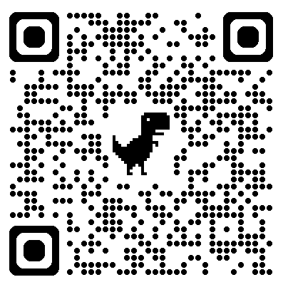
Thank you for being here!
Join Texas AAUP-AFT

Slide 24
More info on Texas SB 37

Slide 25
SB 37 Deep Dive: Undergrad Curriculum
Board of Regents / Trustees (pages 1-3)
Oversees content, workforce alignment & return-on- investment analysis to keep/close degrees
May appoint committee to oversee each institution
May overturn decisions by institutions
Institutions under direction of Board
Develop curriculum & degree programs (page 3)
Review minors & certificate programs for adequate enrollment and workforce alignment (pages 4-5)

Slide 26
SB 37 Deep Dive: State Core Curriculum
Texas Higher Education Coordinating Board forms a statewide committee “Curriculum Advisory Committee” to develop methods for:
determining core curriculum course content
reducing the number of core courses by Nov. 1, 2026;
Committee disbands Sept. 1, 2027 (pages 5-6)

Slide 27
SB 37 Deep Dive: Due Process
The Board of Regents / Trustees must approve/deny hiring of a Provost, Assoc. Provost, and Asst. Provost, and may overturn hiring of Deans and VPs (pages 6-8)
President shall conduct annual evaluations of any administrator in charge of curriculum or student affairs, which may lead to their removal (pages 13-14)
Faculty who do not have administrative positions may not have final decision-making authority in grievances and hiring (page 14)

Slide 28
SB 37 Deep Dive: Enforcement
Creates “Office of the Ombudsman” (pages 14-20)
Part of the Texas Higher Education Coordinating Board
Office director is appointed by the Governor
Complaints must be from a campus community member
Investigates complaints of non-compliance with SB 37 and/or the diversity, equity, and inclusion bill from the last session (SB 17)
  Reports findings concerning employees to their institutions with penalties including the possibility of dismissal
  Reports findings concerning institutions to the Legislature with penalties including loss of State General revenue for an academic year
Comment: This “Ombuds” is not a neutral, third-party resource for advice but instead a formal investigative unit for enforcement

