Slide 1
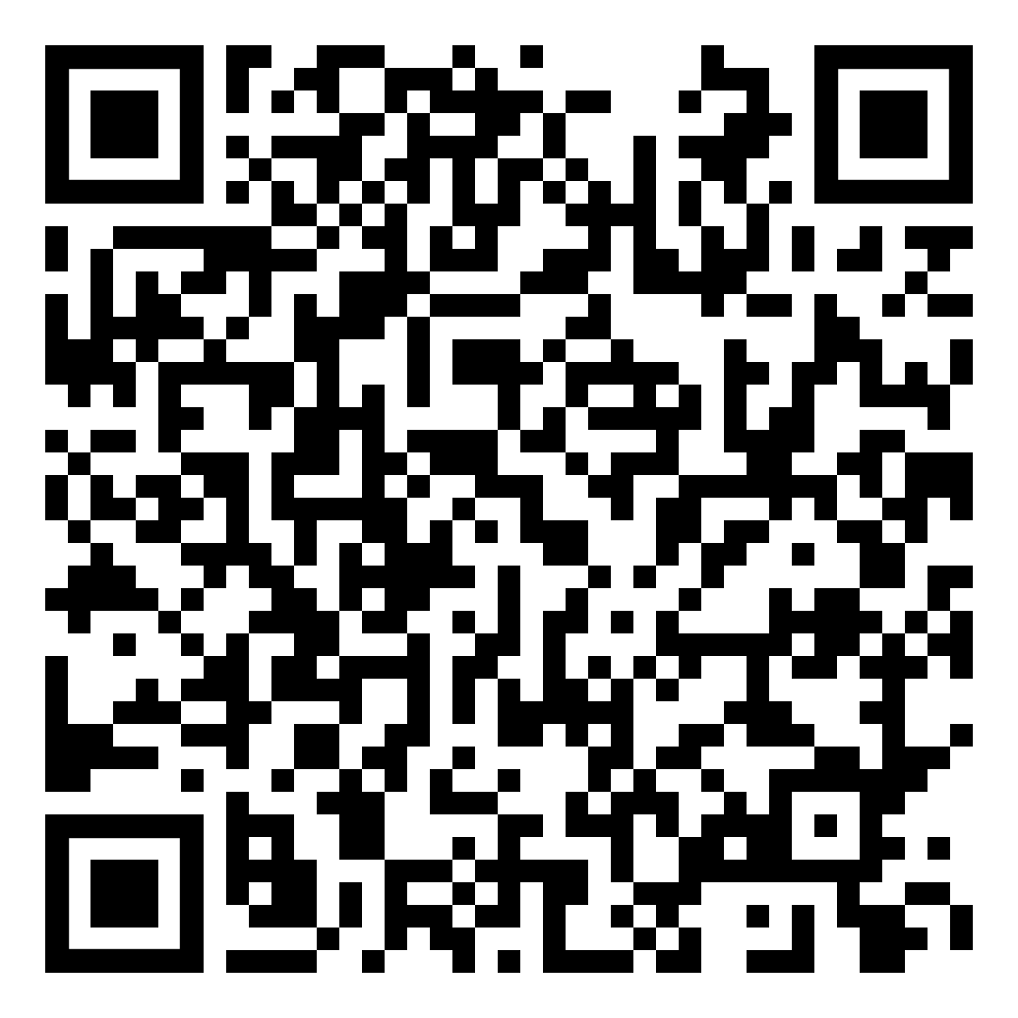
Texas Faculty Survey
2026 Results & Comparison with 2024
Texas AAUP –AFT Conference
1,000+
Texas faculty responses
Aug 4–Sep 4
2026 field period
2024
comparison year
Slides generated from the 2026 Texas Responses on the Faculty in the South Survey by ChatGPT
Summary of the results is available on the Texas AAUP-AFT blog site (see the above QR code)

Slide 2
Executive snapshot
Selected 2026 results reported by the Texas AAUP Conference
70.2%
would not recommend Texas for a faculty position
35.1%
plan to interview outside Texas
72.6%
cite academic-freedom restrictions as a concern
20.3%
do not plan to remain in academia long term
32.0% said they interviewed elsewhere during the previous two years.
Nearly 30% reported experiencing censorship of course content by administrators in the last year.
Hiring impacts reported by respondents included fewer applicants (54.0%), candidate hesitancy (52.0%), and lower-quality applicants (48.7%).
The survey reports that California, New York, and Colorado were the top destinations among faculty seeking positions outside Texas.
Source: Texas AAUP Conference, “Texas Faculty Survey Summary Sept 2026” • 2

Slide 3
Selected indicators: 2024 vs. 2026
Percent of respondents; the source reports changes over time
+9.2 pts
would not recommend Texas
+8.8 pts
plan to interview outside Texas
+3.7 pts
interviewed elsewhere
Source: Texas AAUP Conference, “Texas Faculty Survey Summary Sept 2026” • 3

Slide 4
Issues associated with a desire to leave Texas
2026 respondents; multiple concerns could be selected
Source: Texas AAUP Conference, “Texas Faculty Survey Summary Sept 2026” • 4

Slide 5
Reported effects on faculty hiring
2026 respondents reporting impacts they had noticed
40%+
knew of faculty who refused positions offered at their campus
<15%
knew of no impact on hiring
The source says respondents also reported vacant positions left unfilled, canceled searches, and some conversions of tenure-track/tenured roles to contingent positions.
Source: Texas AAUP Conference, “Texas Faculty Survey Summary Sept 2026” • 5

Slide 6
Private universities: hiring challenges reported
The source separately reports responses from private-university faculty
57% saw candidate hesitancy.
53% saw fewer applicants; 49% saw lower-quality applicants.
24% reported all three effects.
23% knew of faculty who declined offers; 12% reported no hiring impact.
The source notes that the cited state laws do not apply to private universities and interprets the findings as evidence of interconnected hiring conditions.
Source: Texas AAUP Conference, “Texas Faculty Survey Summary Sept 2026” • 6

Slide 7
Who responded?
Texas respondents; categories may not sum to 100% where multiple selections were allowed
53.5%
women
46.3%
men
0.2%
other
Race / ethnicity reported
White • 76.8%
Hispanic • 12.7%
Multi-racial • 7.9%
Black • 5.9%
Asian • 5.7%
Middle Eastern • 1.1%
Native American / Pacific Islander • 1.8%
Source: Texas AAUP Conference, “Texas Faculty Survey Summary Sept 2026” • 7

Slide 8
Survey scope and context
Important context for interpreting the reported percentages
Fielded Aug. 4–Sept. 4, 2026 and distributed by social media and email.
More than 1,000 Texas faculty responded; the source compares these results with a 2024 survey that had more than 950 responses.
The 2026 Texas results are part of a broader survey covering 13 Southern states, with more than 2,850 respondents.
The source reports respondent composition by institution type, appointment status, gender, and race/ethnicity.
For context, the source cites 2021 IPEDS data showing 54,305 full-time faculty of all ranks in Texas, including 25,934 (46.8%) in tenured or tenure-track positions.
54,305
full-time Texas faculty (IPEDS 2021)
Source: Texas AAUP Conference, “Texas Faculty Survey Summary Sept 2026” • 8

Slide 9
What the survey reports
A concise synthesis of the document’s numerical findings
Retention signal
70.2% would not recommend Texas for a faculty position; 35.1% plan to interview outside Texas.
Primary concerns
Academic-freedom restrictions (72.6%) and political climate (70.2%) were the two most frequently cited issues among those describing reasons to leave.
Hiring signal
More than half reported fewer applicants (54.0%) or candidate hesitancy (52.0%); 48.7% reported lower-quality applicants.
Long-term outlook
20.3% said they do not plan to remain in academia long term.
Source: Texas AAUP Conference, “Texas Faculty Survey Summary Sept 2026” • 9

Slide 10
Source & presentation notes
Primary source: Texas AAUP Conference, 2026 Texas Responses on the Faculty in the South Survey, dated Sept. 15, 2026.
This presentation visualizes and condenses the numerical results reported in that two-page source document; it does not independently validate the survey methodology or causal claims.
Percentages are presented as reported. Where the source describes approximate values (for example, “nearly 30%” or “more than 40%”), the slide retains that wording rather than converting it to a precise number.
The 2024 comparison values shown on slide 4 are the values reported in the source document.
Source: Texas AAUP Conference, “Texas Faculty Survey Summary Sept 2026” • 10

