Slide 1
5/2/25
SB 37: House Testimony Training
Hosted by Texas AAUP-AFT
Presenters are speaking for themselves as private individuals

Slide 2
AGENDA
Breathe – we’re stronger together
Higher Education in Texas
SB 37 Updates
Overview of House Higher Ed Committee
Testimony Training

Slide 3
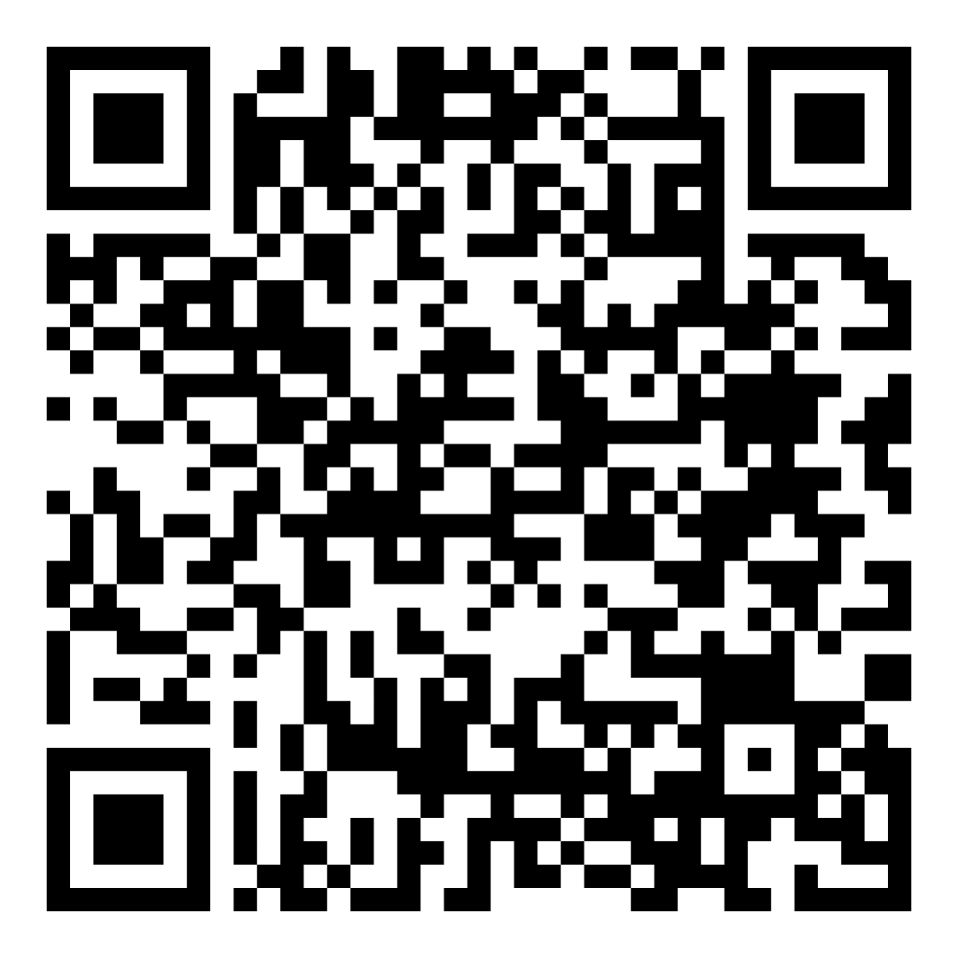
AAUP blog
on SB 37:
Higher Ed in Texas
1.4M students & 80,000 faculty in public higher ed
74 community & technical colleges -- meet Texas workforce needs in skilled labor (e.g. plumbers, electricians) and prepare students for transfer to universities
37 universities – give students foundation to enter professional careers (e.g. business, community service, engineering government, journalism, law, nursing, STEM, and teaching) and develop innovative research ideas and technologies.
15 health institutions – provide medical treatment in all 254 counties in Texas, including half of the 22M clinical visits each year and 1 in 7 who seek hospital care in Texas. For example, MD Anderson Cancer Center is part of the UT System.

Slide 4
AAUP blog
on SB 37:
SB 37 Summary
SB37 is a sweeping omnibus bill
Gives political appointees control over what students learn in courses
Limits discussions on race, sex, ethnicity, politics, religion, and social beliefs
Restricts faculty hiring in liberal arts and related fields
Dismantles shared governance and due process
Fires faculty and defunds institutions that violate SB 37
Empowers Governor, Lt. Governor, and House Speaker to redesign the core curriculum for Associates & Bachelors degrees

Slide 5
AAUP blog
post on SB 37:
Updates on SB 37
Senate passed SB 37 along party lines (20-11) April 16
Engrossed version (that passed the Senate)
Creates new curriculum review bureaucracy
Texas Higher Education Coordinating Board
Board of Regents (universities) / Trustees (comm. colleges)
Institution
Faculty do not have decision-making authority on ANY hiring decisions
Removes peer review during faculty grievance procedures

Slide 6
AAUP blog
post on SB 37:
Updates on SB 37
Committee substitute changes:
Curriculum requirements
Defunding/sunsetting programs based on
thresholds set by THECB
Establishes the “Curriculum Review Committee”
Faculty Senate membership qualifications and appointments
Faculty say in hiring & grievance processes
Establishes the “Office of the Ombudsman”
The committee substitute was voted out from the Senate floor on Tuesday, April 15th. The vote was 20-11.
Creighton introduced two new amendments to the bill

Slide 7
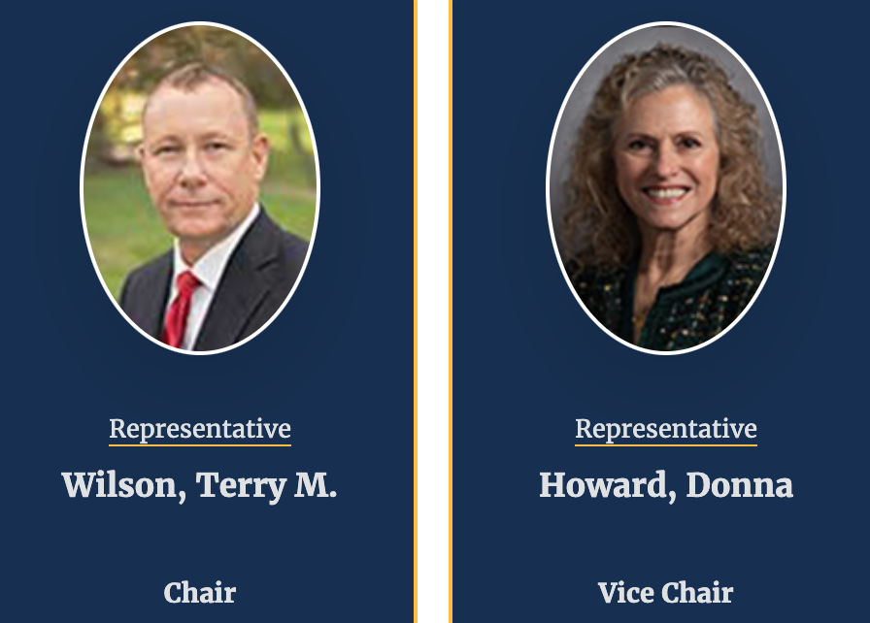
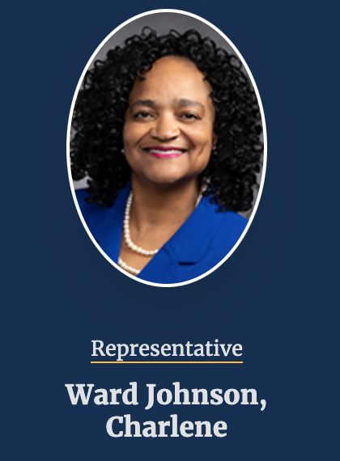
House Comm. on Higher Ed
Terry Wilson (R) Chair
Donna Howard (D) Co-Chair
Seniority Appointments
Stan Lambert (R)
Vincent Perez (D)
Matt Shaheen (R)
Tony Tinderholt (R)
Speaker Appointments
Aicha Davis (D)
Suleman Lalani (D)
Joanne Shofner (R)
Gary VanDeaver (R)
Charlene Ward Johnson (D)

Slide 8
SB 37 Testimony Toolkit
Write your testimony beforehand.
Please be clear that you’re speaking for yourself as a private individual.
Max 3 minutes for a House hearing (375 words) but the committee chair may limit it to 2 minutes (250 words)
Tell your story!
Personal narratives are important
Tie how it impacts you and others back to the issues
How will SB 37 affect your teaching?
Make the call to action clear!
How to
Testify

Slide 9
The hearing is taking place at the Texas Capitol, room E2.036 at 8 am.
Please arrive early to make sure you’re registered to testify.
Witness registration kiosks are on E2. If you need help finding the kiosks, please reach out to Amanda Garcia or Dr. Brian Evans (512-516-5991) and we’ll help you get signed up!
Getting
Involved
in Person

Slide 10
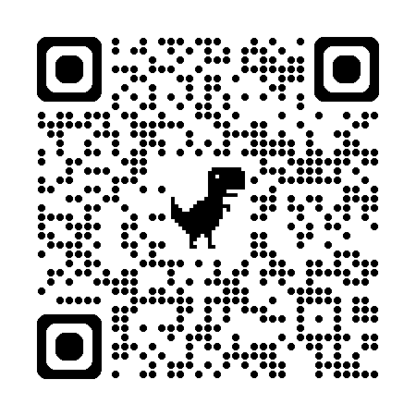
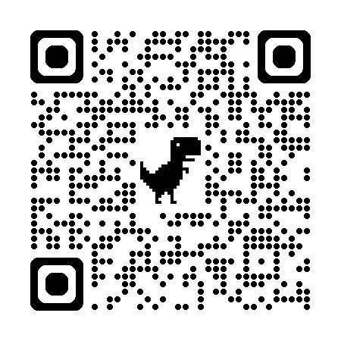
Take action against SB 37
Blog Posts
SB37 Toolkit for testifying

Slide 11
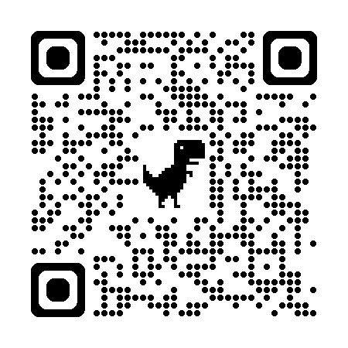
Thank you!
Texas AAUP-AFT
Higher Education Bill Tracker

