Slide 1
Texas AAUP-AFT:
What the affiliation with Texas AFT has meant
Brian L. Evans, PhD Texas AAUP-AFT President
aaup.texas@gmail.com
512-516-5991
I am speaking for myself as a private citizen and not representing any other group, institution, or organization other than Texas AAUP-AFT
April 12, 2025

Slide 2
AGENDA
Supporting one other & building community
Academic freedom & shared governance
American Association of University Professors
Texas AAUP affiliation with Texas AFT

Slide 3
Freedom to Learn & Teach
Teachers need freedom to teach so students have freedom to learn.
Free inquiry, free expression, intellectual exploration, and open dissent are critical for student learning and the advancement of knowledge.
Academic freedom is the freedom from censorship by the institution in the instructional staff ‘s teaching, research, and expression.
AF allows instructors to develop/disseminate new knowledge from all viewpoints, including conservative, moderate, liberal, apolitical.
Safeguards include shared governance, tenure and due process
Codified in the 1940 AAUP Statement of Principles on Academic Freedom and Tenure adopted by more than 85% of all four-year public and non-profit private universites in the United States

Slide 4
Shared Governance
Higher ed Administration delegates tasks using a division of labor
Shared decision-making among students, staff, faculty, administrators, and board of governors based on communication, trust, mutual understanding, and transparency
Faculty (due to expertise) have primary decision-making authority
Curriculum, subject matter, and methods of instruction
Matters related to faculty status – appointments, reappointments, non-reappointments, promotions, granting of tenure, dismissal
Faculty have authority in financial exigency and program closures
1966 AAUP Statement of Government of Colleges and Universities adopted by 1500+ colleges and universities in the US

Slide 5
AAUP
Founded in 1915 by faculty
42,000 members and 500 campus chapters
AAUP champions academic freedom, advances shared governance, and organizes all faculty to promote economic security and quality education.
AAUP affiliated with the American Federation of Teachers (AFT) on Aug. 1, 2022, after 10 years of collaboration on new collective bargaining units
AFT has 1.8M members including 300,000 in higher ed and is part of AFL-CIO with 12M members
Join AAUP

Slide 6
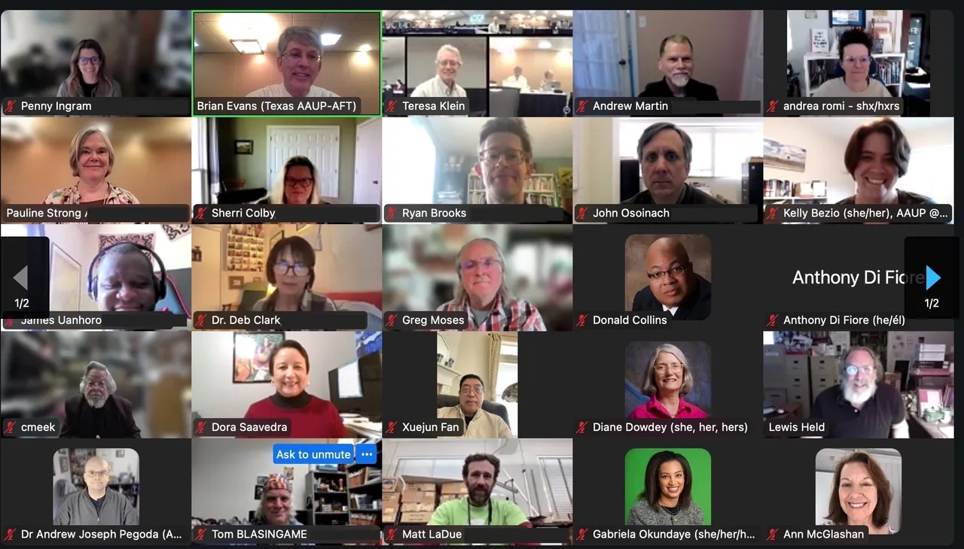
Texas AAUP
Texas has about 80,000 faculty in 167 institutions
Texas AAUP Conference launched in 1964
Today, 1,350 members on 75 public & private campuses
Campus Chapters: 32 (added 1/mo since Jan. 2024)
Primary driver in doubling membership since Jan. 2024
Monthly online meetings with chapter presidents
Statewide meetings twice a year (in-person & online)
Weekly online trainings during Legislative session
Daily updates @TexasAaup and @texasaaup.bsky.social
Office of Faculty Representation launched Oct. 2023
Helps members facing investigations, disciplinary action, dismissal
Texas AAUP-AFT Meeting Spring 2025
Kelly Hand, Texas AAUP-AFT Conference, Academe, Fall 2024. Profile of Texas AAUP-AFT.

Slide 7
Employment Protections
Texas AAUP-AFT provides five layers of employment protection:
The campus AAUP chapter has expertise on campus policies and procedures.
The Office of Faculty Representation (OFR) helps members facing investigations, disciplinary action, or dismissal. Since OFR launched in Oct. 2023, they have helped more than 70 faculty and staff resolve issues with their administration. Send email.
Texas AFT member benefits provide $8M in professional liability coverage and $35,000 in legal aid to respond to criminal investigations. More info
Texas AAUP-AFT can provide a list of attorneys for legal counsel.
Texas AAUP-AFT legal defense fund if you registered for membership through the Texas AAUP-AFT registration page.

Slide 8
Texas AAUP Officers
Five regional VPs help coordinate chapters and activities in their regions

Slide 9
Texas AFT Partnership 2023
88th Texas Legislative session Jan. 10 to May 29, 2023
Texas AFT partnered with Texas AAUP to
Provide media, testifier, and Legislative advocacy training
Help us navigate Texas House and Senate (181 members)
Connect us with their bi-partisan coalition for public ed
Support Legislative office visits and testifying at hearings**
Coordinate press conferences, releases, and interviews**
Launch social media @TexasAaup and blog sites**
Help us set up a higher ed bill tracker
Submit op-eds to reach key legislators**
** Speaking as private citizens / AAUP members

Slide 10
2023 Texas Legislative Session
In the Texas House, Texas AAUP and Texas AFT coordinated efforts among 10 higher ed advocacy orgs to garner bi-partisan support to
Change the legal definition of tenure in tenure bill from one-year guaranteed employment contracts to continuous employment (SB 18)
Add exceptions in the bill banning diversity, equity and inclusion (DEI) employment practices for external grants (SB 17)
Defeat the censorship bill (SB 16)
In Summer 2023, Texas AAUP worked with Texas Council of Faculty Senates to advocate in our seven public university systems (37 campuses) for favorable implementations of tenure and DEI bills
Karma R. Chávez, Lessons from AAUP Advocacy in Texas, Academe, 2023. How a revived AAUP chapter and a coalition of allies mobilized against a legislative assault. (Describes the AAUP Chapter at UT Austin).

Slide 11
Affiliation with Texas AFT 3/24
Autonomy. Texas AAUP continues to operate under its by-laws and practices.
Amplified advocacy. Texas AFT has 66,000 members and 45 dedicated full-time staff, including organizers, lobbyists, lawyers, media specialists, and IT.
Members can be from public or private institutions of higher education.
Member benefits include $8M occupational liability coverage, $35k legal aid for civil cases, and a legal defense fund for employment matters.
Officer benefits include Board of Directors insurance.
Amid Attacks on Higher Education, Texas AAUP Votes to Affiliate with Texas AFT, April 4, 2024
Historic vote by Texas AAUP approves affiliation with the Texas AFT, March 30, 2024

Slide 12
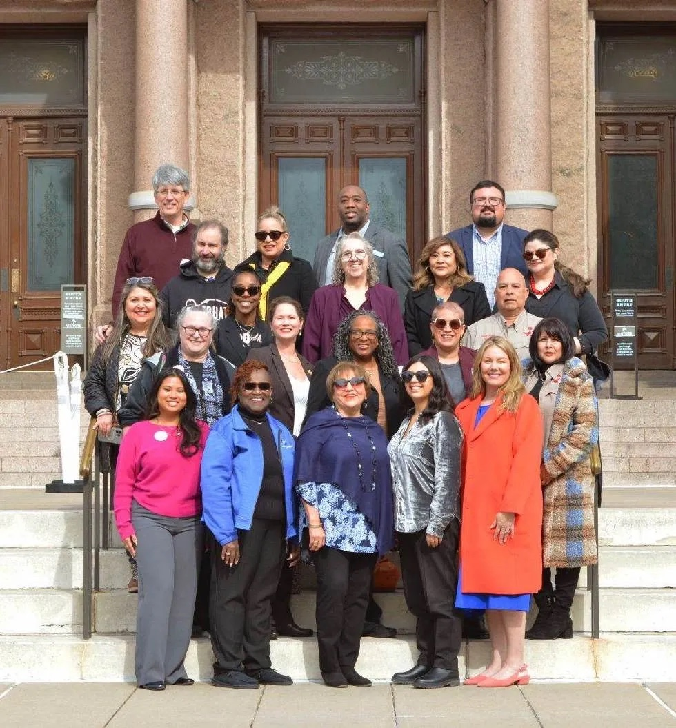
2025 Legislative Priorities
Freedom to Learn and Teach: Encouraging and protecting free inquiry, free expression, intellectual exploration, and open dissent for student learning and advancement of knowledge
Freedom to Research and Create: Removing barriers hindering researchers to win government and private grants.
Faculty Economic Security & Tenure: Upholding current tenure policies that recruit and retain workforce development instructors.
Faculty Senates and Other Advisory Faculty Bodies: Faculty input to improve curriculum, teaching methods, research, and hiring decisions.
Leaders of Texas AFT and Texas AAUP-AFT advocating on Opening Day of Session, January 14, 2025

Slide 13
Come to these monthly legislative updates! Apr. 21 and May 19 at 6pm CT.
Sign the Texas AFT Educator's Bill of Rights for K-12 and higher ed educators.
Get active in your AAUP Campus Chapter or start one if there isn’t one.
Look for opportunities for advocacy on Texas AFT Mobilize such as phone banking, email campaigns, and local office visits.
Getting
Involved
Remotely

Slide 14
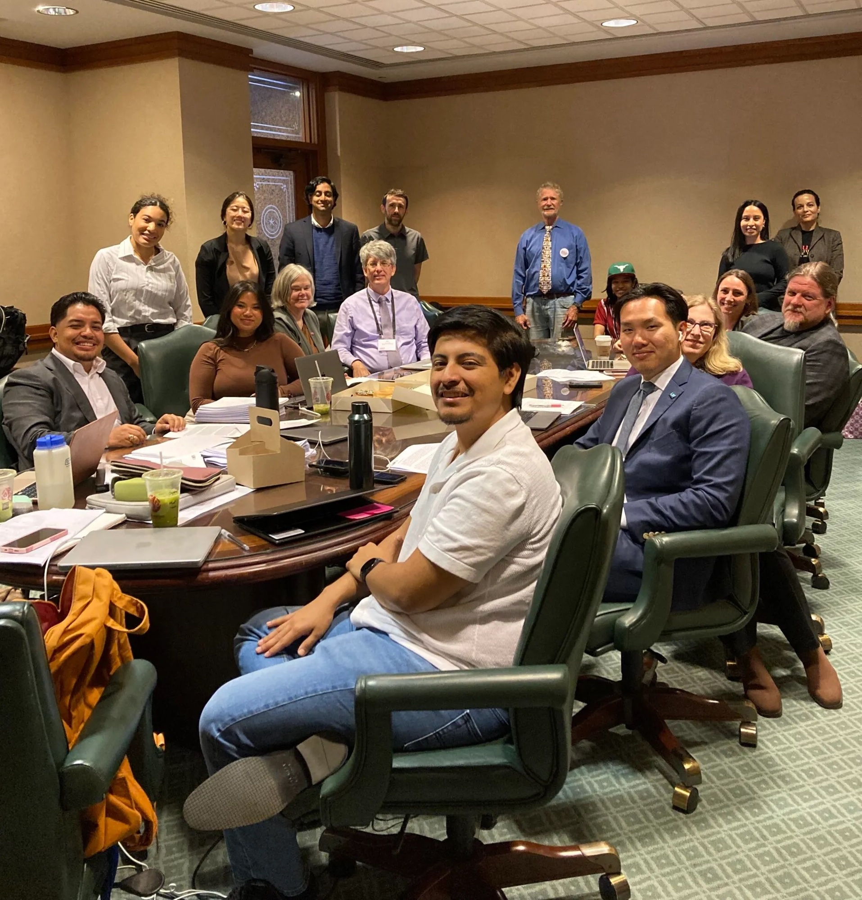
Join Texas AAUP-AFT to visit Legislative Offices on Thursdays, 9:30am-12:30pm.
Testify at the House Committee on Higher Education on Tuesdays
Testify at the Senate Committee on Education K-16 on Thursdays
Getting
Involved
in Person
Texas AAUP members and allies preparing to testify against SB 37 on March 20, 2025

Slide 15
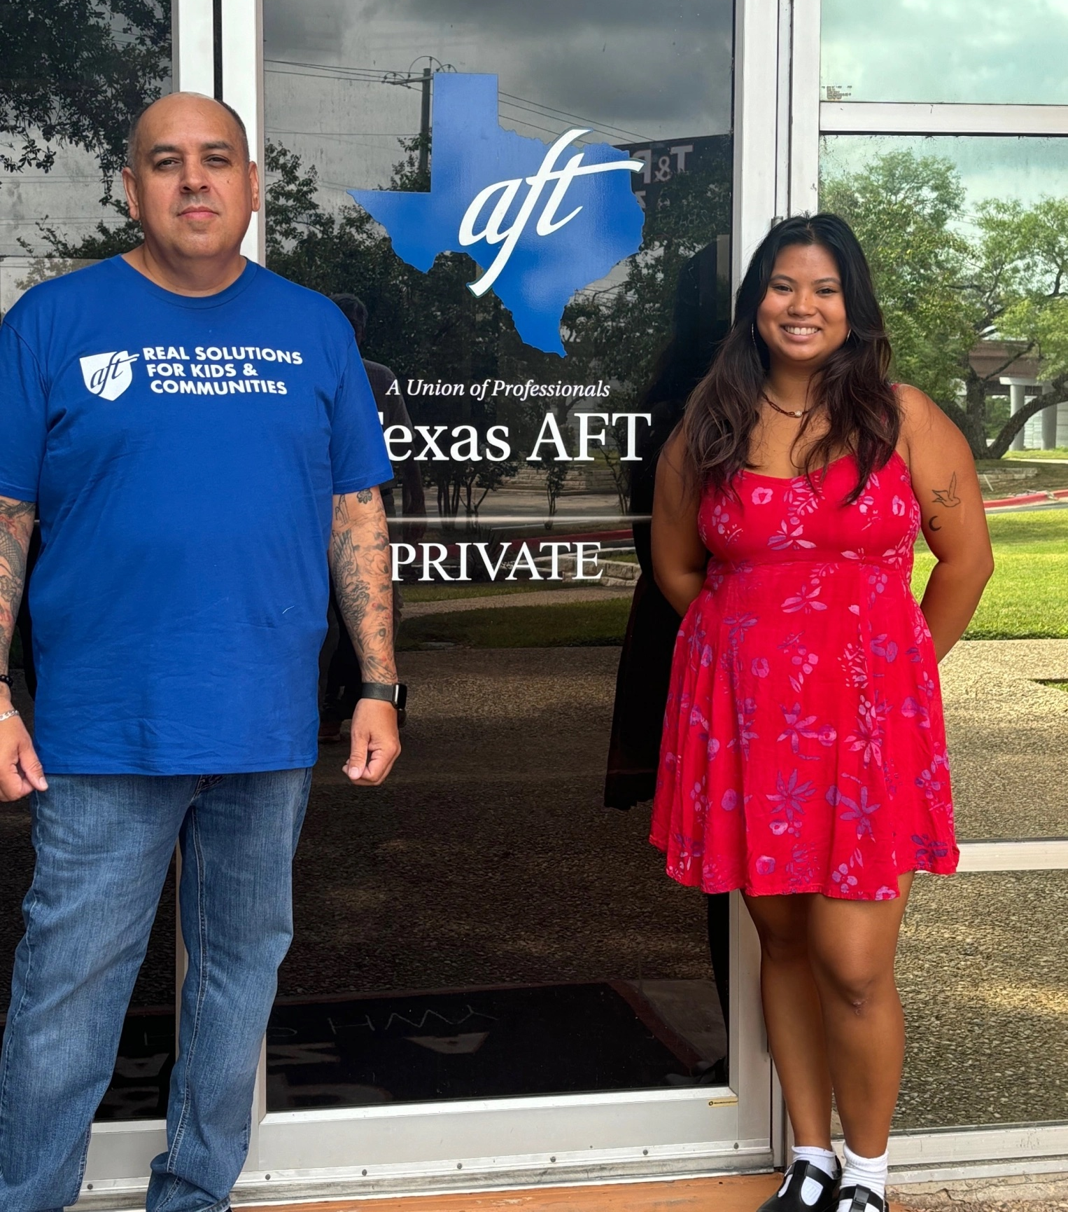
Affiliation with Texas AFT
Amplified Organizing
New Staff: Two full-time organizers started July 1, 2024
Amplified Training
Members: Media relations, advocacy, communications
Amplified Advocacy
On Campus: Organizing issue campaigns
At Legislature: Office visits, testifying, bill amendments
Amplified employment protections
Communication Platforms
Internal: Signal, WhatsApp, Proton Mail
External: Action Network (email), Hustle (texting), X, Bluesky, Blogs, Website
Access to the Texas AFT legal team
Alvaro Chavez and Amanda Garcia are the two full-time organizers for Texas AAUP-AFT

